Slide 1
Title of the Presentation
Zsófia Németh ¹, Edina Pallagi ¹, Dorina Gabriella Dobó ¹ and Ildikó Csóka ^{1,}*
¹ University of Szeged, Faculty of Pharmacy, Institute of Pharmaceutical Technology and Regulatory Affairs, H-6720, Szeged, Eötvös u. 6., Hungary
* Corresponding author: csoka.ildiko@szte.hu

Slide 2
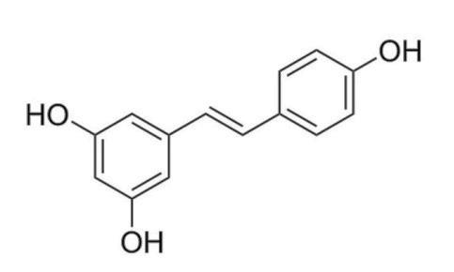
Abstract:
Trans-resveratrol, due to its antioxidant property, has the potential to be successfully applied in the prevention and the treatment of neurological disorders (Parkinson’s and Alzheimer’s disease). Nevertheless, its traditional administration (intravenous, oral) and bioavailability are limited by its physical-chemical characteristics (solubility, chemical instability, sensitivity to heat, UV-light and pH). The ‘nose-to-brain’ application, as an alternate administration route, represents a way to reach the brain without the limitations of the blood-brain barrier, while the use of nano-sized drug delivery systems, like the liposomes, can overcome the developmental and therapeutic issues of the formulations.
Figure 1. Structural formula of trans-resveratrol
This research paper shows the application of Risk Assessment, the key element of the Quality by Design mindset, in the development of a liposomal resveratrol-containing formulation with brain target and nasal administration.
The study intends to demonstrate the definition of the quality target product profile, the selection of the critical factors, and the application of the RA to get a detailed view on the critical parts of the development process.
On these terms, the factors with the most significant impact on the product quality among the critical material attributes (phospholipids, active pharmaceutical ingredient (API) content, cholesterol ratio, surface modification), furthermore the production process (temperature, oxidation and light protection) were identified; subsequently, an RA-based liposome preparation process was described.
The formulation procedures of ‘nose-to-brain’ liposomal systems loaded with drugs with many limiting factors meet several risks; however, the adaption of the QbD tools helps to focus on the aimed final product quality and achieve effective experimental designs.
Keywords: liposome; resveratrol; nose-to-brain; Quality by Design; Risk Assessment

Slide 3
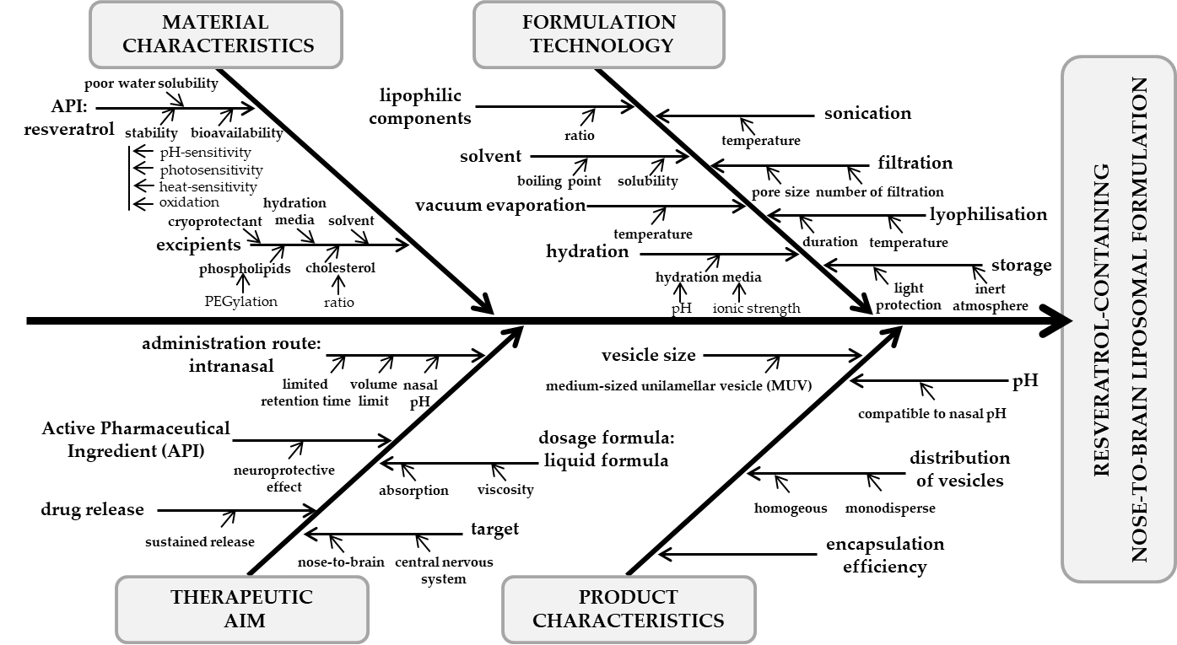
Results and Discussion
Figure 2. Ishikawa diagram for the evaluation of the cause-and-effect relationships in the trans-resveratrol containing ‚nose-to-brain’ liposomal formulation
An Ishikawa diagram was designed to organise the knowledge and the requirements what are needed to execute a successful experimental design. The fishbone diagram collects the most important material quality and formulation requirements, furthermore the therapeutic and target product-oriented aspects.

Slide 4
Results and Discussion
QTPP | details | CQAs | details
indication | neuroprotection | morphology of liposomes | spherical conventional vesicles
target patient population | ageing population | size of vesicles | medium-sized unilamellar vesicles (MUV)
route of administration | “nose-to-brain” | surface modification | polyethylene glycol (PEG) chains
dosage form | aqueous solution; lyophilised plaques | polydispersity | monodisperse formulation
drug target | dopaminergic neurons; β-amyloid plaques | zeta potential | highly charged
drug release | sustained release | phase transition temperature | formulation-suitable, trans-resveratrol decreases the value
viscosity | enough but not too viscous | API content | trans-resveratrol -containing vesicles
osmolarity | tolerable | position of the API | in the lipophilic double membrane
pH | suitable for intranasal administration and trans-resveratrol stability | encapsulation efficiency | high value
stability | stable formulation
homogeneity | homogenous formulation
Table 1. QTPP and CQAs of the trans-resveratrol-containing “nose-to-brain” liposomal formulation
The profile of the target product (QTPP) and the quality requirements of the formulation (CQAs) are summarised in Table 1. The QTPP depends mainly on the therapeutic or clinical aims and requirements, the characteristics of the drug substance, the administration route and the dose of the drug. This collection of the properties is always unique for a formulation. The CQAs of the product are the physical, chemical, biological and microbiological properties that should reach the indicated quality, range or limit to ensure the consistent end-product quality. For example, the features of liposomes, the size, the size distribution and the surface charge of the vesicles, furthermore the API-related properties of the formulation can be a part of the CQAs. These factors are also always unique for the
preparation and depend on the QTPP.

Slide 5
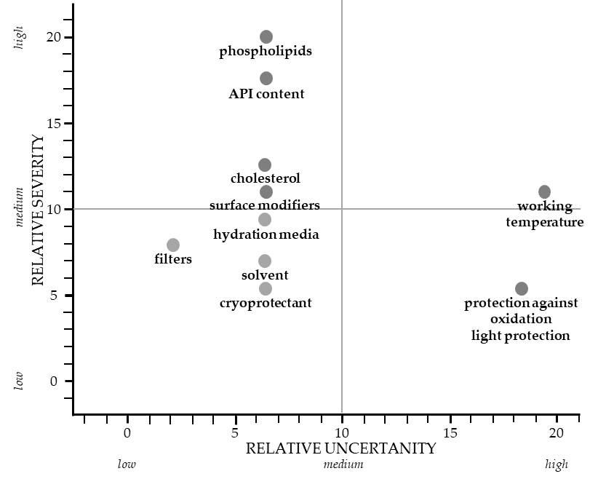
Results and Discussion
The relative severity-relative uncertainty diagram, as a result of the RA, has shown that the liposome wall-forming agents, the quality of the hydration media and the solvent used in the formulation, the applied temperature, the oxidation and the protection against light are the riskiest steps and factors during the manufacturing process and should get the most attention. The results also mean that the quality of the product can be influenced the easiest by changing the parameters related to the wall-forming agents (ratio, quality) and the trans-resveratrol-content. At the same time, the most critical point of the manufacturing process is the working temperature, because its change has a great impact on the outcome.
Figure 3. Relative severity-relative uncertainty diagram presenting the CMAs and CPPs of the formulation as a result of the RA
The effect of the CMAs and CPPs can be accurately investigated if some of the values are set on the same level, while the ones under the scope of the study are being changed according to the Design of the Experiment.

Slide 6
Conclusions
Even though trans-resveratrol displays several health-beneficial properties and possesses remarkably strong antioxidant activity, its positive effects are restricted by the characteristics of the compound itself. The paper showed the opportunities of a liposomal formulation containing trans-resveratrol as an active ingredient, designed for the “nose-to-brain” administration route, the technological challenges of development and their possible solutions by applying the QbD approach during the design phase of the research. As a conclusion, we can say that the RA highlights the critical points of the formulation process, and in this way helps to achieve the targeted quality for the product. Applying the QbD approach to design pharmaceutical formulations is a functioning way to improve the development process of the pharmaceutical formulations by collecting the proper information, optimising and rationalising the required experiments and measurements. The determination of the critical features and parameters (QTPPs, CQAs, and CPPs) provides a holistic network of information that can be useful to achieve a more effective experimental design.
Acknowledgments
This work was supported by the ÚNKP-19-3-SZTE-61 New National Excellence Program of the Ministry for Innovation and Technology, the construction of EFOP 3.6.3-VEKOP-16-2017-00009, GINOP-2.3.2-15-2016-00060 and the Gedeon Richter’s Talentum Foundation.

