Slide 1
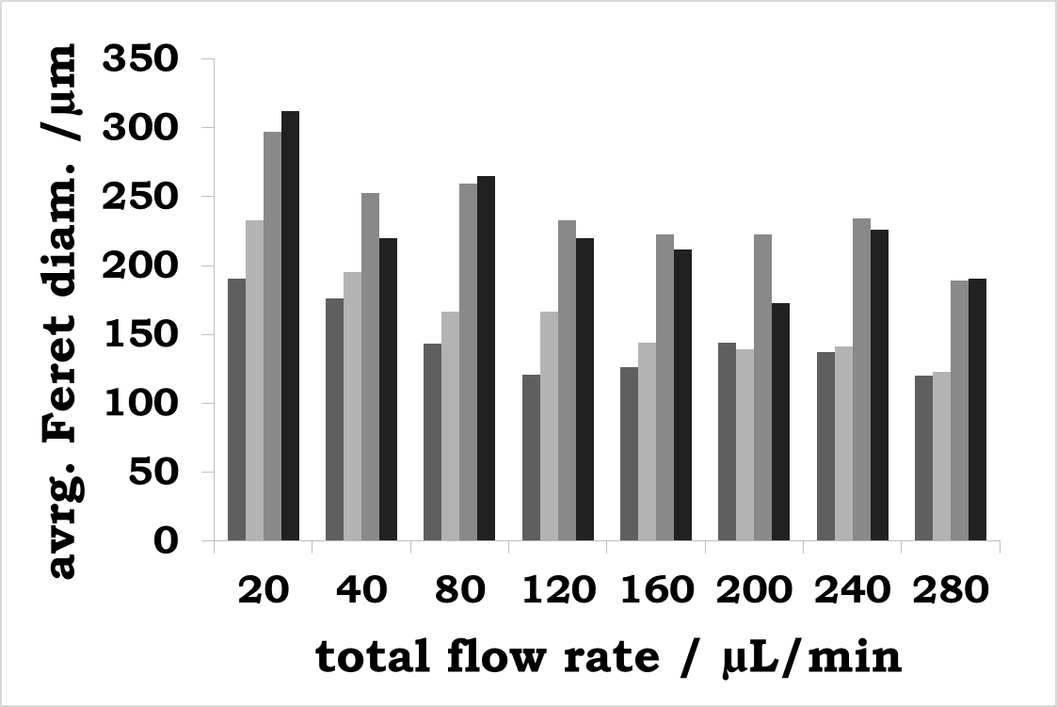
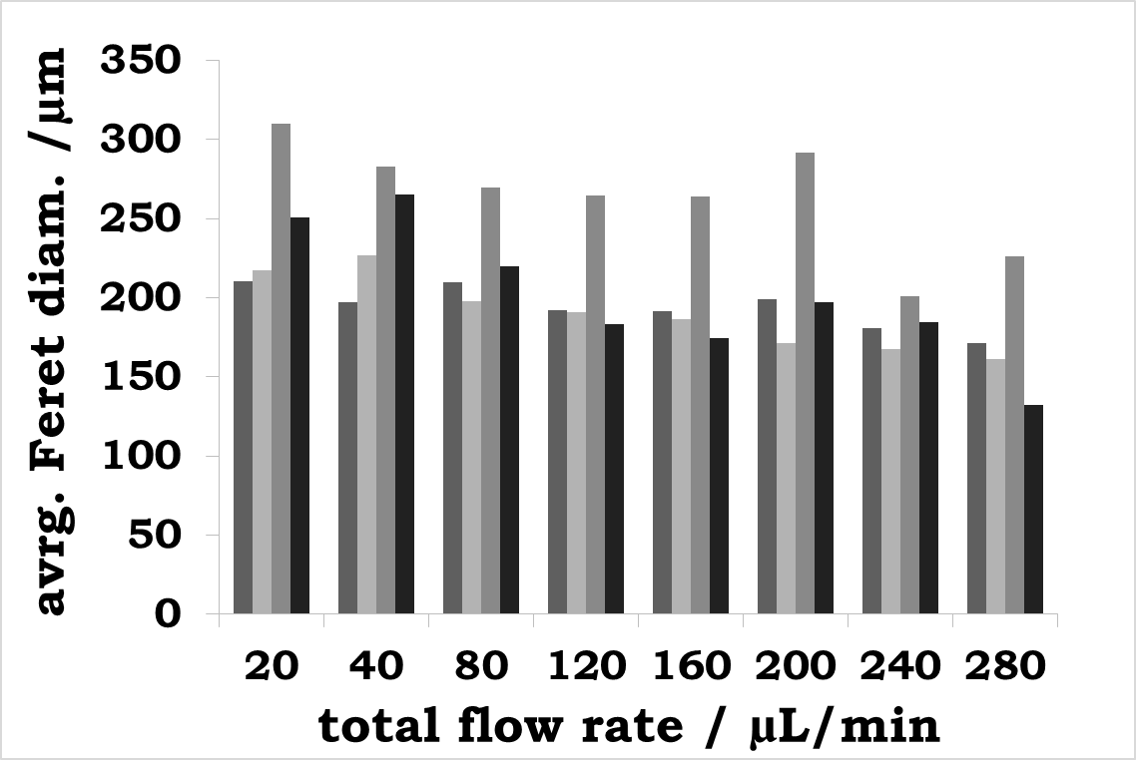
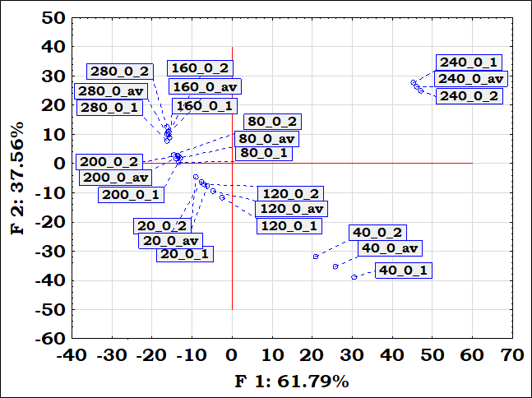
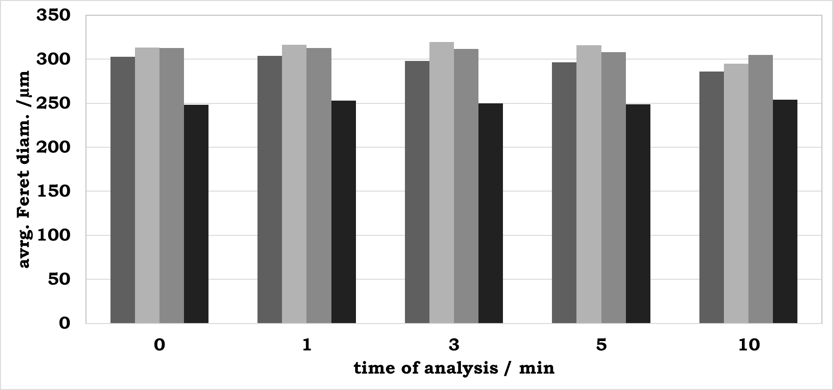
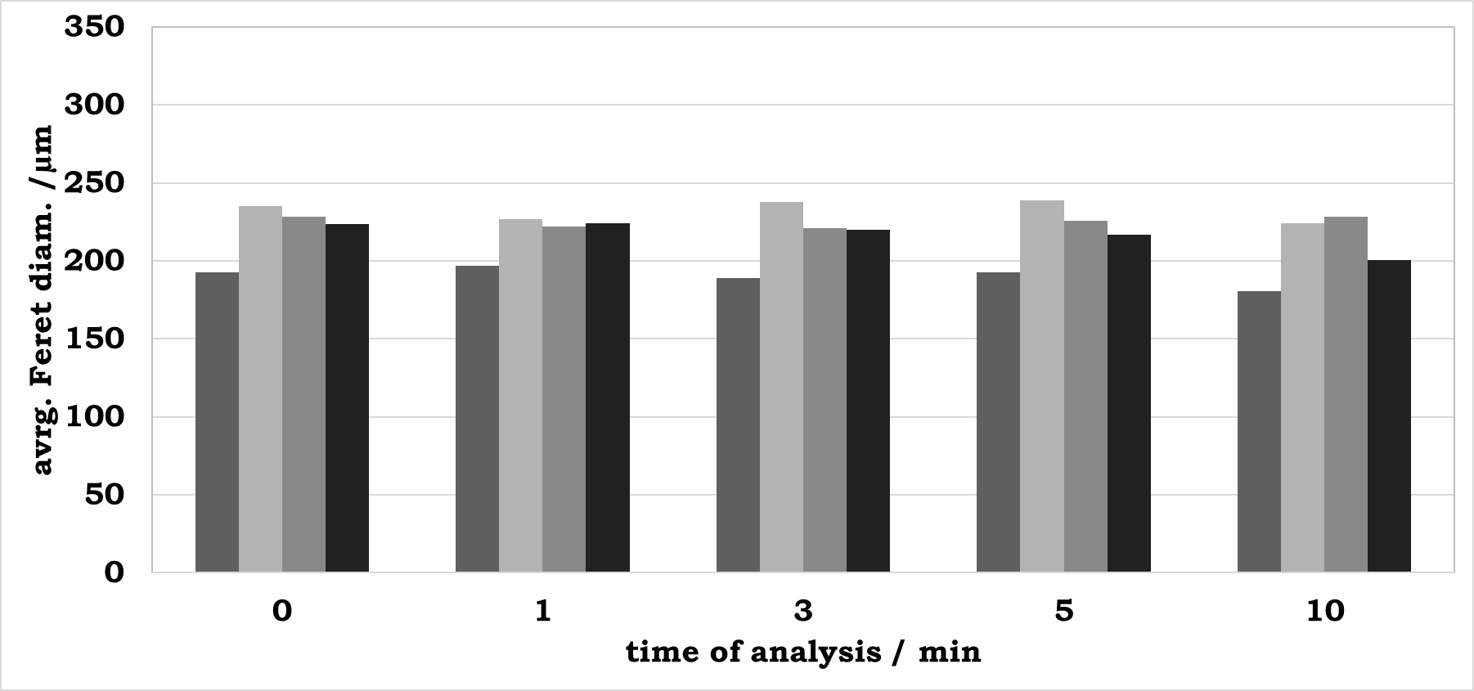
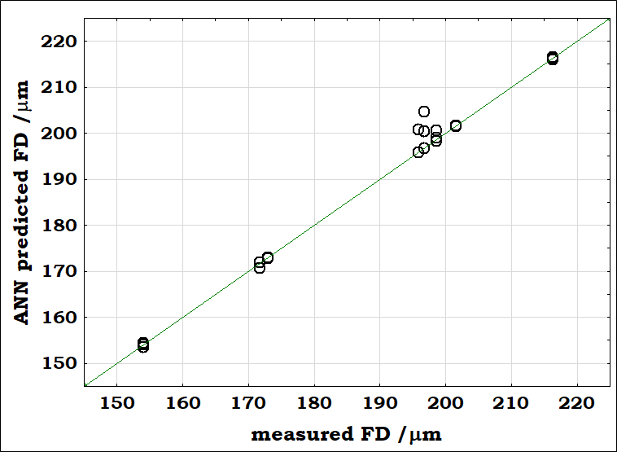
The effect of micromixer geometry on the diameters of emulsion droplets: NIR spectroscopy and Artificial Neural Networks modeling
Tamara Jurina*, Ivana Čulo, Maja Benković, Jasenka Gajdoš Kljusurić, Davor Valinger, Ana Jurinjak Tušek
University of Zagreb, Faculty of Food Technology and Biotechnology, Pierottijeva 6, 10000 Zagreb, CROATIA
*corresponding author: tamara.jurina@pbf.unizg.hr
Abstract: In this work, teardrop micromixer and swirl micromixer were used for preparation of oil-in-water (O/W) emulsions with Tween 20 and PEG 2000 as emulsifiers (concentrations: 2 % and 4 %) at different total flow rates (20 - 280 µL/min). Stability of the prepared O/W emulsions was evaluated based on the droplet size of the dispersed phase. For determination of the droplet size, the average Feret diameter was used. Furthermore, near infrared (NIR) spectra of all prepared samples were collected. Obtained results showed that the change in the droplet size followed the same trend for both micromixers used in the experiment. At higher total flow rates, emulsification resulted in smaller values of the average Feret diameter. Values of the average Feret diameter were higher for emulsions prepared in the swirl micromixer, compared to the teardrop micromixer.
Artificial Neural Network (ANNs) models, based on the recorded NIR spectra of emulsions, were developed to predict the droplet size of the dispersed phase. The obtained ANN models have high values of R² for training, test, and validation, with small error values and show that NIR spectroscopy, in combination with ANNs, could be efficiently used for evaluation of the stability of oil-in-water emulsions.
Experimental set up, sample analysis and modeling
The influence of two different geometries (teardrop micromixer and swirl micromixer) at different total flow rates on the stability of oil-in-water (O/W) emulsions was analysed.
The droplet size was analyzed as the average Feret diameter (FD) based on the microscopic photos.
ANN models based on NIR spectra of emulsions were developed to predict the droplet size of the dispersed phase.
Fig.1. Experimental set up used for the emulsion preparation
The change in the size of the emulsions, presented as the average FD, follows the same trend for both micromixers used in the experiment (Fig. 5). At higher total flow rates, oil-in-water emulsions with a smaller average FDs were obtained. The emulsification in swirl micromixer resulted in larger average FD. Furthermore, the changes of the average FD of emulsions prepared at 120 µL/min over the time was also analysed (Fig. 6) and no significant differences were noticed.
Results and discussion
Fig.2. Emulsion samples analysis
Light microscopy provides an insight into the size of the emulsion droplets and their structure. Photos of the emulsion droplets for both analysed micromixer geometries and both used emulsifiers are present at Figs. 3-4.
NIR spectra of all prepared samples were collected. The absorbance maximum were noticed in the wavelength range from 900 nm to 1000 nm and from 1350 nm to 1699 nm Principle component analysis (PCA) of NIR spectra showed grouping of the samples for the flow rates 20-40 µL/min in the third quadrant and for the samples 80-280 µL/min in the first and second quadrant (Fig. 7).
a
b
Fig.5. Average FD at different total flow rates prepared using emulsifier (a) Tween 20, (b) PEG 2000 (■) 2 % in teardrop micromixer, (■) 4 % in teardrop micromixer, (■) 2 % in swirl micromixer, (■) 4 % in swirl micromixer
Fig.3. Photos of the emulsion droplets prepared using emulsifier Tween 20 at total flow rate of 120 µL/min (a) 2 % in teardrop micromixer, (b) 4 % in teardrop micromixer, (c) 2 % in swirl micromixer, (d) 4 % in swirl micromixer
a
Fig.7. PCA of NIR spectra of emulsions prepared with PEG 2000 2 % in teardrop micromixer
The obtained ANN models have high values of R² for training, test, and validation, with small error values (example, Fig. 8.)
b
Fig.4. Photos of the emulsion droplets prepared using emulsifier PEG 2000 at total flow rate of 120 µL/min (a) 2 % in teardrop micromixer, (b) 4 % in teardrop micromixer, (c) 2 % in swirl micromixer, (d) 4 % in swirl micromixer
Fig.6. Average FD over the time (a) Tween 20, (b) PEG 2000 (■) 2 % in teardrop micromixer, (■) 4 % in teardrop micromixer, (■) 2 % in swirl micromixer, (■) 4 % in swirl micromixer
Fig.8. Average FD of emulsions prepared with PEG 2000 2 % in teardrop micromixer vs ANNs

