Slide 1


Origins of antibiotic resistance genes reported in bacteriophage
Neil R. McEwan*, Charlotte V. Edwards and Aidan McGonigle
School of Pharmacy and Life Sciences,
Robert Gordon University, Aberdeen, Scotland
* n.mcewan@rgu.ac.uk
1

Slide 2
Background to topic
Origins knowledge about the effects of antibiotics go back to work of Fleming in 1928
Full effects of the potential use of penicillin date from the early 1940s when it was used to treat a patient with streptococcal meningitis
However soon afterwards microbes started to show resistance to penicillin
2

Slide 3
Background to topic
In general genes for antibiotic resistance have been found on bacterial plasmids
Therefore the normal mode of transmission of antibiotic resistance genes between organisms is by plasmid conjugation
However some resistance genes can also be acquired by transformation from DNA environmental samples
3

Slide 4
Background to topic
More recently antibiotic resistance genes have been shown to have association with mobile elements
This has been hypothesised as being the reason that they have been reported in bacteriophages
4

Slide 5
Purposes of investigation
Study the taxonomic relationship between antibiotic resistance genes in bacteriophages and those in other organisms
Use codon usage patterns to compare the antibiotic resistance gene with other genes within the bacteriophages
5

Slide 6
Methodology
Bacteriophage genomes which contained one or more antibiotic resistance genes were identified in GenBank
Full gene DNA sequences were downloaded from GenBank
Related antibiotic genes, from bacterial sources, were downloaded
6

Slide 7
Methodology
DNA sequences were aligned using Clustal Omega compared by use of Neighbor-Joining analysis with use of bootstrapping in PHYLIP
Codon usage evaluated by mutational response index and effective codon number
7

Slide 8
Results
First dataset examined was for tetO
5 genes from bacteriophage identified
Based on BLASTn searches they appear to be most similar to sequences previously described in Streptococcus species
8

Slide 9
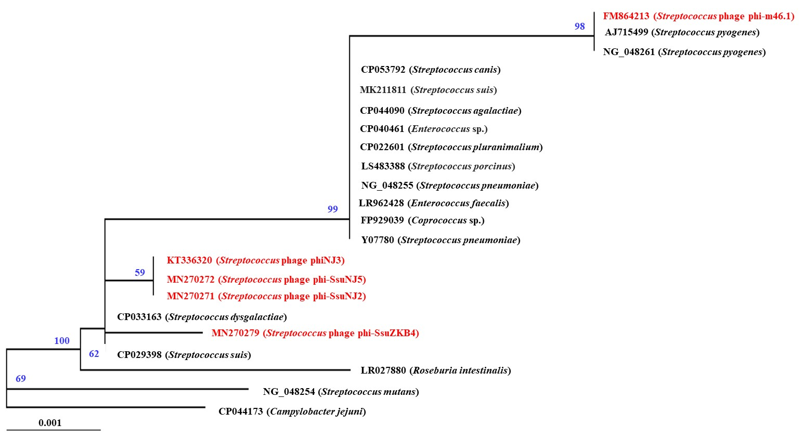
Results
9

Slide 10
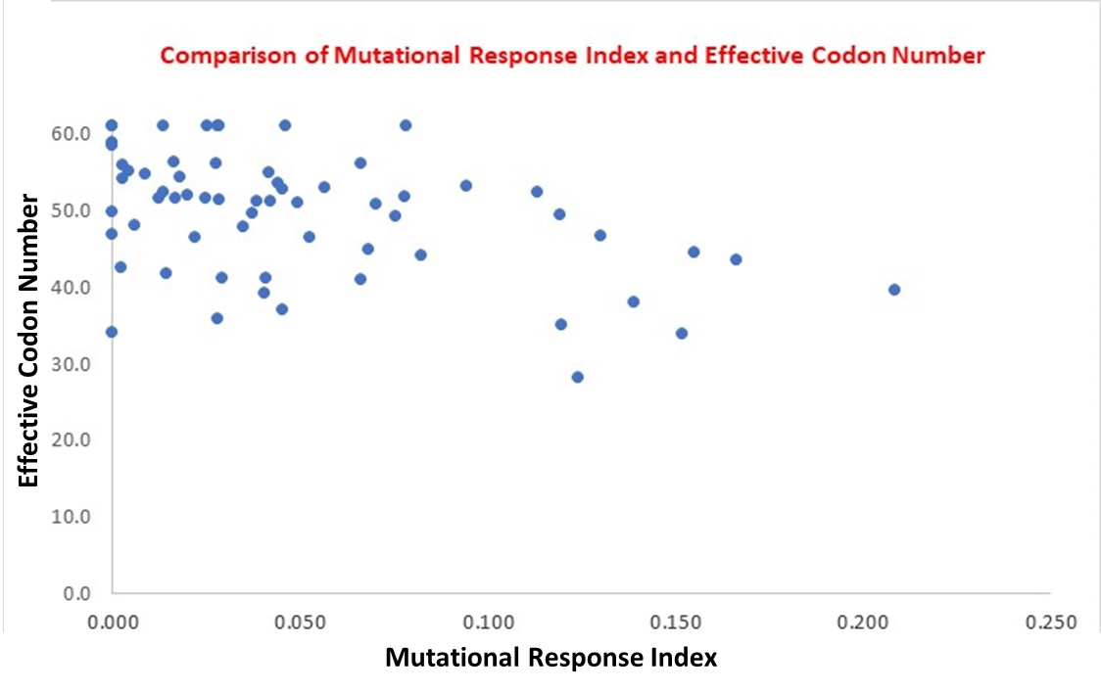
Results
10

Slide 11
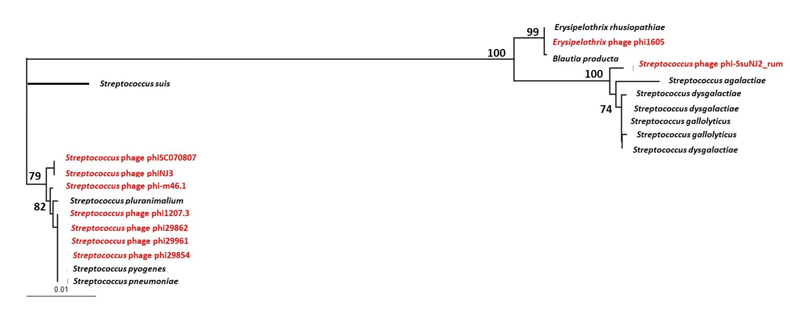
Results – msrD (macrolide resistance)
11

Slide 12
Discussion
The data presented here are only a small component of antibiotic resistance genes reported in bacteriophage
Results suggest that antibiotic resistance genes in the phages are most similar to the organism which they are associated with
Codon usage patterns are in keeping with other genes
12

Slide 13
Discussion
This suggests that the genes for antibiotic resistance have been transferred into the phages from the bacterium
In the unlikely event that they came into the bacterium from elsewhere, they have rapidly ameliorated their codon usage pattern to conform to that of the bacteriophage
13

Slide 14
Questions?
14

