Slide 1

Probabilistic Modelling for Unsupervised Analysis of Human Behaviour in Smart Cities
Yazan Qarout
Yordan P. Raykov
Max A. Little

Slide 2
Contents
Introduction
Model structure – the AI-HMM
Identifying mode of transport from GPS trajectories
Traffic trend analysis – what are usual/unusual car trips in Beijing
Taxi identification – can we recognize drivers from their GPS trajectories
Conclusion

Slide 3

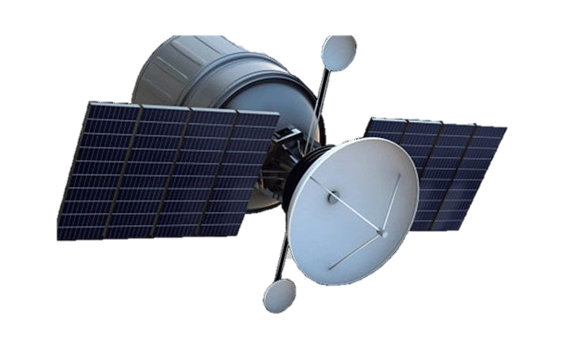
Introduction
2.5 quintillion bytes of data collected daily as of 2019
Smart city data is often context dependent: e.g. time of day trends, weekend/weekday trends seasonal trends, etc…
Many existing algorithms for data analytics lack interpretability and contextual awareness, which are important attributes for understanding smart city data
The AI-HMM offers Interpretable and context aware data analysis with potential for:
  Facilitating better personalisation
  Improve security
  City management

Slide 4

The Adaptive Input Hidden Markov model (AI-HMM)
Context
$$Θ_{k}|H \sim H$$
$$β^{\left(i\right)}|γ,H \sim GEM\left(γ\right)$$
$$π_{k}^{\left(i\right)}|α,β^{\left(i\right)} \sim DP\left(α+κ,\frac{αβ^{\left(i\right)}+κδ_{k}}{α+κ}\right)$$
$$z_{t}|z_{t−1},τ_{t}=i,{\left(π_{k}^{\left(i\right)}\right)}_{k=1}^{∞} \sim π_{z_{t−1}}^{\left(i\right)}$$
$$y_{t}|z_{t},{\overline{Y}}_{t},{\left(Θ_{k}\right)}_{k=1}^{∞} \sim f\left(Θ_{z_{t}}{\overline{Y}}_{t}\right)$$
Where distribution $f\left(∙\right)$ can be linear or non-linear
Given you are at a fixed time zone $τ_{t}=i$, we have:
$$y_{t}=\sum_{r=1}^{R}{θ_{r}^{z_{t}}y_{t−r}+ε^{z_{t}}}$$
with $ε \sim Ν\left(0, Σ\right)$
Behaviour and trend

Slide 5
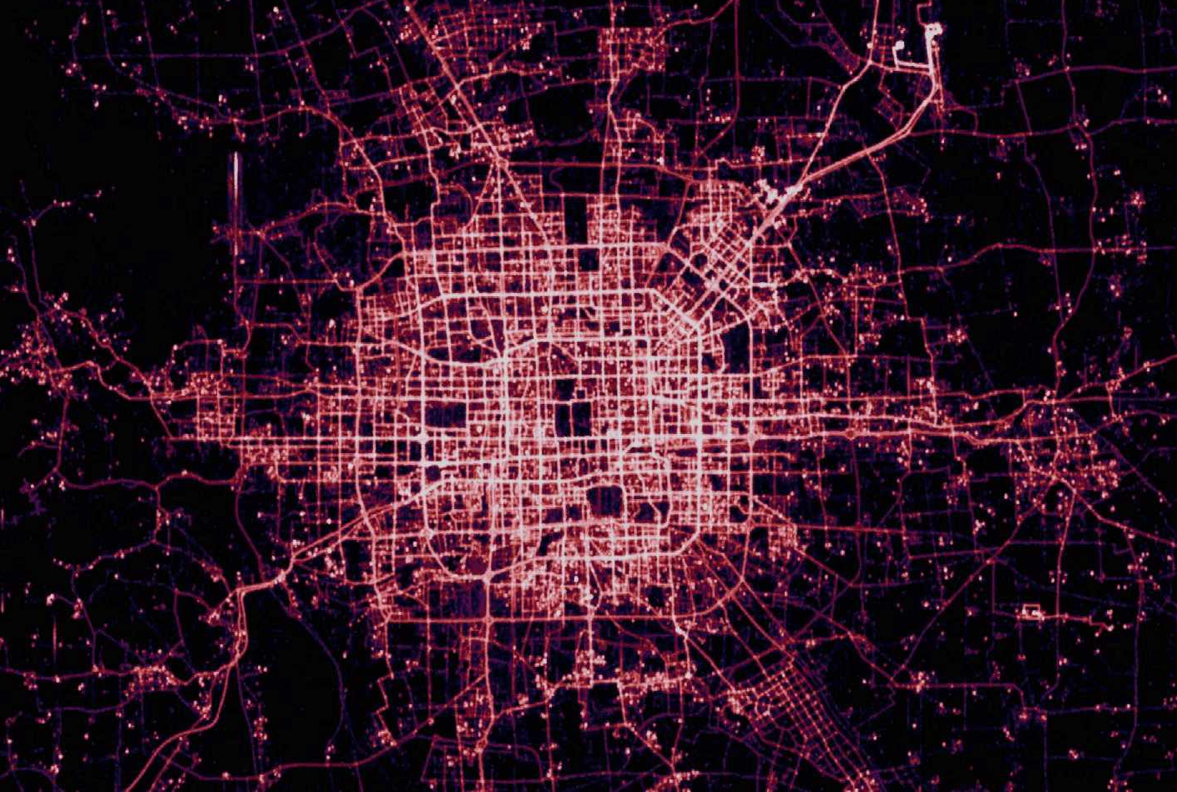
Experimentation
Experiments were made on the T-drive and Geolife datasets consisting of the GPS trajectories of willing civilian participants and taxis respectively.
GPS data are a collection of geolocated points each recording time, longitude and latitude coordinates which were used as features in addition to features such as velocity extracted through the Haversine formula

Slide 6
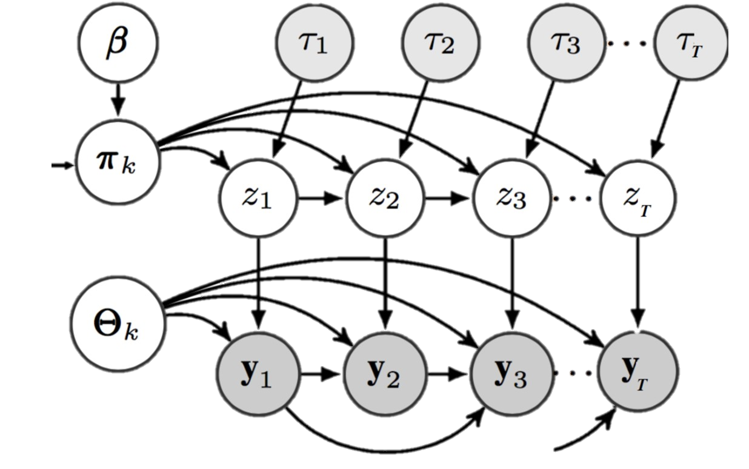

Behaviour and Trend Detection
Experiment 1: This is an exploratory study to automatically extract underlying trends in taxi GPS data. We assume that the contextual vector $τ_{t}$can take 2 values representing peak and off-peak traffic time.
Experiment 2: Assumes a single contextual realisation (one value for $τ_{t}$) and clusters modes of transport used by civilians with an accuracy of 78%.

Slide 7
Traffic trend analysis
The red state represents night trips at high velocity in typically congested areas
The purple state represents trips in similar locations but at lower speeds in peak times
The blue states represents higher speed travel on the highway network
The green state represents taxis parked in the Airport queue
The brown state represents noisy observations of scattered around the map

Slide 8
Comparison with neural network models
The green and brown states represent noisy observations of scattered around the map
All other states capture the average dynamics with interchangeable meaning

Slide 9
Mode of transport identification

Slide 10
Mode of transport identification

Slide 11

Context identification – Identity detection
Context
In this experiment we adaptively infer the value of the contextual variable $τ_{t}$ representing taxi identity given pretrained emission and transition distributions. The journeys of two different taxis were analysed where an inferred value of $τ_{t}=1$ refers to taxi 1 and $τ_{t}=2$ refers to taxi 2. The model is successful at capturing the identity of the taxi with an accuracy of 93%

Slide 12
Taxi identity identification

Slide 13

Conclusion
Proposed the Adaptive Input Hidden Markov model (AI-HMM) for sensor data analysis
Time series trend analysis
Given a suitable model such as the AI-HMM, differences in transition trends can help us identify the data's underlying contextual information, or help in driving richer data exploration
Potential for wide range applicability on linear and non-linear time series data to extract meaningful information which can help drive decision making and planning
Can you think of any other areas where the AI-HMM can be applied?

Slide 14
Questions?
Find out more:
Qarout, Y., Raykov, Y.P. and Little, M.A., 2020. Probabilistic Modelling for Unsupervised Analysis of Human Behaviour in Smart Cities. Sensors, 20(3), p.784.
Qarout, Y., Raykov, Y.P. and Little, M.A., 2021. Few-shot time series segmentation using prototype-defined infinite hidden Markov models. arXiv preprint arXiv:2102.03885.
Contact:
yazan.qarout@gmail.com

