Slide 1
Fix-Wavelength Multi-Analyte Detection with serial SOI Ring Resonators
Laura Kasper¹, Abbas Zein Al-Din¹, Rudolf Volkmer², Jürgen Bruns¹, and Klaus Petermann¹
¹Technische Universität Berlin, FG Hochfrequenztechnik - Photonik, Einsteinufer 25, Berlin, 10587, Germany
²Institut für Medizinische Immunologie, Charité - Universitätsmedizin, Lindenberger Weg 80, 13125 Berlin, Germany

Slide 2
Overview
Introduction
  Motivation
  Ring Resonator Basics
  Thermal Modulation for Fix-Wavelength Measurement
Fix-Wavelength protein interaction measurement
  Experimental setup
  Sensor array preparation
  Experimental procedure and Results
Summary
L. Kasper | I3S2021

Slide 3
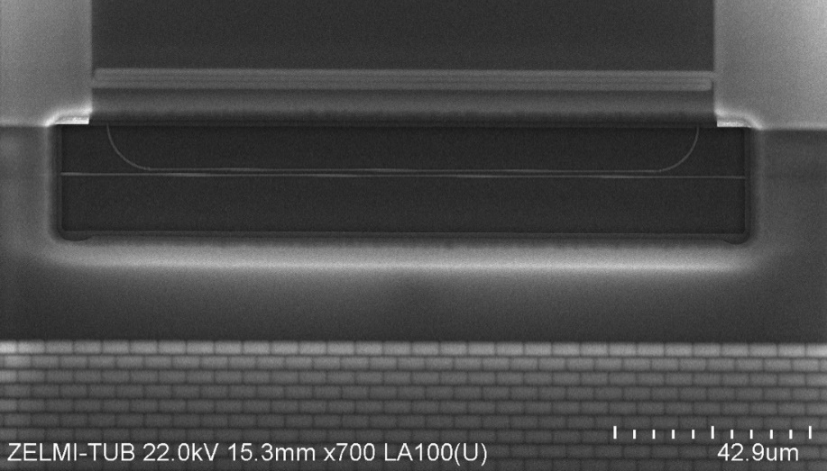



1. Introduction
Motivation for SOI Ring Resonators:
Working label-free:
  No fluorescent or enzymatic label needed
  No incubation time
Optical Ring Resonators on silicon:
  Small sensor footprint
  Low cost fabrication
  Microelectronic integration
SOI Ring Resonators as biosensors:
  Very low limit of detection
  Specifictiy by surface functionalization
  Multisample-tests
L. Kasper | I3S2021
Notes:
Label free:
→ no fluorescent or enzymatic label needed
→ increased reliability, reproducability and accuracy
→ no incubation time

Slide 4
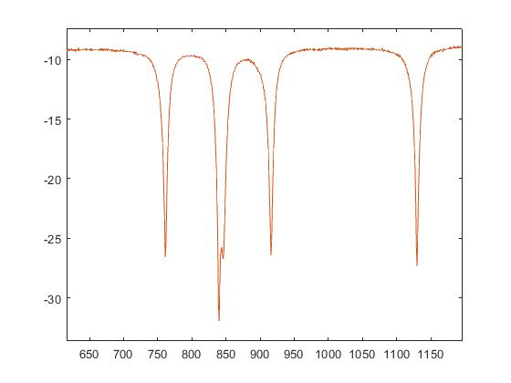
1. Introduction
Basic working Principle
Light - sample interaction via evanescence field
Molecule binding results in an effective refractive index change and thus in a wavelength shift
Chemical functionalization of the ring waveguide for antigen-selective surface
    Opens the door to complex media analyzation
Antibody 1
Antibody 1
Antibody 2
Antibody 2
  Problems:
  no sensor assignment in serial arrangement
  expensive tunable laser source
  slow scanning repetition rate
Transmission (dBm)
L. Kasper | I3S2021

Slide 5
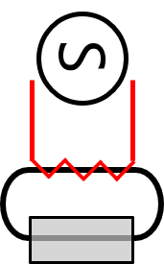
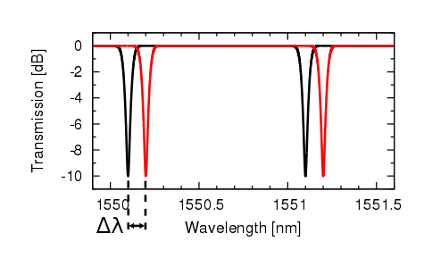
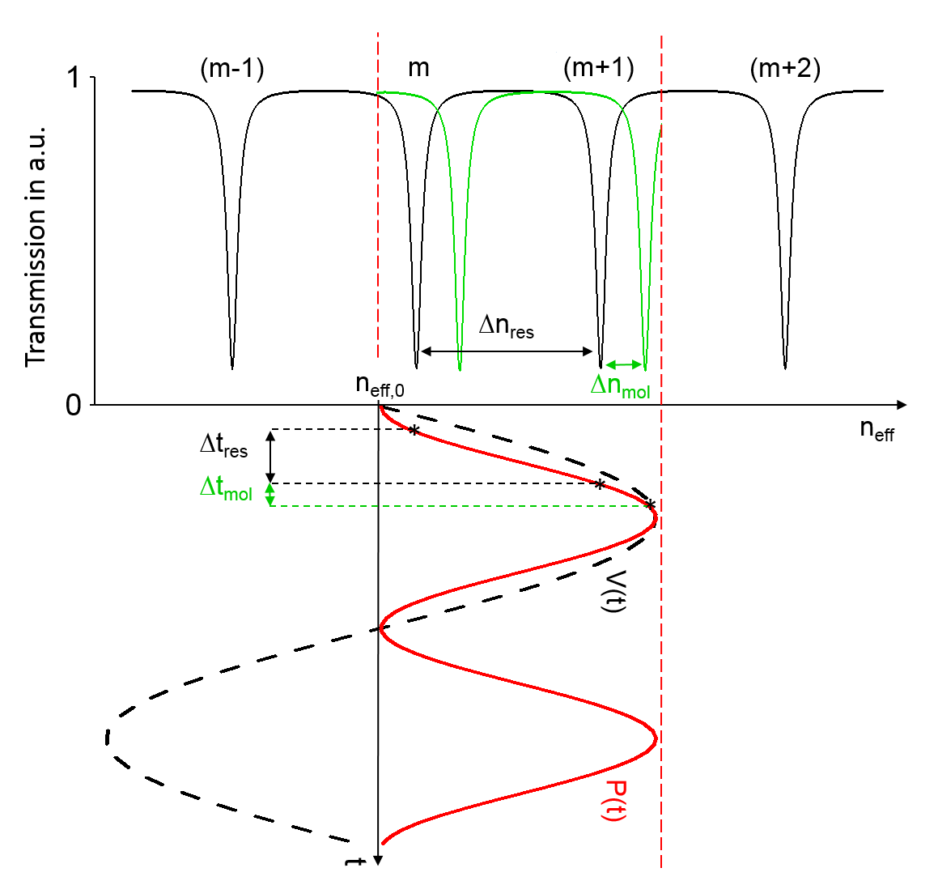
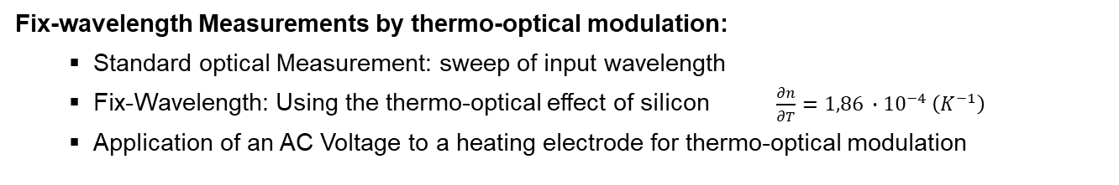


1. Introduction
Fix-wavelength Measurements by thermo-optical modulation:
  Standard optical Measurement: sweep of input wavelength
  Fix-Wavelength: Using the thermo-optical effect of silicon $\frac{∂n}{∂T}=1,86 ∙{10}^{−4} \left(K^{−1}\right)$
  Application of an AC Voltage to a heating electrode for thermo-optical modulation
λ_{res} = $\frac{neff L}{m}$ , m $∈$Ν
n_{res} = $\frac{λ0 ∙ m}{L}$ , m $∈$Ν
L. Kasper | I3S2021

Slide 6
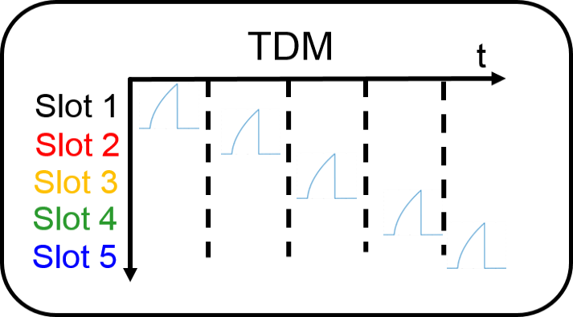

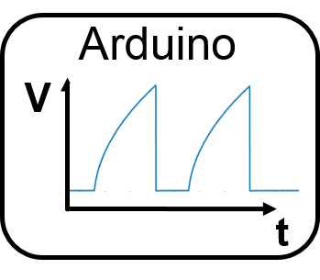

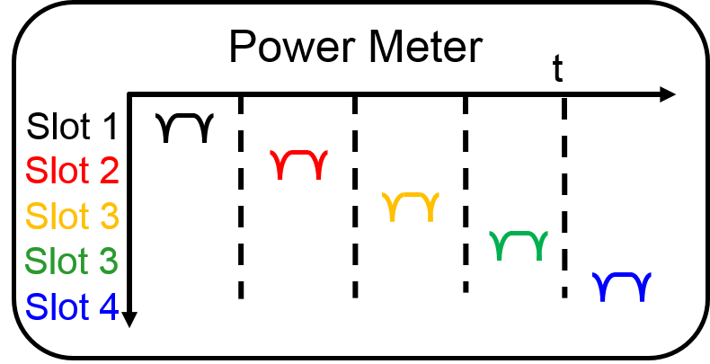
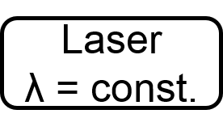
2. Fix-wavelength protein interaction measurement
Measurement Set-up:
Signal gen.
t
in
R1 (Ref)
R2
R3
R4
R5
out
L. Kasper | I3S2021

Slide 7
2. Fix-wavelength protein interaction measurement
Sensor Preparation:
Initial surface silanization (immersion, 2% APTES in toluene for 1h)
Immobilization of two different antibodies (biotin, hexa-His-complex)
  3mg/ml biotin in DI-Water for 1h
  250µl/ml ac-hexa-His-peptide in EDC and OSu, 3 x 15 min
in
out
R1 (Ref)
R2
R3
R4
R5
Biotin
ac-hexa-His-peptide
L. Kasper | I3S2021

Slide 8
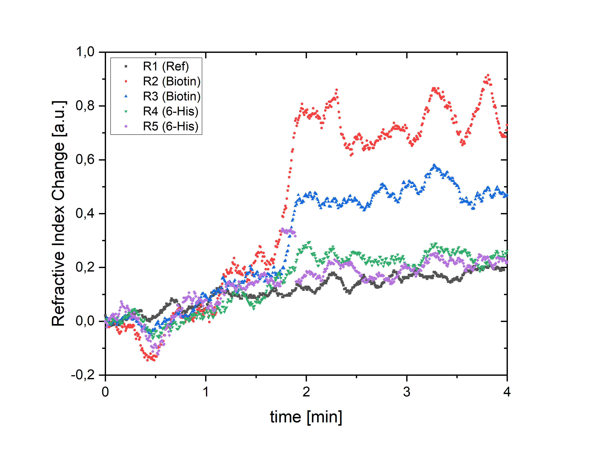
2. Fast Protein interaction measurement - Experiment
Experiment:
specific antigen lead to the sensor array via microfluidic system
Detecting and tracking the response of each ring separatetely over time
Parameters:
  f = 3 Hz / Ring
  Signal = Square-Root shaped voltage, periodic
  Analyte via Microfluidics - Steps: 2 min PBS - 2 min Streptavidin (Biotin antagonist)
L. Kasper | I3S2021

Slide 9
4. Summary
Measurement of multiple biosensors simultaneously strongly desired for multi-analyte tests
Using thermo-optical modulation in a time-division-multiplex scheme
  enables the possibility to use simple ring resonator structures (all-pass-configuration) for multi-analyte tests for e.g. in Lab-on-Chip devices
  no expensive tunable laser required
  compact set-up
L. Kasper | I3S2021

Slide 10

4. Summary
Special thanks to:
Technical assistance:
from M. Lucht, B. Bujok, M. Mahnkopf, M. Gruse, I. Kretzschmar and E. Brose
L. Kasper | I3S2021

Slide 11
Thank you for your attention
L. Kasper | I3S2021

Slide 12
L. Kasper | I3S2021

Slide 13
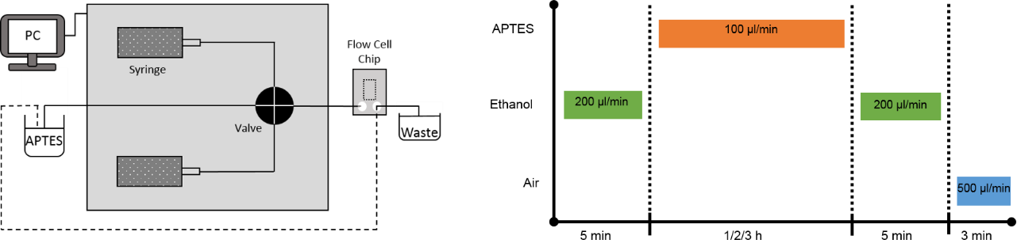
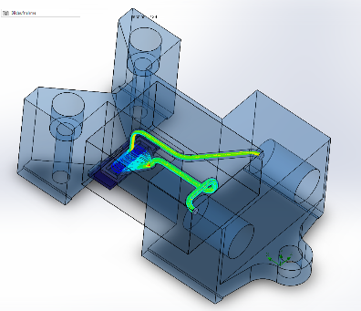
2. Setup
L. Kasper | I3S2021

Slide 14
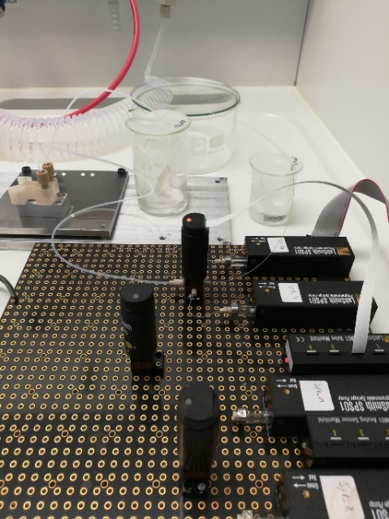
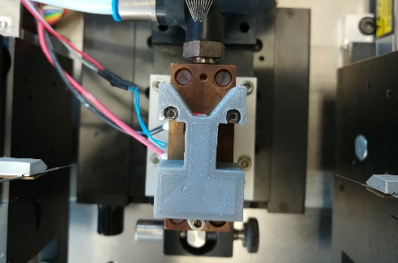
Microfluidic System (LabSMITH)
Optical inline measurements – Microfluidic system
Optimized control over fluid volumes
Predefined and continous flow speeds
Definition of speed and volume for each protocol step
L. Kasper | I3S2021
Notes:
Kim et al: 1510 cm^-1 : spricht für eine gute und dünne schicht APTES (1510 da, 1575 weg: Silanolgruppen sind mit NH2-Gruppen abgesättigt, ausserdem taucht der Peak um 1510 bei Schichten um die 6 – 7 nm auf

Slide 15
3. Results - IR Surface Characterization
Characterization on Si with IR-spectroscopic ellipsometry:
900 – 1200 cm⁻¹ relevant range for investigations on Si/SiO₂ surface
Si-O-Si band (1045 cm⁻¹) and Si-O-C (1111 cm⁻¹) decreasing with increased concentration
Indicates lower APTES densitiy at the native oxide of the Si-surface for increased concentrations
1045
1111
L. Kasper | I3S2021

