Slide 1
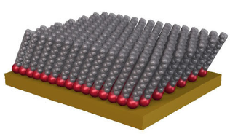
8th International Symposium on Sensor Science
Self-assembled monolayers based on 1,3-dimercaptopropan-2-ol: preparation, characterization and applications in electrochemical chemosensors
17-28 May 2021
Online conference presentation

Slide 2
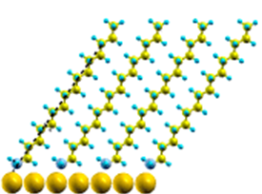
Work topic ?
Context and objectives
What does SAMs mean?
Investigation on modified electrodes in electroanalytical applications
Many approaches have been used:
Molecular self assembly (SAM)
Terminal functional group
Spacer (AlkaneChain)
Why SAMs are important?
Ligand or head group
Metal Substate
They provide grafting of monolayers and also multilayers of 3D molecular structures onto an electrode surface
2

Slide 3
Context and objectives
SAMs are widely applied in sensing and biosensing.
SAM properties
Simplicity of preparation
Ability to transfer optical / electrical properties
Introducing chemical funtionalities
Ability to link macroscopic phenomena of the interface
Lack of stability
Lack of reproducibility
Non specific response
3

Slide 4
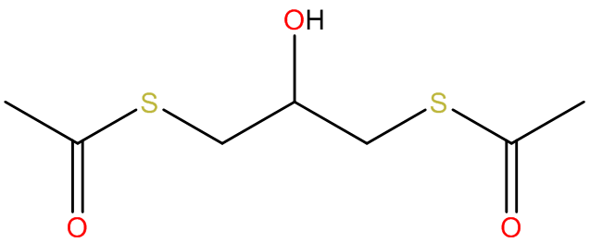
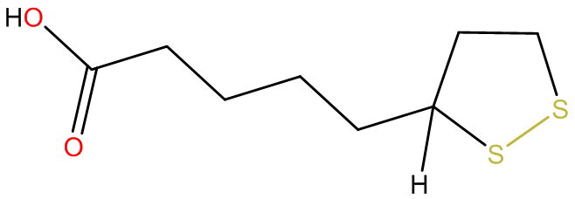
How can we overcome these limitations?
Context and objectives
Use anchor molecules possessing more than one thiol moieties
The mostly known example: thiotic acid
1,3-dithioacetatepropan-2-ol
Symmetrical structure
Better orientation of the tethered structures
Contains two thiol groups protected by acetate
High stability
4

Slide 5
Electrochemical investigation of the anchor site
Immobilization fashion of the 1,3-dimercaptopropan-2-ol onto gold substrate
12 h / 1 mM
3 h / 0.1 M
SAM 1
SAM 2
5

Slide 6
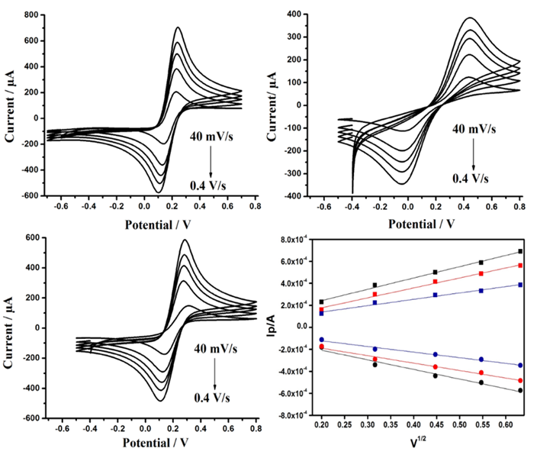
Electrochemical investigation of the anchor site
Cyclic voltammograms in:
10 mM K₄[Fe(CN)₆] + 0.1 M KCl
at different sweep rates
Uncoated gold
SAM1
Electrodes | CV in K₃[Fe (CN)₆] 10 Mm
 | ΔE_{p} (mV) | I_{p,a} (µA) | A / A₀ | k⁰ (ms⁻¹)
Bare gold | 115 ± 2 | 1040.2 ± 0.1 | 1 | (3.05 ± 0.67)×10⁻⁵
SAM1 | 308 ± 7 | 722.5 ± 0.4 | 0.569 | (0.52 ± 0.03)×10⁻⁵
SAM2 | 160 ± 5 | 774 ± 1 | 0.827 | (1.93 ± 0.62)×10⁻⁵
SAM2
Randles-Sevcik plots
6

Slide 7
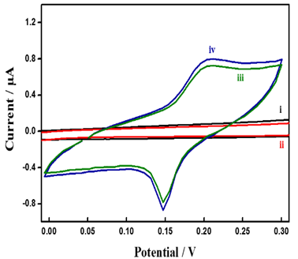
Electrochemical investigation of the anchor site
Michael addition
Cyclic voltammograms recorded in phosphate buffered saline (PBS) at pH = 7.4 after 40 min incubation in 5mM ethanolic solution of BQ
No binding
Binding
7

Slide 8
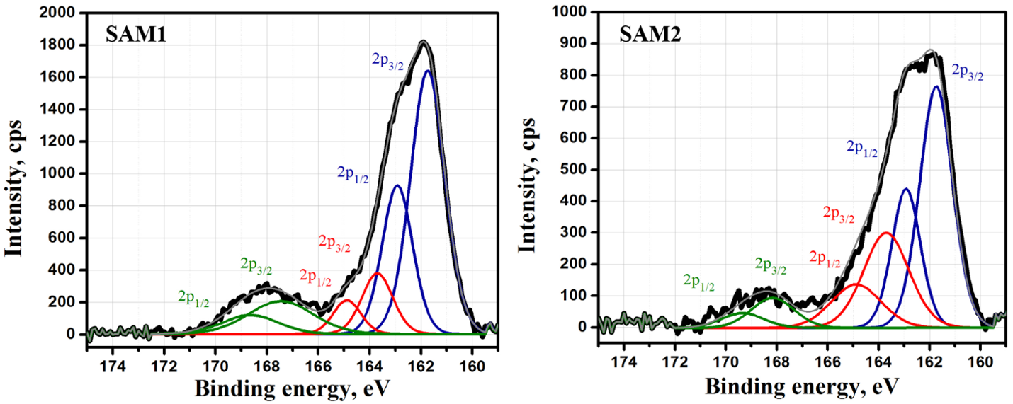
Spectroscopic investigation of the anchor site
8

Slide 9
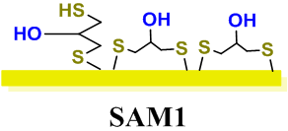
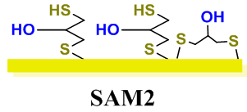
Spectroscopic investigation of the anchor site
SAM 1
SAM 2
$$\frac{S_{2p} (bonded)}{S_{2p}(free)}\sim 5$$
$$\frac{S_{2p} (bonded)}{S_{2p}(free)}\sim 1.8$$
70 %
30 %
30 %
70 %
9

Slide 10
Electrochemically active SAM design
A. Laroussi, M. Kot, J. Ingo Flege, N. Raouafi, V. M. Mirsky, Appl. Surf. Sci. 2020, 513, 145827.
10

Slide 11
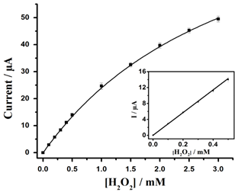
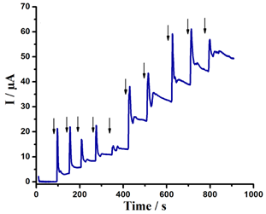
Electrocatalytic sensing of hydrogen peroxide
Chronoamperometry responses for successive hydrogen peroxide additions
Calibration Curve
Gold modified SAM-terminated-BQ
E = + 0.4 V (vs. Ag/AgCl)
LOD : 2,3 μM
Sensitivity : 1700 A.m⁻².L.mol⁻¹
12

Slide 12
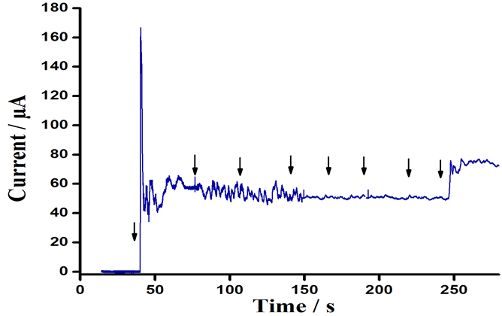
Electrocatalytic sensing of hydrogen peroxide
Test of selectivity
Fast response
Glucose (7 mM)
Ascorbic Acid (0.1 mM)
Glucose (14 mM)
Ascorbic Acid (0.2 mM)
Uric Acid (0.36 mM)
Uric Acid (0.72 mM)
High sensitivity
H₂O₂ (4 mM)
H₂O₂
(3 mM)
No interferents
A. Laroussi, N. Raouafi, V. M. Mirsky, Electroanalysis (minor correction)
13

Slide 13
To conclude !
Application of this system for hydrogen peroxide analysis in different technological processes
BQ is a perspective material for the development of electrocatalytic sensors for hydrogen peroxide
Electrochemically active SAM terminated-BQ
Preparation and characterization of SAMs based on the symmetric molecule with two thiol groups
https://doi.org/10.1016/j.talanta.2018.11.026
18

Slide 14
Thanks for your attention !

