Slide 1



A novel electrochemical microneedles-based nanoporous gold sensor for real time
L-ascorbic acid detection
Riccarda Antiochia¹, Anthony E.G. Cass², Cristina Tortolini¹
¹Sapienza University of Rome, Rome, Italy
²Imperial College, London, UK
I3S2021 – 8° International Symposium on Sensor Science, Dresden, 17-28 May 2021

Slide 2
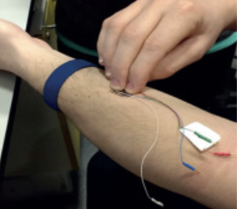

L-ascorbic acid (AA) monitoring
AA is an essential dietary component, as it cannot be synthesized by the human body;
AA plays an important roles: maintaining a healthy immune system, wound healing, iron adsorption, preventing cancer and heart diseases, treatment of viral infections, including SARS-CoV-2;
Changes of AA concentrations have a close connection with nutrition status assessment;
Real-time monitoring of AA levels in a minimally invasive manner opens as a new frontier in personal nutrition and clinical care applications;
Classical analytical methods (e.g. chemiluminescence, spectrophotometry, HPLC) have drawbacks;
Amperometric (bio)sensors are valid alternatives

Slide 3
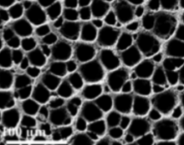
Electrochemical detection of AA
Biosensor
AA oxidase (AAOx)
Sensor
enzymeless
enzyme denaturation
leaching out from electrode surface
high overpotential
0.4 V vs AgAgCl at GC
0.6 V vs AgAgCl at Pt, Au
short life time
instability
biofouling
modification of electrode surface
with nanomaterials
O₂ limitations
h-nPG 0.2-2 nm

Slide 4
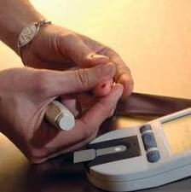
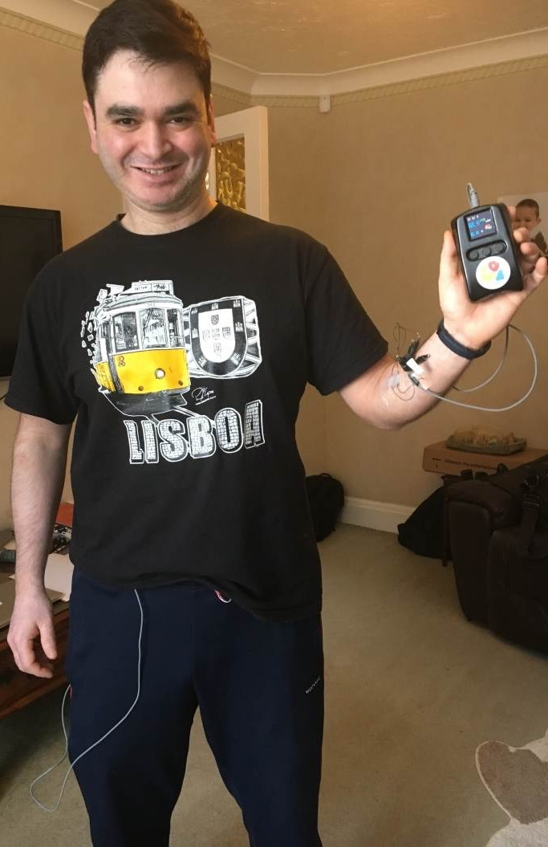
Microneedle arrays-based sensors
Current AA sensors and biosensors use blood or urine to to the test
Drawbacks:
repeated finger pricks
with disconfort for the patient
or
repeated sample collection
Microneedle arrays-based sensors overcome this problem:
Interstitial fluid (ISF)
 
less invasive continuous monitoring

Slide 5
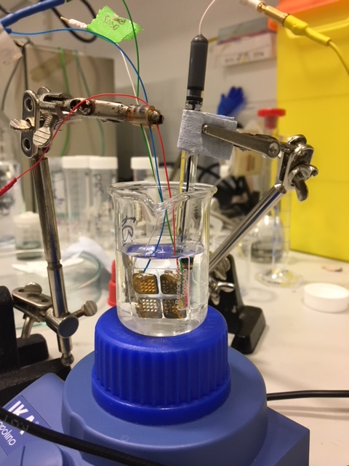
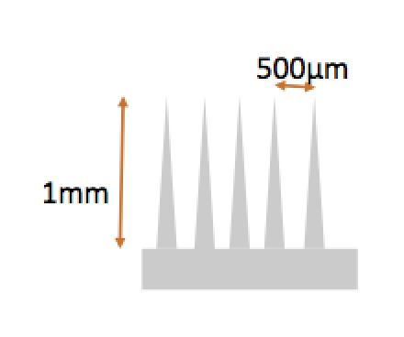
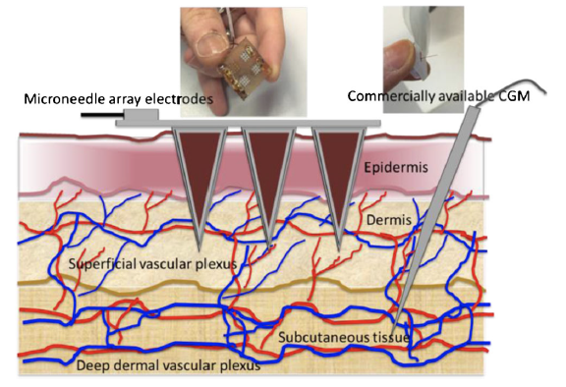
Microneedle arrays-based electrodes
metallized with Au and Ag
polycarbonate structure (2.5x2.5x0.2 cm)
comprising of 4 microneedle arrays
(16 pyramidal microneedles, base 0.06 cm, height 0.1 cm)
d tip = 35 μM
A array = 0.2 cm²

Slide 6
Dermal interstitial compartment
Measurements are made in the upper part of the dermal interstitial compartment
No blood vessels
No nerve endings
Interstitial Fluid (ISF) is in equilibrium with capillary bloods
very good correlation between AA in ISF and in blood

Slide 7
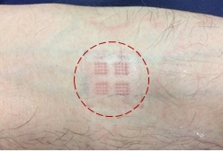
Microneedle arrays-based devices advantages
minimally invasive
reduced biofouling effects
large currents
The minimally invasive nature of microneedles arrays suggests:
low skin irritation
reduced pain and tissue trauma
low risk of local infection
low risk of bleeding
full recovery within 24 hours
mark after removal

Slide 8
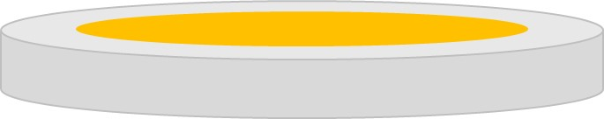
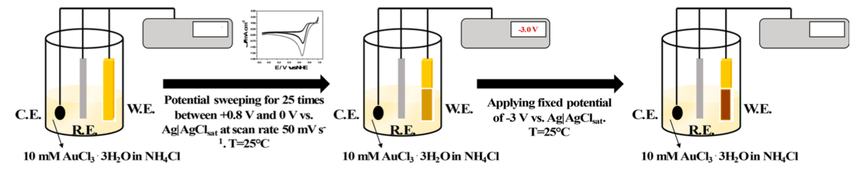
Electrode modification
self-templating electrodeposition
Au electrode
h-nPG electrode
H₂ bubbling

Slide 9
Aim of the work
to realize a minimally invasive pain-free microneedles-based sensor for continuous monitoring of AA in the interstitial fluid with comparable sensitivity, selectivity and costs to non-wearable sensors operating in blood or urine.

Slide 10
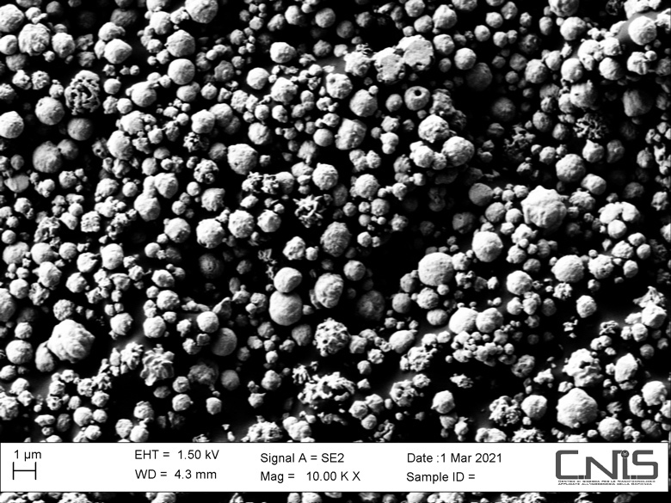
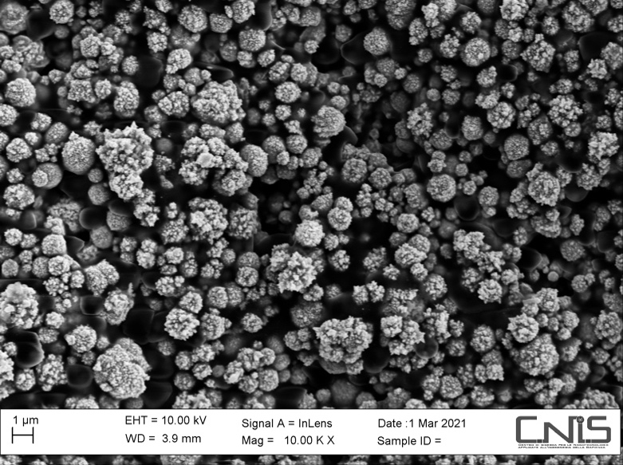
SEM characterization
sponge-like appearance
SEM images of bare gold electrode and h-nPG gold electrode.
Magnification: 10000 x; voltage: 10 kV

Slide 11
CV characterization
CVs for Au bare (solid line) and h-nPG (dotted line) electrodes in 5 mM [Fe(CN)⁶]^{3-/4-} and 0.1 M KCl, υ = 50 mV s⁻¹
diffusion-controlled mass transfer process at the solution/h-nPG electrode interface
The increase in the k₀ value is quite limited compared to the 20-times increase in the electroactive area:
the redox probe has a fast kinetics
its concentration at the outerpore rapidly drops to zero: the inner pore surface is “not utilized”

Slide 12
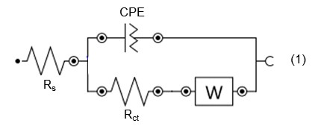
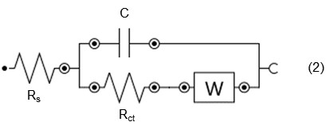
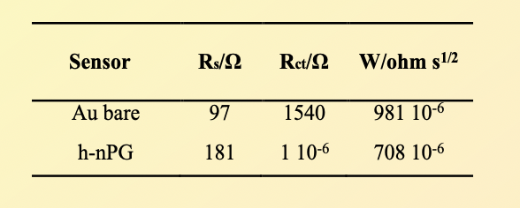
EIS characterization
Au bare
h-nPG
Nyquist plots of Au bare (●) and Au h-NPG (▲) electrodes in 0.1 M KCl containing 5.0 mM Fe(CN)₆^{3-/4-}
Au bare
h-nPG
the high conductivity of the h-nPG promotes a higher electron transfer rate in the redox probe

Slide 13
Electrochemical behavior of AA sensor
0.55 V vs Ag/AgCl
0 V vs Ag/AgCl
CVs of Au bare and h-nPG electrodes in 0.1 M PBS buffer (pH 7.4), 0.1 M KCl in absence and presence of different concentrations of AA (0; 10; 25; 150; 200; 400; 800; 1000 mM).
AA ——→ dehydro-AA + 2H⁺ + 2e-
slow kinetics
improved electron transfer kinetics
marked shift of the anodic E_{p} towards more negative values
the AA concentration at the outerpore does not fall to zero and the AA oxidation takes place deeper inside the nanopores

Slide 14
Selectivity of the AA sensor
Ascorbic acid
0 V vs Ag/AgCl
Dopamine
0.20 V vs Ag/AgCl
Uric acid
0.32 V vs Ag/AgCl
The reduction of the oxidized species takes place deeper inside the nanopores: “nanoconfinement effect”
improvement of the electron transfer kinetics with a concomitant anodic shift of the peak potentials

Slide 15
AA calibration curves
(c)
8.76x10⁻² μA μM⁻¹cm⁻²
microneedles h-nPG
h-nPG
(b)
2.60x10⁻² μA μM⁻¹cm⁻²
Au bare
(a)
3.12x10⁻³ μA μM⁻¹cm⁻²
Calibration curves of Au bare (a), h-nPG (b) and microneedles h-nPG modified sensors (c ) in 0.1 M PBS pH=7.4, KCl=0.1M.
Experimental conditions: E= 0 V vs. Ag/AgCl, adding time = 40 s, under stirring = 400 rpm; T = 25 °C.

Slide 16
AA-sensors analytical parameters
planar bare Au
R² | 0.96
LOD / µM | 3.8
Linear range / µM | 10-1000
Sensitivity / µA cm⁻² mM⁻¹ | 3.12 x 10⁻³ ± 12.5
planar h-nPG
R² | 0.98
LOD / µM | 1.8
Linear range / µM | 5-1000
Sensitivity / µA cm⁻² mM⁻¹ | 2.60 x 10⁻² ± 80.5
microneedles h-nPG
R² | 0.99
LOD / mM | 1.5
Linear range / µM | 5-1000
Sensitivity / µA cm⁻² mM⁻¹ | 8.76 x 10⁻² ± 32.1

Slide 17
AA calibration curve
in artificial interstitial fluid (ISF)
microneedles h-nPG in ISF
R² | 0.96
LOD / µM | 3
Linear range / µM | 10-100
Sensitivity / µA cm⁻² mM⁻¹ | 5.25 x 10⁻² ± 38.1
2 mM CaCl₂
5.5 mM glucose
10 mM Hepes
3.5 mM KCl
0.7 mM MgSO₄
123 mM NaCl
1.5 mM NaH₂PO₄
7.4 mM saccharose
Artificial ISF contains:
Calibration curve performed with microneedles h-nPG sensor in artificial ISF.
Experimental conditions: E=0 V vs. Ag/AgCl, adding time = 40 s, under stirring = 400 rpm; T = 25 °C.
pH 7.4

Slide 18
Conclusions
AA sensor based on microneedle-arrays modified with h-nPG allowed the detection of AA in the ISF with the following advantages:
minimally invasive
continuous monitoring
cost effective
high sensitivity
high selectivity
high stability
wearable sensor for real-time monitoring of AA opens a new frontier in personal nutrition and clinical care applications
The sensor will be further optimized for “in vivo” measurements through clinical studies in healthy volunteers.

Slide 19
Acknowledgements
Sapienza University of Rome
Paolo Bollella
Imperial College, London
Tony Cass
Thank you
for your kind attention!

