Slide 1




Disclosing the Sensitivity and Selectivity of Metal Oxide/Graphene Oxide-based Chemoresistors Towards VOCs
NRL
Nanotechnology Research Laboratory
Dipartimento di Chimica
E. Pargoletti^{1,2*}, A. Tricoli³, M. Longhi^{1,2}, G. L. Chiarello¹ and G. Cappelletti^{1,2}
¹ Dipartimento di Chimica, Università degli Studi di Milano, via Golgi 19, 20133, Milano, Italy
² Consorzio Interuniversitario Nazionale per la Scienza e Tecnologia dei Materiali (INSTM), Via Giusti 9, 50121, Firenze, Italy
³ Nanotechnology Research Laboratory, Research School of Engineering, Australian National University, Canberra 2601, Australia
e-mail: eleonora.pargoletti@unimi.it

Slide 2
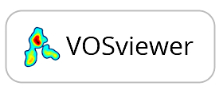
Introduction: VOCs Sensing
Why and How
Low LOD
Accurate
Gas Sensors
Portable
Meng et al., Trends Anal. Chem., 37 (2015) 37–47
Inexpensive
Light-assisted sensing
Tricoli et al., Adv. Funct. Mater., (2017) 1605271
Disclosing the Sensitivity and Selectivity of Metal Oxide/Graphene Oxide-based Chemoresistors Towards VOCs
e-mail: eleonora.pargoletti@unimi.it
2/10

Slide 3
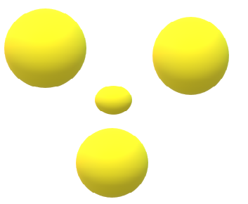
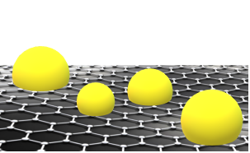
Introduction: VOCs Sensing
Why and How
Hyo-Joong Kim et al., Sensors and Actuators B, 192 (2014) 607–627
Metal Oxide
Light-assisted sensing
Hybrid
chemoresistor
M. Arvani et al., Sci. Iran., 3 (2017) 3033
Disclosing the Sensitivity and Selectivity of Metal Oxide/Graphene Oxide-based Chemoresistors Towards VOCs
e-mail: eleonora.pargoletti@unimi.it
2/10

Slide 4
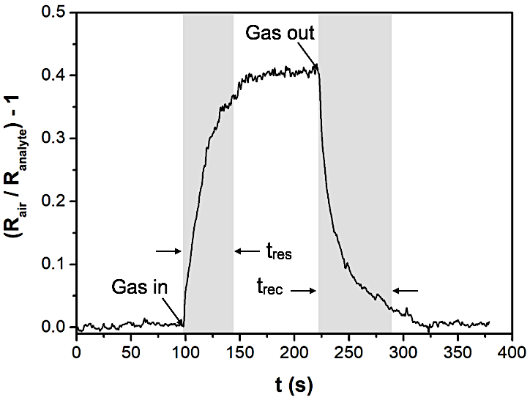
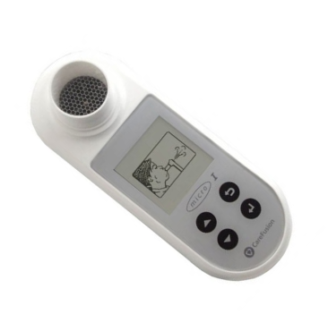
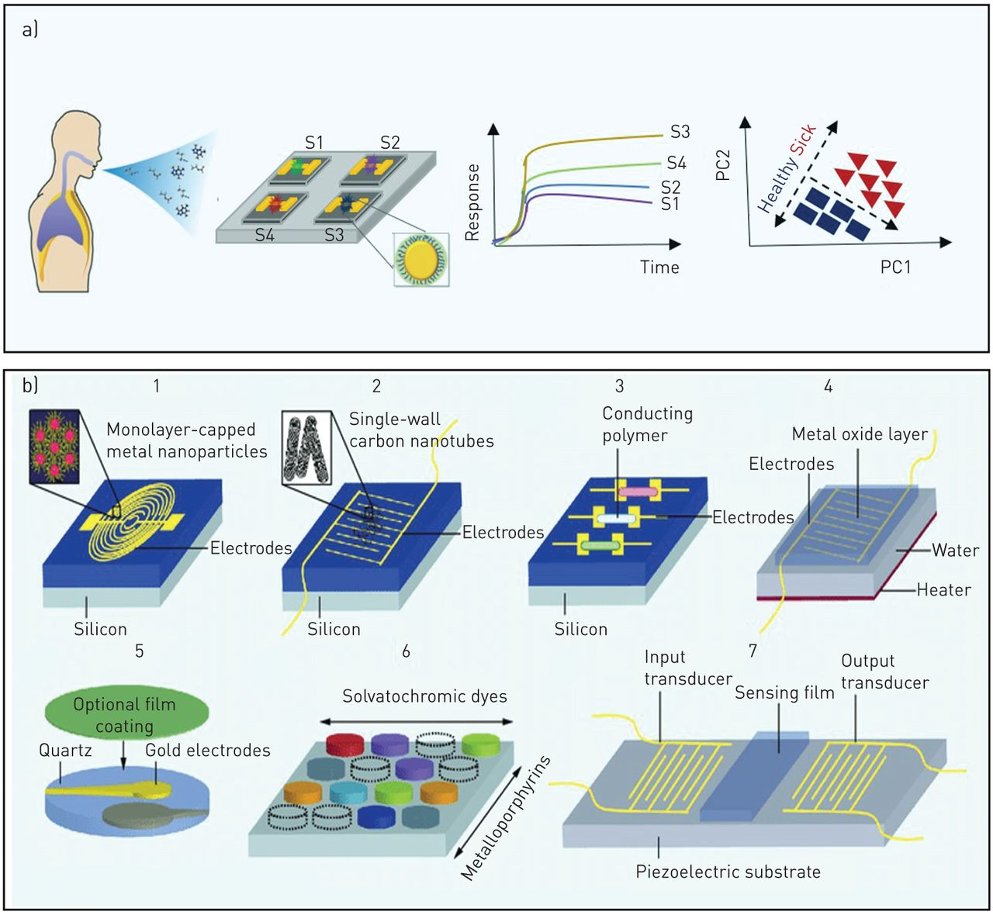
A General Overview
Complexity
Medical applications
Analyzed biomarkers
Ethanol: alcohol misuse
Acetone: diabetes type I
Toluene/ethylbenzene: lung cancer
Gas out
Operating T = 300 °C
20 ppm
Response and Recovery Times
Kim et al., ACS Appl. Mater. Interfaces, 7 (2015) 17199−17208
10 ppm
4 ppm
Sensitivity & Selectivity
2 ppm
1 ppm
0.8 ppm
Different Metal Oxide Semiconductors (MOS)
ZnO
SnO₂
WO₃
SnO₂-TiO₂
0.6 ppm
0.4 ppm
Gas in
0.2 ppm
Light assisted-low operating T sensing
Synthesis of metal oxide (MOS) / graphene oxide (GO) nano-heterojunctions:
increased conductivity under light sources, reducing the OT
synergistic effect between MOS and GO
Disclosing the Sensitivity and Selectivity of Metal Oxide/Graphene Oxide-based Chemoresistors Towards VOCs
e-mail: eleonora.pargoletti@unimi.it
3/10
Notes:
Composite materials/mixed oxides

Slide 5
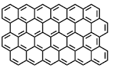
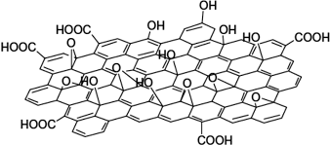
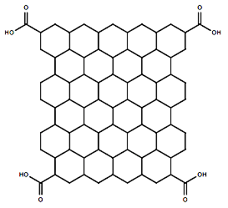
The Adopted Synthetic Route
Graphene oxide (GO) synthesis
Modified Hummers method
H₂SO₄, NaNO₃, KMnO₄
H₂O₂ (30 %wt)
Powder graphite (G)
Graphene Oxide (GO)
Pure MOS
MOS-GO nano-heterojunctions
Precipitating/structure directing agents
(NH₄OH, urea, oxalic acid, tensides, NaOH)
MOS salt precursors (Zn(NO₃)₂, SnCl₄, Na₂WO₄, H₂WO₄, TTPI)
O₂
Pure MOS
50 ºC, 6 h
400ºC, 6 h
Different MOS salt/GO weight ratios (i.e. 4 – 32)
GO aqueous suspension
(3.0 mg mL⁻¹)
MOS NPs
MOS-GO
Pargoletti* et al., Applied Surface Science, 483 (2019) 1081–1089
Pargoletti* et al., Nanomaterials, 10 (2020) 761
Pargoletti et al., Nanoscale, 11 (2019) 22932-22945
Pargoletti et al., ACS Appl. Mater. Interfaces, 12 (2020) 39549−39560
Disclosing the Sensitivity and Selectivity of Metal Oxide/Graphene Oxide-based Chemoresistors Towards VOCs
e-mail: eleonora.pargoletti@unimi.it
4/10
Notes:
Depending on the material

Slide 6
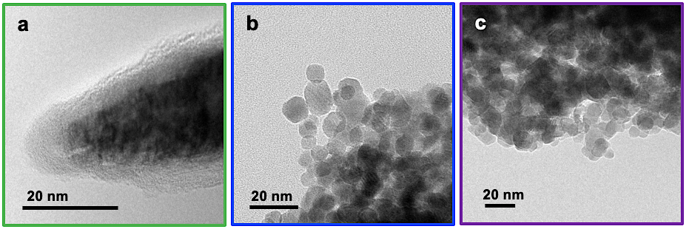
Materials Physico-Chemical Characterizations
The case of SnO₂ and SnO₂/GO
XRPD
XPS
SnO₂
4:1 SnO₂/GO
Raman
Sample | S_{BET} (m² g⁻¹) | V_{tot. pores} (cm³ g⁻¹)
Graphite | 11 | 0.030
GO | 30 | 0.010
SnO₂ | 67 | 0.210
4:1 SnO₂/GO | 40 | 0.110
32:1 SnO₂/GO | 50 | 0.133
32:1 SnO₂/GO
Disclosing the Sensitivity and Selectivity of Metal Oxide/Graphene Oxide-based Chemoresistors Towards VOCs
e-mail: eleonora.pargoletti@unimi.it
5/10

Slide 7
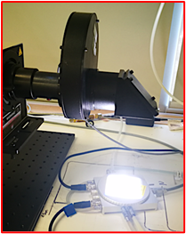
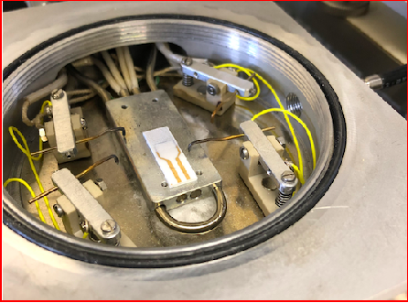
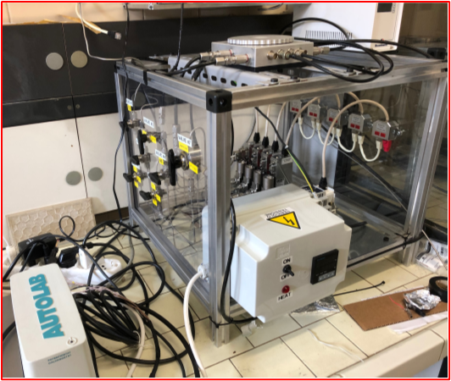
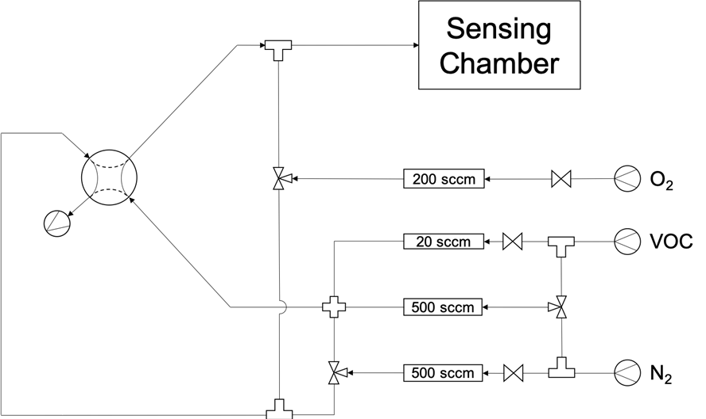
Gas Sensing Set-Up
Sensing layer deposition
Heating plate
4 mL of ethanol powders suspensions (2.5 mg mL⁻¹) sprayed (p = 0.8 bar) on a heating plate (230 ºC)
→ Final calcination step (in air, at 350 ºC for 1 h)
Lamp: UV Thorlabs
(290 - 370 nm, 2-20 μW cm⁻²)
Sensing chamber
Tips
Range 2-5 𝝻m
Electrode
Gas inlet/outlet
Flowmeters
Heating controller
Valves
Potentiostat/Galvanostat, applied bias = +1.0 V
Disclosing the Sensitivity and Selectivity of Metal Oxide/Graphene Oxide-based Chemoresistors Towards VOCs
e-mail: eleonora.pargoletti@unimi.it
6/10

Slide 8
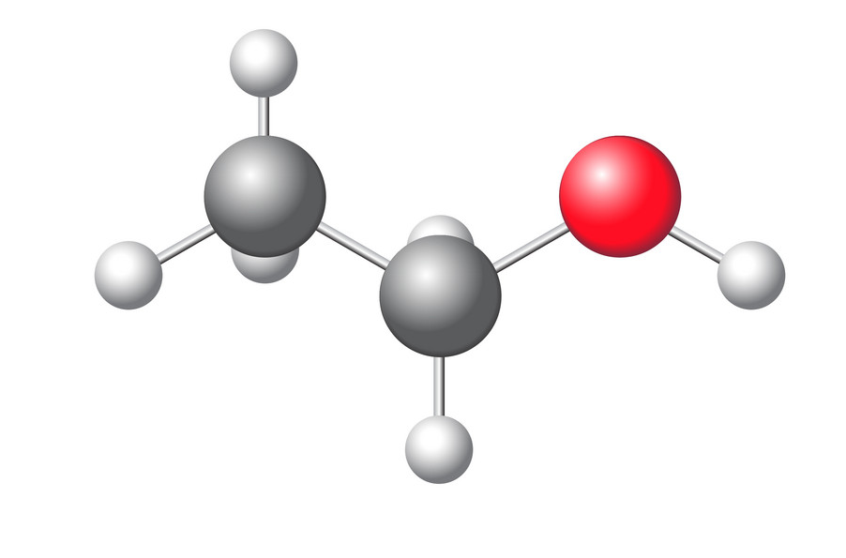
Gas Sensing
Sensitivity at high and low T (UV-aided) – The case of hybrid 32:1 ZnO/GO and SnO₂/GO towards EtOH
ZnO-based materials
SnO₂-based materials
Pargoletti et al., Nanoscale, 11 (2019) 22932-22945
Pargoletti* et al., Applied Surface Science, 483 (2019) 1081–1089
Pargoletti, Hossain, Di Bernardo, Chen, Tran-Phu, Lipton-Duffin, Chiarello, Cappelletti, Tricoli, ACS App. Mat.&Int., 12 (2020) 39549−39560
ZnO
32:1 ZnO/GO
SnO₂
32:1 SnO₂/GO
OT = 350 °C
UV off
OT = 350 °C
UV off
OT = 350 °C
UV off
OT = 350 °C
UV off
RT sensing
RT sensing
OT = 150 °C
OT = 150 °C
With the highest GO coverage by MOS NPs (32:1 MOS/GO), 100 ppb of ethanol are sensed at RT with the aid of UV light
By comparing ZnO-based to SnO₂-based materials: tin dioxide matrix gives the greatest response signal, both at high and low T
Disclosing the Sensitivity and Selectivity of Metal Oxide/Graphene Oxide-based Chemoresistors Towards VOCs
e-mail: eleonora.pargoletti@unimi.it
7/10

Slide 9
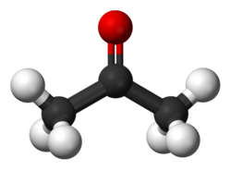
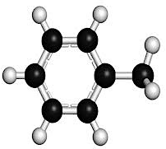
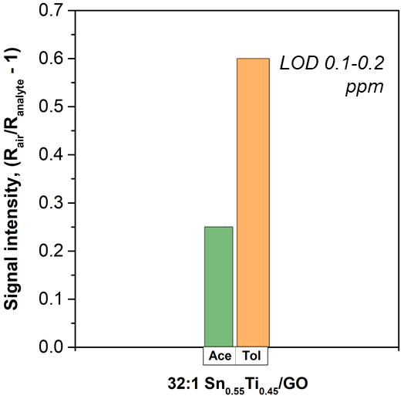
Gas Sensing
Selectivity – The case of ternary hybrid 32:1 SnO₂-TiO₂/GO towards Acetone and Toluene
4 ppm of VOCs, 350 ºC
4 ppm of VOCs, 250 ºC
LOD 0.1-0.2 ppm
E_{g} = 3.40
Increasing of Ti content
E_{g} = 3.26
At high T, 32:1 SnO₂/GO has higher selectivity towards acetone than toluene
At high T, Sn_{0.55}Ti_{0.45}/GO is the most selective to toluene
At lower T, with UV light: Sn_{0.55}Ti_{0.45}/GO keeps the selectivity towards toluene molecules
E_{g} = 3.20
Disclosing the Sensitivity and Selectivity of Metal Oxide/Graphene Oxide-based Chemoresistors Towards VOCs
e-mail: eleonora.pargoletti@unimi.it
8/10

Slide 10
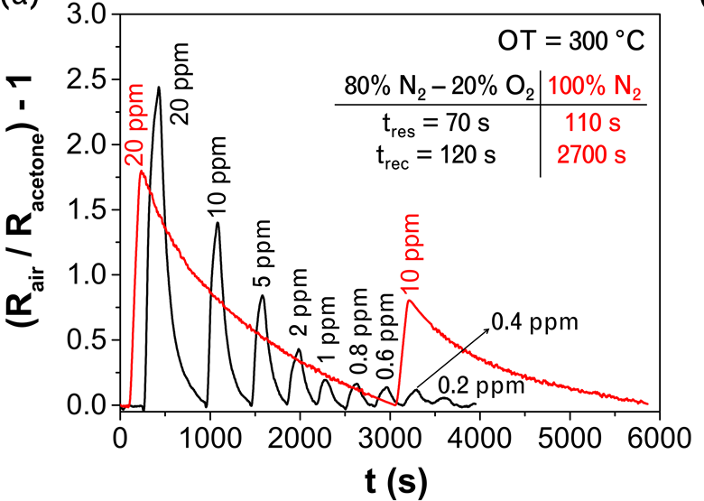

The Hypothesized Mechanism
n-type oxide semiconductor sensing mechanism
O_{2(gas)} → 2O_{(ads)}
O_{(ads)} + e⁻_{(from MO)} → O₂⁻_{(ads)} RT < T < 100 °C
O₂⁻_{(ads)} + e⁻ → 2O⁻_{(ads)} 100 < T < 300 °C
O⁻_{(ads)} + e⁻ → O²⁻_{(ads)} T > 300°C
Reducing gas + ads oxygen species → CO₂ + e⁻_{(to MO)} (R decreases)
WO₃
H.J. Kim et al., Sensors and Actuators B, 192 (2014) 607–627
H.W. Kim et al., Sensors and Actuators B, 249 (2017) 590–601
Reaction
Simple ads
Disclosing the Sensitivity and Selectivity of Metal Oxide/Graphene Oxide-based Chemoresistors Towards VOCs
e-mail: eleonora.pargoletti@unimi.it
9/10

Slide 11
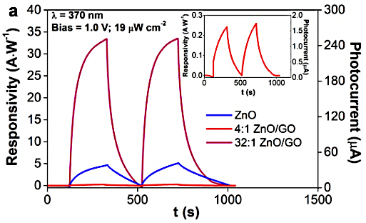
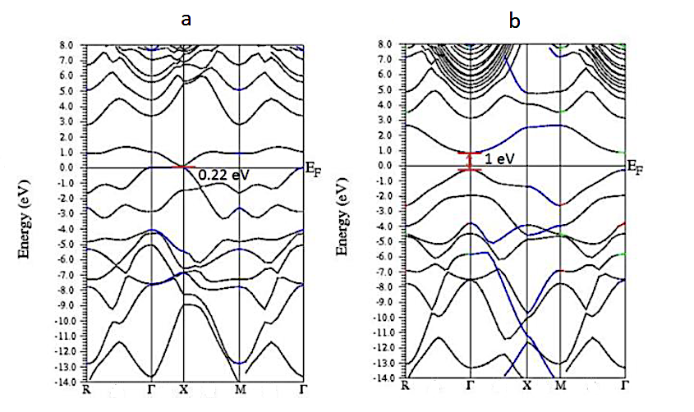
The Hypothesized Mechanism
n-type oxide semiconductor sensing mechanism
Photocurrent measurements
O_{2(gas)} → 2O_{(ads)}
O_{(ads)} + e⁻_{(from MO)} → O₂⁻_{(ads)} RT < T < 100 °C
O₂⁻_{(ads)} + e⁻ → 2O⁻_{(ads)} 100 < T < 300 °C
O⁻_{(ads)} + e⁻ → O²⁻_{(ads)} T > 300°C
Reducing gas + ads oxygen species → CO₂ + e⁻_{(to MO)} (R decrease)
Pargoletti et al., Nanoscale, 11 (2019) 22932-22945
p(GO)-n(MOS)
nano-heterojunctions
Band structure of (a) only hydroxyl GO and (b) only epoxy GO
H. Luo et al., J. Appl. Phys., 122 (2017)
Disclosing the Sensitivity and Selectivity of Metal Oxide/Graphene Oxide-based Chemoresistors Towards VOCs
e-mail: eleonora.pargoletti@unimi.it
9/10

Slide 12
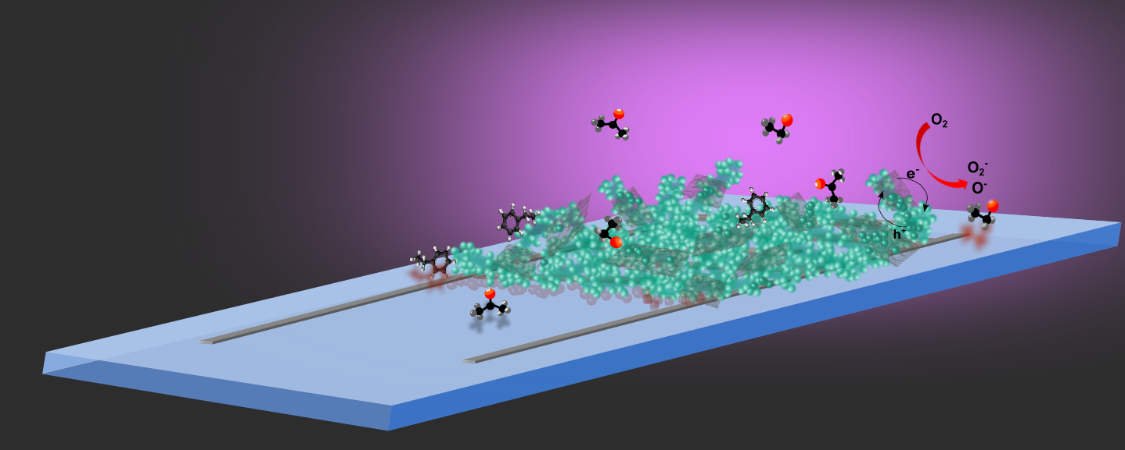


Conclusions
Pivotal role of GO and UV light
p-n heterojunction in hybrid materials
high performances of composites also as photodetectors
Sensor & possible mechanism
32:1 SnO₂/GO: highly selective to EtOH
32:1 Sn_{x}Ti_{1-x}/GO samples: higher selectivity to toluene
4:1 SnO₂/GO: much more selective to EtBz, displaying a reversed signal
Selectivity
Light assisted-low operating T sensing
Fundamental role of pores shape/size, specific surface area
films with thickness < 5 μm
Sensitivity
Response and
Recovery Times
SnO₂ is the most performing matrix showing the highest intensity response
low LOD values (of 100 ppb) are reached even at RT
Disclosing the Sensitivity and Selectivity of Metal Oxide/Graphene Oxide-based Chemoresistors Towards VOCs
e-mail: eleonora.pargoletti@unimi.it
10/10

Slide 13
NRL
Nanotechnology Research Laboratory
Thank you for your kind attention!

