Slide 1
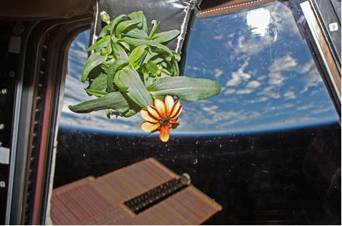
GRAVITY VARIATION EFFECTS ON THE GROWTH OF MAIZE SHOOTS
1
BY:
Funmilola Oluwafemi
Engineering and Space Systems Department, National Space Research and Development Agency (NASRDA), Abuja, Nigeria.

Slide 2
PRESENTATION OUTLINE
2
Introduction
Microgravity Research
Selected Crop for Microgravity Simulations
Importance of Plants Shoot
Aim
Experiment
The Three Samples
Results
Discussion
Future Work
Conclusion
References

Slide 3
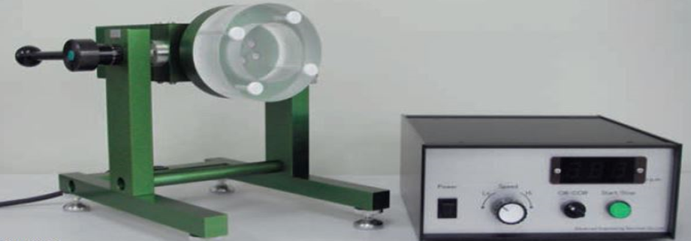
INTRODUCTION
3
Gravity is always present on earth.
Microgravity is a characteristic of the outer space environment.
On-board spaceflight microgravity-experiments are rare and expensive.
Similar experiments are now being conducted on the earth surface using microgravity equipment that provides simulated microgravity conditions; such as the Clinostats.
A Clinostat device uses rotation to negate gravitational-pull effects on plant growth and development.
A two-dimensional (2-D) Clinostat has a single rotational axis, which runs perpendicular to the direction of the gravity vector. It operates with respect to speed and direction of the rotation.
International Space Station (ISS)
2-D Clinostat

Slide 4
MICROGRAVITY RESEARCH
Microgravity research gives insight on the new orientation of plants after been impacted by microgravity.
These effects of microgravity on plants sometime gives definite changes which could be beneficial.
These researches are therefore called gravity variation researches as the normal-earth-gravity (1G) and microgravity (µg) platforms are possible variations for experimental purposes.

Slide 5
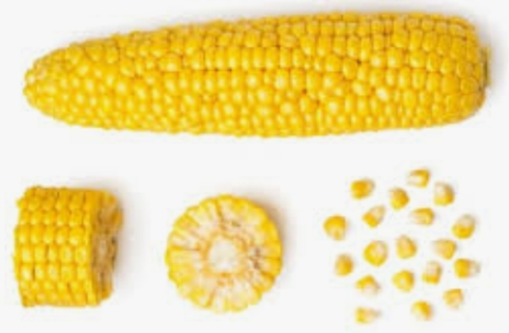
SELECTED CROP FOR MICROGRAVITY SIMULATIONS
5
The selected crop is maize.
It is selected because of its nutritional and economical values.
It is number one cereal in Africa and number two cereal in the world.
Corn (Zea mays)

Slide 6
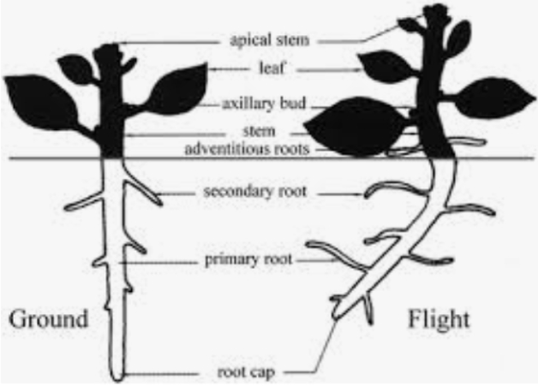
IMPORTANCE OF PLANTS SHOOT
6
In the experiment, the shoots of the plants were the focus.
The shoots of the seedlings were studied because plant shoot physiology is important for gravi-responses. If the shoot of a plant is unable to perform or function, then so will the plant not be able to function.

Slide 7
AIM
7
The aim of this study was to understand the impact of gravity on maize growth to determine what its orientation will be in space, where there is microgravity; as well as to identify the underlying mechanisms and to conduct observational experiments (by measurement of the curvature angles and growth-rates of shoots using ImageJ software) with respect to gravitropic reactions with the shoots grown of maize under simulated microgravity environment and comparing them with those of control experiments.

Slide 8
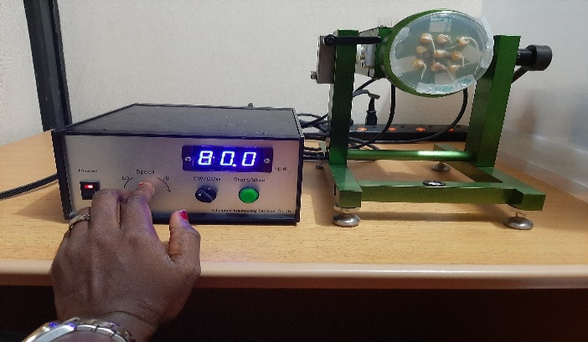
EXPERIMENT
8
The steps necessary for preparing an experiment using the Clinostat with plants include:
preparation of the substrate for seeds in petri dishes.
planting of seeds into the substrate.
cultivation inside a wet chamber.
Ascertain that gravity is active in the laboratory (90º-turned sample).
Placement of the seeds on the Clinostat (source of simulated microgravity).
The possible experimental variables are humidity, temperature and light while on the Clinostat, rotation-speed, rotational-axis angle and rotation-direction are the specific experimental variables.
possible methods for getting results with a further analysis of observed gravi-responses to compare the effect of simulated microgravity on grown roots of plants to those under gravity response.
Observations were made for 4 hours during the experiments on the samples and a wide range of observational and measurement tools (such as imageJ) were used.

Slide 9
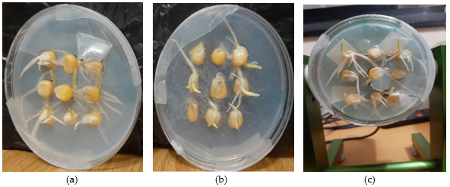
THE THREE SAMPLES
9

Slide 10
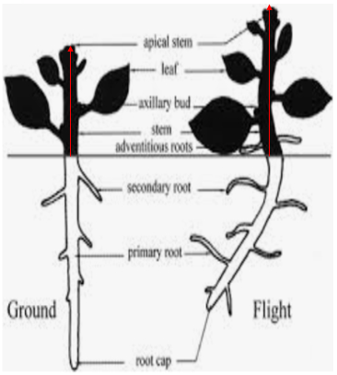
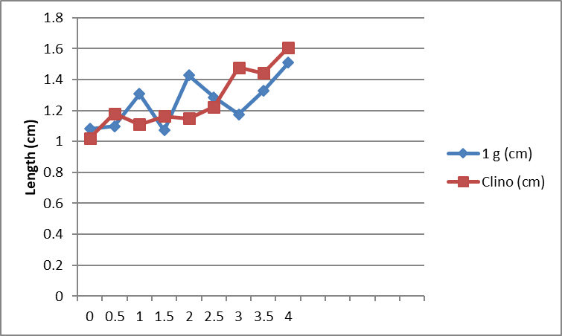
RESULT
10
Growth-rate
The average growth-rate of the shoots for the 1G-control sample was 1.25cm/hr while that of the clinorotated sample was 1.26cm/hr.
Shoot length of the 1G-control and the clinorotated samples of maize seedlings.

Slide 11
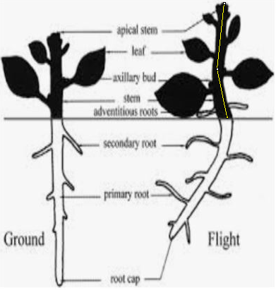
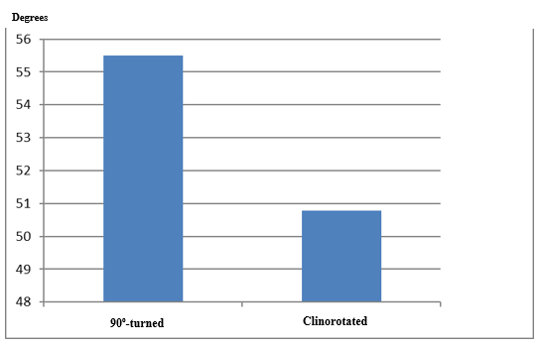
RESULT CONT’D
11
Shoot curvature
The average angular rate of the shoot bending for the 90⁰-turned was 55.49⁰/hr while that of the clinorotated was 50.77⁰/hr.
Shoot curvature of the 90⁰-turned and the clinorotated samples of maize seedlings.

Slide 12
DISCUSSION
12
The shoot length enhancement have physiological basis.
It can be deduced that there could be changes in the vascular structure of the shoots as a result of the orientation of microfibrils and their assembly in developing vessels perturbed by simulated microgravity.
The image of the 90°-turned sample showed that the shoots started bending in the direction of gravity after the petri-dish was turned by 90°. This is an evidence of gravitropism of the shoots; this indicates a positive response to simulated microgravity.
Therefore, maize has a promising result with the use of Clinostat simulated microgravity model.

Slide 13
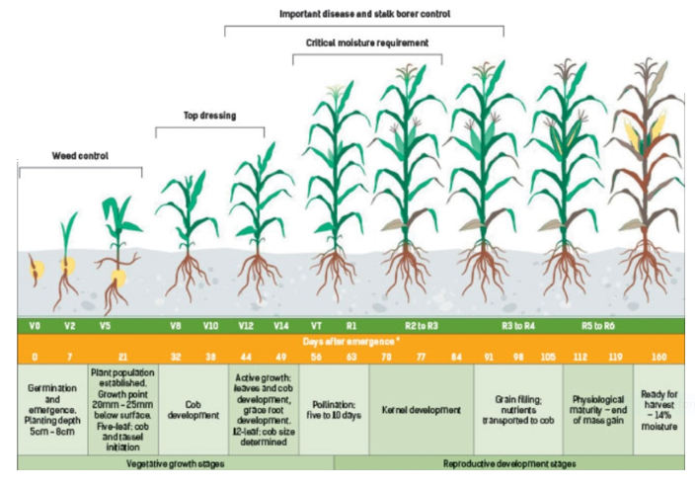
FUTURE WORK
13
This study is only on the shoot morphology (curvature and length); further research work is proposed on the plant photosynthesis, respiration, transpiration, and gene expression. All these involve the flow of information and communications within the underlying cells.
Developmental vegetative stages of corn

Slide 14
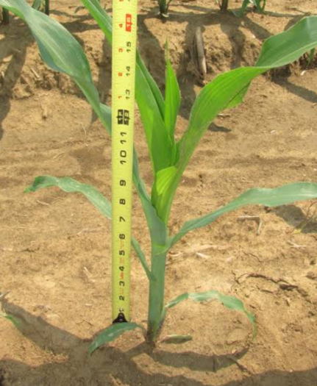
CONCLUSION
14
Plants account for the majority of human food. Therefore, improving the growth-rate status of plants will help increase the crop’s yield which is an important factor to feeding the world’s growing population.
In this study, simulated microgravity using 2-D Clinostat was able to cause an increase in the shoot growth-rate of maize as a response from gravity to simulated microgravity.
Therefore, simulated microgravity of Clinostat is proposed to have beneficial effects on the in-built structure of seedlings before they are transplanted unto the field to produce better product yields and higher nutritional qualities. Thus, “simulated space stressing” of plant at the early stage of seedling could be advantageous.

Slide 15
REFERENCES
15
Afolayan, E.M.; Oluwafemi, F.A.; Jeff-Agboola, E.O.; Oluwasegun, T.; Ayankale, J.O. Socio-economic benefits of microgravity research. Arid Zone Journal of Engineering, Technology and Environment (AZOJETE), Centre for Satellite Technology Development Special Issue: Space Science and Technology for Sustainable Development 2019, 15, SP.i2: 57-74, Print ISSN: 1596-2490, Electron vic ISSN: 2545-5818.
Oluwafemi, F.A.; De La Torre, A.; Afolayan, E.M.; Olalekan-Ajayi, B.M.; Dhital, B.; Mora-Almanza, J.G.; Potrivitu, G.; Creech, J.; Rivolta, A. Space food and nutrition in a long-term manned mission. Adv. Astronaut. Sci. Technol. 2018, 1, 1. Doi: 10.1007/s42423-018-0016-2.
Howard, G.L. The Influence of microgravity on plants. NASA Surface Systems Office, Space Life Sciences Laboratory, Mail Code NE-S-1, Kennedy Space Center, FL 32899. NASA ISS Research Academy and Pre-Application Meeting, South Shore Harbour Resort & Conference Center, League City, Texas, 2010.
Oluwafemi, F.A.; Ibraheem, O.; Fatoki, T.H. Clinostat microgravity impact on shoot morphology of selected nutritional and economic crops. Plant Cell Biotechnol Mol Biol. 2020, 21(43&44), 92-104. ISSN: 0972-2025.
Oluwafemi, F.A; Olubiyi, R.A. Investigation of corn seeds growth under simulated microgravity. Arid Zone Journal of Engineering, Technology and Environment (AZOJETE), Centre for Satellite Technology Development Special Issue: Space Science and Technology for Sustainable Development 2019, 15, SP.i2:110-115, Print ISSN: 1596-2490, Electronic ISSN: 2545-5818.
Awika, M.J. Major cereal grains production and use around the world. ACS symposium series. 2011, 1089, pp. 1-13. DOI: 10.1021/bk-2011-1089.ch001.
United Nations. Teacher’s guide to plant experiments in microgravity. Human Space Technology Initiative. United Nations Programme on Space Applications, Publishing and Library Section, United Nations Office, ST/SPACE/63, New York, 2013.

Slide 16
THANKS FOR YOUR ACTIVE ATTENTION

