Slide 1
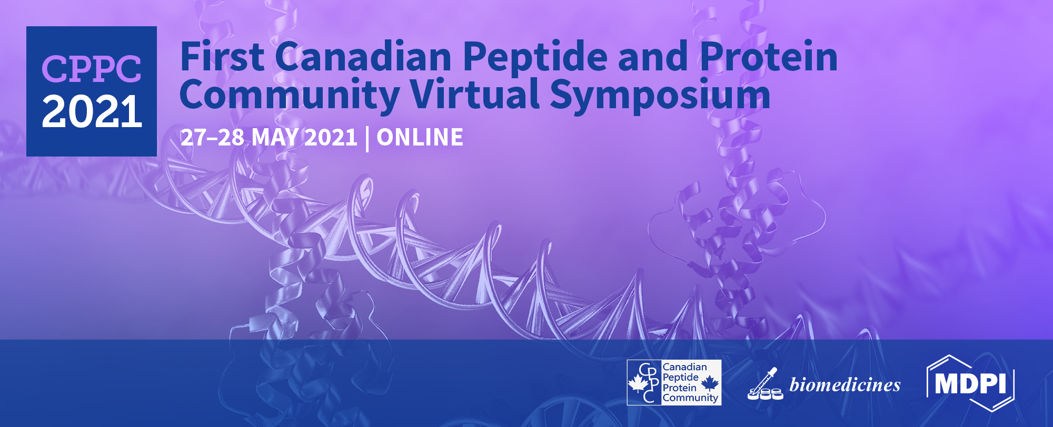

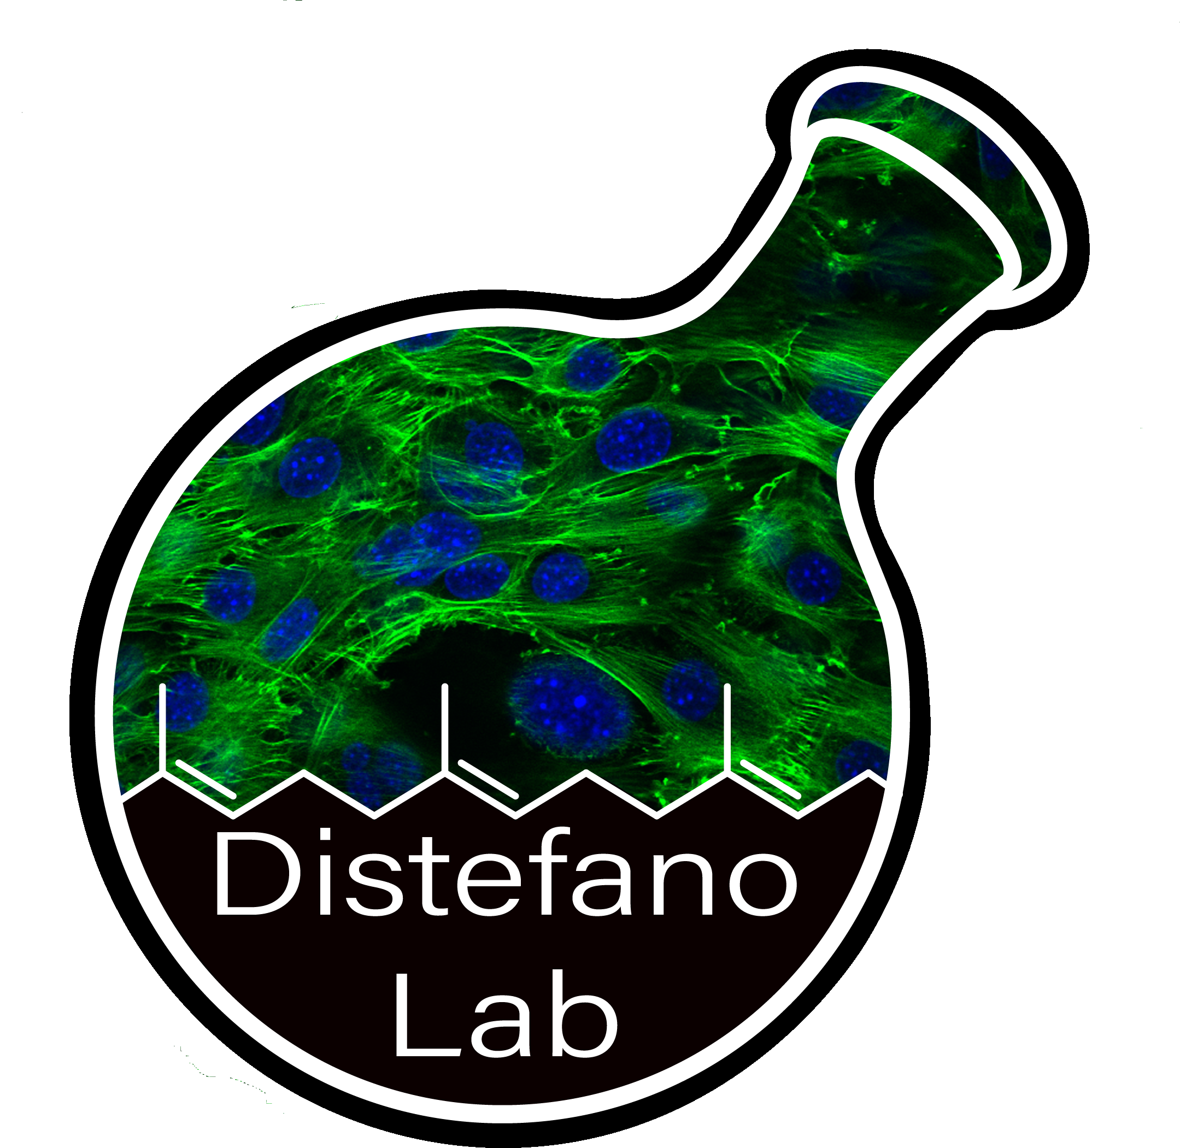
MALDI/MS as a tool to rapidly screen peptide libraries for novel substrates of Farnesyltransferase
Garrett L. Schey^{1*}, Emily R. Hildebrandt², Sadie X. H. Novak³, James L. Hougland³, Walter K. Schmidt², Mark D. Distefano¹
¹ Department of Medicinal Chemistry, University of Minnesota, Minneapolis, Minnesota USA
² Department of Biochemistry and Molecular Biology, University of Georgia, Athens, Georgia USA
³ Department of Chemistry, Syracuse University, Syracuse, New York USA
* Corresponding author: schey013@umn.edu

Slide 2

Abstract: Protein farnesylation is a post-translational modification where a 15 carbon farnesyl isoprenoid is appended to the C-terminal end of a protein by Farnesyltransferase (FTase). In the canonical understanding of FTase, the isoprenoids are attached to the Cysteine residue of a four amino acid CaaX box sequence. However, recent work has shown that five amino acid sequences can be recognized, such as the pentapeptide CMIIM. This new discovery greatly increases the number of potential FTase substrates, as the FTase is already known to tolerate a wide variety of amino acids in the canonical CaaX sequence. With the goal of developing a more rapid and methodical method to evaluate potential substrates, we envisioned using MALDI to assay libraries of 10 peptides at a time, varying one amino acid in the CaaX box to all 20 canonical amino acids over two libraries. Through this method we observed 30 hits in the mass spectrum and chose eight for further evaluation. Seven of these sequences are novel substrates for FTase, with several meeting or surpassing the in vitro efficiency of the benchmark sequence CMIIM. Additionally, in vivo experiments in yeast demonstrate that proteins bearing these sequences can be efficiently prenylated in a biological context.
Keywords: prenylation; peptide libraries; MALDI

Slide 3
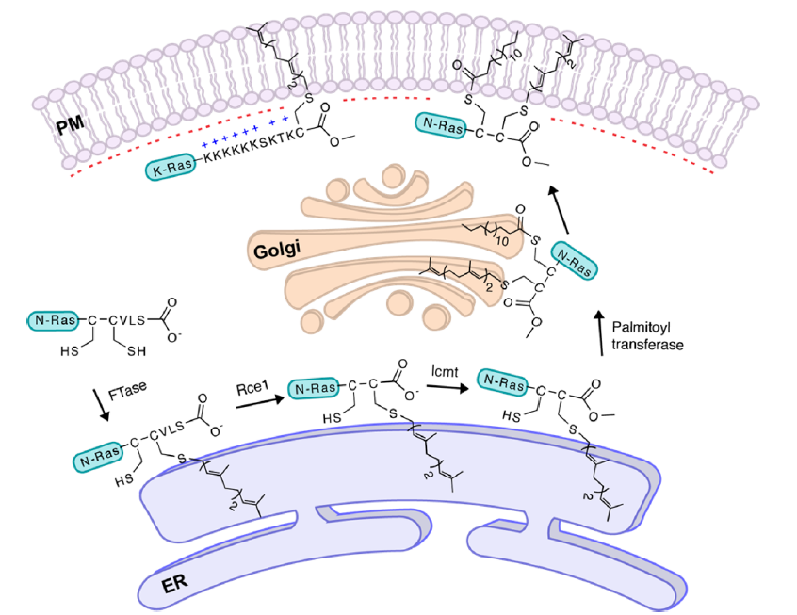
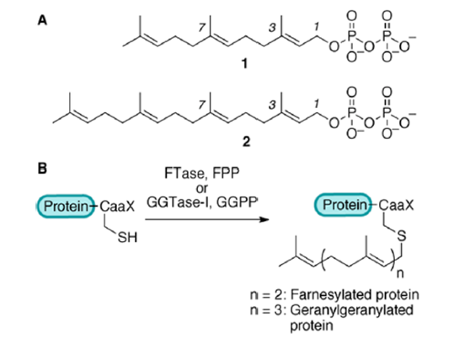
Protein prenylation – the anchor of life

Slide 4
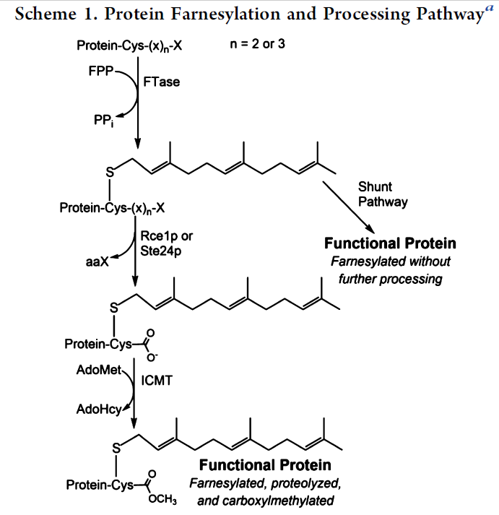
The canonical view of a CaaX box is expanding
Blanden, et al. J Biol Chem 2018

Slide 5
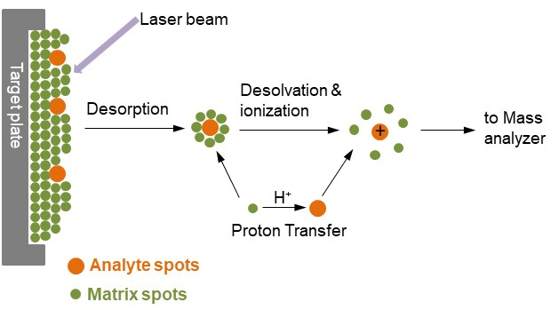
MALDI has several advantages as a library screening tool
Small sample volume
High throughput
Single charged species for simple analysis of complex mixtures
Gentle ionization reduces fragmentation
https://www.creative-proteomics.com/technology/maldi-tof-mass-spectrometry.htm

Slide 6
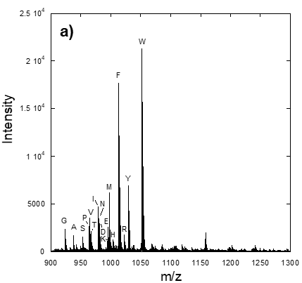
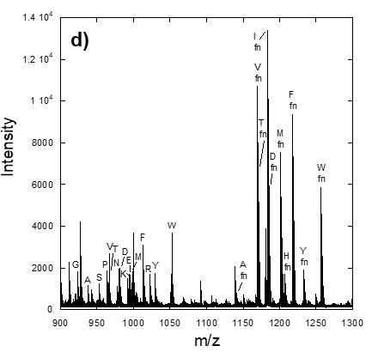
MALDI analysis of a previously studied CVIA library - RAGCVXA

Slide 7
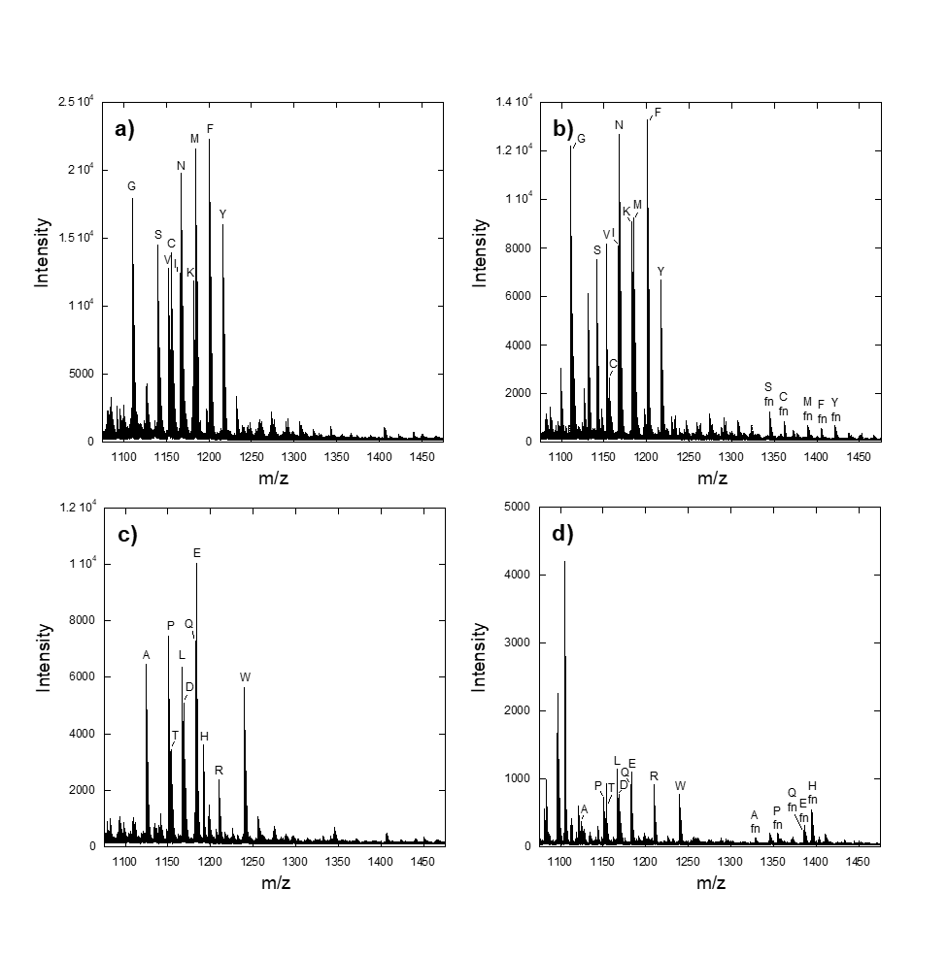
Use of MALDI to observe prenylation in peptide libraries based on CMIIM - CXIIM

Slide 8
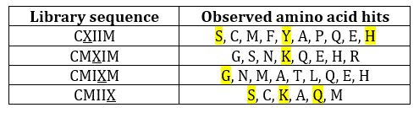
30 new potentially prenylated CaaaX sequences were discovered

Slide 9
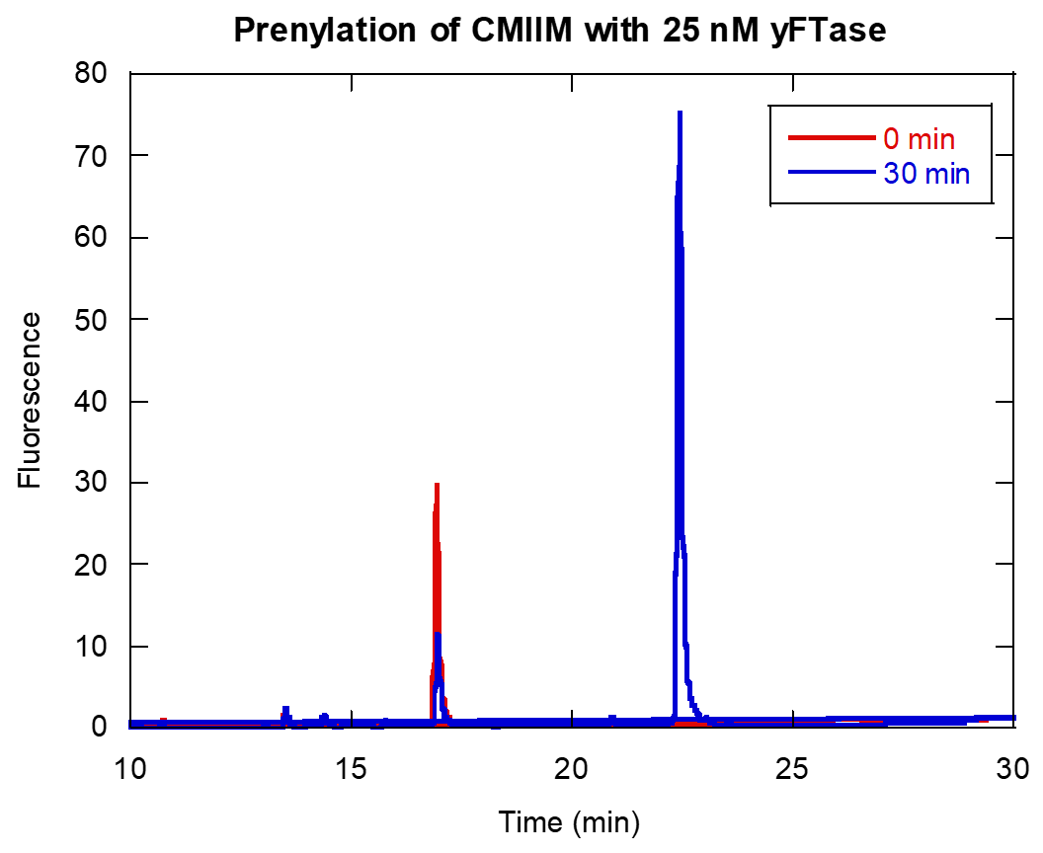
Detecting HPLC retention time shifts of prenylated peptides by fluorescence

Slide 10
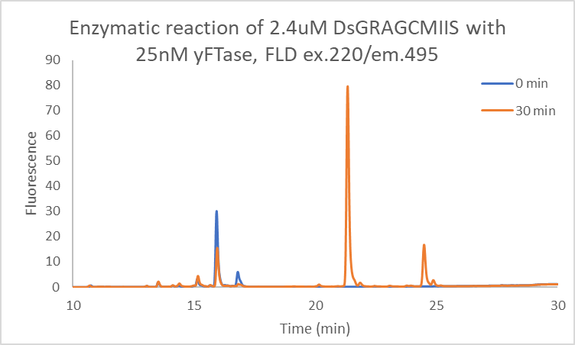
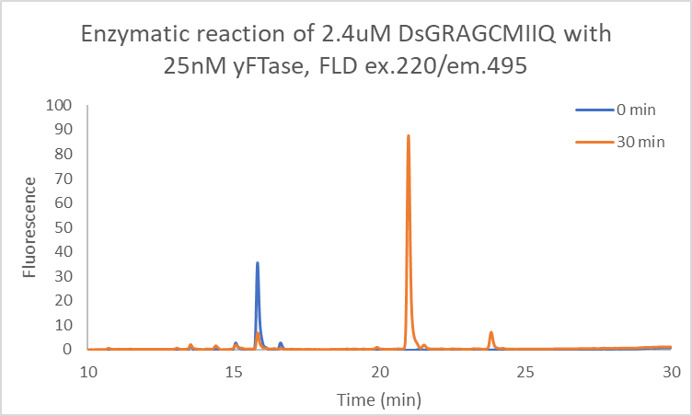
CMIIS and CMIIQ showed excellent conversion to prenylated product
Notes:
Unsurprisingly CMIIS and CMIIQ were good substrates, we could expect those to be good X position aas based on classic CaaX boxes

Slide 11
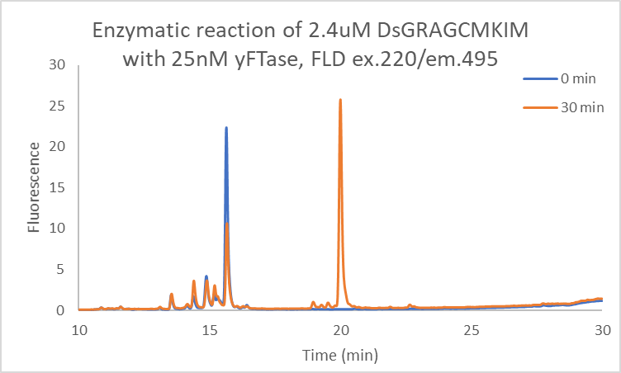
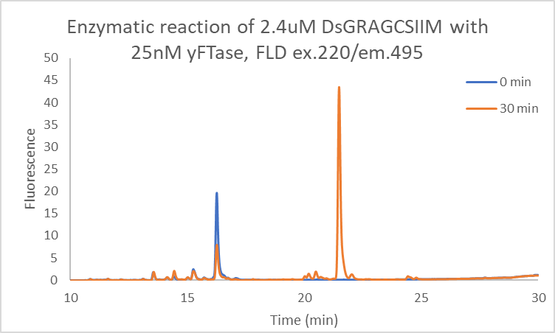
CMKIM and CSIIM showed excellent conversion to prenylated product
Notes:
A bulky residue like Y is acceptable, although it isn’t great it is qualitatively better than H. S is good at the a1 position, which again is something we might expect.

Slide 12
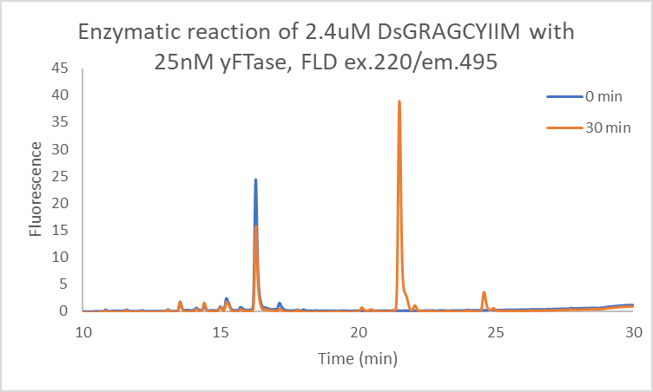
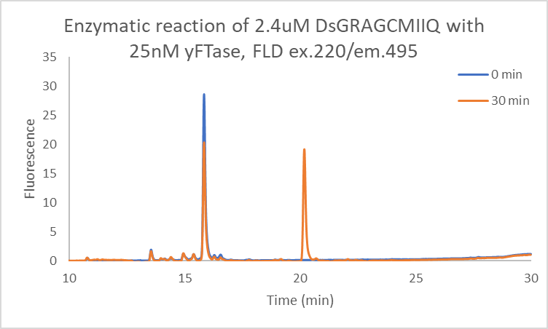
CYIIM and CHIIM showed some conversion to prenylated product
DsGRAGCHIIM
Notes:
Most surprisingly a K in the a2 position was actually a good substrate! G doesn’t work in a3. I highly doubt any CaaX or CaaaX would function with a G or P

Slide 13
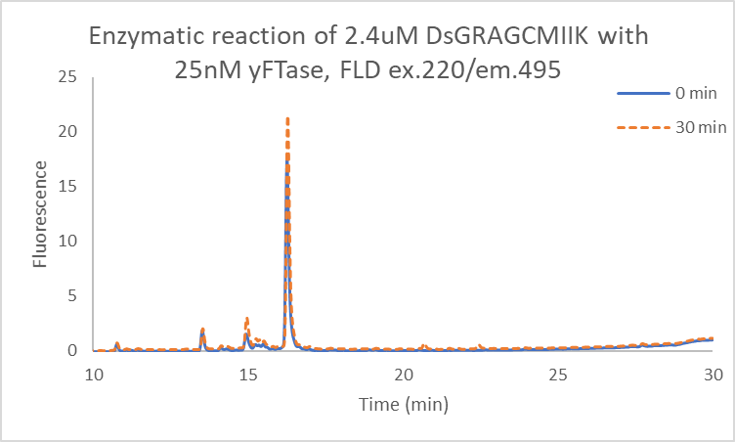
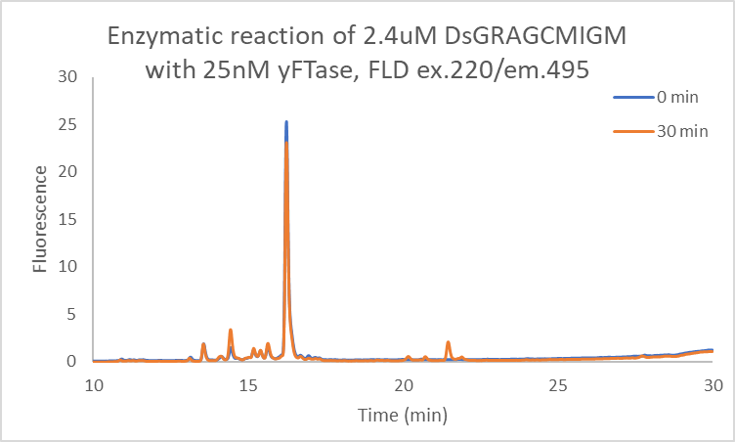
CMIIK and CMIGM did not show conversion to prenylated product
Notes:
CaaaX box cant end in K, what a bummer. H at the a1 position did work a little bit!

Slide 14
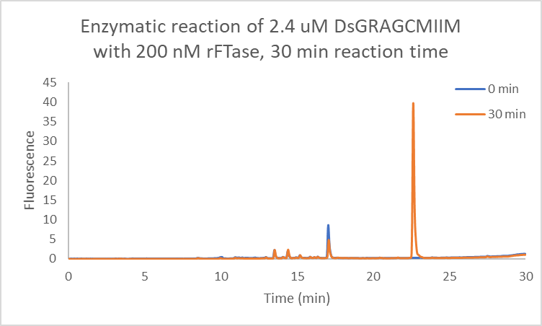
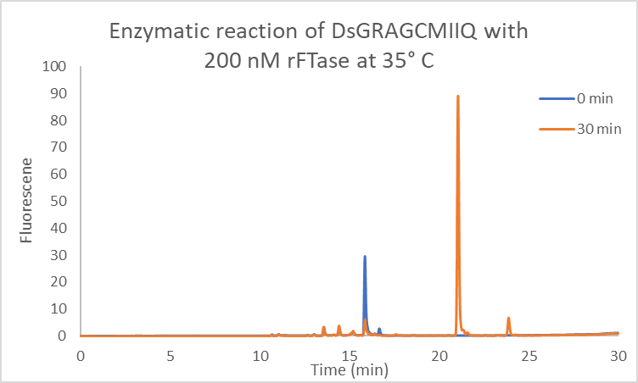
Only two of the CaaaX peptides were substrates of rat FTase
Notes:
Summary of data as an average of triplicates. The important number is percent conversion. Also you can see the fluorescence of almost all the peptides after overnight rxn (not CMIIK). Even CMIGM showed eventual conversion. You can also see precipitate, this is easiest to see in the bottom of tube 2.

Slide 15
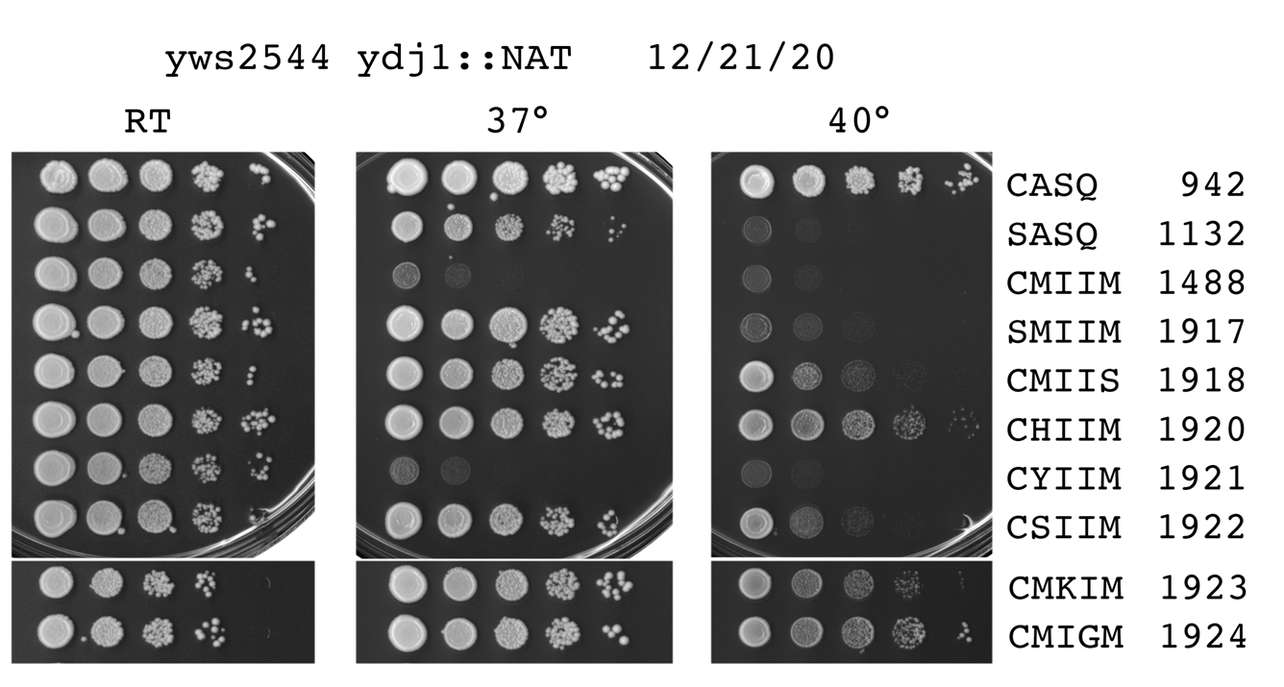
Thermotolerance of CaaaX hits is variable
Courtesy of Walter Schmidt

Slide 16
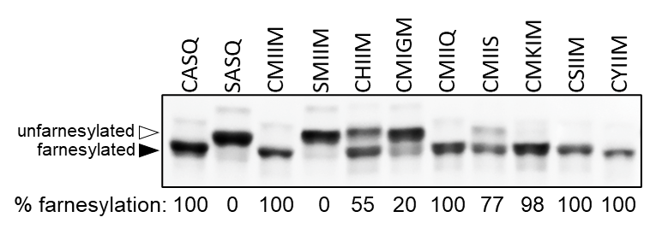
Western Blot Gel shift assay of CaaaX hits in yeast shows prenylation in a biological context
Courtesy of Walter Schmidt

Slide 17
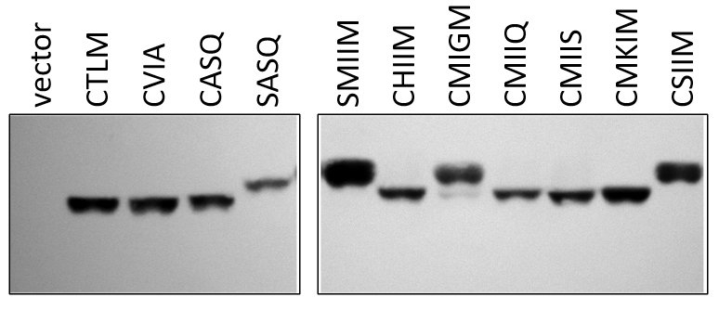
A strain of yeast expressing human FTase also shows excellent conversion of CaaaX hits
Courtesy of Walter Schmidt

Slide 18
Conclusions and future directions
30 potentially novel CaaaX sequences based on CMIIM were discovered using yFTase
Of the eight hits chosen for follow up, four were found to qualitatively convert with a same level of efficiency as the CMIIM parent
Of particular interest is the sequence CHIIM, as a charged amino acid is not allowed in the canonical CaaX box
This work will be extended to the mammalian relevance by searching for potentially prenylated CaaaX in the human genome
This methodology could be used to quickly screen mutant FTases to check for substrate specificity both for peptides and bioorthogonal isoprenoids.

Slide 19
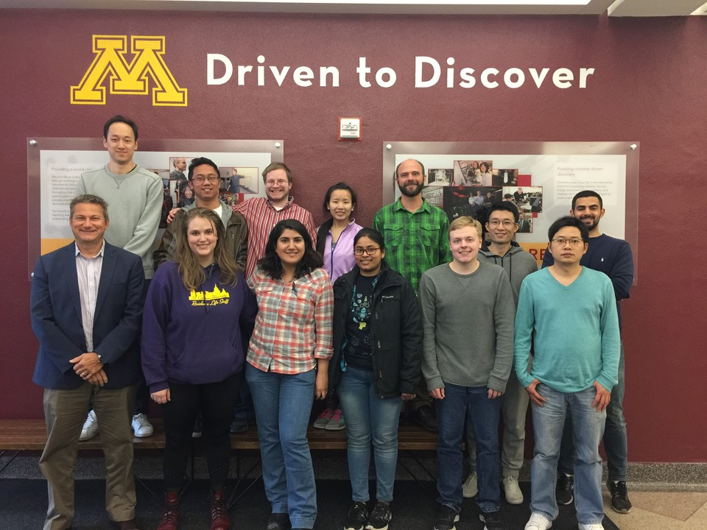
Acknowledgments
Distefano group

