Slide 1
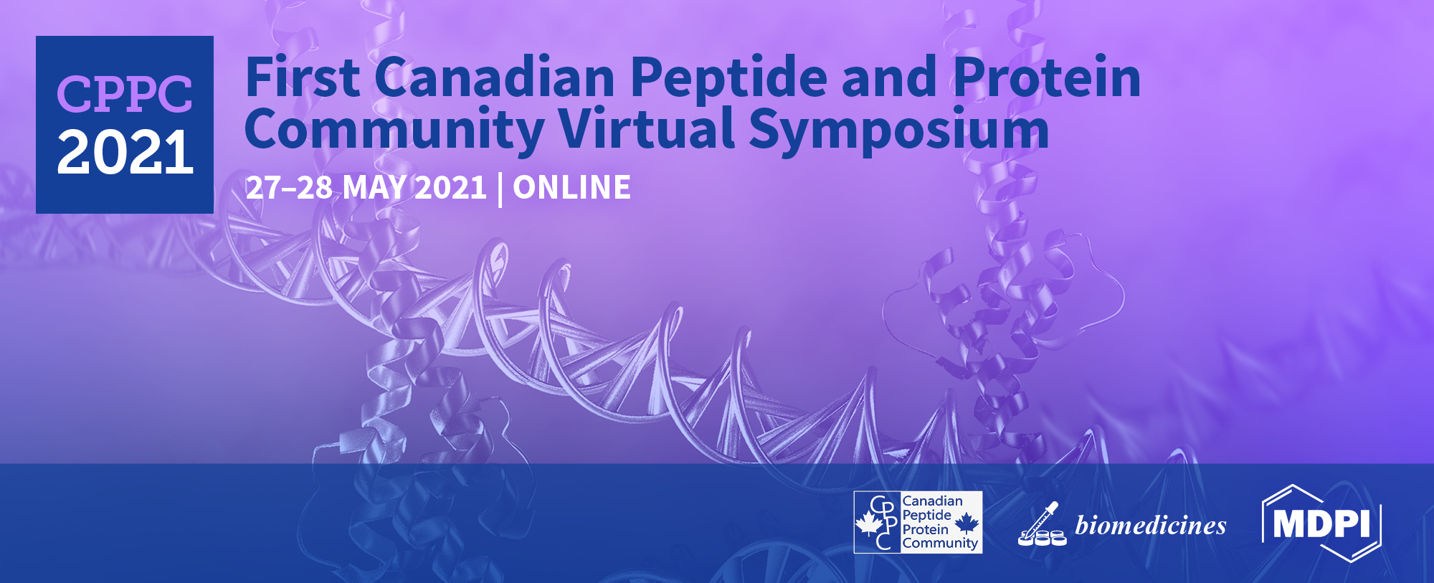
Genetically encoded fragment-based discovery from phage-displayed macrocyclic libraries with genetically encoded unnatural pharmacophores
^{Dr. Arunika Ekanayake}
^{Derda Research Group}
^{Department of Chemistry}
^{University of Alberta}

Slide 2
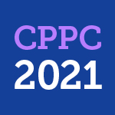
Abstract
Peptide therapeutics are known to have high selectivity and strong interactions with their targets of interest. While there is increased interest in the therapeutic application of peptides, there is a continuous need to generate peptides with improved stability and cellular internalization properties. This requires the incorporation of pharmacophores or chemical fragments onto peptides. Generation of genetically encoded (GE) macrocyclic peptide libraries containing unnatural fragments can give rise to libraries of value-added ligands against a plethora of protein targets. Generally, these fragments are installed at the macrocyclization step, requiring optimization of different reactions depending on the chemical fragment. In Derda Research Group, we have employed the potent Knorr-pyrazole synthesis reaction to develop a robust two-step ligation reaction for late-stage functionalization of GE-peptide libraries. A readily available 1,5-dichloropentane-2,4-dione linchpin coverts peptide libraries displayed on phage to 1,3-diketone macrocyclic peptides that provide a handle to be functionalized by a variety of hydrazines. The phage libraries carry a silent-DNA barcode that encodes the amino acid sequence and the unnatural fragment displayed on the peptides. These libraries can be applied for genetically encoded-fragment-based discovery (GE-FBD) against various therapeutic targets.

Slide 3
Insulin to present: the story of peptide therapeutics
Global pharmaceutical market (2019)
Therapeutic indications
Peptide drug approvals
Nature Reviews Drug Discovery
20, 309-325 (2021)

Slide 4
Chemistry as a tool to design value added ligands
Improving pharmacokinetics by macrocyclization
Proteolytic stability
Targeting active sites
Internalization
Protein & Peptide Letters, 25, 1-25 (2018)

Slide 5
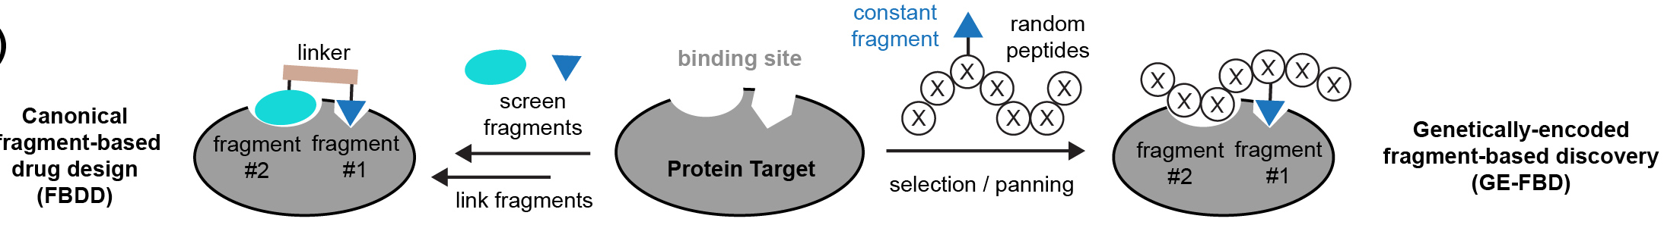
Providing a platform to introduce phamacophores
Canonical fragment-based drug design (FBDD)
Genetically-encoded fragment -based discovery
(GE-FBD)
Dawson
Derda
Current opinion in chem. Bio,50, 128-137 (2019)
Org. Biomol. Chem., 14, 5539-5545 (2016)

Slide 6
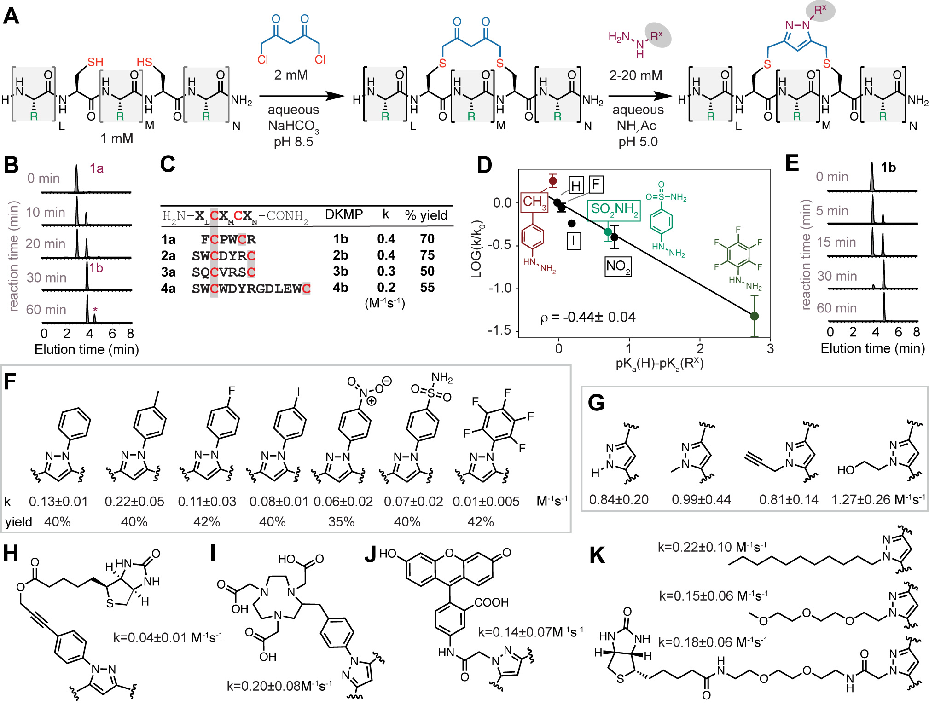
Late-stage functionalization of 1,3-diketone macrocycles
1
2
Knorr pyrazole synthesis
k=
JACS ,143, 5497-5507 (2021)

Slide 7
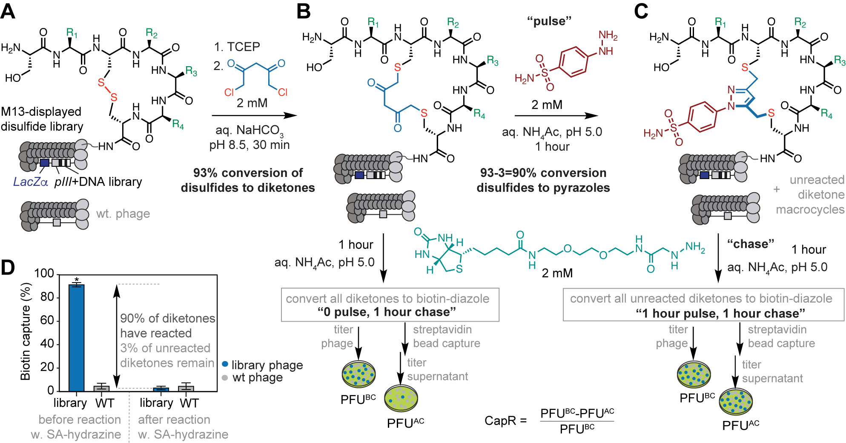
Macrocyclization of genetically encoded peptides
JACS ,143, 5497-5507 (2021)

Slide 8
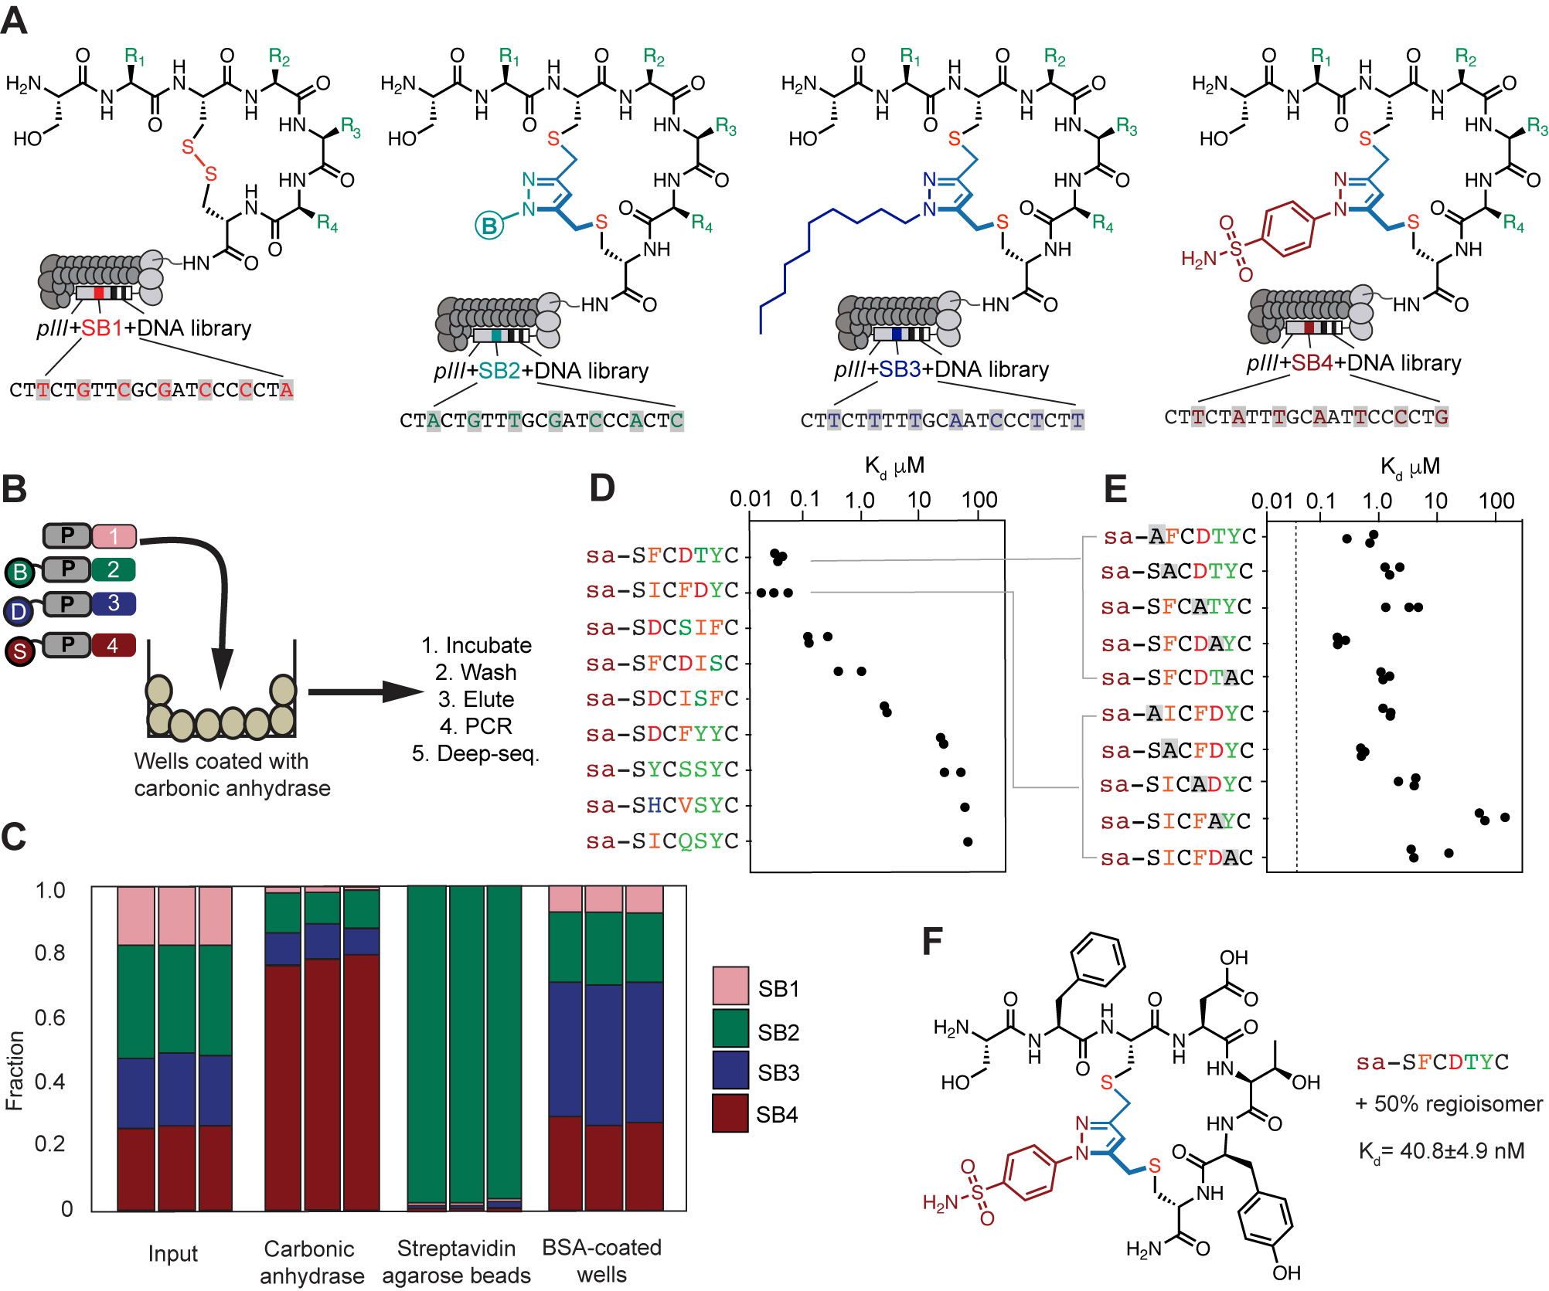
Selection of ligands from functionalized macrocyclic libraries
JACS ,143, 5497-5507 (2021)

Slide 9
Applications of GE-FBD
Electrophilic fragments reactive
towards active site cysteines
Electrophilic fragments reactive
towards allosteric site cysteine
CPP for intracellular targets
(Ongoing work)

Slide 10
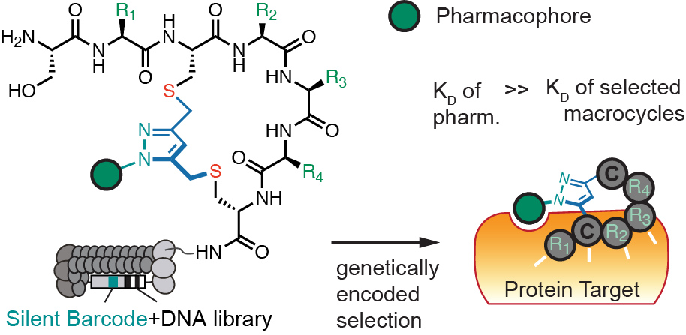
Conclusions and Perspective
Broad substrate scope of Knorr Pyrazole Synthesis
Attractive strategy for diversification of macrocycles with built in 1,3-diketones using a large range of hydrazines
Robust and straightforward macrocyclization with late-stage functionalization
Ability to generate large number of ligands already containing post validation modifications
Shelf stable linchpin allows storage of intermediate libraries for immediate modification and application
JACS ,143, 5497-5507 (2021)

Slide 11


Acknowledgments
Dr. Ratmir Derda
Lena Sobze
Dr. Raja Mukherjee
Jihea Youk
Dr. Nichols J. Bennett
Collaborators
Dr. Lela Vukovich
Payam Kelich
Dr. Frank Wuest
Dr. Atul Bhardwaj
Jeff
Kejia
Eric
Revathi
Lena
Mirat
Ganesh
Ellen
SVEKY
Elizabeth
Tracy
Guilherme
Ratmir

