Slide 1
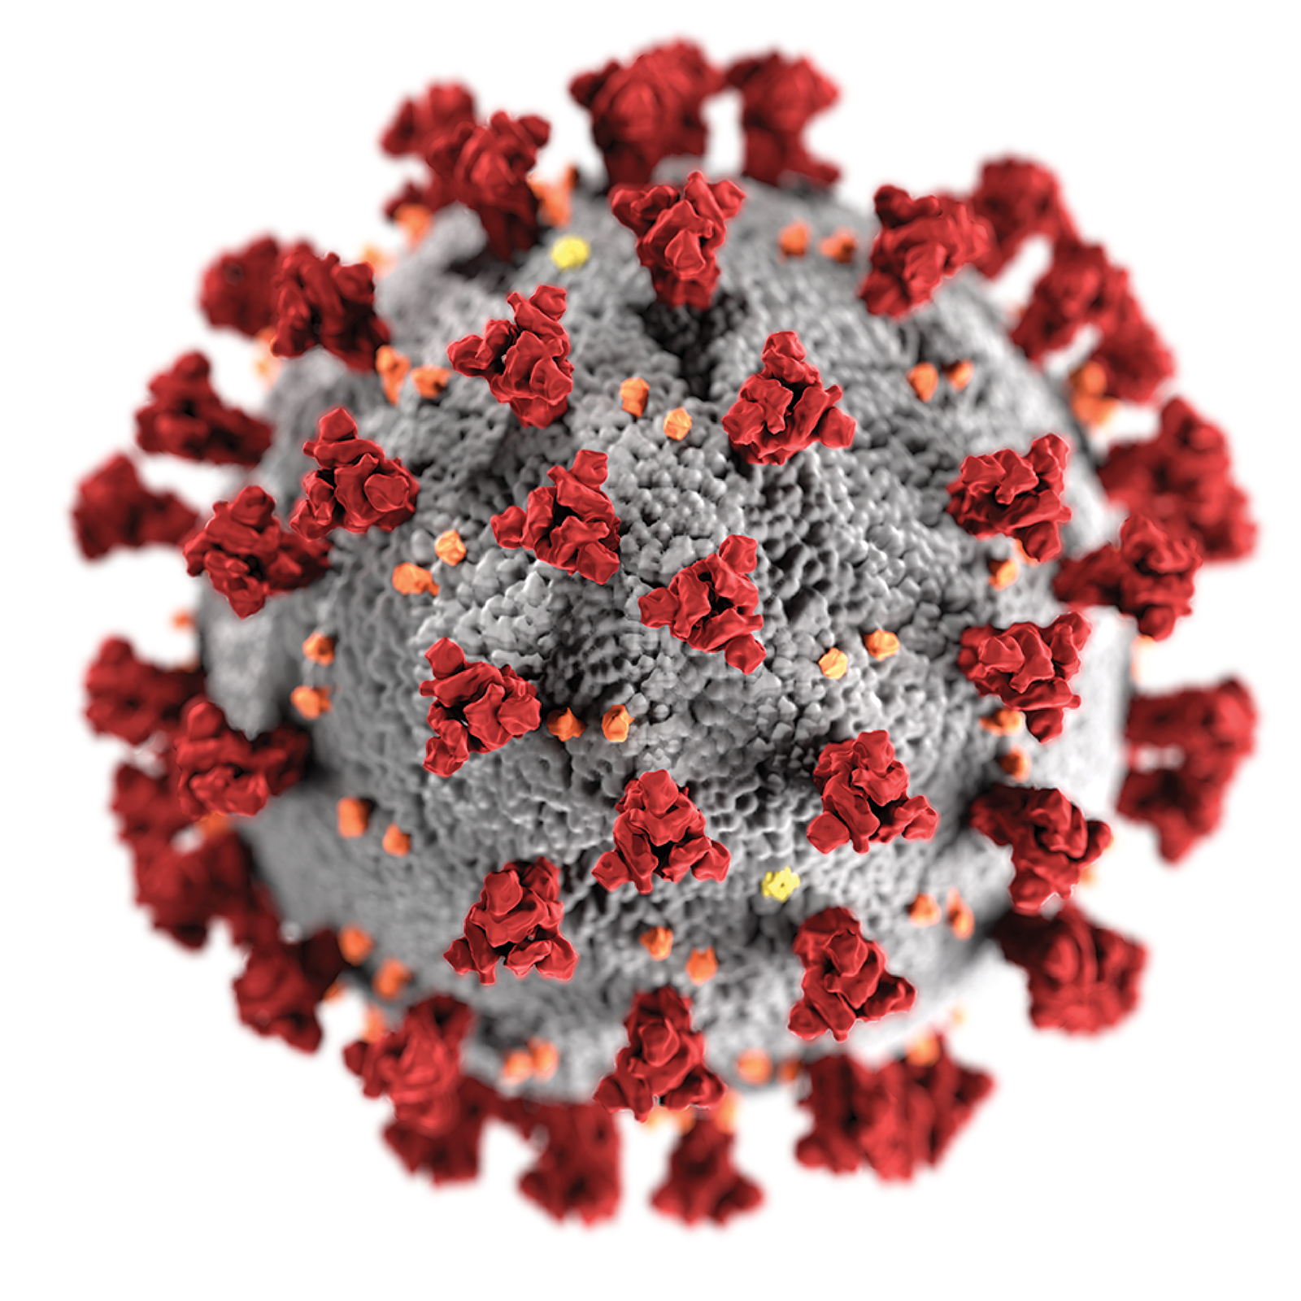

FlICked ACE2 mimics inhibit SARS-CoV-2 spike protein-ACE2 interaction
Mihajlo Todorovic¹, Antonio A. W. L. Wong¹, Naysilla L. Dayanara, Taylor Navi, David M. Perrin²
¹ These presenters contributed equally
² Corresponding authors contact: dperrin@chem.ubc.ca | 2036 Main Mall, Vancouver, BC CANADA V6T 1Z1

Slide 2
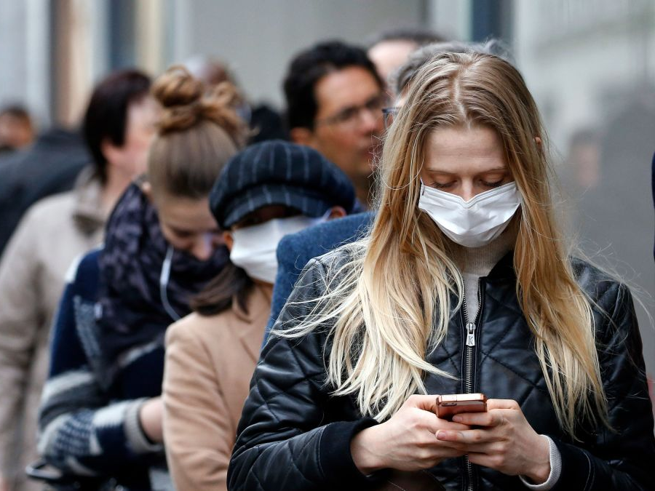

2
Coronavirus Disease 2019
COVID-19
Notes:
https://images.app.goo.gl/FXSRC2AuEEbjy8M77

Slide 3
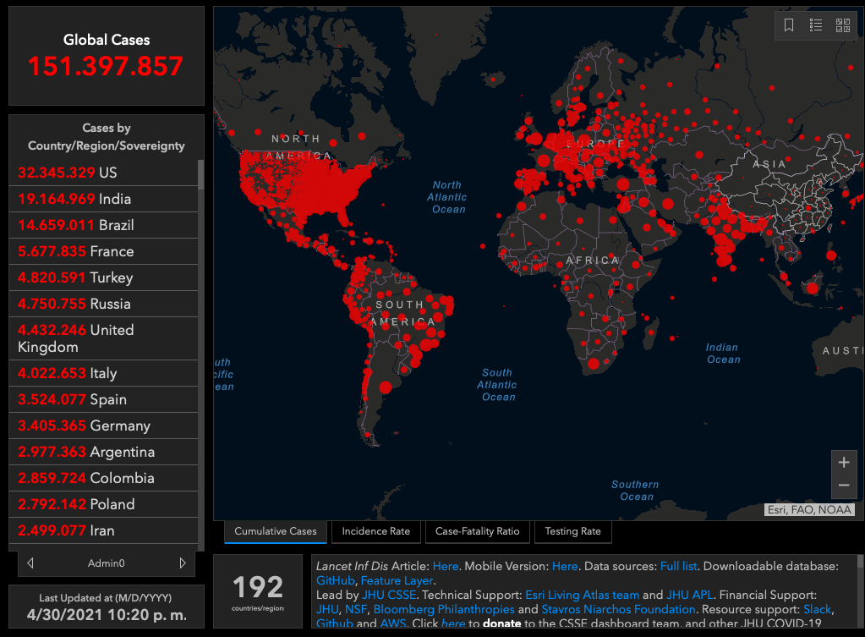
3
3.179.927
Global Deaths
Notes:
https://www.arcgis.com/apps/opsdashboard/index.html#/bda7594740fd40299423467b48e9ecf6, accessed 2021/04/30

Slide 4
4
3.179.927
Global Deaths
Notes:
https://www.arcgis.com/apps/opsdashboard/index.html#/bda7594740fd40299423467b48e9ecf6, accessed 2021/04/30

Slide 5
200 nm
5
Causative agent of COVID-19
SARS-CoV-2
Severe Acute Respiratory Syndrome Coronavirus 2
Notes:
https://images.app.goo.gl/J15XWhK6WdxbFZj59

Slide 6
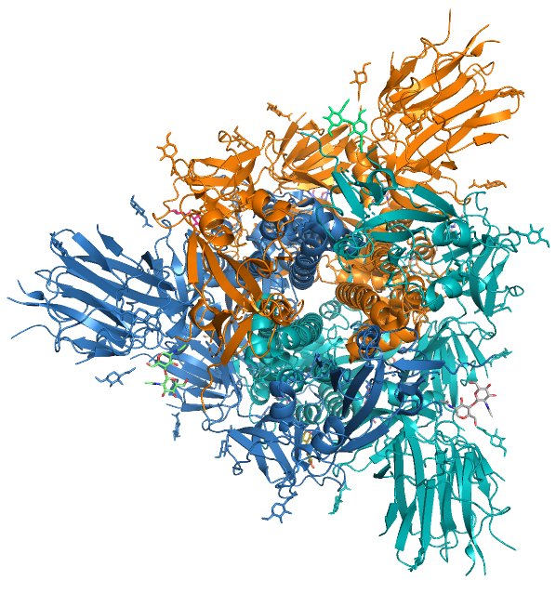
PBDID 6VXX
6
On the surface…
Spike protein homotrimer
Allow penetration and subsequent entry
Notes:
https://images.app.goo.gl/J15XWhK6WdxbFZj59

Slide 7
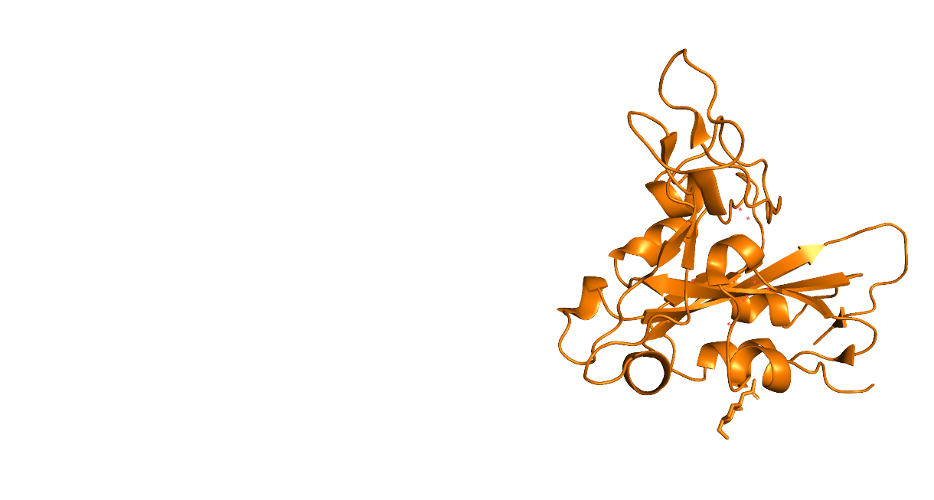
PBDID 6M0J
7
In the S1 (Spike) protein…
Receptor Binding Domain (RBD)
Residue number (resn) 319-541
PBDID 6VXX

Slide 8
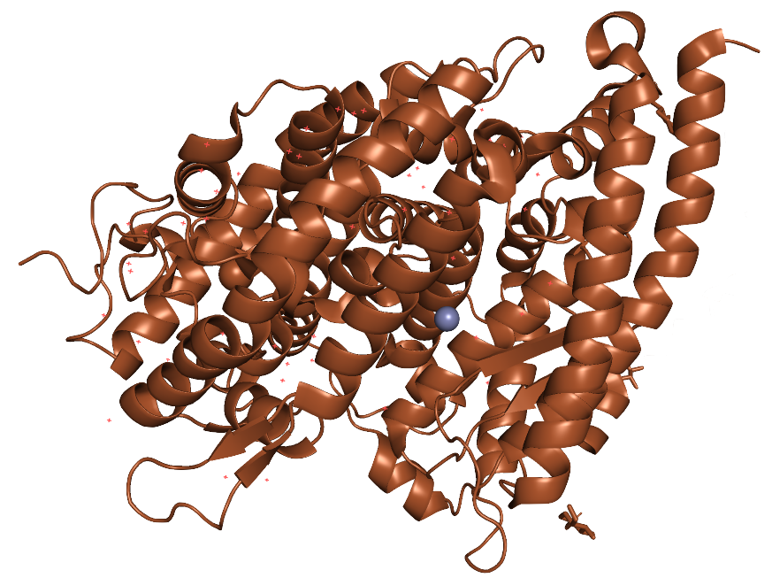
S1 Subunit Receptor
Binding Domain (RBD)
Human Angiotensin
Converting Enzyme 2 (hACE2)
8
In the S1 (Spike) protein…
Substrate bound X-ray structure
PDBID 6M0J

Slide 9
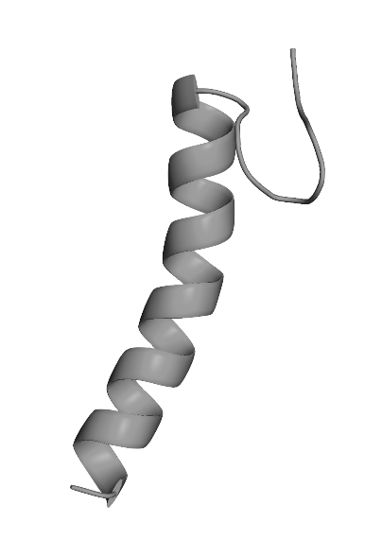
S1 Subunit Receptor
Binding Domain (RBD)
FlICk peptide
Human Angiotensin
Converting Enzyme 2 (hACE2)
9
In the S1 (Spike) protein…
Substrate bound X-ray structure
PDBID 6M0J

Slide 10
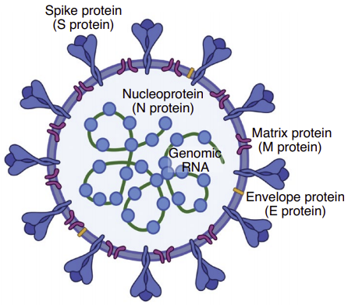

(Peptide Introduction): Challenges associated with mass vaccination
Virus structure
Vaccine and antiviral targets
Production and distribution of vaccines
Variable vaccine acceptance
Imperfect vaccine efficacy
Development of vaccination-resistant strains
10

Slide 11
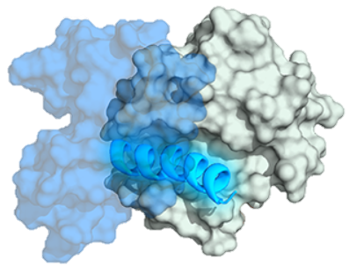
(Peptide Introduction): Peptides as drugs
Better at targeting protein-protein interactions
Effective for extracellular targets
Less prone to resistance
Stapling increases protease resistance
11

Slide 12
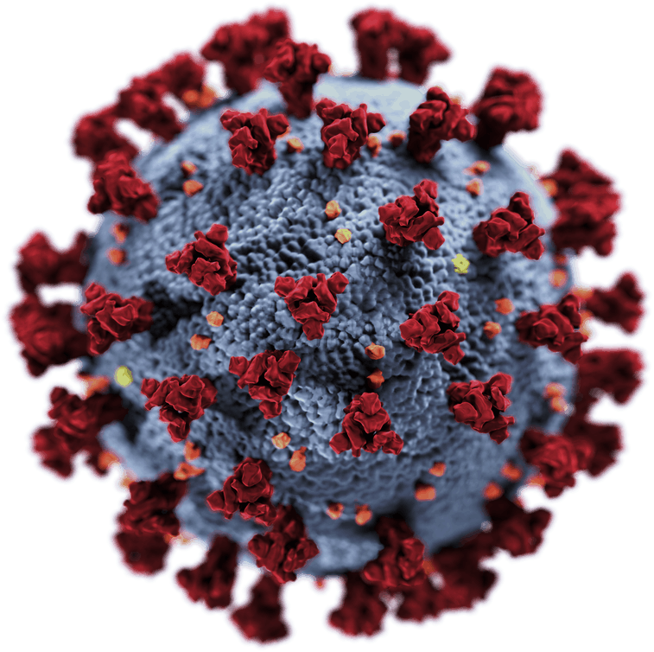
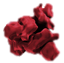
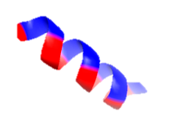
(Peptide Introduction): SARS-CoV-1 inhibitory peptides
SARS-CoV-1 inhibitory peptide
12
Ho, T. Y.; Wu, S. L.; Chen, J. C.; Wei, Y. C.; Cheng, S. E.; Chang, Y. H.; Liu, H. J.; Hsiang, C. Y. Antiviral Res. 2006, 69 (2), 70–76. https://doi.org/10.1016/j.antiviral.2005.10.005.

Slide 13
(Peptide Introduction): Peptide Stapling
13
Blackwell, Helen E., & Grubbs, Robert H.
(1998). Angewandte Chemie International
Edition, 37(23), 3281–3284.
Spokoyny, A. M., Zou, Y., Ling, J. J., Yu, H.,
Lin, Y. S., & Pentelute, B. L. (2013). Journal
of the American Chemical Society, 135(16),
5946–5949.
Zhang, J., Mulumba, M., Ong, H., & Lubell,
W. D. (2017). Angewandte Chemie –
International Edition, 56(22), 6284–6288.
Frost, J. R., Scully, C. C. G., & Yudin, A. K.
(2016). Nature Chemistry, 8(12), 1105
1111. https://doi.org/10.1038/nchem.2636

Slide 14
(FlICk): Isoindole Formation
Isoindole Formation is a classic analytical reaction
Condensation of ortho-phthalaldehyde with an amine and a thiol results
in a fluorescent heterocycle
- Used to quantify amino acids and peptides and as an active site titrant
Todorovic, M.; Schwab, K. D.; Zeisler, J.; Zhang, C.; Bénard, F.; Perrin, D. M. Angew. Chemie - Int. Ed. 2019, 58 (40), 14120–14124. https://doi.org/10.1002/anie.201906514.
14

Slide 15
(FlICk): Monocycles and Bicycles
Todorovic, M.; Schwab, K. D.; Zeisler, J.; Zhang, C.; Bénard, F.; Perrin, D. M. Angew. Chemie - Int. Ed. 2019, 58 (40), 14120–14124. https://doi.org/10.1002/anie.201906514.

Slide 16
(FlICk): Proof of Concept Peptides
Todorovic, M.; Schwab, K. D.; Zeisler, J.; Zhang, C.; Bénard, F.; Perrin, D. M. Angew. Chemie - Int. Ed. 2019, 58 (40), 14120–14124. https://doi.org/10.1002/anie.201906514.

Slide 17
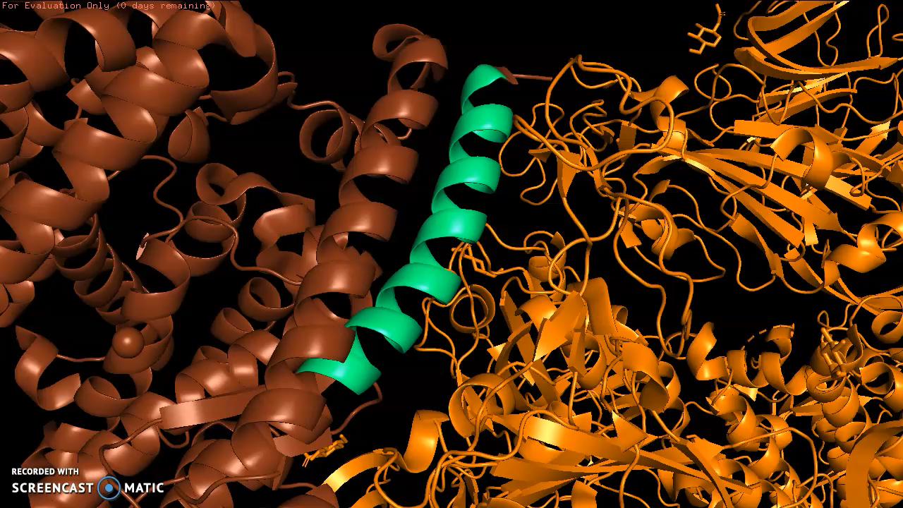
(FlICk): ACE2 Mimicking Peptide Literature Precedence
Direct cut-outs of N-terminal fragment of hACE2 were made by Pentelute¹ and Altseens²
Binding to Spike protein tested by Biolayer Interferometry (BLI) or Atomic Force Microscopy
Little binding in the high micromolar range was reported and no inhibition of the ACE2-Spike protein interaction was observed in our hands
Doubled stapled (olefin metathesis) versions of ACE2 helix made by Debnath³
Although binding measured by BLI, activity in in-vitro antiviral show
1) Zhang, G.; Pomplun, S.; Loftis, A. R.; Loas, A.; Pentelute, B. L. bioRxiv 2020, 2020.03.19.999318. https://doi.org/10.1101/2020.03.19.999318.
2) Yang, J.; Petitjean, S. J. L.; Koehler, M.; Zhang, Q.; Dumitru, A. C.; Chen, W.; Derclaye, S.; Vincent, S. P.; Soumillion, P.; Alsteens, D. Nat. Commun. 2020, 11https://doi.org/10.1038/s41467-020-18319-6.
3) Curreli, F.; Victor, S. M. B.; Ahmed, S.; Drelich, A.; Tong, X.; Tseng, C.-T. K.; Hillyer, C. D.; Debnath, A. K. MBio 2020, 11 (6), e02451-20.

Slide 18
(FlICk): Double FlICked ACE2 Peptides
X=K or C
Peptide | Sequence
1 | CKCK
2 | CKKC
3 | KCCK
4 | KCKC
18

Slide 19
(FlICk): Peptide 3 Double Flicking
19

Slide 20
(FlICk): Peptide 3 Double Flicking
20

Slide 21
(FlICk): Peptide 3 Double Flicking
21

Slide 22
(FlICk): Peptide 3 Double Flicking
22

Slide 23
(FlICk): Peptide 3 Double Flicking
1-2,3-4
2
3
4
1
1-3,2-4
2
1
3
4
1-2,3-4
1-3,2-4
23

Slide 24
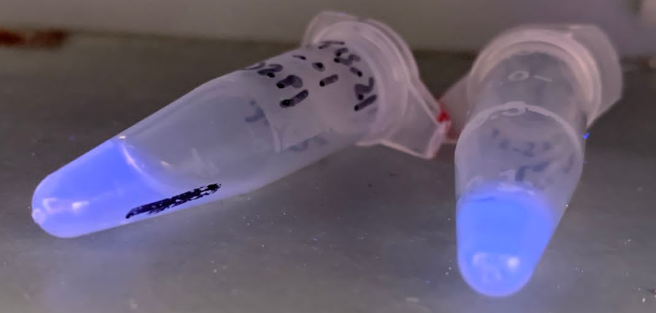
(FlICk): Double Flicked Peptide Fluorescence
1 2 3 4
24
1-3, 2-4
1-2, 3-4

Slide 25
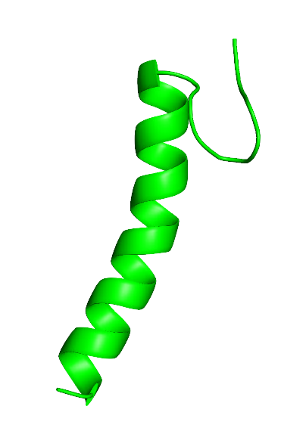
S1 Subunit Receptor
Binding Domain (RBD)
FlICk peptide
Human Angiotensin
Converting Enzyme 2 (hACE2)
25
Enzyme ImmunoSorbent Assay
ELISA

Slide 26
ELISA: Enzyme ImmunoSorbent Assay
Negative results/ poor binder
Positive results/ good binder
SARS-CoV-2
Spike RBD
SARS-CoV-2
Spike RBD
26
ELISA Plate

Slide 27
ELISA: Enzyme ImmunoSorbent Assay
Negative results/ poor binder
Positive results/ good binder
FlICk Peptide
(Poor)
FlICk Peptide
(Good)
hACE2
hACE
SARS-CoV-2
Spike RBD
SARS-CoV-2
Spike RBD
27
ELISA Plate

Slide 28
ELISA: Enzyme ImmunoSorbent Assay
Negative results/ poor binder
Positive results/ good binder
FlICk Peptide
(Poor)
FlICk Peptide
(Good)
hACE2
hACE
SARS-CoV-2
Spike RBD
SARS-CoV-2
Spike RBD
28
ELISA Plate

Slide 29
ELISA: Enzyme ImmunoSorbent Assay
Negative results/ poor binder
Positive results/ good binder
FlICk Peptide
(Poor)
hACE
hACE2
FlICk Peptide
(Good)
SARS-CoV-2
Spike RBD
SARS-CoV-2
Spike RBD
29
ELISA Plate

Slide 30
FlICK Peptide
(Poor)
hACE
ELISA: Enzyme ImmunoSorbent Assay
Negative results/ poor binder
Positive results/ good binder
His₆
hACE2
FlICk Peptide
(Good)
SARS-CoV-2
Spike RBD
SARS-CoV-2
Spike RBD
30
ELISA Plate

Slide 31
ELISA: Enzyme ImmunoSorbent Assay
Negative results/ poor binder
Positive results/ good binder
HRP
HRP
His₆
His₆
His₆
His₆
hACE2
FlICk Peptide
(Good)
SARS-CoV-2
Spike RBD
SARS-CoV-2
Spike RBD
31
ELISA Plate

Slide 32
HRP
His₆
His₆
ELISA: Enzyme ImmunoSorbent Assay
Negative results/ poor binder
Positive results/ good binder
HRP
His₆
His₆
hACE2
FlICk Peptide
(Good)
SARS-CoV-2
Spike RBD
SARS-CoV-2
Spike RBD
32
ELISA Plate

Slide 33
ELISA: Enzyme ImmunoSorbent Assay
Negative results/ poor binder
Positive results/ good binder
HRP
TMB (red)
TMB (red)
His₆
His₆
hACE2
FlICk Peptide
(Good)
SARS-CoV-2
Spike RBD
SARS-CoV-2
Spike RBD
33
ELISA Plate

Slide 34
ELISA: Enzyme ImmunoSorbent Assay
Negative results/ poor binder
Positive results/ good binder
HRP
TMB (red)
TMB (red)
TMB (ox)
TMB (ox)
His₆
High OD₄₅₀
Low OD₄₅₀
His₆
hACE2
FlICk Peptide
(Good)
SARS-CoV-2
Spike RBD
SARS-CoV-2
Spike RBD
34
ELISA Plate

Slide 35
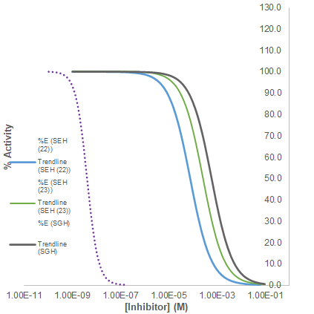
(FlICk): Double Flicked Peptide IC50s
Entry | 1234 | Topology | R.T. (min) | IC50(μM)
1 | CKCK | 1-4,2-3 | 4.71 | Not active (>900)
2 | CKCK | 1-2,3-4 | 5.21 | Not active (>900)
3 | CKKC | 1-3,2-4 | 3.57 | 77
4 | CKKC | 1-2,3-4 | 5.22 | 260
5 | KCCK | 1-3,2-4 | 3.75 | Not active (>500)
6 | KCCK | 1-2,3-4 | 5.39 | Not active (>900)
7 | KCKC | 1-4,2-3 | 5.00 | Not active (>900)
8 | KCKC | 1-2,3-4 | 5.36 | 620
35

Slide 36
(FlICk): Debnath Peptide 4 IC50s
Entry | XXXX 1234 | Topology | R.T. (min) | IC50(μM)
1 | CKCK | 1-4,2-3 | 4.71 | Not active (>900)
2 | CKCK | 1-2,3-4 | 5.21 | Not active (>900)
3 | CKKC | 1-3,2-4 | 3.57 | 77
4 | CKKC | 1-2,3-4 | 5.22 | 260
5 | KCCK | 1-3,2-4 | 3.75 | Not active (>500)
6 | KCCK | 1-2,3-4 | 5.39 | Not active (>900)
7 | KCKC | 1-4,2-3 | 5.00 | Not active (>900)
8 | KCKC | 1-2,3-4 | 5.36 | 620

Slide 37
(FlICk): Double Flicked Peptide IC50s
Entry | XXXX 1234 | Topology | R.T. (min) | IC50(μM)
1 | CKCK | 1-4,2-3 | 4.71 | Not active (>900)
2 | CKCK | 1-2,3-4 | 5.21 | Not active (>900)
3 | CKKC | 1-3,2-4 | 3.57 | 77
4 | CKKC | 1-2,3-4 | 5.22 | 260
5 | KCCK | 1-3,2-4 | 3.75 | Not active (>500)
6 | KCCK | 1-2,3-4 | 5.39 | Not active (>900)
7 | KCKC | 1-4,2-3 | 5.00 | Not active (>900)
8 | KCKC | 1-2,3-4 | 5.36 | 620
37

Slide 38
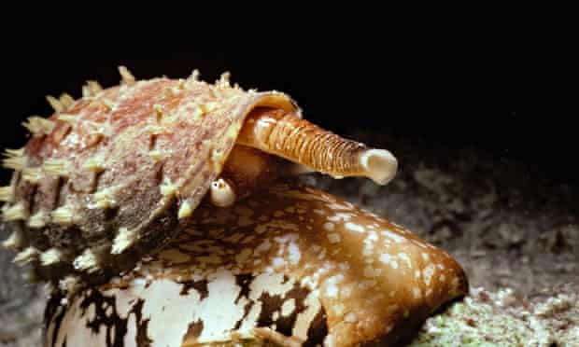
(FlICk): Alpha Conotoxin Topology
Alpha-Conotoxin
1 2 3 4
Photograph: Jeff Rotman/Alamy
1 2 3 4
38

Slide 39
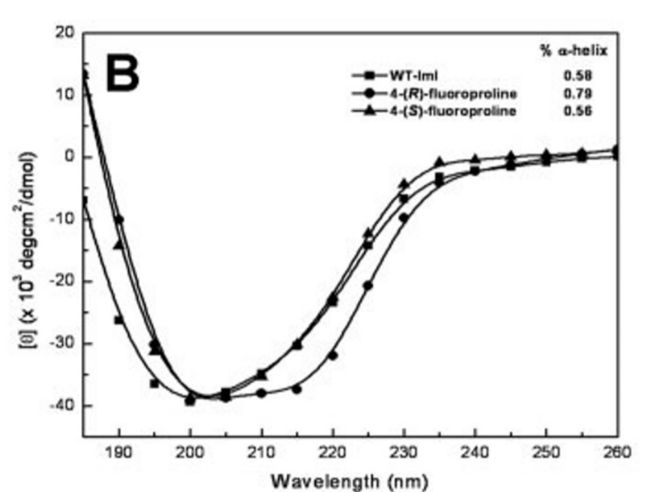
(FlICk): Alpha Conotoxin Topology
Armishaw, C.; Jensen, A. A.; Balle, T.; Clark, R. J.; Harpsøe, K.; Skonberg, C.; Liljefors, T.; Strømgaard, K. J. Biol. Chem. 2009, 284 (14), 9498–9512. https://doi.org/10.1074/jbc.M806136200.
39

Slide 40
(FlICk): CD Match? Alpha Conotoxin
Alpha-Conotoxin
1 2 3 4
Entry 3
1 2 3 4
Armishaw, C.; Jensen, A. A.; Balle, T.; Clark, R. J.; Harpsøe, K.; Skonberg, C.; Liljefors, T.; Strømgaard, K. J. Biol. Chem. 2009, 284 (14), 9498–9512. https://doi.org/10.1074/jbc.M806136200.

Slide 41
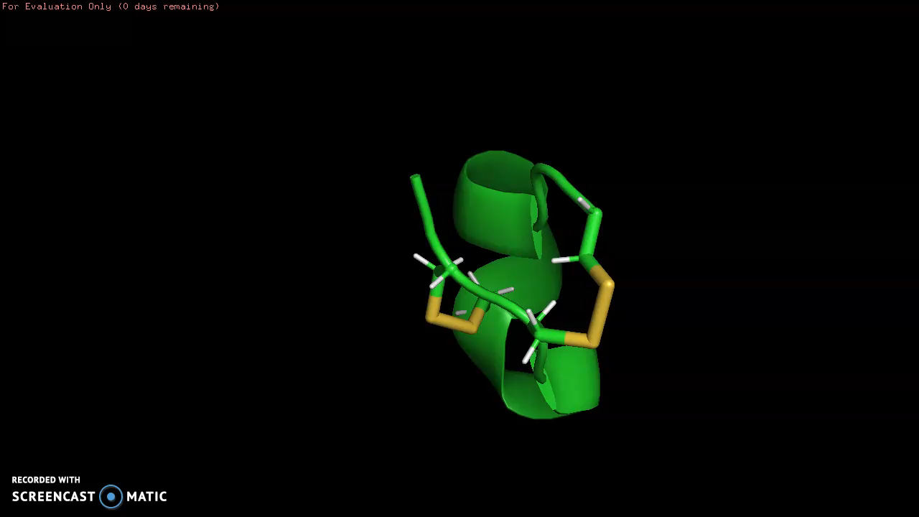
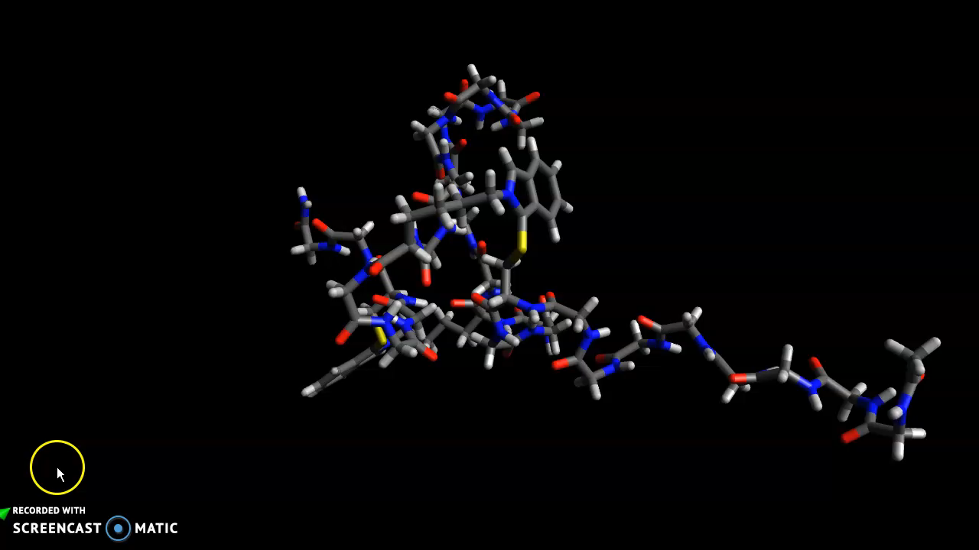
(FlICk): CD Match? Alpha Conotoxin
Alpha-Conotoxin
Entry 3

Slide 42
(FlICk): Effect of chaotropes and salts on Peptide 3 crosslinking selectivity
Chaotrope/salt (concentration) | 1-2,3-4 : 1-3,2-4 ratio | HPLC chromatogram
none | 2.5
Guanidinium chloride (2% w/w) | 2.5
Urea (2% w/w) | 2.4
Polysorbate 20 (2% w/w) | 3.2
Polysorbate 80 (2% w/w) | 2.7
Triton X-100 (2% w/w) | 3.5
Mr. Clean® dish detergent (2% w/w) | 2.9
Magnesium chloride (450 mM) | 2.3
42

Slide 43
(FlICk): Effect of temperature and solvent on Peptide 3 crosslinking selectivity
Solvent | Temperature (ºC) | 1-2,3-4 : 1-3,2-4 ratio | HPLC chromatogram
Sodium borate buffer, pH 9 | 4 | 1.90
Sodium borate buffer, pH 9 | 20 | 2.52
Sodium borate buffer, pH 9 | 37 | 2.34
Sodium borate buffer, pH 9/EtOH (1:1) | -20 | 7.78
Sodium borate buffer, pH 9/EtOH (1:1) | 20 | 7.46
43

Slide 44
(FlICk): Effect of solvent on Peptide 3 crosslinking selectivity
Peptide | Solvent | 1-2,3-4 : 1-3,2-4 ratio | HPLC chromatogram
3 | Sodium borate buffer, pH 9 | 2.52
3 | Sodium borate buffer, pH 9/EtOH (1:1) | 7.46
4 | Sodium borate buffer, pH 9 | 2.26
4 | Sodium borate buffer, pH 9/DMF (1:1) | 3.95
4 | Sodium borate buffer, pH 9/DMA (1:1) | 3.39
4 | Sodium borate buffer, pH 9/MeCN (1:1) | 2.46
4 | Sodium borate buffer, pH 9/THF (1:1) | 6.98
44

Slide 45
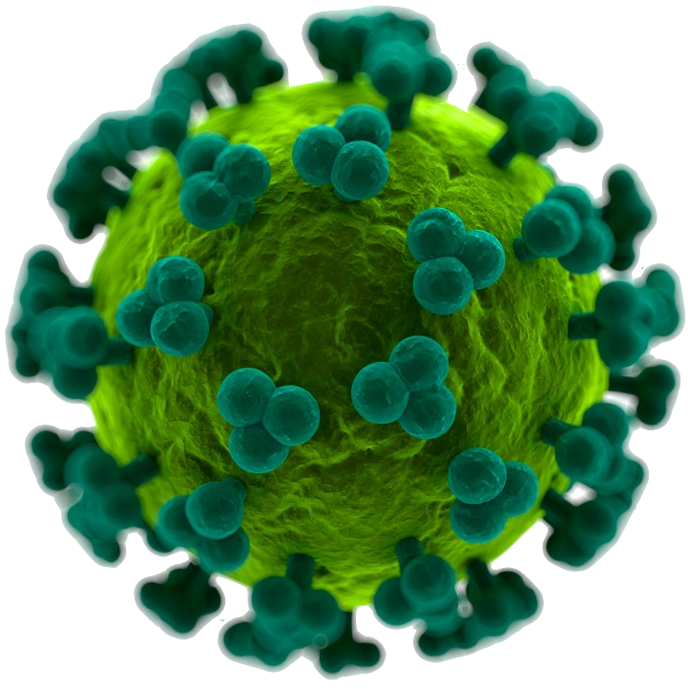
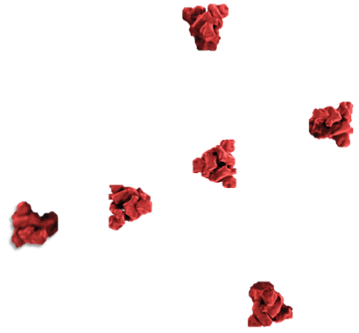
Coronavirus
Lentivirus
45
Future direction
Psuedovirus Neutralization Assay (PNA)
Notes:
Lentivirus https://images.app.goo.gl/ddh53n6UWmDFaE18A

Slide 46
Coronavirus
Lentivirus
46
Future direction
Psuedovirus Neutralization Assay (PNA)
Notes:
Lentivirus https://images.app.goo.gl/ddh53n6UWmDFaE18A

Slide 47
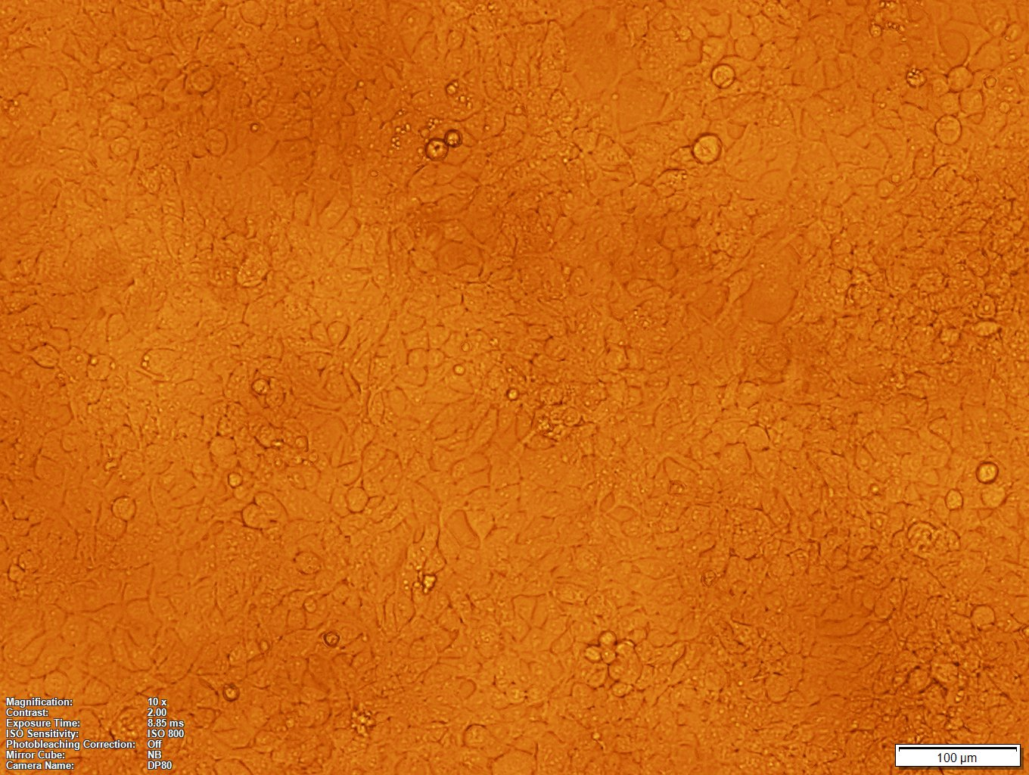
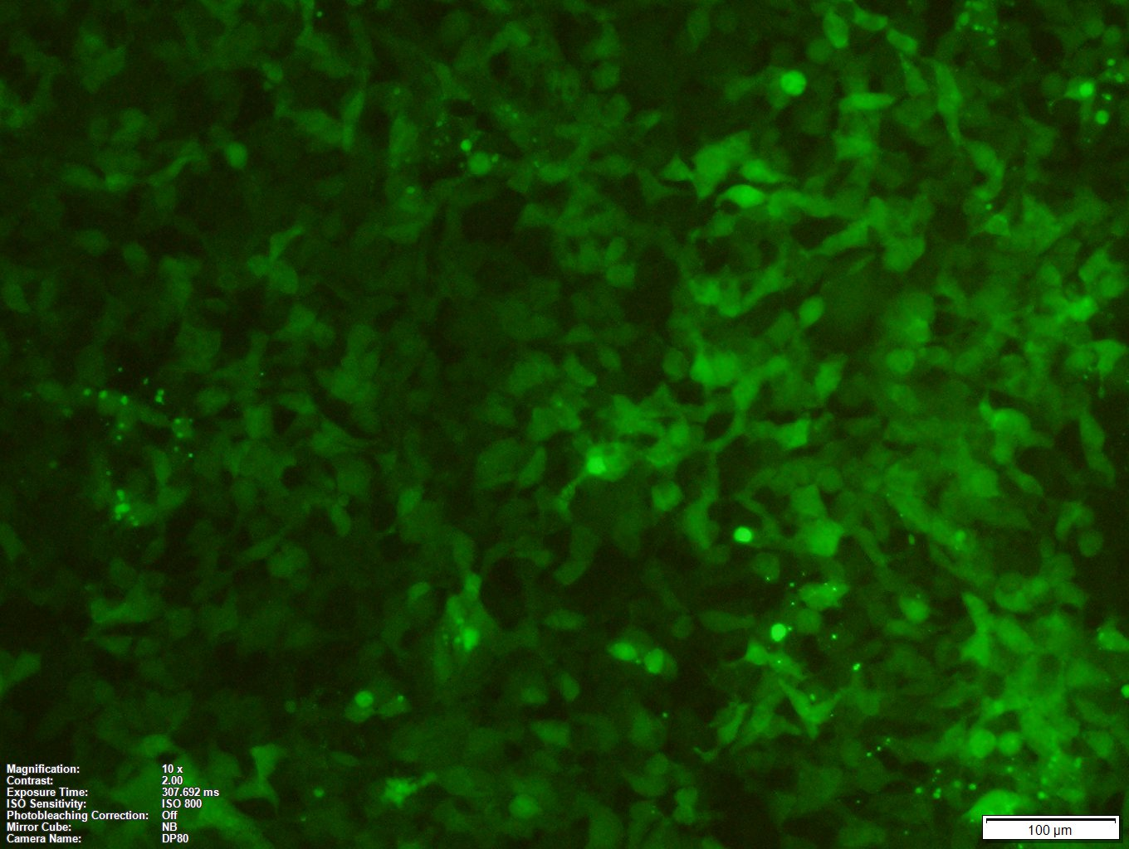
Infection
48-60 h
47
Future direction
Psuedovirus Neutralization Assay (PNA)

Slide 48
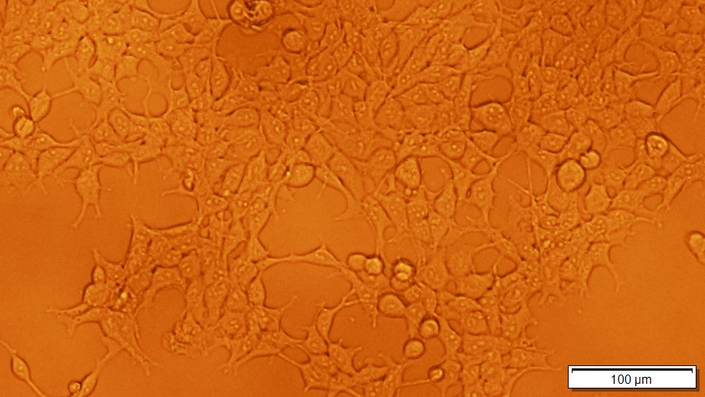
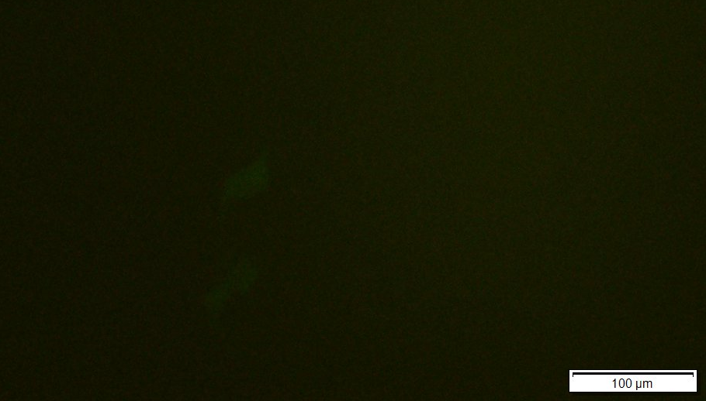
Infection
48-60 h
Infection
48-60 h
48
Future direction
Psuedovirus Neutralization Assay (PNA)

Slide 49
✔️
Infection
+ ACE2⁺ cells
+ inhibitor
❌
Infection
+ ACE2⁺ cells
Pseudovirus Neutralization Assay
Biological validation
49
Lentivirus

Slide 50
Magnification | 10X
Constrast | 2.00
Exposure Time | 307.692 ms
ISO Sensitivity | ISO 800
Photobleaching Correction | Off
Mirror Cube | NB
Camera Name | DP80 (Olympus IX50)
Fluorescent microscopy parameters
Olympus IX50, A410 (BioServices)

Slide 51



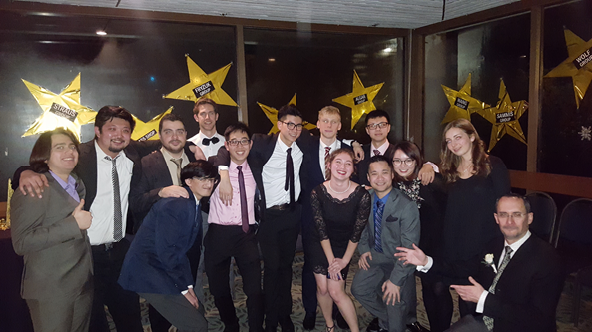
Acknowledgements
PRINCIPAL INVESTIGATOR | Dr. David M. Perrin
(Insert picture)
Naysilla Dayanara Taylor Navi
CHEMISTRY
Johan Hurtig, Gyros Peptide Technologies, Tuscon, AZ, USA
Skylar Frink, Gyros Peptide Technologies, Tuscon, AZ, USA
MOLECULAR AND CELL BIOLOGY
BioServices, Department of Chemistry, UBC
Jessie Chen, Dr. Elena Polishchuk
Subramaniam Group, Djavad Mowafaghian Centre for Brain Health, UBC
Dhiraj Mannar, Dr. Sriram Subramaniam
TECHNOLOGY TRANSFER
Bloom Group, UW, Seattle, WA, USA
Dr. Jesse Bloom
Trono Group, EPFL, Lausanne, Switzerland
Dr. Didier Trono
SPECIAL CREDITS FOR FRUITFUL DISCUSSIONS
Fabian Mehrt, Bertram Group, Department of Chemistry, UBC
Andy Johnson, ubcFLOW, Life Science Institute, UBC
Mostafa Hagar, Andersen Group, Department of Chemistry, UBC
Leo Liu, Perrin Group, Department of Chemistry, UBC

Slide 52
Questions?

