Slide 1
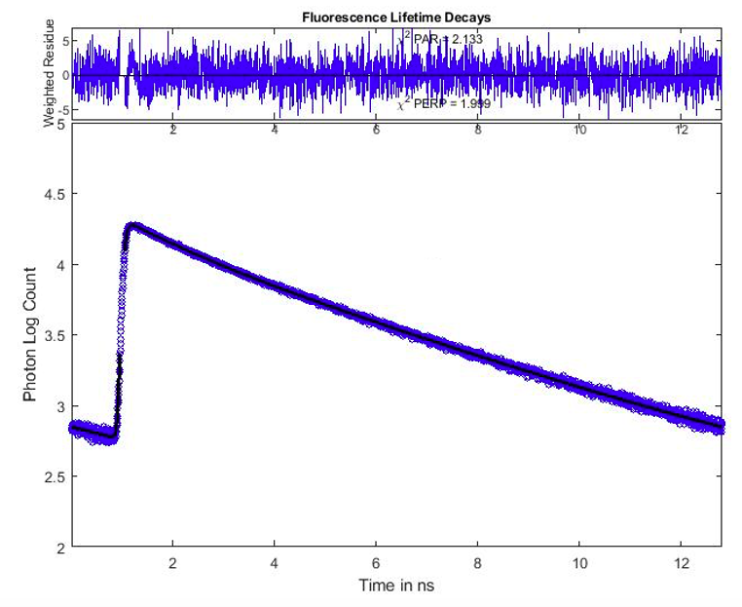
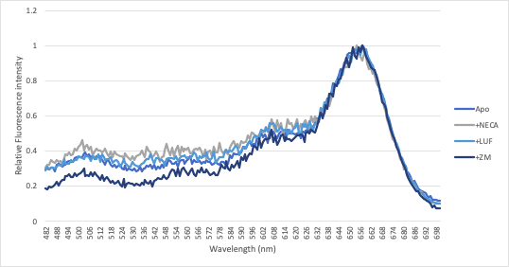
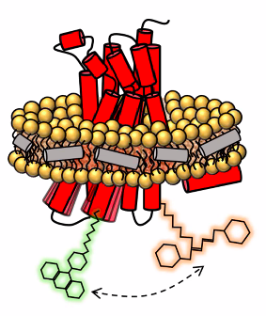
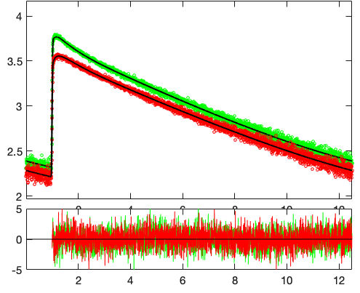
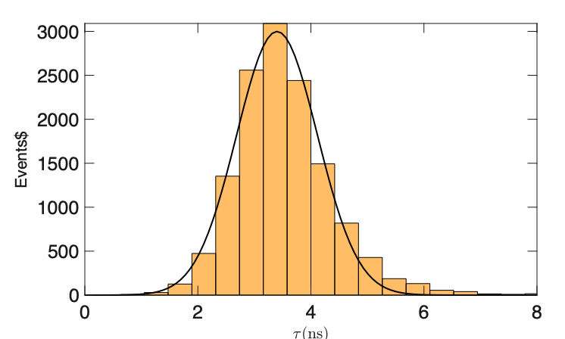
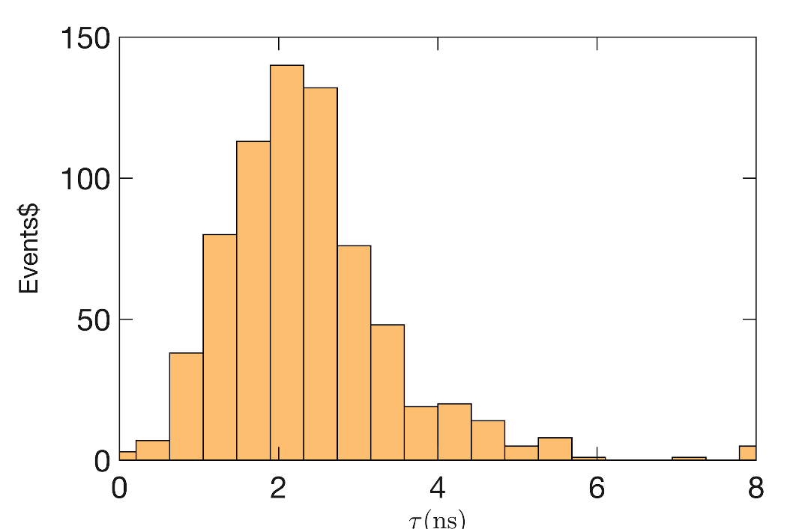
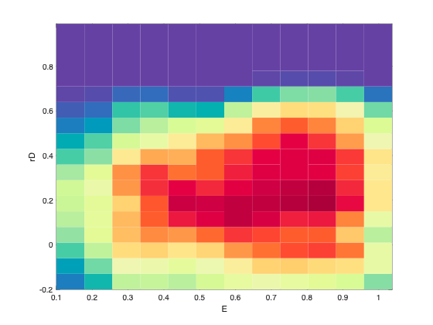
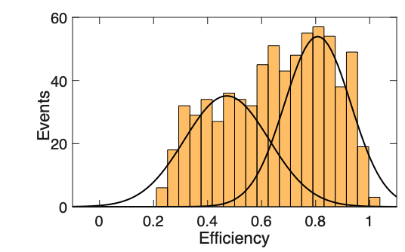
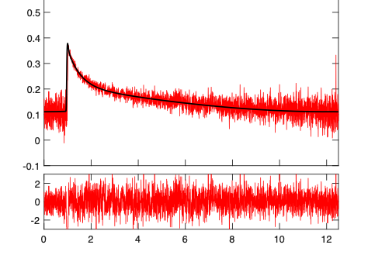
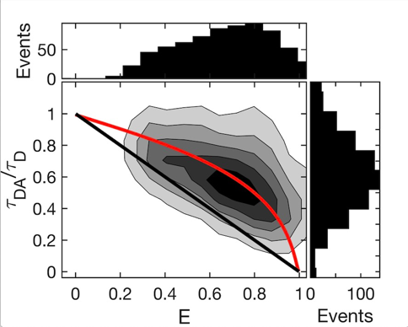
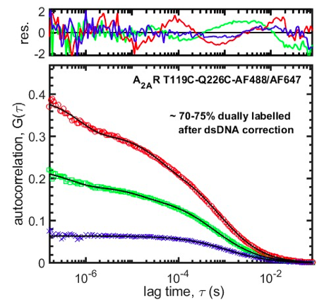
Measuring Conformational Selection in a G Protein-Coupled Receptor by Single-Molecule Fluorescence
The Gradinaru Lab
Single-Molecule Biophysics Research
Ivonne Rebeca Lopez-Miranda¹, Dennis D. Fernandes^{1,2}, Omar Almurad^{1,3}, Yevgen Moskalenko^{1,2}, Scott Prosser^{1,3} and Claudiu C. Gradinaru^{1,2}
¹Department of Chemical and Physical Sciences, University of Toronto Mississauga, ²Department of Physics, University of Toronto, ³Department of Chemistry, University of Toronto
Introduction & Overview
Quality of Labelled A_{2A} Receptor
Emission & Excitation Spectra
G-protein-coupled receptors (GPCRs) are a family of transmembrane receptors consisting of well-conserved seven transmembrane domains which respond to a variety of stimuli, such as light, odorants, hormones, and neurotransmitters¹.
The intracellular details of G protein-coupled receptors (GPCRs) tagged with fluorescent dyes can be visualized by using fluorescence imaging microscopy. Spatial information regarding the molecular behaviour of fluorescent molecules can be determined by using a variety of bulk fluorescence techniques, such as spectra, lifetime, and anisotropy, followed by single molecule FRET (smFRET).
FRET techniques were applied to characterize and detail the conformations exhibited dye-labelled A_{2A} adenosine receptors (A_{2A}R) reconstituted in nanodiscs to probe local conformational-fluctuations of between TM4 and TM6 of A_{2A}R.
Fluorescence lifetime measurements confirm the existence of FRET in the Apo A_{2A}R sample.
Average FRET efficiency estimated at 70 ± 2%.
Table 1. Lifetime fitting parameters for Apo A2AR(T119C-Q226C) in HDLs
τ_{D} (ns) | 3.53 ± 0.03
τ_{DA} (ns) | 1.08 ± 0.06
τ₃ (ns) | 0.15 ± 0.02
β₁ | 0.58 ± 0.01
β₂ | 0.22 ± 0.01
Reduced χ² | 1.05
Fluorescence Lifetime Analysis
Emission spectra upon donor excitation (470 nm) demonstrated FRET a variety of samples.
Excitation spectra of the acceptor (emission at 750 nm) also demonstrated FRET in the same samples
Fluorescence labelling of the A_{2A} Receptor
Table 3. FRET efficiency of A_{2A}R(T119C-Q226C) calculated from the spectral decomposition of emission spectra.
FRET efficiency of A_{2A}R in the presence of different ligands:
Ligand free: 84 ± 4%
1 mM NECA (agonist): 83 ± 2%
1 mM NECA (agonist) + 6 µM mini-G protein: 82 ± 1%
1 mM ZM (inverse agonist) 85 ± 2%.
50 µM ZM (partial agonist): 84 ± 2%.
Green – parallel polarization
Red – perpendicular polarization
 | Apo | NECA | ZM | LUF
FRET Efficiency % | 81 ± 2% | 80 ± 2% | 82 ± 2% | 83 ± 2%
Photon Log Count
Single-molecule FRET Analysis
Alexa Fluor 647
Fluorescence Intensity
The fluorescence quantum yield, $Φ_{D}$, of the donor (AF488) attached to A_{2A}R was experimentally determined to be $0.80 ± 0.02$.
The Förster radius for the sample was calculated to be $53.9 ± 2.9 Å$.
The fluorescence lifetime of donor-only A_{2A} receptor (𝛕_{D}) was measured to be 3.53 ± 0.03 ns by both the single-molecule (Fig. a) and the bulk measurements.
The fluorescence lifetime of the dually labelled A_{2A} receptor (𝛕_{DA}) was measured to be 2.38 ± 0.03 ns (Fig. b).
The smFRET histogram for the Apo A_{2A}R sample is described by two distinct populations (Fig. c), corresponding to active (low-FRET) and inactive (high-FRET) receptor conformations
The mean FRET efficiencies for the active and inactive states are 0.47 $±$ 0.04 and 0.81 $±$ 0.04, which correspond to inter-dye distances of 55.1 ± 3.7 Å and 42.3 ± 4.3 Å, respectively.
The identified FRET states lie close to the dynamic line (red) in Fig. d, as opposed to the static line (black). This is evidence for A_{2A}R being highly dynamic on the time scale of the diffusion time of single HDLs through the confocal detection volume (~1 ms).
a.
Alexa Fluor 488
Weighted Residue
Wavelength (nm)
A_{2A}R was labelled at T119C (TM4) and Q226C (TM6) with AF488 (donor) and AF647 (acceptor) and reconstituted in high-density lipid (HDL) nanodiscs.
Emission spectra upon donor excitation at 470 nm (blue) shows the acceptor peak at 670 nm, indicative of FRET; direct acceptor excitation at 630 nm confirms the labelling with AF647.
Time in ns
b.
The Kappa Squared “Problem”
FRET, Lifetime and Anisotropy
Steady state anisotropy for the donor dye shows a range of anisotropy values from 0 to 0.4. If it were in a range of 0 to 0.2, one can invoke the assumption that $κ^{2}$= 2/3 and that the dyes are randomly oriented. Therefore, the deviation from this general assumption was quantified.
Anisotropy decay measurements of donor-only labelled Alexa 488 A_{2A}R (excited at 480 nm) fit two rotational correlation times:
0.40 ± 0.08 ns pertains to the fast rotation of the dye linker.
13.8 ± 2.9 ns pertains to the rotation of the receptor.
The deviation of $κ^{2}$ from the isotropic value (2/3) was calculated to be ~40%²
FRET (Förster Resonance Energy Transfer):
E = FRET efficiency
R_{DA} = Distance between donor and acceptor fluorophores
R_{o} = Förster radius, characteristic for the donor-acceptor pair
c.
$E = \frac{1}{1+{\left(\frac{R_{DA}}{R_{o}}\right)}^{6}}$
E = FRET efficiency
$τ_{DA}$ = fluorescence lifetime of donor in the presence of acceptor
$τ_{D}$ = fluorescence lifetime of donor in the absence of acceptor
Photon Log Count
$$E=1−\frac{τ_{DA}}{τ_{D}}$$
d.
Weighted Residue
$$R_{o} \left(Å\right)=0.2108\sqrt[6]{\frac{Φ_{D}κ^{2}}{n^{4}}\frac{J}{M^{−1}cm^{−1}nm^{4}}}$$
Time in ns
Dual-color Fluorescence Correlation Spectroscopy
$Φ_{D}$ = fluorescence quantum yield of the donor
$κ^{2}$= dipole orientation factor, equal to 2/3 if dyes are randomly orientated
$J$ = spectral overlap ${(M}^{−1}cm^{−1}nm^{4})$ between the normalized donor emission spectrum and acceptor absorption spectrum
$n$ = the refractive index of the medium between the dyes
From the amplitudes for Alexa Fluor 488 (green) and Alexa Fluor 647 (red), the sample was determined to be 75% dually-labelled. The remaining 25% was a heterogeneous mixture of donor-only and acceptor-only labelled receptor.
Summary & Conclusions
$J=\int_{0}^{∞}{F_{D}(λ)ε_{A}(λ)λ^{4}dλ}$ (in M⁻¹cm⁻¹nm⁴)
The overall goal of this project was to characterize the A_{2A} adenosine receptor after reconstitution in HDL nanodiscs using time-resolved and single-molecule fluorescence spectroscopy. The dual-labelling was confirmed by dcFCS and the existence of FRET in the sample was assessed by bulk spectrometry (excitation/emission and lifetime). FRET was measured under different environmental conditions, i.e., inverse/partial/full agonist ligands and a G protein mimetic (mini-G).
Additional measurements were conducted to find corrections regarding the donor quantum yield and dipole orientation factor к² in order to determined the Förster radius for the sample. By applying this value to the mean efficiency values measured through smFRET bursts, the distances between the probes were found to be 55.1 ± 3.7 Å for the active and 42.3 ± 4.3 Å for the inactive conformations.
Fluorescence Lifetime and Anisotropy Decay:
Lifetime:
$$F\left(t\right)=\frac{β_{1}}{1−e^{{−T}/{τ_{L1}}}}e^{{−t}/{τ_{L1}}}+\frac{β_{2}}{1−e^{{−T}/{τ_{L2}}}}e^{{−t}/{τ_{L2}}}+\frac{1−β_{1}−β_{2}}{1−e^{{−T}/{τ_{L3}}}}e^{{−t}/{τ_{L3}}}$$
Table 2. dcFCS fitting parameters for Apo A2AR(T119C-Q226C) in HDLs.
τ_{Li} = fluorescence lifetime of species i
β_{i} = fraction of species with lifetime τ_{i}
Amplitude for green curve (Go_g) | 0.071 ± 0.001
Amplitude for red curve (Go_r) | 0.075 ± 0.001
Amplitude for cross-correlation (Go_x) | 0.059 ± 0.001
Reduced χ² | 1.03
Hydrodynamic radius (Rh) [Å] | 60 ± 10
Anisotropy:
$$r\left(t\right)=r_{o}\left[α_{1}e^{{−t}/{ρ_{1}}}+α_{2}e^{{−t}/{ρ_{2}}}\right]$$
References
r_{o} = fundamental anisotropy
ρ_{i} = rotational correlation time of species i
α_{i} = fraction of species with correlation time ρ_{i}
Gurevich, V. V. et al. Molecular Mechanisms of GPCR Signaling: A Structural Perspective. Int. J. Mol. Sci. 2017 18, 2519.
Badali, D., and Gradinaru, C. C. The effect of Brownian motion of fluorescent probes on measuring nanoscale distances by Förster resonance energy transfer. J of Chem Phys, 2011, 134: 225102-5.

