Slide 1
Structural analyses of metallodrug/β-lactoglobulin adducts for rational design of new biomaterials
Domenico Loreto ^{1,}*, Antonello Merlino¹, and Giarita Ferraro²
¹ Department of Chemical Sciences, University of Naples Federico II, Complesso Universitario di Monte Sant’Angelo, via Cinthia, 21, 80126, Naples, Italy;
² Department of Chemistry “Ugo Schiff”, University of Florence, Via della Lastruccia, 3-13, Sesto Fiorentino, Florence, Italy.
* Corresponding author: domenico.loreto@unina.it

Slide 2
Abstract:
β-lactoglobulin (BLG) is a good system for the preparation of micro- or nanoparticles for pharmaceutical industry. It has been demonstrated that β‐lactoglobulin–pectin nanoparticles can transfer cytotoxic Pt compounds to cancer cells. With the aim to unveil the molecular basis of the metallodrug recognition by BLG, we are analyzing the interactions between this protein and a number of metallodrugs. The interaction between cisplatin (CDDP), the most used Pt-based anticancer agent, and BLG has been investigated both in solution and at solid state. The results reveal that cisplatin interacts with the protein without affecting the overall protein 3D structure. Oxaliplatin (OXA) is preferred to cisplatin because of a lower toxicity and an increased reactivity against cisplatin resistant tumors. The adduct formed upon reaction of BLG with the metal complex has been synthetized and structurally characterized by X-ray crystallography and electrospray ionization mass spectrometry. Structural analyses demonstrate that OXA binds BLG via coordination to Met7 side chain upon releasing oxalate ligand. In vitro cytotoxicity data reveal that cisplatin and oxaliplatin exert higher cytotoxicity in their adduct with BLG than the free drugs. These results suggest that BLG could act as a carrier for anticancer metallodrugs.
Keywords: Metallodrugs; metal-protein interactions; anticancer agents.

Slide 3
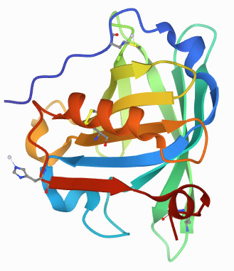
Introduction
β-lactoglobulin is the major whey protein in cow’s milk (18.4 kDa, 162 amino acids)
It is a globular protein composed by 8-stranded antiparallel β-barrel with a 3-turn α-helix on the outer surface.
β-lactoglobulin is a good system for production of delivering vehicles for orally administrated bioactive molecules
E. Dufour et al. Biochimica et Biophysica Acta, 1994, 1205(1), 105.
Z. Teng et al. Food Chemistry, 2016, 204, 391. Z. Teng et al. Food Chemistry, 2014, 159, 333.
Z. Shafaei et al. Int. J. Biol. Macromol., 2017, 13, 1685

Slide 4
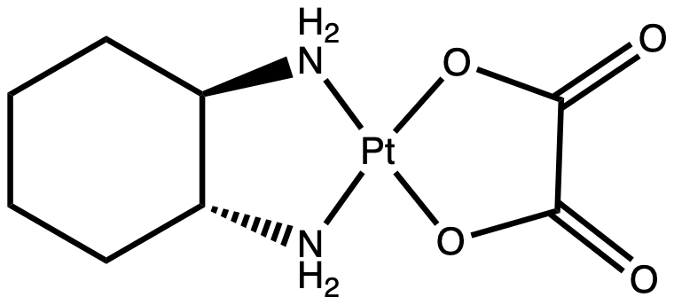
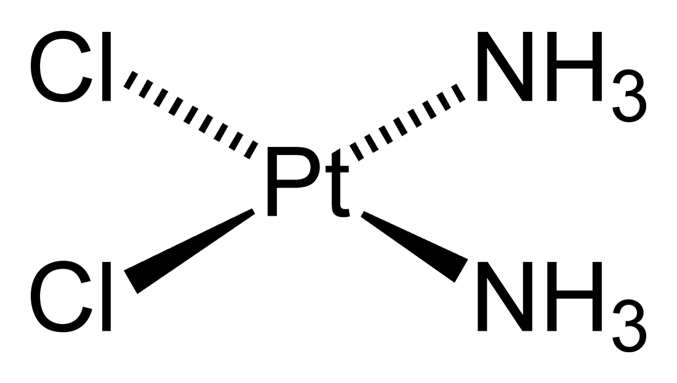
Introduction
Cisplatin
Oxaliplatin
The most used platinum-based anticancer agent in clinics
Several side effects
Preferred to cisplatin for treatment of colorectal cancer due to its lower toxicity and activity against CDDP-resistant cells
The interactions between β-lactoglobulin and these Pt-based metallodrugs have been analyzed
Z. Izadi et al. Chem Biol and Drug Design 2016, 88(2), 209. Z.H. Siddik, Oncogene 2003, 22, 7265. L. Kelland, Nature Reviews Cancer 2007, 7, 573.
S. Bogliolo et al. Expert Opin Investig Drugs 2015, 24(9), 1275

Slide 5
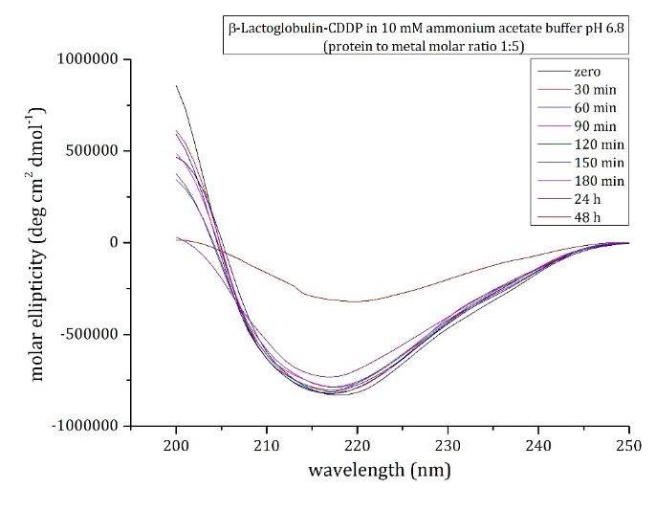
N. Balasco et al. Dalton Trans., 2020, 49, 12450
Results and Discussion: interaction with Cisplatin
In solution characterization
Absorption intensity decreases in the first two hours
After two hours, an increase of absorption intensity occurs, due to CDDP binding
β-lactoglobulin conserves its secondary structure in the presence of the metal compound

Slide 6
N. Balasco et al. Dalton Trans., 2020, 49, 12450
Results and Discussion: crystallographic data
CDDP soaking for 18h
A Pt fragment is found close to the side chain of Met7 both A and B chains
Side chain of Lys8 coordiantes a Pt fragment in chain B

Slide 7
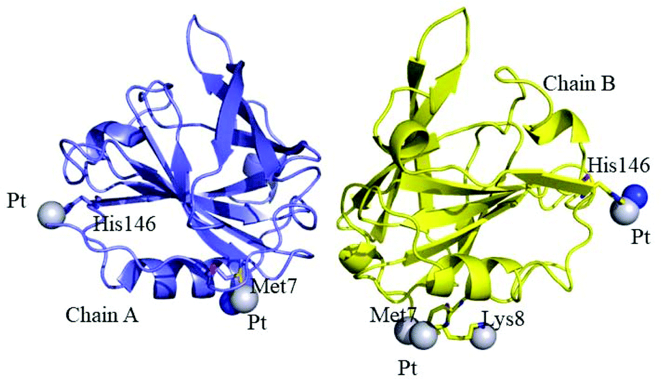
N. Balasco et al. Dalton Trans., 2020, 49, 12450
Results and Discussion: crystallographic data
CDDP soaking for 72h
An additional Pt binding site is found close to the side chain of H146 in both A and B chains

Slide 8
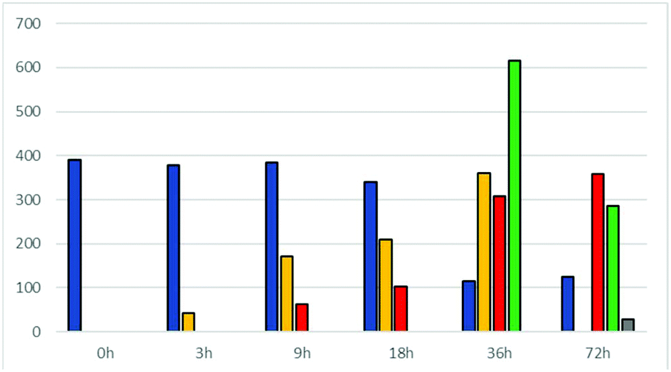
N. Balasco et al. Dalton Trans., 2020, 49, 12450
Results and Discussion: Mass spectrometry analysis
Blue: Metal-free protein
Yellow: [Pt(NH₃)₂Cl⁺] or [Pt(NH₃)₂OH₂⁺]
Red: Pt(NH₃)₂²⁺]
Green: Adduct with 2 CDDP fragments
Grey: Adduct with 3 CDDP fragments
Bar graph summarizes the results of mass spectrometry course experiments. Two forms of native protein are observed for A and B variants of the protein. After three hours the first Pt/β-lactoglobulin is formed. Longer reaction times (9h) give rise to another protein-metal fragment. Only after 36h the presence of two binding Pt sites is observed, while 72h are needed for observing adducts of the protein with three CDDP molecules

Slide 9
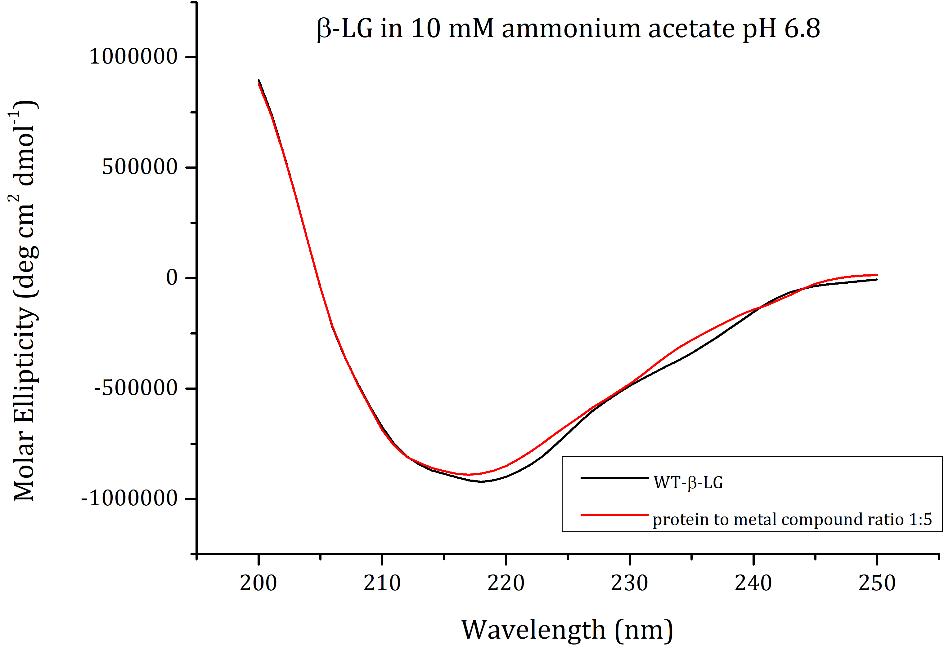
Results and Discussion: interaction with Oxaliplatin
In solution characterization
The protein retains its secondary structure in presence of oxaliplatin

Slide 10
Results and Discussion: crystallographic data
OXA soaking for 72h
Molecule B
Molecule A
As in the adduct with cisplatin, a Pt binding site is observed in proximity of Met7 side chain of molecule A
Access to the side chain of Met7 of molecule B is hampered by crystal lattice

Slide 11
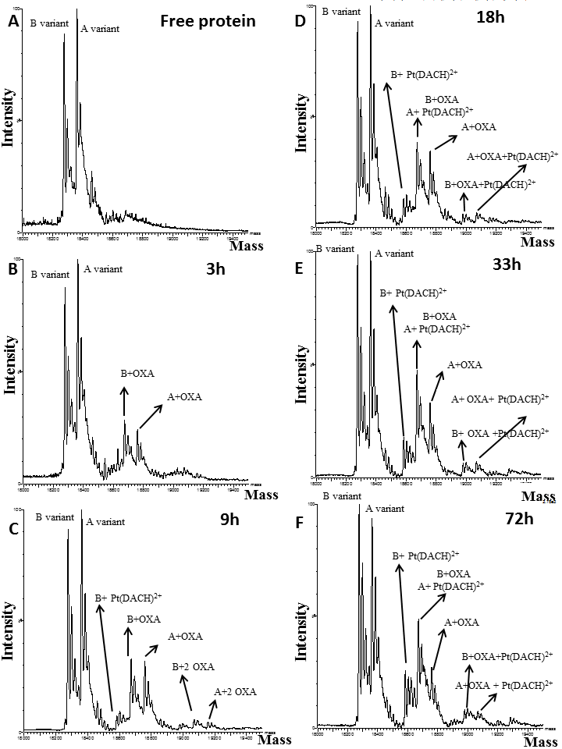
Results and Discussion: Mass spectrometry analysis
Oxaliplatin first binds 𝛽-lactoglobulin non-covalently (3h) and successively it coordinates to protein residue side chains (9h) upon relasing of oxalate moiety (72h)

Slide 12
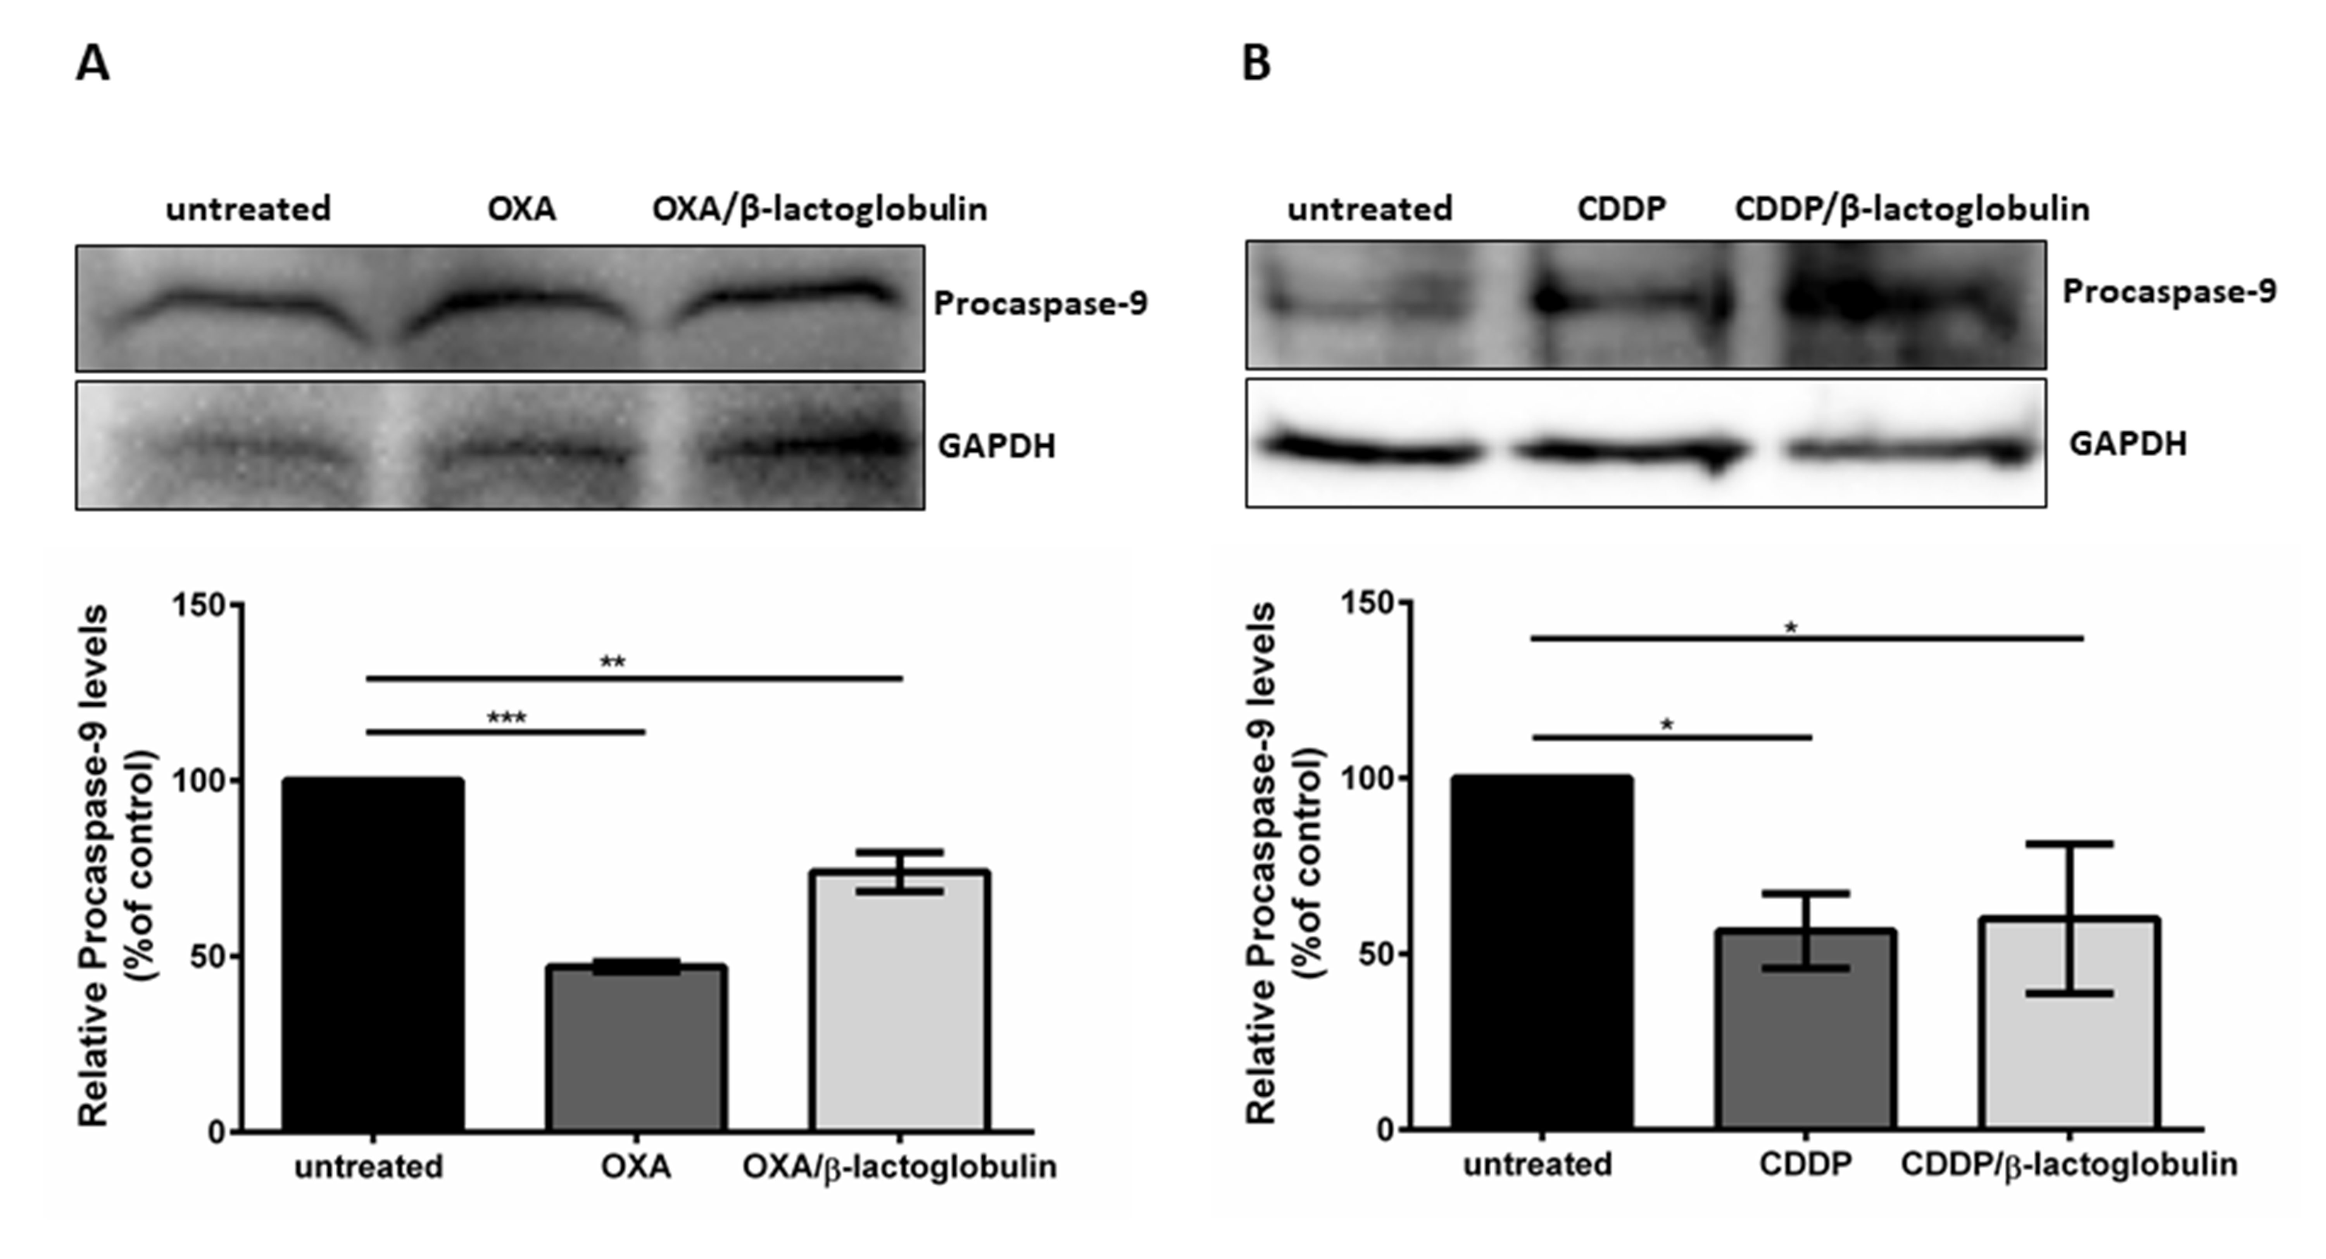
Results and Discussion: In vitro cytotoxicity analyses
 | IC₅₀ μM (48h)
 | A431 | SVT2 | HaCaT | BalbC 3T3
OXA | 90.7 ± 16.2 | 4.9 ± 1.2 | 10.0 ± 1.0 | 89.1 ± 2.2
OXA/BLG | 17.1 ± 2.4 | 1.5 ± 0.07 | 12.0 ± 2.0 | 11.0 ± 2.3
CDDP | 39 ± 12* | 195 ± 7* | 6.6 ± 0.3* | 240 ± 47*
CDDP/BLG | 8.7 ± 0.5 | 3.5 ± 0.9 | 4.4 ± 0.1 | 12.0 ± 0.9
MTT assay reveals IC₅₀ values much lower for metal/protein adducts than the those of free drugs
oxaliplaltin
cisplatin
A decrease in pro-caspase 9 indicates that metal/protein adducts are able to induce apoptosis

Slide 13
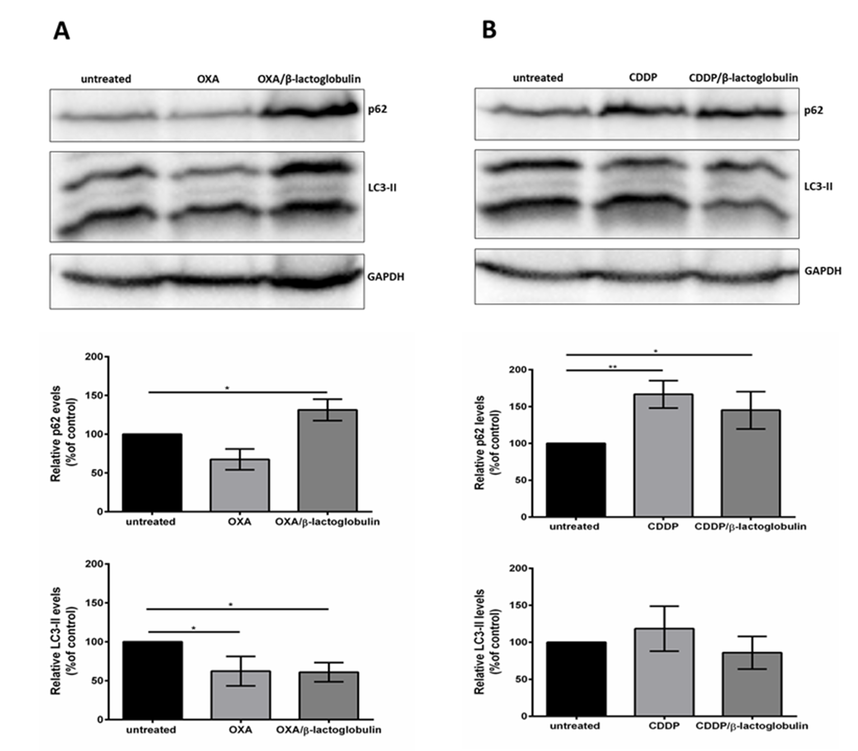
Results and Discussion: In vitro cytotoxicity analyses
An alteration of autophagic markers p62 and LC3 was observed for the metal protein adducts

Slide 14
Conclusions
The interactions between 𝛽-lactoglobulin and Pt-based anticancer metallodrugs cisplatin and oxaliplatin have been investigated both in solution and at solid state.
Spectroscopic analyses reveal that 𝛽-lactoglobulin binds cisplatin or oxaliplatin without altering its overall conformation.
The structure of the adduct formed upon reaction of cisplatin with 𝛽-lactoglobulin has been solved by X-ray crystallography. The results reveal that the number of cisplatin fragments bound to the protein increases with the incubation time. Pt binding sites are observed close to the side chain of Met7, Lys8 and His146.
The structure of the adduct formed upon reaction of oxaliplatin with 𝛽-lactoglobulin reveal the presence of a single Pt binding site close to Met7.

Slide 15
Conclusions
ESI-MS analyses reveal that BLG binds CDDP in a monodentate mode and then in a bidentate fashion. Up to 3 CDDP molecules can bind the protein.
ESI-MS data suggest that OXA rapidly binds the protein non-covalently and then via coordination of a [Pt(DACH)]²⁺ fragment to a β-lactoglobulin residue side chain.
Since the Pt binding to Met side chain could be reversible, our data suggest that β‐lactoglobulin could be used as Pt-based drug delivery system.
Cytotoxicity data reveal that CDDP/BLG and OXA/BLG adducts exert higher cytotoxicity than free drugs and that the mechanism of action involves apoptosis.
These results open the way for a rational design and development of new biomaterials based on metallodrug/β-lactoglobulin adducts potentially useful as oral drugs

Slide 16
Acknowledgments
Prof Antonello Merlino
Dr Giarita Ferraro

