Slide 1
Molecular docking study on the interaction of Rhodopsin-like receptor with tetra-coordinated gold(III) complex
Ana Kesić¹*, Dejan Milenković¹, Marko Antonijević¹, Biljana Petrović², and Zoran Marković¹
¹ University of Kragujevac, Institute for Information Technologies, Jovana Cvijica bb, 34000 Kragujevac, Serbia; akesic@uni.kg.ac.rs
2 niversity of Kragujevac, Faculty of science, Radoja Domanovica 12, 34000 Kragujevac, Serbia
* Correspondence: akesic@uni.kg.ac.rs ;

Slide 2
Abstract:
The pharmacologic properties of gold compounds have been known since the end of the 19th century. In the last decade, gold complexes have received increased attention due to the variety of their applications.
Rhodopsin-like receptors are a family of proteins that belong to the largest group of G protein-coupled receptors (GPCRs).
In this paper, the molecular interactions between active binding sites of the Rhodopsin-like receptor (RLR) and synthesized gold(III) complex ([Au(DPP)Cl₂]⁺ where DPP=4,7-diphenyl-1,10-phenanthroline) were investigated by molecular docking simulations.
The binding energy of gold(III) complex to RLR was found to be -35.35 kJ/mol, as opposed to 11-cis-retinal which of about -40.5 kJ/mol.
The most prominent interactions are hydrogen bonds, alkyl-π, and π-π interactions.
The preliminary results suggest that gold(III) complex showed good binding affinity against RLR, as well as native bound ligand, 11-cis-retinal, as evident from the free binding energy (ΔGbind in kJ/mol).
Keywords:
Rhodopsin-like receptor; gold(III) complex; molecular

Slide 3
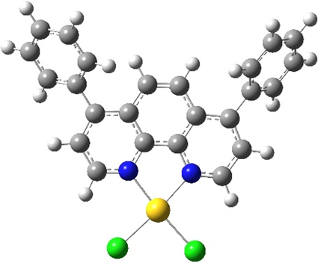
Introduction:
In the last decade, gold complexes have received increased attention due to the variety of their applications
Encouraging results for in vivo and in vitro investigations were obtained after the utilization of gold(III) complexes.
Change of Au(III) to Au(I) species, responsible for further interaction with different biomolecules, DNA/BSA, proteins, and enzymes.
Au(III) and Au(I) compounds can undergo ligand exchange reactions in the presence of thiol-containing enzymes, including thioredoxin reductase.
However, the stability of gold(III) complexes can be improved with the appropriate choice of inert ligands
Stability of Gold(III) complexes were reached using the nitrogen-donor ligands, such as pyridine, bipyridine, terpyridine, phenanthroline, macrocyclic ligands, and porphyrins

Slide 4
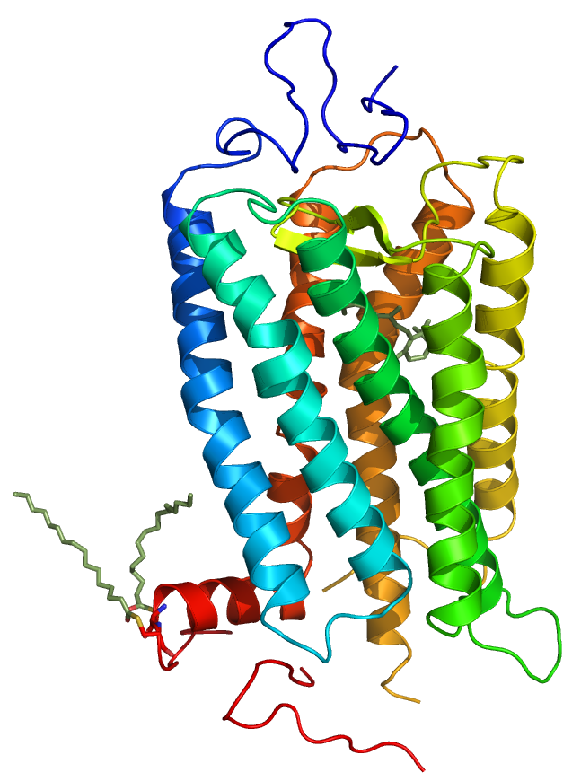
Introduction:
Gold compounds have been used for different studies, even though they are usually used for the treatment of arthritis.
In the last decade, gold complexes have received increased attention due to the variety of their applications
The G protein-coupled receptors (GPCR) belong to seven-transmembrane helix proteins.
They have a role in the coupled binding of extracellular ligands to conformational changes and activation of intracellular G proteins and GPCR kinases.
Rhodopsin is activated by light-induced isomerization in the native membranes due to the covalently binding inverse agonist 11-cis retinal to the all-trans-retinal within a very tight binding pocket

Slide 5
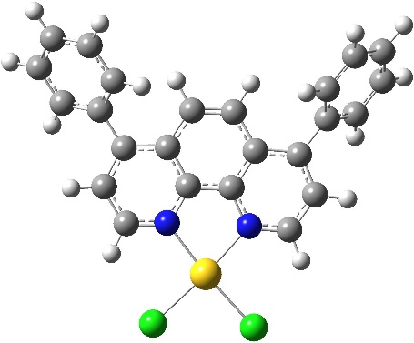
Optimized structures of gold(III) complex ([Au(DPP)Cl₂]₊
DPP=4,7-diphenyl-1,10-phenanthroline, C1

Slide 6
Material and Metods
The pockets and binding sites of RLR were determined by the AutoGridFR (AGFR) program
The Discovery Studio 4.0 was used for the preparation of protein for docking by removing the co-crystallized ligand, water molecules and co-factors.
The AutoDockTools (ADT) graphical user interface was used to calculate Kollman charges and to add polar hydrogen
The protein - ligand flexible docking were done using the Lamarckian Genetic Algorithm (LGA) method
The grid center with dimensions 10.988 × 45.838 × 35.362 Å3 in -x, -y, and -z directions of human RLR was used
The AutoDock program calculate the free energy of binding values according to the following equation, Eqn 1:
ΔG_{bind}= ΔG_{vdw+hbond+desolv} + ΔG_{elec} + ΔG_{total} + ΔG_{tor} - ΔG_{unb} (1)

Slide 7
Results and Discussion
The values of the estimated free energy of binding and the inhibition constant (Ki) for the investigated ligands in three different conformations are given.
The lower value of Ki and the more negative value of ΔG_{bind} indicate better binding ligand to receptor.
Conformations of ligand | ΔG_{bind} (kJ/mol) | K_{i} (nM) | Hydrogen Bond | Hydrophobic Contact
1 | -35.44 | 6.2x10² | A:ILE189:HN | A:MET207 A:TRP265 A:TYR268 A:TYR191 A:ALA272 A:TYR191 A:PHE208 A:ILE189 A:LEU125
Estimated free energy of binding (ΔG_{bind}) in kcal/mol, estimated inhibition constant (Ki) (μM) of best position of C1 against RLR protein

Slide 8
Results and Discussion
The pockets and binding sites of RLR were determined by the AutoGridFR (AGFR) program
The binding energies of gold(III) complex and 11-cis-retinal to RLR were found to be -35.4 and -40.5 kJ/mol
Conformations of ligand | ΔG_{bind} (kJ/mol) | K_{i} (μM) | Hydrogen Bond | Hydrophobic Contact
1 | -40.50 | 8.1x10¹ | / | A:MET207 A:ALA269 A:ALA272 A:ILE189 A:VAL204 A:TYR191 A:TRP265 A:TYR268
Estimated free energy of binding (ΔG_{bind}) in kcal/mol, estimated inhibition constant (Ki) (μM) of best position of 11-cis-retinal against RLR protein.
The obtained results indicate that the ligands strongly bind to RLR receptor
The docking analyses of investigated molecules revealed that several non-covalent interactions existed between investigated molecules and target receptor

Slide 9
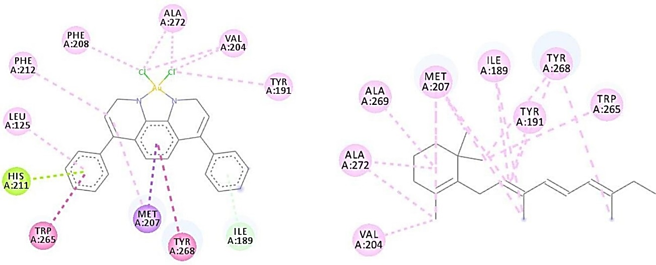
Results and Discussion
The position The most prominent interactions are π-donor H-bonds, alkyl-π, π-lone pair and π-π interactions
HIS, MET, ALA, ILE, TYR, TRP and TYR in the primary structure of RLR have a predominant role as the active site of this receptor regarding ligands
The position of active amino acids, the C1 binds at the same active site of RLR protein as its native ligand, 11-cis-retinal, by weak non-covalent interactions .

Slide 10
Conclusions
To evaluate the binding affinity of investigated gold (III) complex to Rhodopsin-like receptor (RLR), the molecular docking study was performed.
According to the results of the molecular docking study, the investigated ligand form stable complexes with RLR as evident from the free binding energy (ΔG_{bind} is -40.5 kJ/mol for C1), as well as achieve a more effective interaction with the target receptor.
The most important interactions are π-donor H-bonds, alkyl-π, π-lone pair and π-π interactions.
The obtained preliminary results suggest that the gold (III) complex might exhibit strong binding activity to the RLR receptor

Slide 11
Acknowledgments
The authors are grateful to the Ministry of Education, Science and Technological Development of the Republic of Serbia (Agreement No. 451-03-9/2021-14/200378 and Agreement No. 451-03-68/2021-14/200122) for financial support.

