Slide 1
Photosensitizer chlorophyllin
in the treatment of oncopathologies
Natalia Plekhova¹*, Olga Shevchenko^{1,2}, Oksana Korshunova¹ and Vladimir Apanasevich¹
¹Pacific State Medical University of the Ministry of Health of the Russian, Federation, Ostryakov Avenue, 2, Vladivostok, Russia;
²Pacific Institute of Bioorganic Chemistry, Prospect 100 let Vladivostoku 159, Vladivostok, Russia
* Corresponding author: pl_nat@hotmail.com

Slide 2
Abstract: In this article we report the antitumor activity of the derivative chlorophyllin with Cu (CuChlNa) and Chlorin e6 (Ce6). Ehrlich' s ascites tumor 1X10⁶ cells/ml were incubated with Cе6 and CuChlNa at various concentrations and subjected at 15 min to the photodynamic irradiation from a semiconductor laser with 32 mW output power at the light wavelength of 650 nm, giving an irradiation dosage of 6 J/cm². Intracellular uptake of CuChlNa and Ce6, phototoxicity, apoptosis and necrosis of cells after incubation at 9 days was studied. Were shown, that CuChlNa is able to more intense absorption at therapeutically relevant wavelengths. After 6-days exposure to CuChlNa more than 77±6.1% of the cells apoptoses were detected, whereas in the same period after contact with Ce6 were indicated predominant cell necrosis. The therapeutic efficacy of photosensitizers has been shown in vivo by demonstrating the high survival rate of mice treated with CuChlNa and PDT.
Keywords: photosensitizer; chlorophyllin; Chlorin e6; cytotoxicity, intracellular localization; Ehrlich' s ascites tumor; photodynamic therapy; oncology

Slide 3
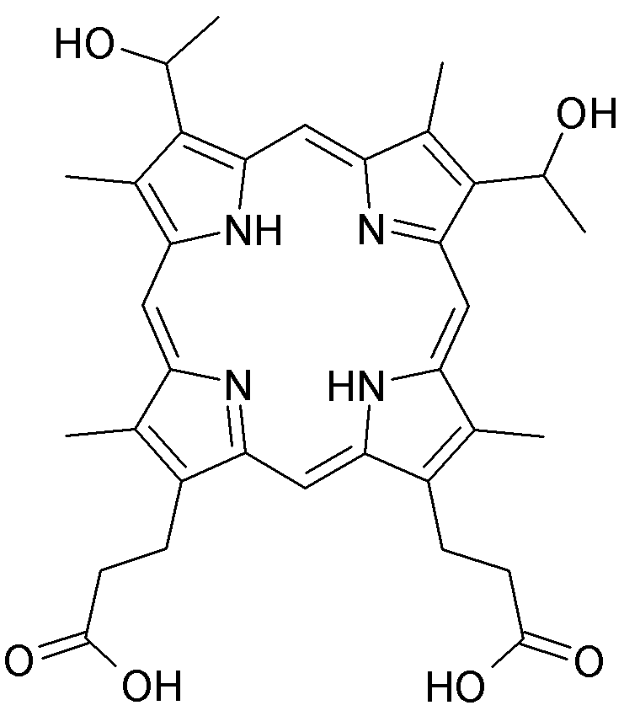
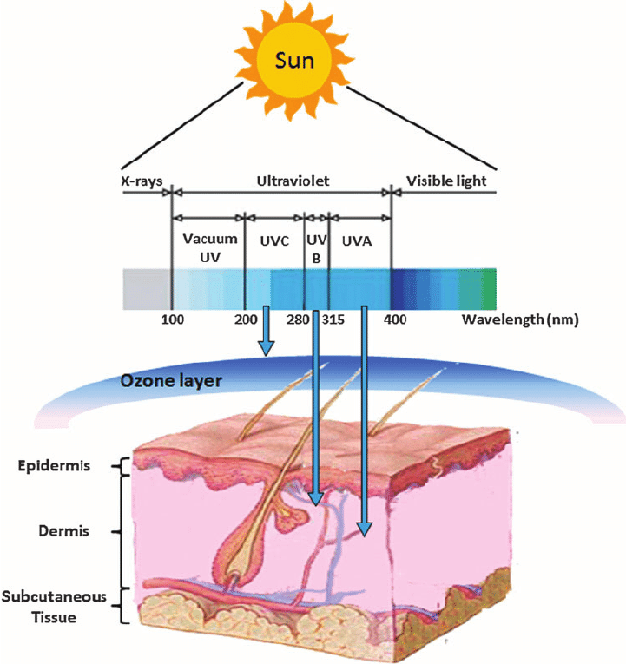
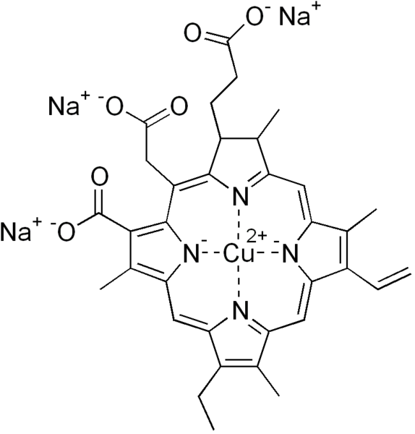
Figure 1. Hematoporphyrin structure
Figure 3. Depth of light penetration into tissue [1]
Figure 2. Chlorophyllin sodium-copper structure (CuChlNa)
[1] - Gupta A. et al. Ultraviolet radiation in wound care: sterilization and stimulation. Advances in wound care. 2013, 2 (8), 422-437.

Slide 4
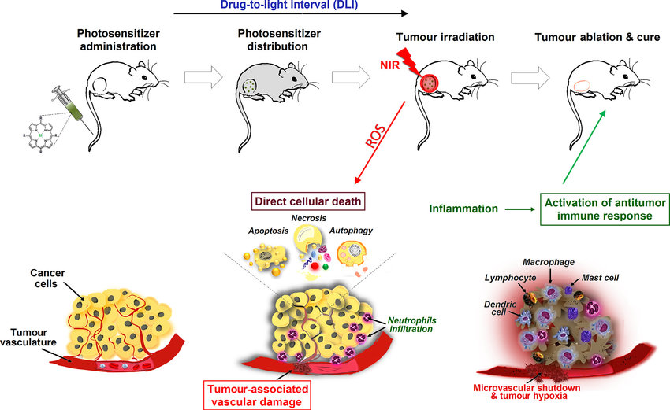
The principle of Photodynamic Therapy
Figure 4. Principles of photodynamic therapy: the steps of PDT procedure and biological mechanisms resulting in the direct and indirect elimination of tumours by apoptosis, necrosis, autophagy, vascular damage and inflammatory response.
[2] - Dąbrowski J. M. et al. Engineering of relevant photodynamic processes through structural modifications of metallotetrapyrrolic photosensitizers . Coordination Chemistry Reviews. 2016, 325, 67-101.

Slide 5
Results and Discussion. Absorption spectra
Figure 5. (A) The absorption spectra of Ce6 and CuChlNa (both 1 mg/m) (a) and (B) CuChlNa in various solvents .

Slide 6
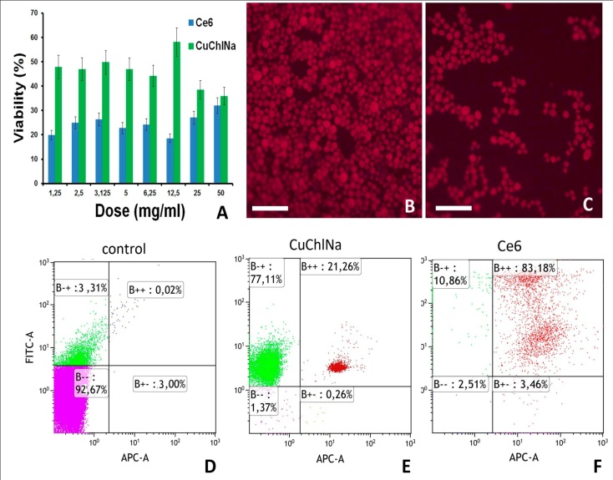
Results and Discussion. In vitro phototoxicity assay
Figure 6. (A) EAT cells treated with Ce6 and CuChlNa (1.25 μg/ml) after incubated for 8 days. (B, C) The cell survival rates of EAT cells were assessed by the MTT assay; subcellular localization (red) of Ce6 and CuChlNa in EAT were detected with fluorescence microscope. (D-F) Scale bar, 25 μm. Cell apoptosis and necrosis of EAT cell was detected by the Annexin-V/PI staining and flow cytometry.

Slide 7
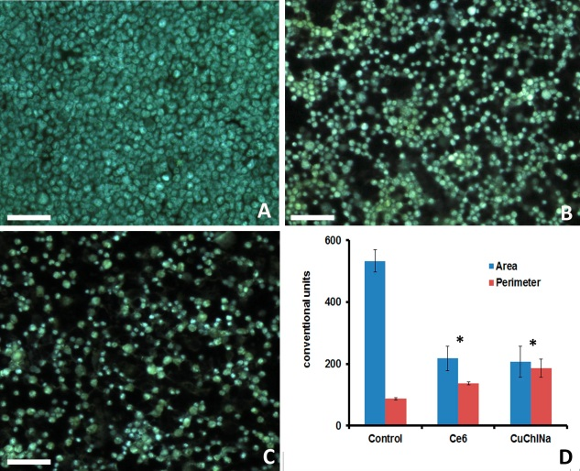
Results and Discussion. Analyzing Cell Death by Nuclear Staining with Hoechst 33342
Figure 7. EAT cells treated with Ce6 and CuChlNa (1.25 μg/ml), after incubated for 6 days. (A, B, C) EAT cells stained Hoechst 33342 were detected with fluorescence microscope. Scale bar, 25 μm. (D) Statistical analysis of EAT cells sizes treated with Ce6 and CuChlNa and PDT. Compared with the corresponding control group without photodynamic irradiation, *P < 0.05

Slide 8
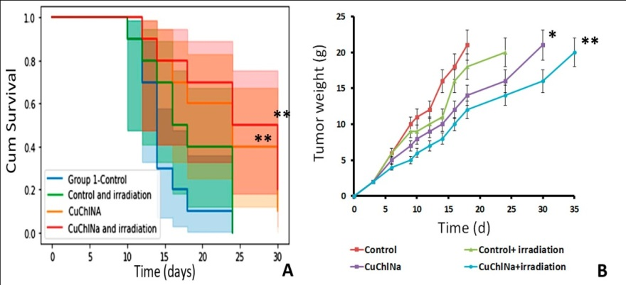
Results and Discussion. In vivo therapeutic efficacy of PSs
Figure 8. (A) Kaplan-Meier survival curve of mice treated with saline, saline plus Tween and CuChlNa (7.25 μg/ml) (N = 10 in each group) (a). (B) Effect of Ce6 and CuChlNa (7.25 μg/ml) on tumor weight in mice. *P<0.05 and ** P <0.01 compared with control group.
Conclusions
Natural PS isolated from plants can be seen as a green approach to PDT in cancer therapy. Low systemic cytotoxicity in relation to normal cells and selective action against malignant cells is one of the main advantages of natural PS for PDT. In addition, since natural compounds are commonly found ubiquitously, they may be more readily available compared to synthetic chemotherapeutic agents. Researchers are now able to discover these photoactive plants in nature and compare the effects with more traditional PSs. In addition, loading conventional PSs or natural phototoxic agents into nanostructures can help achieve better cancer treatment with PDT.

Slide 9
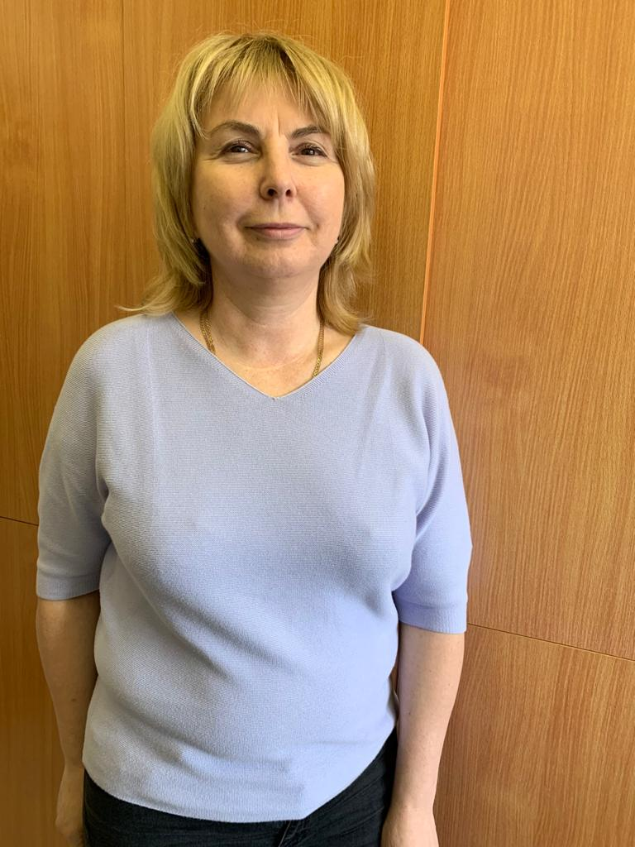
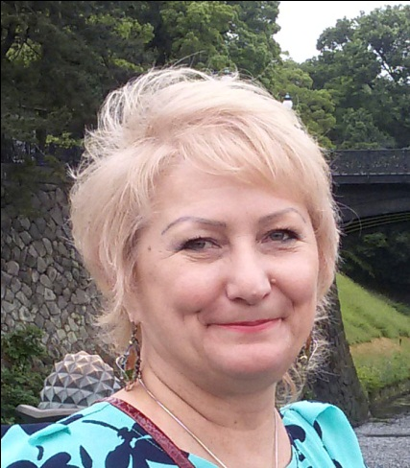
Research team
Doctor of Science
Plekhova Natalia G.
Ph.D. of Medical Sciences
Korshunova Oksana V.
Junior Reseacher
Shevchenko Olga V.
Doctor of Science, Professor
Apanasevich Vladimir I.
The reported study was funded by PSMU «Evaluation of anti-tumor activityphotosensitizers of the porphyrin class»

Slide 10
Thank You for attention!

