Slide 1
Protective Roles of Black Seed, Thymoquinone Nanoformulations: Potential Nanonutraceuticals in Human Diseases
Shaker A. Mousa, PhD, MBA, FACC, FACB
Professor of Pharmacology, Chairman of The Pharmaceutical Research Institute at Albany College of Pharmacy and Health Sciences

Slide 2
Outlines & Objectives
Bioactive Compounds derived from Nigella Sativa,
Documented Utilities of Nigella Sativa/ TQ,
Survey of Issued 10 US Patents, Years 2000 -2020 - Review Compositions and Utilities,
Nano-Nigella Sativa/Nano –TQs: Potential Impact of Nano-Assembly and Products Developments,
Summary
Selected References from our Work

Slide 3
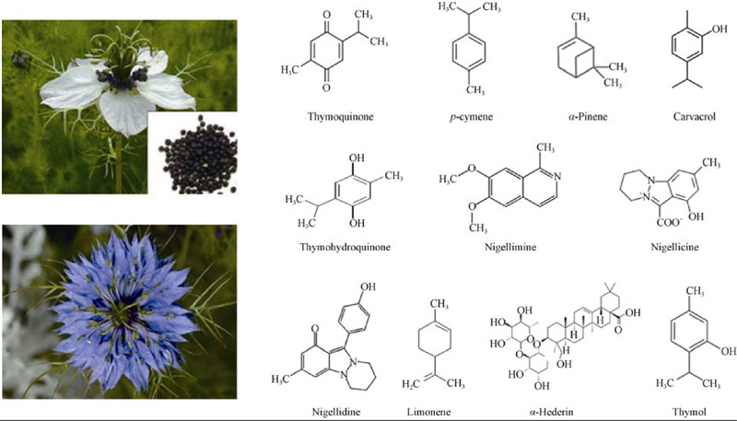

Slide 4
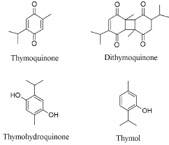
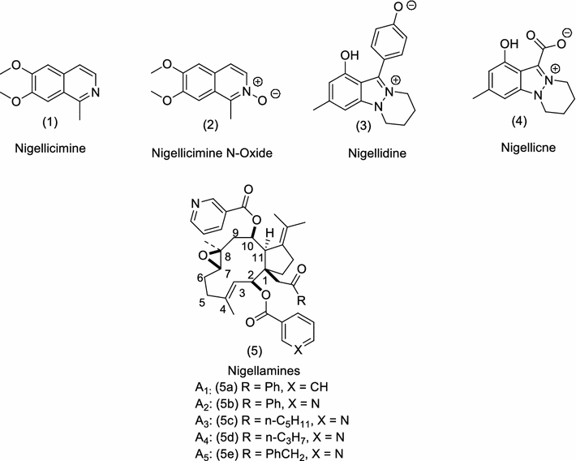
Bioactive Compounds in Nigella Sativa (Black Seed)
TQ
Structures of alkaloids isolated from Nigella sativa L.
Khan & Afzal: Chemical composition of Nigella sativa: Part 2 Recent advances. Inflammopharmacology volume 24, pages67–79(2016)

Slide 5
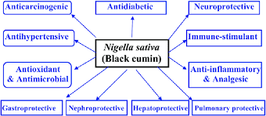
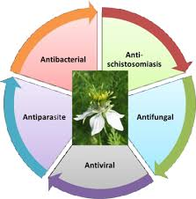
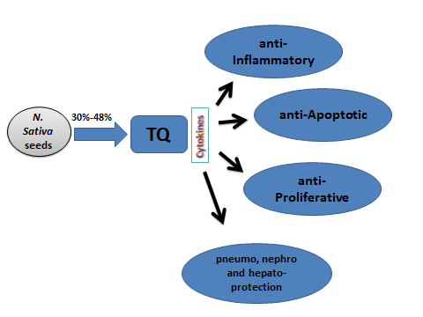
Documented Utilities of Nigella Sativa/ TQ

Slide 6
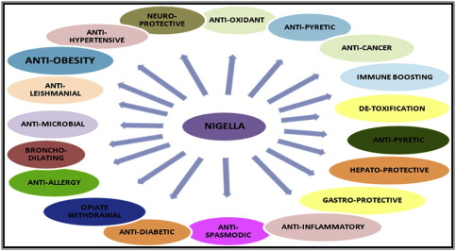
Documented Utilities of Nigella Sativa/ TQ –Cont.

Slide 7
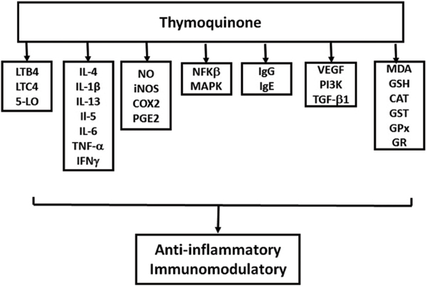

Slide 8
US Patents: Nigella Sativa/ TQ
Salem, et al. Thymoquinone derivatives for treatment of cancer. US Patent 10,501,428; 2019, United Arab Emirate, Al Ain Univ. [TQ Derivatives in Cancer]
Madhavamenon, et al. Composition of nigella sativa seeds to treat anxiety, stress and sleep disorders with significant memory enhancement properties and a process for producing the same. US Patent 10,485,837; 2019 - AKAY FLAVOURS & AROMATICS PVT, LTD (Kerala, IN). [CO2 Black Cumin Extract -Oil or powder form for CNS Disorders]
DuBourdieu, et al. Oral delivery compositions for treating atopic dermatitis disorders in mammals. US Patent 10,406,232; 2019 - VETS PLUS, INC. (Menomonie, WI). [Ceramides, Omega 3/6 fatty acids, Black Seed Extract in soft Dough oral delivery]
Ibrahim. Dentifrice compositions containing extracts of Nigella sativa and related methods. US Patent 10,004,676; 2018 - Health and Natural Beauty USA Corp. (New Brunswick, NJ).

Slide 9
US Patents: Nigella Sativa/ TQ- Cont.
Babish, et al. Compositions from Nigella sativa – Anti-Inflammatory, US Patent 9,180,155, 2015 - Bio Nexus, Ltd (Ithaca, NY). [Black Seed Powder CO2 Extracts, Fractions TQ/Di-TQ production in Obesity Weight Loss, Diabetes, Anti-Oxidant]
Alzahrani, et al. Natural compositions and methods of promoting wound healing. US Patent 8,703,205; 2014. KSA [Honey, Myrrh, Black seed in Wound Healing: Foot Ulcer, Diabetic, and Infection]
Pacioretty, et al. Formulations containing thymoquinone for urinary health. US Patent 8,029,831, 2011 - Bionexus, Ltd. (Ithaca, NY). [TQ, Cranberry fruit, Methionine for Low Urinary Tract Disorders – anti-inflammatory/pain, anti-microbial,..]
Greene, et al. Anti-microbial composition and methods of use thereof, US Patent 7,258,878; 2007 - Kimberly-Clark Worldwide, Inc. (Neenah, WI). [For Yeast and Fungal Infection]
Crooks, et al. Use of the naturally-occurring quinones thymoquinone and dithymoquinone as antineoplastic and cytotoxic agents, US Patent 6,218,434; 2001. University of Kentucky Research Foundation. [TQ/Di-TQ in cancer & cancer Resistance]

Slide 10
Nano-Nigella Sativa/Nano -TQs & Potential Impact of Nano-Assembly and Products Developments

Slide 11
Nigella Sativa - Thymoquinones Nanoformulation
Primary Emulsion
Double Emulsion
Drop by drop
Drop by drop
2 g PLGA + 100 mg Thymoquinone
(Dissolved in 20 ml DMSO)
PLGA- Thymoquinone /PVA
100 ml 2 % PVA
100ml 1 % PVA
- Homogenizer 15 min
- US Probe 80 W for 90 min
- Homogenizer 15 min
- US Probe 60 W for 90 min
Dialysis with 12 kD membrane for 2 days
Centrifugation and freeze drying

Slide 12
Nano & Enhanced Utilities of Nigella Sativa/ TQ
Antidiabetic
Skin Disorders
Anticancer
↓ blood glucose
↓ HbA1c
↓ TAG
↓ T. cholesterol
↓ LDL-C
↓ VLDL-C
↑ HDL
DOX
PXT
Nano-
TQ
↑ p53
↓ Bcl2
↑ apoptosis
Hepatic / Pulmonary protective
CNS protectant
↑ monoamines
↑ SOD1
↑ SOD2
↑ SOD3
↑ GPx
↓ SGPT
↓ SGOT
↓ ALP
Adjuvant with Various Therapies
Anti-microbial
Anti-inflammatory
↓ IL-2
↓ IL-6
↓ IL-7
↓ IL-1β
↓ TNF-α
↓ Candida albicans
↓ Candida biofilm
Forms: Oral, Patches, Topical, Spray, etc.

Slide 13
Summary
Evidence Based Complimentary and Alternative Medicines Investigations documented.
Nigella Sativa (Black Cumin) and derived products demonstrated the best natural remedy in wide ranges of illness globally by Muslim and Non-Muslim Scientists,
Based on Patent Searches, Novel Nano-Assembly of various bioactive Compounds derived from Nigella Sativa and whole Nigella Sativa to be used in different forms represent product lines for various illnesses

Slide 14
Selected References by our team
Shahein SA, Aboul-Enein AM, Higazy IM, Abou-Elella F, Lojkowski W, Ahmed ER, Mousa SA, AbouAitah K. Targeted anticancer potential against glioma cells of thymoquinone delivered by mesoporous silica core-shell nanoformulations with pH-dependent release. Int J Nanomedicine. 2019 Jul 19;14: 5503-5526.
Atta MS, El-Far AH, Farrag FA, Abdel-Daim MM, Al Jaouni SK, Mousa SA. Thymoquinone Attenuates Cardiomyopathy in Streptozotocin-Treated Diabetic Rats. Oxid Med Cell Longev. 2018 Oct 30; 2018: 7845681.
El-Far AH, Al Jaouni SK, Li W, Mousa SA. Protective Roles of Thymoquinone Nanoformulations: Potential Nano nutraceuticals in Human Diseases. Nutrients. 2018 Sep 25; 10(10). pii: E1369.
Atta MS, Almadaly EA, El-Far AH, Saleh RM, Assar DH, Al Jaouni SK, Mousa SA.
Thymoquinone Defeats Diabetes-Induced Testicular Damage in Rats Targeting Antioxidant, Inflammatory and Aromatase Expression. Int J Mol Sci. 2017 Apr 27;18(5). pii: E919.
Muralidharan-Chari V, Kim J, Abuawad A, Naeem M, Cui H, Mousa SA. Thymoquinone Modulates Blood Coagulation in Vitro via Its Effects on Inflammatory and Coagulation Pathways. Int J Mol Sci. 2016 Mar 30; 17(4):474.

Slide 15
OBSERVATION

