Slide 1



Co-entrapment of sorafenib and cisplatin in poly[ε-caprolactone-co-(12-hydroxystearate)] copolymer for dual drug delivery application
Izolda Kántor ^{1,2,}*, Diana Aparaschivei ³, Anamaria Todea ³, Francisc Péter ³, Zoltán May ¹, Emese Biró ³, and Tivadar Feczkó ^{1,2}
¹ Institute of Materials and Environmental Chemistry, Research Centre for Natural Sciences, Magyar tudósok körútja 2, H-1117, Budapest, Hungary;
² Research Institute of Biomolecular and Chemical Engineering, Faculty of Engineering, University of Pannonia, Egyetem u. 10, H-8200, Veszprém, Hungary;
³ University Politehnica of Timişoara, Faculty of Industrial Chemistry and Environmental Engineering, Carol Telbisz 6, RO-300001, Timişoara, Romania.
* Corresponding author: kizolda93@gmail.com

Slide 2

Abstract: sciforum-044771
Drug-loaded nanocarriers have overcome various challenges compared with the bare chemo-drug, such as limited bioavailability, multiple drug resistance, poor patient compliance, adverse drug reactions, particularly side effects of chemotherapy and offer advantages such as protection from degradation in the blood stream, better drug solubility and improved drug stability. One promising group of controlled and targeted drug delivery systems is the polymer-based nanoparticles which can sustain release of active agent by diffusion and their degradation.
Sorafenib is the only drug which is capable to prolong the life of patients suffered from hepatocellular carcinoma. Cisplatin remains one of the most widely used broad spectrum anticancer drug for the treatment of a variety of solid tumors. Nanoformulations can exert synergistic effect by entrapping two drugs with different mode of action, such as sorafenib and cisplatin.
In our study, we prepared polymeric nanoparticles by optimised double emulsion solvent evaporation method with a good production yield by a novel biocatalytically synthetized 12-hydroxystearic acid ε-caprolactone copolymer (12CL) which is biocompatible and biodegradable carrier for the co-entrapment of sorafenib and cisplatin in nanotherapeutics in order to investigate the synergistic effect of sorafenib in combination with cisplatin. The active agents were encapsulated and also cross-linked with carbodiimide to increase the encapsulation efficiency. To improve the drug encapsulation efficiency, bovine serum albumin (BSA) was also incorporated as a protein capable of complexation with the cisplatin.
Keywords: polymeric nanoparticles; drug encapsulation; drug delivery; sorafenib; cisplatin

Slide 3
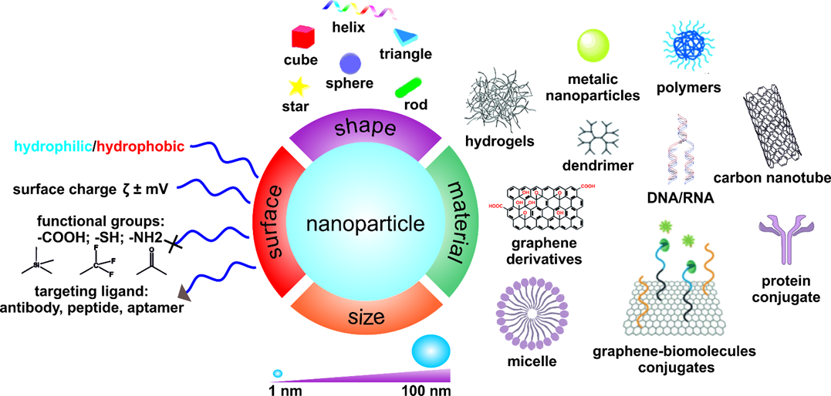
Introduction
Nanomedicine
  One of the most growing fields of pharmaceutics.
  Nanomaterials in medical applications.
  Integration of nanomaterials with biology.
Diagnostic devices.
Contrast agents.
Analytical tools.
Drug delivery vehicles.
Source: http://cnbm.amu.edu.pl/en/nanomaterials
Notes:
Nanomedicine is one of the most growing fields of pharmaceutics (Kántor et al., 2020), which involves nanomaterials in medical research and applications.
The integration of nanomaterials with biology has led to the development of diagnostic devices, contrast agents, analytical tools and drug delivery systems (Cole et al., 2015).
Nanomedicine has been defined as the new way of intervention for detection, treatment, and prevention of disease (Colombo et al, 2001).
Nanocarriers have a large spectrum of composition, various morphologies, furthermore their chemistry was modified to improve the loading efficiency and delivery capacity (Seo et al., 2017).
Nanoformulations can play an important role in the improvement of anticancer drug therapies (Kántor et al., 2020), widely using active agents as sorafenib and cisplatin.

Slide 4
Introduction
Cisplatin (CIS)
  Is administrated intravenously, interferes with DNA replication.
  1978 – FDA approval: testicular and ovarian cancer.
  The most widely used and effective anticancer agent.
  Side effects: nephrotoxicity, neurotoxicity, auditory toxicity.
Source: Duan et al., 2016.
Notes:
Cisplatin is administrated intravenously and interferes with DNA replication, which kills the cancer cells.
In 1978 gained the FDA approval for treating testicular and ovarian cancer (Duan et al., 2016).
Today cisplatin remains one of the most widely used and effective anticancer agent for the treatment of a variety of solid tumors, including sarcomas, carcinomas, liver, lung, ovarian, cervical cancer (Alam et al., 2014).
Its use is associated with serious side-effects like: kidney and hearing problems, nerve damages (Gryparis et al., 2007).
The figure one shows that how many nanoparticle formulations are used for cisplatin delivery.

Slide 5
Introduction
Sorafenib (SOR)
  Orally active multikinase inhibitor drug.
  Is used against:
    Hepatocellular carcinoma,
    Kidney cancer,
    Thyroid cancer.
  Side effects:
    Diarrhoea, rash, vomiting,
    Hand-foot skin reaction,
    Weight loss.
Source: Forner et al., 2012.
  Hepatocellular carcinoma (HCC)
    LIVER CANCER – 5th most common cancer.
    Its mortality rate ranks third among all cancers.
    The most common type – HCC.
    Causes: Hepatitis B or C, cirrhosis.
Notes:
Sorafenib is a kinase inhibitor drug.
Beside HCC Sorafenib is used for the treatment of kidney cancer and thyroid cancer.
Liver cancer is the fifth most common cancer in the world.
The most common type of liver cancer is hepatocellular carcinoma (HCC).
Its mortality rate ranks third among all cancers.
It is often caused by hepatitis B or C or cirrhosis. (Gauthier & Ho 2013).
The table shows two clinical trials of two groups of patients. The first group was treated with sorafenib and the other group only with placebo. The patients treated with sorafenib show slower time to progression of the disease and the median survival was higher than patients treated with placebo.
At present, sorafenib is the only drug which is capable to prolong the life of patients suffered from advanced HCC .

Slide 6
Introduction
Nanoscale drug delivery
Disadvantages of active agents:
Advantages of nanoscale drug carriers:
Quickly recognized.
Removed from the body.
High doses.
Protection from degradation.
Better drug solubility.
Improved drug stability.
Controlled and targeted drug delivery
Reduced drug toxicity
Reduced adverse effects
Reduced doses
Reduced overall cost
Improved stability of drug
Improved bio-availability
Notes:
Disadvantages of these active agents are that they are quickly recognized and removed by the immune system of the body before they reach their target and because they are not targeted in the body during their administration, their dose must be increased in order to reach the therapeutic level, causing serious side effects.
Nanoscale drug carriers offer many advantages compared with the bare chemo-drug, such as protection from degradation in the blood stream, better drug solubility and improved drug stability.
With controlled and targeted drug delivery we can reduce the drug toxicity, the adverse effects and the administrated doses.

Slide 7
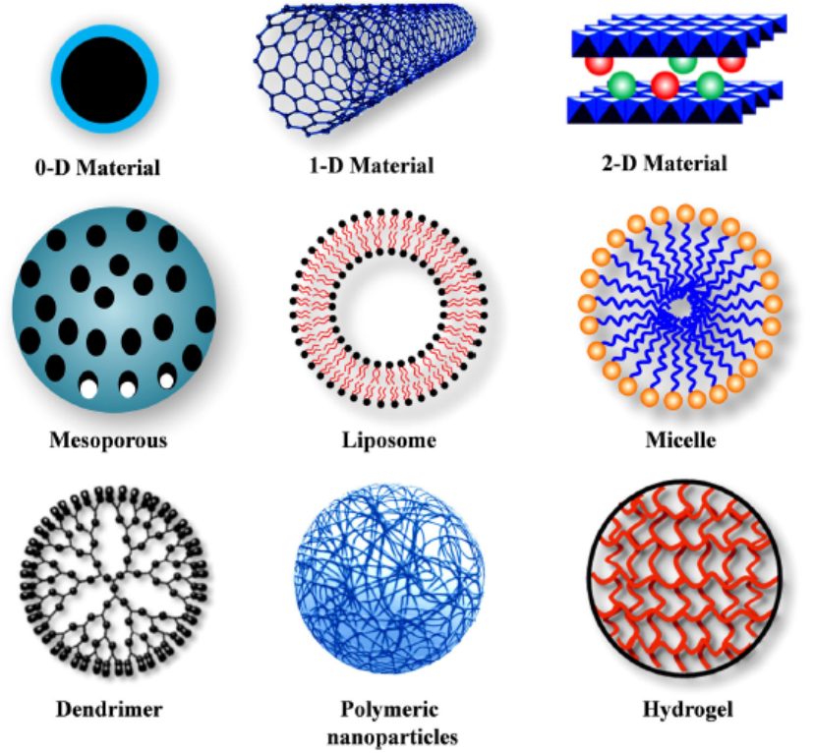
Aims
Preparation of anticancer drug-loaded nanocomposites that can become effective sustained and targeted drug delivery devices.
Finding of the proper biodegradable and biocompatible polymer.
Investigation of the encapsulation possibility of the active agent.
Source: Senepati el al., 2018.
Notes:
Currently there are several clinically approved nanoscale materials that are promising nanoparticle drug delivery systems that have shown reduced side effects and effective therapeutic levels (Cole & Holland, 2015).
One of the controlled and targeted drug delivery systems are polymer based nanocomposite particles which can sustain release of active agent by diffusion and their degradation. In this work the polymeric nanoformulation was used.
So the aim of the work basically is to prepare anticancer drug-loaded nanocomposites that can become effective sustained and targeted drug delivery devices. Finding of the proper polymer and investigation of the encapsulation possibility of the active agents in the choosen polymer.

Slide 8
Encapsulating polymer
Preparation of sorafenib-loaded PCL nanocomposites by emulsion method with a very good production yield.
Selection of most suitable polymer in which the active agent was encapsulated with a satisfying encapsulation efficiency.
Kántor I., Aparaschivei D., Todea A., Biró E., Babos Gy., Szerényi D., Kakasi B., Péter F., Șișu E, Feczkó T. 2021. Biocatalytic synthesis of poly[ε-caprolactone-co-(12-hydroxystearate)] copolymer for sorafenib nanoformulation useful in drug delivery, Catalysis Today, 366, p. 195 – 201.
Notes:
In our previous work we managed to prepare nanocomposites by optimised emulsion method with a very good production yield. and we also found the proper polymer, in which the active agent was encapsulated with a satisfying encapsulation efficiency.

Slide 9
Polymers
Controlled drug release
Biodegradable
Good permeability
Good mechanical properties
Biocompatible
Encapsulating polymer
New active agent: Cisplatin.
Encapsulation possibility.
  PLGA (poly(lactic-co-glycolic acid))
  PCL (polycaprolactone)
  12CL, 16CL (hydroxy-stearic-acid epsilon-caprolatone copolymers)
Co-encapsulation: Sorafenib.
Notes:
We started to study a new active agent, cisplatin. We aimed at the co-delivery of cisplatin and sorafenib entrapped in one type of nanoparticle, since we would like to increase their therapeutic effect synergistically.

Slide 10
Encapsulating polymer
12HSA_ECL (12CL)
Kántor I., Aparaschivei D., Todea A., Biró E., Babos Gy., Szerényi D., Kakasi B., Péter F., Șișu E, Feczkó T. 2021. Biocatalytic synthesis of poly[ε-caprolactone-co-(12-hydroxystearate)] copolymer for sorafenib nanoformulation useful in drug delivery, Catalysis Today, 366, p. 195 – 201.
Notes:
For encapsulating polymer we used 12hydroxystearic acid E-caprolactone copolymer, further named 12CL, which is a novel, biocatalytically synthesised polymer, consisting of linear and cyclic copolyesters, PCL homopolymers and 12HSA homopolymers. It is biocompatible and biodegradable so it is suitable for drug delivery.

Slide 11
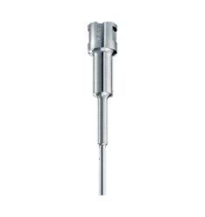
Preparation method
W₂
Solvent evaporation
W₁
O
Cisplatin solution
Polymer in DCM
+ Sorafenib
Aqueous phase
Organic phase
W₁/O emulsion
PVA in 2nd aqueous phase
W₁/O/W₂ emulsion
1st step
2nd step
Notes:
For the preparation of the nanoparticles the double emulsion method was used. In the first step the cisplatin solution was added to the polymer solution dissolved in dichloromethane, containing sorafenib, and the two phases were emulsified with sonication. Then, this first emulsion was transferred to the outer water phase that is an aqueous solution of PVA, and homogenized again with sonication.
The solvent was evaporated by stirrig the mixture magnetically under room temperature and atmospheric pressure.

Slide 12
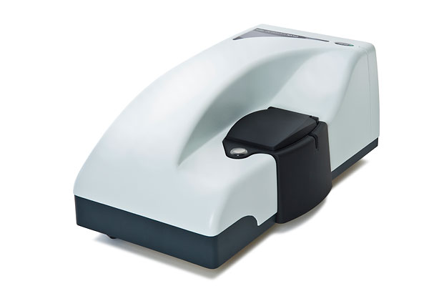
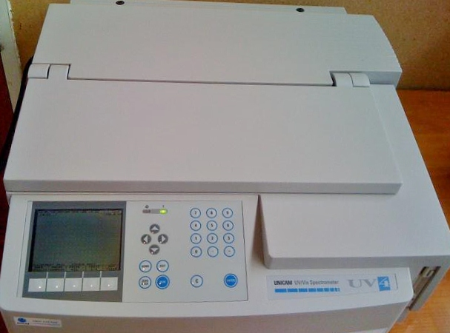
Analytical methods and instruments
Zetasizer Nano ZS (Malvern Instruments, Malvern, UK)
  Particle size measurement - Before and after washing with MilliQ water
  Zeta potential measurement - After removing the PVA by washing with MilliQ water
UV-VIS Spectrophotometer
  Encapsulation efficiency
  Concentration of SOR
ICP-OES
  Encapsulation efficiency
  Concentration of CIS
Production yield
Notes:
The particles size and the zeta potential were measured by Zetasizer Nano instrument.
The encapsulation efficiency was determined by measuring the concentration of SOR spectrophotometrically after dissolving the nanoparticles in DMSO.
The concentration of cisplatin was measured using ICP-OES.
We also determined the production yield by gravimetry.

Slide 13
Results
Notes:
The results of preliminary experiments can be seen in the table. In these experiments we examined the co-encapsulation of sorafenib and cisplatin in three type of green and in one chemically synthesised polymer. The particle size was about 200 nm with a narrow size distribution. We obtained a modest nanoparticle production yield and the encapsulation efficiency measured only for sorafenib was moderate.

Slide 14
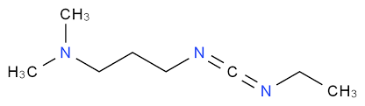
Results
Improvement of encapsulation efficiency.
Conjugation of cisplatin.
EDC cross-linker (1-Ethyl-3-(3-dimethylaminopropyl)carbodiimide).
Notes:
For improving the encapsulation efficiency we investigated the conjugation of cisplatin on the nanoparticle surface.
In order to reach our goal we used the activation method with carbodiimide, a carboxyl activating agent which conjugate the cisplatin through its ammonia ligand.
Unfortunatelly during the activation step, the polymer became partially water soluble, which can be observed in the low production yields of the nanoparticles.

Slide 15
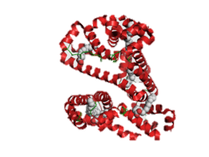
Results
Human serum albumin (HSA)
  It is the most abundant protein in human blood plasma
  Encapsulation of proteins is widely used:
    Controlled release kinetics
    Preservation of secondary structure
    High loading efficiency
BSA – Model protein
Notes:
To overcome these problems the idea of using HSA as carrier for drug delivery was introduced.
Encapsulation of proteins into nanoparticles is widely used nowadays because its release kinetics is contorlled, the secondary structure of proteins is preserved and in addition, significant amounts of drug can be incorporated into the particle matrix because of the large number of drug binding sites on the albumin molecule.
The using of HAS was modeled by using BSA in our preliminary studys.

Slide 16
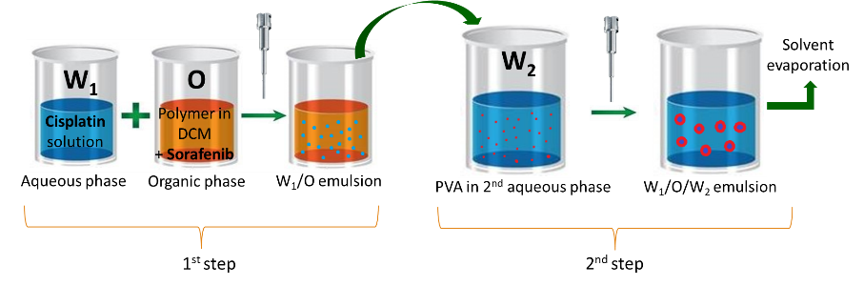
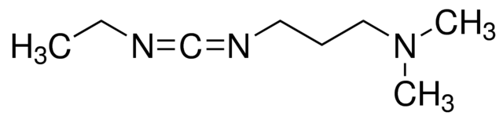
Results
Encapsulation
Cross-linking with EDC
EDC = 1-Ethyl-3-(3-dimethylaminopropyl)carbodiimide
Notes:
The BSA was encapsulated by double emulsion, solvent evaporation method. The optimisation of the method was carried out by varying the preparation parameters like oil-in-water ratio, polymer concentration, polyvinyl alcohol concentration and the amount of BSA.
Among the experimets presented in this table the sample number 6 was proved to be the most desirable. The one-to-five oil-in-water ratio with 0,5 mg BSA gave an acceptable size, but the size distribution was too wide which can be seen from the PDI value.
In order to decrease the polydispersity of the system we tried to couple the BSA in the polymer matrix with carbodiimide coupling.
The polydispersity of the system was not improved by introducing this carbodiimide.

Slide 17
Results
Encapsulation of BSA in presence of active agents SOR and CIS.
EDC = 1-Ethyl-3-(3-dimethylaminopropyl)carbodiimide
Notes:
The behavior of the double emulsion system was investigated in the presence of active agents.
The active agents were encapsulated and also cross-linked with carbodiimide.
The samples had wide size distribution, except two samples where we obtained a particle size about 200 nms and a very narrow size distribution.
However, in these samples the forming polymer suspensions were too diluted, we suppose that the carbodiimed made the particles water soluble, hence the particle yield became very low. In this case the size measurment was not reliable.

Slide 18
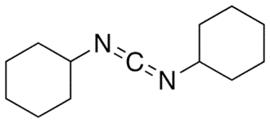
Results
Encapsulation of BSA using DCC.
DCC = N,N′-Dicyclohexylcarbodiimide
Notes:
To prevent the water solubility of the cross-linked polymer particles, which was caused by EDC carbodiimide, dicyclohexyl-carbodiimide, abbreviated DCC, which is a water insoluble carbodiimide, was used as cross-linker.
The samples were prepared using the same preparation parameters. Using DCC resolved the water solubility of the particles. A very good encapsulation efficiency was obtained.

Slide 19
Results
Encapsulation of BSA using DCC.
Notes:
From the Dynamic Lights Scatering measurement low particle size and a narrow size distibution was obtained.
The hydrodynamic size of the particles were about 200 nms.

Slide 20
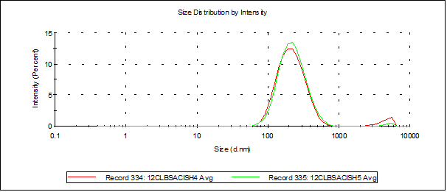
Results
Encapsulation of BSA and CIS using DCC.
Notes:
Encapsulating the active agents with BSA and using DCC at sample cisH5, a better production yield and encapsulation efficiency were obtained compared with the sample CIS 4 , which was prepared without DCC. The sample cisH5 was also more stable than sample cisH4.
So it can be conluded that the presence of active agents improve the particle size and using DCC with active agents improves the EE and the system stability.

Slide 21
Conclusions
The double emulsion-solvent evaporation method for the preparation of nanoparticles was optimized.
The BSA was encapsulated and cross-linked successfully by using DCC.
The cisplatin and sorafenib was co-encapsulated successfully by double emulsion method.
The presence of active agents decreases the particle size and using DCC with active agents improves the encapsulation efficiency and the system stability.

Slide 22
Thank you for the attention!

