Slide 1
Repellent effect of basil (Ocimum spp) on pea aphid (Acyrthosiphon pisum Harris) and potential use in crops
Boni Barthélémy Yarou
Thomas Bawin
Françoise Assogba-Komlan
Armel G.C. Mensah
Frédéric Francis

Slide 2
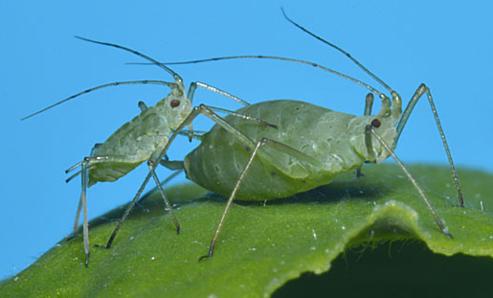
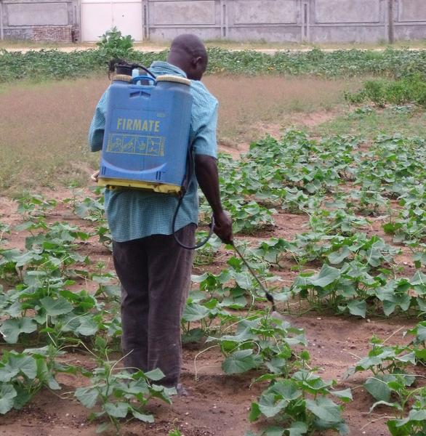
Background
2
Synthetic :
Induce resistance effects on aphid (Diabaté et al., 2014; Nikolova & Georgieva, 2014)
Produce negative effects on non-target organisms
Produce harmful effects on environment and human health (Ndakidemi et al., 2016; Sankoh et al., 2016).
https://influentialpoints.com/Gallery/Acyrthosiphon_pisum_Pea_aphid.htm
1
Aphids are one of the most important crop pests in the world (Blackman & Eastop, 2007)
(© A. Perrin/Cirad)
3
Environmental-friendly agricultural practices have become attractive in order to solve these problems.
4
An interesting approach in this respect is the use of pesticide plants (Mkindi et al., 2017; Yarou et al., 2017)
Objective: Evaluate the repellent activity of Ocimum basilicum L. and Ocimum gratissimum L. on the pea aphid under laboratory conditions using an Y-tube olfactometer.

Slide 3
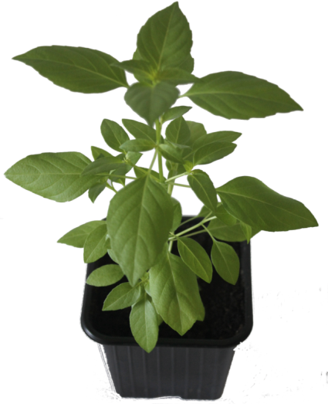
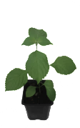
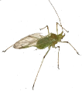
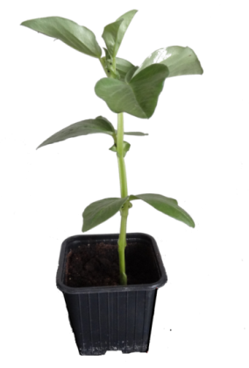
Materials & Methods
Aphids
Plants
Vicia faba
O. basilicum
O. gratissimum
Plants were individually grown.
They were used in experiments once they reached four and five weeks after seeding for O. basilicum and O. gratissimum respectively.
Aphids (Acyrthosiphon pisum) were reared on Vicia faba L.
Temperature (T) :25 ± 5°C - Relative humidity (RH), 50-70% - Photoperiod: 16:8-h light: dark

Slide 4
Materials & Methods
Olfactometer tests : Experimental design
Charcoal filter (Purifies air before entering the jars).
Teflon pipes
Glass jar
Y-tube olfactometer
Push air pump
Airflow through the arms was maintained at 100 mL.min⁻¹.

Slide 5
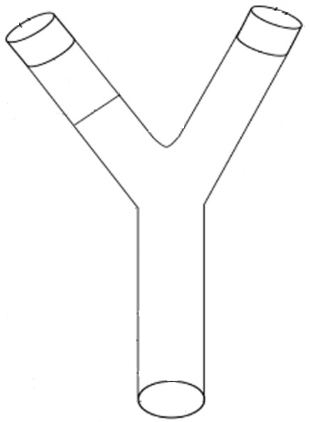
Materials & Methods
Olfactometer tests
Tested modalities:
Soil pot versus O. gratissimum.
V. faba versus O. gratissimum.
Soil pot versus O. basilicum.
V. faba versus O. basilicum.
Decision line
Aphids were individually introduced into the stem part of the olfactometer and their position was recorded during 3 min.
An aphid was considered as responding when it crossed the line marked on one of the arms before the end of the 3 min.
60 aphids were tested for each modality.

Slide 6
Materials & Methods
Olfactometer tests
After every 10 aphids
The glass jars and the olfactometer were cleaned with pure n-hexane and dried at room temperature for 5 min.
Potting soil and plants were replaced.
The position of the jars was switched to avoid bias.
Observed parameters
First entered zone.
Last entered zone.
Zone where aphids stayed for the longest time period.
Number of visits in each olfactometer arm.
Laboratory condition : T: 24±1˚C , RH: 45±5% RH.

Slide 7
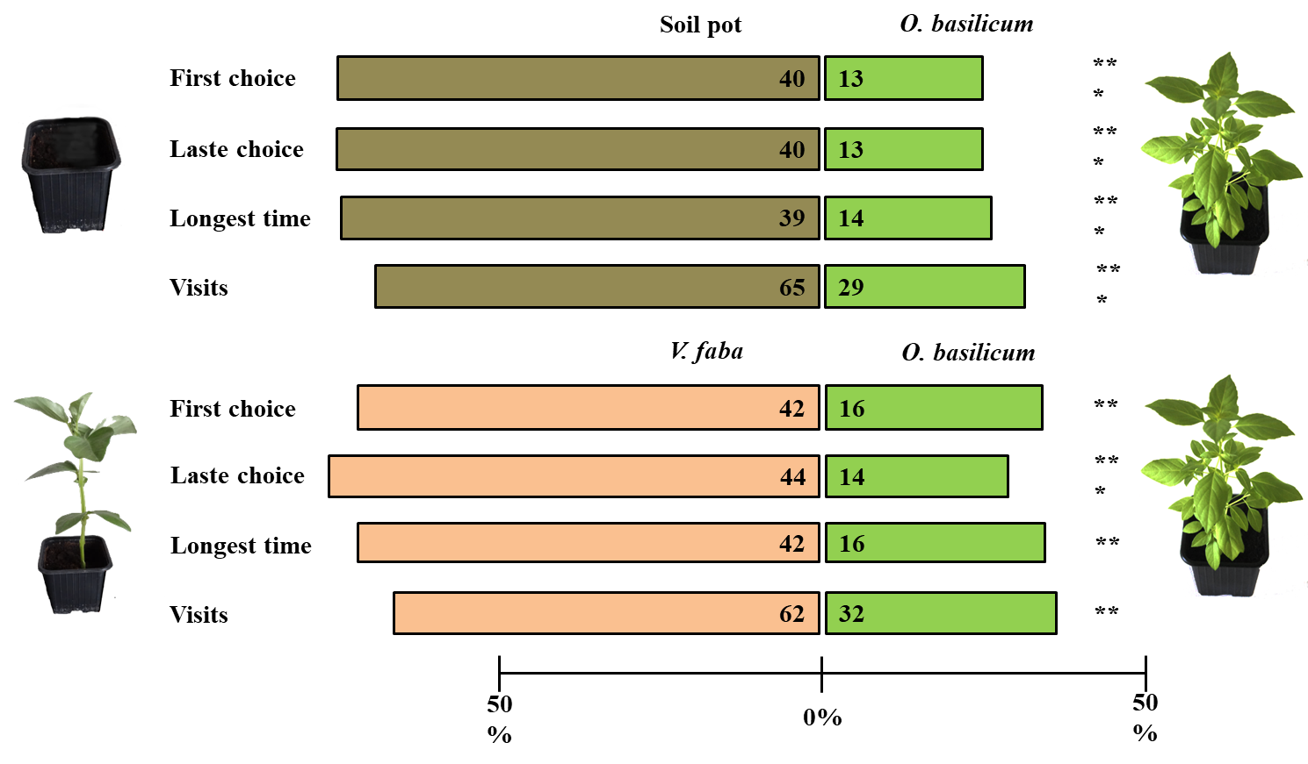
Results
O. basilicum effect on aphids
Responding aphids (%)*
53 (88)
Responding aphids (%)*
58 (97)
*Responding insects include living individuals present in one of the two side areas of the olfactometer.
Aphid distribution in dual choice tests
** = p < 0.05, *** = p < 0.001

Slide 8
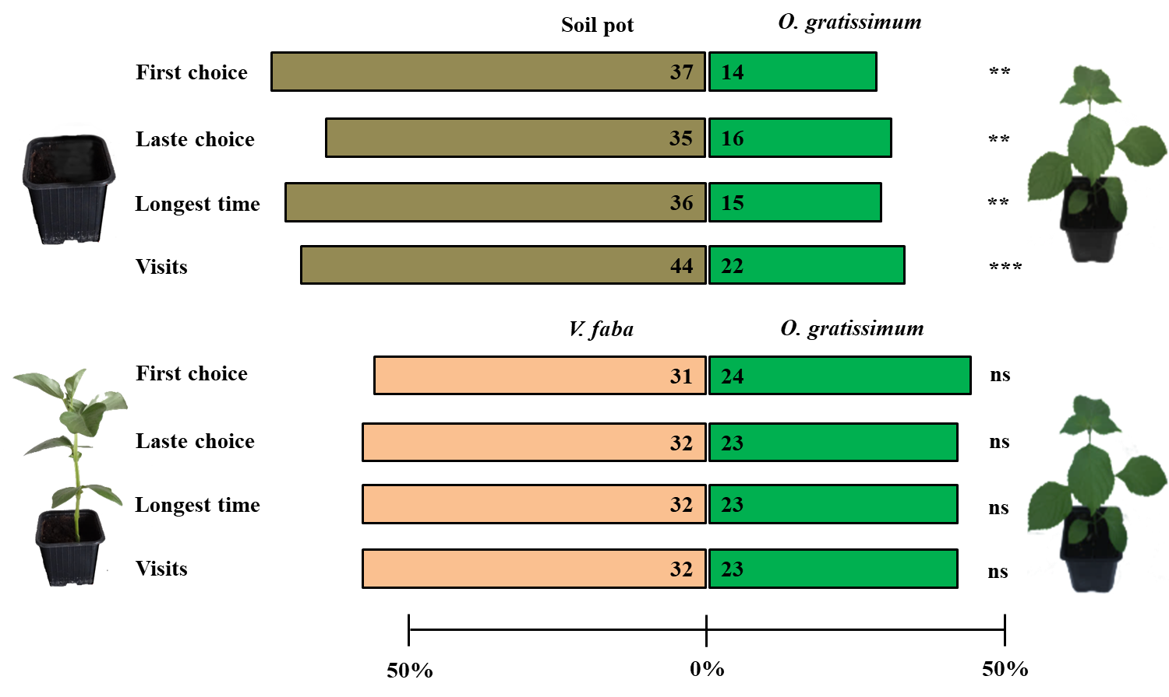
Results
O. gratissimum effect on aphids
Responding aphids (%)*
51 (85)
Responding aphids (%)*
55 (92)
*Responding insects include living individuals present in one of the two side areas of the olfactometer.
Aphid distribution in dual choice tests. ** p < 0.05, *** p < 0.00, ns =not significant

Slide 9
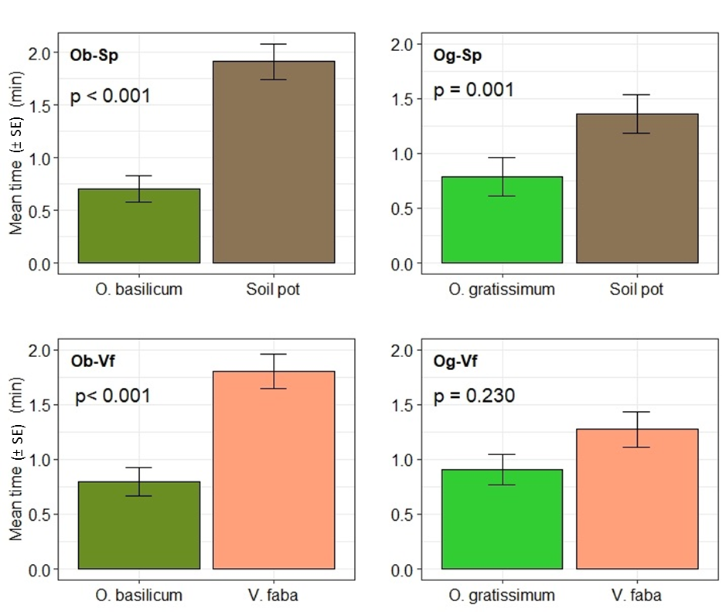
Results
Mean time spent by aphids
Legend
Ob-Sp : O. basilicum versus soil pot
Ob-Vf : O. basilicum versus V. faba
Og-Sp : O. gratissimum versus soil pot
Og-Vf : O. gratissimum versus V. faba
Duration (mean ± SE) spent in each olfactometer arm

Slide 10
Conclusion & Perspectives
O. basilicum
O. gratissimum
O. basilicum induced a stronger repellent effect on A. pisum compared to O. gratissimum.
Carry out assays under field conditions to validate the results.

Slide 11
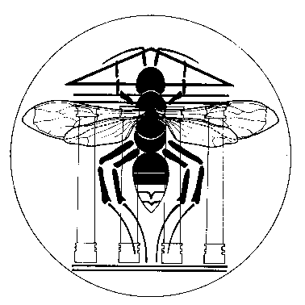
Thanks

