Slide 1
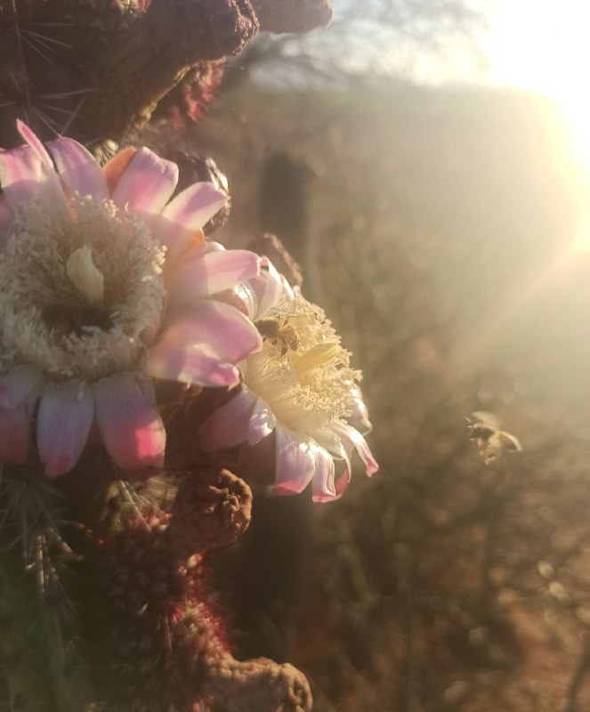
Harvest Flight Synapse of Apis mellifera on the vegetative architecture of cacti in the Sonoran desert, Mexico
Héctor Tecumshé Mojica-Zárate ¹*, Luis Miguel Campos-Cardoso²
¹Universidad de la Sierra, Moctezuma, Sonora, México, C.P 84560; hectortecumshe@gmail.com
²Universidad Central “Marta Abreu” de Las Villas, Santa Clara, Cuba. C.P. 50100; lmcampos@uclv.edu.cu
*Correspondence: hectortecumshe@gmail.com; Tel.: 00 53 (634) 3453622
†Presented at the 1st International Electronic Conference on Entomology, Online, 01 – 15 July 2021.

Slide 2
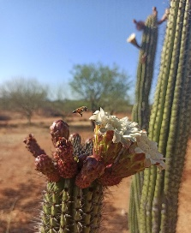
Highligths about the Abstract
"Harvest Flight Synapse (HFS)" refers to the way in which a pollinator communicates and interconnects the organization of a flower system through a sequence of flight performed through the space of the vegetative architecture of a plant.
The importance of the HFS is that the pollinators establish a pre-designed flight transit order on the vegetative architecture so that subsequent visitors perform a flight sequence in which they include more floral structures, ensure pollination - harvest and at the same time stimulate the flowering.
HFS prevailed initially from the east and the differences in time of stay in each column were not governed by their height or distance between them but by the number of columns with the presence of floral appendixes determined by their respective floral range and flowering scale.

Slide 3
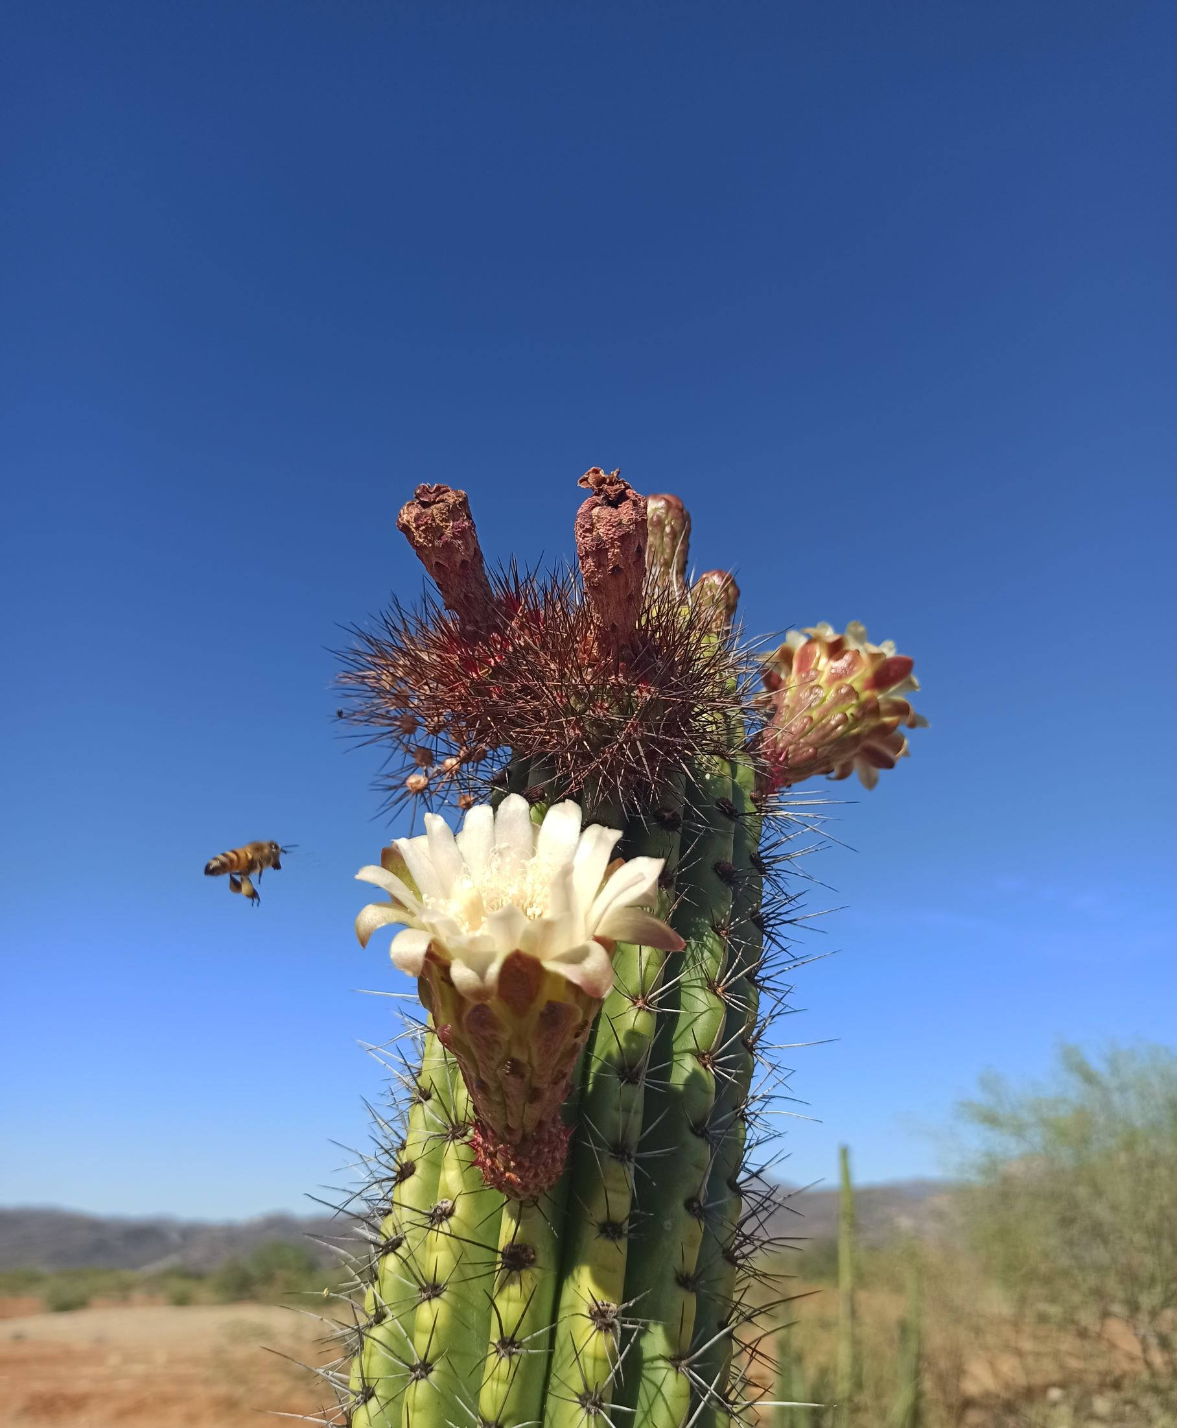
Presentation Items
1. Introducción
2. Materials and Methods
3. Results
4. Discussion
5. Conclusions

Slide 4
1. Introduction
Harvest Flight Synapse (HFS)
Makes prevail possible latent and indirectly tangible aspects
Harvest flight is not only determined by the stimulus that favors the presence of floral structures or random flight sequence
Establish an interconnection and communication among each column of the plant and its respective floral structures
Flight of the visiting bee
Represents more than a visible environmental service of harvesting and pollination
Establishes a link between the plants that the bees visit to stimulate their development
Cognitive - neuroanatomical association where predictability as well as information storage coexist

Slide 5
2. Materials and Methods
2.1. Study region and site
The study was managed in the province of Moctezuma, Sonora, México, 658 above sea level (29°42´ 01´´ N; 109° 39´ 05´´W).
The study area corresponds to a landscape of the Sonoran desert located in an intermontane valley
2.2 Graphic reference and vegetative plant architecture
A photograph was taken for each individual and the position per quadrant of its columns in a Cartesian plane was identified with respect to its individual center from its observation from the geographic south and from an aerial perspective. (Figure 1)
2.4. Descriptive analysis and interpretation of Harvest Flight Synapse model.
The magnitudes for each of the variables involved in the HFS were processed and analyzed by descriptive analysis, dispersion measures were obtained and inferential tests were performed.
2.3. Observation of flight behavior
observation to identify the Harvest Flight Synapse (HFS) consisted of the visual monitoring of the flight sequence together with the recording of the time spent by a single bee, Apis mellifera, visitor at a time on the vegetative architecture per individual of pitaya.

Slide 6
Figure 1. Location of the arid territory of Moctezuma, Sonora, Mexico.

Slide 7
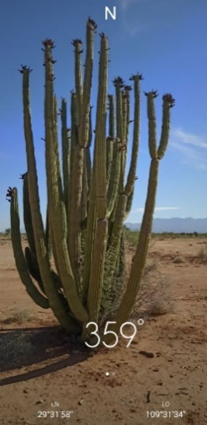
a)
b)
Figure 2. The vegetative architecture by the pitaya cactus in a Cartesian plane. a) With a perspective from the south, shows a specimen. b) This, same is visualized for the identification of the honeybee HFS from an aerial view

Slide 8
Figure 3: The flight sequence was observed in the vegetative architecture of n=21 individuals of pitaya cactus in which the flight path of three and up to five bees was analyzed, obtaining an average of time per plant, for the total of events measured per date.

Slide 9
Figure 4: The interpretation of a flight sequence model and the synaptic map of HFS is shown

Slide 10
3. Results
3.1. Vegetative architecture of Stenocereus thurberi
Height values ranged from a maximum of 5.4 meters to no less than 1.8; and amplitude of cover ranged from 0.8 to 2.4 meters
From these magnitudes, the bees arrived in the airspace from the East 64% and from the Northeast 36% at an average pitaya height of 2.40 meters
3.2 Synaptic condition for flower structures
Other elements that conditioned the HFS were: ACH, ADC and ADCIC) (maximums and minimums respectively: 3.9 - 1.4; 1.1 - 0.35 and 1.8 - 0.25 meters).
3.3. Harvest Flight Synaptic Map
The flight sequence in the harvesting flight synapse is represented by describing a Harvesting Flight Synaptic Map.
The model expresses the original flight path (OF) for the development of the harvest service as well as a relationship with the columns with flower bulbs.
A difference was identified between the time the bee spent visiting flower bulbs and the time spent visiting flowers (P < 0.05)

Slide 11
Figure 3. Vegetative architecture manifests in pitaya measurements, the total amplitude and height

Slide 12
Figure 4. Intrinsic vegetative architecture consisting of Average Column Height (ACH), Average Distance between Columns (ADC) and Average Distance between Columns and the Individual Center (ADCIC)

Slide 13
Table 1. HFS Sequence Model. Shows the floral range with residence time and priority action developed in the HFS sequence
Stay point | Time (%) | Priority action developed
Vegetative architecture limit of pitaya | 1.45 | Enter pitaya airspace
Flower range
Floral bulb | 9.88 | Close flight of flower stimulation
Flower | 72.96 | Harvest and pollination ¹
Fruit | 9.88 | close flight to stimulate maturity ²
Intercolumn airspace | 4.37 | Intercolumn flights
Vegetative architecture limit of pitaya | 1.45 | Exit pitaya airspace and departure flight
¹ Primarily in flowers with a floral scale of 100%
² Only in early stages of maturity
Figure 5. Percentage of floral appendixes present by the total of observed columns observed

Slide 14
Figure 6. Synaptic Harvest Flight Map representing pitaya in the Cartesian plane with 6 theoretical internal contacts by the visiting bee in an equal number of columns.

Slide 15
4. Discussion
4.1 The flight sequence and vegetative architecture of Stenocereus thurberi
4.2. Interconnection and communication from HFS
The synaptic map expresses an intrinsic, non-tangible relationship that interconnects the plant with each bee through a tangible stimulus [28].
HFS defines a pre-established flight sequence, columns with more bulbs or those bulbs close to flowering are integrated and an interfloral connection
This stimulus occurs when the bee travels through the growing floral structures, thus configuring an initial synapse [25].
Some authors mention Brownian or diffuse movements but we consider that there is more than a Lévy movement, it is an intangible relationship that promotes this synaptic pathway in the cactus [30, 32, 33, 35-50].
The presence of mature fruits injured by other insects or by birds modified the time in the flight sequence per bee with stays of 7± 1.18 minutes.
The HFS included flowers with flower opening scales between 5 - 25% in which the bee made a connecting flight "circling" the structure but without stopping.

Slide 16
4. Conclusions
The Apis mellifera Harvest Flight Synapse, as a behavior and as an essential element in the ecological function, maintains the reduction of risks and the level of vulnerability in the ecosystem of the Sonoran desert produced by the climatic emergency and other and varied severe conditions.
The importance of the HFS is that the pollinators establish a pre-designed flight transit order on the vegetative architecture so that subsequent visitors perform a flight sequence in which they include more floral structures, ensure pollination - harvest and at the same time stimulate the flowering.
The flower bulbs that are visited tangentially, while the adjacent flowers are visited for harvesting, stimulate their growth and development while generating a series of interconnections that suggest a "communication" and a link defined by the harvesting flight performed in an orderly sequence.
Communication and interconnection coexist in the bee-cactus relationship and allow sequencing the ecological processes in both organisms from the HFS.[Texto]

Slide 17
Very grateful for your attention !!
Héctor Tecumshé Mojica-Zárate ¹*, Luis Miguel Campos-Cardoso²
¹Universidad de la Sierra, Moctezuma, Sonora, México, C.P 84560; hectortecumshe@gmail.com
²Universidad Central “Marta Abreu” de Las Villas, Santa Clara, Cuba. C.P. 50100; lmcampos@uclv.edu.cu
*Correspondence: hectortecumshe@gmail.com; Tel.: 00 53 (634) 3453622
†Presented at the 1st International Electronic Conference on Entomology, Online, 01 – 15 July 2021.

Slide 18
Photo album
By Héctor T. Mojica

Slide 19
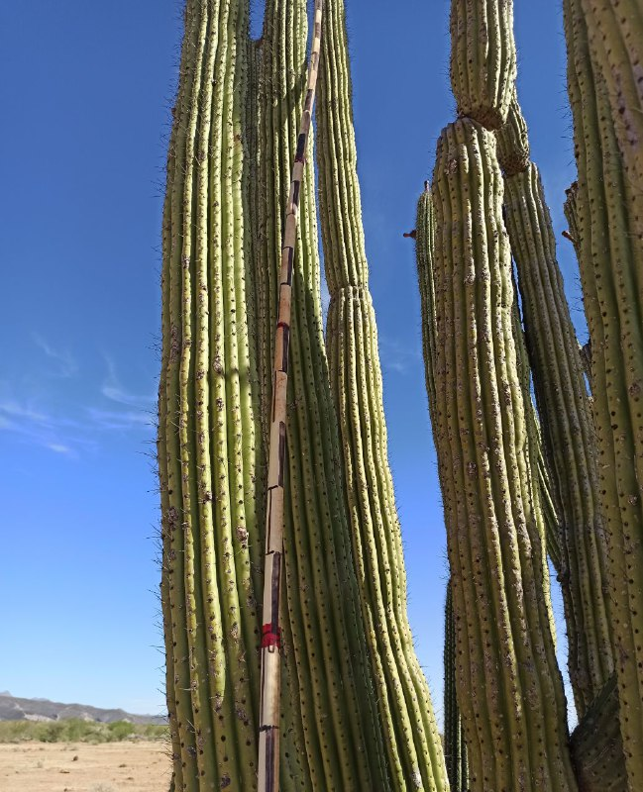
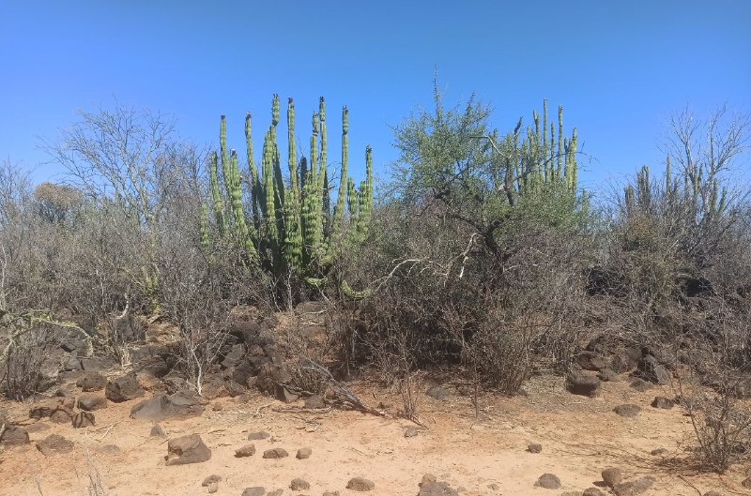

Slide 20
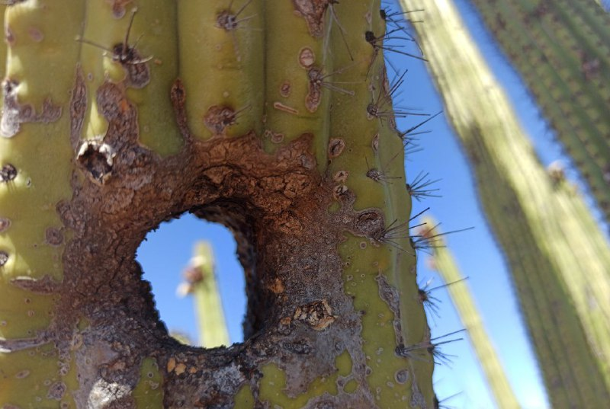
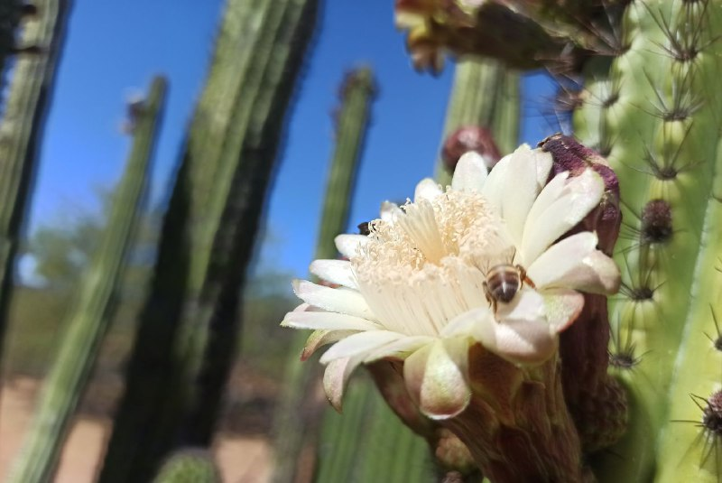

Slide 21
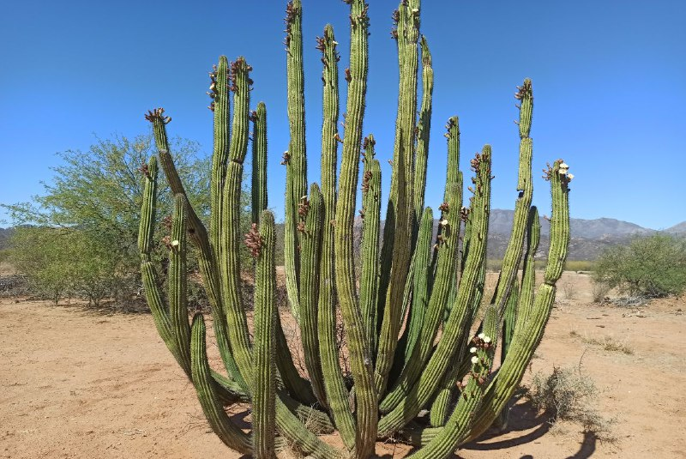
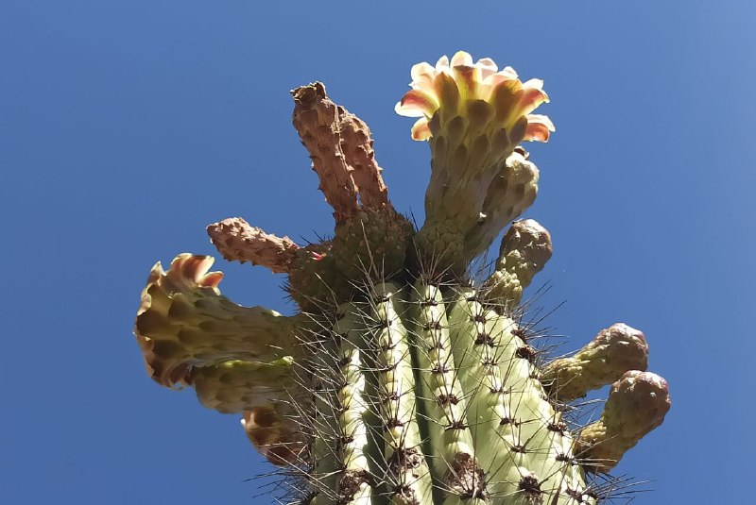

Slide 22
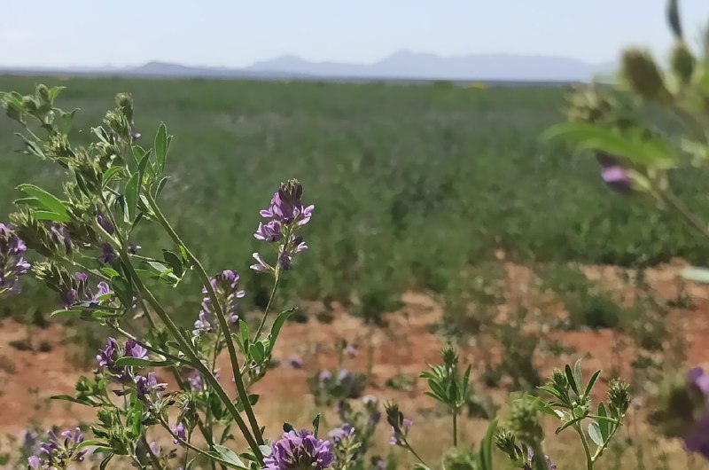

Slide 23
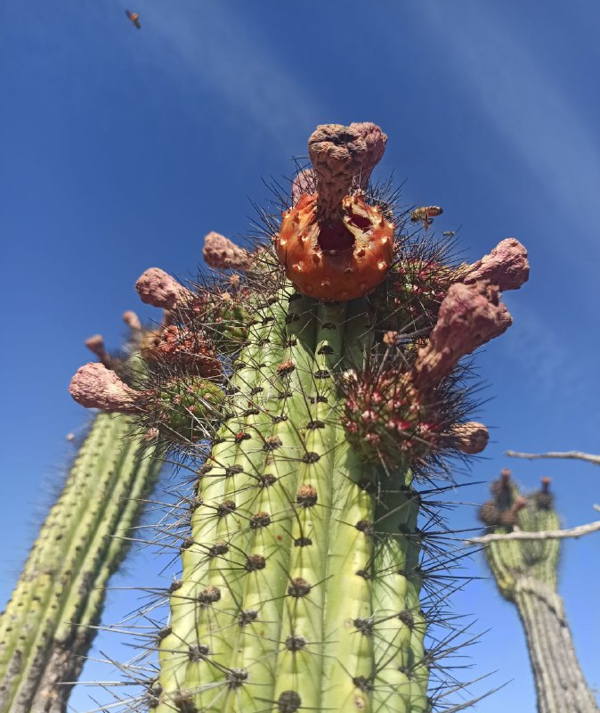

Slide 24
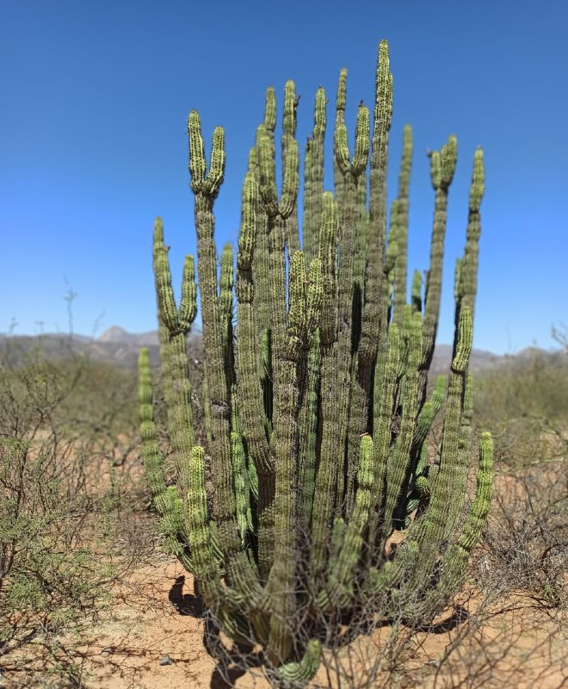

Slide 26
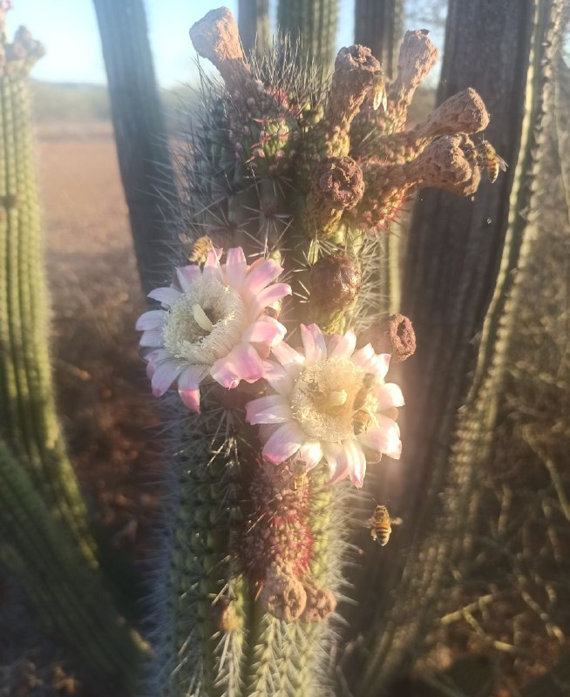

Slide 27
