Slide 1
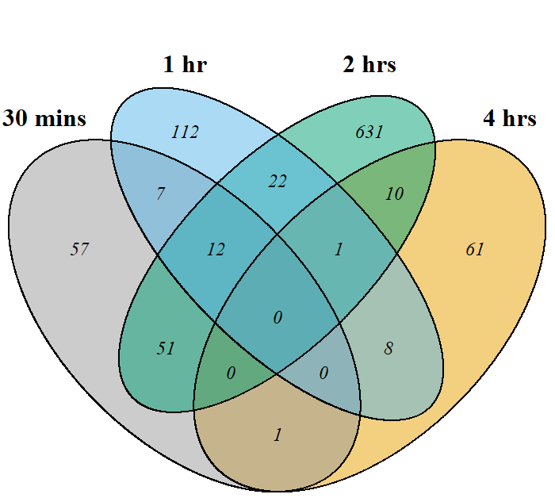
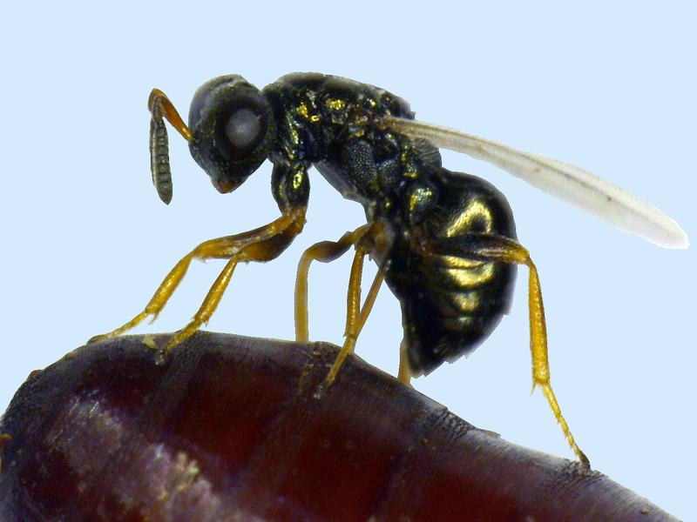
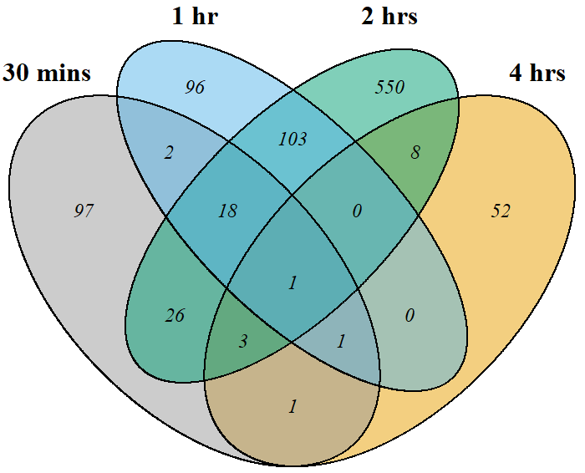
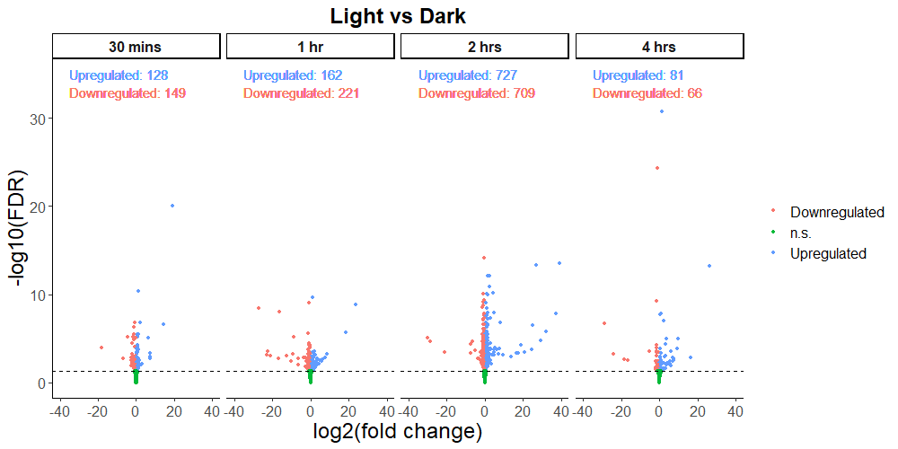
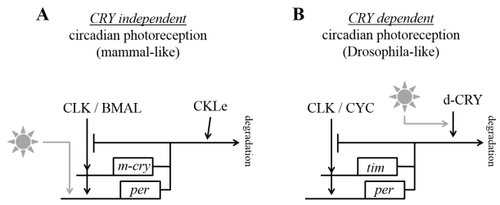
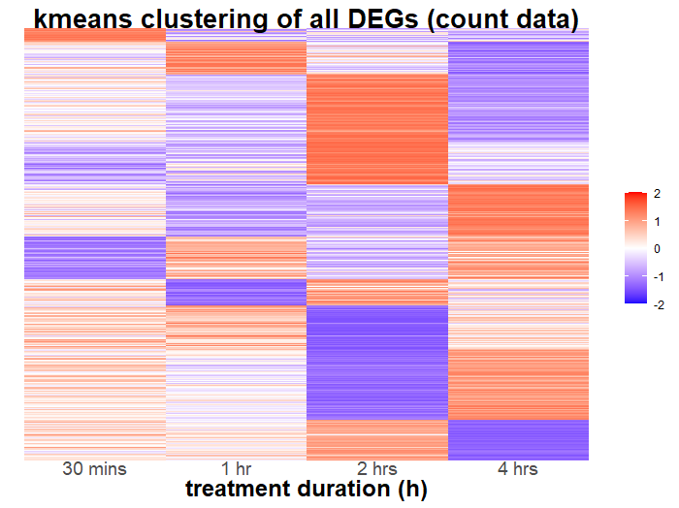
Searching for light-induced genes in hymenopteran insect - Nasonia vitripennis : transcription of 13% of the genes is regulated by light
Non-Cognitive Predictors of Student Success: A Predictive Validity Comparison Between Domestic and International Students
Searching for light-induced genes in hymenopteran insect - Nasonia vitripennis : transcription of 13% of the genes is regulated by light
Yifan Wang, Roelof Hut
Yifan Wang, Roelof Hut
Groningen Institute for Evolutionary Life Sciences, University of Groningen, The Netherlands
Yifan.wang@rug.nl
upregulated genes
Introduction:
The aims of the study is to answer:
1. What are the circadian photoreceptors in Nasonia vitripennis?
2. What is the molecular mechanism underlying light entrainment in Nasonia vitripennis?
Hypothesis:
As Nasonia has a more mammalian-like clock system with light-insensitive CRY, it is hypothesized that there is light- induced gene induction like in mammalian clock light input pathway.
downregulated genes
1891 DEgenes
Volcano plots for each light vs dark contrast
Methods:
Unmated Nasonia females entrained under 14:10 LD for a week, treatment is given on Day 8 from ZT18
Treatment: light treatment or dark control
Treatment Duration: 0.5h, 1h, 2h, 4h
Collecting head tissue (100 heads per sample)
30M 150bp paired end mRNA RNAseq by Illumina Novaseq6000☑
Gene expression peak at different time points
Results & Conclusion:
In total, 1891 genes expression level changed significantly due to the light pulse
CLOCK gene was significantly upregulated after 2 hrs of light pulse
two interesting pathways: juvenile hormone and rhodopsin
Gene set enrichment analysis and pathway analysis still need to be done for more insight into the light entrainment pathway in Nasonia
Gene expression dip at different time points
ZT20
ZT21
ZT18
ZT19
Notes:
Zoiets wellicht, met het vogeltje? Let op, het is even snel geknipt en geplakt – als je het erin laat zou ik het even overnieuw doen met een betere resolutie et al.
Misschien is het niks, plus de methoden moeten er nog in. Maar is een ideetje om het Plaatje er verder in te verwerken. Beetje creativiteit van de Keizer.

