Slide 1
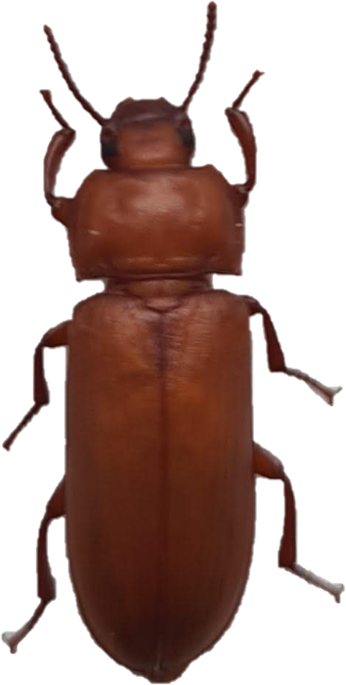
The effect of (E,E)-2,4-decadienal,
(E)-2-decenal, 2-undecanone and furfural on reproduction of Tenebrio molitor
Justyna Mirek, Karolina Walkowiak-Nowicka, Małgorzata Słocińska
Department of Animal Physiology and Development, Institute of Experimental Biology, Faculty of Biology, Adam Mickiewicz University in Poznań, Poznań, Poland
Introduction
Natural origin compounds such as plant-derived substances containing plants secondary metabolites show great potential as bioinsecticides. They are safe for the environment, biodegradable and widely available. Moreover, they exhibit broad biological activity, and might be used as such as insecticides, nematicides, fungicides, nematicides and ovicides. They are also able to inhibit food intake or the growth and development of insects. Because insects can produce many eggs, oogenesis and oviposition could be the worthwhile aim of pest control.
Materials & methods
We used compounds in 2 concentrations: 10-5 and 10-7 M injected into an adult females Tenebrio molitor. In the research, we took ovarian development and reproduction parameters into account and assessed the volume of terminal oocytes,
the number of eggs laid and larvae hatching.
Follicle epithelium
Changes in the volume of terminal oocytes
10⁻⁵ M
10⁻⁵ M
10⁻⁷ M
(E,E)-2,4-decacienal
furfural
Control group
2-undecanone
(E)-2-decenal
The numer of laid eggs / female
Results
The application of (E)-2-decenal, furfural, 2-undecanone and (E,E)-2,4-decadienal caused changes in the volume of terminal oocytes. We showed a significant decrease in the volume of terminal oocytes after application of 2-undecanone at concentration 10⁻⁵ M and an increase for (E,E)-2-4-decadienal after furfural treatment. In the lower concentration of chemicals, we noted a gentle drop in the volume of terminal oocytes only after (E)-2-decenal. In each case, the follicle epithelium was well developed. We observed a gentle decrease in the number of laid eggs by females for each of the tested compounds. However, statistical analysis showed significant change only for 2-undecanone at the lower concentration of 10⁻⁷ M. Moreover, the application of tested compounds at both concentration caused a decrease in the number of hatched larvae. We show significant results in each case, except 10⁻⁷ M
(E)-2-decanal.
10⁻⁵ M
10⁻⁷ M
Changes in larvae hatchability
10⁻⁵ M
10⁻⁷ M
Conclusions
Our results suggest that (E,E)-2,4-decadienal, 2-undecanone, furfural and (E)-2-decanal show ootoxic and embryotoxic properties.

