Slide 1
A comparison of ground beetle assemblages (Coleoptera: Carabidae) between birch forests of continuous and isolated peat bog habitats in Belarusian Lake District
Gennadi Sushko
Vitebsk State University,
Department of Ecology and Geography,
Vitebsk, Belarus;
gennadisu@tut.by

Slide 2
Introduction
Largest in Central Europe ancient and almost intact Belarusian peat bogs are habitats with very specific environmental conditions and biodiversity. Many peat bog dwellers have habitat requirements, such as nutrient poor and acidic conditions, specific subarctic or boreal host plants. As a result, European peat bogs formed habitat islands which rise up to several meters by accumulation of sphagnum peat above the level of the surrounding landscapes. In Belarus they are extend over thousands of hectares and rise up to 5-7 meters.
The theory of island biogeography predicts the effects of habitat isolation and size on species richness and persistence and community composition. It is known that in isolated habitats species richness generally increases with habitat size and heterogeneity. Probably, peat bog ground beetles can follow this pattern.
In addition, the carabid morphology and species traits can also be changed. Body size is an essential proxy for the adaptation, various physiology and life-history parameters, and is also linked to spatial distribution. Changes in body size distribution within assemblages are one of the most fundamental responses to island environments. Carabid beetles are different according to their wing morphology. Brachypterous or short-winged species have lower dispersal ability, while macropterous or winged species are better at dispersal. As a result, wing morphology plays an important role for ground beetle spatial distribution.

Slide 3
The present study aimed to investigate the ground beetle diversity patterns and main species traits in isolated peat bog birch forests and adjacent continuous birch forests.
In this study, I expected the following:
there are significant differences in species richness, abundance, and diversity of ground beetle assemblages between isolated peat bog birch forests and adjacent continuous birch forests;
a lower abundance of forest specialists in the isolated peat bog birch forests, in which more generalist and specialized peat bog species from the surrounding peatlands, could be expected than in adjacent continuous birch forests;
carabid body size and wing morphology vary significantly in the isolated peat bog birch forests and adjacent continuous birch forests.

Slide 4
Materials and Methods
Study sites:
BFI - Isolated birch forests (Betuletum myrtillosum) on the mineral soil islands within the peat bog covered by Betula pubescens. The understory vegetation contains predominantly Vaccinium myrtillus. Also here Vaccinium vitis-idaea, Festuca ovina, Calamagrostis epigeios, Melampyrum prаtense were occurred. The area of such mineral soil islands was less than 1 hectare.
BFP - Isolated birch forests (Betuletum ledo-sphagnosum) on the peat soil are located at the bog margin. Besides containing Betula pubescens, such forests supported a more heterogeneous plant community characterized by sphagnum mosses, ericaceous dwarf shrubs such as Ledum palustre, Chamaedaphne calyculata, Calluna vulgaris, Vaccinium oxycoccus, and as well as Eriophorum vaginatum, occurs. The area of such birch forests was about 1 hectare.
BF - The adjacent continuous birch forests (Betuletum myrtillosum) on the mineral soil outside peat bogs were covered predominantly by Vaccinium myrtillus. Also here Vaccinium vitis-idaea, Festuca ovina, Melampyrum prаtense, and Convallaria majalis were occurred. This forest type are homogenous stands large (˃2 ha) and were at least 500 m apart and at least 100 m from peat bog.
The study was conducted in the Belarusian Lake District (Northern Belarus). This postglacial
region contains the most intact peatlands, both in Belarus and in Central Europe as a whole.
Peat bogs occupy 185 thousand hectares within of the Belarusian Lake District.
The research was carried out in large pristine peat bog Boloto Moh of 4602 hectares,
which is protected as hydrological reserve (coordinates: 55°37' N 28°06' E) and adjacent
continuous birch forests.
Figure – Map showing the location of the study sites

Slide 5
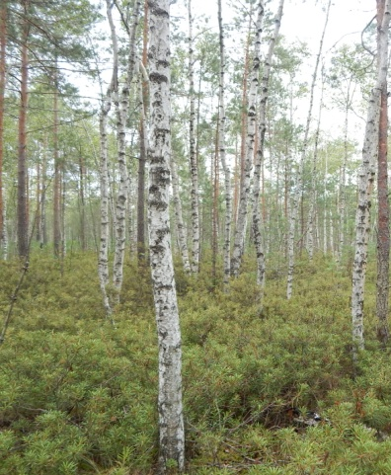
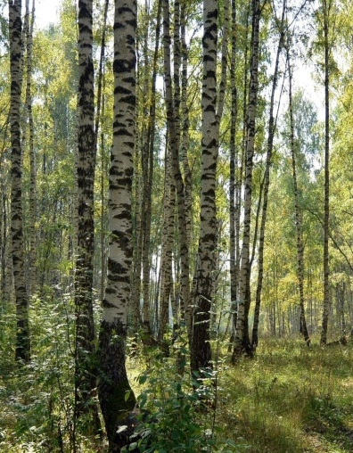
Carabid sampling
The study was conducted in 2020. Carabids were sampled using pitfall traps in the form of plastic cups (250 cm³) with a preservative liquid (100 ml of 11% vinegar solution and 10 g of NaCl). Each treatment was repeated 5 times in each of the 3 forest type. In total 15 research sites were selected. On each site 5 traps were placed 5 m apart. The traps were checked at 10–14 day intervals. Pitfall trapping was started in the first half of April and all traps were removed at the beginning of November. Ground beetle species were identified according to Freude et al. (2004)
Isolated birch forest
(Betuletum myrtillosum)
Data analysis
Habitat association of carabid species was determined on the basis of main habitat preference: habitat generalists, peat bog, forest and open habitats. Ground beetles were classified according to mean body sizes into following categories: small (0–5 mm), medium (6–10 mm), large (11–15 mm) and largest (˃15 mm). The degree of hind wing development was defined as: brachypterous (short or no wings), macropterous (long wings), and dimorphic (both forms present). Data about habitat preferences, body size and wing morphology were gathered from Freude et al. (2004), Aleksandrowicz (2014) and personal measurements.
To estimate the potential number of species, the estimators Chao 2 and Jackknife 2 were used. To examine the carabid diversity, Shannon (H’) and Pielou’s evenness (J’) indexes were calculated. Prior to the analyses, the data were tested for normality using Shapiro–Wilk normality test. Differences of ground beetle species richness, abundances, Shannon–Wiener diversity, habitat preferences and morphological characteristics were examined using Kruskal–Wallis test with Dunn’s post hoc test (the level of significance P < 0.05, tests with Bonferroni correction). Non-metric multidimensional scaling (NMDS) based on the Bray-Curtis similarity index and analysis of similarity test (ANOSIM) were applied to assess assemblage composition at the different forest types. Analyses were performed in R software and Past
Isolated birch forest (Betuletum ledo-sphagnosum)
Continuous birch forest
(Betuletum myrtillosum)

Slide 6
Results A total of 2,354 individuals belonging to 39 carabid species were collected. The mean species richness differed significantly among the carabid assemblages of the three birch forest types. The lowest mean number of species in BFP (7.0±0.54) was recorded, whereas in the BF (14.87±0.96) and in BFI (17.61±0.87) the numbers of species were similar. The non-parametric species richness estimators Chao 2 and Jackknife 2 showed expected species richness that is close to the actual number of observed species. The estimator Chao 2 showed that the mean number of carabid species in the studied birch forest types was 9.80-33.14 species suggesting that the observed total of 9-28 species represented 84.49% to 99.59% of the recorded species richness. The estimator Jackknife 2 showed that the mean species richness was 11.80-39.30 species suggesting that the observed number species represented 71.79% to 99.59% of the recorded species richness.
Figure. Species richness in carabid beetle assemblages of studied birch forest types: BF – continuous birch forests, BFI – isolated birch forests on the mineral soil, BFP – isolated birch forests on the peat soil. Differences among habitats were tested using the Kruskal-Wallis test. The letters (a, b, c) indicate significant differences (post-hoc Dunn's test; P<0.05).

Slide 7
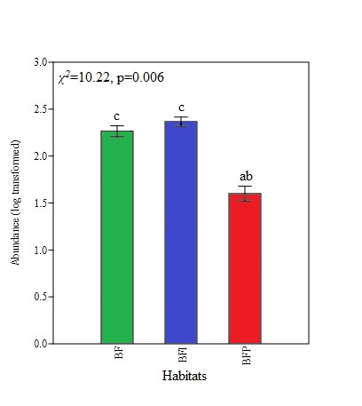
The mean abundance differed significantly among the carabid assemblages of the three birch forest types. The lowest mean number of individuals in BFP (42.2±6.40) was recorded, however the mean abundance in the BF (190.0±23.26) and in BFI (238.6±25.37) not differed significantly (Dunn’s post hoc test p ˃ 0.05). The six most abundant species in BF were Carabus granulatus (25.63 %), Pterostichus niger (24.68 %), Poecilus versicolor (18.03 %), Carabus cancellatus (12.13 %), C. hortensis (5.27 %), Amara communis (5.16 %). The four most abundant species in BFI were Amara communis (44.96 %), Calathus micropterus (15.60 %), Amara brunnea (12.33 %), Pterostichus niger (10.06 %). Among abundant species in BFP were Agonum ericeti (34.59 %), Pterostichus diligens (20.37 %), P. rhaeticus (19.90 %), Poecilus cupreus (11.37 %) and Pterostichus niger (7.58 %). Of these, the only Pterostichus niger was generally abundant across all three birch forests types. Whereas, other recorded species were abundant only in one of forest types.
Figure. Abundance in carabid beetle assemblages of studied birch forest types: BF – continuous birch forests, BFI – isolated birch forests on the mineral soil, BFP – isolated birch forests on the peat soil. Differences among habitats were tested using the Kruskal-Wallis test. The letters (a, b, c) indicate significant differences (post-hoc Dunn's test; P<0.05).

Slide 8
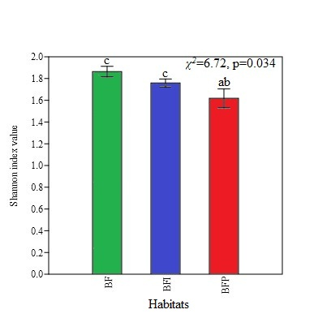
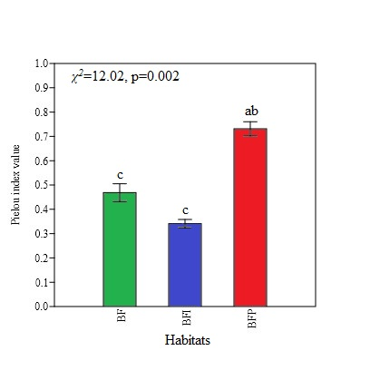
Diversity. The mean values of Shannon index differed significantly (Kruskal–Wallis test, χ²=6.72, p=0.03) among the carabid assemblages of the three birch forest types. The lowest index value was recorded from the BFP (H′= 1.618±0.08). The mean Shannon index ranges in the BF (1.916±0.04) and in BFI (1.781±0.03) not differed significantly (Dunn’s post hoc test p ˃ 0.05) (Figure a). In contrast, the Pielou evenness index was highest in the BFP (J = 0.731) and low in BFI (J = 0.340) and BF (J = 0.468) (Figure b).
a
b
Figure. (a) Shannon index and (b) Pielou index values in carabid beetle assemblages of studied birch forest types: BF – continuous birch forests, BFI – isolated birch forests on the mineral soil, BFP – isolated birch forests on the peat soil. Differences among habitats were tested using the Kruskal-Wallis test. The letters (a, b, c) indicate significant differences (post-hoc Dunn's test; P<0.05).

Slide 9
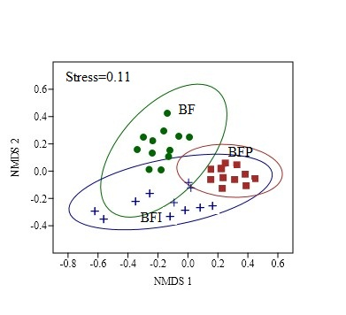
Species composition. NMDS ordination (stress: 0.11) showed a clear separation of ground beetle species composition. The assemblages sampled in the BFP were all more similar to BFI. On the other hand, BFP and BF were the most different (Figure 3). The ANOSIM was performed to test the significance of forest type in forming the ground beetle species composition. A significant difference in carabid species composition was detected (ANOSIM, R=0.893, P <0.001).
Figure. NMDS-ordination diagram of the carabid beetle assemblages of studied birch forest types: BF – continuous birch forests, BFI – isolated birch forests on the mineral soil, BFP – isolated birch forests on the peat soil.
Table. Statistical significance of the differences in carabid beetle assemblage composition (999 permutations) based on
ANOSIM test.
Habitats | P-level
BF vs BFI | 0.008
BF vs BFP | 0.009
BFI vs BFP | 0.008

Slide 10
According to habitat preferences, BF and BFI were dominated by individuals of forest species. Nevertheless, abundances of open habitat species (in BF) and generalists (in BFI) were high as well. The proportion of individuals belonging to the forest specialists significantly increased in BFI, and the opposite was observed for open habitat dwellers. Least of all forest dwellers in BFP were found. These habitats were dominated significantly by peat bog specialists (Dunn’s post Hoc test, P < 0.05).
a
b
c
Figure. Plots of the distribution of habitat preferences of carabid species of studied birch forest types: (a) continuous birch forests, (b) isolated birch forests on the mineral soil, (c) isolated birch forests on the peat soil.

Slide 11
In terms of morphological characteristics, carabid assemblages of all studied birch forests were dissimilarly. The BF dominated significantly by individuals of largest body size category, while the BFI and (Kruskal–Wallis test, χ²=6.72, p=0.03) BFP were dominated by medium-sized individuals.
a
b
c
Figure. Plots of the distribution of traits of carabid species of studied birch forest types: (a) continuous birch forests, (b) isolated birch forests on the mineral soil, (c) isolated birch forests on the peat soil.

Slide 12
According to the degree of hind wing development in the BF the most of the individuals were brachypterous. The BFI was equally dominated by macropterous and brachypterous individuals. In the BFP abundance of dimorphic, macropterous and brachypterous individuals not differed significantly (Dunn’s post hoc test p ˃ 0.05).
a
b
c
Figure. Plots of the distribution of degree of hind wing development of carabid species of studied birch forest types: (a) continuous birch forests, (b) isolated birch forests on the mineral soil, (c) isolated birch forests on the peat soil.

Slide 13
Conclusion Carabid abundance, species richness and diversity significantly decreased only in Betuletum ledo-sphagnosum forest type compared to continuous forest, while in another isolated forest type such as Betuletum myrtillosum and in continuous forests these parameters were similar. This pattern may be caused by more extremely microclimatic and soil conditions of peat bog sphagnum cover such as strong acidity, moisture and temperature variation. Apparently higher habitat stability in the forested sites without sphagnum cover on the mineral soil within peatland can affect the more favorable conditions for ground beetles. As a result, in these habitats and in continuous birch forests diversity parameters were similar. The species composition of the ground beetles, both continuous and isolated habitats, differed significantly. In terms of dominant species composition, differences between isolated and continuous birch forest were revealed even clearer. Only one species Pterostichus niger was generally abundant across all birch forests types, both isolated and continuous. Whereas, other recorded dominant species were abundant only in one of forest types. Carabid assemblages of birch types covered by sphagnum mosses were the most different compared to other. There is a clear increase of the abundances of forest species from continuous to isolated Betuletum myrtillosum forest type. Whereas in another isolated Betuletum ledo-sphagnosum type. In isolated forests, a gradually decrease of the abundances of large-sized and brachypterous species and increase of medium-sized beetles were recorded. The abundance of macropterous species was the most abundant only in isolated Betuletum myrtillosum forest type, and thus they are having a higher dispersal power.

Slide 14
Thank you for the attention

