Slide 1
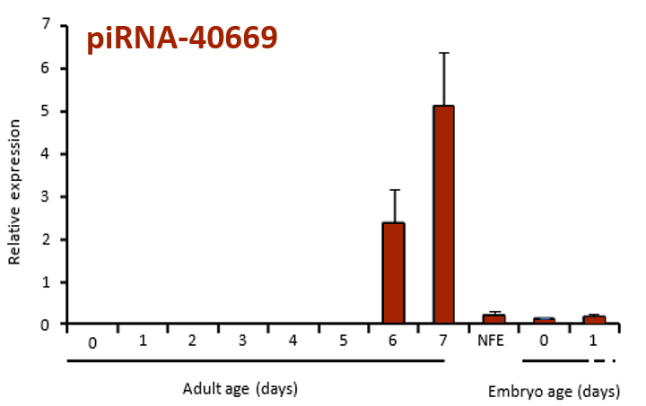
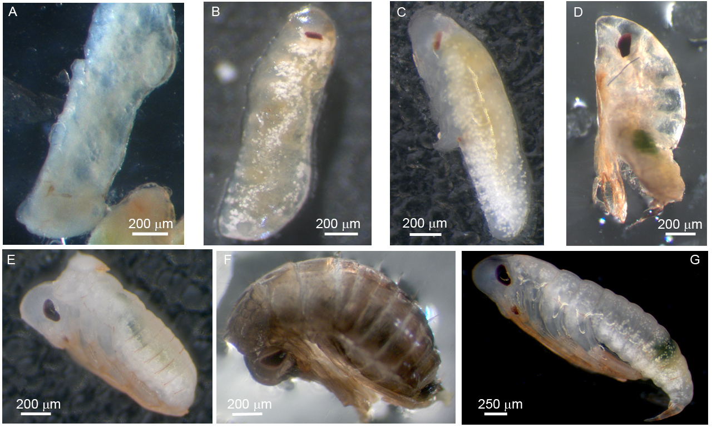
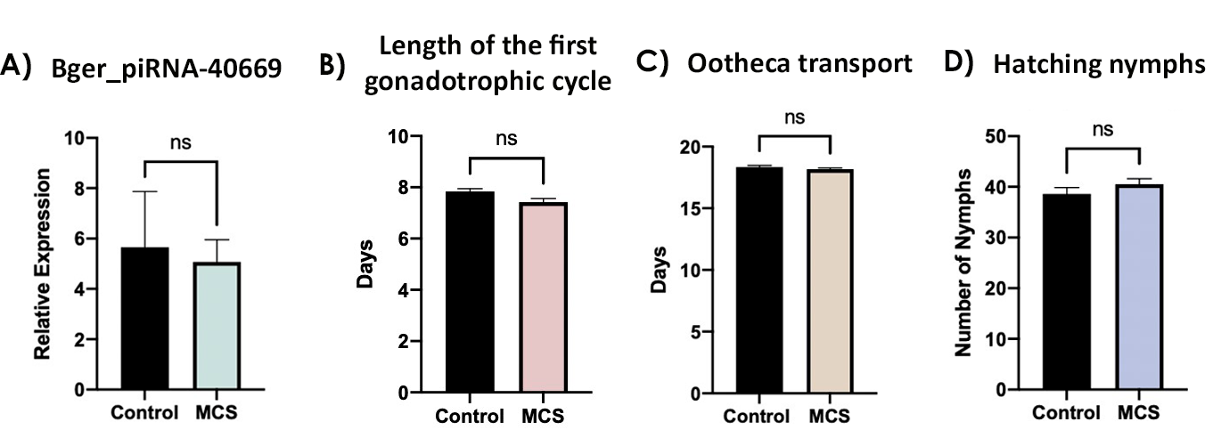
piRNA FUNCTION IN INSECT OOGENESIS
Lancho-Exposito, A.^{1,} Paniello, O.^{1,} Bau, J.^{2,} Piulachs, M.D.¹
¹Insitute of Evolutionary Biology (CSIC-Pompeu Fabra University), Barcelona, Spain
²Department of Biosciences, Universitat de Vic - Central University of Catalonia, Vic, Spain
Syn-40669
Piwi-interacting RNAs (piRNAs) is a class of small non-coding RNAs (sncRNAs) poorly conserved across species. The first function to be associated to piRNAs was the repression of transposable elements (TE) expression in early embryogenesis. However, there is growing evidence for other functions, especially for the role of piRNAs in the regulation of mRNA expression.
Using the cockroach Blattella germanica as a model, we studied the function of piRNA-40669 (5’-UCCACGACGAUAAUAUUCUCUGUAAUGUC-3’), a piRNA specific to this species. This sequence is present only once throughout the genome and is not targeting at any transposon.
In adult females, the piRNA-40669 is expressed in ovary at a very specific moment of the gonadotrophic cycle, just before oviposition (Fig. 1), and is maternally provided to the embryo.
In B. germanica Syn-40669 treated females the length of the first gonadotrophic cycle (days) was advanced one day compared to MCS-treated females.
In the apical pole of basal ovarian follicles, the follicular cells have closed the intercellular spaces (Fig. 3), suggesting changes in polarity or in chorion formation.
DAPI
TRITC
Merge
DAPI
TRITC
Merge
Fig. 3: Basal ovarian follicle from 6-day-old adult B. germanica, treated with MCS (A-C) or Syn-40669 (D-F). Scale bars: 50 µm
In most of the Syn-40669-treated females the embryos do not hatch at the end of the embryogenesis. The oothecae of these treated females were opened two days after embryos hatch in MCS females, and embryos analyzed.
Around half of the embryos displayed similar morphology to that of normal embryos (Fig. 4G), but the rest showed a great variety of phenotypes. We found embryos that stopped development very early (Fig. 4A), that presented incomplete segmentation (Fig. 4B), with the legs and antennae not fully developed (Fig. 4C), or with anomalies in the eyes formation (Fig. 4B and C). In addition, some of the embryos that attained a more advanced development stage, were found to present an irregular growth of some body parts (Fig. 4D and E), or to have completed the cuticle chitinization process within the ootheca (Fig. 4F).
Fig. 1: Relative expression of piRNA-40669 in Blattella germanica adult ovaries, in a non-fecunded egg (NFE) showing the maternal provision of piRNA-40669 to the embryo, and at the first 2 days of embryogenesis. Data is presented as copies of piRNA-40669 per 1000 copies of U6. Each value represents three biological replicates, and is expressed as Mean ± S.E.M. (Data from Paniello and Piulachs, unpublished)
Our purpose is to study the possible function of this piRNA by injecting it to females, right after the final molt to adult, when it is not naturally expressed. The effect of this untimely increase of the piRNA levels will be assessed resulting by observation of oviposition time and embryo development phenotypes.
Newly molted adult females were treated with 1µL of 1mM solution of a synthetic piRNA-40669 (Syn-40669) with a phosphate group at the 5' end and a 2’-O-methylated at 3’ end.
As a negative control an unspecific oligonucleotide was used, based in the sequence of five restriction enzyme target sites:
MCS: 5’-UCUAGAAAGCUUGGUACCGGAUCCCAGGU-3’
MCS as a negative control
The treatment with the MCS, do not determined unspecific results
Fig. 4: Some of the phenotypes observed in embryos unhatched in oothecae from females treated with Syn-40669.
Fig. 2: A. Relative expression levels of piRNA-40669 in animals treated with water (Control) or with MCS (mean ± S.E.M). qRT-PCR was carried out with RNA from 7-day-old adult ovaries(ADd7) and represent six biological replicates. Data represents copies of piRNA per 1000 copies of U6 (relative expression). B. Effect of MCS on B. germanica reproduction. 5-day-old adult females were treated with water or MCS. Length of the first gonadotropic cycle (Days). C. Days of ootheca transport (embryogenesis). D. Number of nymphs hatching. Data represent 12 biological replicates and are expressed as mean ± S.E.M., ns indicates no significant differences (p-value > 0.05).
Our results demonstrate that is possible to modify the piRNA expression in insects. We show that the piRNA-40669 has a specific function in ovarian follicle development, regulating the expression of some mRNAs key for B. germanica embryogenesis. Future work will be directed to analyze the possible mRNA targets and the interplay between mRNAs and piRNAs.
Acknowledgment
Financial support from the Ministry of Science and Innovation, Spain for grant CGL2016-76011-R that also received financial assistance from the European Fund Economic and Regional Development (FEDER) and from the Catalan Regional Government (grant 2017 SGR 1030) are gratefully.
Notes:
#1DF3F3 color cycle piRNA

