Slide 1
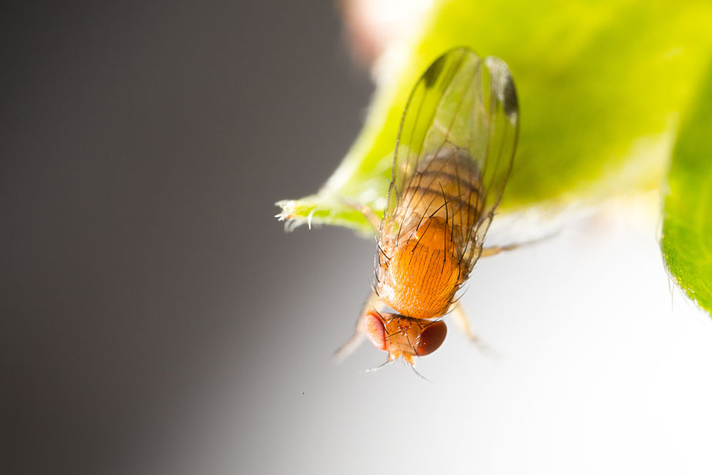




Effects of combined administration
of bacteria pathogens to the spotted wings Drosophila (Drosophila suzukii)
Maristella Mastore, Sara Caramella
and Maurizio Francesco Brivio.
Lab of Comparative Immunology and Parasitology, DiSTA, Varese, Italy – email maurizio.brivio@uninsubria.it

Slide 2
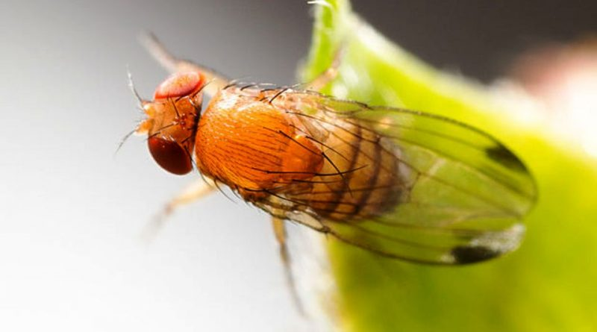
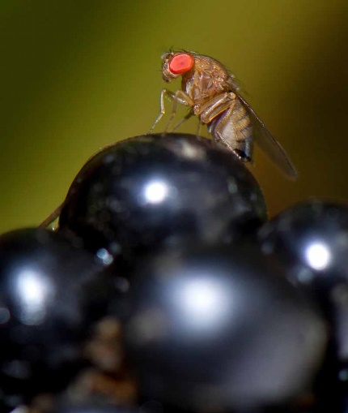
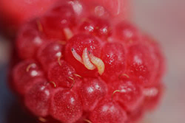
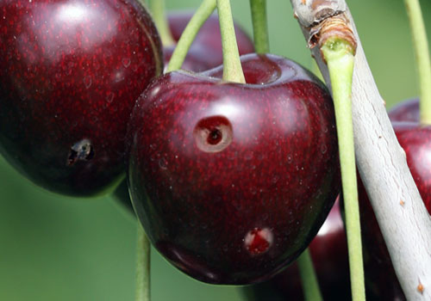
Drosophila suzukii (Matsumura)
D. suzukii, or spotted wing drosophila, it is native to south-eastern Asia, and has spread widely in America and Europe since 2008/2009, its life cycle, which occurs in thin-skinned fruit at the ripening stage, has caused severe yield losses in many crops.
Sources Images from: 1) https://gardenerspath.com/how-to/disease-and-pests/spotted-wing-drosophila-control/ Photo via Alamy
2) https://www.andermattbiocontrol.com/sites/pests/spotted-wing-drosophila.html Photo by Andermatt biocontrol
3) https://extension.colostate.edu/topic-areas/insects/5-596-spotted-wing-drosophila-management-home-plantings/

Slide 3
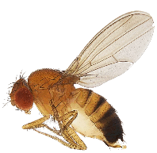
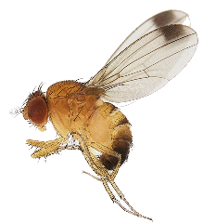



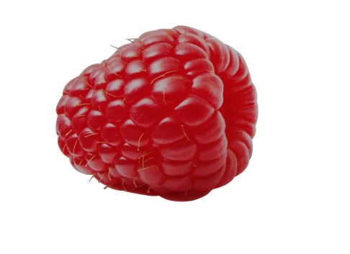
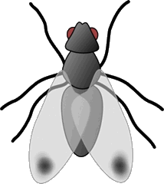


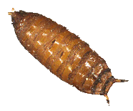

Life cycle of the spotted wing Drosophila
Fertilization
Oviposition
Eggs
(12-72h)
Three larval instars (5-7d)
Pupae (4-15d)
Adult

Slide 4

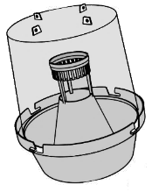

Common methods of control of D. suzukii
Chemical control
Insecticides
Physicochemical methods
Physical barriers
Pheromones Traps
Dissuasive compounds
Biological Control
Spiders
Wasps
Fungi
Bacillus thuringiensis
Nematodes

Slide 5
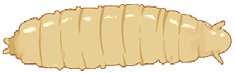
Biological control by means of entomopathogen bacteria
In this report we are presenting preliminary data on the effects of a combination of B. thuringiensis (Bt) and Xenorhabdus nematophila (Xn), or its secretion (Xn_{sec}), on the early instar larvae of D. suzukii.
Bt+Xn
We analyzed the lethality rate of the D. suzukii larvae and the effects on the larvae gut after Bt administration.
Bt
Xn
Xn_{sec}
Bt+Xn_{sec}
Lethality rate
Gut morphology

Slide 6
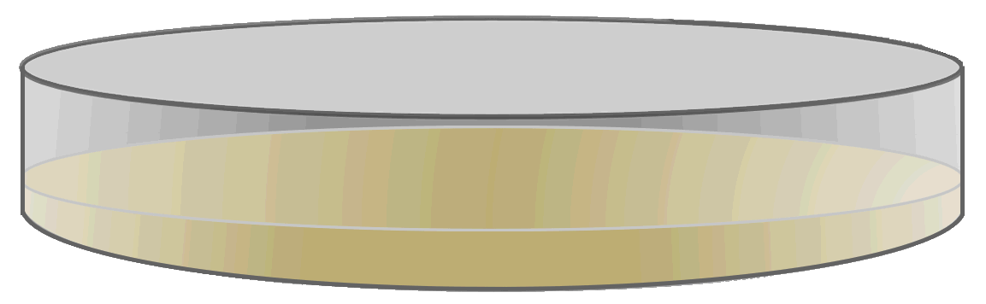


Oral administration by Agar Trap method
Early instars larvae were placed on Agar-sucrose in a Petri dish.
Bt, Xn or Xn secretions were added to the trap;
bioinsecticides were administered both in single
or in combination
Mortality rate and effects on the larvae gut were
evaluated at various times (16-24-32 and 48h)
Bioinsecticides

Slide 7
B. thuringiensis action
To infect insect hosts, Bt is taken with oral feeding and in the gut must overcome various physical barriers, such as the gut peritrophic membrane, epithelium, commensal microbiota, and peristalsis.
Bt reaches the insect hemolymph through the action of toxins crystallized in the spore; toxins, such as Cry1 and Cyt, have a strong affinity for membrane receptors of gut epithelial cells.
Their binding alters intestinal permeability by damaging cells and opening the pathway to the target insect's hemocoelic cavity.
bacteria spread

Slide 8
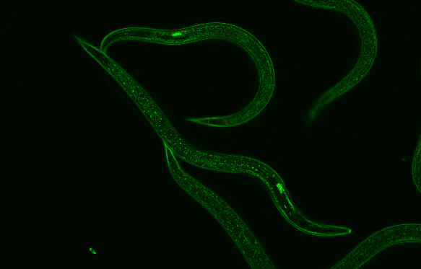
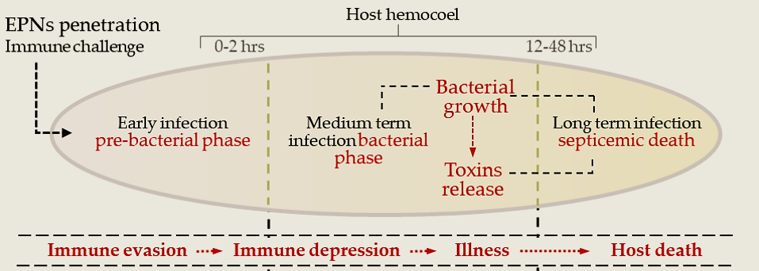
Entomopathogen nematodes (EPN) and their symbionts bacteria
EPNs (Steinernema spp.) live in symbiosis with Xenorhabdus spp. bacteria in the gut. After penetration, bacteria are released in the host hemolymph and contribute to the death of the insect target.
Before bacteria release, the nematode eludes and depresses the host immune response, then symbionts proliferate in the hemolymph and releasing toxins (secondary metabolites) lead to the death of the host by septicemia
Bacteria release
GFP-Xn inside Steinernema gut

Slide 9

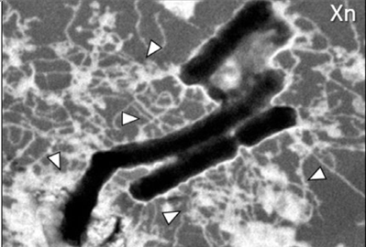

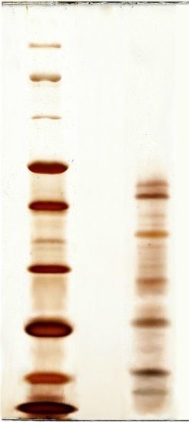
Isolation, cultures, and harvesting of X. nematophila secretions
Symbiotic bacteria were isolated from Steinernema carpocapsae nematodes, then secondary metabolites were obtained from bacteria cultures.
Secretions (Sec_{Xn}) were obtained by 24h cultures of isolated X. nematophila
Cultured X. nematophila
150
100
70
The protein content of Xn secretions was analyzed
by SDS-PAGE
S: standard molecular weights, M: culture medium,
Sec_{Xn}: X. nematophila secretions
45
50
42
40
35
28
30
21
20
16
15
12
10
S M Sec_{Xn}

Slide 10
Preliminary tests were carried out by single administration of bioinsecticides
Bt Xn Xn_{sec}
The results showed moderate efficacy of both Bt and Xn, whereas Xn secretions did not induce high mortality rate. However, in all tests significant effects were obtained only with treatment times longer than 32 hours.

Slide 11
Then we carried out the combined administrations to D. suzukii larvae
B. thuringiensis plus X. nematophila
B. thuringiensis plus Xn secretions
B. thuringiensis and X. nematophila
were added concurrently to Agar traps and the lethal effects were evaluated at various times.
B. thuringiensis and X. nematophila secretions were added concurrently to Agar traps and the lethal effects were evaluated at various times.
The data obtained from the combination of bioinsecticides show that, compared to single administrations, there is a significant increase in mortality, and above all, there is a high effectiveness in a considerably shorter time.

Slide 12
A possible interference between the two pathogens have been investigated by co-cultures in the presence of their secretions
The presence of Xn secretions (obtained after 24 h of culture)
affects drastically the growth of B. thuringiensis after 3h of treatment.
Bt cultured in the presence of Xn secretions
 | CFU/mL (means ± SE n=3)
Bt t3* | 6.65 x10⁶ ± 1.3x10⁵
Bt+Sec_{Xn} | 2.08x10⁶ ± 7.0x10⁴
*t3= 3h treatment
Xn cultured in the presence of Bt secretions
 | CFU/mL (means ± SE n=3)
Xn t3 | 2.2 x10⁶ ± 3.9x10⁵
Xn+Sec_{Bt} | 2.1x10⁶ ± 3.2x10⁵
While Bt secretions do not significantly affect the growth of X. nematophila
*t3= 3h treatment

Slide 13
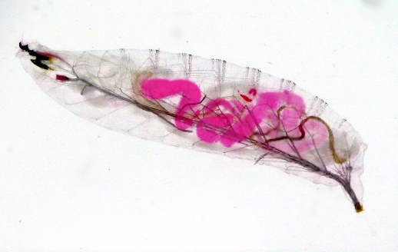

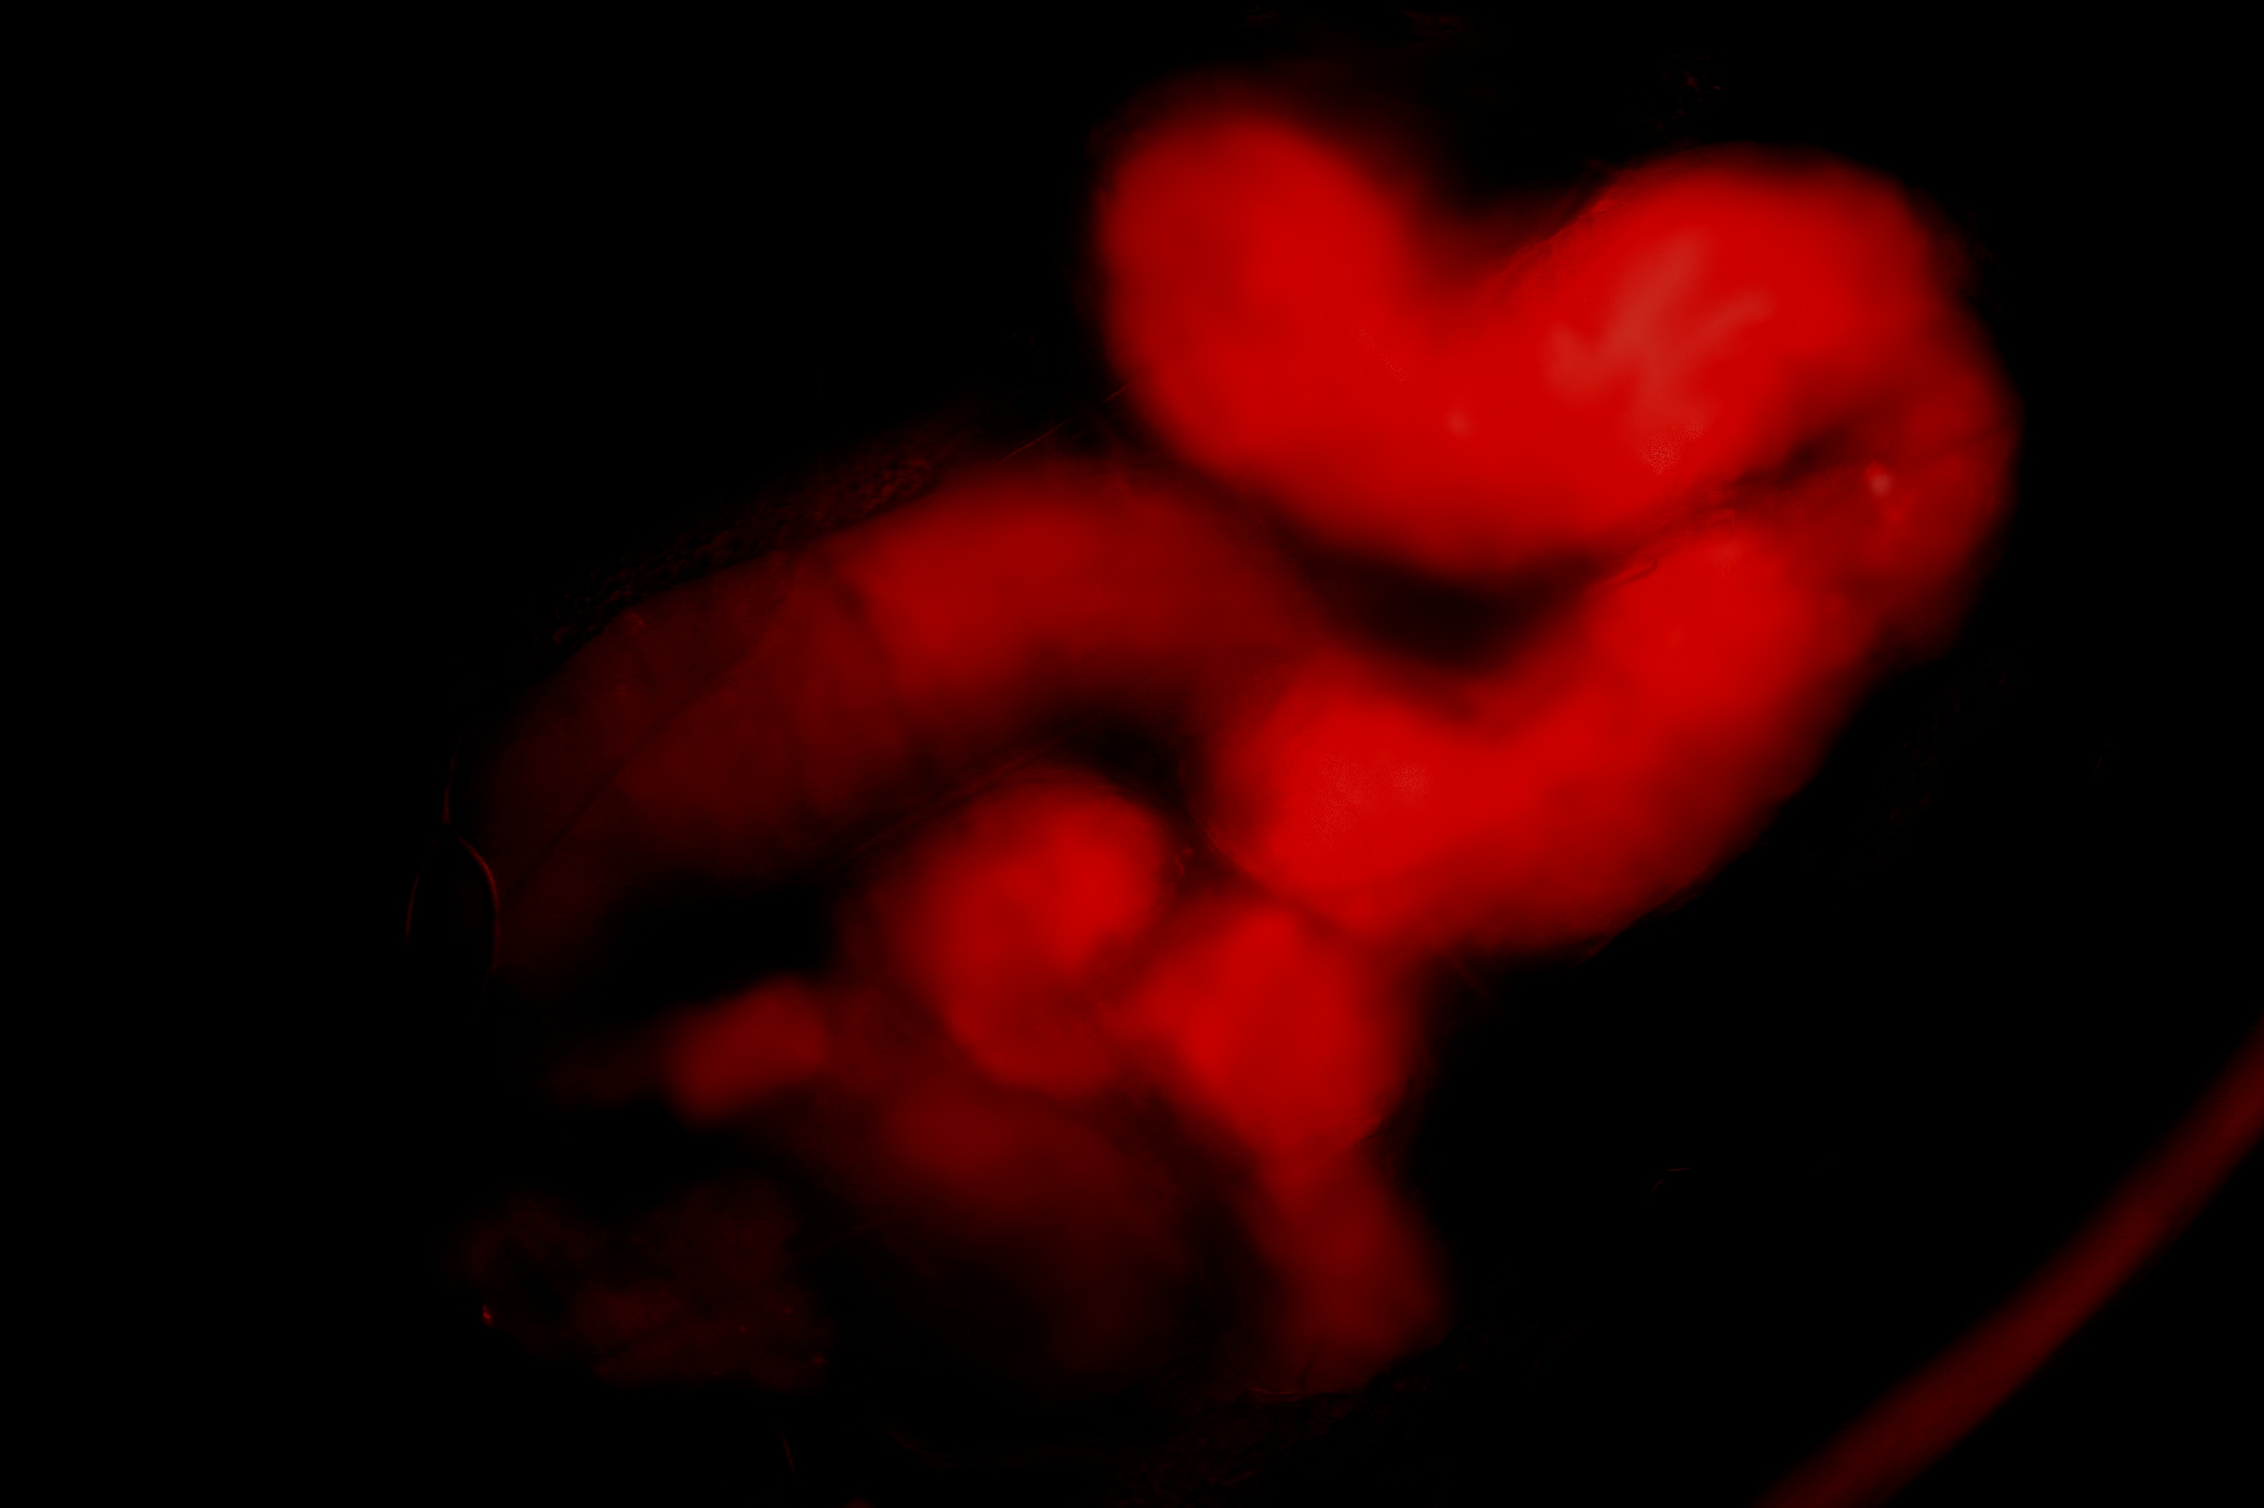
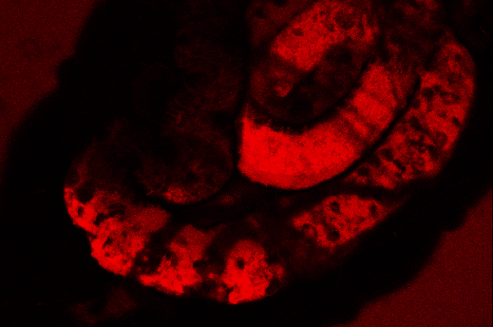
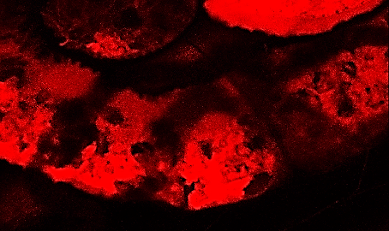
D. suzukii gut morphology after Bt treatments
A
12h
The normal morphology of D. suzukii gut was observed by means of oral administration of Erythrosine (E127)
or by TRITC-Dextran70
TRITC-Dextran labeling reveals a marked damage to the intestinal wall 12 hours after ingestion of B. thuringiensis.
(Laser Confocal Image)
E127
50x
100x
B
12h
TRITC-Dextran
200x
300x
Bt/TRITC-Dextran
12h
C
200x
300x

Slide 14
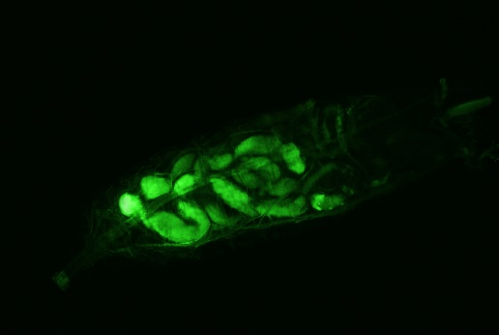

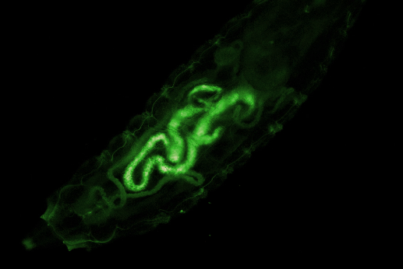

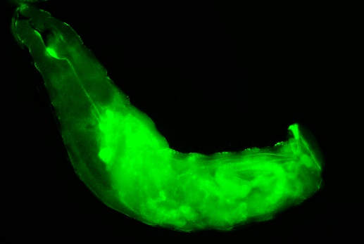

Hemocoel diffusion of X. nematophila when administered in the presence of B. thuringiensis
Xn-GFP 12h
X. nematophila-GFP in single administration is limited to the gut area of the D. suzukii larvae.
3h post treatment with Bt-Xn, X. nematophila-GFP is observable only in the intestinal area
12h after treatment with Bt plus X. nematophila-GFP, it is possible to observe an evident diffusion of the fluorescent bacteria that have entered the hemocoelic cavity of the dipteran.
A
50x
100x
Bt/Xn-GFP 3h
B
50x
100x
Bt/Xn-GFP 12h
B1
50x
100x

Slide 15
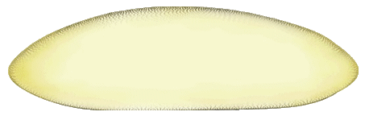
Conclusions
Single administration of bioinsecticides to first and second stage larvae of D. suzukii shows efficacy by inducing discrete mortality rates but only at times of 48h.
Combined administrations of Bt and Xn and with the secondary metabolites of the Xn, significantly increase the efficacy of treatments.
Particularly, in addition to the increase in mortality rate, the reduction in treatment time seems to be promising for a possible application of these procedures in the field.
Damage to the intestinal wall of the host, induced by B. thuringiensis toxins, could promote the spreading of the second bioinsecticide (X. nematophila), into the hemocoel cavity of the host, amplifying the lethal effects of treatment.
Bt/Xn intake
gut damage by Bt
Xn spreading

Slide 16



Hoping that the topic was of interest to you,
I have concluded, thank you for your attention
Brivio's Lab of Comparative Immunology and Parasitology
University of Insubria
Department of Theoretical and Applied Sciences (DiSTA)
Via Jean Henry Dunant 3, Varese, Italy
email: maurizio.brivio@uninsubria.it

