Slide 1
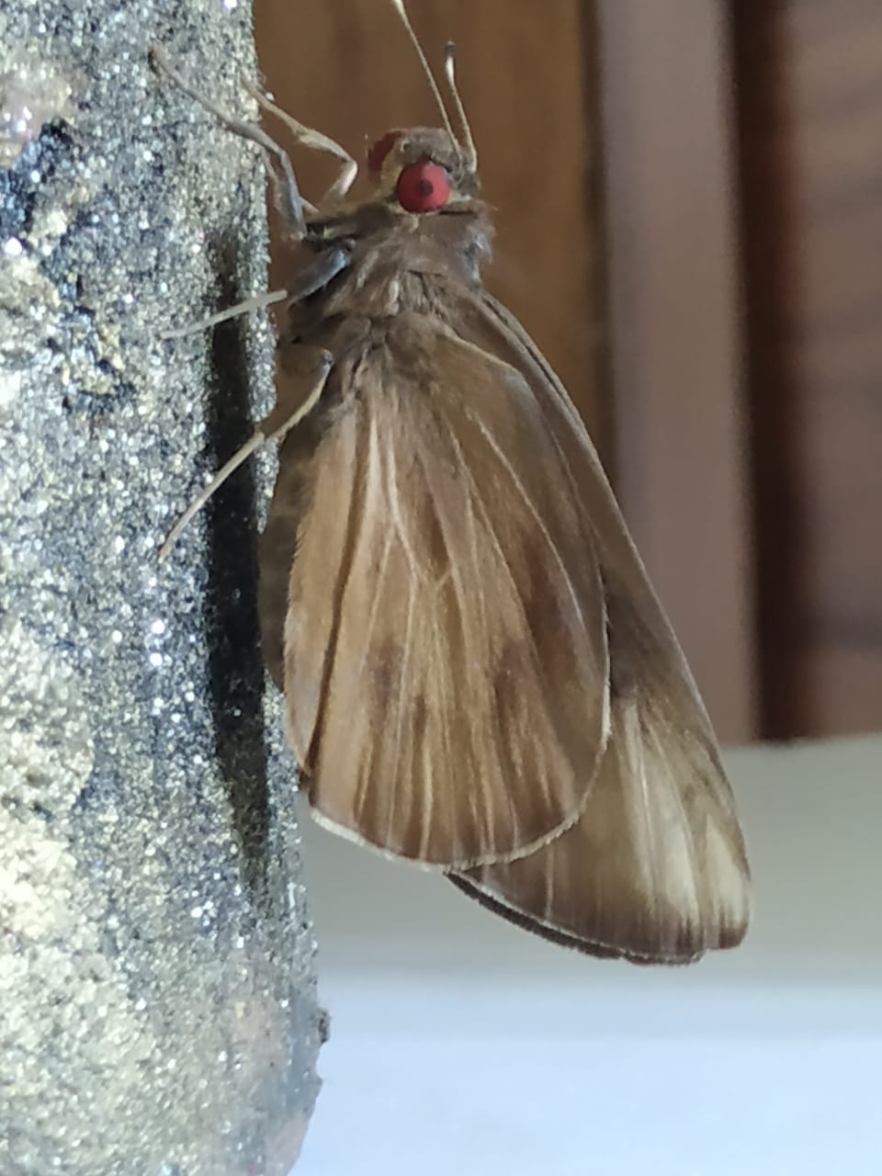
Use of DNA barcoding to confirm invasive banana skipper Erionota torus (Evans) from Malabar region of Kerala
Abdul Jaleel K & S.M Ghosh
Research Department of Zoology
Government College Kasaragod

Slide 2
Contents
01
Introduction
02
Methodolgy
03
Results and discussion
04
Conclusion

Slide 3
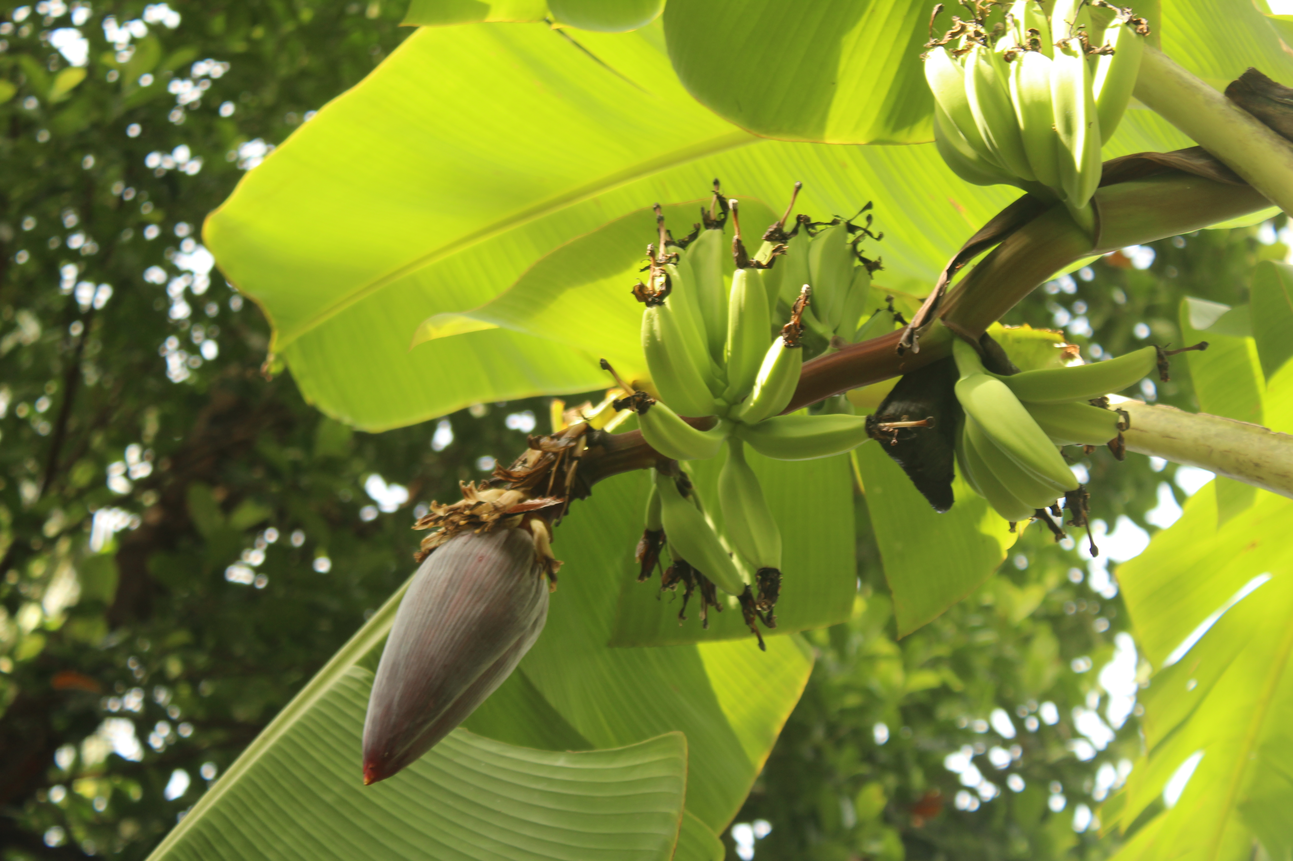
Introduction
Biodiversity refers to the diversity and variability of life on Earth at all dimensions, from genes to ecosystems, as well as the ecological and evolutionary processes that keep it going
The major causes of biodiversity reduction include habitat loss, environmental degradation, resource overexploitation, and invasive species activities. Invasive species are regarded as a major contributor to global biodiversity loss, and as a result, public awareness of the issue has grown in recent decades
Invasion of banana skipper Erionota spp. have been documented in various banana-growing plots in Kerala . The banana is one of the most important fruit crops in the world, and it is widely grown in tropical countries .
It is a favorite fruit of all classes of people and has good export potential due to its year-round availability, affordability, varietal variety, taste, nutritive and medicinal value. The banana leaves are a regular income sources of many people in South India

Slide 4
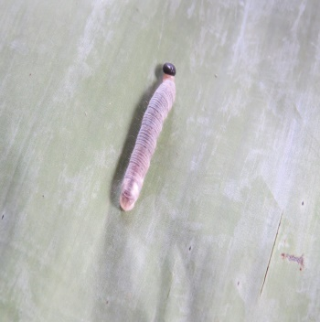
Introduction
India is the largest producer of banana in the world and also in Asia, and contributes 22.15 percent to global production from 7.4 % area (2009) followed by China and Philippines
Among the 470 insects and mites recorded globally on banana as major and minor pests, 250 feed on the foliage .During September - October 2013, epidemic build up of leaf roller pest Erionota was reported from banana plantations at several places in Kerala viz., Peechi, Palghat and Nilambur .
A survey conducted in southern districts of Kerala exposed the presence of the banana leaf roller Erionota in almost all important banana varieties .The infestation percentage was up to 40 and severe defoliation with mean leaves damaged per plant to 2.88. %
Both Erionota thrax and Erionota torus were reported in different parts of Kerala . E.thrax and E.torus have similar morphology often making their distinction by classical identification using morphological criteria difficult. Since there is no reliable way to separate the early stages of E. thrax, E. torus and E. acroleuca morphologically, a careful study and documentation of reared material, supported by reared vouchers and barcoding of individuals, is needed .

Slide 5
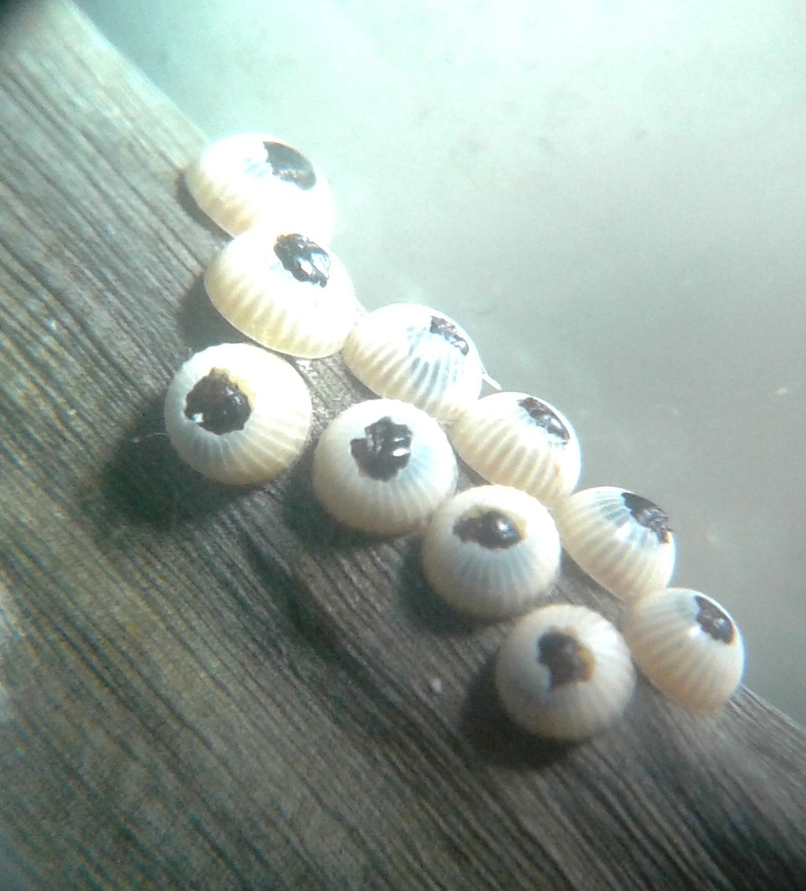
Introduction
DNA barcode based identification has been proposed as a molecular method for assigning individual specimens to known species .DNA barcode involves DNA sequence analysis of a portion of the mitochondrial gene cytochrome c oxidase subunit I (COI) of about 600-700 bp. The basic concept is that barcode variation between even closely related species will be substantially greater than the variations observed within species
Many invasive species' early life stages have been successfully identified using DNA barcoding.Armstrong and Ball discovered that the COI barcode marker outperformed earlier molecular assays when it came to identifying moth species from eggs found on imported vehicles.In addition, compared to earlier methods, this barcoding marker was able to identify a wider taxonomic range of foreign species
In a study of blue butterflies from the Lycaenidae family, Wiemers et al., discovered that interspecific variance outnumbers intraspecific variation and that there is no barcode gap. They were able to discover a number of cryptic species that were phenotypically identical to the others. They provided the idea that minimum distances between species are crucial, rather than average
The barcoding of the maize weevil, Sitophilus zeamais (Motsch.) and rice weevil, Sitophilus oryzae (L.) mitochondrial cytochrome oxidase I gene and subsequent alignment by Thomas et al., revealed that out of 620 base pairs in the sequences, 82 were found to be different between the two species, despite their morphological similarities.The precise identification of various insect pests would undoubtedly aid in the development of effective management techniques, such as natural enemy selection and IPM.

Slide 6
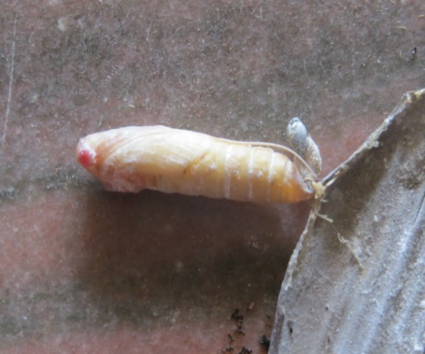
Introduction
Wu and Yan used the barcoding results of Sitophilus zeamais and Sitophilus oryzae (Coleoptera: Curculionidae) in 34 species from different parts of China and three from outside to study their distribution pattern. They found that S. oryzae is only found in Central and South China, while S. zeamais is found all over the country. These findings are significant because both weevils were morphologically similar
Pushapraj Karthika et al., used DNA barcoding to track the evolutionary ancestry of 15 insect pests that attack horticultural crops in South India. They were able to screen the pests and determine their genetic variations, resulting in better IPM control
Smith et al., investigated the identification of microgastrine wasps that are caterpillar parasitoids, as well as host-parasitoid biology and ecology, using DNA barcoding. The investigation resulted in biological control programmes and the naming of new cryptic species and taxa as a result of their employment as biological control agents
The objective of this study is to assess the applicability of DNA barcoding to identify the invasiveness of Erionota spp. which cause serious damage to banana in Malabar region of Kerala, India.

Slide 7
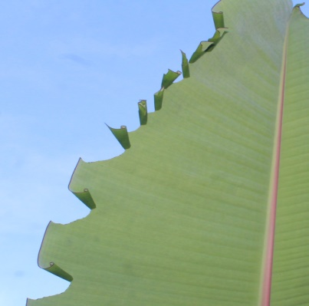
1
Collection of specimens:
2
DNA preparation of Erionota torus (Evans)
3
PCR amplification of the COI region
Methodology

Slide 8
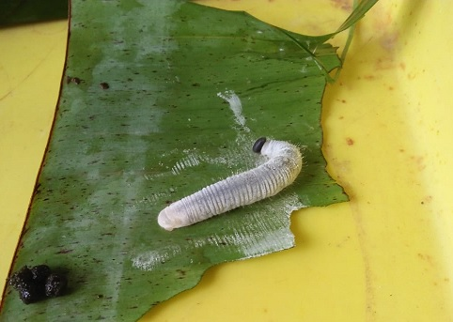
4
DNA sequencing and analysis
5
Infestation on cultivars was observed in the chosen area using the roving survey approach.
Methodology

Slide 9
Results
Phylogeny analysis of Erionota torus was carried out by the partial sequencing of the mitochondrial COI which yielded a 630 bp product by PCR amplification. GenBank deposition of the above product indicated the novel and first time records of Erionota torus from Malabar region of Kerala and was provided with a genbank accession number KT783538.1.
It was followed by the phylogenetic tree construction by Fast Minimum Evolution method (Fig.1) and by neighbor joining method (Fig.2) [29]. Genbank analysis showed the sequence has 100% identity with E. torus (GenBank accession number: KP299167.1) , 98.10% identity with GenBank accession number:KY019746.1 which is deposited as Erionota thrax and 95.73 % identity with GenBank accession number: KY019745.1 which is deposited as Erionota spp. by Sahoo et al.

Slide 10
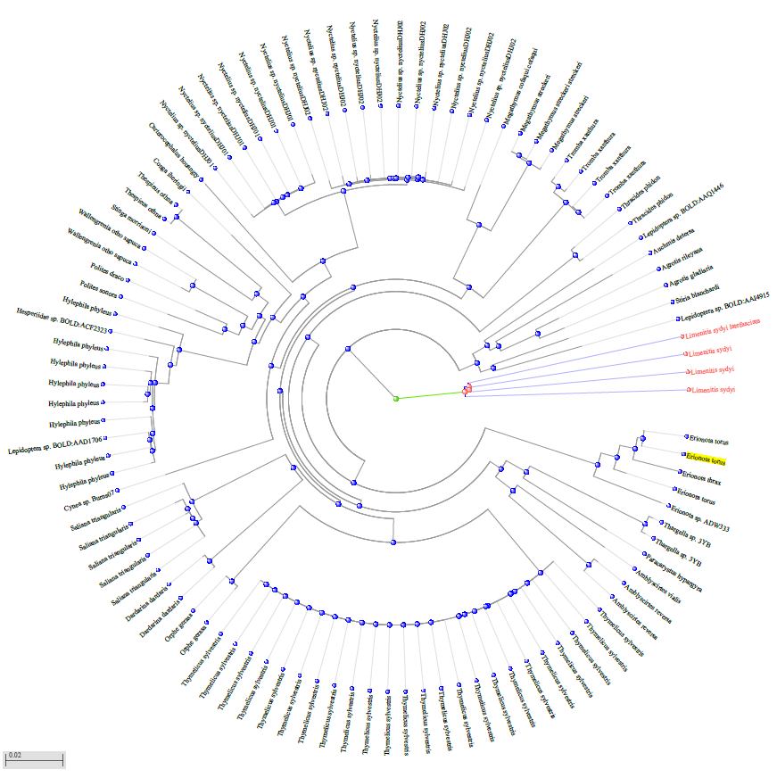

Slide 11
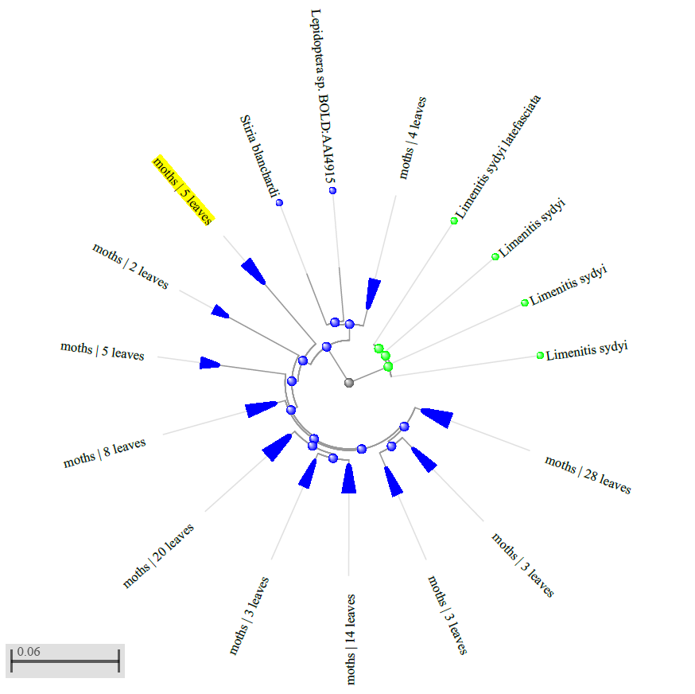

Slide 12
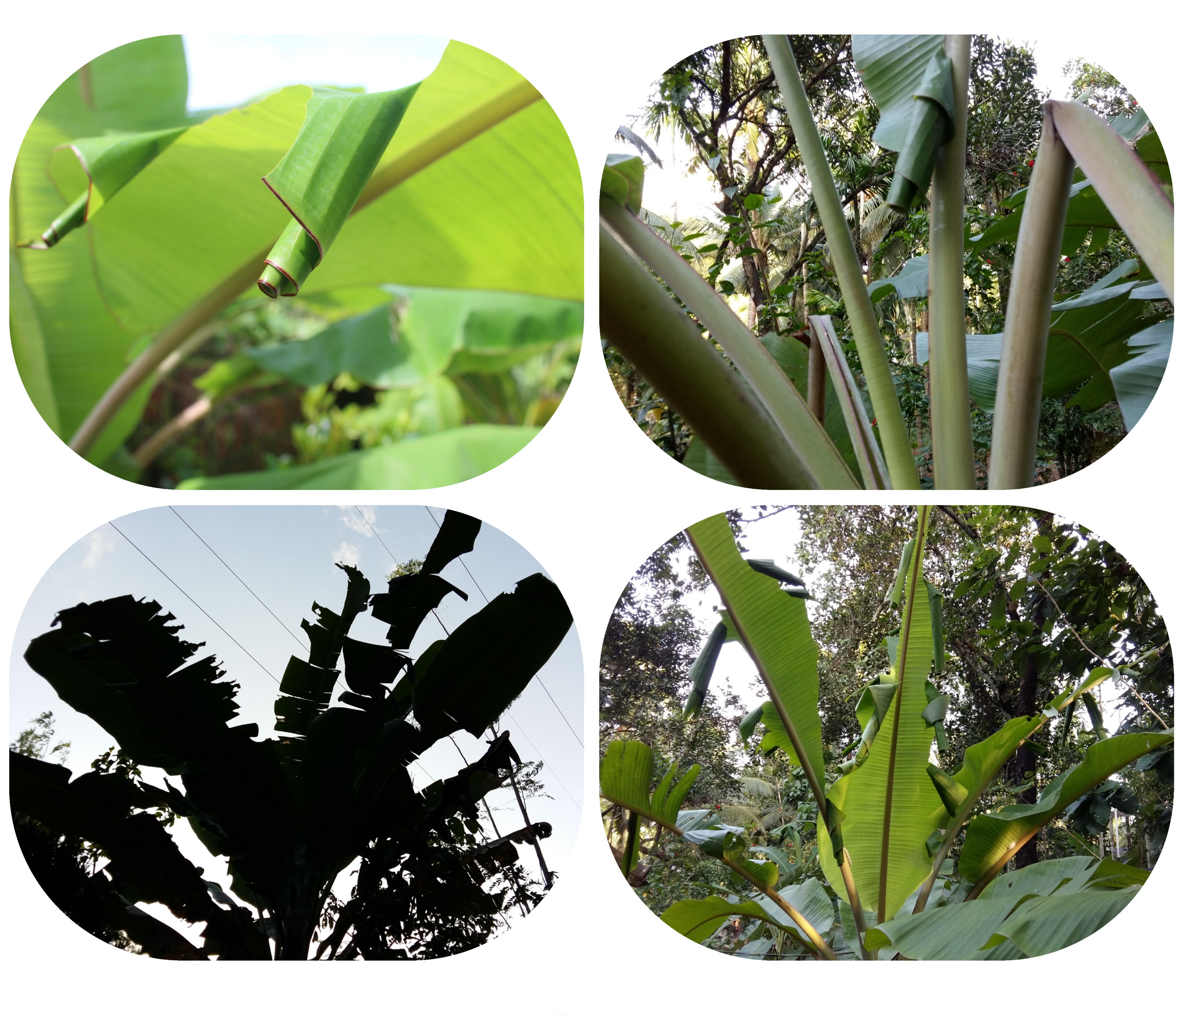
Fig.3.Infested banana leaf and fully infested plants.

Slide 13
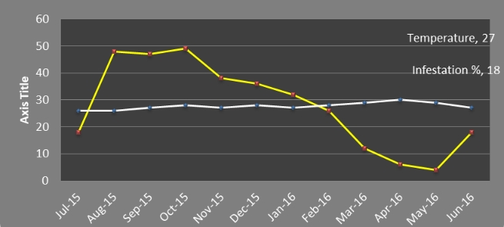
Fig. 4. Incidence of E. torus (2015-16) in banana plantation at Payyanur

Slide 14
Conclusion
Invasion of banana leaf roller Erionota spp. has been found throughout Kerala especially in banana plantations in Malabar region .Many studies reported that the banana leaf rollers E. thrax and E. torus coexist in Kerala, and that they should be considered as a single species.In order to develop successful biological control programmes to manage this pest, species level identification is required.DNA barcodes are used in invasive species programmes because they allow for early and rapid detection of new invading species.Invasive species can be recognised at any stage of their life cycles thanks to rapid genetic identification that does not require any morphologically mature features, whether vegetative or reproductive. Surveying specimens at mature, reproductive, or advanced life stages, which are typically only available at certain times of year or under specified climatic conditions, is typically required for morphological identification of species [32]. Because the early stages of E. thrax and E. torus are difficult to differentiate, and because they are frequent banana pests, morphological identification of species is challenging.The COI sequences of banana skipper confirm the presence of E.torus species in infested areas, and all parasitoid species collected during the course of the investigation were E.torus. DNA barcoding techniques to identify will be an easiest way in quick identification and too implement management strategies to prevent its spread.

Slide 15
References
https://www.amnh.org/research/center-for-biodiversity-conservation/what-is- biodiversity
Didham, R.K., Tylianakis, J.M., Hutchinson ,M.A., Ewers, R.M., Gemmell ,N,J. Are invasive species the drivers of ecological change? Trends in Ecology and Evolution. 2005. 20:470–474.doi: 10.1016/j.tree.2005.07.006
Richardson ,D.M; Pysek ,P; Rejmanek, M; Barbour ,M.G ; Panetta, F.D; West,C.J. Naturalization and invasion of alien plants: Concepts and definitions. Diversity and Distributions. 2000b 6: 93–107. doi: 10.1046/j.1472-4642.2000.00083.x
Mack ,R.N., Simberloff ,D., Londsale ,W.M., Evans, H., Clout, M., Bazzaz ,F.A . Biotic invasions: Causes, epidemiology, global consequences, and control. Ecological Applications.2000.10:689–710. doi:10.1890/10510761(2000)010[0689:BICEGC2.0.CO;2
Nandakumar ,T.Banana farmers reel under ‘butterfly’ attack. The Hindu. July 07. 2014.

Slide 16
Padam, B. S; Tin ,H. S, Chye ,F. Y., Abdullah, M. I. Banana by-products: an under-utilized renewable food biomass with great potential. Journal of Food Science Technology. 2014. 51(12): 3527-3545.
Kumar, K.P.S. , Bhowmik, Debjit ., Duraivel .S., Manivannan, Umadevi. Traditional and medicinal uses of banana. Journal of Pharmacognosy and Phytochemistry. 2012. 1. 51-63.
Nayar, N.M. The bananas: botany, origin, dispersal. Horticultural Reviews. 2010. 117–164. https://doi.org/10.1002/9780470527238.ch2
https://icar.org.in/files/ICAR-Vision-2030.pdf .
Ostmark ,H .E. Economic insect pests of bananas. Annual Review of Entomology. 2003. 19: 161-176.
Soumya, K .C., Sajeev ,T. V., Maneetha ,T. K., Keerthy Vijayan and George Mathew. Incidence of Erionota thrax (Hübner) (Lepidoptera: Hesperiidae) as a pest of banana in Kerala. Entomon . 2014.38(1): 53-58.

Slide 17
Sivakumar ,T., Jiji ,T., Anitha, N. Field observations on banana skipper Erionota thrax L. (Hesperiidae: Lepidoptera) and its avian predators from southern peninsular India. Current Biotica. 2014. 3 (8): 220-227.
Raju ,D., K. Kunte, Kalesh, S, Chandrashekaran ,V. K., Manoj, P., Ogale ,H., Sanap ,R. 2020. Erionota torus Evans, 1941- rounded palm-red eye. Kunte K, S Sondhi, P. Roy (eds.). Butterflies of India, v. 2.74. Indian Foundation for Butterflies. http:// www.ifoundbutter flies.org/sp/2756/Erionota torus.
Cock ,M .J. A critical review of the literature on the pest Erionota spp. (Lepidoptera, Hesperiidae): taxonomy, distribution, food plants, early stages, natural enemies and biological control. CAB Reviews. 2015. 10 (7): 1-30.
P.D.N. Hebert , A.Cywinska A, S.L.Ball , J.R.deWaard . Biological identifications through DNA barcodes‖. Proceedings of the Royal Society of London B—Biological Sciences.2003. Vol.270 (1512) pp313–321,2003.

Slide 18
Armstrong KF, Ball SL DNA barcodes for biosecurity: invasivespecies identiﬁcation. Philosophical Transactions of the Royal Society B:Biological Sciences.2005.360, 1813–1823.
Hajibabaei, Mehrdad & Janzen, Daniel & Burns, John & Hallwachs, Winnie & Hebert, Paul. DNA barcodes distinguish species of tropical Lepidoptera. Proceedings of the National Academy of Sciences of the United States of America.2006. 103. 968-71. 10.1073/pnas.0510466103.
Wiemers M, Fiedler K. Does the DNA barcoding gap exist? – a case study in blue butterflies (Lepidoptera: Lycaenidae). Frontiers in Zoology.2007 4: 8. https://doi.org/10.1186/1742- 9994-4-8
Foottit RG, Maw HE, VON Dohlen CD, Hebert PD. Species identification of aphids (Insecta: Hemiptera: Aphididae) through DNA barcodes. Mol Ecol Resour. 2008 Nov;8(6):1189-201. doi: 10.1111/j.1755-0998.2008.02297.x. PMID: 21586006.
Sheffield, C.S., Hebert, P.D.N., Kevan, P., Packer, L. DNA barcoding a regional bee (Hymenoptera, Apoidea) fauna and its potential for ecological studies. Mol. Ecol.Res. 2009.9, 196–207
Ander M, Troell K, Chirico J. Barcoding of biting midges in the genus Culicoides: a tool for species determination. Med Vet Entomol. 2013 Sep;27(3):323-31. doi: 10.1111/j.1365-2915.2012.01050.x. Epub 2012 Oct 29. PMID: 23106166.

Slide 19
Wu, F. and Yan, X. P. . Distribution of the related weevil species Sitophilus oryzae and Sitophilus zeamais (Coleoptera: Curculionidae) in farmer stored grains of China. Journal ofEconomic Entomology,2018. 111(3): 1461- 1468.
http://www.blast.ncbi.nlm.nih.gov/Blast.cgi.
Justin, Okolle & Mansor, Mashhor & Hassan, Ahmad. . Spatial distribution of banana skipper (Erionota thrax L.) (Lepidoptera: Hesperiidae) and its parasitoids in a Cavendish banana plantation, Penang, Malaysia. Insect Science. 200613. 381 - 389. 10.1111/j.1744-7917.2006.00107.x.
Abdul Jaleel K.,Ghosh.S.M and Jiji Joseph V. DNA Barcoding and Evolutionary lineage of banana skipper Erionota torus (Evans)(Lepidoptera:Hesperiidae) from Malabar,a part of Southern Western Ghats ,India .Int.Jou.of Scientific research in Biological sciences.2019.6 (4) pp 29-32.
Sahoo,R.K., Warren,A.D., Wahlberg,N., Brower,A.V., Lukhtanov,V.A., Kodandaramaiah,U.Ten genes and two topologies: an exploration of higherrelationships in skipper butterflies (Hesperiidae) . 2016.Peer J. 4, E2653
Abdul Jaleel K.,S M Ghosh Biology and damage of Banana skipper Erionota torus (Evans)from Malabar region of Kerala.Indian Jou.Entomology 2020.82 (3) pp 429-434 .

Slide 20
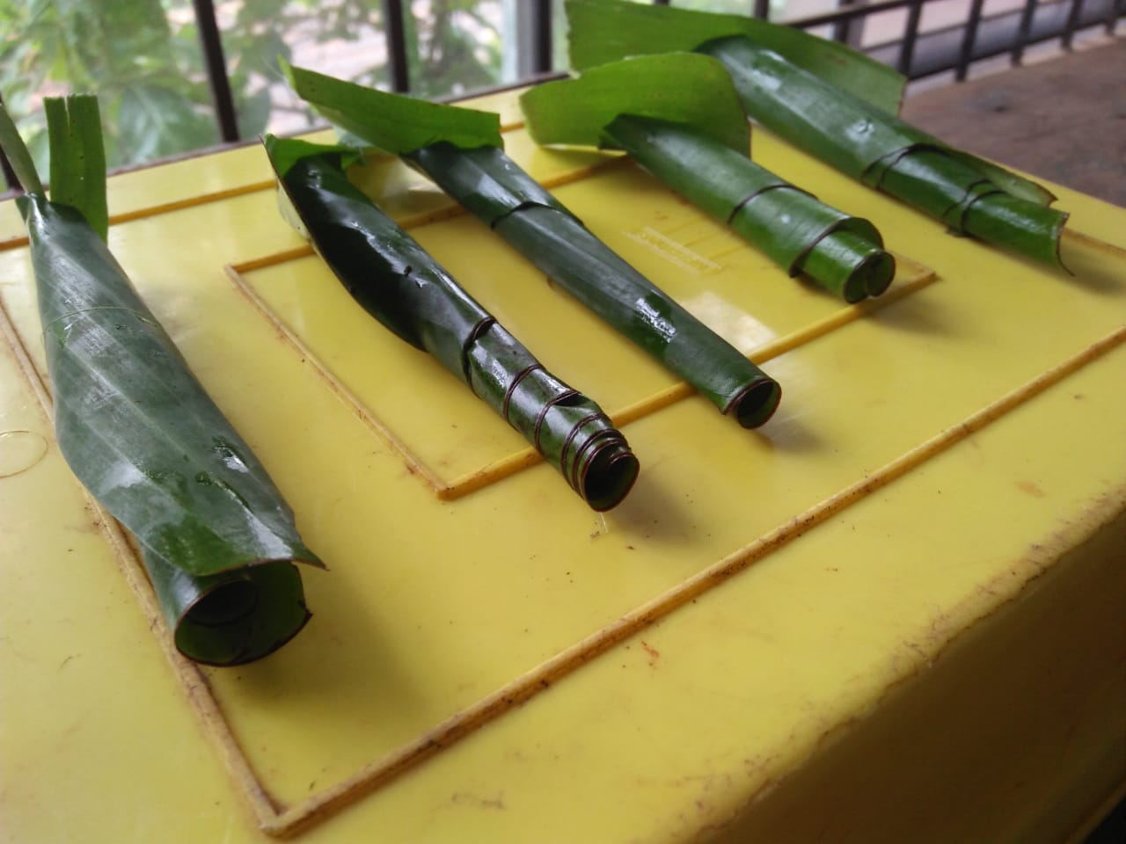
THANK YOU！

