Slide 1

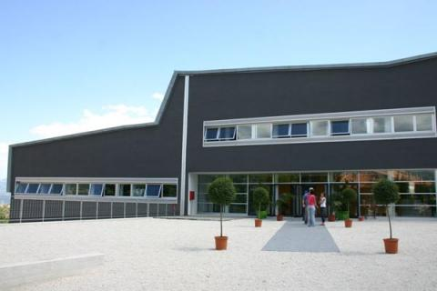

Microbial symbiosys in mosquito vectors
Guido Favia
School of Biosciences and Veterinary Medicine
guido.favia@unicam.it

Slide 2
Syllabus
Microbiota: the microorganisms permanently resident in a particular site / habitat
Microbiome: are the collective genomes of microorganisms residing in an environmental niche
Hologenome: The hologenome theory is a postulate that states that the object of natural genomic selection is not a single organism, but the organism and its microbial communities

Slide 3
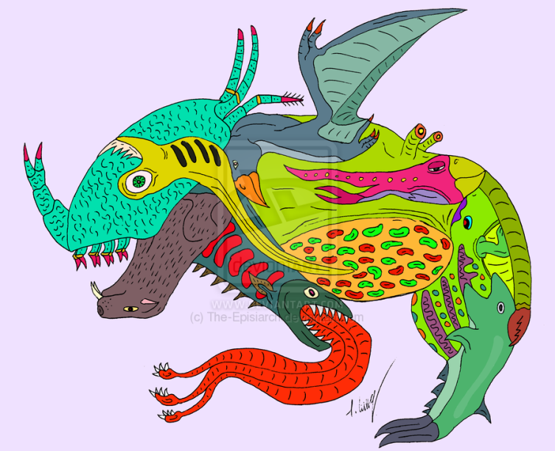
The concept of hologenome
Holobiome: This hypothesis proposes that a dynamic relationship exists between organisms (hosts) and their symbiotic microbial communities. By changing its composition, this "holobiont" can adapt to changing environmental conditions much more rapidly than with genetic mutation and selection alone.

Slide 4

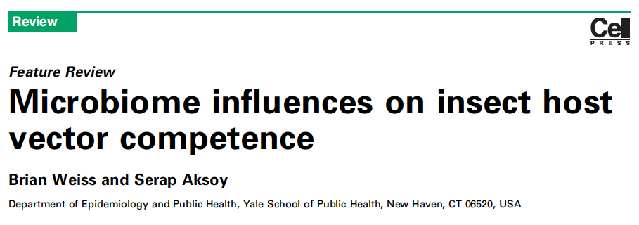
Insect symbiosis

Slide 5
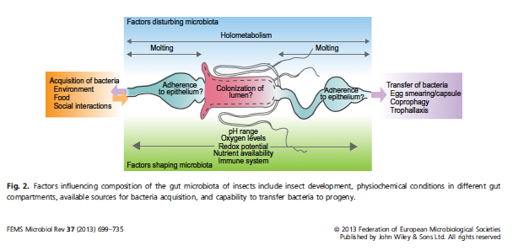
Insect symbiosis

Slide 6
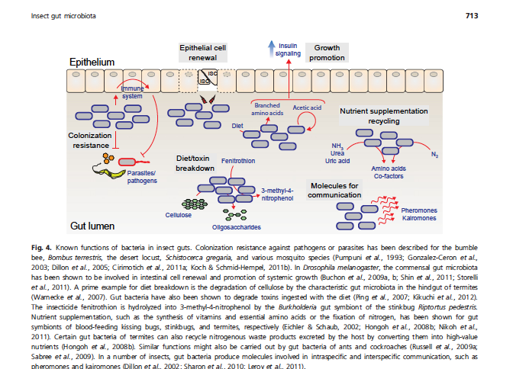
Insect symbiosis

Slide 7
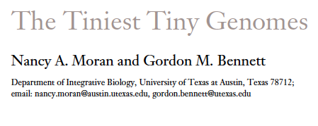
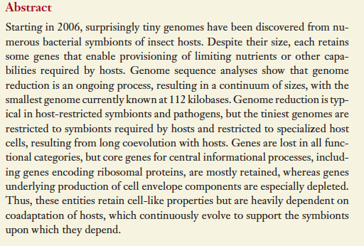

Slide 8
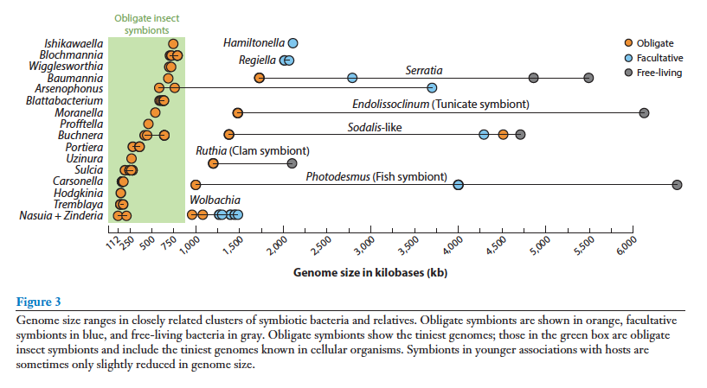
“The tiniest tiny genomes”

Slide 9
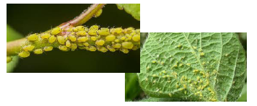

Aphids and Buchnera
In the body of aphids, bilobed bacteriomes are present, containing 60-80 bacteriocytes.
Inside the bacteriocyte there are vesicles that contain the primary Gram negative symbiont Buchnera aphidicola, belonging to the phylum gamma-Proteobacteria (extreme reduction of the genome: 425-g50 kb).
Vertical transmission of Buchnera occurs through transfer into the egg (in the case of sexual reproduction) or into the embryo (in the case of reproduction by parthenogenesis).

Slide 10
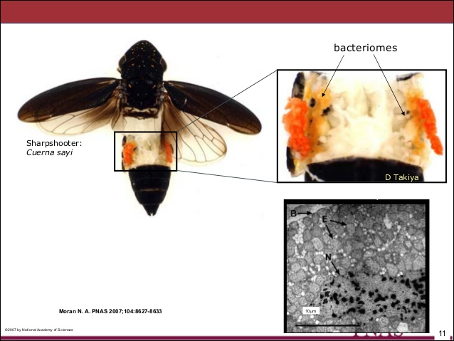
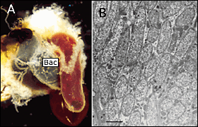
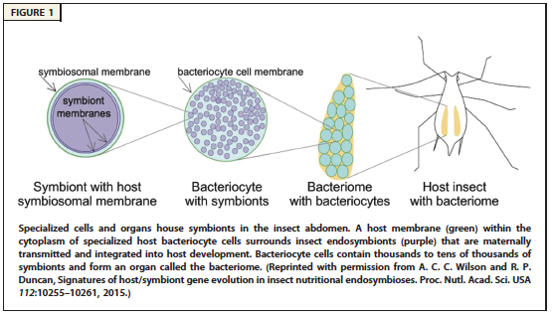
Other examples
Glossina
Cuerna (Cicladellidae)

Slide 11
Potential effects of the symbiont in the biology of the host
Ecology of insect nutrition
Defense against pathogens
Adaptation to different environmental conditions
Influence on plant-insect interactions
Impact on population dynamics
Resistance to insecticides
.... many others ... ..

Slide 12
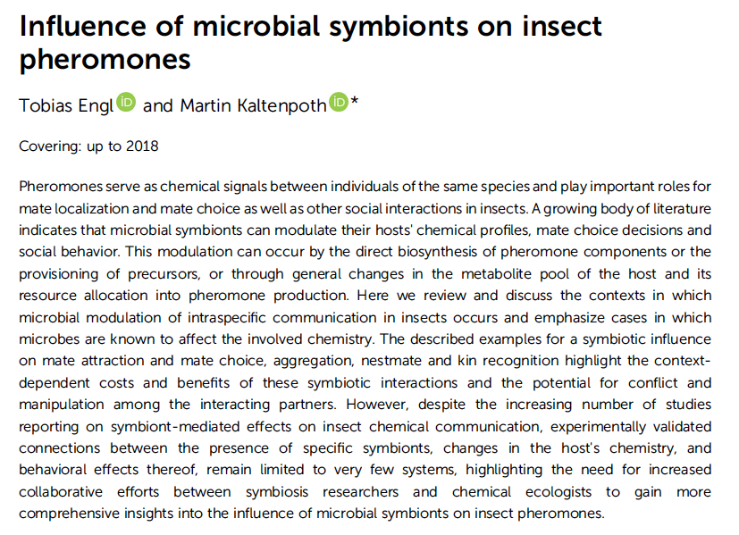
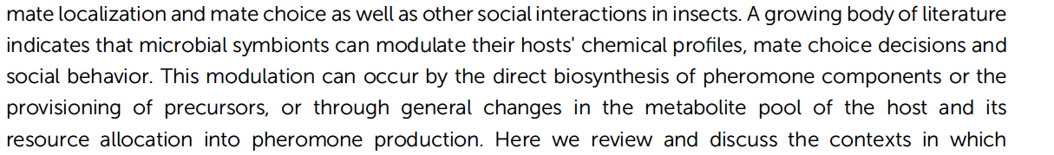
What kind of interactions?

Slide 13
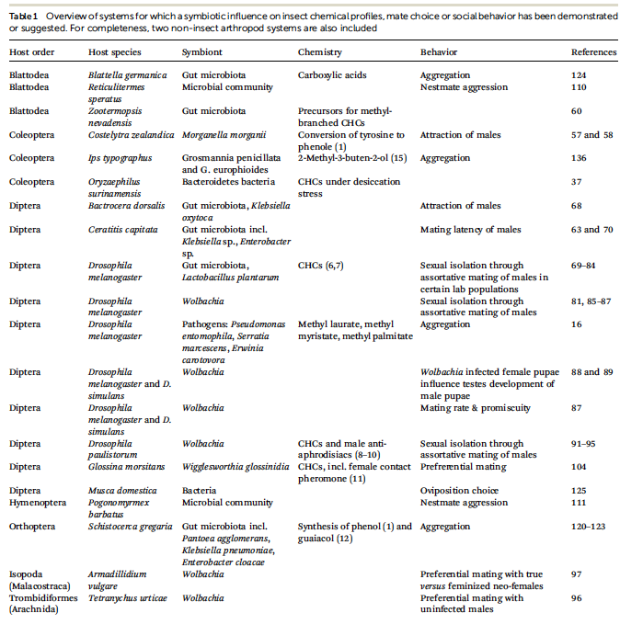
Quali interazioni?

Slide 14
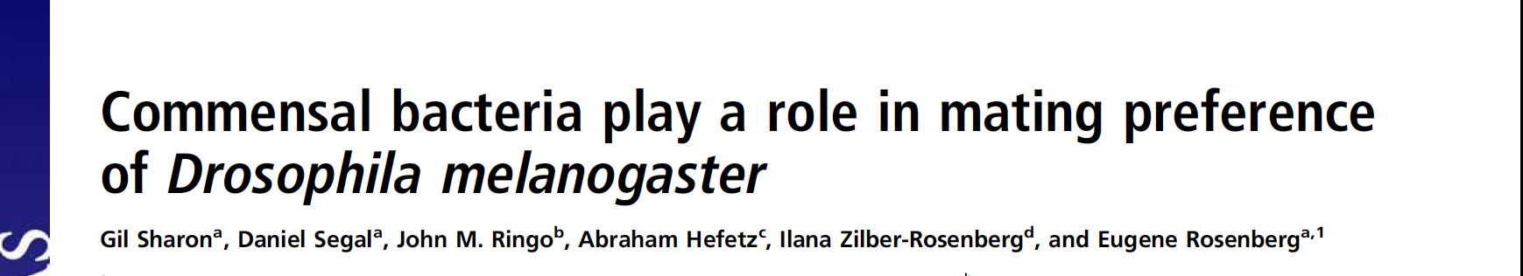
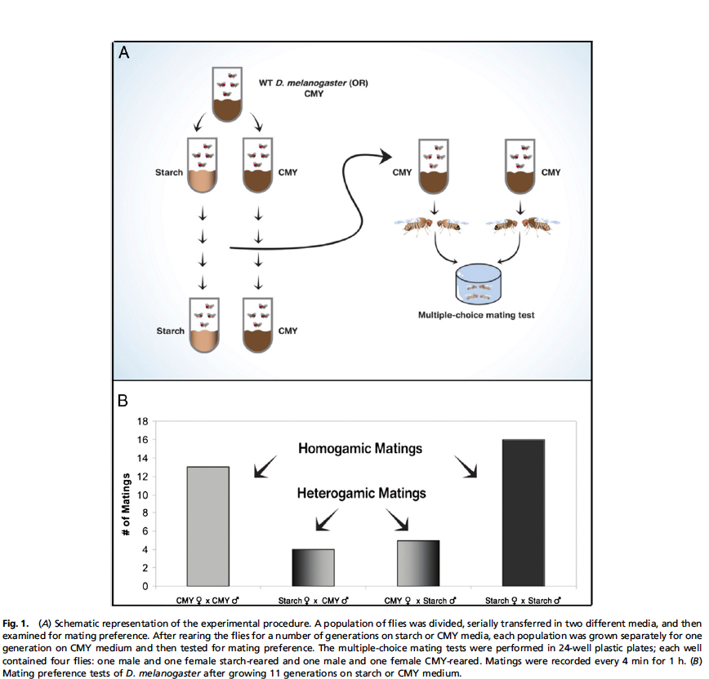
How can a bacterially induced mating preference, as described here, contribute to speciation and evolution in nature?
One possibility is that, in the natural world, multiple environmental factors act synergistically to differentiate the microbiota and strengthen the homogamic mating preference.
For example, it is reasonable to assume that fly populations living on different nutrients will be, at least to some extent, geographically separated.
The combination of partial geographic separation and diet-induced mating preference would reduce interbreeding of the populations. Slower changes in the host genome could further enhance the mating preference.
The stronger the mating preference, the greater the chance that two populations will become sexually isolated.

Slide 15
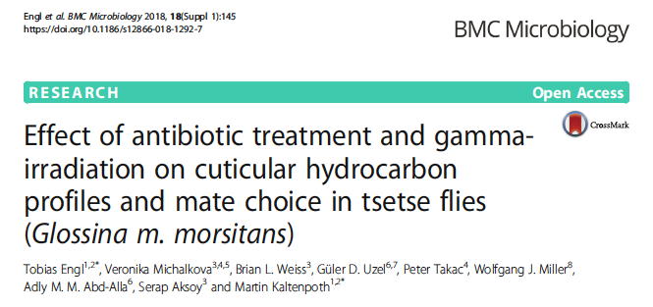
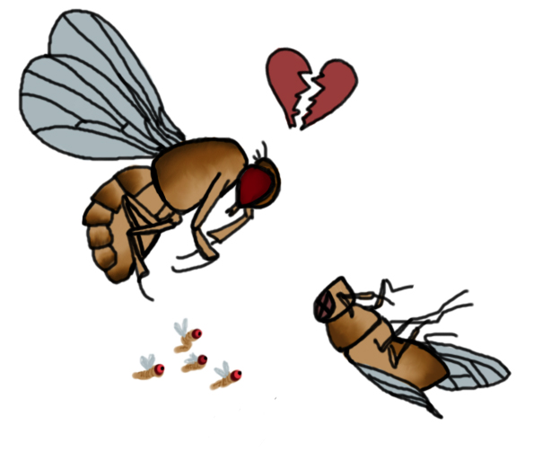
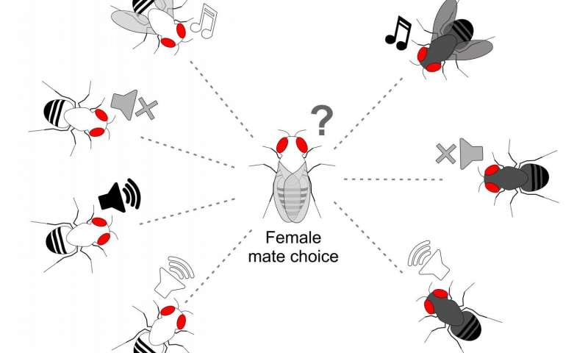

Slide 16
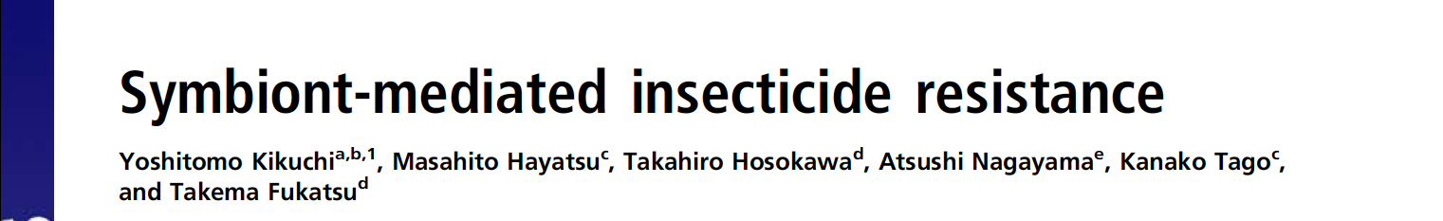
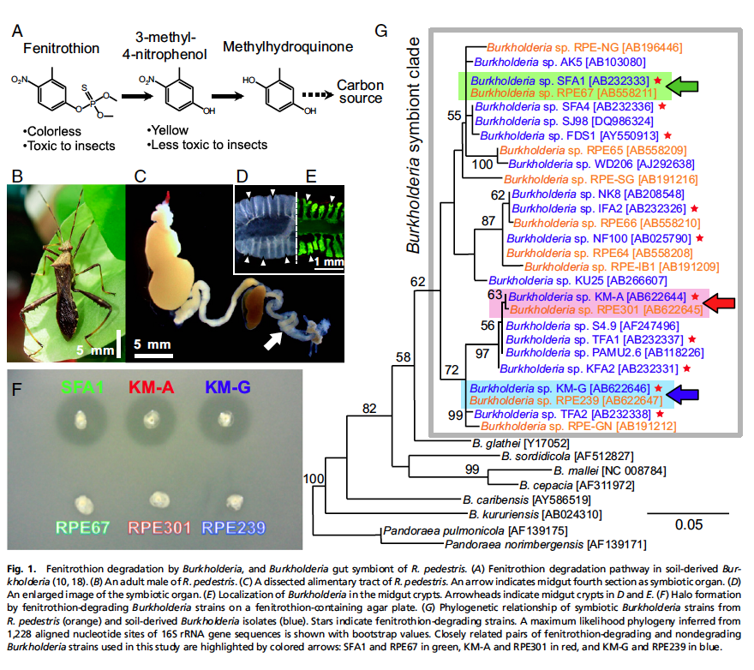
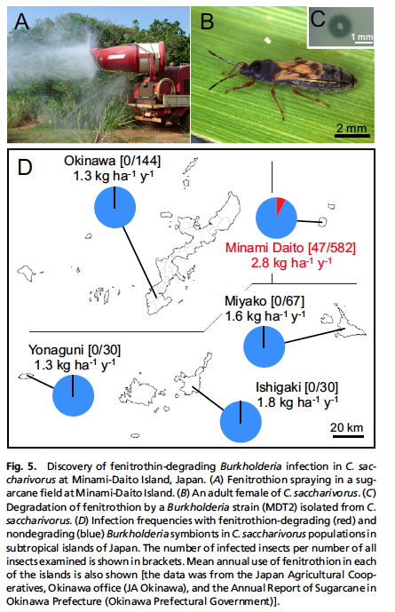

Slide 17
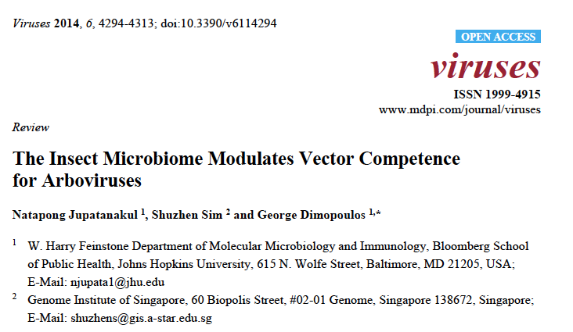
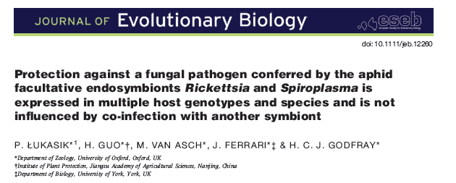
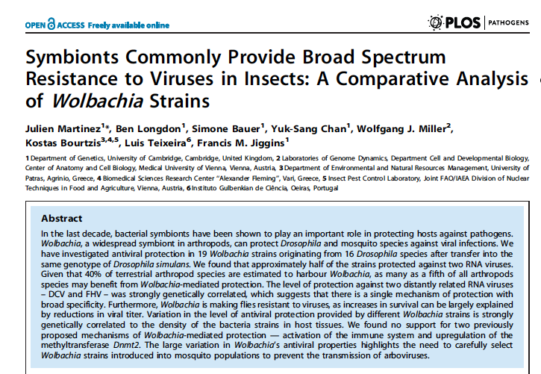
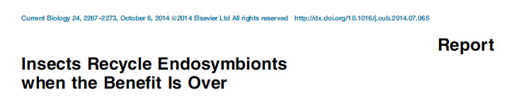
The symbionts "know" to protect the host
But… insects recycle endosymbionts when the benefit no longer occurs

Slide 18
Symbiotic Control
Current advances in understanding the relationships between microbiota and vectors could have a major impact on:
i) a better understanding of some traits of mosquito biology;
ii) the development of innovative control strategies for mosquito-borne diseases aimed at reducing the vector capacity of mosquitoes and / or inhibiting the transmission of the pathogen.
PARATRANSGENESIS: genetic modification of the symbiont to express "anti-pathogenic" molecules within the insect to stop transmission.
Notes:
.

Slide 19
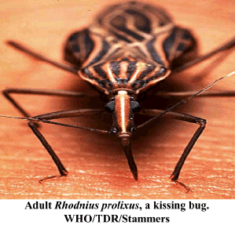
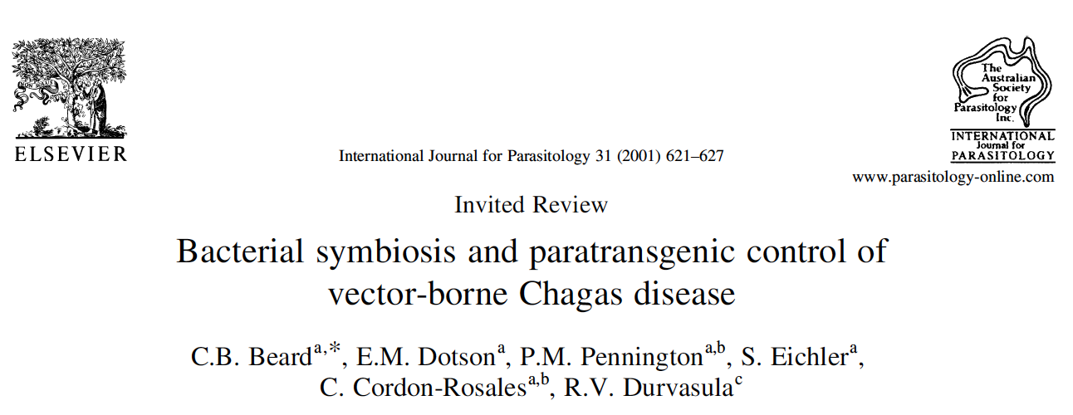
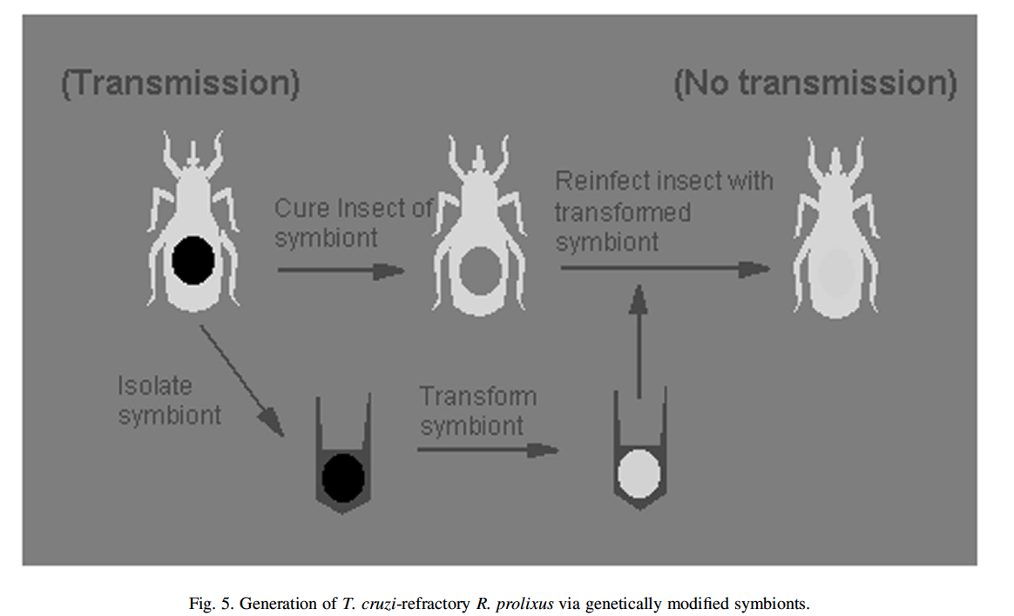
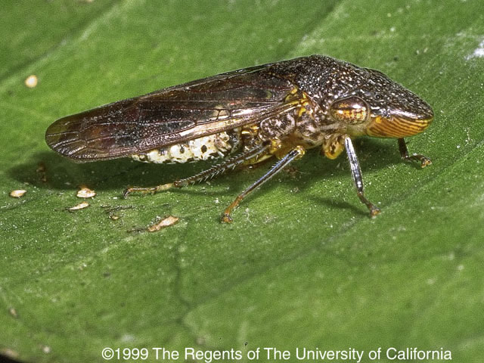
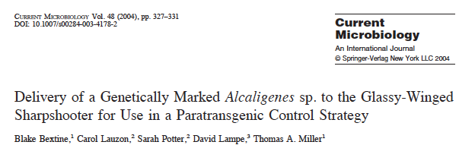
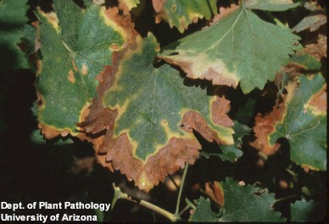
SC of insect pests/vectors
Modification of the extracellular bacterial symbiont of the Chagas disease vector Rhodnius prolixus (Beard et al. 1992, 1993, 2000). The symbiont is transmitted to the progeny by contaminating egg shells or of food with infected feces and genetically modified symbionts can be transmitted to hosts lacking symbionts (Richard 1993, Beard et al. 2000).
A paratransgenic approach to interrupt transmission of Xylella fastidiosa (the bacterial pathogen causing Pierce's disease of grape), by insect vectors has been recently set-up.

Slide 20
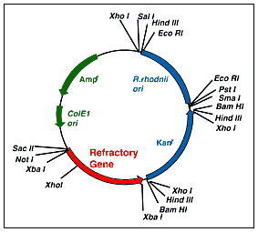
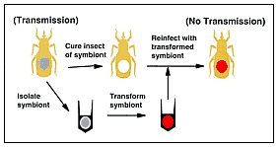
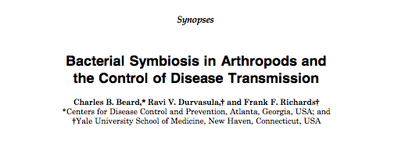
SC of Chagas Diseases
Beard et al, 1998. EID; 4: 581-591.

Slide 21
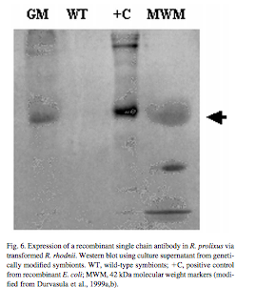
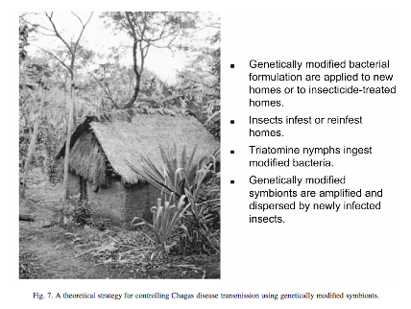
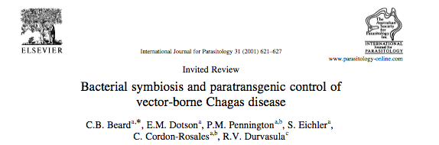
SC of Chagas Disease
Beard et al, 2001. IJP; 31: 621-627.

Slide 22
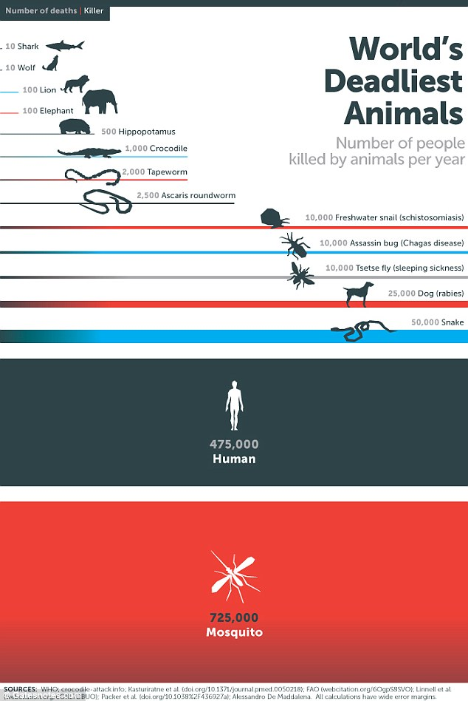
Symbionts and mosquitoes: new opportunities for MBD control?
Mosquitoes are potential vectors of many pathogens responsible for diseases of great health importance:
Malaria,
Dengue,
Yellow Fever,
West Nile Virus,
Chikungunya,
Filariasis,
and many others!

Slide 23
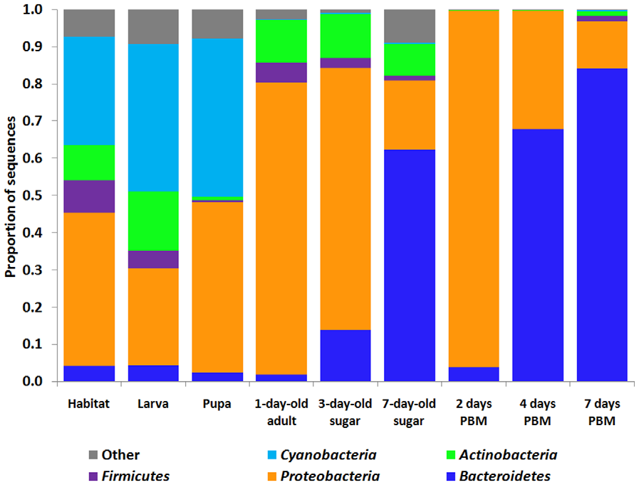
Microbiota fluctuations in mosquito
Larval-pupal stage: Cyanobacteria
Adult (sugar): Proteobacteria (Enterobacteriaceae)
Adult (7-day-old) : Bacteroides (Flavobacteriaceae)
Adults (PBM): Proteobacteria (Enterobacteriaceae, Aeromonadaceae and Pseudomonadaceae)
Adults (7 days PBM): Bacteroides
(Wang et al, 2011)

Slide 24
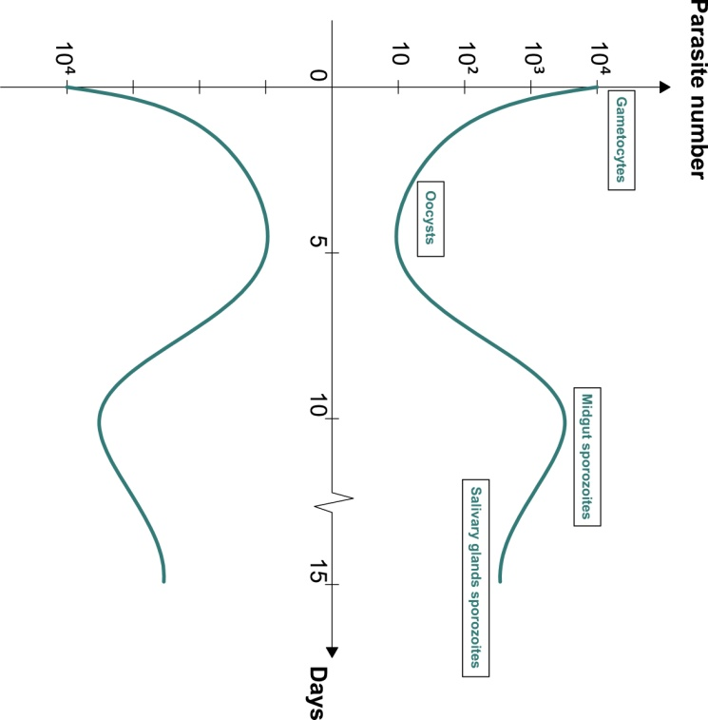
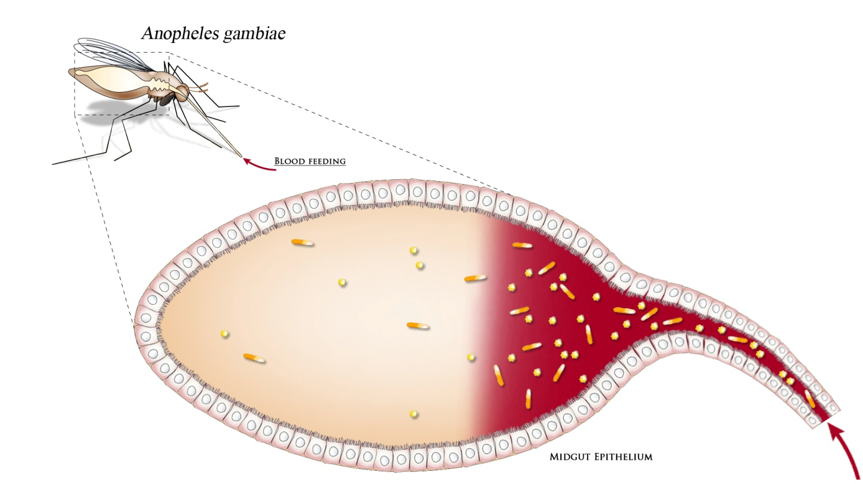
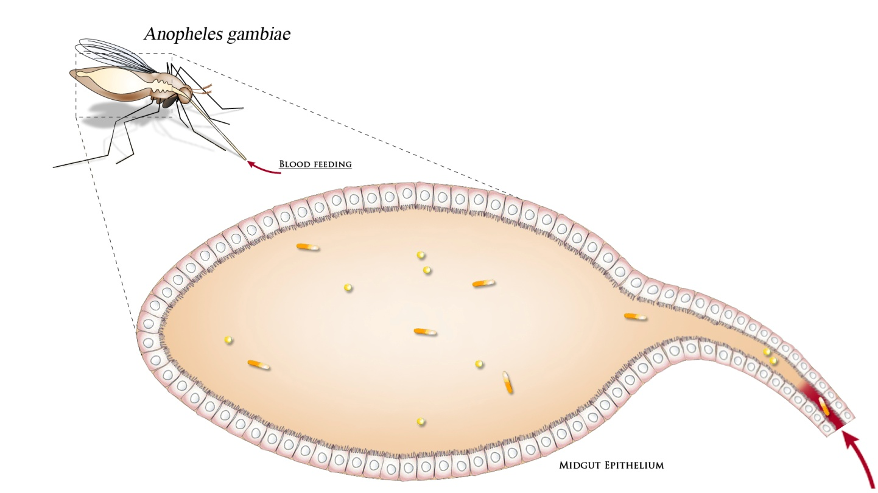
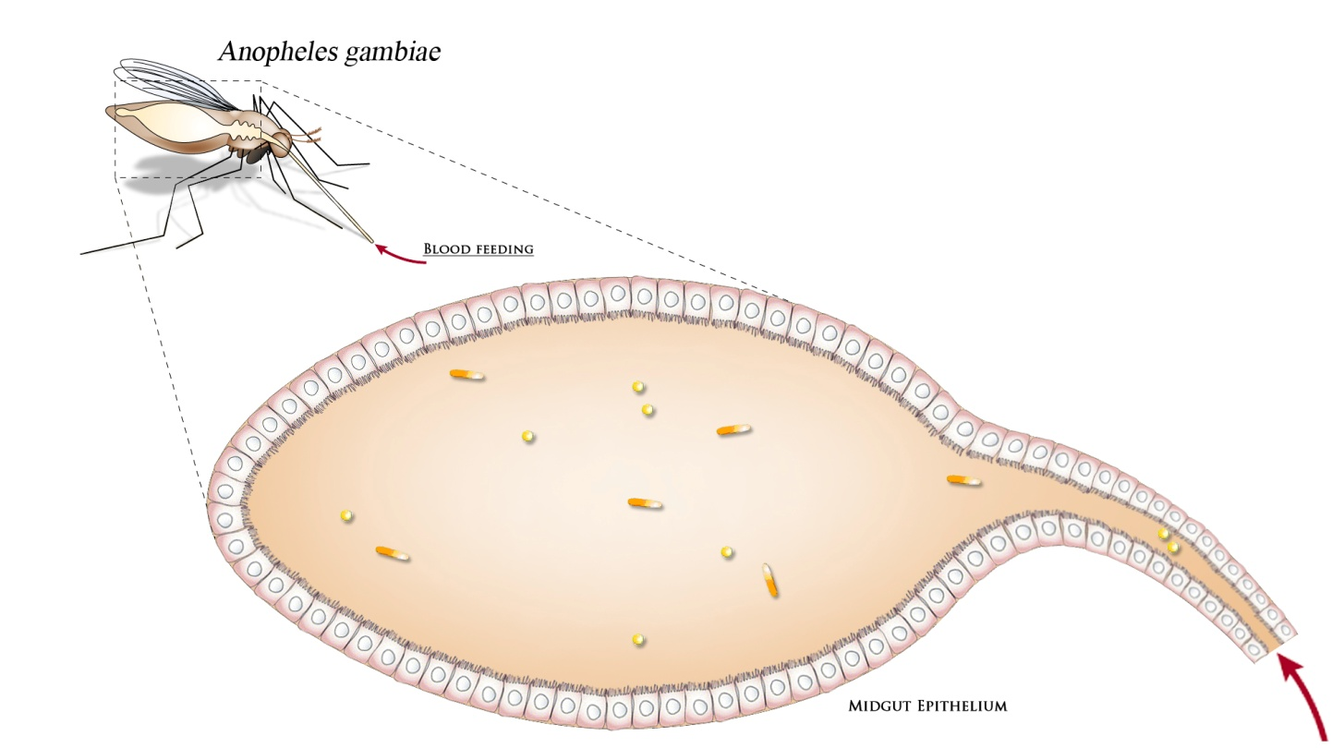
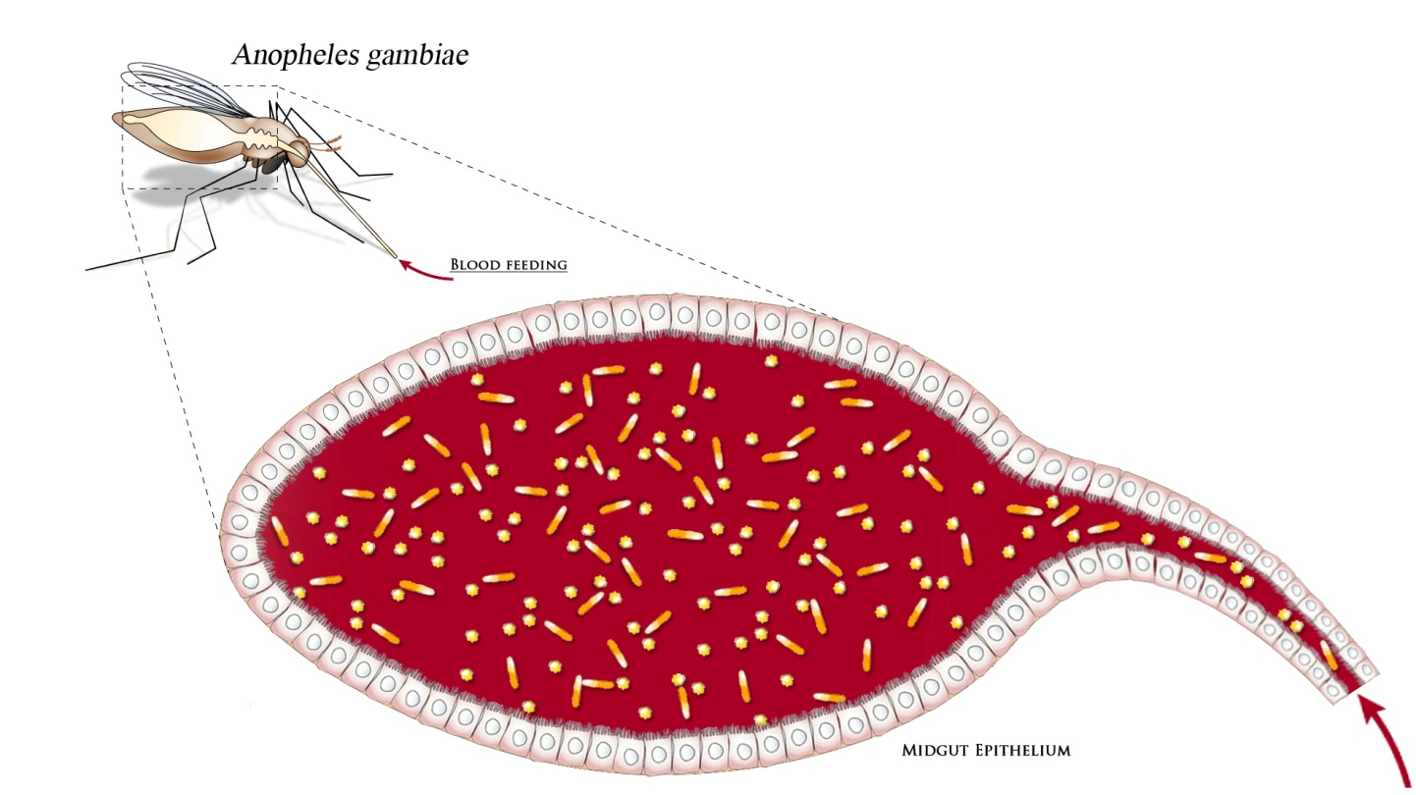
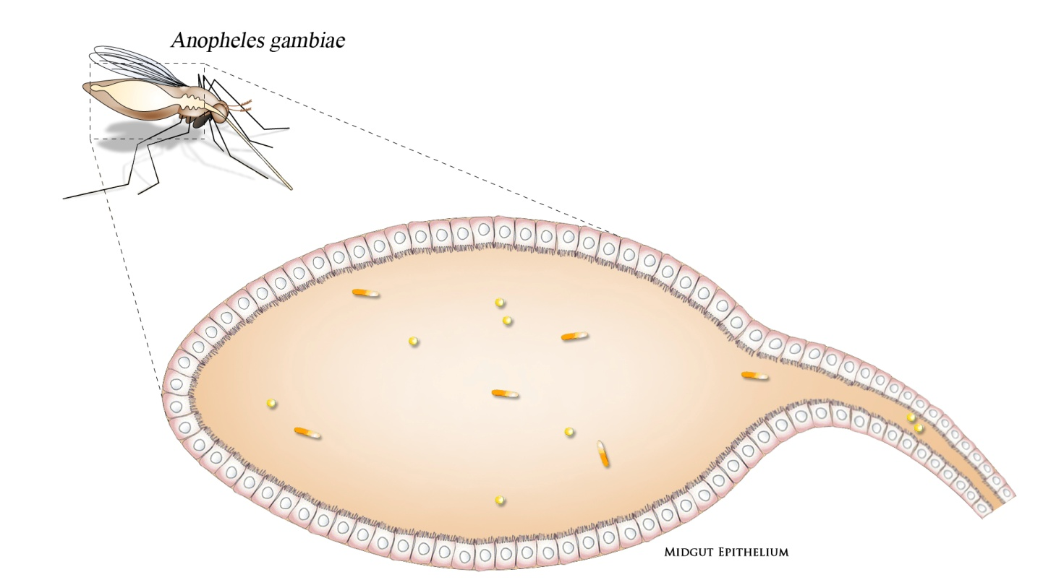
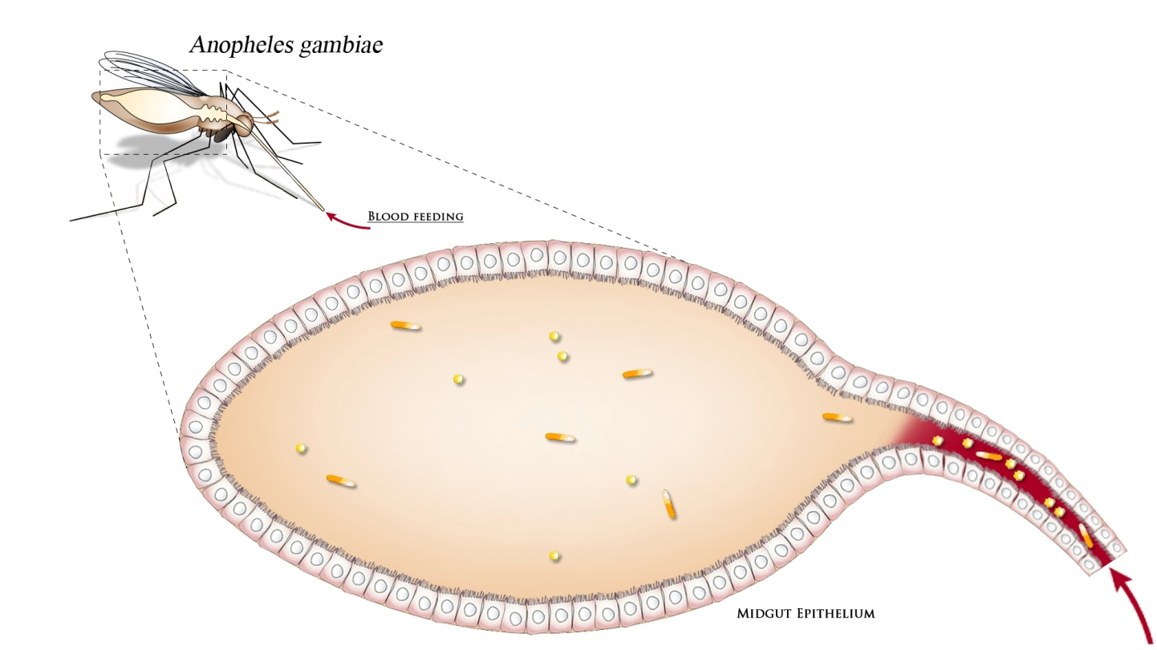
Effects on Plasmodium transmission
Colonization of Gram-negative bacteria species has been associated with an inhibitory activity on the sporogonic development of the parasite

Slide 25
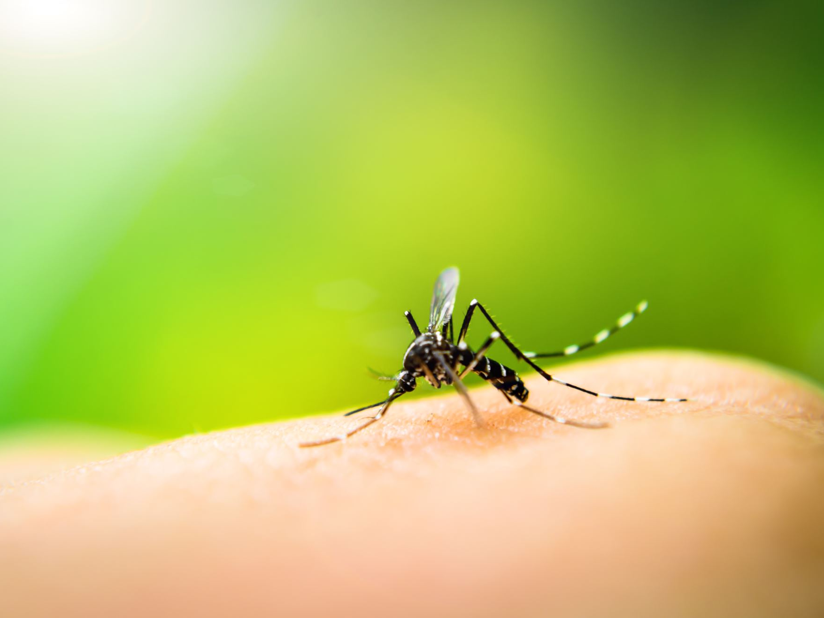
Wolbachia as a tool for controlling mosquito-borne diseases

Slide 26
Wolbachia in insects
Wolbachia is an α-proteobacterium, first identified in the ovaries of Culex mosquitoes in 1924 and is probably the best known endosymbiotic microbe in the biosphere. It is thought to infect up to 76% of the millions of insect species on Earth

Slide 27
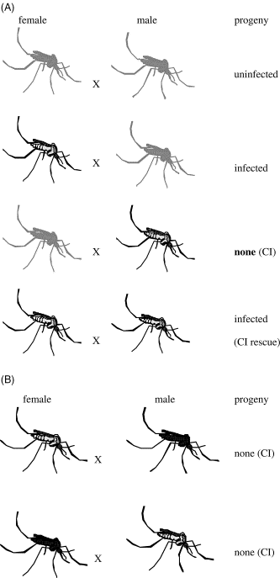
The success of these intracellular bacteria has been attributed to their ability to induce a range of reproductive distortions in their hosts to increase the reproductive success of infected females, thus improving maternal transmission of Wolbachia.
These traits include transforming genotypic males into phenotypic females, modifying male sperm so that females cannot produce offspring unless they mate with a male infected with the same Wolbachia strain, or inducing parthenogenetic reproduction of females.
Wolbachia can also increase host fitness by influencing nutrition and development and providing resistance to pathogens

Slide 28
Wolbachia in mosquitoes
Many species of mosquitoes are home to Wolbachia (eg Ae. albopictus)
Rarely detected in the whole genus Anopheles * and in Ae. aegypti
We can "force" Wolbachia to infect Anopheline and Ae. aegypti

Slide 29

Wolbachia in Mosquitoes
The approaches using Wolbachia for the control of the mosquito-borne diseases mentioned above rely on the successful stabilization of Wolbachia infections, usually by purified Wolbachia microinjection from infected insect hosts.

Slide 30


How to use Wolbachia to control MBD’s ?
Turley et al, PLoS Negl Trop Dis. 2009 September; 3(9): e516.

Slide 31

A “drunk” mosquito!

Slide 32


Life shortening and priming the immune system
The expression of six immune genes were analyzed by qRT-PCR: leucine-rich repeat immune protein, LRIM1; thioester-containing protein, TEP1; cecropin, CEC1; defensin, DEF1; C-type lectin, CTL4; and clip-domain serine protease, CLIPB3.
Adult An. gambiae females were injected with E. coli, wMelPop or the buffer alone, 2–3 days post-eclosion, and RNA was extracted from these adults eight days after injection. Expression was normalized to non-injected adult females of the same age from the same colony.
Most pathogens require a relatively long development period in their vector before they can be transmitted to a new human host; therefore, only the "older" insects have epidemiological importance.
Wolbachia can shorten the life span of the mosquito by reducing / abolishing the competence of the vector

Slide 33



Slide 34




Wolbachia to eliminate Dengue(www.eliminatedengue.com)
These studies mark the first time that a deliberate Wolbachia-mediated population-replacement strategy has been attempted in nature, and herald the beginning of a new era in the control of mosquito-borne diseases.
The advantage of population-replacement approaches is that, once established, they are self-propagating. And because the mosquito population is simply changed rather than eliminated, effects on the ecosystem should be minimal.

Slide 35
Anopheles and symbionts
For many years we have started an investigation aimed at:
Identifying and characterizing mosquito symbionts "suitable" for the SC;
Use them in the paratransgenic control of vector-borne disease.

Slide 36

Symbiosis in Anopheles
This enormous scientific effort was not accompanied by in-depth studies aimed at characterizing the bacterial components associated with the mosquito, therefore, until a few years ago, only little information was available (Lindh et al 2005).

Slide 37


Malaria paratransgenesis
Symbiont identification and isolation
Block of the transmission
Symbiont transformation
Reintroduction of
modified symbiont

Slide 38



The Gram- a-proteobacterium Asaia: a dominant symbiont of mosquito vectors
√Localizes properly: in the midgut and salivary glands thus overlapping Plasmodium localization, and in the gonads.
√ It’s cultivable and transformable with exogenous DNA.
√ Modified strains of Asaia are able to efficiently colonize midgut, salivary glands and gonad
√ Transmission occurs trough horizontal (co-feeding, mating) and vertical routes (maternal transmission). In particular vertical routes offers the chance to introduce engineered bacteria into mosquito populations in the field!

Slide 39

We have provided evidence that the transfer of Asaia from parents to offspring is likely mediated by a mechanisms of egg smearing
D
Damiani et al, Microbial Ecology, 2010
Our demonstration of vertical transmission of Asaia from female mosquito to progeny is important because it suggests means to spread recombinant bacteria in field populations. A female mosquito typically lays 50~80 eggs (half of which develop into female adults).
This amplification of the number of mosquitoes carrying Asaia should result in rapid spread of the bacterium into the local population. If mosquitoes not carrying Asaia lay eggs in the same breeding site, the speed of the spread would be enhanced

Slide 40



Asaia: potentially a “suitable” candidate for paratransgenesis!

Slide 41

Anti-Plasmodium effector molecules
Parasite killing: around 15 i.e. Scorpin, Shiva, Gambicin;
Interaction with parasite: i.e. single chain antibodies;
Interaction with mosquito midgut or salivary gland epithelia: i.e. SM1
Manipulation of mosquito immune system: i.e. AKT, Rel2

Slide 42

Possible applications in malaria control
Asaia has been transformed for expressing the
scorpin as effector molecule
Interference with malaria transmission has been already proved!

Slide 43


Asaia-PM mosquitoes: release in confined field conditions
By the use of facilities hosted in PERUGIA we are now monitoring the spread of the bacteria in the “recipient populations” and in subsequent generations to acquire the basic parameters for the development of mathematical models.

Slide 44


Asaia-PM mosquitoes: release in confined field conditions
Release of paratransgenic males in cages hosting a w.t. population
Release of paratransgenic bacteria in feeding stations within the cages to monitor the spread of the bacteria in a SAD population
At defined time intervals, aliquots of mosquitoes will be analyzed to verify the horizontal spread of the bacteria, as well as the vertical transmission through analysis of next generations

Slide 45

SEMI-FIELD CAGES in Muccia (8 kms from Camerino)

Slide 46


Asaia-PM mosquitoes: release in confined field conditions

Slide 47



Asaia-PM mosquitoes: proof of principle for malaria control

Slide 48
Asaia-PM mosquitoes: proof of principle for malaria control

Slide 49
Combining Asaia and Wolbachia

Slide 50

Asaia circulation in human samples
One of the problems related to the use of bacteria in the paratransgenic control of insect-borne diseases is their potential infectivity and virulence for humans and animals.
This is particular crucial for bacteria that localize at the level of the salivary gland implying potential transmission by the mosquito saliva.
We have studied the “circulation” of Asaia within human samples.
Epis et al, 2012

Slide 51
Asaia circulation in human samples
This data coupled with the fact that Asaia has been found in tropical flowers (now quite widespread like for instance the plumbago tree), in grapevine, in glutinous fermented rice and in insects is a strong evidence that Asaia is most likely a non-pathogenic bacterium (none of the known acetic acid bacteria has thus far been shown to be pathogenic).

Slide 52

Ethical issues
Consequently, we have performed a pilot study in Burkina Faso to explore the perspectives of Burkinabè citizens and of national and government organisations familiar with Bt cotton to gauge paratransgenesis receptiveness
We aim to progress this approach in Burkina faso and extend it to other African (i.e. Mali, Ghana) and Asian countries (i.e. Laos) in endemic region for MBD to properly address all the concerns related to the release of paratransgenic mosquitoes in field.

Slide 53

Asaia may stimulate host immune response

Slide 54

Asaia activates immune genes in mosquito eliciting an anti-Plasmodium response.

Slide 55



Activation of immune genes in leafhopper by Asaia

Slide 56



Asaia shows sign of genome reduction
----

Slide 57
Asaia symbionts from insects underwent convergent genome reduction, preserving an insecticide-degrading gene
*

Slide 58


Not only Asaia…

Slide 59


Metagenomic analysis in three different organs / tissues of nine different mosquito species

Slide 60

Metagenomic analysis in three different organs / tissues of nine different mosquito species
Many other bacteria could be used in the SC of VBD's

Slide 61

Metagenomic analysis in three different organs of Aedes albopictus (the tiger mosquito)
Bacterial diversity between organs is quite high. Also in the reproductive organs dominated by Wolbachia, and in the female salivary glands, dominated by Serratia, there is still a relevant component of additional bacteria.

Slide 62

Take home message

Slide 63








