Slide 1
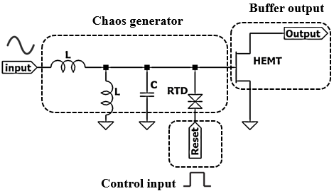
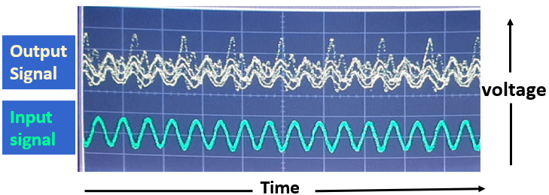
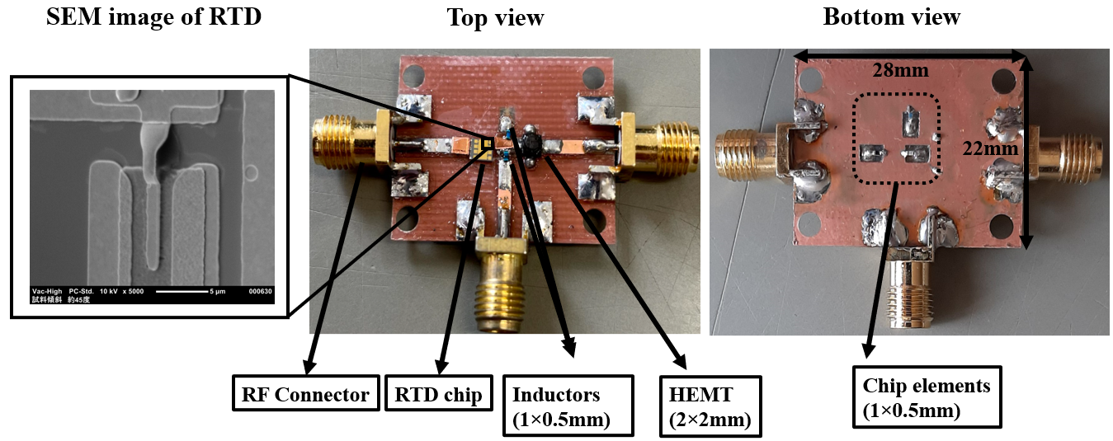
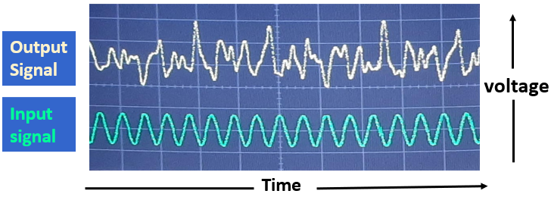
A microwave chaos generator circuit employing a resonant tunneling diode
Umer Farooq^{1, *}, Masayuki Mori¹, Koichi Maezawa¹
¹Faculty of science and engineering, University of Toyama, Japan
Introduction
Period adding behavior from experimental data
A resonant tunneling diode (RTD) is a high-speed nanodevice based on III-V compound semiconductors. Ultra-high frequency oscillations at around 2 THz [1] have been already demonstrated for the oscillators using an InP-based RTD. One of the most important features of the RTD is its strong non-linearity. Such non-linearity generates complex signals including chaos, which can be used for various applications. In this paper, a chaos generator circuit using an RTD has been fabricated and characterized in a microwave frequency range on a PCB substrate.
Keywords: Resonant tunneling diode; InP; Microwave Chaos; PCB
The behavior of the circuit was demonstrated experimentally with a various-frequency input. Period adding behavior has been clearly shown in our experiment. This circuit depicts period adding behavior as well as chaotic by varying input frequency.
Single period:
At 2.5GHz sinusoidal input signal.
Chaos generator using a resonant tunneling diode
Our circuit uses an InP-based RTD for the negative differential resistance device in the van der pol oscillator [2]. It is well known that the van der pol oscillators show complex chaotic behavior as well as period adding behavior when perturbed with external sinusoidal forcing signal. Using RTD, ultra-high frequency chaos signals higher than microwave frequencies can be generated easily with this circuit. This may open up various applications such as secure communications. In this study, we also implement a control circuit that enables/disables chaotic oscillations and resets the circuit to the same initial state. This permits us to observe non-periodic chaos signals with a sampling oscilloscope.
Double period:
At 4.95GHz sinusoidal input signal.
Microwave chaos generator and control circuit
Triple period:
At 7.65GHz sinusoidal input signal.
Operating principle:
The Periodic oscillating signal is applied at the input port of chaos generator.
Pulse signal with DC bias is injected at the reset node.
At pulse ON state, circuit nonlinearities become stronger, which generates chaos.
At pulse OFF state, circuit nonlinearities become weaker, which outputs sinusoidal signal
Direct observation on sampling oscilloscope
The chaos signal is non-periodic, so that, one cannot observe it using a sampling oscilloscope. However, with a repeated control pulse signal, the circuit returns to the same initial condition, and it outputs a repeated chaos signal. This permits us to observe chaotic waveforms on the sampling oscilloscope.
Screen of the sampling oscilloscope is shown in the following figures.
Basic microwave resonant tunneling chaos generator and control circuit
The purpose of HEMT is to buffer and amplify the chaotic output
Prototype circuit on PCB substrate
The circuit was integrated using chip elements and an RTD on a PCB substrate
RTD was fabricated with conventional photolithography, wet etching, and lift-off process, and interconnected employing bonding wires
Blur output without control signal
Clear output with control signal
T. Maekawa, H. Kanaya, S. Suzuki, and M. Asada, Appl. Phys. Exp., vol. 9, 024101, 2016.
Y. Kawano, S. Kishimoto, K. Maezawa, T. Mizutani, Jpn. J. Appl. Phys. Vol. 39 (2000) pp. 3334–3338

