Slide 1



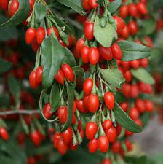
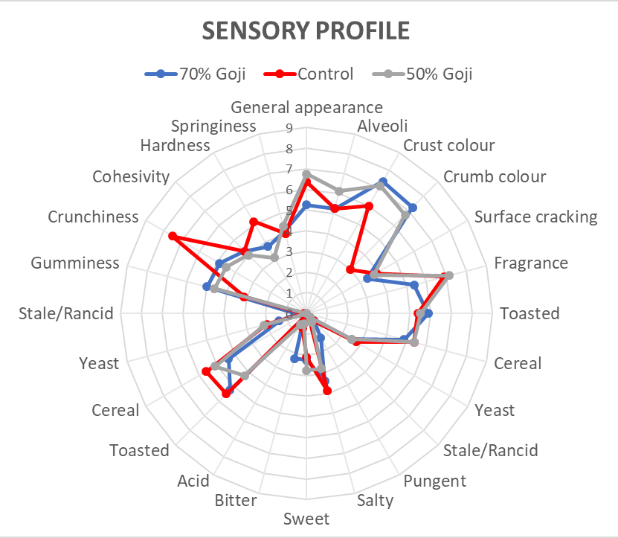
Functionalization of bread with Lycium barbarum (goji) puree
Monica Rosa Loizzo^{1,*}, Antonio Mincione¹, Rosa Tundis¹, Vincenzo Sicari²
¹Department of Pharmacy, Health and Nutritional Sciences, University of Calabria, 87036 Arcavacata di Rende (CS), Italy. (Email: monica_rosa.loizzo@unical.it)
²Department of Agraria, University “Mediterranea” of Reggio Calabria, Salita Melissari, Feo di Vito, Reggio Calabria (RC), 89124, Italy
INTRODUCTION
With a great variety of foods on the market, the consumer’s responsibility is choose food that can allow him to maintain his state of health and prevent chronic diseases. For this reason, several functional foods classified as fortified or enriched foods are developed. In fact, the functional food market size is estimated to reach $267,924.4 million by 2027 [1].
Functional foods are able to provide essential nutrients such as vitamins, minerals and bioactive substances. The opportunities for incorporating these bioactive constituents into bread have grown rapidly as bread is the staple food in many countries. Lycium barbarum (goji) berries are a source of phytochemicals with important biological functions and are designated as super-fruits [2].
The aim of the study was to add goji puree at different percentages (50 and 70%) to the bread dough to evaluate the impact of this addition of bread quality and health properties.
MATERIALS AND METHODS
Goji sample and bread preparation
Commercial fresh goji fruits were purchased to be used for bread enrichment. The bread enriched with goji puree was made at the "Neto" bakery in Reggio Calabria. The type of bread is ciabatta, obtained in three different compositions. The first, which we will call BTEST, is the classic ciabatta made by the same oven, without the addition of goji. The second, which we will call "B50G", was added with goji puree in the proportion of 50g/kg of dough. The third and last, which we will call "B70G", was added with goji puree in the proportion of 70g/kg of dough
Texture analysis
Cut slice and Texture Profile Analysis (TPA) rheological analyses were performed with a TA-XT Plus Texture Analyzer (Stable Micro Systems Ltd, UK) [3]. Exponent software 6.1.4.0 (Stable Micro Systems Ltd, UK) was used for data acquisition and integration. The Cut Slice test was performed using a Blade Set with Knife probe (HDP/BSK set probe, Stable Micro Systems Ltd, UK) with the following parameters: pre-test speed: 1 mm/sec; test speed: 2 mm/sec; post-test speed: 10 mm/sec; distance: 100 mm; trigger force: 3 g; data acquisition rate: 400 pps. The TPA (Instrumental Texture Profile Analysis) test was performed using a 100 mm compression platen (P/100 compression platen probe, Stable Micro Systems Ltd, UK) probe on a whole bread sample with the following parameters: pre-test speed: 1.00 mm/sec; test speed: 5.00 mm/sec; post-test speed: 5.00 mm/sec; distance: 20.0 mm; trigger force: 5.0 g; data acquisition rate: 400 pps. For each sample, three repetitions were carried out. From test results, the hardness, springiness, cohesiveness, gumminess, chewiness and resilience parameters were taken into consideration. Data were expressed as mean values; means were further analysed by one-way ANOVA and Tukey’s test, at 5% probability, using statistical software (IBM SPSS Statistics for Windows, Version 20, IBM Corp., Armonk, NY, USA).
Sensory analysis
Samples were evaluated by descriptive sensory analysis by a trained panel of 8 adult judges (5 males and 3 females, aged between 23 and 65 years, recruited among departmental faculty staff). Samples were served in a standard sensory booth in random order at room temperature, with data averaged over three replicates. Assessors were trained according to ISO 8586:2012 guidelines for selection, training and monitoring of expert sensory assessors. Additional training was given with reference products to address specific taste and appearance descriptors. Panelists cleansed with mineral water between samples. Judges rated samples on a 10-point structured scale from 0 to 9 for appearance, smell, taste and texture descriptors, with a score 0 indicating the absence of the attribute and 9 an extremely high attribute value.
Preparation of the dough and baking of bread
BTEST
B50G
B70G
Goji bread samples
Samples functional properties
For the evaluation of total phenols content (TPC), Folin-ciocalteu method was used whereas for and radical scavenging activity ABTS test was carried out [4]. Before analysis samples were subjected to hydroacholic extraction procedure.
RESULTS AND DISCUSSION
Cut slice test performance evidenced that enriched Goji breads exhibited significantly lower hardness values compared to the control. TPA hardness parameter, in opposition to the same one in the Cut slice test, did not show significant differences among samples: this could be ascribed to the different instrument fixtures used for testing (Table 1). Main appearance descriptors were found to be the presence of crust and crumb colouring. The main olfactory descriptor was fragrance flavour, while principal taste descriptors were toasted and cereal; all textural descriptors were actively recognized by panelists, with a particular emphasis on crunchiness. Modified breads at both 50% and 75% Goji extract differentiated from control bread for significantly higher appearance descriptors. Flavour and taste descriptors did not show significant differences. Textural descriptors showed a significant decrease in crunchiness as compared to control bread (Table 2).
Table 1. Cut slice rheological characteristics of breads.
Bread Sample | Cut Slice test
 | Hardness (g)
Control | 13945.62±1263.08ª
50% Goji | 9965.30±923.77^{b}
70% Goji | 9113.69±1958.85^{b}
Table 2. Texture Profile Analysis rheological characteristics of breads.
Bread Sample | Texture Profile Analysis (TPA) test
 | Hardness (g) | Springiness (mm) | Cohesiveness | Gumminess (g) | Chewiness (g) | Resilience
Control | 6871.96±1467.12° | 0.83±0.03° | 0.52±0.08° | 3550.68±521.63° | 2942.90±468.30° | 0.19±0.04°
50% Goji | 6556.93±3925.43° | 0.81±0,02° | 0.68±0.02^{b} | 4412.09±2574.79^{b} | 3847.27±2258.49^{b} | 0.31±0.01^{b}
70% Goji | 7616.37±3824.32ª | 0.87±0.02ª | 0.67±0.03^{b} | 5097.56±2485.90^{b} | 4449.18±2245.96^{b} | 0.32±0.04^{b}
Bread enriched with 50% of goji puree (B50G) showed a total phenol content of 42.07 mg gallic acid equivalent/100 g bread and an ABTS radical scavenging activity of 833.48 µmol Trolox/100g bread.
CONCLUSION
Goji bread sensory profile
Collectively, our results demonstrated the potential health properties of this enriched bread.
REFERENCES
[[1] Functional Food Market by Ingredient (Probiotics, Minerals, Proteins & Amino Acids, Prebiotics, & Dietary Fibers, Vitamins and Others), Product (Bakery & Cereals, Dairy Products, Meat, Fish & Eggs, Soy Products, Fats & Oils and Others), Application (Sports Nutrition, Weight Management Clinical Nutrition, Cardio Health, and Others): Global Opportunity Analysis and Industry Forecast 2021–2027, (https://www.alliedmarketresearch.com/functional-food-market, access 24 June 2021); [2] Yao, R.; Heinrich, M.; Weckerle, C.S. (2015). The genus Lycium as food and medicine: A botanical, ethnobotanical and historical review. J. Ethnopharmacol., 212, 50-66. https://doi.org/ 10.1016/j.jep.2017.10.010. Epub 2017 Oct 16. PMID: 29042287. [3] Carullo, G.; Scarpelli, F.; Belsito, E.L.; Caputo, P.; Oliviero Rossi, C.; Mincione, A.; Leggio, A.; Crispini, A.; Restuccia, D.; Spizzirri, U.G.; Aiello, F. Formulation of New Baking (+)-Catechin Based Leavening Agents: Effects on Rheology, Sensory and Antioxidant Features during Muffin Preparation. Foods 2020, 9, 1569. https://doi.org/10.3390/foods9111569; [4] Sicari, V.; Pellicanò, T.M.; Laganá, V.; Poiana, M. (2018). Use of orange by‐products (dry peel) as an alternative gelling agent for marmalade production: Evaluation of antioxidant activity and inhibition of HMF formation during different storage temperature. J. Food Proces. Preserv. 42. e13429. 10.1111/jfpp.13429.

