Slide 1
Effective production of bioactive phenolic compounds from olive stones
Carmen Padilla-Rascón^{1,2*}, Encarnación Ruiz^{1,2}, Eulogio Castro^{1,2}, Luisa B. Roseiro³, Luis C. Duarte³, Florbela Carvalheiro³
¹ Department of Chemical, Environmental and Materials Engineering, Universidad de Jaén, Jaén, Spain.
² Centre for Advanced Studies in Earth Sciences, Energy and Environment (CEACTEMA), Universidad de Jaén, Campus Las Lagunillas, 23071, Jaén, Spain
³ Unidade de Bioenergia e Biorrefinarias, LNEG—Laboratório Nacional de Energia e Geologia, Lisboa, Portugal.
* Correspondence: cpadilla@ujaen.es; Tel.: +34 953 21 36 45

Slide 2
Index
Introduction
Objective
Materials and methods
Results
Conclusions
References
Acknowledgments
1

Slide 3
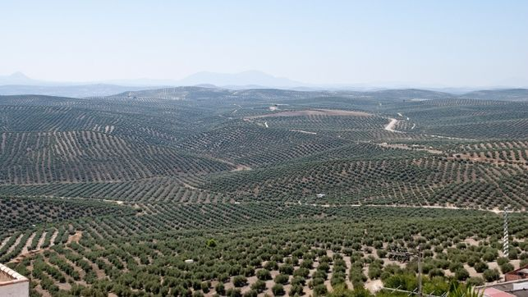
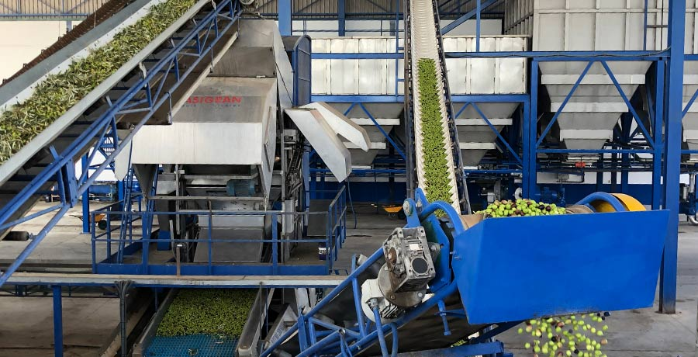
Introduction
Olive growing and the associated industry generate a large amount of waste.
Olive growing
Associated industry
Olive stone
Leaves
Pomace
Waste water
Pruning
2

Slide 4
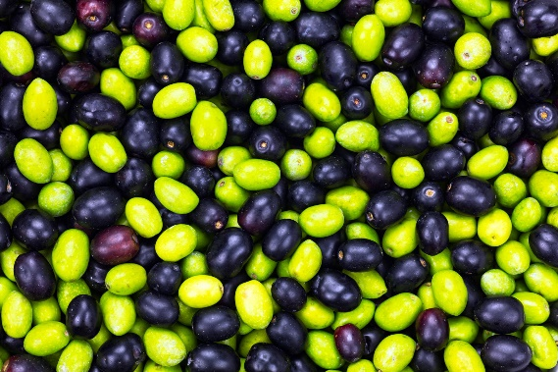
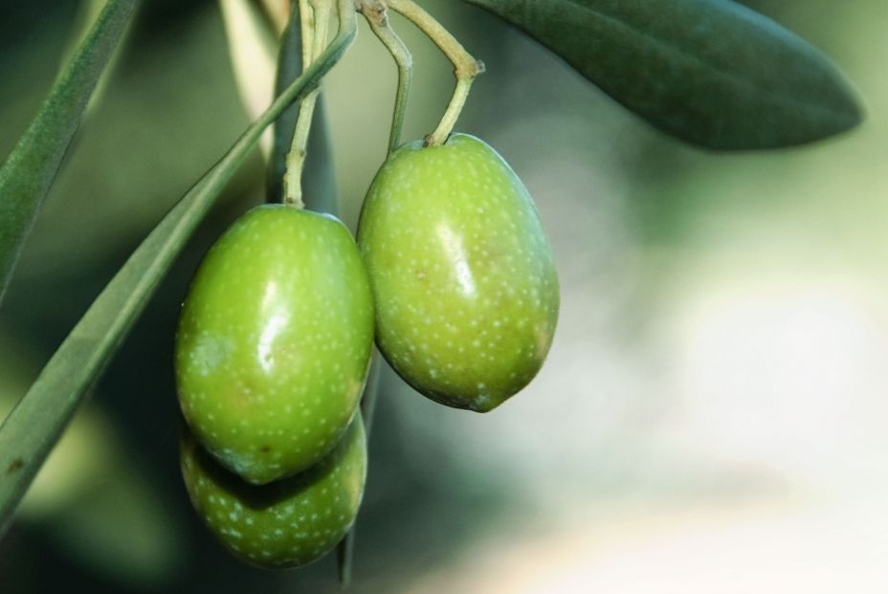
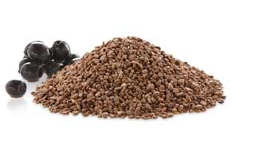
Introduction
.
,6 million tonnes/year of olives stones in Spain
-
,The olive stone accounts for 10% of the weight of the olive
.
,600,000 tonnes of olive stone per year
Olive stones (OS) are a by-product generated in the olive oil production process, obtaining an average of 600,000 tons of OS/year.
3

Slide 5
Introduction
Olive stones:
• Renewable and abundant lignocellulosic biomass.
• High concentration of sugars.
• Centralised location in mills and associated industries.
It is an ideal material to obtain high added value products in the BIOREFINERIES concept:
Ethanol
Furfural
Antioxidants
Biopolyols
Proteins
Lignin
Xylitol
Antioxidants present potential health benefits and applications for the pharmaceutical and food industries.
4

Slide 6
Objective
The aim of this work is the valorization of the liquor obtained after a two-stage process, first acid stage followed by an organosolvent stage, for its use as a biosource of preservatives and non-synthetic additives for the food industry.
5

Slide 7
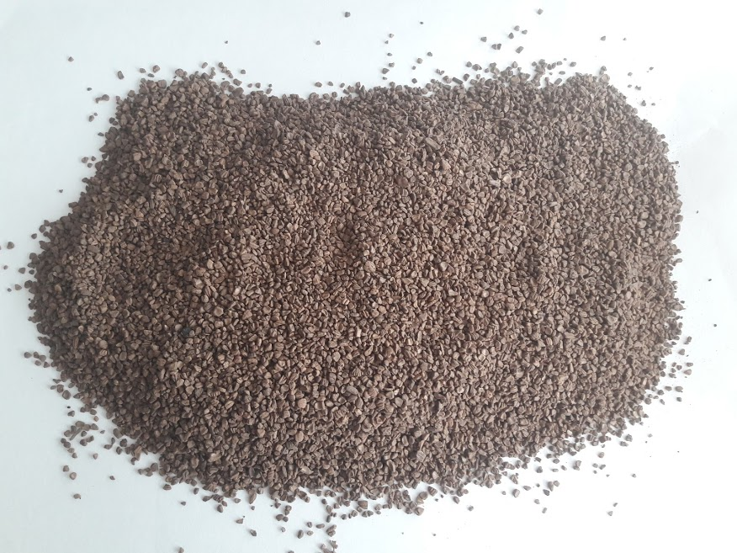
Materials and methods
BIOMASS CHARACTERIZATION
OLIVE STONES
Sugars
Extractives
Acid Insoluble Lignin
Acid Soluble Lignin
Acetyl gropus
Ash
METHODOLOGY
6

Slide 8
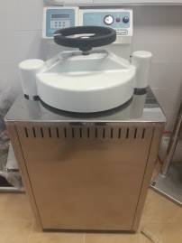
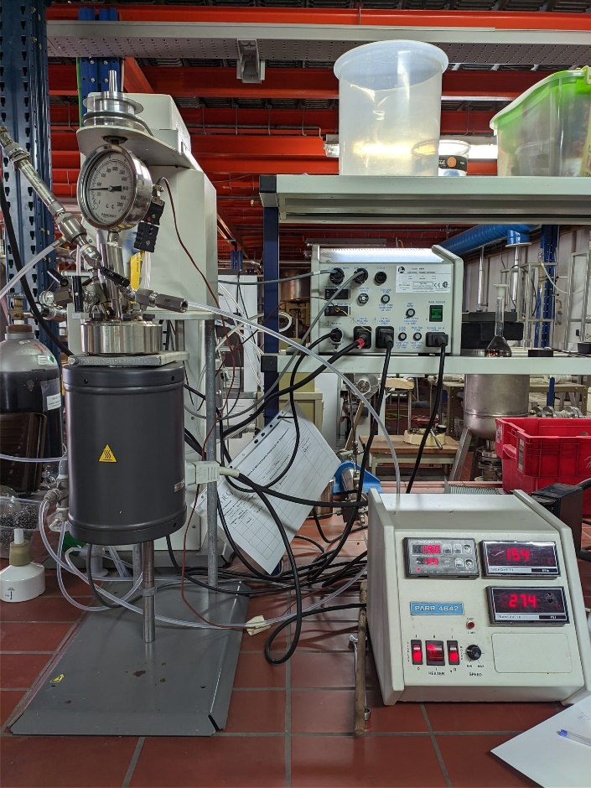
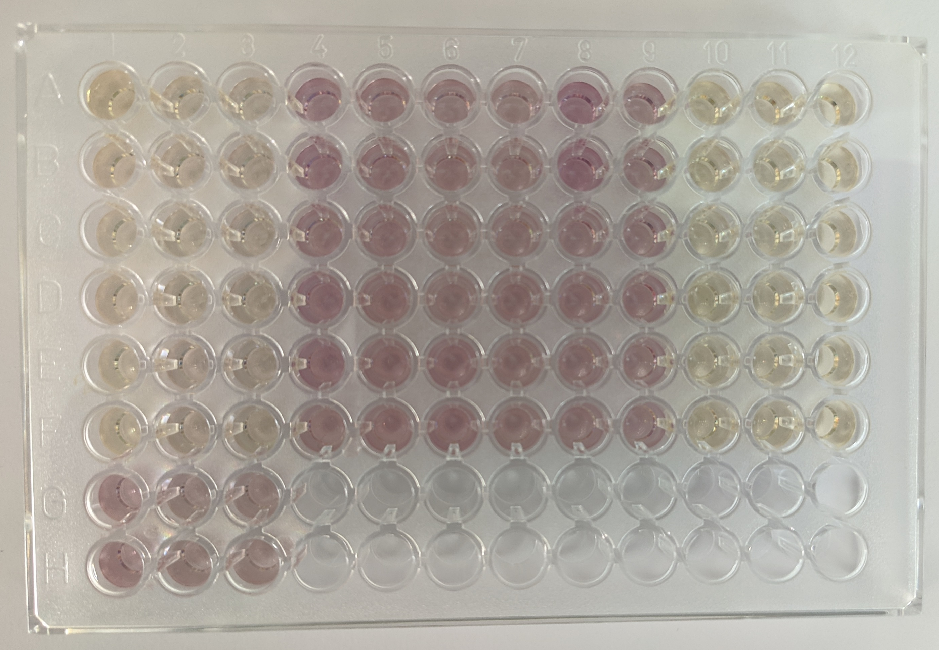
Materials and methods
ORGANOSOLV
DELIGNIFICATION
TOTAL PHENOLIC CONTENT (TPC)
ACID HYDROLYSIS
OLIVE STONES
Solid
Liquid
Folin-Ciocalteu
Solid
ANTIOXIDANT ACTIVITY
Liquid
Box-Behnken design
Time → 60 minutes
Temperature →128 °C
Biomass loading → 33%
H₂SO₄ concentration →10.55%
(g acid/100 g biomass)
Ethanol:water → 50:50 (w/w)
Biomass loading → 1/6 solid/liquid (w/w)
Temperature → 140-190 °C
H₂SO₄ concentration → 0-100mM
Time → 0-150 min
DPPH
7

Slide 9
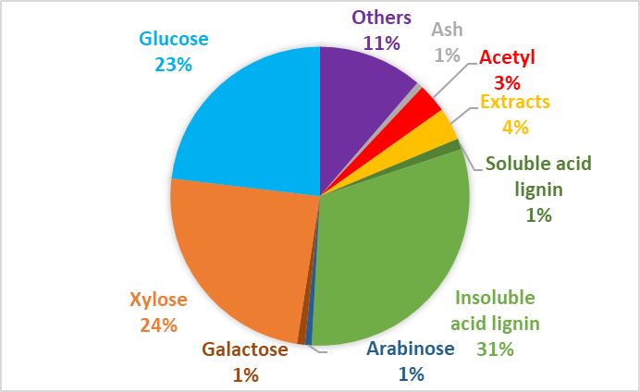
Results
OLIVE STONES COMPOSITION
Olive stones is a lignocellulosic material composed mainly of cellulose, hemicellulose and lignin.
Xylose is the main hemicellulosic sugar.
8

Slide 10
Results
TWO-STAGE EXPERIMENTAL
FIRST ACID STAGE
Most of the hemicelluloses are solubilized in the first acidic stage.
In the second organosolv stage, most of the lignin is removed, resulting in a cellulose-rich solid.
The liquor obtained in the second organosolv stage is enriched in phenolic compounds and antioxidants.
SECOND ORGANOSOLV STAGE
9

Slide 11
Results
TOTAL PHENOLIC CONTENT OF THE ORGANOSOLV LIQUID
The phenols concentration measured in the liquors is between 5 and 12 g GAE/L.
Tannins between 2 and 6 GAE g/L. Tannins are non-synthetic preservatives and additives.
It implies a phenols yield of 7 GAE g/100 g of processed material, being in the range of those obtained from other vegetable sources.
The highest concentrations of phenols and tannins are obtained in the experiments performed at 165ºC and 50 mM H₂SO₄ and at 190 °C in those with longer reaction time.
10

Slide 12
Results
ANTIOXIDANT ACTIVITY OF THE ORGANOSOLV LIQUID
No major variations were observed in the concentrations obtained in the different experiments.
The highest concentrations are found in the experiments at 190 °C and with times between 30 and 105 minutes, reaching almost 3 g TE/L.
11

Slide 13
Conclusions
Therefore, with the present study, we were able to determine that the liquor obtained after organosolv pretreatment of olive stones can be also valued as a bio-source of non-synthetic preservatives and additives for the food industry.
12

Slide 14
References
Padilla-Rascón, C.; Ruiz-Ramos, E.; Romero, I.; Castro, E.; Oliva, J.M.; Ballesteros, I.; Manzanares, P. Valorisation of Olive Stone By-Product for Sugar Production Using a Sequential Acid/Steam Explosion Pretreatment. Ind. Crops Prod. 2020, 148, 112279, doi:10.1016/j.indcrop.2020.112279.
Padilla-Rascón, C.; Romero-García, J.M.; Ruiz, E.; Romero, I.; Castro, E. Microwave-Assisted Production of Furfural from the Hemicellulosic Fraction of Olive Stones. Process Saf. Environ. Prot. 2021, 152, 630–640, doi:10.1016/j.psep.2021.06.035.
Gómez-Cruz, I.; Romero, I.; Contreras, M. del M.; Padilla-Rascón, C.; Carvalheiro, F.; Duarte, L.C.; Roseiro, L.B. Exhausted Olive Pomace Phenolic-Rich Extracts Obtention: A First Step for a Biorefinery Scheme Proposal. Proceedings 2020, 70, 10, doi:10.3390/foods_2020-07612.
13

Slide 15
Acknowledgments
The authors want to acknowledge the financial support from Agencia Estatal de Investigación (MICINN, Spain) and Fondo Europeo de Desarrollo Regional, reference project ENE2017-85819-C2-1-R.
Carmen Padilla Rascón expresses her gratitude to the Universidad de Jaén for financial support grant R5/04/2017 and Acción 6 "Ayudas para estancias breves de Personal Investigador en Formación encaminadas a la obtención del título de Doctor con Mención Internacional".
This research has been carried out at the Biomass and Bioenergy Research Infrastructure (BBRI)-LISBOA-01-0145-FEDER-022059, supported by Operational Programme for Competitiveness and Internationalization (PORTUGAL2020), by Lisbon Portugal Regional Operational Programme (Lisboa 2020) and by North Portugal.
14

Slide 16
Effective production of bioactive phenolic compounds from olive stones
Carmen Padilla-Rascón^{1,2*}, Encarnación Ruiz^{1,2}, Eulogio Castro^{1,2}, Luisa B. Roseiro³, Luis C. Duarte³, Florbela Carvalheiro³
¹ Department of Chemical, Environmental and Materials Engineering, Universidad de Jaén, Jaén, Spain.
² Centre for Advanced Studies in Earth Sciences, Energy and Environment (CEACTEMA), Universidad de Jaén, Campus Las Lagunillas, 23071, Jaén, Spain
³ Unidade de Bioenergia e Biorrefinarias, LNEG—Laboratório Nacional de Energia e Geologia, Lisboa, Portugal.
* Correspondence: cpadilla@ujaen.es; Tel.: +34 953 21 36 45

