Slide 1
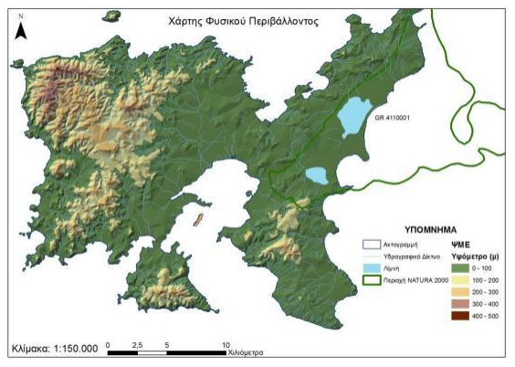
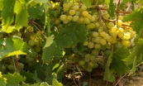
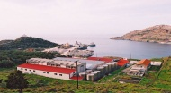
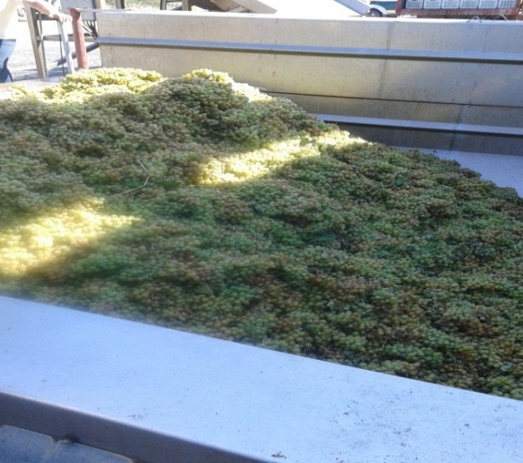
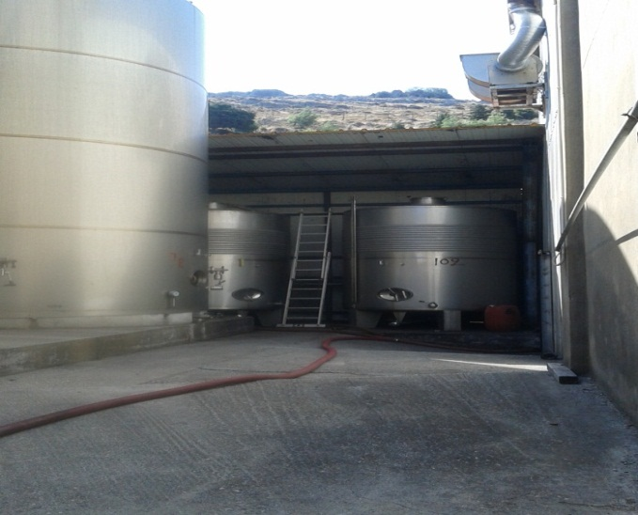
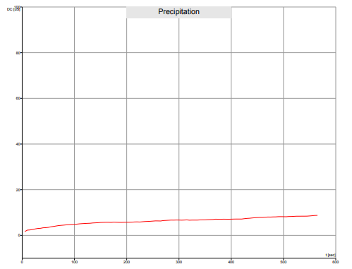
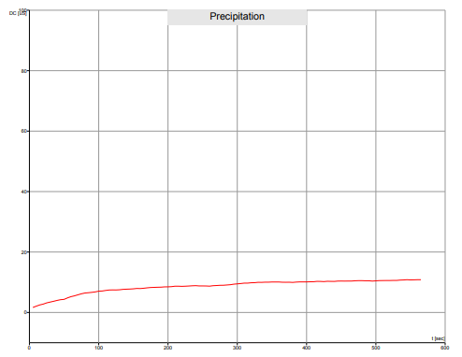
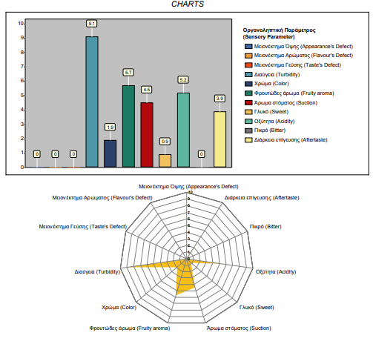
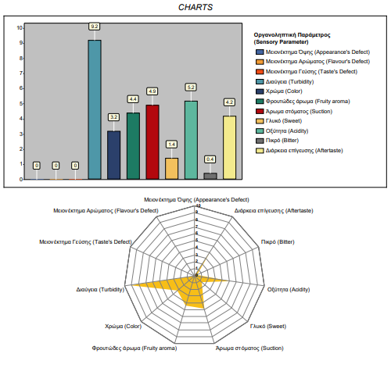
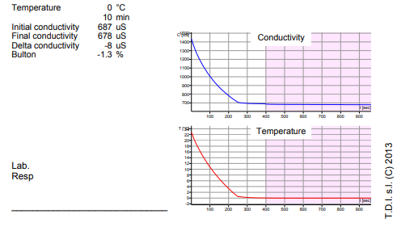
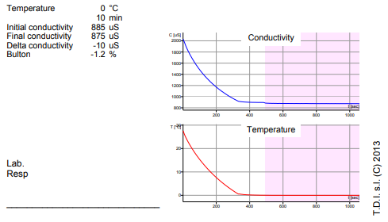
Sulfur dioxide (SO₂) replacement by p-coumaric acid:
a green alternative in wine industry.
Christina Sakarikou*¹, Constantinos Giaginis¹, Zacharoula Kokonozi¹, Nikolaos Vakirtzis², Dimitrios Krassos², Yorgos Kotseridis³, Georgios K. Vasios¹.
(1)Department of Food Science and Nutrition, School of the Environment, University of the Aegean, 81400 Myrina, Lemnos, Greece, (2) Limnos Wines, Cooperative of Limnos, 81400 Myrina, Lemnos, Greece, (3) Department of Food Science and Human Nutrition, School of the Food Science and Nutrition, Laboratory of Enology & Alcoholic Drings (LEAD), Agricultural University of Athens, 11855 Athens, Greece.
*chsakarikou@aegean.gr
Introduction & Study Aim
Sulfur dioxide has been traditionally used in winemaking as an effective preservative even though often its negative taste and health related effects to consumers particularly when it used in excess.
Furthermore, it can induce both the SO₂-related resistance and the SO₂-related viable but not culturable (VBNC) state of different wine yeast and bacteria species.
Currently, sulfur dioxide replacement by plant-derived compounds, used as food bio-preservatives, has been proposed in winemaking, at laboratory scale, as a green and healthier alternative
The aim of this study was to replace sulfur dioxide by p-coumaric acid, a plant-derived phenolic compound, in winemaking at industrial scale in order to produce a safe, natural wine, more sustainable, genuine and healthier.
Materials & Methods
Winemaking of both sulfur dioxide- and p-coumaric acid-treated wine was conducted in parallel at winery industrial scale (into two 10,000 L stainless steel tanks) using the same quantity of the same grape variety (10,000 kg of Lemnos island organic white wine grapes Muscat of Alexandria) during the harvest of 2019 and following the same oenological procedures. The influence of p-coumaric acid on wine properties and quality has been compared with that of sulfur dioxide under the same conditions, after 3 months of storage in bottle. To this end, several analytical parameters of wine related to oenological, microbiological, antioxidant, sensory and safety properties were determined according to International Standards Organization (ISO) and International Organization of Vine and Wine (OIV) official analytical methods for both wine samples.
Results & Conclusions
Table 1. Oenological & antioxidant profile
Figure 1. Stability profile
Figure 2. Sensory profile
PARAMETERS | RESULTS A* / B** | METHOD OF ANALYSIS
Reducing Substances (Glucose + Fructose) | 0.63g/L / 0.1g/L | OIV-MA-AS311-01A
Density at 20°C | 0.9911g/mL / 0.9908 g/mL | OIV-MA-AS2-01A
Alcoholic Strength by Volume at 20°C | 11.39% v/v / 11.08% v/v | OIV-MA-AS312-01A
Total Acidity | 5.10g tartaric acid/L / 5.25 g tartaric acid | OIV-MA-AS313-01
Volatile Acidity | 0.28g acetic acid/L / 0.52g acetic acid | OIV-MA-AS313-02
Total Sulfur Dioxide | 133mg/L / 5.1mg/L | OIV-MA-AS323-04A
Free Sulfur Dioxide | 21mg/L / 0,0 mg/L | OIV-MA-AS323-04A
Phenolics' Index | 8.7 A / 6.5 A | ΟΕ 1001
pH | 3,28 pH units / 3,49 pH units | OIV –MA-AS313-15-PH
Lactic acid | 1.1g/L / 1.14 g/L | OIV-MA-AS313-04 _UHPLC-MS/MS
Citric acid | 0.1g/L / <0.1g/L | OIV-MA-AS313-04 _UHPLC-MS/MS
Tartaric acid | 1.6g/L / 2.4 g/L | OIV-MA-AS313-04 _UHPLC-MS/MS
Malic Acid | 1,22 g/L / 0,01 g/L | OIV-MA-AS313-11
Table 2. Microbiological profile
A*
B**
A*
B**
PARAMETERS | Total Viable Count | Yeasts | Moulds | Lactobacillus spp.
RESULTS A* / B** | 8.6E+02cfu/ml / Estimated 65cfu/mL | 6.0E+02cfu/mL / Presense (<40) cfu/mL | <10cfu/mL / <100cfu/mL | 2.5E+02cfu/mL / Presense (<40) cfu/mL
METHOD OF ANALYSIS | ISO 4833- 1:2013 | ISO 21527- 1:2008 | ISO 21527-1:2008 | MRs Agar. Incubation: 5 days at 30°C, under CO₂ atm. Confirmation: White colonies, Gram(+), nonspore bacillus, Catalase(-), Oxidase(-).
In general, there were no significant differences observed in stability, microbiological, antioxidant and oenological profiles due to sulfur dioxide replacement by p-coumaric acid while sensory profile was slightly ameliorated.
A* dioxide-treated wine sample
B** p-coumaric acid-treated wine sample
This replacement technology resulted a suitable green alternative to sulfur dioxide and could be easily applied by wine industries in order to guarantee
high quality green products.

