Slide 1



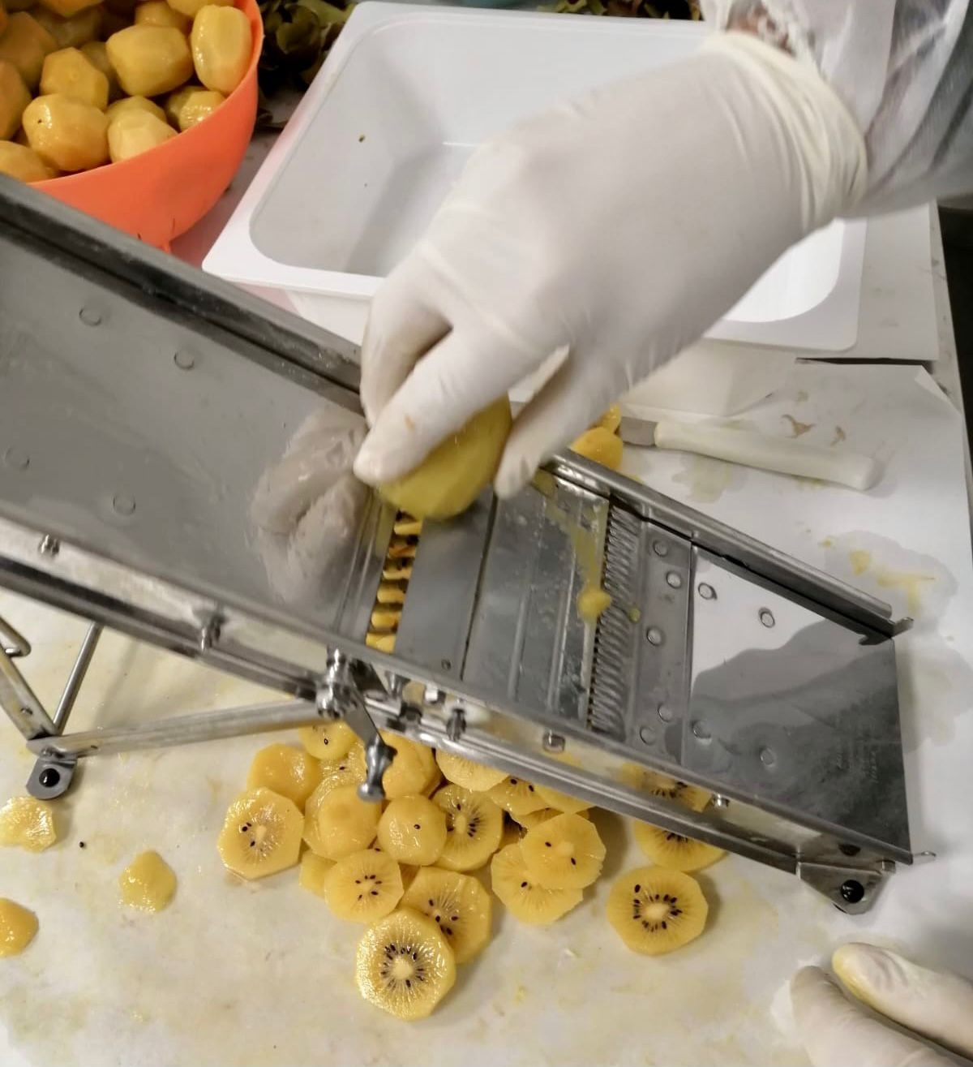
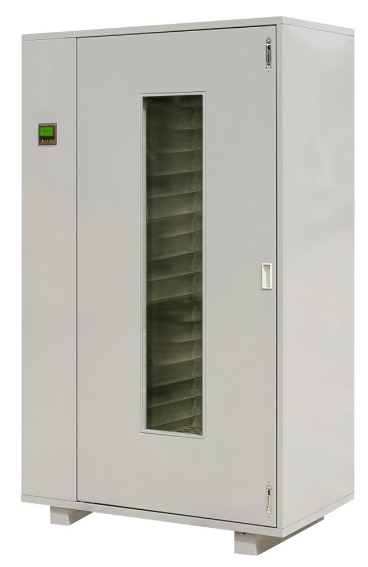
Evaluation of drying conditions on the quality properties of dried kiwi slices
Vincenzo Sicari^{1*}, Rosa Romeo¹, Rosa Tundis², Monica Rosa Loizzo²
¹Department of Agraria, University “Mediterranea” of Reggio Calabria, Cittadella Universitaria, Feo di Vito, Reggio Calabria (RC), 89124, Italy (Email: Vincenzo.sicari@unirc.it)
²Department of Pharmacy, Health and Nutritional Sciences, University of Calabria, 87036 Arcavacata di Rende (CS), Italy. (Email: monica_rosa.loizzo@unical.it)
INTRODUCTION
Fruits and vegetables are products which can be consumed in its raw form without undergoing processing or transformation. Drying is one of the oldest methods of food preservation. It is still used widely to preserve foods for home consumption and for sale (Ratti, 2001). Dried fruits are one of the most popular products made by small-scale processors. The health benefits of consuming fruit are well documented [2]. Kiwifruit (Actinidia deliciosa cv Hayward) is a nutrient-dense fruit and extensive research over the last decade on its health benefits has linked its regular consumption to improvements not only in nutritional status, but also benefits to digestive, immune and metabolic health. Dried kiwis are highly needed in food industries. The dehydration process removes much of the water content from kiwi slices, making richer in nutrients. This work aimed to evaluate the effect of the air-drying temperature on quality and nutritional compounds of dehydrated kiwi slices, during 120 days of storage.
MATERIALS AND METHODS
Drying Processes
Kiwifruits (Actinidia deliciosa cv. Sungold) at commercial maturity stage were obtained from a farm in Calabria (Cosenza, Italy) in February 2020. Homogenous samples (15 kg) washing with a solution of sodium hypochlorite were peeled and cut vertical to their axis into cylindrical slices of 7 mm thickness using a mechanical cutter. The drying process was carried out in a convective dryer set to two different temperatures, 40°C and 55°C, to final moisture content of 12% from initial moisture content of about 80%. The dried samples were stored in sealed containers at 25°C. Physiological and biochemical parameters were analyzed at fixed time for 120 days.
Preparation of extracts
For determination of chemical parameters, the fruits were homogenised in a common blender, and 5 g of the sample was added to 50 ml of distilled water centrifuged (5000 rpm for 10 min). Supernatant solution was filtered through a paper and analysed.
Physicochemical analysis
For the extracts, titratable acidity, expressed as g of citric acid 100 g⁻¹dw, and pH (with a pH meter Crison GLP, Barcelona, Spain) were measured according to the AOAC method. A digital refractometer PR-201α (Atago, Milan, Italy) was used for total solid soluble content (TSS). Results were expressed as °Brix. Water activity (aw) was measured by means of the AquaLab LITE (Decagon, Inc., Washington, USA) instrument.
Ten,fruits were used for the color analysis and color parameters (L*, a* and b*) were measured on 3 different points on the cut surface for a total of 30measures for each treatment. A colorimeter (CR-400, Konica Minolta, Osaka, Japan) equipped with the D65 illuminant, in the reflectance mode and in the CIE L* a* b* color scale was used. The color parameters were used to calculate the Browning index.
Bioactive compounds and antioxidant activity
For the estimation of Total Phenolic Compounds (TPC), Total Flavonoids Content (TFC) and Antioxidant Activity (DPPH and ABTS+ assay), Actinidia deliciosa fruits were were homogenised in a common blender, and 5 g of the sample was added to 25mL of methanol : water (80 : 20, v : v), mixed, and then centrifuged at 5000 rpm for 10 min according to the method of Sicari et al; 2019 with some modifications. The methods of Izli et al; 2019 with appropriate modifications was followed to determine total phenolic content. 250 µL of Kiwifruit extract was mixed with Folin-Ciocalteu reagent and Na₂CO₃ (7.5% w/v). the determination of Flavonoids content was carried out mixing 0.5 mL of extract and 0.3 mL of 0.5 mol L⁻¹ sodium nitrite solution for 3 min; then 0.3 mL of 0.3 mol/L aluminum chloride solution, 2 mL of 1 mol L⁻¹ sodium hydroxide solution, and water to 5 mL were added sequentially and rested for 10 min, the absorbance was measured at 510 nm. The antioxidant activity was determined using DPPH test as reported by Brand-Williams et al; 1995 .
RESULTS AND DISCUSSIONS
Physicalchemical parameters
aw | 0.99±0.00
pH | 3.19±0.04
°Brix | 14.5±0.08
Total acidity (g 100g⁻¹dw) | 1.51±0.00
L | 58.57±4.37
a* | 1.19±0.78
b* | 15.34±3.07
Bioactive compounds and antioxidant activity
TPC (mg GAE 100g⁻¹dw) | 541.79±4.49
TFC (mg CTE 100g⁻ ¹dw) | 160.19±6.22
DPPH (mmol Trolox 100g⁻¹dw) | 1195.87±15.19
ABTS (mmol Trolox 100g⁻¹dw) | 56.05±3.06
This work aimed to evaluate the effect of the air-drying temperature on quality and nutritional compounds of dehydrated kiwi slices, during 120 days of storage. Hot air drying of kiwi slices was investigated at drying temperature ranged from 40°C to 55°C and slice thickness of 4 mm. Fresh and dried kiwi slices were analysed for their pH, activity water, total solid soluble (TSS), colour, titratable acidity, ascorbic acid content, total phenols and flavonoids content as well as radicals scavenging activities evaluated by ABTS test [3,4]. The analysis carried out on the dehydrated kiwifruit have shown a good disposition of the kiwi towards the drying process. Particularly, it has been observed that drying treatment at low temperature allowed to preserve the nutraceutical properties of the food matrix. Samples treated at 40°C (Tab. 2 and 1),showed the highest values of total phenols and flavonoids content with values of 2179 mg/100g dried weight (DW) and 281 mg/100 DW fruits, respectively. This high phytochemical content is responsible of the dried kiwifruit promising antioxidant activity (1657 mmol Trolox/100g DW fruits).
Tab. 1. Physicochemicol parameters and bioactive compounds of fresh kiwi
 | aw | pH | TSS (°Brix) | Total acidity (g citric acid 100g⁻¹dw) | Browning index
T0 | 0.45±0.01c | 3.56±0.01b | 2.43±0.06b | 0.34±0.01e | 50.57±9.48
T30 | 0.40±0.00d | 3.56±0.01b | 4.87±0.12a | 0.75±0.01a | 56.20±14.38
T60 | 0.47±0.00b | 3.51±0.00b | 4.37±0.23a | 0.68±0.00b | 55.07±13.40
T90 | 0.47±0.00b | 3.56±0.02b | 4.80±0.00a | 0.63±0.03c | 49.88±10.20
T120 | 0.52±0.00a | 3.70±0.06a | 4.27±0.46a | 0.58±0.00d | 49.92±10.62
Sign. | ** | ** | ** | ** | ns
 | aw | pH | °Brix | Total acidity (g citric acid 100g⁻¹dw) | Browning index
T0 | 0.50±0.00ab | 3.52±0.01ab | 5.38±0.03a | 0.76±0.07b | 57.09±8.11
T30 | 0.44±0.00c | 3.54±0.01a | 3.5±0.00e | 0.69±0.00b | 55.00±10.54
T60 | 0.44±0.00c | 3.37±0.02c | 5.17±0.06b | 0.93±0.04a | 57.22±10.21
T90 | 0.51±0.00a | 3.44±0.00cd | 4.03±0.05d | 0.73±0.04b | 46.29±8.91
T120 | 0.49±0.00b | 3.46±0.05c | 4.30±0.00c | 0.72±0.00b | 51.19±10.91
Sign. | ** | ** | ** | ** | ns
Tab. 2. Physicochemicol parameters of kiwi slices dried at temperature of 40 °C
Tab. 4. Physochemical parameters of kiwi slices dried at temperature of 55°C
 | TPC (mg GAE 100g⁻¹dw) | TFC (mg CTE 100g⁻ ¹dw) | DPPH (mmol Trolox 100g⁻¹dw) | ABTS (mmol Trolox 100g⁻¹dw)
T0 | 2179.42±2.40a | 281.84±2.17a | 1657.62±0.92a | 64.68±0.34a
T30 | 650.54±2.32b | 273.84±2.04b | 1318.95±6.62b | 61.49±2.95ab
T60 | 586.64±2.05c | 243.64±3.70c | 1241.47±1.39c | 58.00±0.82c
T90 | 495.14±5.43d | 116.05±0.99d | 1024.68±4.37d | 55.93±3.76c
T120 | 395.34±0.85e | 113.93±1.12d | 996.79±2.63e | 42.29±1.61d
Sign. | ** | ** | ** | **
 | TPC (mg GAE 100g⁻¹dw) | TFC (mg CTE 100g⁻ ¹dw) | DPPH (mmol Trolox 100g⁻¹dw) | ABTS (mmol Trolox 100g⁻¹dw)
T0 | 526.04±2.40a | 169.07±5.27a | 926.15±2.75a | 670.59±1.68a
T30 | 472.27±4.80b | 166.37±3.50a | 891.13±5.13b | 52.70±2.37b
T60 | 456.82±3.18c | 165.33±2.78a | 889.00±2.95b | 45.96±0.24c
T90 | 453.15±2.64c | 116.60±2.90b | 859.32±1.49c | 39.54±1.39d
T120 | 408.25±2.11d | 102.78±1.61c | 854.35±1.30c | 36.71±0.52d
Sign. | ** | ** | ** | **
Tab. 3. Bioactive compounds and antioxidant activity of kiwi slices dried at temperature of 40°C
Tab. 5. Bioactive compounds and antioxidant activity of kiwi slices dried at temperature of 55°C
REFERENCES
Ratti, C. (2001). Hot air and freeze-drying of high-value foods: A review. J. Food Eng. 49. 311-319. https://doi.org/ 10.1016/S0260-8774(00)00228-4.;
AOAC (1990) Official methods of analysis of the Association of Official Analytical Chemists. 2 vols. 15th ed. Washington, DC;
Sicari, V., Pellicanò, T. M., Giuffrè, A. M., Loizzo, M. R., & Poiana, M. (2019). Effect of packaging materials on the quality of kiwifruits (Actinidia deliciosa cv. Hayward). Journal of Food Measurement and Characterization,13(4), 3033-3039.
W. Brand-Williams, M. E. Cuvelier, and C. Berset (1995)Use of a free radical method to evaluate antioxidant activity,”LWT–Food Science & Technology, vol. 28, no. 1, pp. 25–30

