Slide 1
An Update on Sustainable Valorization of Coffee By-Products as Novel Foods within the European Union. Dr. Dirk W. Lachenmeier
Foods 2021 –
Live Session - "Coffee By-products as Sustainable Novel Foods"

Slide 2
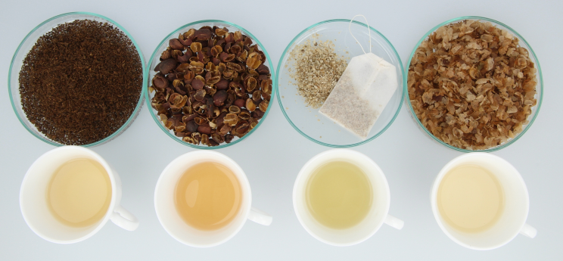
What are „Novel Foods“ in the EU
Foods and/or food ingredients, which are:
Relatively new (>1997) on the European market
Exotic origin or unusual composition
Produced by new or innovative technologies
Products without history as safe food for human consumption
Before placing on the market, these products need:
an approval with safety assessment
In Germany: criminal offence to intentionally place non-approved novel foods on the market

Slide 3
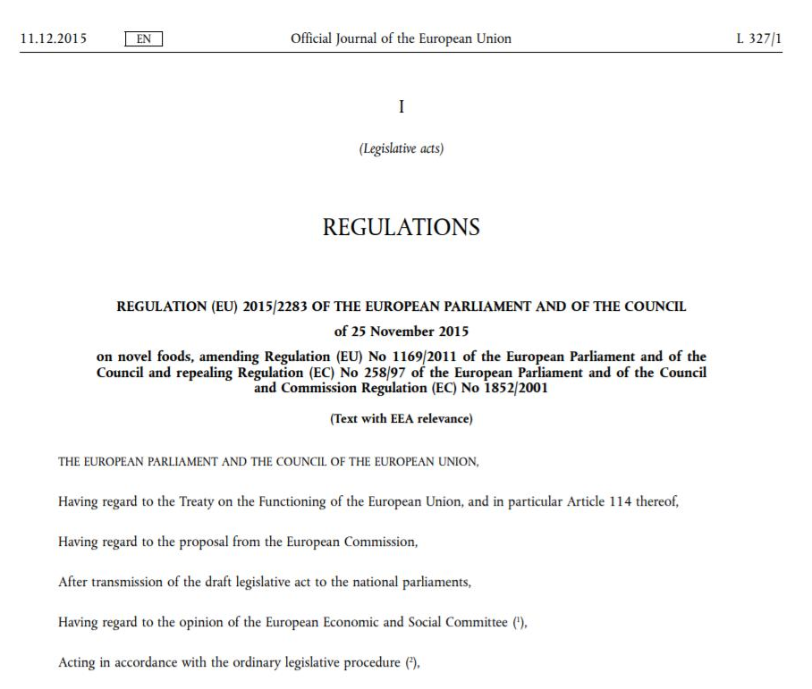
Legal background
Regulation (EU) 2015/2283
In force since 31.12.2015
Legally binding since 01.01.2018
Several new implementing regulations

Slide 4
Legal background
Regulation (EU) 2015/2283
Definition - Article 3 Abs. 2 a)
‘Novel Food’
means any food that was not used for human consumption to a significant degree within the Union before 15 May 1997, irrespective of the dates of accession of Member States to the Union
Note: Industry is responsible for checking novel food status before placing products on the market!

Slide 5
Determination of NF-Status
Novel Food-Catalogue of EU Commission
Harmonized (EU Commission and member states) information about the NF Status of many foods
Non-exhaustive list
Orientation on whether a product will need an authorisation under the NF Regulation.
Constant updates based on new knowledge
EU countries may restrict the marketing of a product through specific legislation.

Slide 6
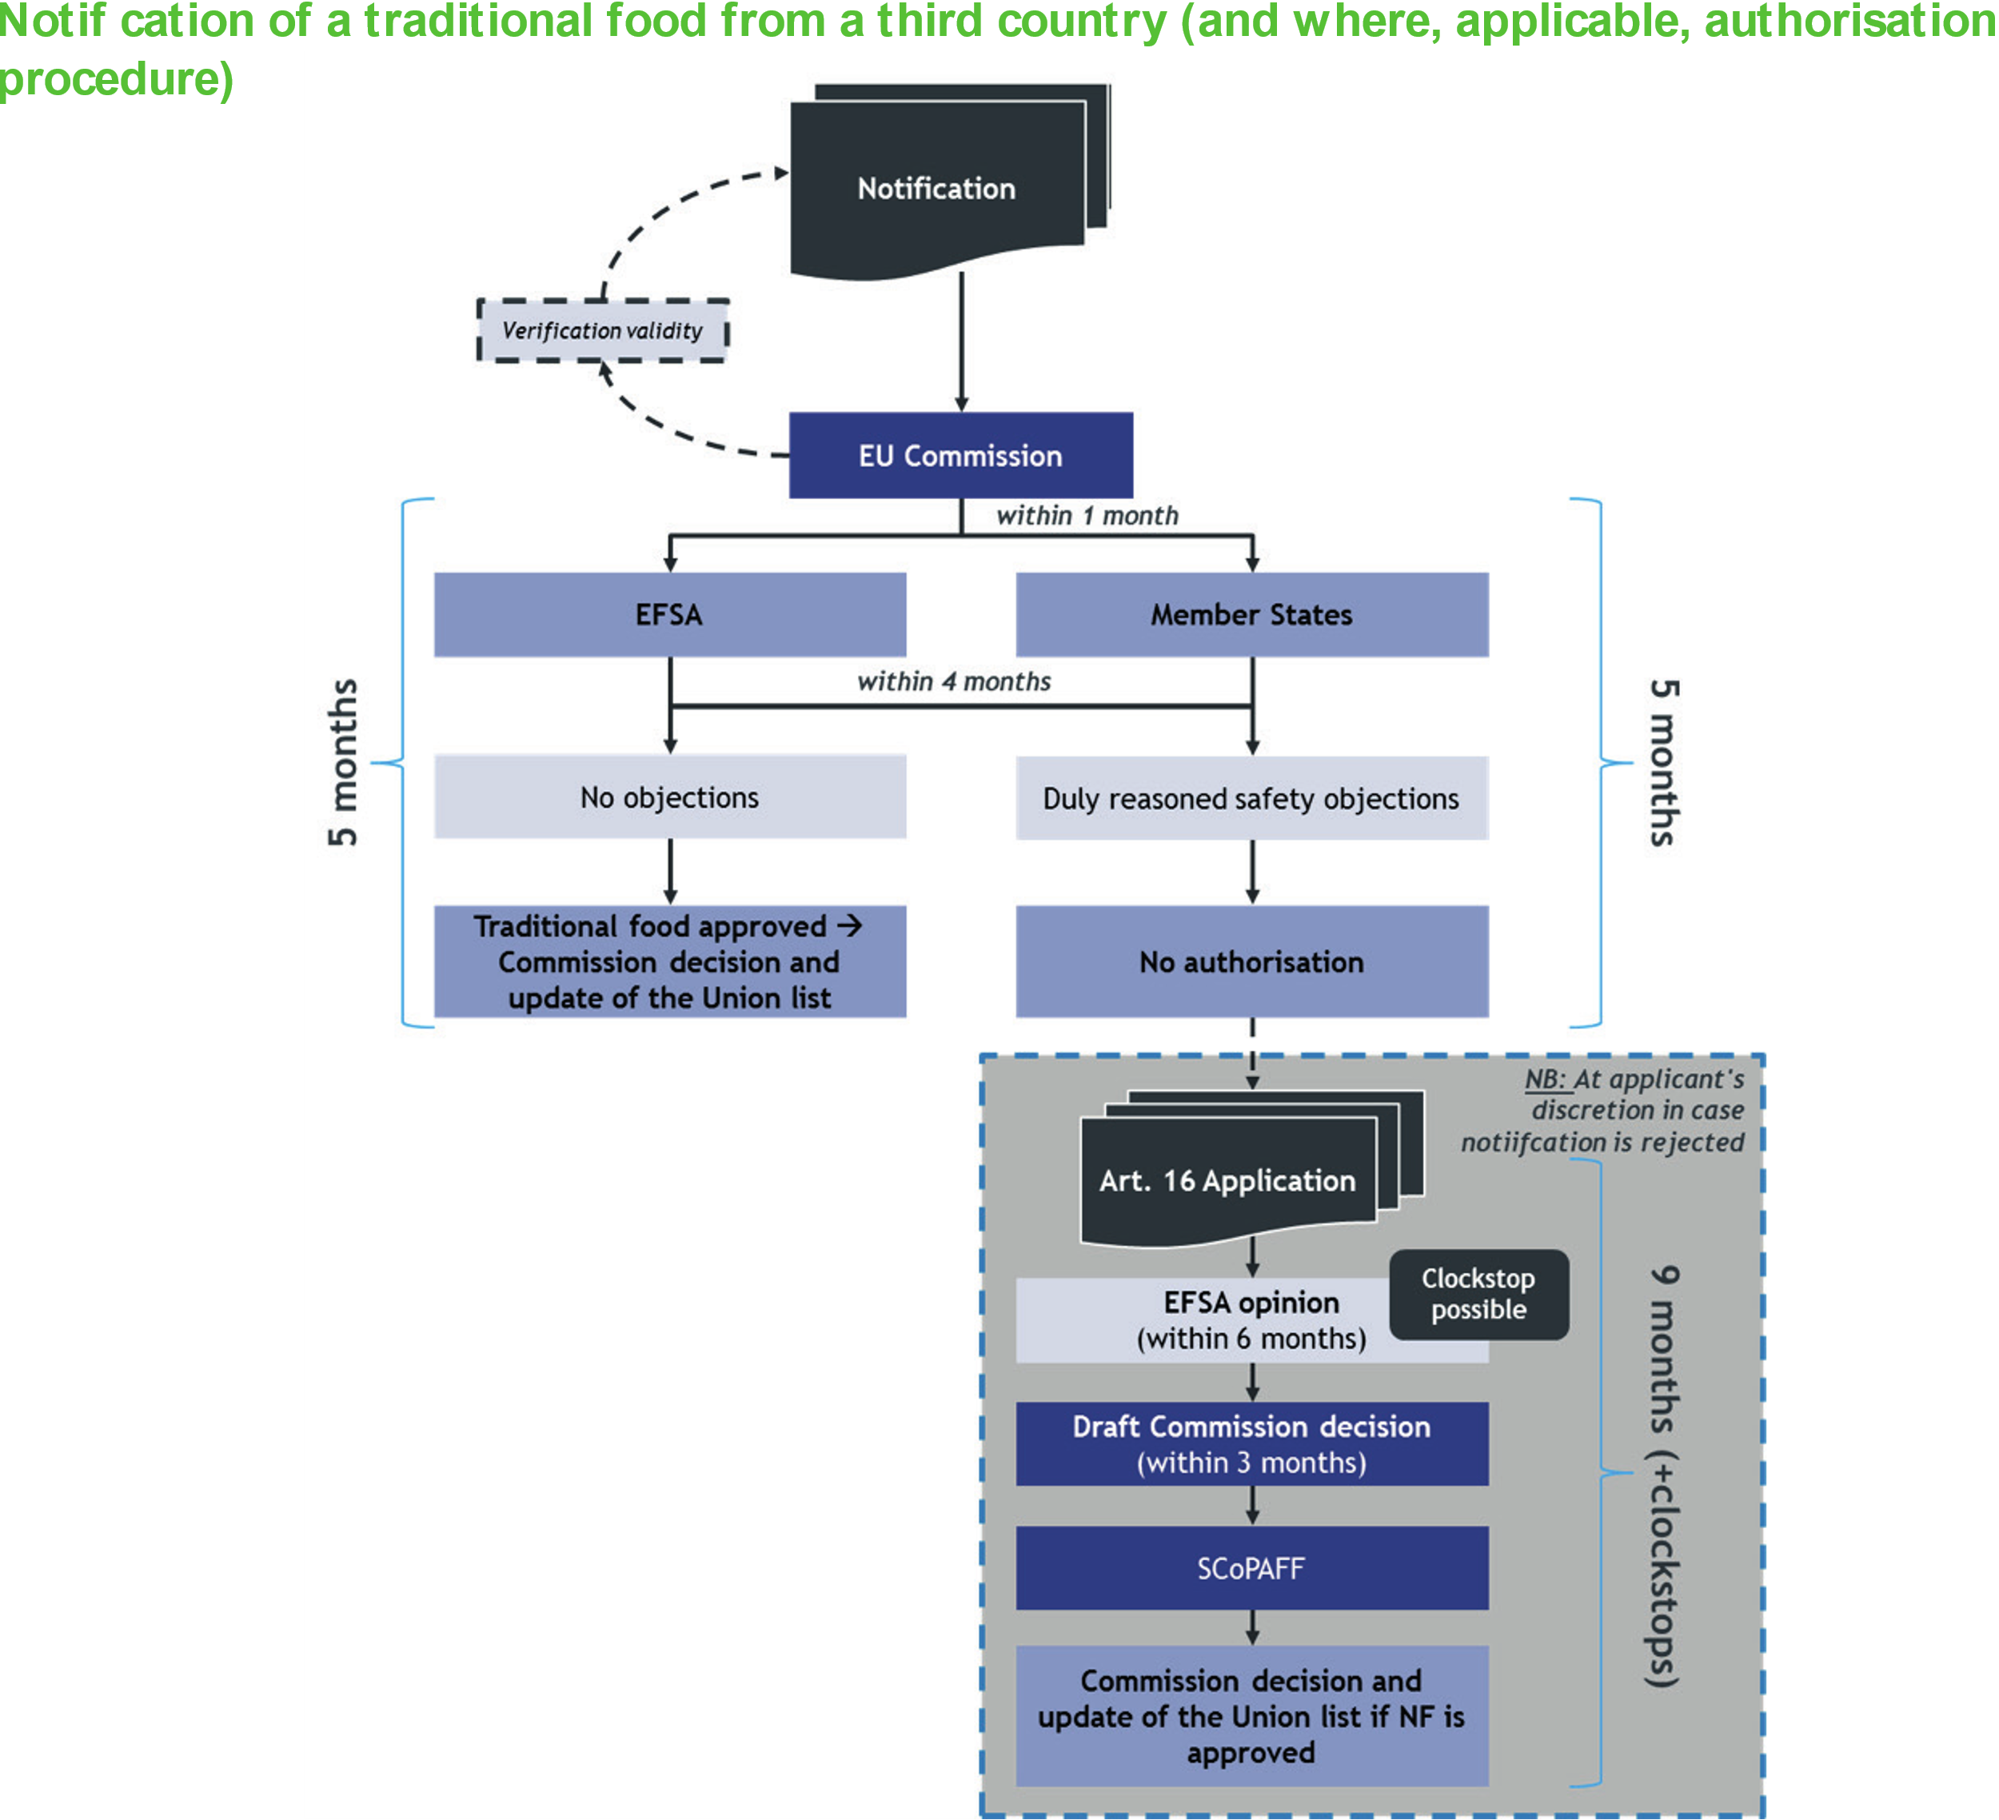

Slide 7
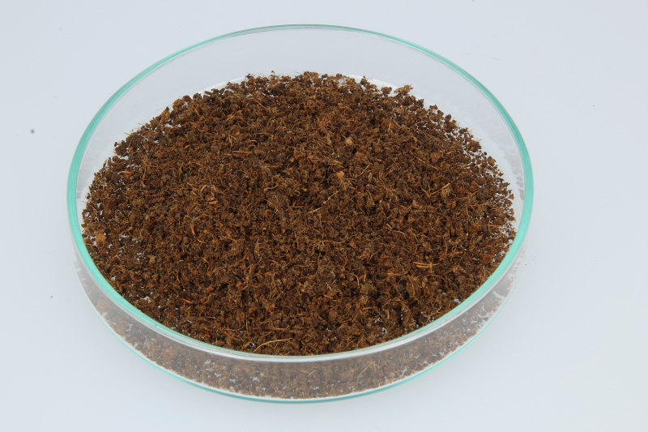
Coffee leaves

Slide 8
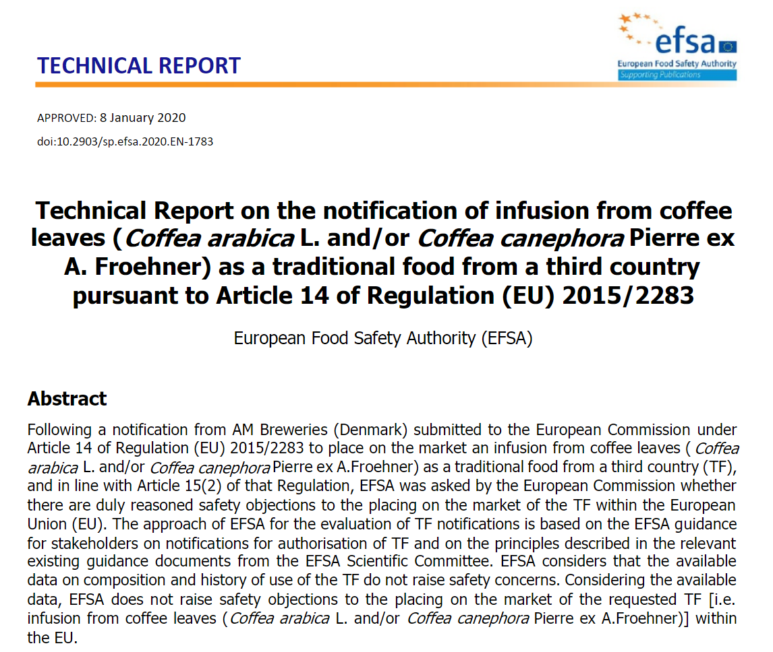

Slide 9
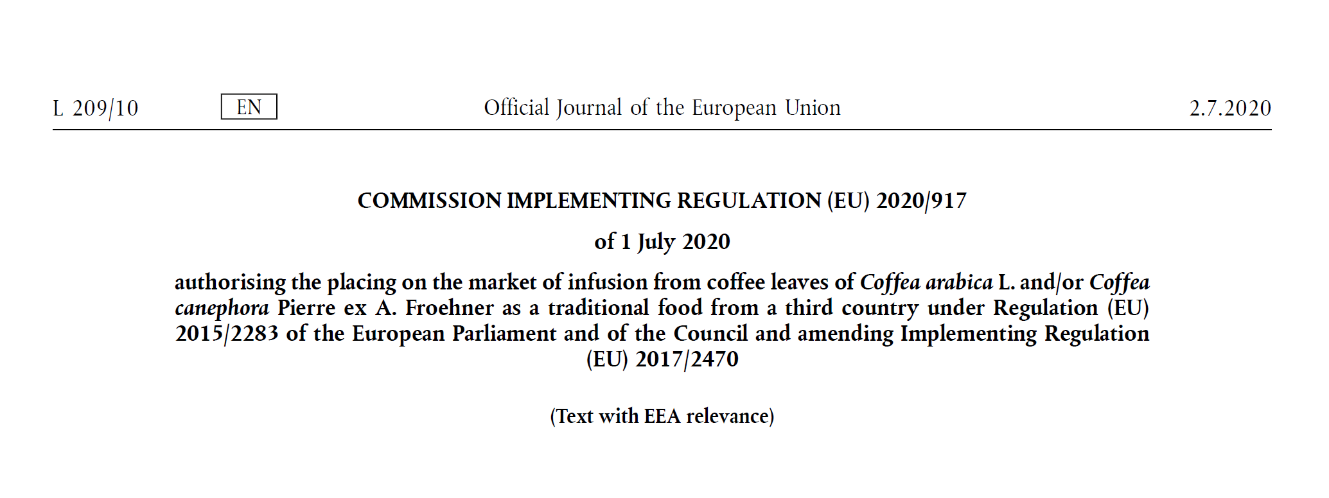
https://eur-lex.europa.eu/legal-content/EN/TXT/PDF/?uri=CELEX:32020R0917&from=DE

Slide 10
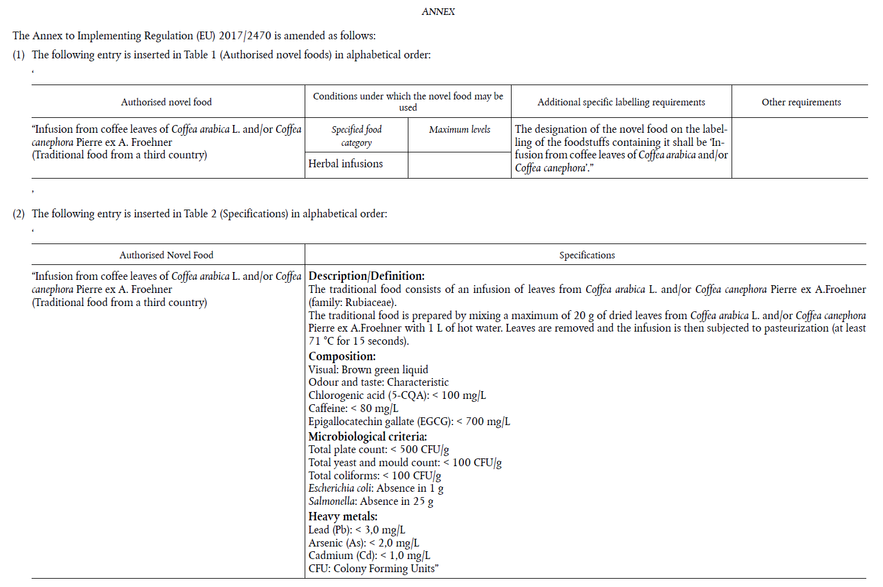
https://eur-lex.europa.eu/legal-content/EN/TXT/PDF/?uri=CELEX:32020R0917&from=DE

Slide 11
Summary coffee by-products novel food status
By-product | Main uses | Novel Food Status
Flowers (blossoms) | Beverages (tea): “coffee blossom tea” | Novel. Anecdotal evidence as a traditional food from third country. Needs approval procedure.
Leaves | Beverages (tea): “coffee leave tea” | Approved as traditional food from third country (herbal infusion).
Coffee cherry materials (husks, cascara, dried or fresh coffee cherries, mucilage or pulp) | Beverages (tea), spirits, qishr (mixture with spices) | Novel, two notifications submitted as traditional food from third country as well as one full application for further uses. EFSA opinions were positive for the notifications. EC implementing regulation is expected in 2021.
Green unroasted beans and infusion made of them (non selective water extraction) | Dietary supplement, beverages (tea): “white coffee” | Not novel (see NF catalogue). Selective extracts could be novel.
Silver skin | Dietary fibre supplementation, vegan smoke flavourings, beverages (tea) | Unclear but indirect consumption before 1997. Consultation suggested.
Coffee grounds | Historical: adulteration of coffee; Flour for savoury and sweet recipes, bakery products, dietary fibre source, confectionary, snacks and ready-to-eat products | Not Novel (spent coffee grounds, defatted spent coffee grounds and defatted unused coffee grounds)
Parchment | Food preservative, antioxidant | Novel, currently not approved. No application pending. Needs approval procedure.

Slide 12
Next Steps
The industry effort to approve coffee by-products is very incoordinated and potentially misaligned
Suggestion for coffee by-product consortium to coordinate efforts
Traditional uses in third countries should be further explored (e.g. indications of cherry spirit in Nepal as traditional artisanal beverage or coffee flower uses in sweets)
Silver skin: consultation to determine novel food status suggested (in Germany at BVL)
Food safety must always be ensured independent of novel food status! E.g., check for contaminants, mycotoxins, microbiology etc.

Slide 13
Thank you for your interest
Contact: Lachenmeier@web.de
Review paper (open access) on coffee by-products:
Klingel et al.: A Review of Coffee By-Products Including Leaf, Flower, Cherry, Husk, Silver Skin, and Spent Grounds as Novel Foods within the European Union. Foods 2020, 9, 665. https://doi.org/10.3390/foods9050665
Many thanks to
Tábata Rajcic de Rezende, Bundesratsvertretung Novel Food
Picture sources (if not otherwise stated): own pictures

