Slide 1
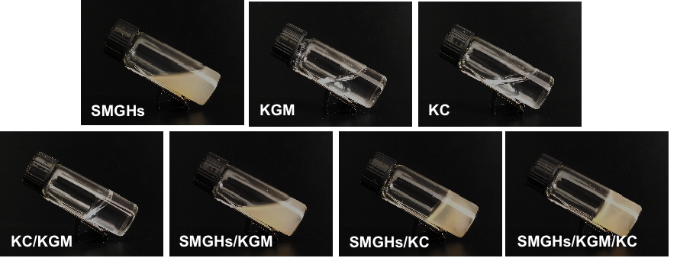
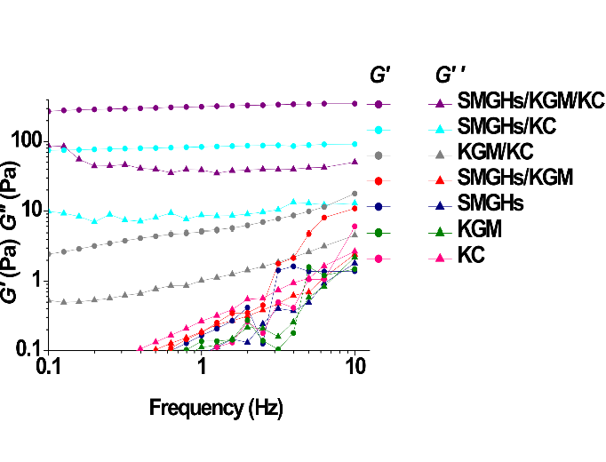
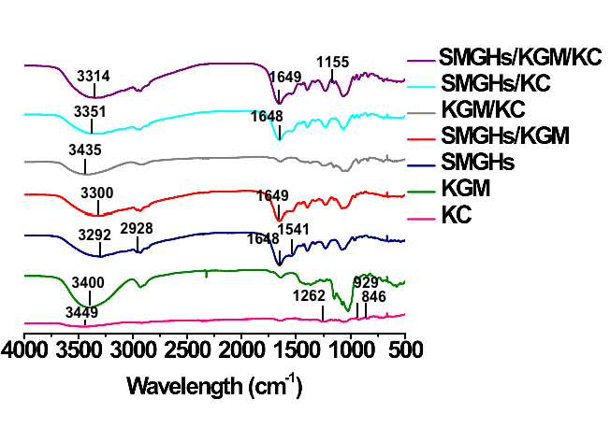
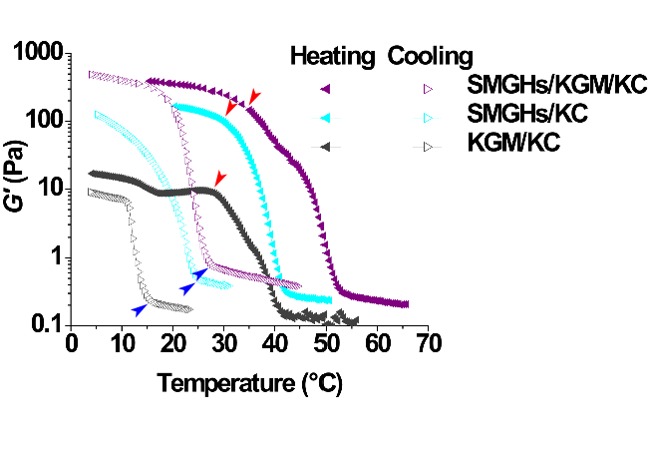
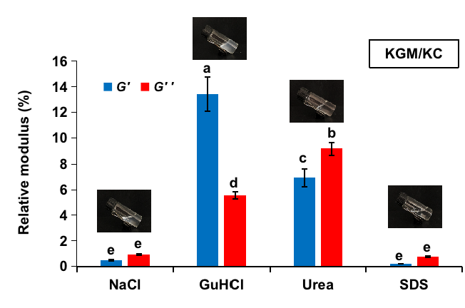
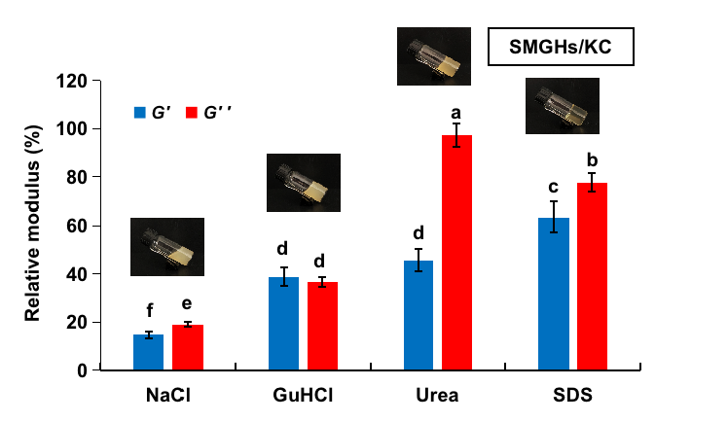
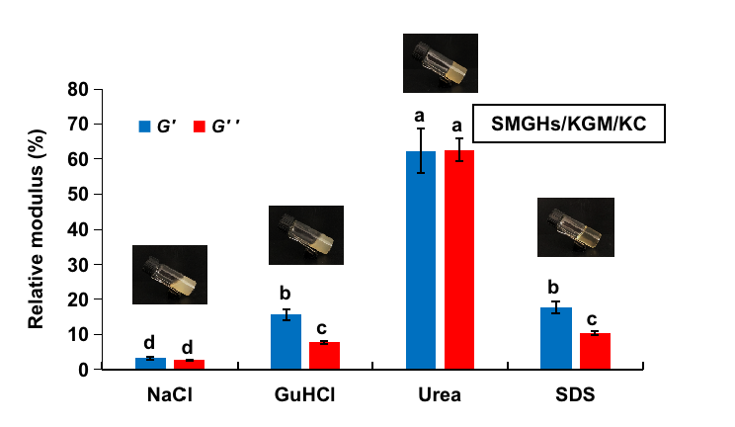
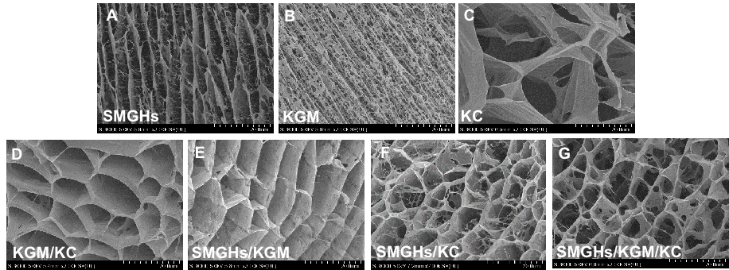
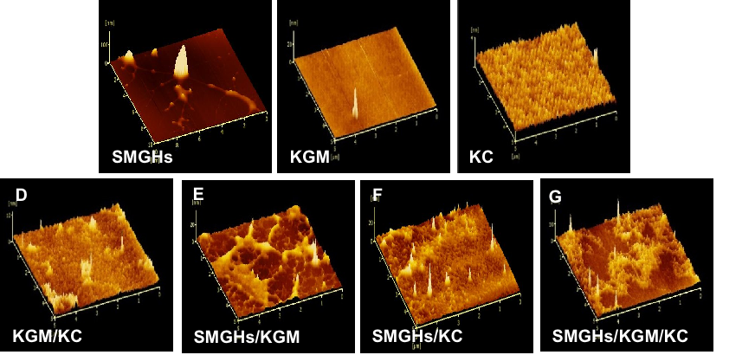
trypsin
Kappa-carrageenan(KC)
Scallop male gonads
Scallop male
gonad hydrolysates
(SMGHs)
Konjac gum(KGM)
Rheology-Frequency
Rheology-Tempreture
FTIR
NaCl
Urea
GuHCl
SDS
Electrostatic interactions
Hydrophobic interactions
Hydrogen bonds
Cryo-SEM
AFM
Intermolecular interactions

