Slide 1
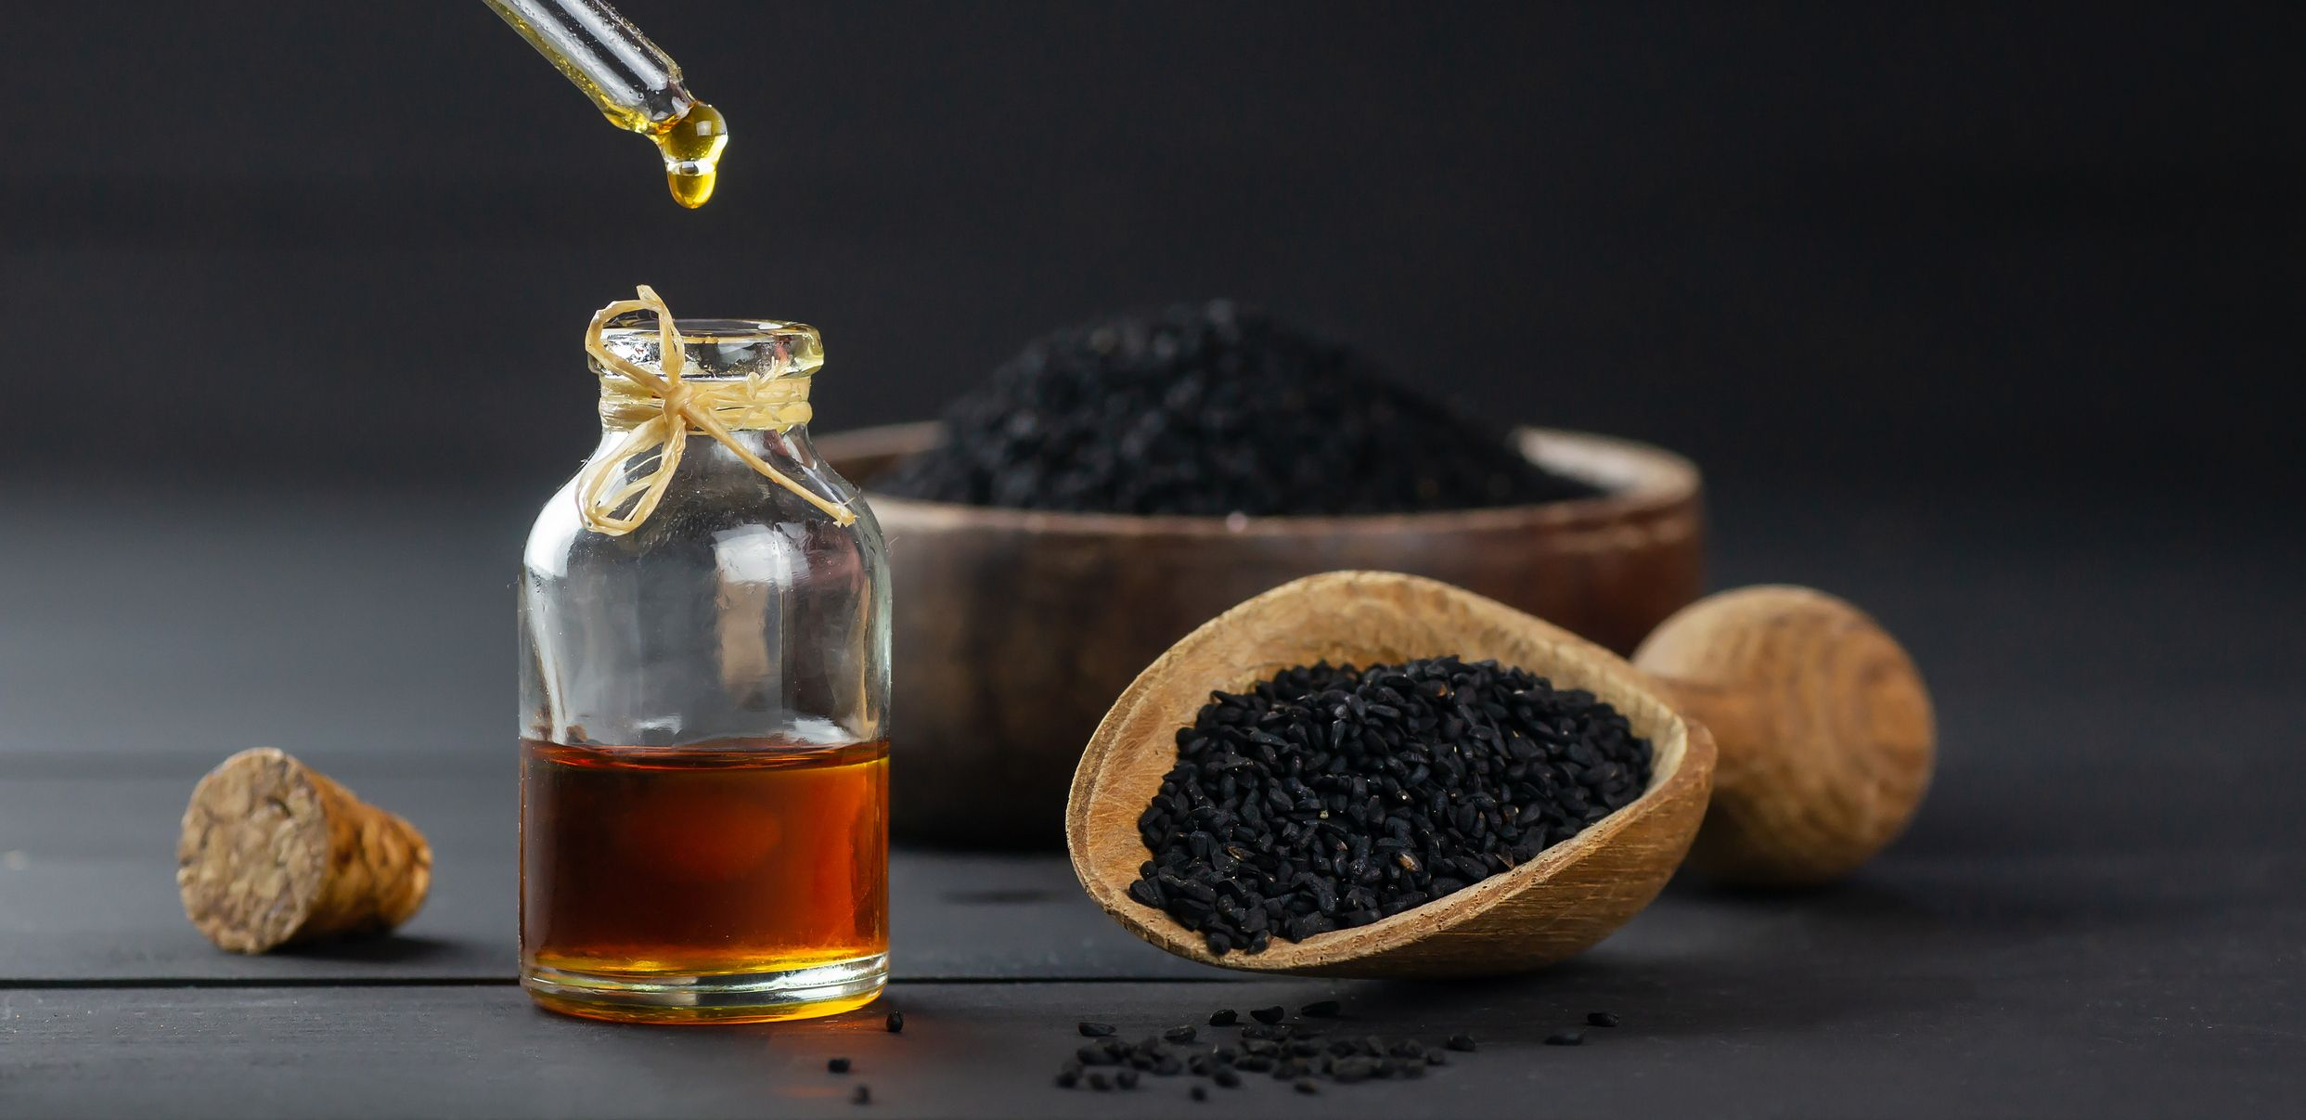
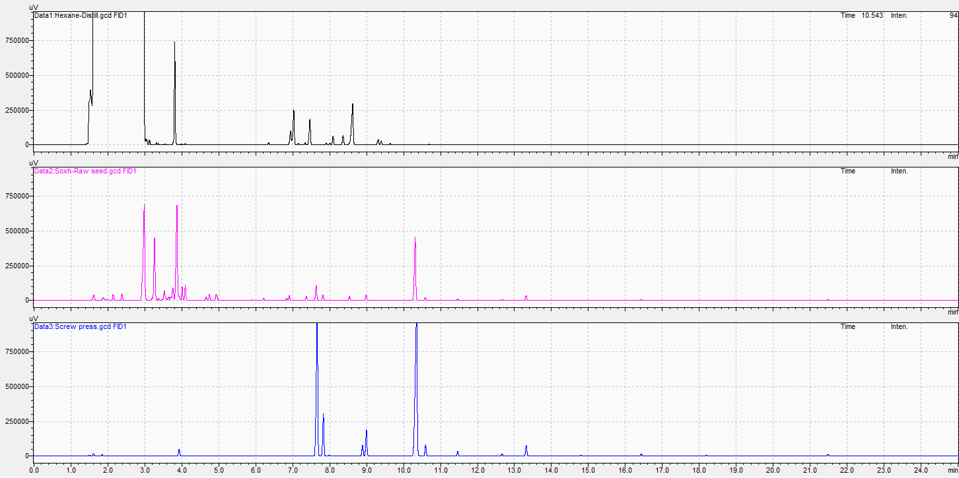
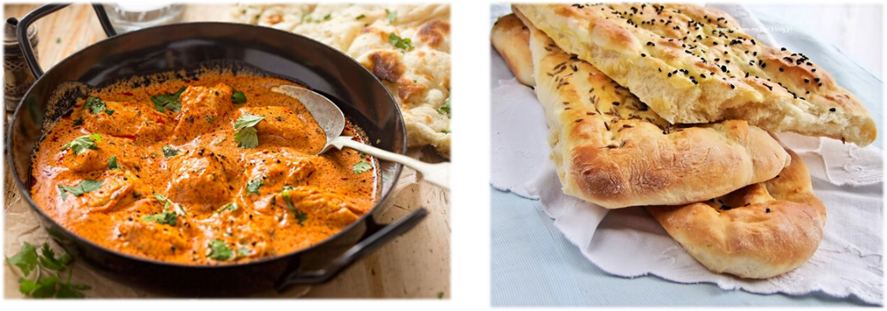
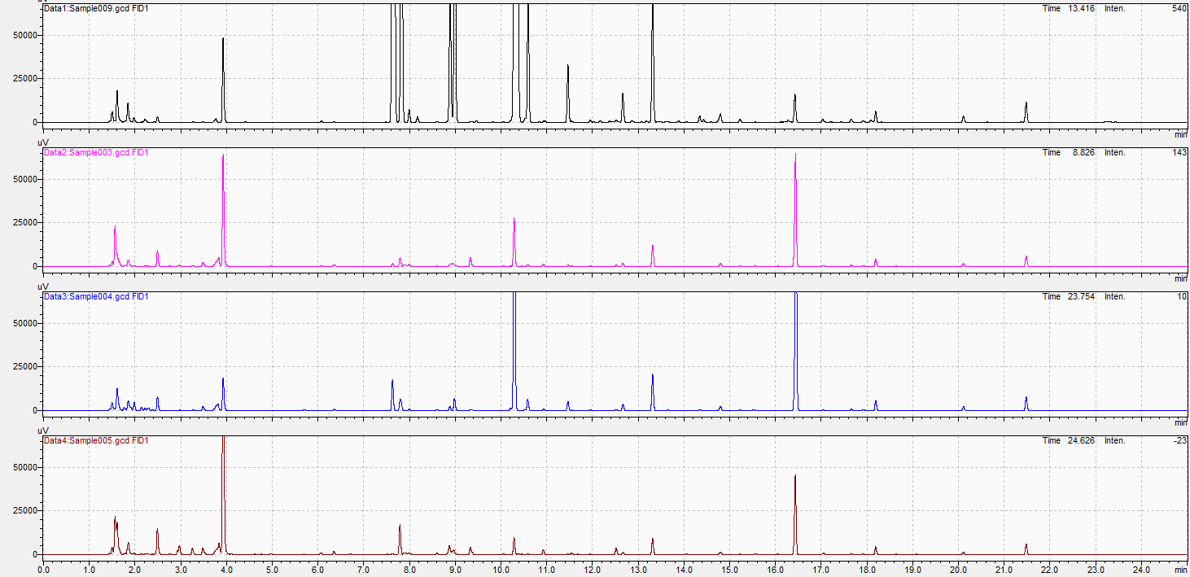
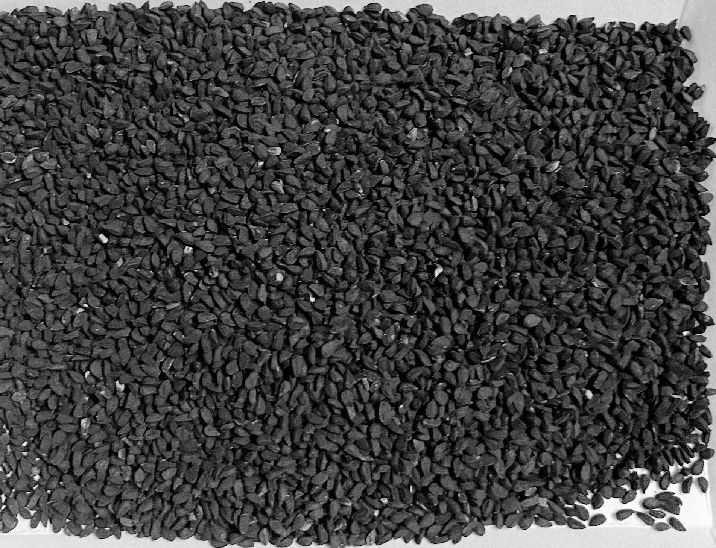
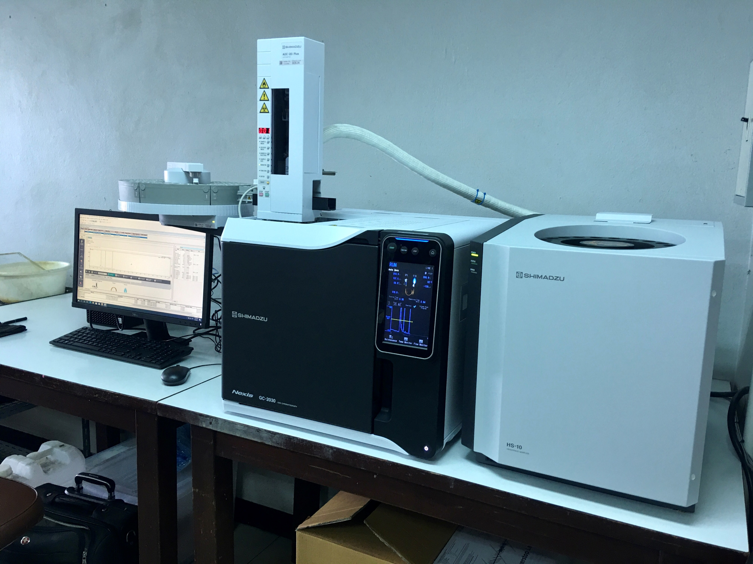
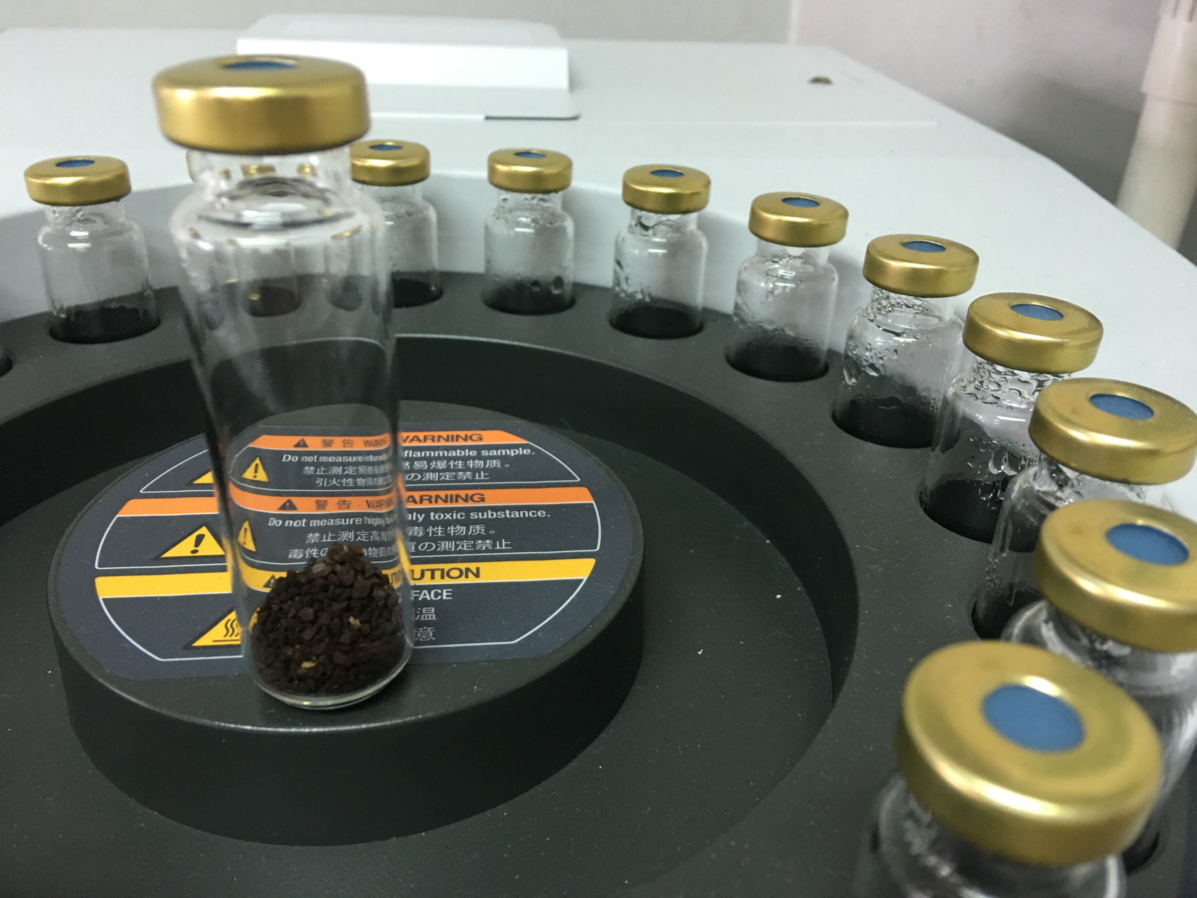
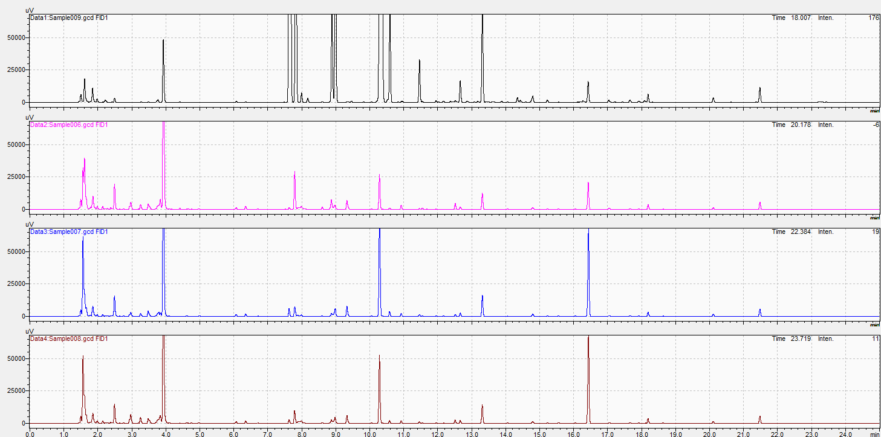
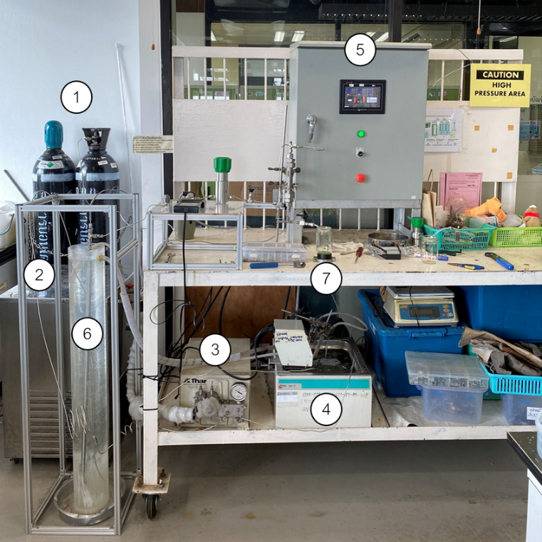
Volatile Compounds Fingerprints of Black Cumin (Nigella sativa L.) Seed Oil Extracted by Supercritical Carbon Dioxide
Winatta Sakdasri ¹, Buntita Sakulkittiyut ², Somkiat Ngamprasertsith ^{2, 3}, Ruengwit Sawangkeaw ^{4,}*
¹ Program in Food Process Engineering, School of Food Industry, King Mongkut’s Institute of Technology Ladkrabang, 1 Chalong Krung 1 Alley, Lad Krabang, Bangkok 10520, Thailand
² Fuels Research Center, Department of Chemical Technology, Faculty of Science, Chulalongkorn University, 254 Phayathai Road, Pathumwan, Bangkok, 10330, Thailand
³ Center of Excellence on Petrochemical and Materials Technology, Chulalongkorn University, 254 Phayathai Road, Pathumwan, Bangkok, 10330, Thailand
⁴ Research Unit in Bioconversion/Bioseparation for Value-Added Chemical Production, Institute of Biotechnology and Genetic Engineering, Chulalongkorn University, 254 Phayathai Road, Pathumwan, Bangkok, 10330, Thailand
*Correspondence: rueangwit.s@chula.ac.th; Tel.: +66 22 18 80 73; Fax.: +66 22 18 80 69
Introduction
Results & Discussion
Moisture
4-6%
Volatile Oil
(Essential Oil)
0.4-2.8%
(a)
Ash
3-14%
Fiber
6-36%
Fixed Oil
(Triglyceride)
34.5-41.8%
(b)
Solvent (n-hexane)
Residue
No detection of High-molecular Weight Compound
Protein
20-23%
Black cumin seed (Nigella sativa L.)
(c)
Chemicals in Essential Oil
Quinones (Thymoquinone 0.1-0.75%)
Monoterpenoid phenols
Alkaloids
Saponins
Phytosterols
Figure 1. The GC chromatograms of (a) n-hexane, (b) Oil obtained from Soxhlet extraction of milled raw seed (Oil_{SE}), and (c) the extracted oil obtained from a screw-press machine (Oil_{SM})
Materials & Methods
(a)
(b)
Mid-boiling point
compounds
The black cumin seed was imported from Guangxi Qinzhou province, The People's Republic of China.
(c)
SCCO₂ selective compound
Volatile
Sampling
(d)
GC2030
HS-10
Figure 2. The GC chromatograms of black cumin seed oils obtained from (a) screw press machine and SCCO₂ extractions at 20.0 MPa (b) 40 °C, (c) 50 °C, and (d) 60 °C.
Static headspace-gas chromatography (SH-GC-FID)
(a)
Analytical column: DB-1, 0.25 mm ID × 0.25 µm × 30.0 m
Carrier gas: He (99.995%), Linear velocity of 40 cm/s. Oven temperature: 50ºC (hold 2 min), ramp 5ºC/min to 150ºC (hold 2 min)
Sample equilibrate: 100ºC (hold 10 min)
Injection condition: 200 ºC 1.00 ml (split ratio of 1:10)
FID temperature: 280ºC
(b)
(c)
SCCO₂ selective compounds
SCCO₂ selective compound
(d)
Household single screw press machine
Figure 3. The GC chromatograms of black cumin seed oils obtained from (a) screw press machine and SCCO₂ extractions at SCCO₂ extractions at 30.0 MPa (b) 40 °C, (c) 50 °C, and (d) 60 °C.
Sample hopper
Compressed oil outlet
Seed cake outlet
Conclusion
Supercritical CO₂ Extraction
Liq. CO₂ cylinder
Cooling bath
High-pressure pump
(4) Preheater
(5) System controller
(6) Extraction tube
(7) Sample collector
The screw press method was suitable to extract the mid-molecular weight compounds, while the SCCO₂ extraction was capable to extract the low- and high-molecular weight compounds. The solvent residue was detected in sample obtained from Soxhlet extraction. The SCCO₂ extraction revealed its selectivity on specific compound based on the extraction temperature and pressure. The unknown compounds will be identified by gas chromatograph-mass spectrometer equipped with the static-headspace autosampler (SH-GC-MS) in the further study.
Unfiltered Black Cumin Seed oil
Black Cumin Seed cake
Before
SCCO₂
Extraction
After
SCCO₂
Extraction
Black Cumin Seed
References
Zarrinpashne, S.; Gorji Kandi, S. A. Sep. Sci. Technol. 2019, 54, 1778-1786.
Wajs, A.; Bonikowski, R.; Kalemba, D. Flavour. Fragr. J . 2008, 23, 126-132.
Piras, A., et., al. Ind. Crop. Prod. 2013, 46, 317-323.
Acknowledgements
The financial supports for this project were provided by the Chulalongkorn University Second Century Fund (C2F) of Postdoctoral Scholarship.

