Slide 1
The 2nd International Electronic Conference on Foods Future Foods and Food Technologies for a Sustainable World
University :
Agricultural University of Athens, School of Food and Nutritional Sciences, Department of Food Science and Human Nutrition, Laboratory of Microbiology and Biotechnology of Foods
Georgios Tsekouras, Paschalitsa Tryfinopoulou and Efstathios Panagou
Authors :
Detection and Identification of Lactic Acid Bacteria in Semi-Finished Beer Products Using Molecular Techniques
October 2021

Slide 2
1. Introduction
Beer is an undistilled alcoholic beverage derived from a source of starch.
Four main ingredients: water, malt, hops and yeast.
Two main categories based on the yeast strain involved in processing:
Lager beer - Saccharomyces pastorianus
Ale beer - Saccharomyces cerevisiae
Ale yeasts operate at room temperature (ca. 18-22 °C), ferment quickly and produce the characteristic “fruitiness” taste. (Top fermenters)
Lager yeasts prefer lower temperatures (ca. 8-15 °C), ferment slowly and utilize more wort sugars, resulting in a cleaner, crisp taste. (Bottom fermenters)

Slide 3
Role of Lactic Acid Bacteria in Beer Processing (1/2)
Deviations in the brewing process may occur due to the activity of LAB.
The growth of LAB during the brewing process implies:
Competition for nutrients with yeasts, causing decreased ethanol yields.
Production of off-flavors (high indications of diacetyl and lactic acid).
Changes in color.
Excessive turbidity and viscosity alteration.
The metabolism of fermentation type could reveal that the spoilage is mainly caused by differences in amino acid and carbohydrate metabolism. According to the metabolic activity of LAB, they can be classified into three types:
Obligately homofermentative.
Obligately heterofermentative.
Facultatively heterofermentative.
Quality
degradation

Slide 4
Role of Lactic Acid Bacteria in Beer Processing (2/2)
Homofermentative LAB produce D-lactic acid while heterofermentative LAB produce D-lactic acid and acetic acid which are associated with spoilage due to the increase of acid content in the product.
acetic acid is perceived as vinegar and lactic acid as stale milk.
Compounds produced from citrate metabolism, such as:
Diketone.
2-3-butanedione.
Diacetyl
Mannitol, which is produced by hef LAB (Lb. brevis) is not responsible for spoilage, but when it works together with acetic acid, D-lactic acid, n-propanol, 2-butanol and diacetyl, beer shows spoilage characteristics with viscous texture, sweet taste and vinegar-estery aroma.
Low concentrations: Major source of pleasant flavor.
High concentrations: Spoilage characteristic.

Slide 5
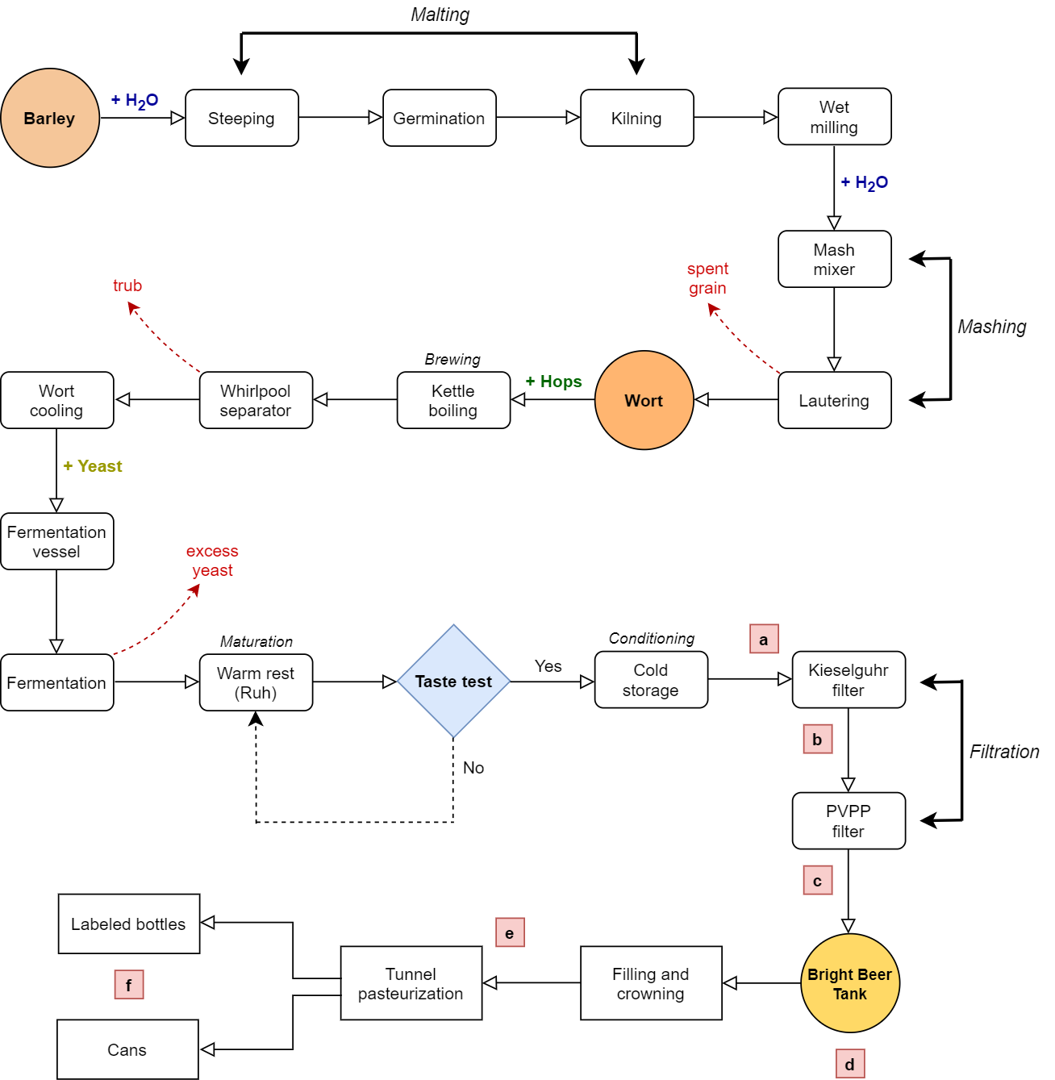
Beer Production Pipeline and Sampling Points

Slide 6
2. Materials and Methods
2.1 Beer samples, transportation and fermentation procedures
Samples were obtained from two different batch productions.
Six sampling points: (a) pre-filtration (d) the filling tank
(b) post-filtration (e) packaged non-pasteurized product
(c) the buffer line (f) packaged pasteurized product
Fermentation conditions: 10-14 °C for approximately 6 days.
Maturation stages:
Warm rest (Ruh) – Breakdown of unwanted volatile components.
Cold storage (2-3 °C) – Yeast in suspension finalizes the flavor profile.

Slide 7
2. Materials and Methods
2.2 Microbiological analyses
Determination of: i) total viable counts (TVCs)
ii) yeasts
iii) lactic acid bacteria (LAB)
*MRS added with cycloheximide 0.5%
20% of the LAB colonies from the proper dilution of the MRS agar plates were purified on the MRS (Cycloheximide-free) medium, followed by a second incubation phase at the same conditions.
Determination | Medium | Temp (°C) | Time (days)
TVCs | Plate Count Agar (PCA) | 25 | 3
Yeasts | Rose Bengal Chloramphenicol agar (RBC) | 25 | 3 - 5
LAB | de Man–Rogosa–Sharpe agar (MRS) * | 30 | 5

Slide 8
2. Materials and Methods
2.3 Molecular analyses
PCR technique: Rep-PCR
Primer: (GTG)5 – (5-GTGGTGGTGGTGGTGGTG-3)
Total number of LAB isolates: 80
Banding profiles of the rep-PCR products were undertaken by the electrophoresis, visualized after staining with ethidium bromide under ultraviolet light and were analyzed by the Bionumerics software.
Finally, 20 representative isolates were selected for partial sequencing analysis of 16S rRNA region.

Slide 9
3. Results and Discussion
3.1 Microbiological results (Yeasts)
Yeast presence was enumerated only before and after filtration.
1st Batch 2nd Batch
Before filtration: 5.40 log CFU/mL 4.98 log CFU/mL
After filtration: No enumerated (<1.0 log CFU/mL) 1.36 log CFU/mL

Slide 10
3. Results and Discussion
3.1 Microbiological results (LAB)
Population of LAB was relatively low.
LAB presence was detected only before filtration.
1st Batch 2nd Batch
Before filtration: 1.52 log CFU/mL 3.44 log CFU/mL
After filtration: No enumerated (<1.0 log CFU/mL) No enumerated (<1.0 log CFU/mL)

Slide 11
3. Results and Discussion
3.2 Molecular identification of LAB
Identified LAB species: i) Lactobacillus brevis
ii) Lactobacillus backii
iii) Lactobacillus harbinensis
Total Isolates | Species | Batch 1 | Batch 2
80 | Lactobacillus brevis | 46.9 % | 50.0 %
 | Lactobacillus backii | 6.2 % | 39.6 %
 | Lactobacillus harbinensis | 46.9 % | 10.4 %

Slide 12
4. Conclusion
The present research elucidates the diversity of LAB isolated from industrially fermented and non-pasteurized Lager-type beer, one of the most economically important beer products in Greece.
The relatively low population before the first sampling point (Kieselguhr filtration) indicates that hygienic conditions are partially successful.
No enumerated population of LAB, after Kieselguhr filtration, advocates the production of a safe and high-quality final product.
Potential subject for further investigation: Mechanisms that make it difficult for LAB cells to get over the Kieselguhr filter even though its pore diameter is multiple times wider than the dimensions of bacterial cells.

Slide 13
Thank you for your attention!

