Slide 1
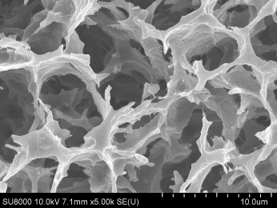
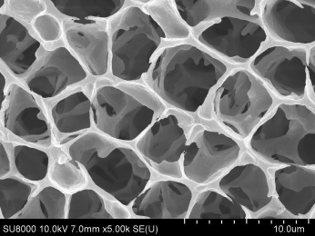
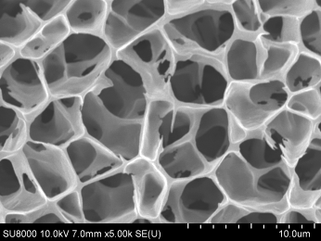
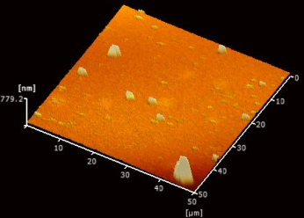
0.6 M NaCl
pH 4
pH 5
pH 6
Heating
(85 ºC 20 min)
pH 7
pH 8
pH 9
Large yellow croaker roe
Vitellogenin Vitellogenin B Vitellogenin C
Protein
isolates
pH 7
pH 8
pH 9
pH 7
pH 8
pH 9
Rheological properties
Gel structure

