Slide 1


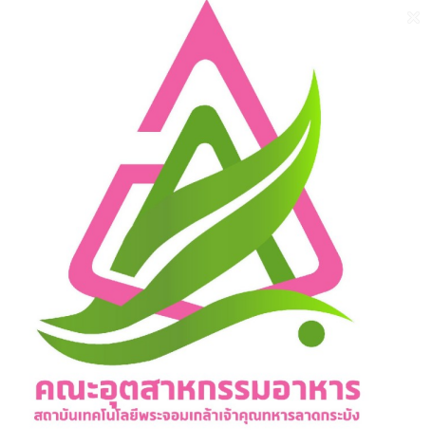
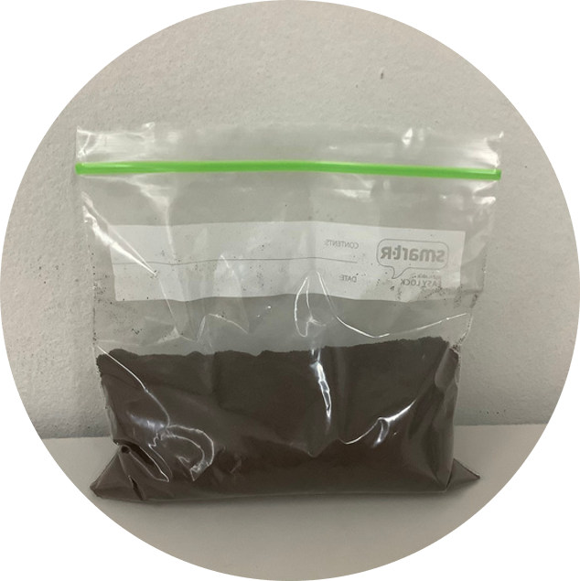
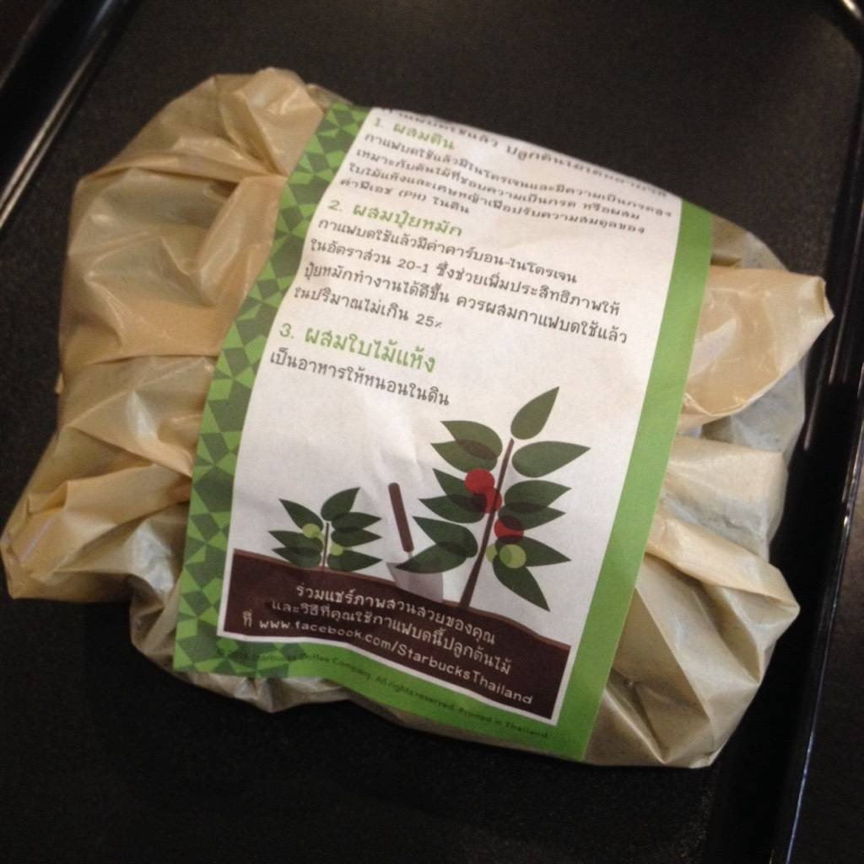
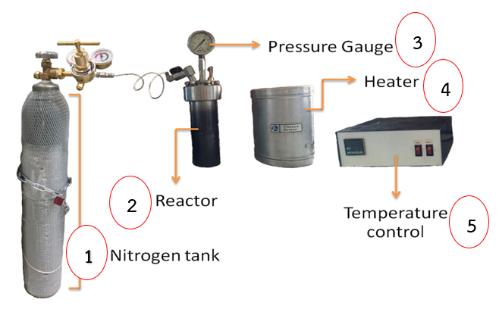
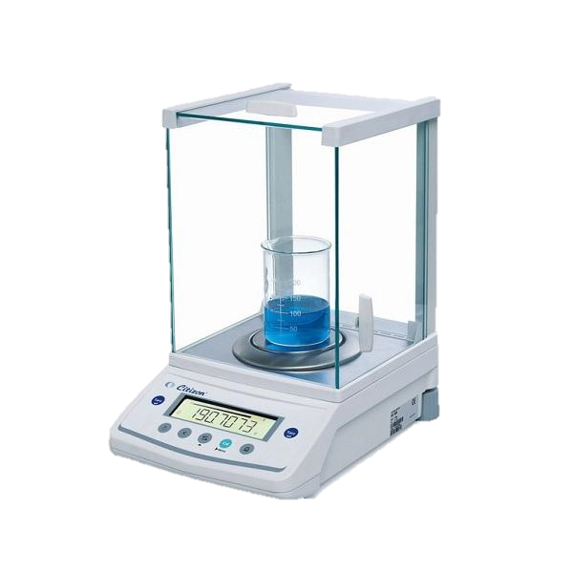
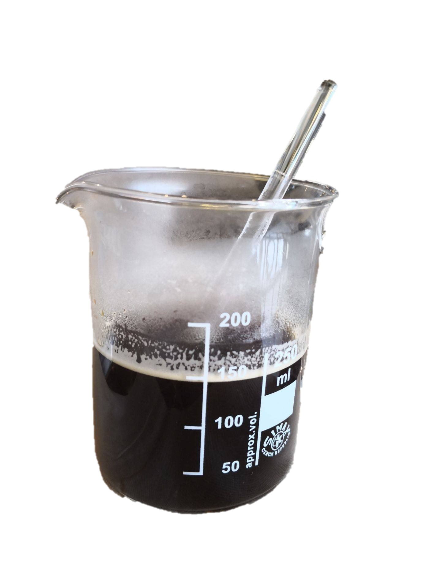
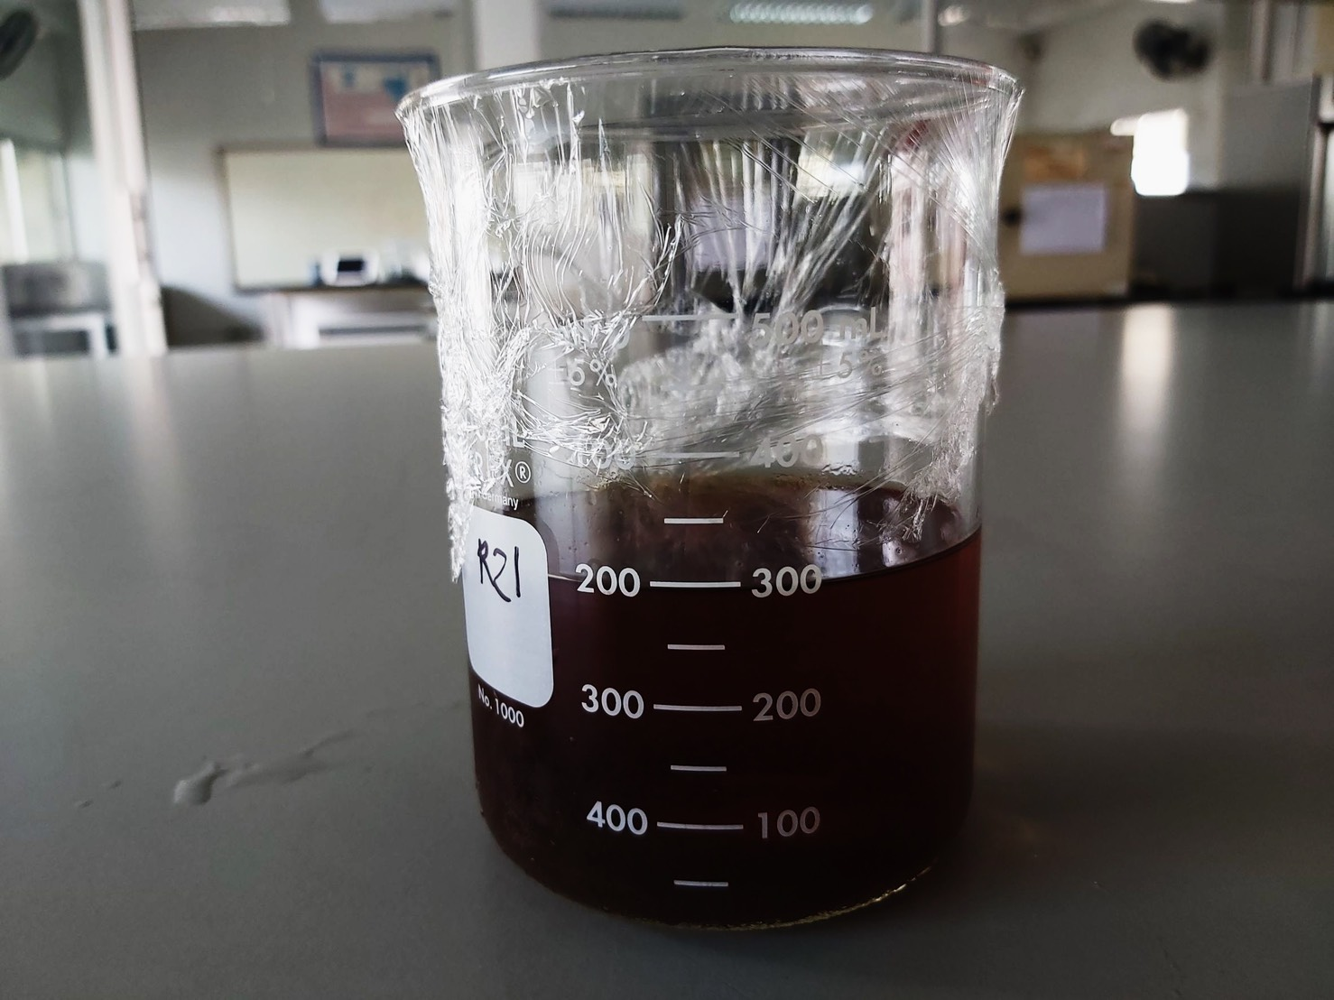
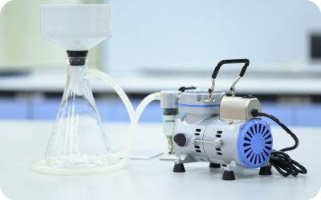
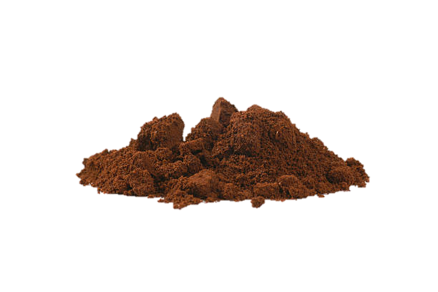
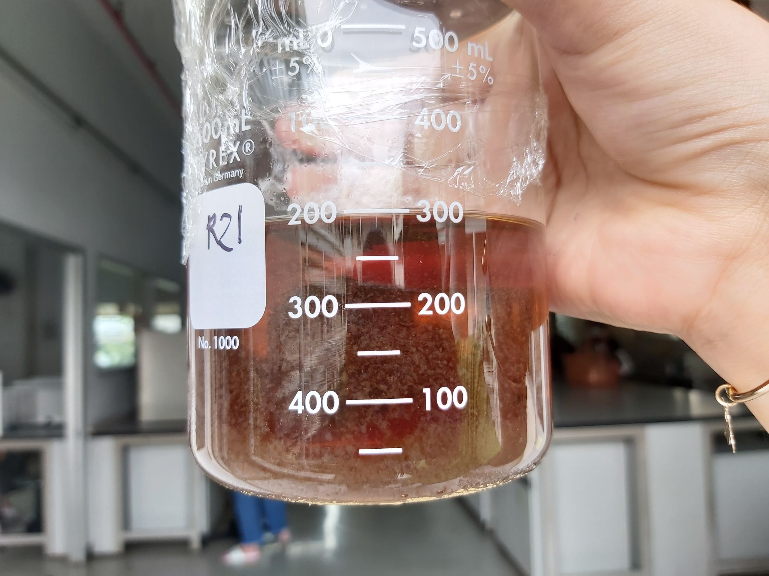
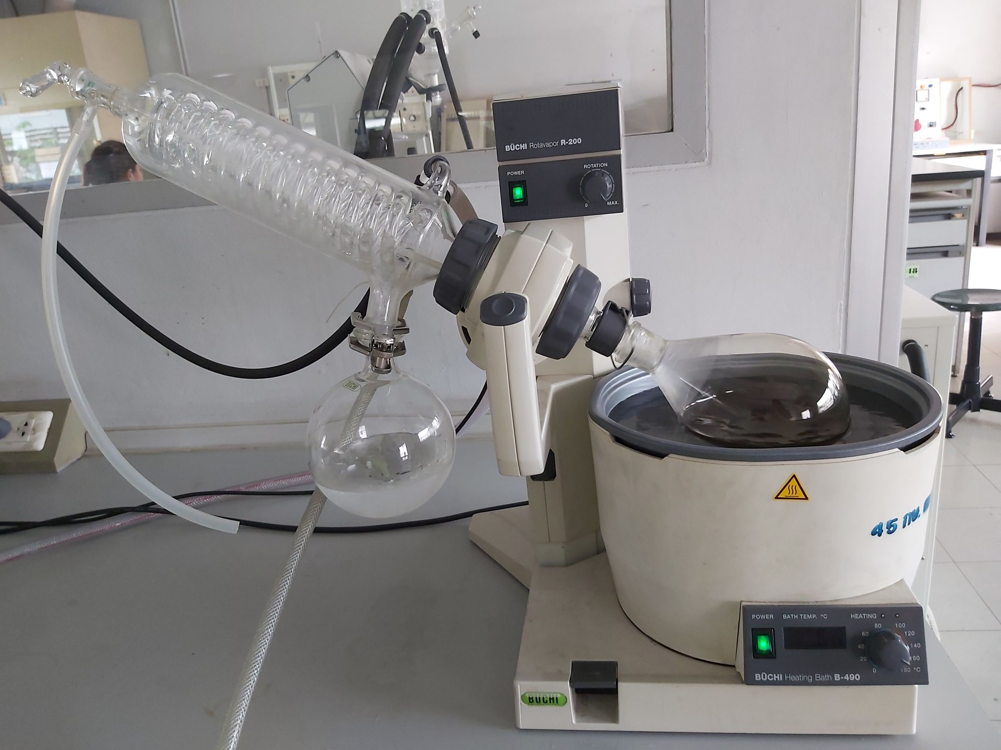
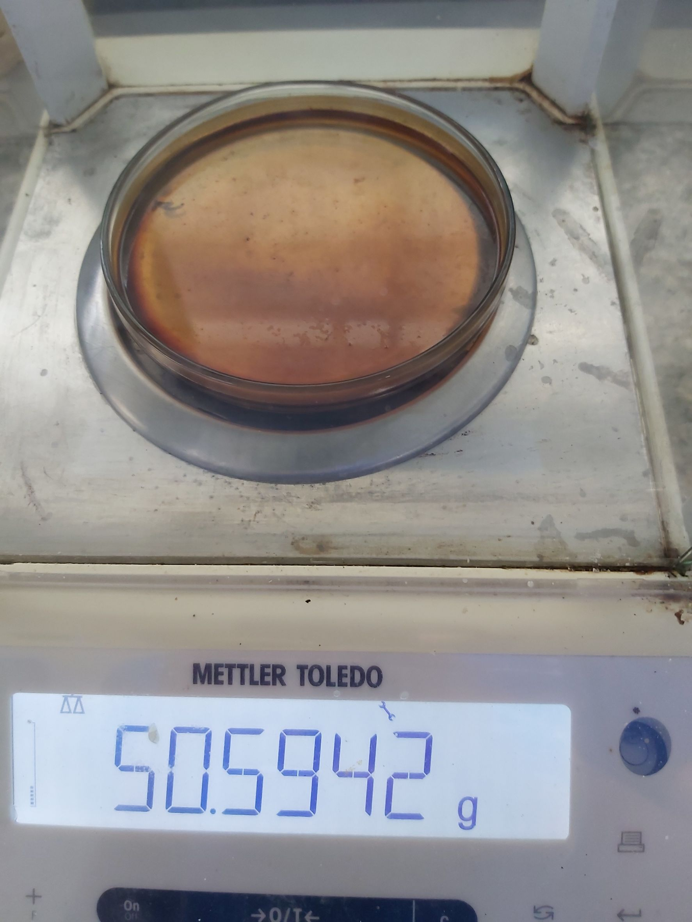
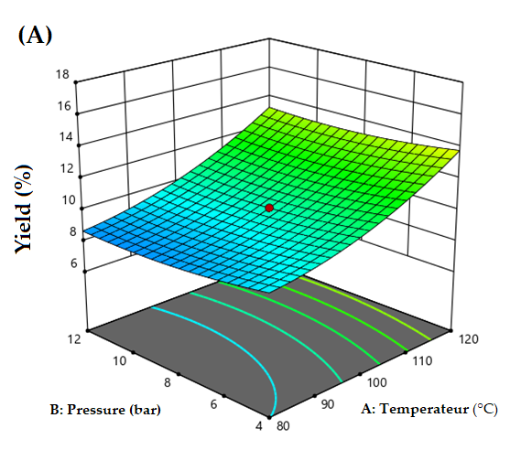
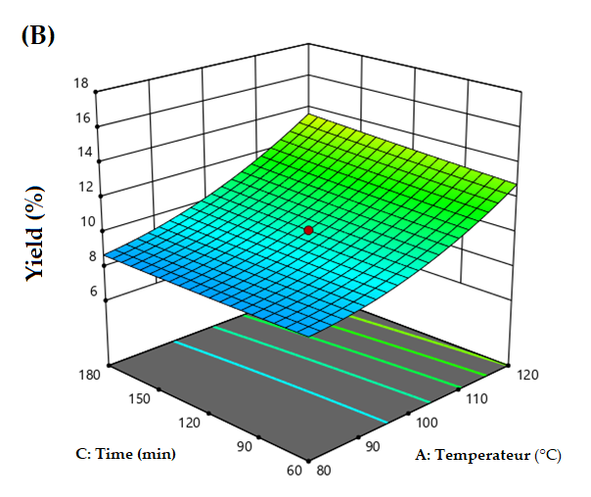
Optimization of polysaccharides extraction from Spent coffee grounds (SCGs) by pressurized hot water extraction
Winatta Sakdasri ^{1,} Kanyagorn Khamseng ¹, Mookanda Wattanavaree ¹, Yaowapa Chandeang ¹,
and Ruengwit Sawangkeaw ^{2, *}
¹Program in Food process engineering, School of Food Industry, King Mongkut’s Institute of Technology Ladkrabang, 1 Chalong Krung 1 Alley, Lad Krabang, Bangkok 10520, Thailand
² Research Unit in Bioconversion/Bioseparation for Value-Added Chemical Production, Institute of Biotechnology and Genetic Engineering, Chulalongkorn University, 254 Phayathai Road, Pathumwan, Bangkok, 10330, Thailand
First author: Winatta.sa@kmitl.ac.th, *Corresponding author: Rueangwit.s@chula.ac.th
Results and Discussion
Table.1 A Central composite design matrix and the response values for the extraction yield of polysaccharide.
Introduction
Spent coffee grounds (SCGs) are a by-product of the food industry, which contains a rich source of polysaccharides. They contain polysaccharide (45-47%), oil or lipids (9-16%), protein (13-17%), phenolic compounds (1.7-3.5%), caffeine (0.5-1.2%), and other minerals (1.6%) [1], depending on the coffee’s species, roasting, grinding, and brewing process.
This research was to study the extraction of polysaccharides from SCGs by environmentally friendly technic of pressurized hot water. The process optimization was investigated by response surface methodology (RSM) to produce the highest extraction yield. The pressurized hot water showed an efficient technique to recover polysaccharides from SCG.
Materials and Methods
The SCGs used in this study was supplied by Starbucks, V Market branch, Ladkrabang, Bangkok, Thailand.
The SCGs sample were dried at 40 °C for 24 hours
Table. 2 The analysis of variance (ANOVA) table for the response surface quadratic model of %yield of polysaccharides.
Source | Sum of Squares | df | Mean Square | p-value
Model | 140.62 | 9 | 15.62 | < 0.0001
A (Temperature) | 125.66 | 1 | 125.66 | < 0.0001
B (Pressure) | 2.73 | 1 | 2.73 | 0.1033
C (Extraction Time) | 0.9019 | 1 | 0.9019 | 0.3384
AB | 0.0684 | 1 | 0.0684 | 0.7898
AC | 0.7850 | 1 | 0.7850 | 0.3710
BC | 1.93 | 1 | 1.93 | 0.1670
Pressurized Hot Water Extraction
Extraction method
Figure 1. Response surface plot demonstrating the effect of (a) temperature and pressure and (b) temperature and extraction time on %yield of polysaccharides
20 g of dried SCGs
Mixed with Distilled water, ratio of 1:15 g SCGs/ml water
Extracted SCGs by Hot compress water
Optimal condition of the highest polysaccharide yield
Filleted by paper filter No.1
Operating parameter | Optimal Condition | %Yield
 |  | Predicted value | Actual value
Temperature (°C) | 120 | 13.782 | 13.71±53
Pressure ( bar) | 4
Extraction time (min) | 60
Recovery of Polysaccharides
Conclusions
Mixed Extracts SCGs 100ml: EtOH 200ml 24 hr.
Evaporated by Rotary evaporator
at 50 °C.
Dried a precipitate at 40°C for 24 hr.
The polysaccharides from Spent coffee grounds (SCGs) have been successfully extracted by pressurized hot water in this study. The temperature was observed as the main influence on the increasing of %polysaccharides yield. The optimization condition was temperature of 120 °C, pressure of 4 bar, and extraction time of 60 min. Under this optimal condition, the highest extraction yield was 13.71±53% and the total phenolic content was 11.13 ± 1.33 mg gallic acid equivalent (GAE)/g dry SCG
Acknowledgements
This research was funded by Research Seed Grant for new Lecturer, KMITL Research Fund (KREF186319). The lab equipment was facilitated by Future food lab of food innopolis at King Mongkut’s Institute of Technology Ladkrabang.
[1] Burniol-Figols, A.; Cenian, K.; Skiadas, I.V.; Gavala, H.N. Integration of chlorogenic acid recovery and bioethanol production from spent coffee grounds. Biochemical Engineering Journal 2016, 116, 54-64.

