Slide 1
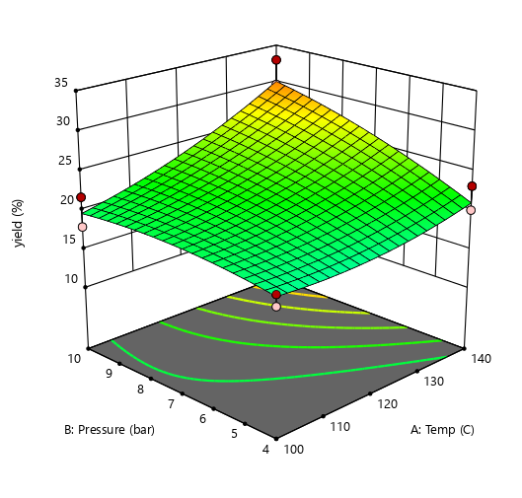
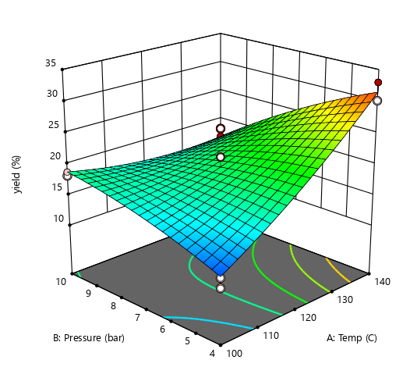
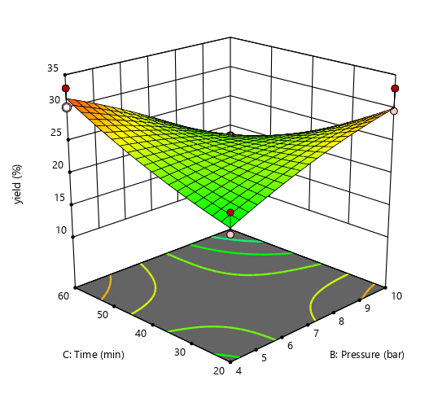
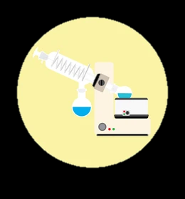
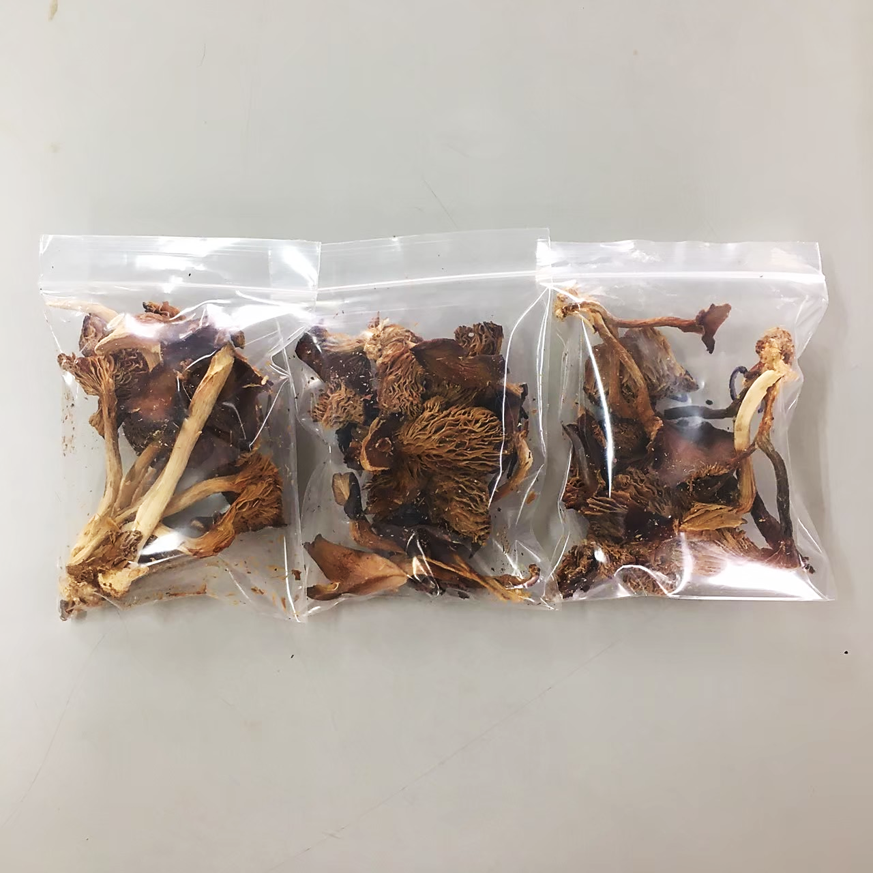
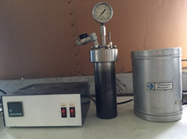
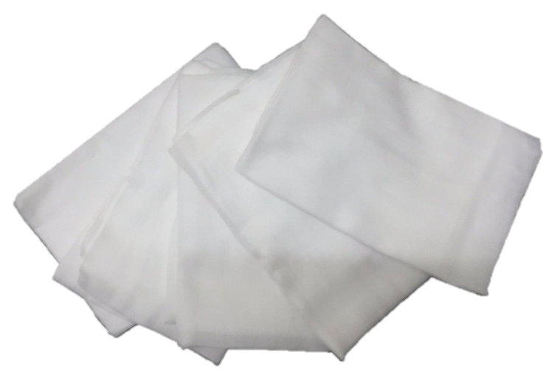
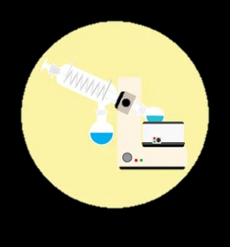
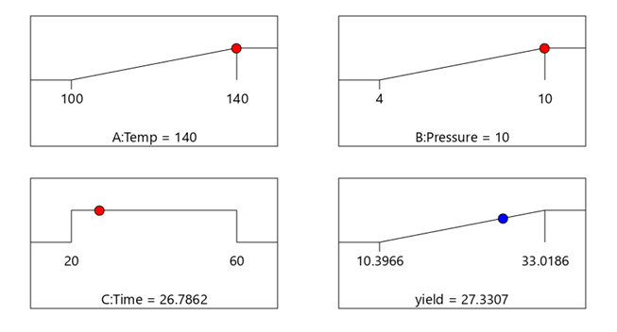
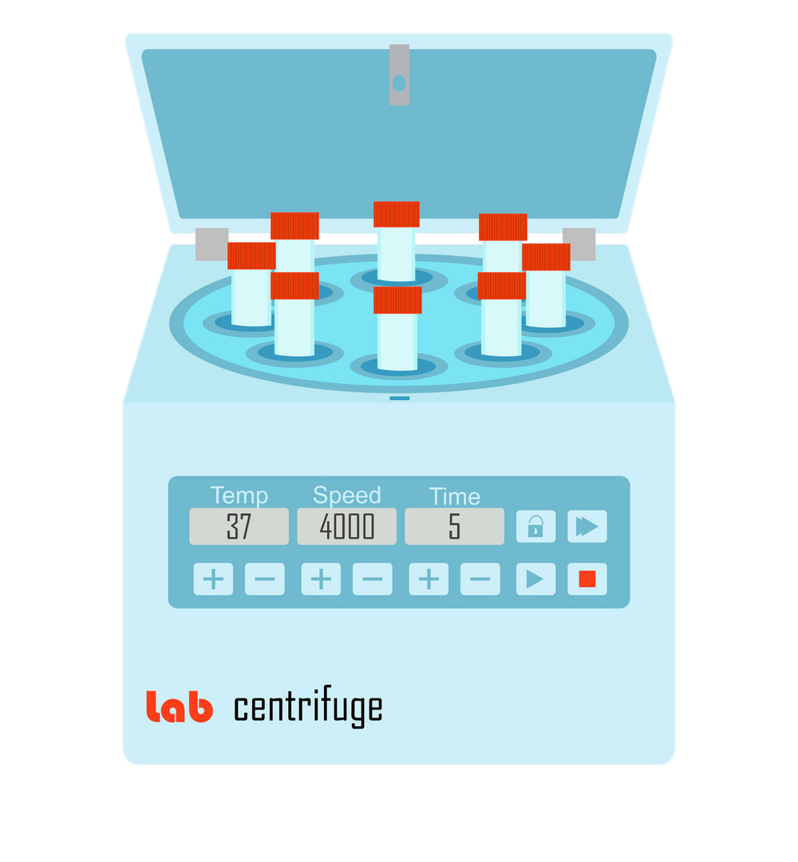
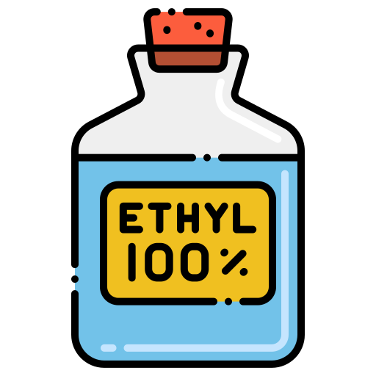
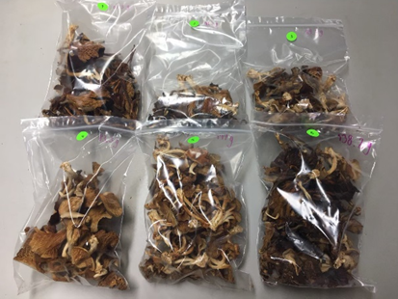
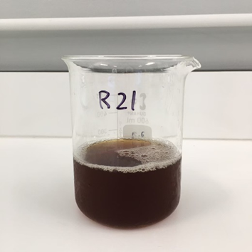
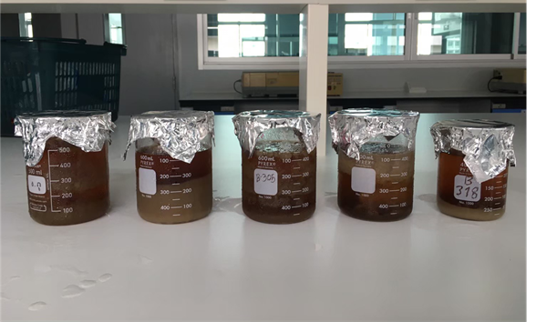
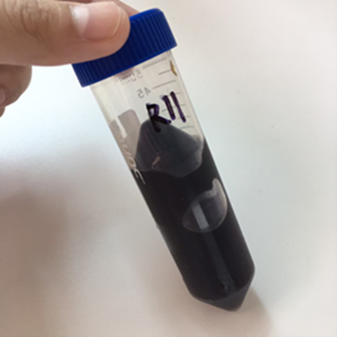
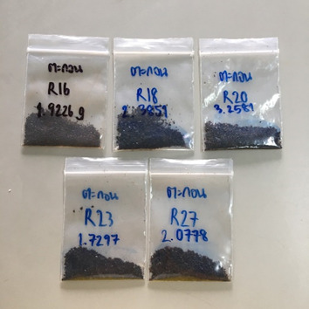
Response surface optimization of crude polysaccharides from grey oyster mushroom (Pleurotus sajor-caju (Fr.) Singer) using pressurized hot water extraction
Winatta Sakdasri ¹, Panisara Arnutpongchai ¹,
Supasuta Phonsavat ¹, Ruengwit Sawangkeaw ^{2, *}
¹Program in Food process engineering, School of Food Industry, King Mongkut’s Institute of Technology Ladkrabang, 1 Chalong Krung 1 Alley, Lad Krabang, Bangkok 10520, Thailand
² Research Unit in Bioconversion/Bioseparation for Value-Added Chemical Production, Institute of Biotechnology and Genetic Engineering, Chulalongkorn University, 254 Phayathai Road, Pathumwan, Bangkok, 10330, Thailand
First author: Winatta.sa@kmitl.ac.th,
*Corresponding author: Rueangwit.s@chula.ac.th
Results and Discussion
Effect of factors on the extraction yield
Table.1 ANOVA table of the effect of reaction condition on the extraction yield
Introduction
Grey oyster mushroom (Pleurotus sajor-caju (Fr.) Singer) is a popular edible mushroom worldwide due to its high nutritional and medicinal benefits. It is sources of carbohydrate, protein, vitamins, and minerals [1]. The bioactive compounds in mushrooms, which is polysaccharides, especially of β‐glucan, have been reported to possess immunomodulatory, antitumor, antiviral, wound healing, anti‐obesity, and antidiabetics activities [2].
This study aims to investigate the effects of extraction temperature (100-140 °C), extraction pressure (4-7 bar), and extraction time (20-60 min) on yield of extracted crude polysaccharides with environmentally friendly pressurized hot water [3]. The extraction condition was optimized by the maximize yield using response surface method based on a central composite design (CCD). Under optimal condition, the total phenolic and total glucan content of crude polysaccharides was indicated as 34.50 ±1.79 g/100 g dry mushroom, which separated as 32.47±1.95 mg/100 g of β-glucans and 2.04±0.98 mg/100 g of α-glucans.
Significant Factor: p-value < 0.05
A
At short time
At long time
Materials And Methods
B
Grey oyster mushrooms (Pleurotus sajor-caju (Fr.) Singer) were harvested from mushroom farm in The Institute of biotechnology and genetic engineering, Chulalongkorn University. They were dried at 60 °C and stored in a desiccator at room temperature.
Extraction method
Fig.1 (A) Effect of interaction of temperature and pressure and (B) effect of interaction of pressure and time on extraction yield
10 g of samples
per 300 ml of water.
Extracted by pressurized hot water
1st filtered by filter cloth and 2nd by paper filters No.1
Evaporated of water
Optimal condition of the highest yield
Temperature : 140 °C
Pressure : 10 bar
Time : 26.79 min
Predicted Yield = 27.3307 %
Actual yield = 31.31±2.55%.
Dried in a hot air oven at 80 °C.
Centrifuged at 10,000 rpm
at 4 °C for 10 mins.
Evaporated of ethanol
Precipitated by ethanol of
polysaccharides (24 hours)
Bioactive compounds
Total phenolic content: 401±8.24 mg GAE/g dried mushroom
Total glucan content: 34.50 ±1.79 g/100 g dried mushroom
β-glucans: 32.47±1.95 mg/100 g
α-glucans: 2.04±0.98 mg/100 g
Dried mushrooms samples
Extracted Solution
Polysaccharides precipitation with ethanol
Centrifuged
at
10,000 rpm
Polysaccharide sediments
Conclusions
Crude polysaccharides of grey oyster mushrooms were successfully extracted by pressurized hot water. The temperature was the main effect on the increasing of extracted yield. The optimum extraction condition was 140 °C, 10 bar, and 26.79 min with a corresponding yield of 31.31±2.55%. Under these conditions, the total phenolic content of crude polysaccharides was 401±8.24 mg GAE/g dry mushroom. In addition, the total glucan content was indicated as 34.50 ±1.79 g/100 g dried mushroom, which separated as 32.47±1.95 mg/100 g of β-glucans and 2.04±0.98 mg/100 g of α -glucans.
References
1. Eswaran A, Ramabadran R: Studies on some physiological, cultural and postharvest aspects of oyster mushroom, Pleurotus eous (Berk.) sacc. 2000.
2. Ahmad A, Anjum FM, Zahoor T, Nawaz H, Dilshad SMR: Beta Glucan: A Valuable Functional Ingredient in Foods. Critical Reviews in Food Science and Nutrition 2012, 52(3):201-212.
3. Teo CC, Tan SN, Yong JWH, Hew CS, Ong ES: Pressurized hot water extraction (PHWE). Journal of Chromatography A 2010, 1217(16):2484-2494.
Acknowledgements
This work was supported by School of Food Industry, King Mongkut’s Institute of Technology Ladkrabang (Grant number 2564-02-07-004). The lab equipment was facilitated by Future food lab of food innopolis at King Mongkut’s Institute of Technology Ladkrabang

