Slide 1
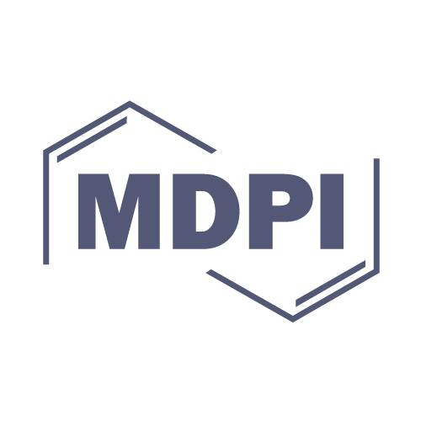
The 2nd International Electronic Conference on Foods - “Future Foods and Food Technologies for a Sustainable World” 15 - 30 Oct 2021
Presented by: Vinita Singh
Ph.D Scholar (Foods & Nutrition)
AIFT, Amity University, Uttar Pradesh, Noida, UP, India
Under the guidance of: Dr. Monika Thakur
Assistant Professor
AIFT, Amity University, Noida, UP, India

Slide 2
Presentation Title…
Food synergy: A sustainable approach to improve the iron status of adolescent girls

Slide 3
Abstract
Low consumption of iron-rich foods combined with poor bio-availability of non-heme iron, has been considered as the foremost cause of iron deficiency in developing countries. According to National Family Health Survey (NFHS-4), 2015-16, the prevalence of anaemia among women aged 15-49 years is 53.1 % in India, which demands due emphasis on approaches that can bring down the total prevalence among rural adolescent girls. Evidence has proven that foods and food patterns act synergistically and can reduce the risk of chronic diseases. The exclusive initiative of food synergy is the interaction between nutrients among many foods When synergistic foods are consumed together, the support for potential health benefits becomes stronger. The present study was conducted to investigate the cross-sectional synergistic relationship between different nutrient combinations to increase the absorption and bio-availability of non-heme iron required to combat iron deficiency anemia among rural adolescent girls in the age group of 10-19 years. They were considered for the intervention of developed iron and vitamin C rich food. The finding indicated that the combination of poorly absorbed plant source non-heme iron and vitamin C rich food improves the bio-availability of iron. Ascorbic acid has been considered as the most potent enhancer of non-heme iron absorption in our body even in the presence of inhibitors like phytates, oxalates, etc. It converts food ferric iron to the ferrous. Adding 50mg of Vitamin C to the same meal, doubles the iron absorption. This synergistic effect of food helps in combating iron deficiency anemia among adolescent girls and improves their nutritional status. Thus, this synergistic relationship between mineral and vitamin helps in development of sustainable food for iron deficient adolescent girls.
Key words: anemia, bio-availability, adolescent, ascorbic acid

Slide 4
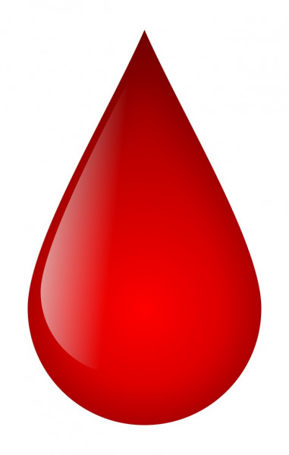
Anemia
Anemia
Is a blood disorder .... critical public health problem in India
Reduced level of hemoglobin in the blood
Manifestations of under nutrition and poor intake of iron in the diet

Slide 5
Prevalence of Anemia (%)
Source : NFHS - 4
Age Group | India |  |  | Uttar Pradesh
 | Urban | Rural | Total | Urban | Rural | Total
Non Pregnant women age 15 - 49 years who are anemic (< 12.0 g/dl) | 51.0 | 54.4 | 53.2 | 52.8 | 52.4 | 52.5
Pregnant women age 15 - 49 years who are anemic (< 11.0 g/dl) | 45.8 | 52.2 | 50.4 | 49.2 | 51.4 | 51.0
All women age 15 - 49 years who are anemic (%) | 50.8 | 54.3 | 53.1 | 52.7 | 52.4 | 52.4

Slide 6
Stages of anemia for adolescent girls
Mild Anemia
Hb
10 – 12
gms / dl
Moderate anemia
Hb
7.1 – 9.9 gms / dl
Severe anemia
Hb
< = 7
gms / dl

Slide 7
Etiology of Iron Deficiency Anemia
Inadequate ingestion
Inadequate absorption
Defects in release from stores
Iron deficiency
Inadequate utilization
Increased blood loss or excretion
Increased requirement

Slide 8
Dietary factors that enhance and inhibit Iron Absorption
Enhancing factors | Inhibiting Factors
Ascorbic acid | Tea, coffee, cocoa (Iron binding compound)
Citric acid | Phytates
Some fruits | Carbonated beverages
Some vegetables | Calcium
Meat, Fish and poultry | Fibres
Sprouts | High dose of minerals
Fermented foods | Soy protein

Slide 9
Food Synergy
The concept of food synergy focuses on how distinct food components interact with one another to produce an effect that is greater than the sum of their separate effects. So, it is an illustration of understanding the positive or negative inter-relationships between nutrients, their absorption, and bio-availability in human body. It considered as the functioning model that elevates the nutritive value of individual food items and control micronutrient deficiency among vulnerable populations. The exclusive purpose of food synergy is the interaction between nutrients present in various foods rather than particular food component and how they affect nutrient absorption and bioavailability in our bodies. According to Jacobs et al (2011), food synergy can be defined as additive or more than additive influences of dietary patterns, foods, and food constituents on health.

Slide 10
Benefits of synergistic combination of vitamins and minerals
Synergistic combination of vitamin and mineral | Benefits for human health
Vitamin A and Zinc | Helps in improving status of vitamin A deficiency Used as a measure of treatment and prevention of vitamin A deficiency prophylaxis programmes in public nutrition programmes. Decreases the risk of stomach cancer.
Vitamin A, D and Zinc | Help body to absorb zinc which in turn enables body to absorb fat soluble vitamins.
Vitamin A and Iron | Increases the bioavailability of pro-vitamin A carotenoids such as alpha-carotene, beta-carotene, and beta-cryptoxanthin improves iron absorption, especially non-heme iron helps to reverse iron deficiency anaemia.
Vitamin B₆ and Magnesium | A minor synergistic effect of daily dietary supplementation with a combination of Mg and vitamin B₆ in the reduction of minor premenstrual anxiety-related symptoms is observed.
Vitamin C and Iron | Vitamin C increases the absorption of non-heme iron in the body helps in improving iron deficiency anaemia.
Vitamin C, D and Zinc | Helps in reducing chances of infection by improving immune functioning. Furthermore, immune system cells actively use vitamin C, D, and zinc while combating infections such as upper respiratory tract infections
Vitamin D and Calcium | Helps in lowering the risk of fractures and osteoporosis as well as in prevention of colorectal neoplasia.

Slide 11
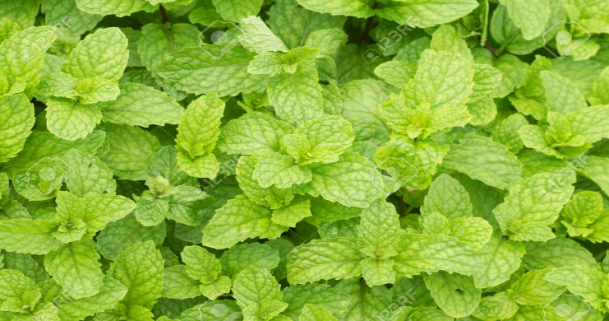
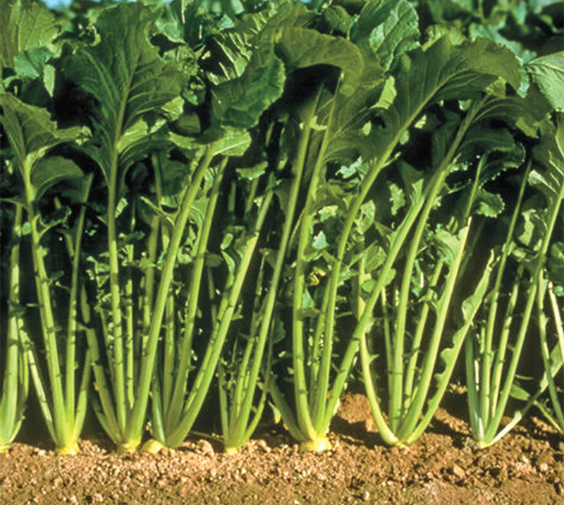
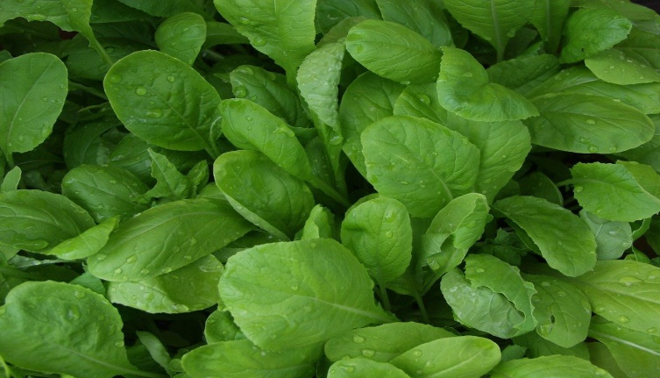
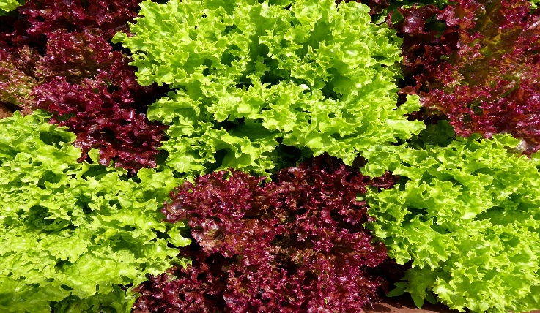
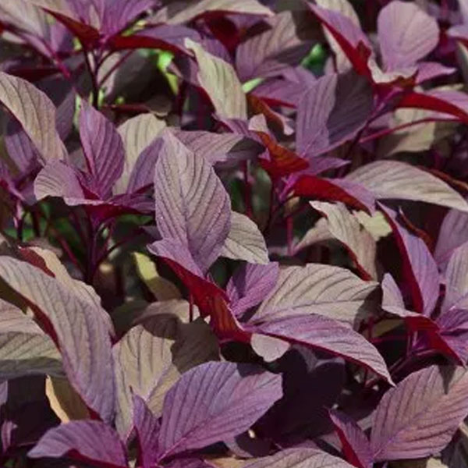
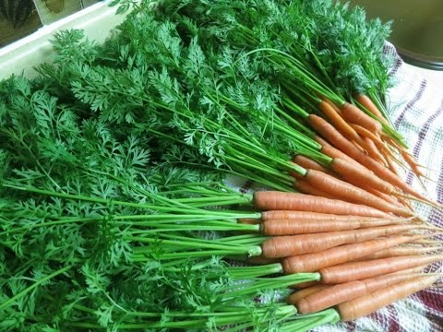
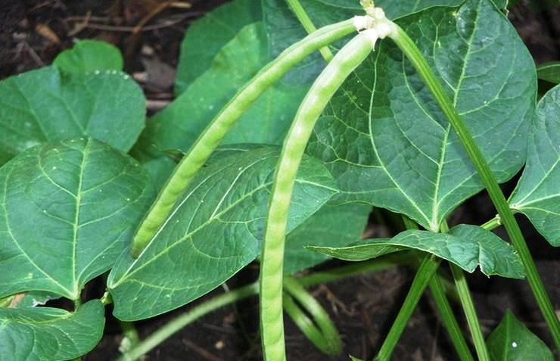
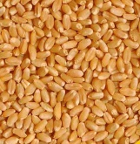
Iron Rich Green Leafy Vegetables (mg / 100g)
RADISH LEAVES (18.0)
MINT LEAVES (15.6)
BROCCOLI (40.0)
TURNIP LEAVES (28.4)
MUSTARD LEAVES (16.3 )
LETTUCE (2.4)
AMARANT HUS (38.5)
CARROT LEAVES (8.8)
COW PEA LEAVES (20.1)
BANGAL GRAM LEAF (23.8)
BENGAL GRAM (CHANA DAL)

Slide 12
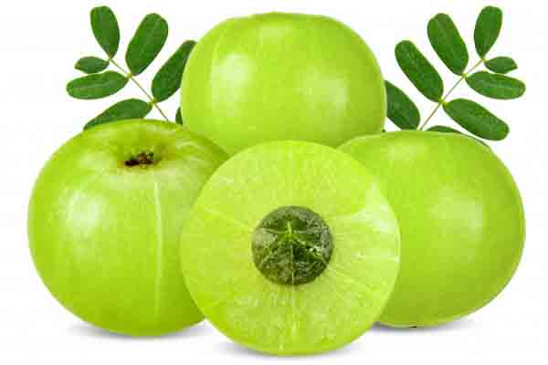
Composition of Fruit Pulp of Aonla
Iron
12μg/g
Vitamin C
6 mg/g
Carbohydrate
13.7%
Phosphorus
0.02%
Protein
0.5%
Calcium
0.5%
Fat
0.1%
Minerals
0.5%
Nicotinic Acid
0.02μg/g
Fibre
3.4%
Moisture
81.8%

Slide 13
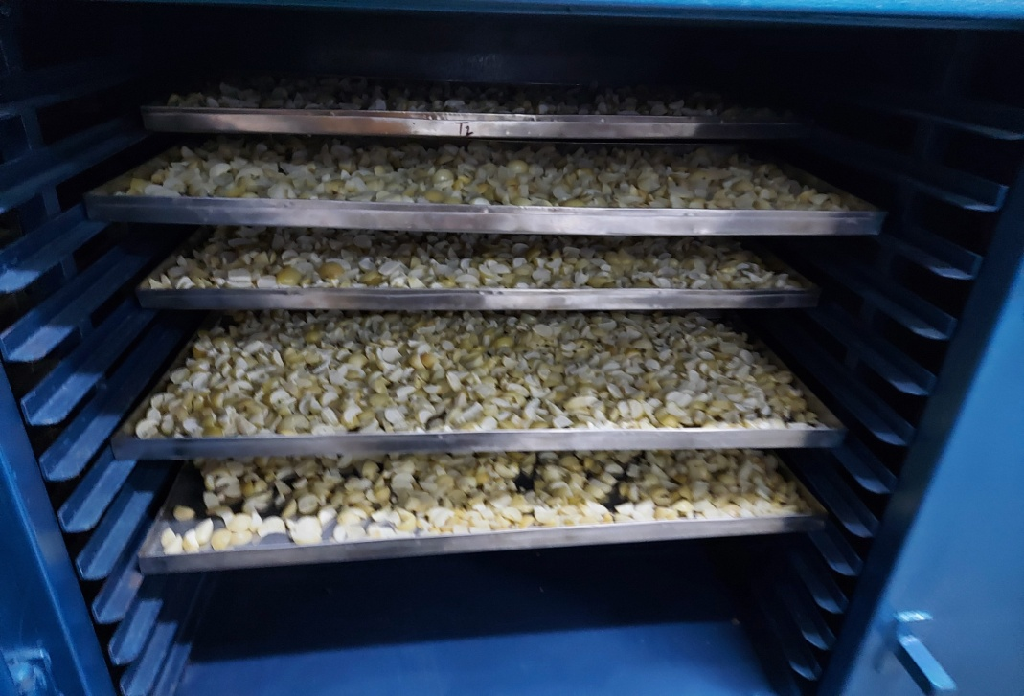
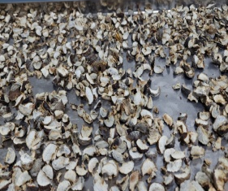
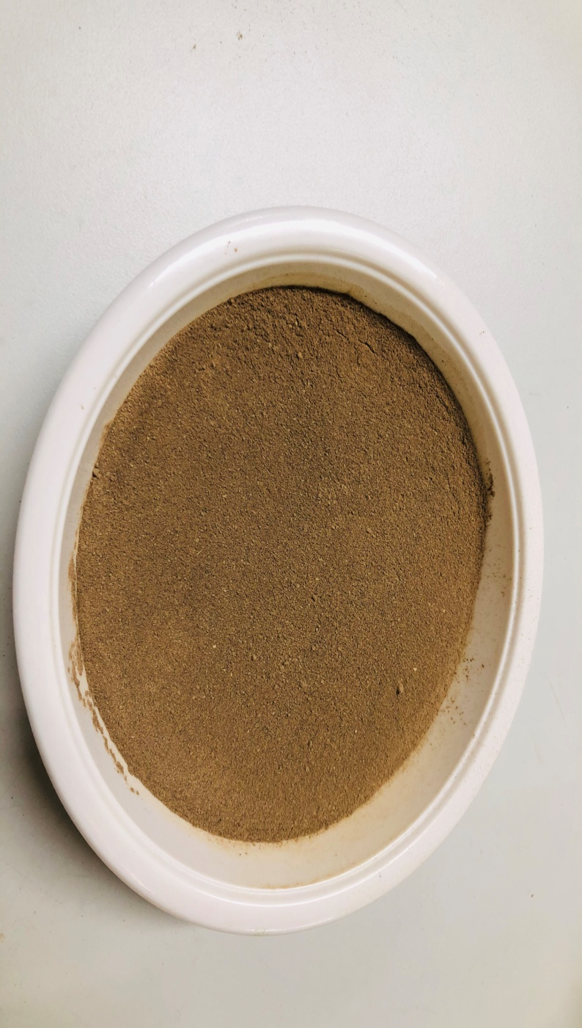
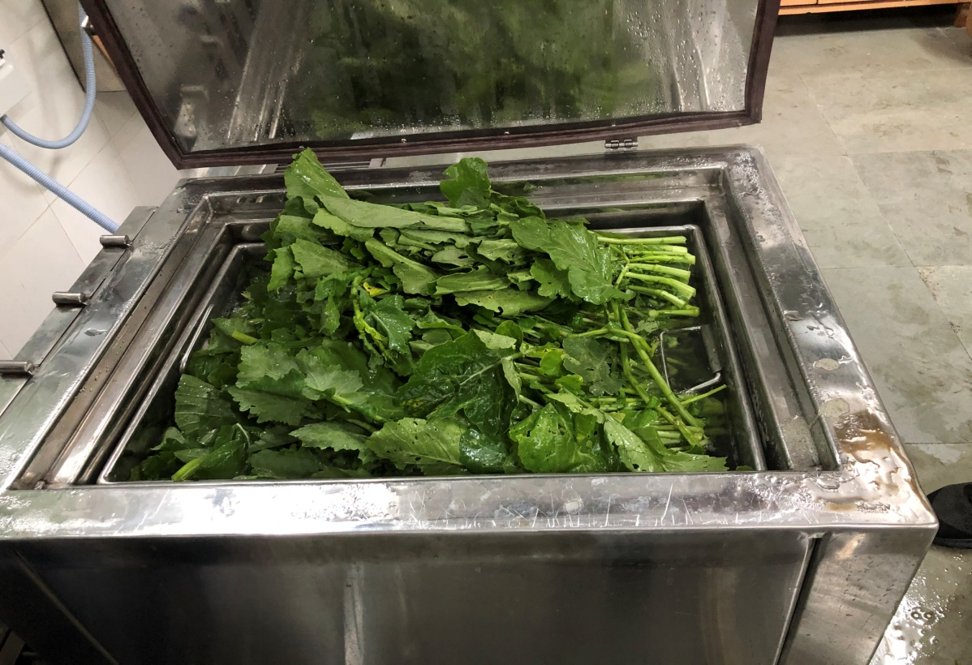
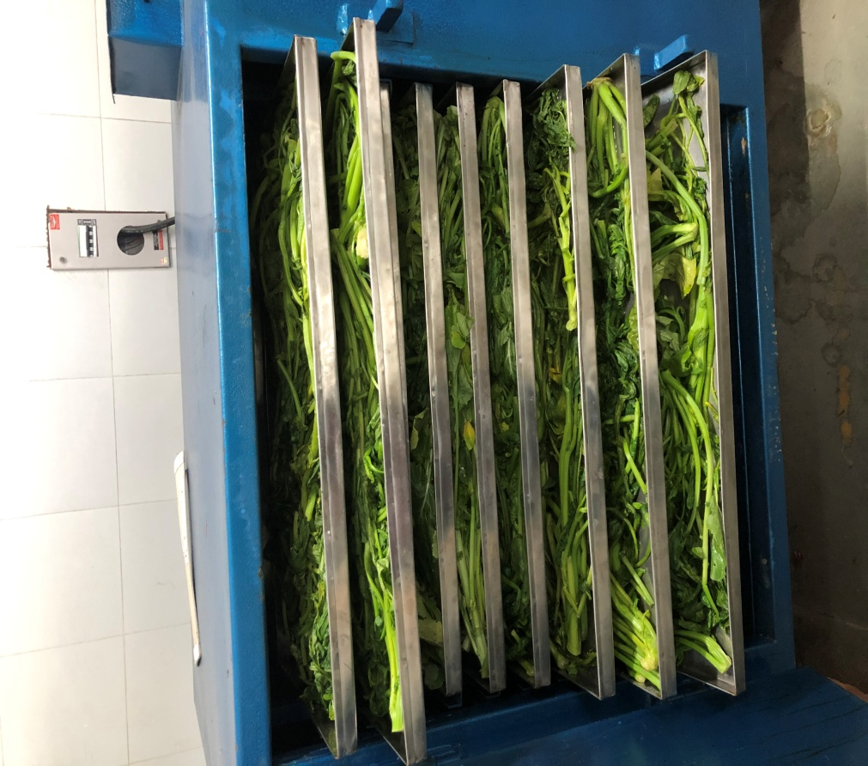
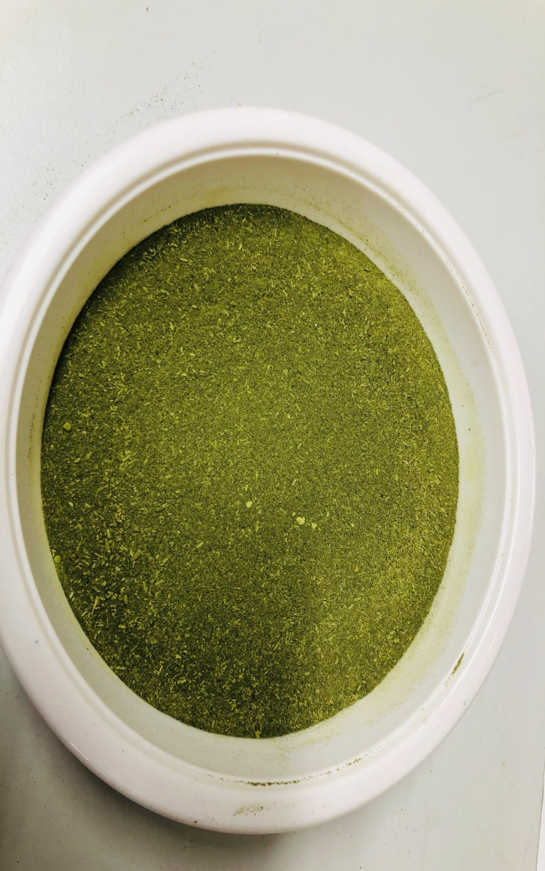
Preparation of Iron and vitamin C Rich Product
Preparation of Aonla powder
Cutting
Drying
Dried
Powder
Preparation of Turnip leaves powder
Iron and Vitamin C Rich Bar
Blanching
Drying
Dryed
Powder

Slide 14
Iron and Vitamin C synergy
Vitamin C (ascorbic acid) acts as a catalyst, that helps in better absorption of iron from food and other supplements. Iron is vital for keeping our blood oxygenated. because it is an essential component of hemoglobin, the substance in red blood cells that delivers oxygen to every cell in our body. There are two types of iron present in food: haem iron and non heme iron. Heme iron obtained from animal sources like chicken, red meat, fish, eggs, which is well absorbed in human body and another form is non-haem iron that can be obtained from plant sources like whole grains, legumes and dark leafy vegetables. which is poorly absorbed in the body So, Combining non-haem foods with vitamin C rich sources like aonla, lemon, oranges, berries etc., helps to change the food ferric to more absorbable form - ferrous, which improve the bio-availability of non-heme iron in body. The absorption of the iron will be much greater if the nutrients are paired in a single meal.

Slide 15
Conclusion
Iron deficiency anemia is a serious public health problem that affects a large proportion of the world’s population, causing “hidden malnutrition. The underutilized fruits and vegetables can prove to be a promising result as it is a rich source of iron and vitamin C that prevent an Iron deficiency anaemia among adolescent girls. Hence, it can be concluded that exploitation of underutilized, locally available low cost seasonal fruits and vegetables can provide a way to nutrient and economic security of iron deficiency anemia among adolescents. Hence the nutrition intervention package including iron rich food supplement and nutrition-education help in formulation of health and nutrition intervention and promotion programme to reduce the prevalence of iron deficiency anemia among adolescent girls. Supplementation of food like rice flakes, jaggery, niger seeds, green leafy vegetables and other locally available foods helps in reducing the prevalence of iron deficiency anemia among adolescent girls at lower cost and useful to the community for combating Iron deficiency anemia.

Slide 16
References
Natrajan T. Devi, ramasamy J Rani, Palanisamy K. Nutraceutical potentials of synergic foods: a systematic review. Journal of Ethenic Foods. volume 6, Article number: 27 (2019).
Jacobs DR Jr, Steffen LM. Nutrients, foods, and dietary patterns as exposures in research: a framework for food synergy. Am J Clin Nutr. 2003;78(3):508S–13S.
Jacobs DR, Tapsell LC. Food, not nutrients, is the fundamental unit in nutrition. Nutr Rev. 2007;65(10):439-50.
Jacobs DR Jr, Gross MD, Tapsell LC. Food synergy: an operational concept for understanding nutrition. Am J Clin Nutr. 2009;89(5):1543S–8S.
Jacobs DR, Tapsell LC, Temple NJ. Food synergy: The key to balancing the nutrition research effort. Public Health Rev. 2011;33(2):507-529.

Slide 17
THANK YOU

