Slide 1

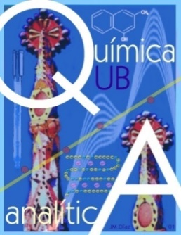

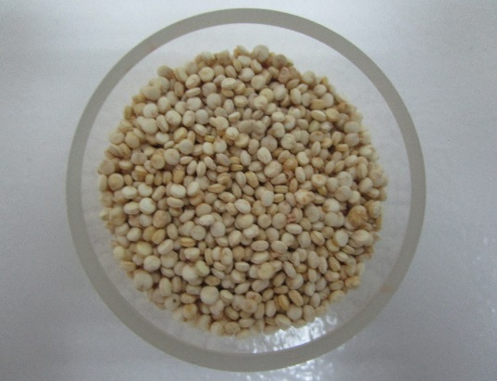
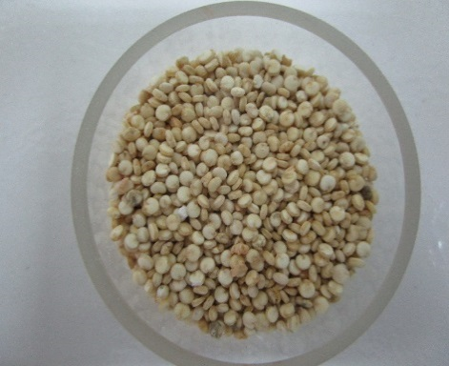
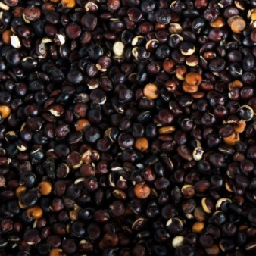
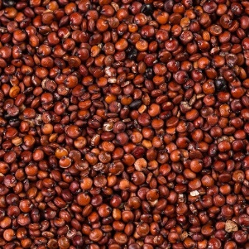
PROTEIN FINGERPRINTING BY CAPILLARY ELECTROPHORESIS WITH ULTRAVIOLET ABSORPTION DIODE ARRAY DETECTION FOR DIFFERENTIATION OF QUINOA VARIETIES
Galindo-Lujan, R.*, Pont, L., Sanz-Nebot, V., Barbosa, J., Benavente, F.
Department of Chemical Engineering and Analytical Chemistry,
Institute for Research on Nutrition and Food Safety (INSA·UB),
University of Barcelona, c/ Martí I Franquès 1-11, 08028 Barcelona, Spain
*rgalindo@ub.edu
Introduction
Experimental
Quinoa (Chenopodium quinoa Willd.) is an andean grain with more than 3,000 ecotypes recognized for its exceptional nutritional properties. In western countries, where it is sold as a gluten-free protein-rich super food with a broad amino acid spectrum, quinoa trade and consumption is rapidly expanding. Quinoa is consumed as a whole grain or after different processing methods (e.g. extrusion), but it is also milled to produce high-value flour, which is susceptible to adulteration. In consequence, there is a growing interest in developing novel analytical methods to expand the knowledge regarding quinoa composition. In this study, we developed a rapid and simple capillary electrophoresis-ultraviolet adsorption diode array detection (CE-UV-DAD) method to obtain characteristic multiwavelength electrophoretic profiles of protein extracts from different quinoa grain varieties (black, red, white from Peru and royal white from Bolivia). Then, advanced chemometric methods (i.e. multivariate curve resolution alternating least squares, MCR-ALS, followed by principal component analysis, PCA, and partial least squares discriminant analysis, PLS-DA) were applied to deconvolute the components present in the CE-UV-DAD electropherograms and classify the different quinoa varieties according to their differential protein composition.
A) Protein Extraction
Bran
Water
Protein
Soluble bran components
Supernadant
Precipitate
250 mg ground grain
1 mL H₂O
Alkaline extraction
Separation I
Precipitation
Separation II
Solubilization
Separation III
pH 10 (39 µL NaOH 0.1 M)
Time: 1 h
Incubation: 36ºC, 900 rpm
Centrifugation 15 000 x g
Time: 20 min
Temperature: 4ºC
pH 5 (22 µL HCl 1 M)
Centrifugation 15 000 x g
Time: 20 min
Temperature: 4ºC
1mL of 60 mM sodium borate BGE
filtered 0.20 µm nylon filter
B) CE-DAD
Supernadant
✓ Protein extracts were dissolved in BGE
✓ Postconditioning (930 mbar): water (3 min)
CE-DAD
✓ Sample injection: 50 mbar, 10 s
✓ Between injections (930 mbar): 0.5% SDS (2 min), water (3 min), 1 M NaOH (3 min), water (3 min) and BGE (3 min).
✓ Separation voltage: +25 kV
✓ Activation (930mbar): 1 M HCl (20 min), water (20 min), 1 M NaOH (20 min), water (20 min) and BGE (20 min).
✓ Wavelength range: 190-400 nm
C) Data Analysis
Results
RAW CE-DAD electropherograms
PLS-DA ANALYSIS
Royal Quinoa (Ro)
White Quinoa (W)
λ = 214 nm
Black Quinoa (B)
Red Quinoa (R)
A) PLS-DA. Scores Plot
C) PLS-DA. VIP Plots
Royal-White
Absorbance (mAU)
Absorbance (mAU)
Absorbance (mAU)
Absorbance (mAU)
Scores on LV 2 (17.0%)
VIP Scores for Quinoa Royal-White
Black
Variable
Complex CE-DAD electrophoretic profiles
Scores on LV 1 (75.6%)
VIP Scores for Quinoa Black
MCR-ALS DECONVOLUTION
B) PLS-DA. Loadings Plot
A) Royal Quinoa Raw Electropherogram
B) MCR-ALS (deconvoluted components)
Variable
Concentration Profiles
ii) UV Spectra
LV 2 (17.0%)
Red
VIP Scores for Quinoa Red
λ = 214 nm
Variable
LV 1 (75.6%)
C4 is the only variable non critical for differentiation (VIP<1)
Two latent variables allow classifying the different quinoa varieties
C2, C3 and C4 do not show the typical UV spectra in proteins
References
Conclusions
[1] R. Galindo-Luján, L. Pont, V. Sanz-Nebot, F. Benavente. Food Chemistry 341 (2021) 128207.
[2] L. Pont, I. Compte, V. Sanz-Nebot, J. Barbosa, F. Benavente. Food Anal. Methods 13 (2020) 325-336.
[3] L. Pont, F. Benavente, J. Jaumot, R. Tauler, J. Alberch, S. Ginés, J. Barbosa, V. Sanz-Nebot. Electrophoresis 37 (2016) 795-808.
[4] A. Barroso, E. Giménez, F. Benavente, J. Barbosa, V. Sanz-Nebot. Talanta 160 (2016) 614-623.
A CE-DAD method to obtain multiwavelength electrophoretic fingerprints was applied to protein extracts from B, R, W and Ro quinoa samples.
Deconvolution with MCR-ALS allowed the resolution of the most relevant components in the electrophoretic profiles, which showed characteristic UV-spectra.
The areas of the 4 resolved components and the total protein content determined by the Kjeldahl method were considered for multivariate data analysis PCA and partial least squares discriminant analysis (PLS-DA).
PCA allowed detecting two white quinoa outlier samples and defining three sample classes (i.e. B, R and W-RO quinoa).
PLS-DA allowed classifying of quinoa varieties based on protein fingerprinting and could be used for simple and enhanced quality control of quinoa-containing foodstuff.
Acknowledgements
This work was supported by the project RTI2018-097411-B-I00 (Ministry of Economy and Competitiveness, Spain) and the Cathedra UB Rector Francisco Buscarons Úbeda (Forensic Chemistry and Chemical Engineering).

