Slide 1



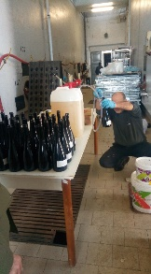
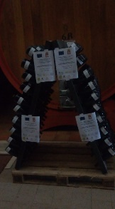
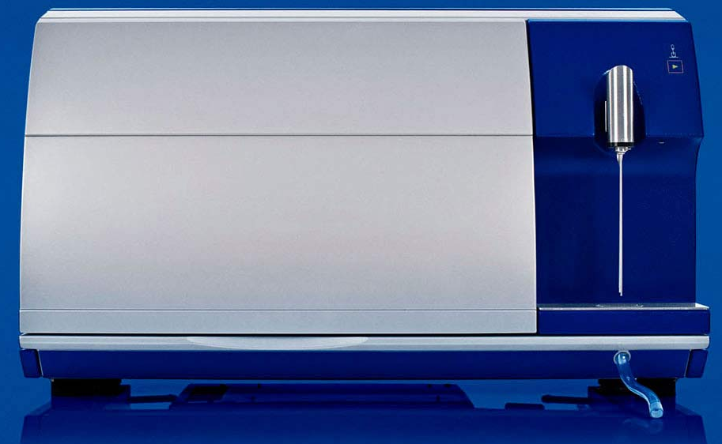
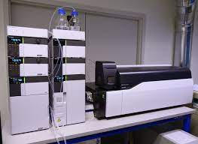
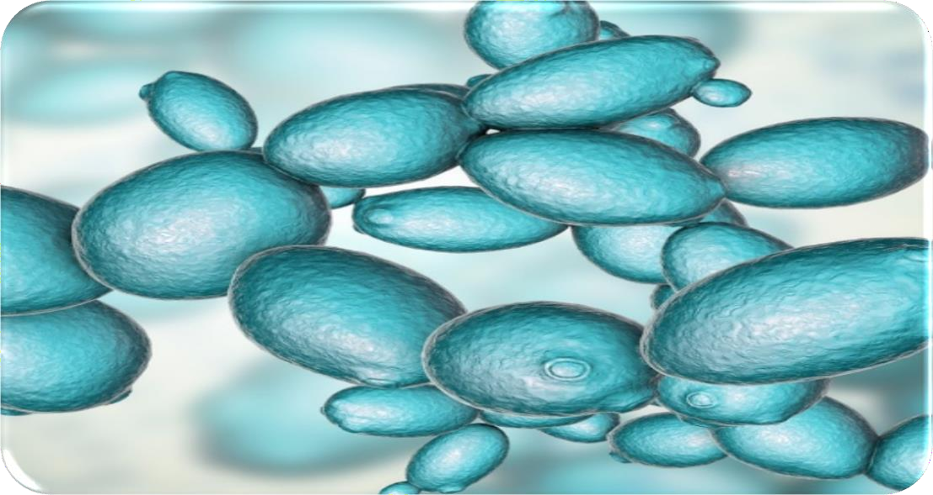
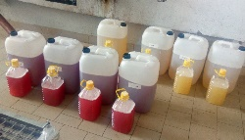

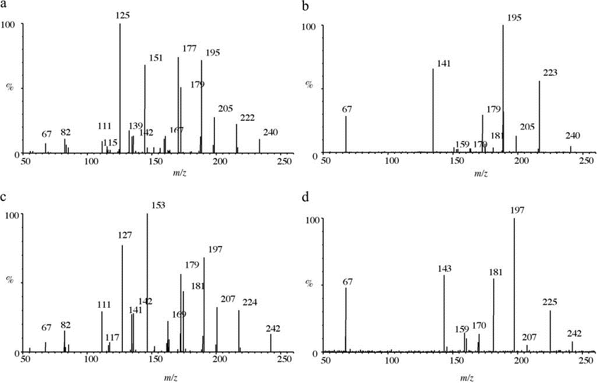
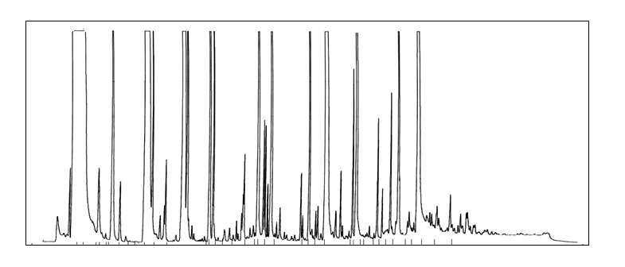
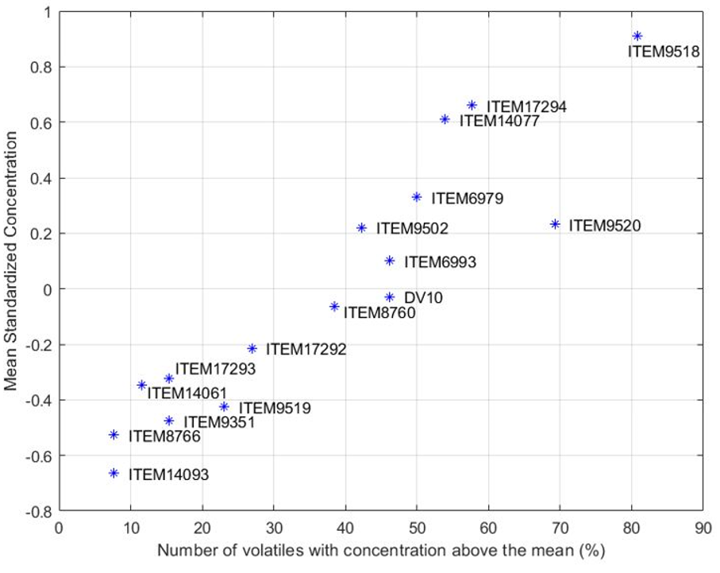
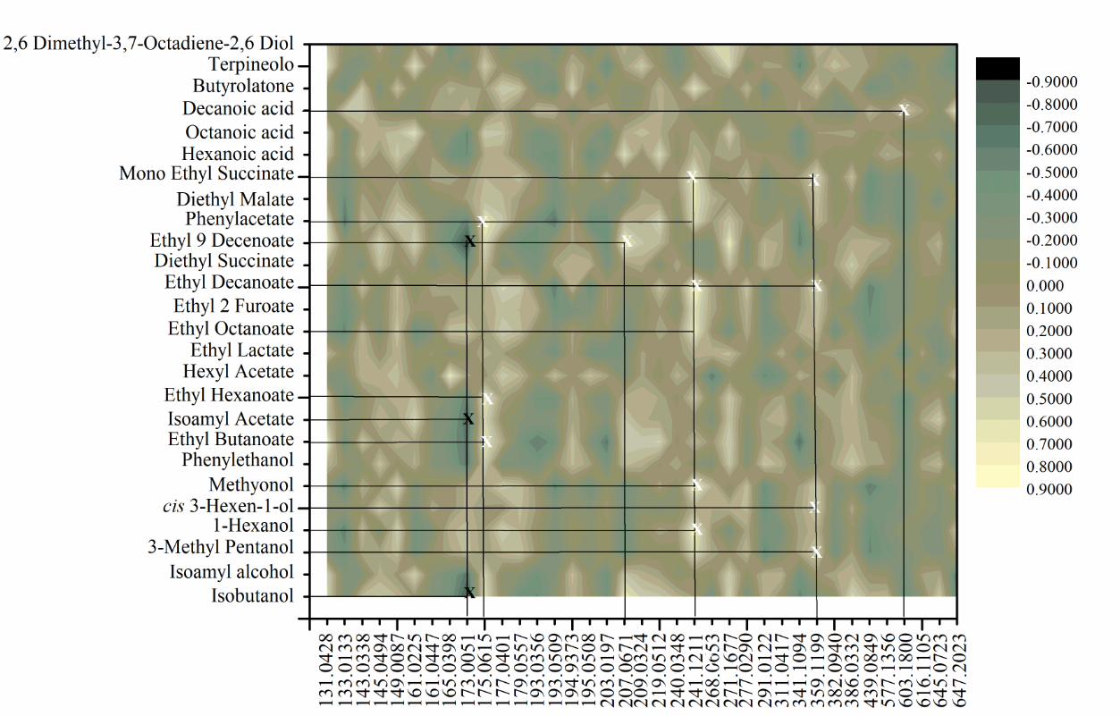

Non-targeted metabolomic approach as a tool to evaluate the chemical and volatile
profile of sparkling wines fermented with autochthonous yeast strains
A. Rizzuti, M. Tufariello, V. Gallo, P. Mastrorilli, L. Palombi, B. Musio, V. Capozzi, F. Grieco
Aim
The Champenoise method is based on “in bottle” refermentation usually driven by few commercial strains belonging to the S. cerevisiae species. In this study, the impact of selected autochthonous yeast strains on the chemical profile of sparkling wines (SW) has been evaluated through non-targeted metabolomic approach based on HPLC-HRMS and GC-MS techniques. The HPLC-HRMS/GC-MS correlation analysis was permitted to draw a map that constitutes a useful tool to monitor the different patterns of aroma release operated by the indigenous strains.
Methods
Chemical analyses
The autochthonous S. cerevisiae strains employed were previously selected [1] and deposited in the ITEM Culture Collection of the CNR-ISPA (www.ispacnr.it/ collezioni-microbiche). The commercial S. cerevisiae DV10 (Lallemand, USA) was used as control.
WineScan Flex was used to determine the principal chemical parameters of SW
The volatile profile was analyzed using SPME-GC/MS [3].
HPLC/High Resolution Mass Spectrometry analysis [4],
Production of sparkling wine was made using the traditional method [2].
Statistical analyses
Results
ANOVA analysis
Principal Component Analysis
Correlation Analysis
Volatolomic Profile
A total of 26 volatiles belonging to higher alcohols, esters, terpenes, acids, were identified;
Quantitative differences of the above compounds were detected in the produced wines;
The selected strains produced higher concentrations of esters (ethyl and acetate), alcohols such as 2-phenylethanol and lower values (<400 ppm) of higher alcohols compared to the wine produced with the control yeast;
Moreover, the SW produced with selected yeast showed a low volatile acidity (<0.3 g/L), high glycerol content, a good phenolic and acid profile that influences the foam stability and the sensorial quality (body, bitterness and astringency);
The Figure 1 shows the score plot reporting, for each sample, the Mean Standardized Concentration (MSC) as a function of the number of volatiles (NV) (reported in percentage) with a concentration higher or equal to the mean. This scatterplot allowed bettering outlining the differences among the samples that on the plane of the three PCs are clustered. ITEM 9518, 17294, 14077, 9520 samples differ from both the control and other samples by a higher number of volatiles in concentration above the mean.
HPLC-HRMS results
61 compounds belonging to several metabolite classes were identified;
HPLC-HRMS analysis showed that DV10 sample was characterized by high values of gluconic acid that adversely affects wine foamability, while lower concentrations of this molecule were detected in sparkling wines produced by the other strains selected in Apulia region. In particular, samples 9518, 14077 and 17294 showed a high content of polysaccharide that promotes a better foam stability and improves the sensory quality.
A HPLC-HRMS/GC-MS correlation analysis (Fig.2) was performed and permitted to obtain a map that constitutes a useful tool to monitor the different patterns of aroma release.
Finally, this contribution provide information to modulate the quality of regional sparkling wines from minor autochthonous grape varieties using selected microbial resources.
Fig.1: Mean value of the standardized concentration of the 26 compounds as a function of the
percentage of compounds whose concentration is higher or equal to the average one.
Fig.2: Plot resulting from the HPLC-HRMS and GC-MS correlation analysis applied to sparkling wine samples.
References
[1] Grieco et al. (2011). https://doi.org/10.1007/s13213-010-0091-7
[2] Garofalo et al. (2018). https://doi.org/10.1016/j.ijfoodmicro.2018.07.004
[3] Tufariello et al. (2019). https://doi.org/10.1016/j.lwt.2019.03.063
[4] Rizzuti et al. (2015). https://doi.org/10.1016/j.foodcont.2021.108099

