Slide 1
VOC profile of high moisture mozzarella as affected by the processing temperature
Dott. Natrella Giuseppe
The Department of Soil, Plant and Food Sciences -University of Bari
Notes:
The title of the present work is …..

Slide 2
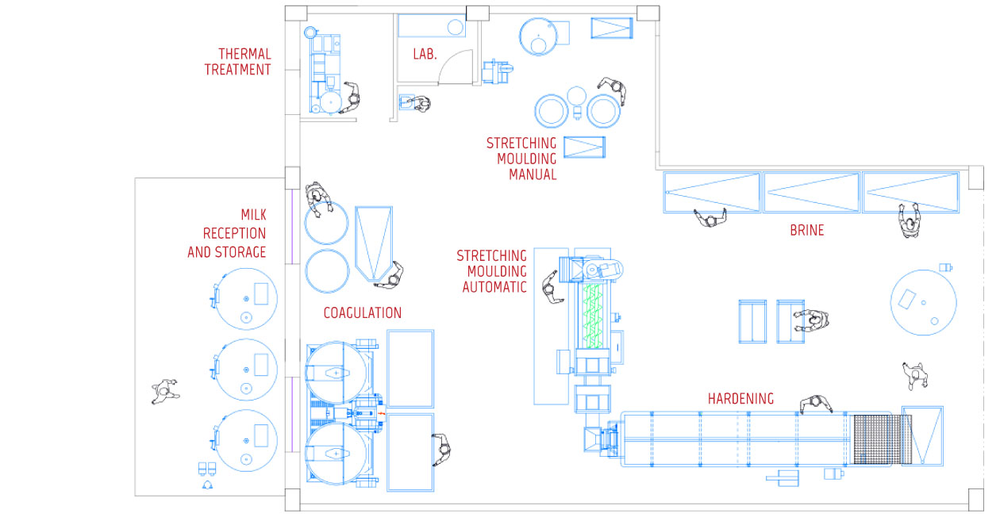
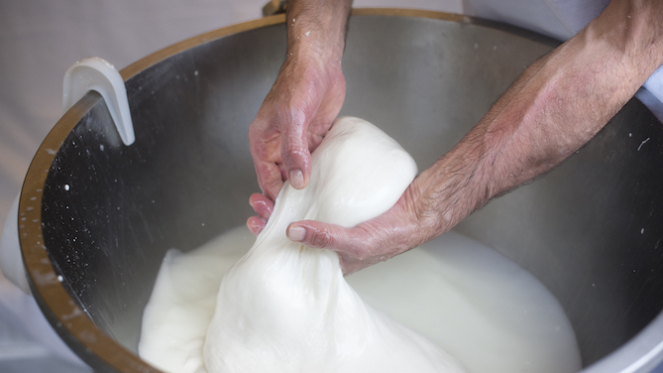
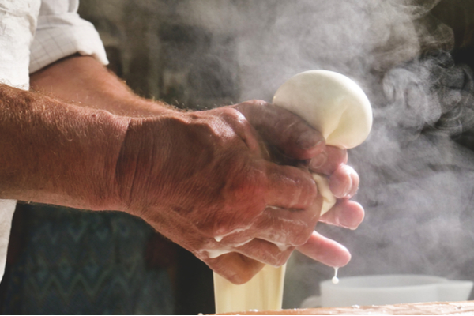
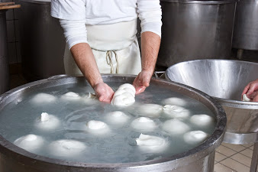
PASTA FILATA CHEESE

Slide 3
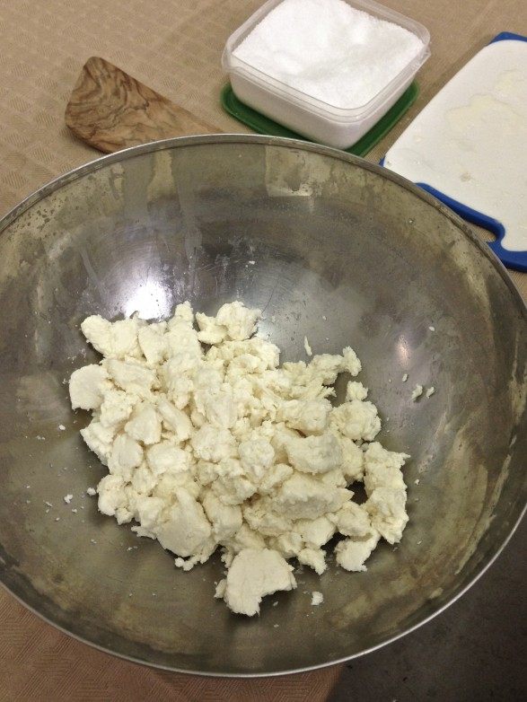
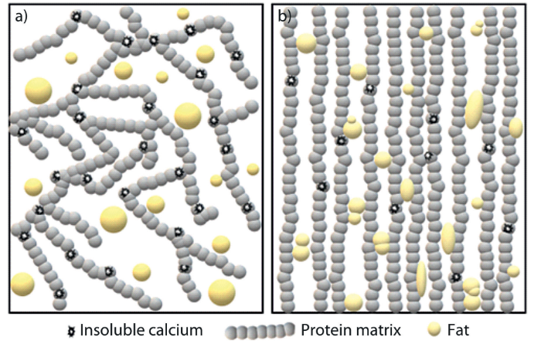
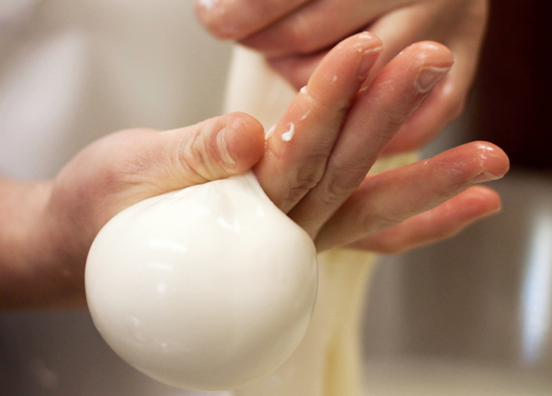
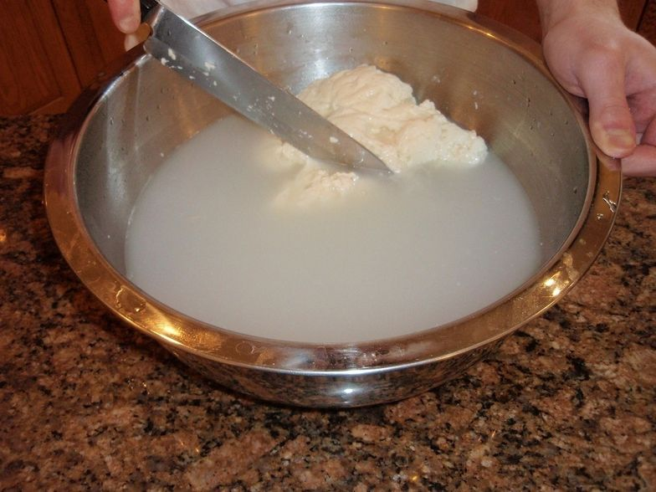
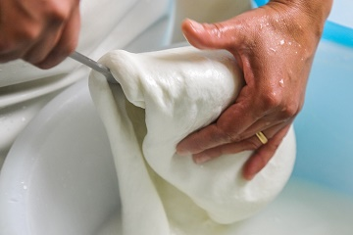
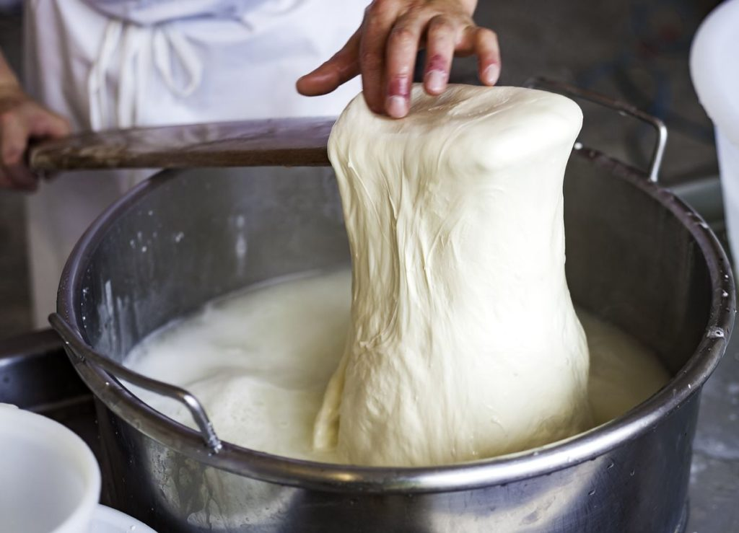
PASTA FILATA CHEESE:
The Stretching phase

Slide 4
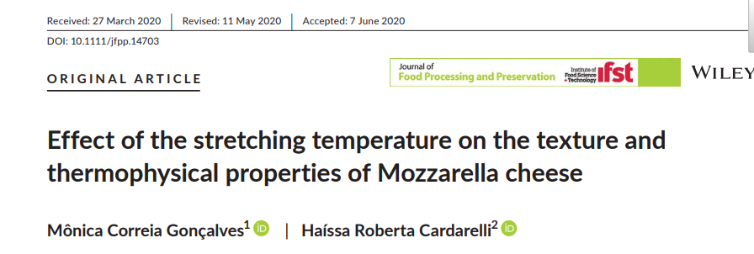
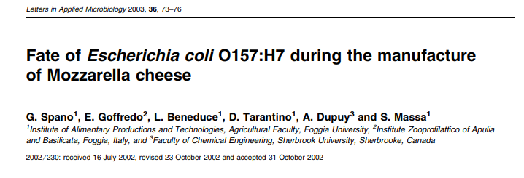
PASTA FILATA CHEESE:
Literature

Slide 5
AIMS
1
2
3
90
70
What happens to the VOC profile during stretching phase in presence of microorganism?
Does the different stretching water temperature affect the odor intensity of mozzarella?
Does the stretching phase cause the formation of new VOC?

Slide 6
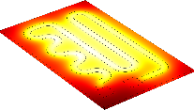
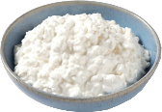
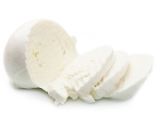
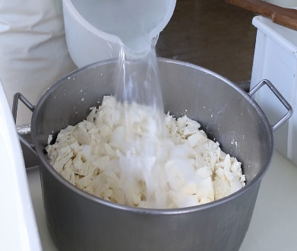
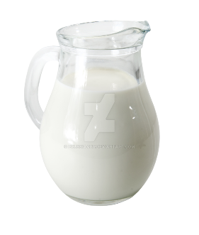
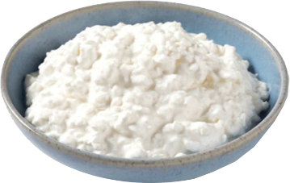
Sodium azide
Raw milk
Citrc acid solution 10%
Calf rennet 0.2 ml/L
Stretching water
Heater
Temperature
Curd
Mozzarella
LEGEND:
70°C
MozzSA70
Experimental design
0.5g/L
38°C
MozzSA90
Aseptic
0.2ml/L
90°C
pH 5.6
38°C
MozzC90
Control
MozzC70
pH 5.6
0.2ml/L
70°C

Slide 7
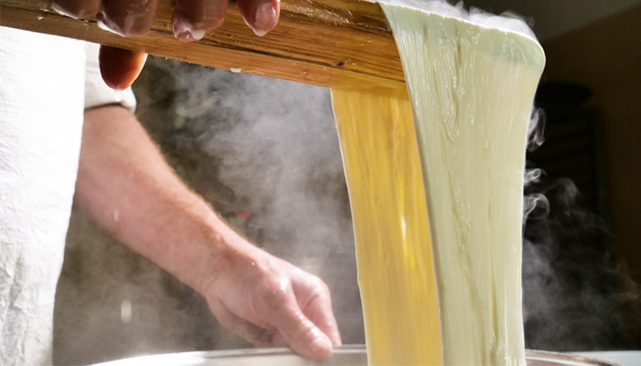
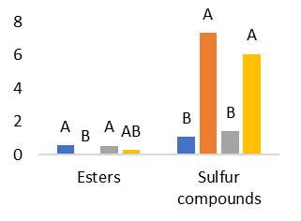
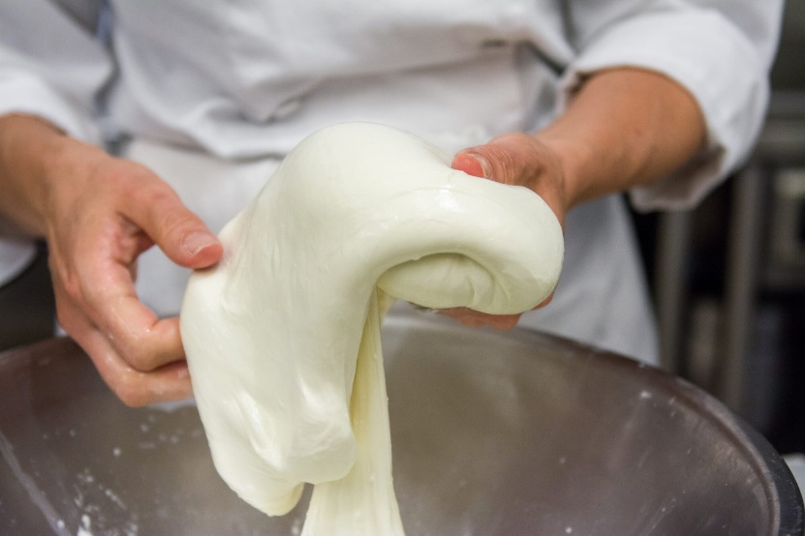
Total VOC amount

Slide 8
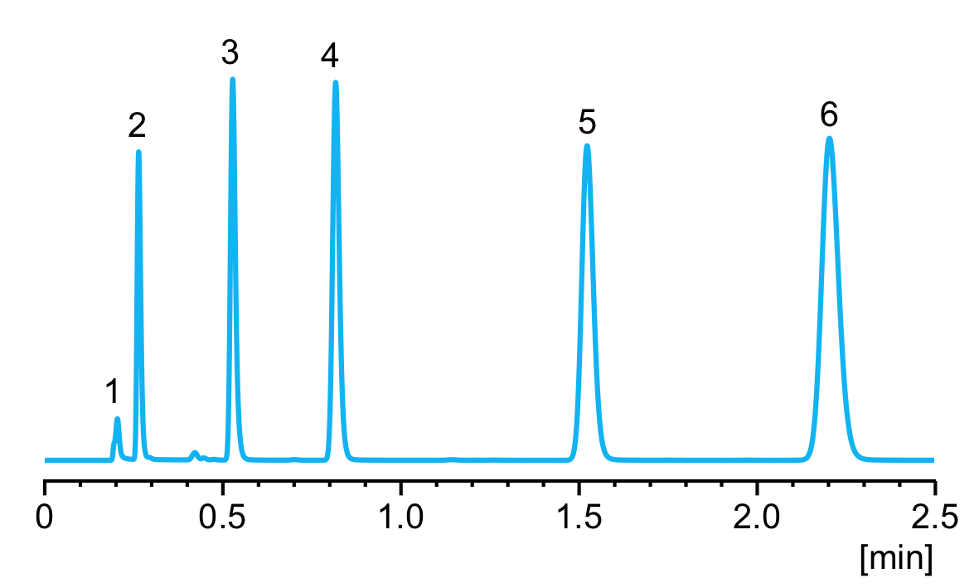
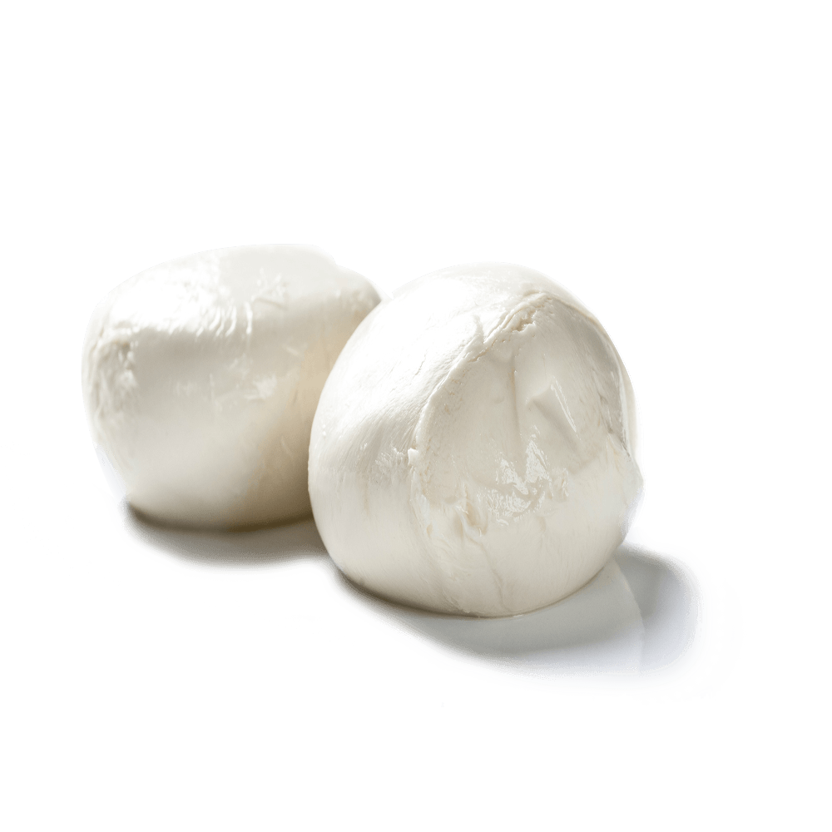
MOST IMPORTANT VOC FOUND
Compound | Curd C | Mozz C70 | Mozz C90 | Curd SA | Mozz SA70 | Mozz SA90
Acetic acid | 10.43 ª | 7.14 ª | 14.52 ª | 3.56 ^{b} | 1.29 ^{b} | 3.63 ^{b}
Butanoic acid | 7.68 ª | 1.02 ^{c} | 3.97 ^{b} | 6.28 ª | 2.01 ^{bc} | 6.58 ª
3-Methyl-Butanoic acid | 0.00 ^{b} | 0.96 ª | 1.54 ª | 0.00 ^{b} | 0.00 ^{b} | 0.00 ^{b}
Hexanoic acid | 9.02 ª | 1.23 ^{c} | 4.97 ^{ab} | 8.47 ª | 2.34 ^{b} | 7.24 ª
Octanoic acid | 3.47 ª | 0.00 ^{c} | 1.66 ^{b} | 3.29 ª | 1.59 ^{b} | 2.50 ª
2-Methyl-Butanal | 3.77 ª | 2.18 ª | 2.25 ª | 0.00 ^{b} | 0.00 ^{b} | 0.00 ^{b}
3-Methyl-Butanal | 32.48 ^{c} | 152.17 ª | 109.07 ^{b} | 0.00 ^{d} | 0.00 ^{d} | 0.00 ^{d}
Hexanal | 7.20 ª | 0.50 ^{d} | 1.40 ^{cd} | 4.63 ^{b} | 1.02 ^{cd} | 2.61 ^{c}
Heptanal | 2.68 ª | 0.30 ^{c} | 0.00 ^{d} | 1.88 ^{ab} | 1.37 ^{b} | 0.00 ^{d}

Slide 9
MOST IMPORTANT VOC FOUND
Single VOC | Curd C | Mozz C70 | Mozz C90 | Curd SA | Mozz SA70 | Mozz SA90
Ethanol | 0.08 ^{c} | 9.58 ª | 1.98 ^{b} | 0.00 ^{d} | 0.00 ^{d} | 0.00 ^{d}
3-Methyl-1-Butanol | 3.1 ^{c} | 50.48 ª | 27.17 ^{b} | 0.00 ^{d} | 0.00 ^{d} | 0.00 ^{d}
Acetone | 39.46 ª | 32.21 ^{ab} | 27.05 ^{b} | 42.58 ª | 15.02 ^{d} | 21.70 ^{cd}
2-Butanone | 35.73 ª | 19.23 ^{c} | 23.48 ^{bc} | 33.80 ^{ab} | 16.17 ^{c} | 21.99 ^{bc}
6-Methyl-5-hepten-2-one | 0.62 ª | 0.47 ^{b} | 0.28 ^{c} | 0.53 ^{ab} | 0.19 ^{c} | 0.18 ^{c}
Acetoin | 11.13 ^{b} | 92.51 ª | 80.06 ª | 1.46 ^{b} | 0.77 ^{b} | 0.61 ^{b}
2-Nonanone | 0.00 ^{b} | 0.14 ª | 0.14 ª | 0.00 ^{b} | 0.00 ^{b} | 0.00 ^{b}
Ethyl acetate | 0.00 ^{b} | 0.55 ª | 0.00 ^{b} | 0.00 ^{b} | 0.54 ª | 0.30 ª

Slide 10
The heating intensity
70°C 90°C
70°C 90°C

Slide 11
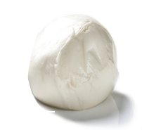
Sensory point of view: Ranking
Odor intensity
MozzC70
MozzC90
MozzSA90
MozzSA70

Slide 12
Sensory point of view: Ranking
More pleasant odor
MozzC70
MozzC90
MozzSA90
MozzSA70

Slide 13
Conclusion
70°C
90°C
Aseptic
MozzSA90
Control
MozzC70
Lower stretching temperature preserve the aroma of control mozzarella, preserving the microbial activities
Higher stretching temperature led to a more intense volatilization of VOC in mozzarella control
Higher stretching temperature led to a higher VOC content when bacteria are absent
The odor intensity result higher in mozzarella stretched at lower temperature, due to a less intense volatilization
Single and total VOC content of control mozzarella result higher than aseptic mozzarella
Notes:
Single and total VOC content of control mozzarella result higher than aseptic mozzarella
Lower stretching temperature preserve the aroma of control mozzarella, preserving the microbial activities
Higher stretching temperature led to a more intense volatilization of VOC in mozzarella control
Higher stretching temperature led to a higher VOC content when bacteria are absent
The odor intensity result higher in mozzarella stretched at lower temperature, due to a less intense volatilization

