Slide 1
The 2nd International Electronic Conference on Foods – “Future Foods and Food Technologies for a Sustainable World” 15-30 Oct 2021
Presented by: Ashmita Singh and Dr. Monika Thakur
Amity Institute of Food Technology
Amity University, Noida, UP

Slide 2
Presentation Title…
Cordia dichotoma G. Forst as Future Food- A way towards Food Security and Sustainability

Slide 3
Abstract
In the last few decades, the attention towards the ethnomedicinal plants has been significantly increased, these plants are underutilized and considered as the mines of various bioactive components. They are generally utilized by local communities for various purposes including culinary, medicinal, wood, animal fodder etc. They are highly nutritious in nature despite have the potential to grow under adverse climatic and soil conditions, these plants also help in achieving the food security by controlling the over-exploitation of the staple food crops. One among these underutilized plants include Cordia dichotoma G. Forst, belongs to Boraginaceae family, commonly known as Lasora in many parts of the India. It mainly grows in tropical and sub-tropical regions including northern parts of India. Cordia has been traditionally utilized as pickle, vegetable, natural gum, decoctions etc. Cordia species has been identified with various bioactive components including Lignans, Terpenoids, Saponins, Carotenoids, Quinones, Phenolics, Alkaloids, Coumarins, Steroids, Flavonoids, Fatty acids, Porphyrins and many Essential oils. Various pharmacological activities including analgesic, anti-helmentic, anti- inflammatory, diuretic, aphrodisiac, anti-microbial etc were reported in cordia. Despite all the functional attributes, it is still underutilized but has the potential to be considered as future food. Therefore, a systematic research is required to manifest cordia as a nutritional alternative in both food and non-food sector in order to promote food security and sustainability.
Keywords: Underutilized plant, Cordia dichotoma G. Forst, Future food, Food Security, Food Sustainability, Bioactive components.

Slide 4
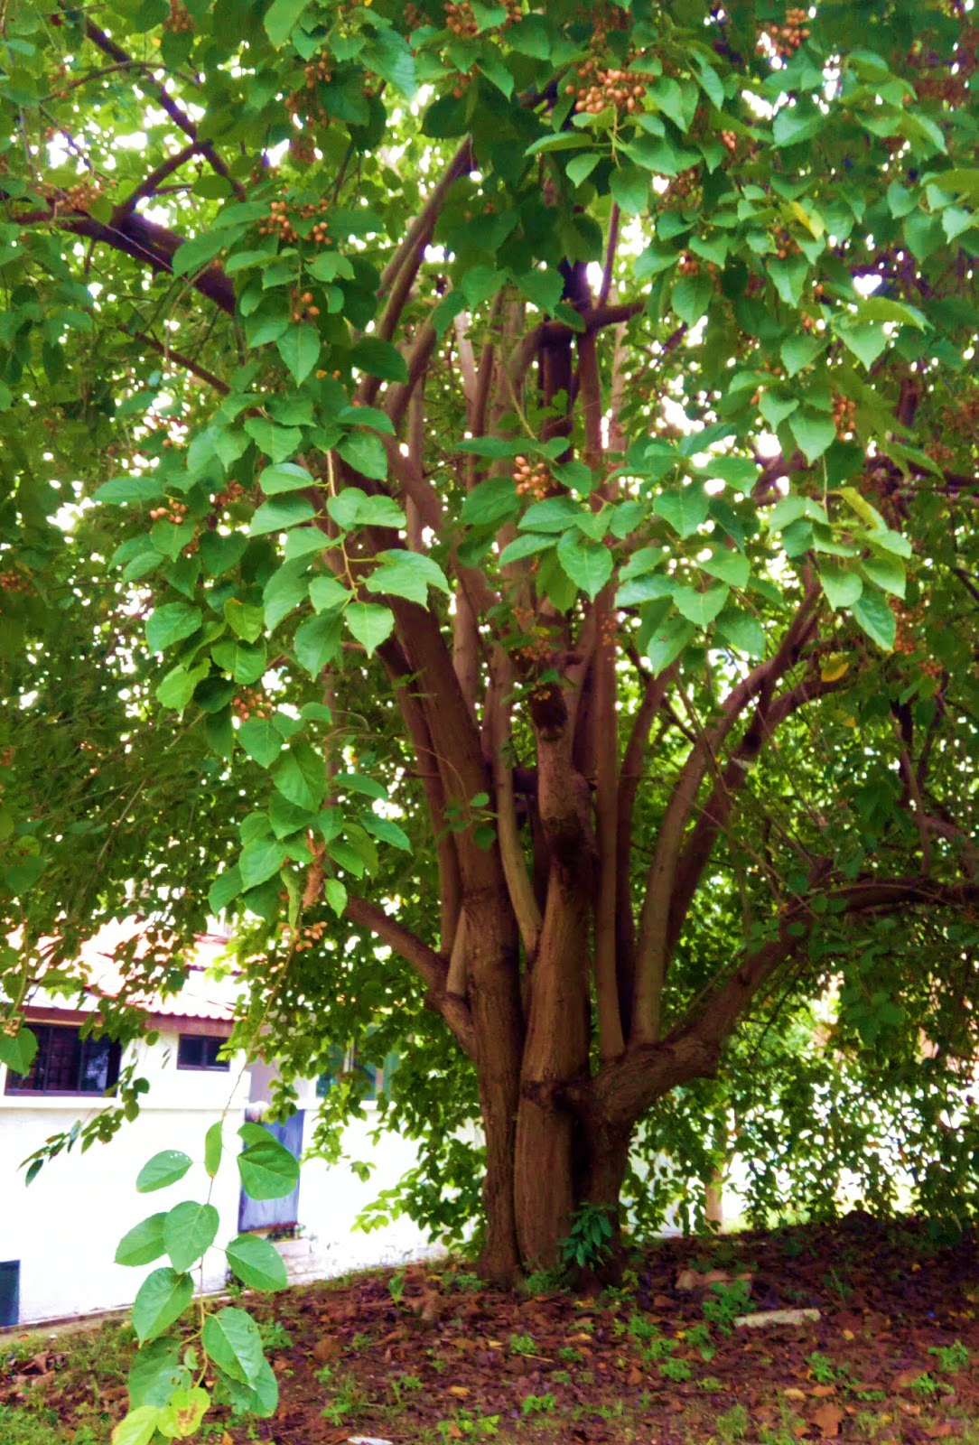
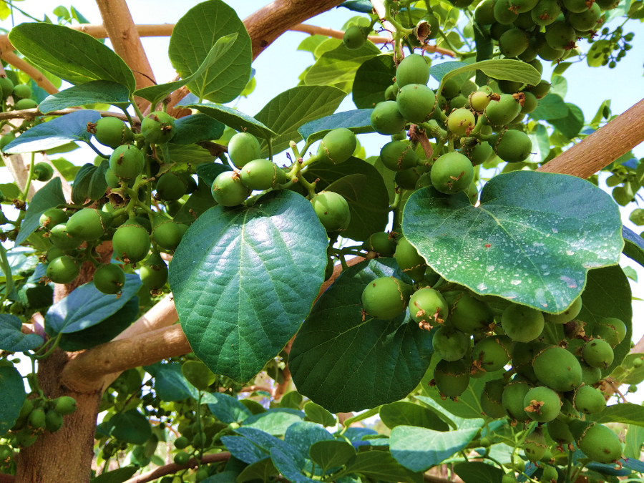
Cordia Dichotoma G. Forst
Cordia Dichotoma G. Forst tree
Unripe Cordia Fruits

Slide 5
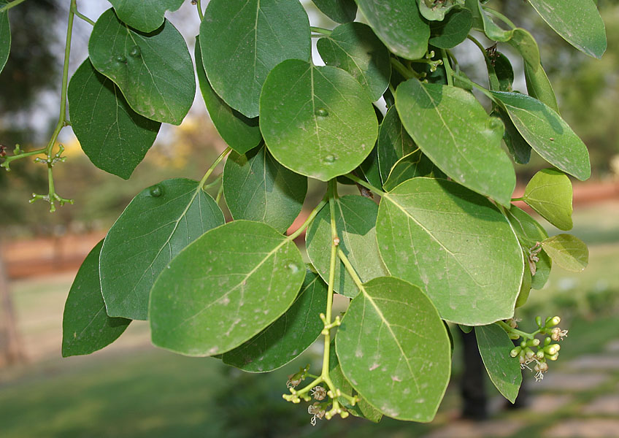
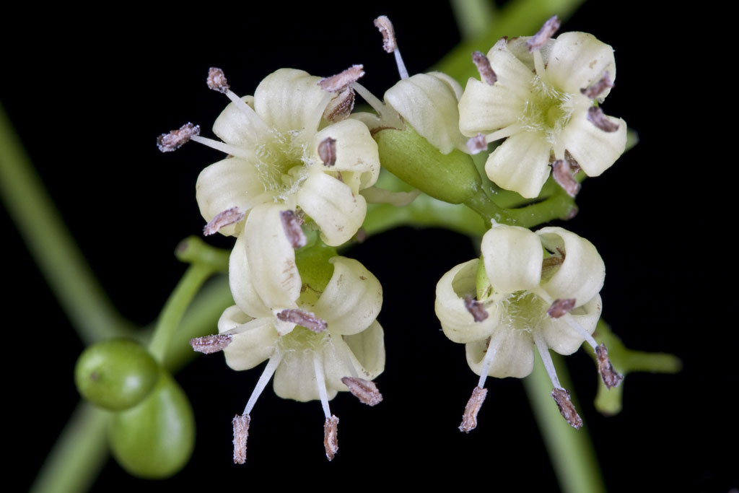
Introduction to Cordia dichotoma G. Forst
Description:
Cordia dichotoma G. Forst belongs to Boraginaceae family, it’s a moderate-sized, deciduous tree with short trunk and spreading crown, the bark of this tree is greyish-brown in color either smooth or longitudinally wrinkled in texture. The leaves of cordia are simple and arranged spirally, flowers are white to pinkish in colour, short stalked and bisexual in nature (Hussain and Kakoti, 2013).
Cordia leaves are reported with sunken stomata which makes it drought tolerant in nature, the vegetative growth in Cordia dichotoma G. Forst is very fast, new flowering appears with the spring in March-April, at that time bunches of light-yellow coloured hermaphrodite fragrant flowers appears (Krishna et al.,2019).
Cordia fruits are round oval-shaped, filled with sweet, transparent, viscid gum surrounding the stone, fruits are green at maturity and turned yellowish-brown to light pink in colour upon ripening. During winters (December-January), the plant goes into dormant stage and shed its leaves naturally during the month of February-March and fruits are harvested during April-May (Meghwal et al.,2014).
Immature fruits of Cordia are used as vegetable, pickle and also dehydrated for off-seasons. Cordia fruits consist of about 80% pulp, 100g dry weight of Cordia pulp contains: Ash- 6.7g, Crude protein- 8.32g, Lipid-2.2g, Crude Fibre-25.7g, Carbohydrates- 57.08g and K/Cal- 281.4; (Meghwal and Singh, 2017).
Indigenous system considers Cordia as a medicine, this species claimed to cure various diseases related to kidney, liver, heart, blood etc. Each part of cordia has its own functionality as an Antipyretic, Antianemia, remedy for impotency, Gastric pain, Asthma, Diarrhea, Mouth ulcers, Dental care, Bronchitis etc (Ganjare et al., 2011).
Cordia Leaves
Cordia Flowers

Slide 6
Introduction to Cordia dichotoma G. Forst
Distribution:
Cordia dichotoma G. Forst is the medicinal plant extensively distributed throughout the north-western India to southern China (Gupta and Kaur, 2015).
Cordia dichotoma G. Forst mainly distributed in tropical and sub-tropical regions. It grows in Himalayan region and outer ranges; it has great diversity ranging from dry deciduous forests of Rajasthan to the moist deciduous forests of Western Ghats in India. Cordia also found in the tidal forests of Myanmar (Jamkhande et al.,2013).
Cordia tree naturally grows in the coastal hills, in primary and secondary forests, riverine zones and also in semi-humid regions at the elevation from 500–1500-meter altitude. Cordia trees has great resistance towards tolerating wide range of soils including deep, moist, sandy loams except dry gravelly soil, it can grow in areas with annual rainfall ranges from 500-3000 mm (Stalin, 2020).
In India, Cordia trees mainly distributed in the regions including the states of Uttar Pradesh, Himachal Pradesh, Madhya Pradesh, Rajasthan, Chhattisgarh, Haryana, Punjab, Gujarat. It mainly grows as an isolated tree on farm boundaries preferably in dry, arid regions like wastelands, cultivated lands, road sides, drying water bodies due to its adaptive feature and high tolerance (Meghwal et al., 2014).

Slide 7
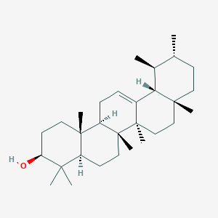
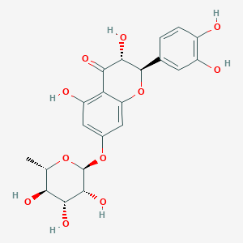
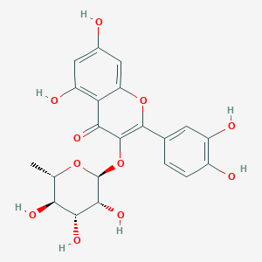
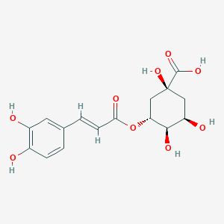
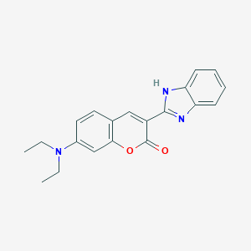
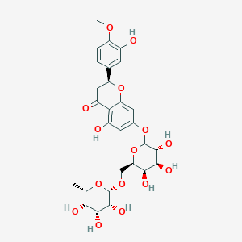
Phytochemistry of Cordia dichotoma G. Forst
Cordia dichotoma G. Forst reported to be loaded with various types of phytochemicals, till today, around 290 different chemical compounds were identified in cordia, including Lignans, Terpenoids, Saponins, Carotenoids, Quinones, Phenolics, Alkaloids, Coumarins, Steroids, Flavonoids, Fatty acids, Porphyrins, Essential oils etc.
The seed of Cordia dichotoma G.Forst contains α-Amyrins, Betulin, Octacosanol, Lupeol-3rhamnoside, β-Sitosterol, β-Sitosterol 3glucoside, Hentricontanol, Hentricontane, Taxifolin-3-5- dirhamnoside, Hesperitin-7-rhamnoside and Fatty acids such as Palmitic acid, Stearic acid, Arachidic acid, Behenic acid, Oleic acid and Linoleic acid. The significant anti-inflammatory activity of seeds is because of α-Amyrins and Taxifolin-3- 5-Dirhamnoside (71.4%, 67.8% respectively).
Four flavonoid glycosides (Robinin, Rutin, Rutoside, Datiscoside and Hesperidin), a flavonoid aglycone (Dihydrorobinetin) and 2 phenolic derivatives (Chlorogenic acid and Caffeic acid) were isolated from seeds.
The bark is medicinal and contains several chemicals including Allantoin, β-Sitosterol and 3’,5-dihydroxy-4’- methoxy flavanone-7-O-alpha-L-rhamnopyranoside.
Fruits and leaves showed presence of Pyrrolizidine Alkaloids, Coumarins, Flavonoids, Saponins, Terpenes and Sterols. Fruit has been identified for Arabinoglucan, D-glucose (67.6%) and L-arabinose (13.2%)
Leaves also contain Quercetin and Quercitrin.
α - amyrins
Taxifolin-3- 5-dirhamnoside
Quercitrin
Chlorogenic acid
Coumarins
Hesperidin

Slide 8
Cordia dichotoma G. Forst- Phytochemicals and their Pharmacological activities
S. No. | Part of Cordia | Phytochemical Components | Pharmacological activity
1. | Leaves | Luteolin Alkaloids, Polyphenols β-sitosterol Apigenin Carotenoids, Flavonoids | Hypertensive, Anti-inflammatory, Chemo preventive activity Antioxidant Activity Growth inhibitory effects on human breast adenocarcinoma cells Antifertility activity Antioxidant activity, Anti-Cancer activity
2. | Bark | Phenolic compounds Flavonoids, Saponins, Alkaloids | Free-Radical Scavenging activity Anti-inflammatory activity, Anti-Oxidant activity
3. 4. | Fruits Seeds | Saponins, Flavonoids lupa-20(29)-ene-3-O-alpha-L-rhamnopyranoside Apigenin Steroids, Tannins, and Glycosides α-Amyrin Hentricontanol, Hesperetin, Taxifolin3-5-dirhamnoside Betulin | Anthelmintic activity Natural gum and Mucilage Anti-Ulcer activity Antibacterial and Antifungal activity Anti-inflammatory Anti-inflammatory activity Anti-inflammatory activity

Slide 9
Traditional Uses of Cordia dichotoma G. Forst
S. No. | Part of Cordia | Culinary/Ethnomedicinal Uses
1. | Fruits | Immature fruits are pickled for off-seasons, used as a vegetable Fruits of Cordia are used for curing skin diseases, dropsy, dysentery, dyspepsia. Fruits of Cordia eaten by tribals of Nandurbar district (Maharashtra) to treat Gonorrhoea Fruits are utilized as Astringent, Expectorant, Demulcent and given in urinary infection in the Northwest Himalayas Cordia Fruits are recommended to be eaten before meals for the treatment of male sexual weakness
2. | Flowers | Mixture of Cordia flowers and curd applied twice a day in order to protect the body against heavy sun heat waves Flowers of Cordia utilized as the fodder plant for honey bees due to its scented fragrance
3. | Leaves | Decoction of cordia leaves used for the treatment of menstrual cramps, snakebite, headache Utilized as a cooling tea for the treatment of colds, flu, fever or detoxification Cordia leaves are utilized as the therapy of Jaundice in Dandakaranya area, Andhra Pradesh Cordia leaves utilized in a birth control practices among tribal women of Meena community of Rajasthan In Myanmar, powdered wood of Aquilaria Malaccensis (Agarwood) mixed with honey and rolled in Cordia leaves and smoked like cigarette to strength heart and stomach by local community in Pin Sein Pin, Southern Shan state
4. | Bark | Mishing tribe of Assam use Cordia (Buwal) bark for treatment of Stomach problem, Gastritis The bark juice mixed with Coconut milk relieves severe colic and also for Dysentery when mixed with pomegranate rind Bark is moistened and applied over the boils and tumors for fast healing, infusion of it is used for gargle. Bark decoction is taken to treat urine infection

Slide 10
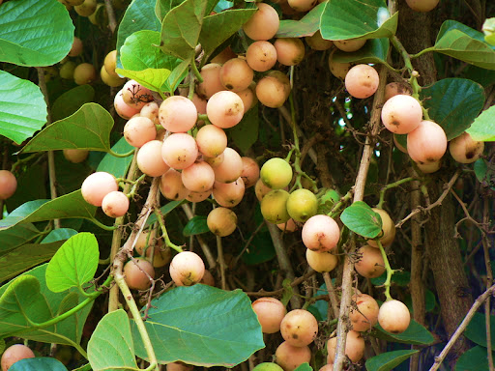
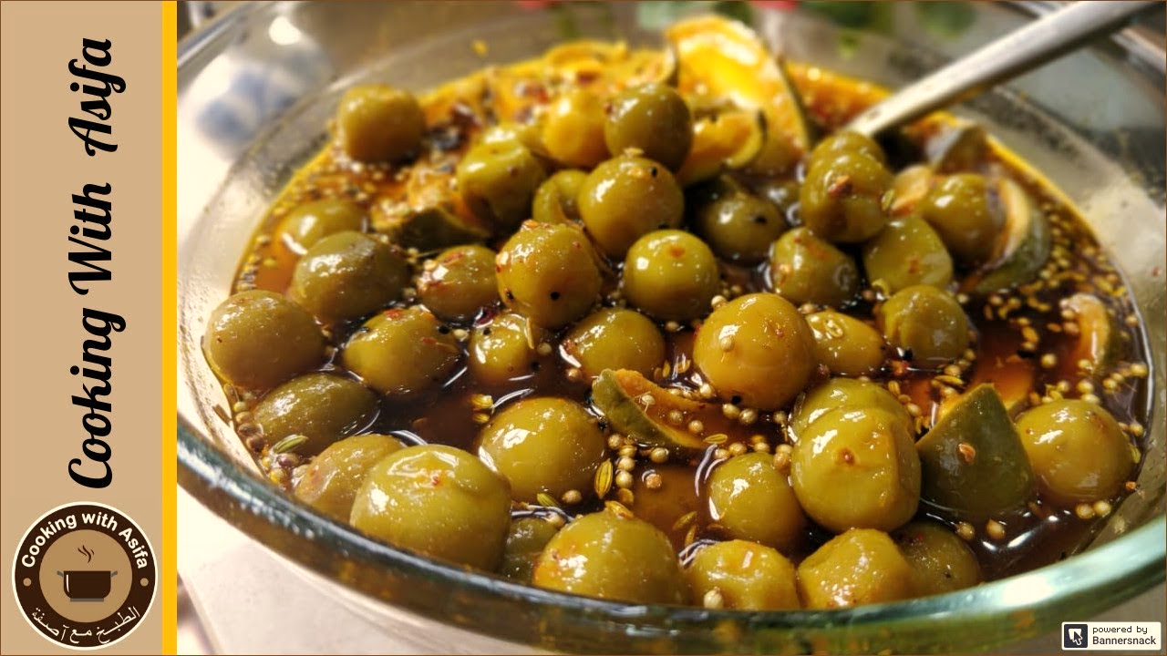
Ripe Cordia fruits
Cordia Pickle
Dried Cordia

Slide 11
Cordia dichotoma G. Forst- An Underutilized Crop
Cordia dichotoma G. Forst is an underutilized tree which has the potential to act as a food or non-food ingredient; every part of this tree from fruits to roots has therapeutic and dietary potential, fruits of cordia have many pharmacological activities including anti-inflammatory, analgesic, hepatoprotective, anti-helmentic etc.
Fruits of Cordia are filled with edible soluble gum, generally utilized raw, cooked vegetable, as pickle and also utilised as a natural adhesive but still it is one of the grossly underutilized plant species because its potentials only utilized by the local communities for purposes like culinary, medicinal, wood, animal fodder etc.
Indigenous people evolve their knowledge about these underutilized plants, develop different ways of their consumption and conservation through the traditional knowledge given by their ancestors. For them, these traditional plants are the only primary option for their therapeutic and dietary needs.
Despite all the therapeutic potential, cordia is still considered underutilized because of the lack of knowledge about its functional potential and because it is seasonal in nature due to that people cannot utilize it throughout the year; to overcome such problems, we need to do research and development in functional foods and nutraceutical by utilizing cordia as functional ingredient.

Slide 12
Functional Potential of Gum Cordia
Gum Cordia as Probiotics: Nutraceutical Yoghurt Drink
Gum Cordia as Natural Emulsifier
Gum Cordia as Binding agent
Gum Cordia as Natural Hydrocolloid
Gum Cordia as Natural thickner and potential Stabilizer
Gum Cordia as Edible Coating

Slide 13
Cordia dichotoma G. Forst as Future Food- A way towards Food Security and Food Sustainability
In current scenario, the demand of food security and sustainability is flaring up. As the population increases the food demand also increases in the market; due to that there is an over-dependency on staple food crops which would result in the major challenges in the near future. To overcome this over-exploitation, diversification in the food consumption is needed today.
Some plant species are “Underutilized” which may contribute in health and nutrition, income generation for local farmers and also helps in maintaining the ecological balance. Cordia dichotoma G. Forst is one among these underutilized plants which is being utilized indigenously at some level as the source of traditional medicine, as vegetables, pickles, decoctions, pastes, powders etc. within the local areas but it has the potential to be used way beyond that.
Every part of this tree from roots to fruits has therapeutic potential, Despite being supremely nutritive in nature, it has great adaptability towards harsh climatic conditions and soil conditions which makes it more economical;
Nowadays people are more inclined towards the plant-based materials for their food and non-food purposes, because of their least side effects and therapeutical activities. Cordia dichotoma is a promising food crop which has an incredible potential to be formulated as a functional food and nutraceutical. Cordia gum is a natural form of gum which can act as an emulsifier, thickner, stabilizer, binder, food supplement or food ingredient but their commercialization is required.
An organization named Crops for future (CFF) is formed which primarily focuses on the underutilized part of the plant world and to make a sustainable and secured utilization of it and to preserve it for our future generations.
Cordia dichotoma is a promising food crop which has an incredible potential to be formulated as a functional food and nutraceutical or as a food ingredient in order to maintain the food security and food sustainability by balancing their utilization by present generation and saving them for future generations.

Slide 14
Conclusion
Through the study we concluded that Cordia is a potential bio-source of many phytochemicals which acts as an incredible therapeutic agent, food modulator, stabilizer, as a natural substitute to drug delivery systems.
Cordia has a potential to act as a future food as health supplement, functional food ingredient and as potential nutraceutical.
Natural gum present in cordia fruits are renewable, non-toxic and biodegradable in nature which make it a remarkable substitute over synthetics.
Cordia species can provide new dimension to the health care and food system and also helps in promoting economic security to the local farmers by that we can mark our ways towards food security and sustainability.

Slide 15
References
Hussain N and Kakoti BB (2013). Review on Ethnobotany and Phytopharmacology of Cordia Dichotoma. J. drug deliv. ther., 3(1), 110–113.
Krishna H, Saroj PL, Maheshwari SK, Singh RS, Meena RK, Chandra R and Parashar A (2019). Underutilized fruits of arid & semi-arid regions for nutritional and livelihood security. IJMFM & AP., Vol. 5(2); 01-14, December 2019.
Meghwal PR, Singh A, Kumar P and Morwal BR (2014). Diversity, distribution and horticultural potential of Cordia myxa L.: A promising underutilized fruit species of arid and semi-arid regions of India. Genet. Resour. Crop Evol., 61(8), 1633–1643.
Meghwal PR and Singh A (2017). Underutilized fruits research in arid regions: A review. Annals of Arid Zone, 56(1–2), 23–36.
Ganjare AB, Nirmal SA, Rub RA, Patil AN and Pattan SR (2011). Use of Cordia dichotoma bark in the treatment of ulcerative colitis. Pharm. Biol.,49(8), 850–855.
Gupta R and Gupta GD (2015). A review on plant Cordia obliqua Willd. (Clammy cherry). Pharmacogn Rev. 9(18): 127–131.
Jamkhande PG, Barde SR, Patwekar SL and Tidke PS (2013). Plant profile, phytochemistry and pharmacology of Cordia dichotoma (Indian cherry): A review. Asian Pac. J. Trop. Biomed., 3(12), 1009–1012.
Stalin N (2020). Cordia dichotoma G. Forst. Boraginaceae. 1–9.
Meghwal PR, Singh A, Kumar P and Morwal BR (2014). Diversity, distribution and horticultural potential of Cordia myxa L.: A promising underutilized fruit species of arid and semi-arid regions of India. Genet. Resour. Crop Evol., 61(8), 1633–1643.

Slide 16
THANK YOU

