Slide 1
The Impact of Covid-19 Hygienic Measures
on Food Choice and Eating Behavior
Jarina G. Oliveira¹, Ph.D Adriana Sampaio¹, Ph.D Olivia M. Lapenta¹
¹Psychological Neuroscience Lab, CIPsi, School of Psychology, University of Minho, Campus de Gualtar, Braga, Portugal.

Slide 2
Study background
Behaviors towards foods are sensitive to many factors;
Altering food choices, preferences and even the flavor perception (Spence, 2017).
With the Covid-19 pandemic everyday life have been changing (Bavel et al., 2020);
And behavioral outcomes in eating, purchasing and preferences relate to food were reported (Marty et al., 2021; Martinez-de-Quel, 2021; Poelman et al., 2021).
Priming effects can provoke behavioral changes (Dijksterhuis, 2016).

Slide 3
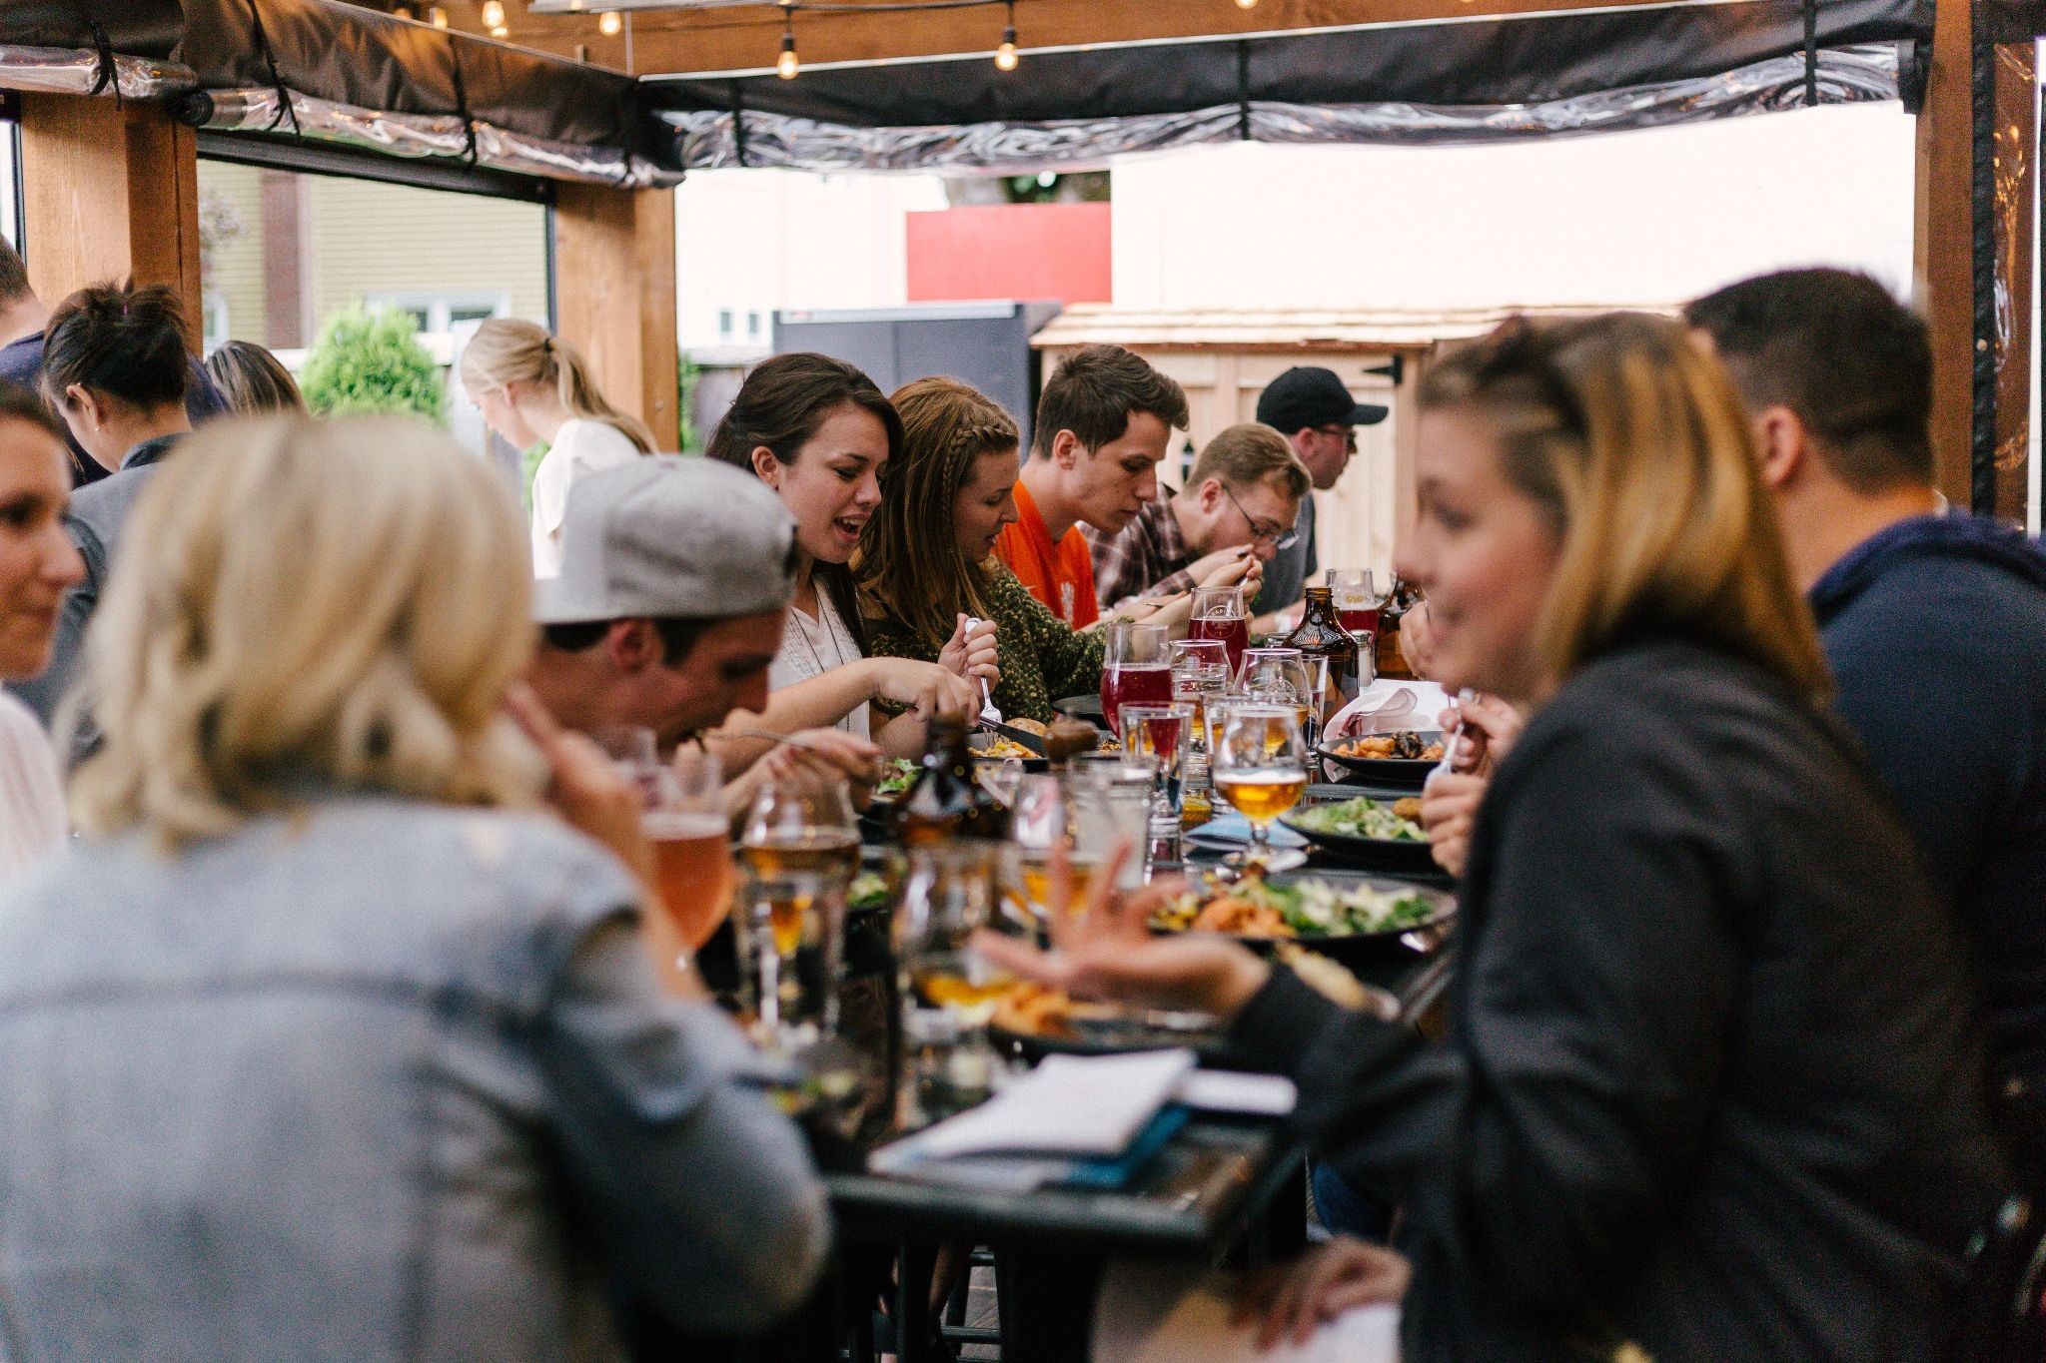
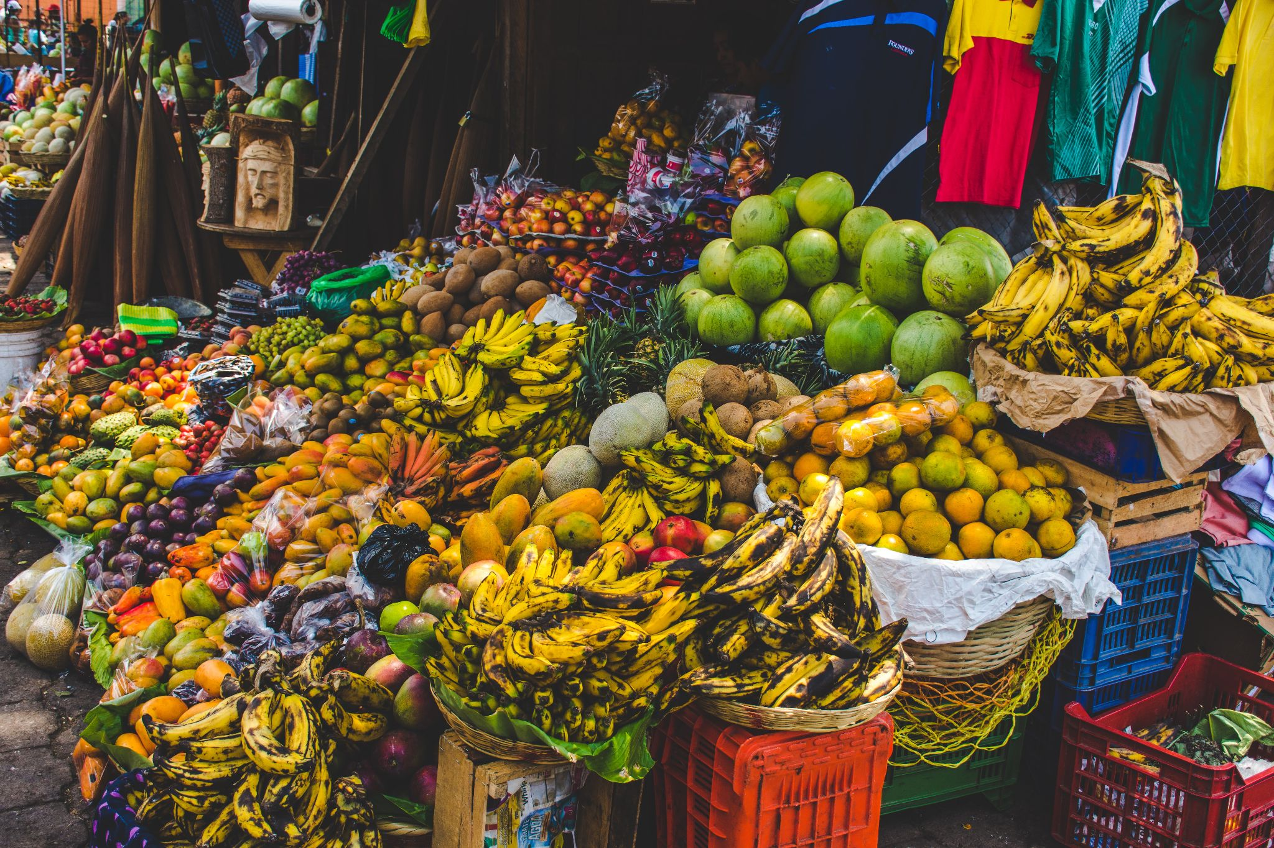
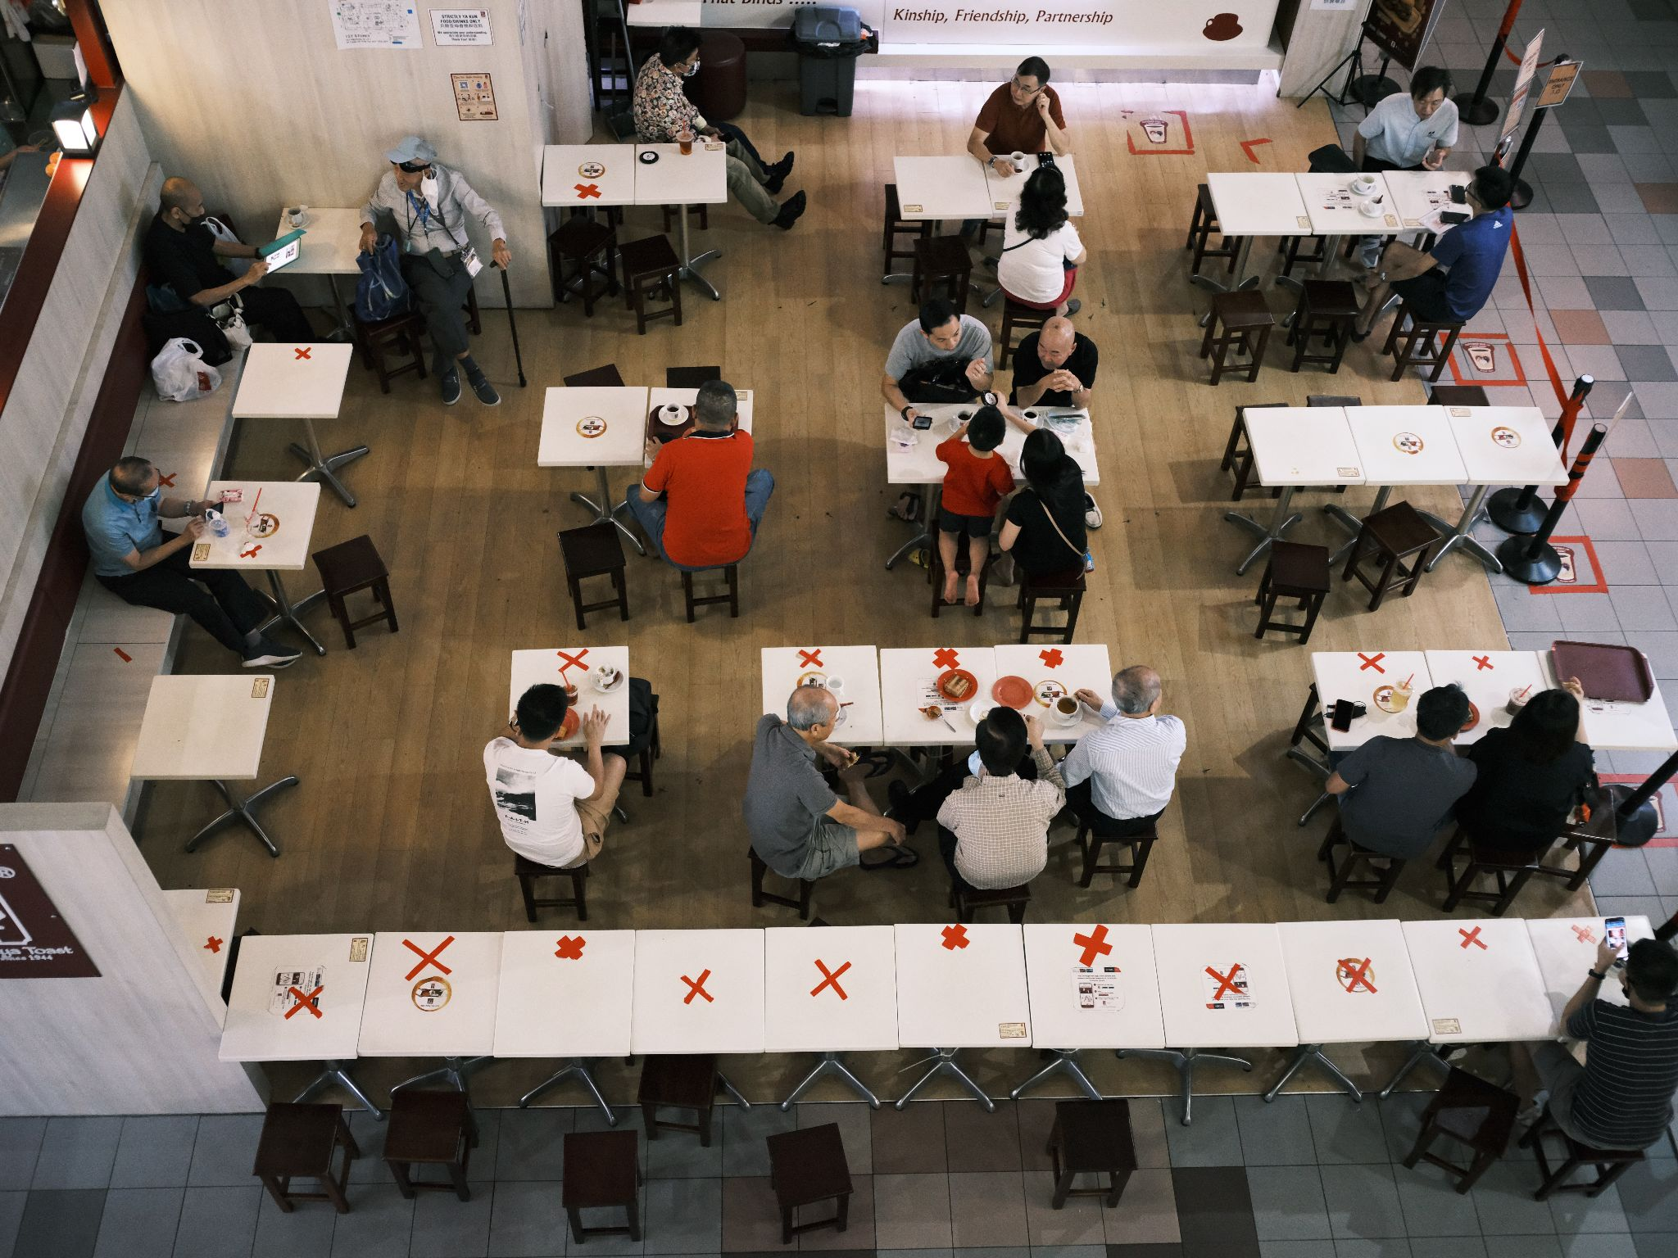
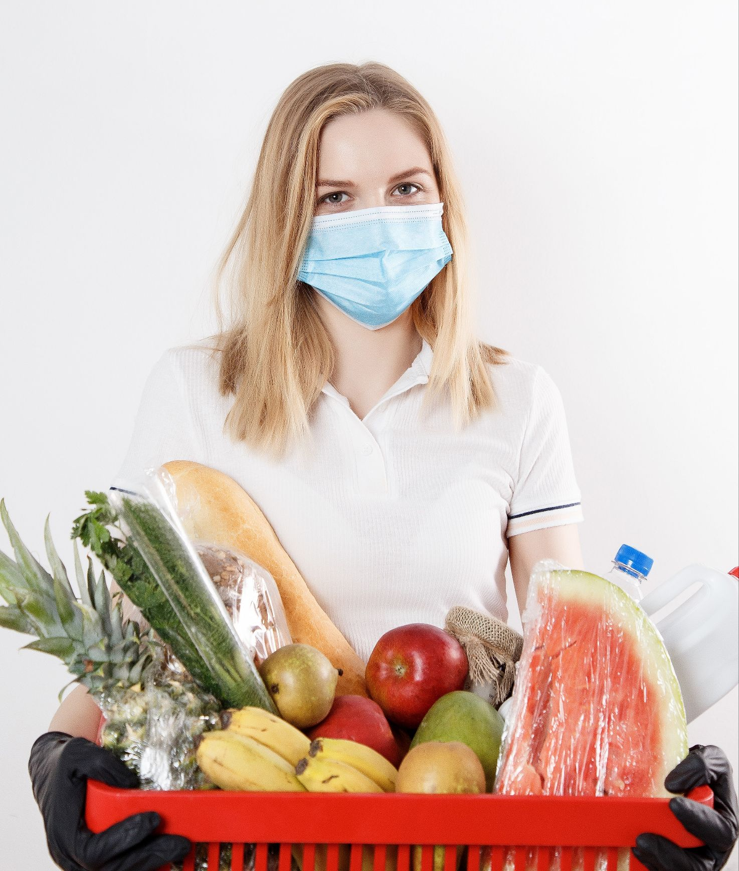
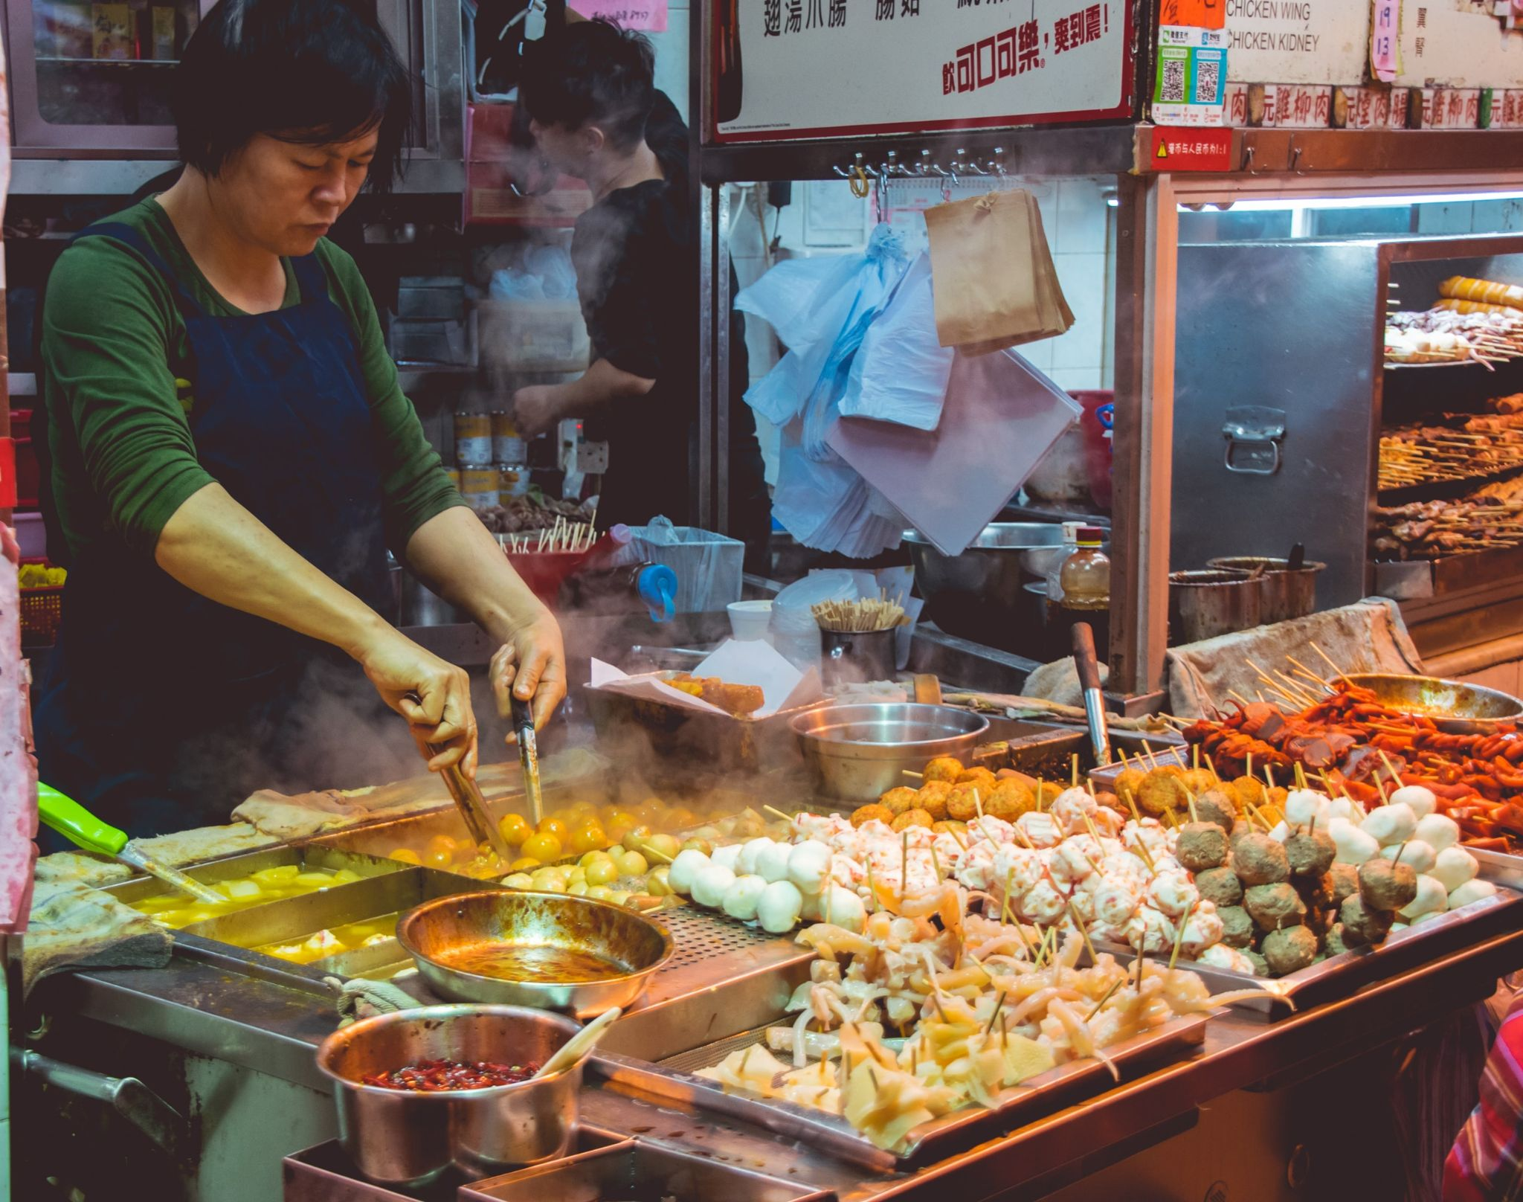
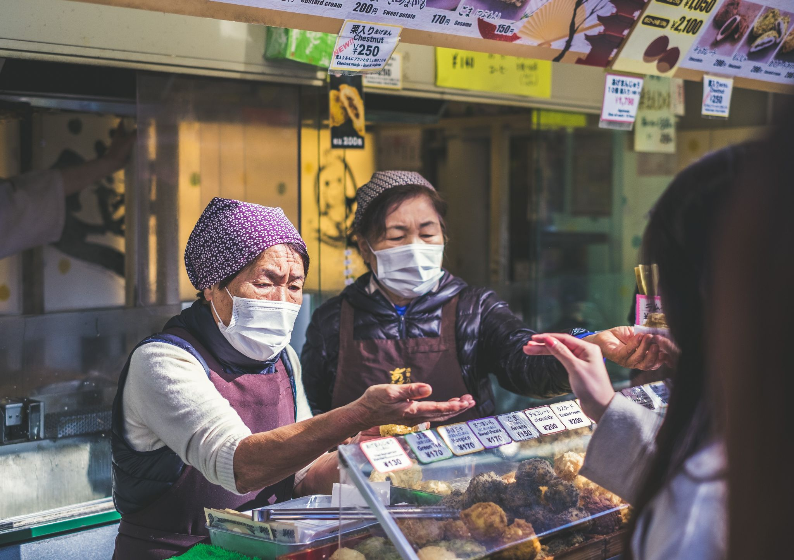
Research question
Does the hygienic measures adopted during Covid-19 pandemic can influence and modify food choice and food attractiveness?

Slide 4
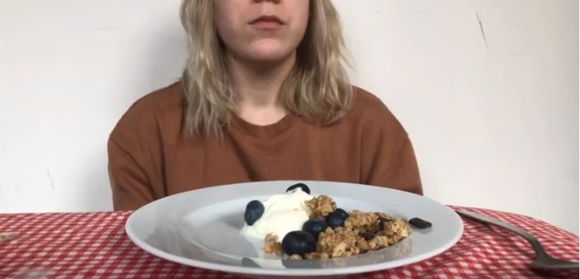
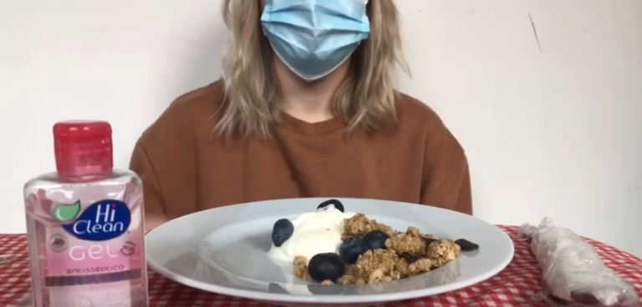
Our hypothesis
We propose a model in which
food preferences are influenced by multiple sensory inputs and social cues
food preferences can be influenced by these sanitary habits
sanitary measures can influence the food quality perception when having meals in different conditions
The principal hypothesis is that the hygienic protocols decrease the attractiveness of food to participants, also we expected to observe differential evaluations regarding high versus low calorie and sweet versus salty foods.

Slide 5
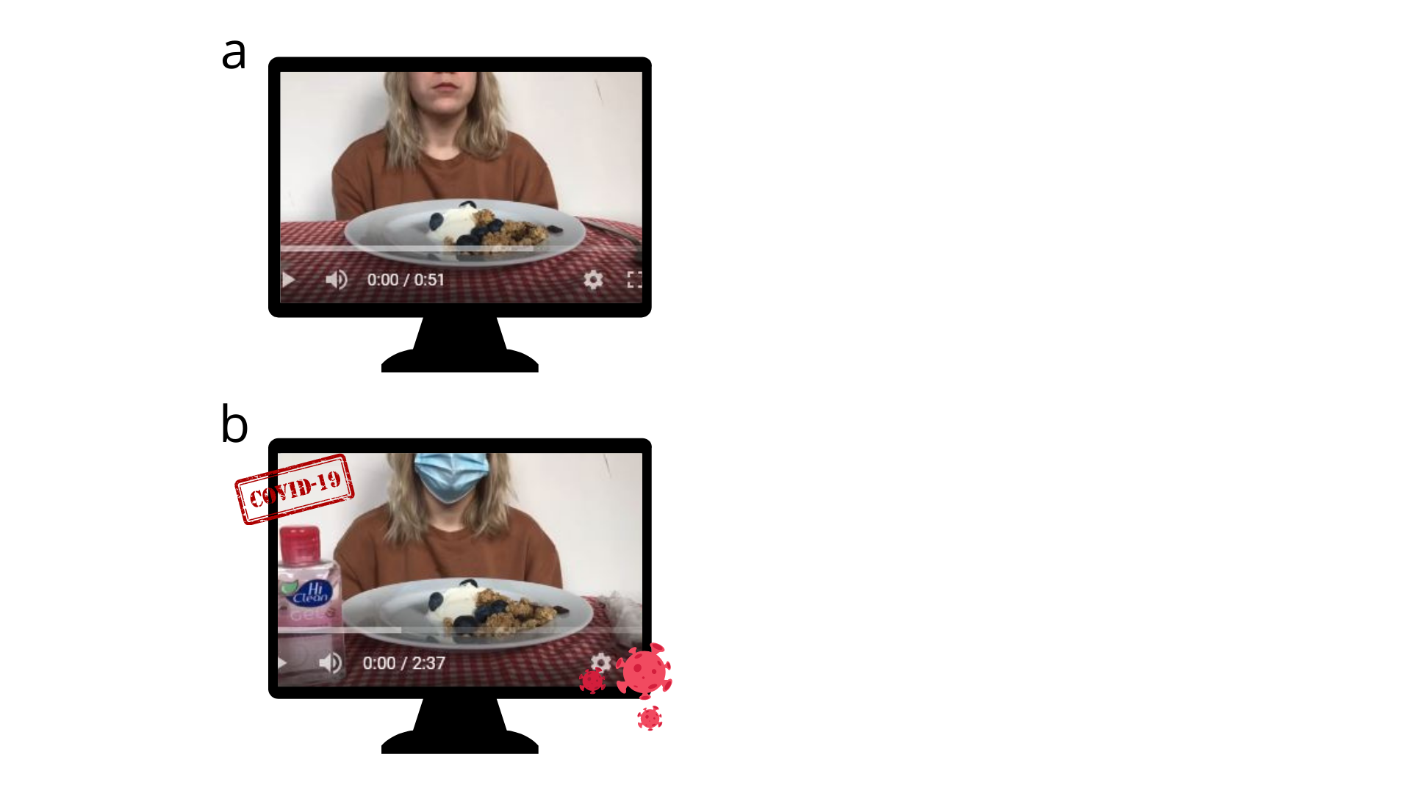
Task design
Men and women between 18 and 59 years old Self-report scales: PHQ-9, GAD-7, LOCES Demographic data Covid-19 and eating behavior informations
Priming video Desire to eat evaluation Food attractiveness ratings
Food pictures presentation Desire to eat evaluation Food attractiveness ratings
Desire to eat evaluation
Desire to eat evaluation
0 seg ~1min ~5min ~10min ~1 min ~17min
Note. Task design, containing steps and approximate duration of each stage and total duration. Desire to eat and food attractiveness (expected taste and smell, and visual aspect of foods presented) were evaluated using visual analogue scales (VAS) from 0 to 10, where 0 was the lower rate and 10 the best one.

Slide 6
Methodology and sample characterization
The study was conducted in accordance to the Declaration of Helsinki and was approved by the local
Ethics Committee for Science and Health Investigations (#129/2020) N=85
Experimental protocol was build and applied through an online platform.
Data collection - February and April. Data analysis using Jamovi software - April and June.
Psychologically, our sample has heterogeneous markers for anxiety and depression symptomatology. LOCES mean score is 1.8 (SD=0.56)
Mean = 20.8 SD = 4.5
75 women 10 men
Mean = 60.3kg SD = 9.8
Mean = 163cm SD = 0.07

Slide 7
Results
In order to analyse the data we computed each individual mean VAS evaluation of such dimensions according to the calories (high and low) and the primary taste (salty and sweet) of the presented food.
rmANOVA was conducted considering as dependent variable each of the perceptual dimensions and the desire to eat considering Priming (Covid vs Non-Covid video), Taste (Sweet vs Salty) and Calories (High vs Low calorie) as within subjects factors.
rmANOVA was performed for Desire to eat considering priming (Covid vs Non-Covid) and time-point (baseline vs after video vs after task) as within-subjects factors.
Paired-sample t-test was conducted on each feature (Visual, Taste and Smell) considering the type of video (Covid vs Non-Covid).
Pearson correlations were performed between the two psychological scales (i.e., PHQ-19 and GAD-7) and further between the scales and the subjective evaluations of food pictures and priming videos (visual aspect, smell, taste and desire to eat).

Slide 8
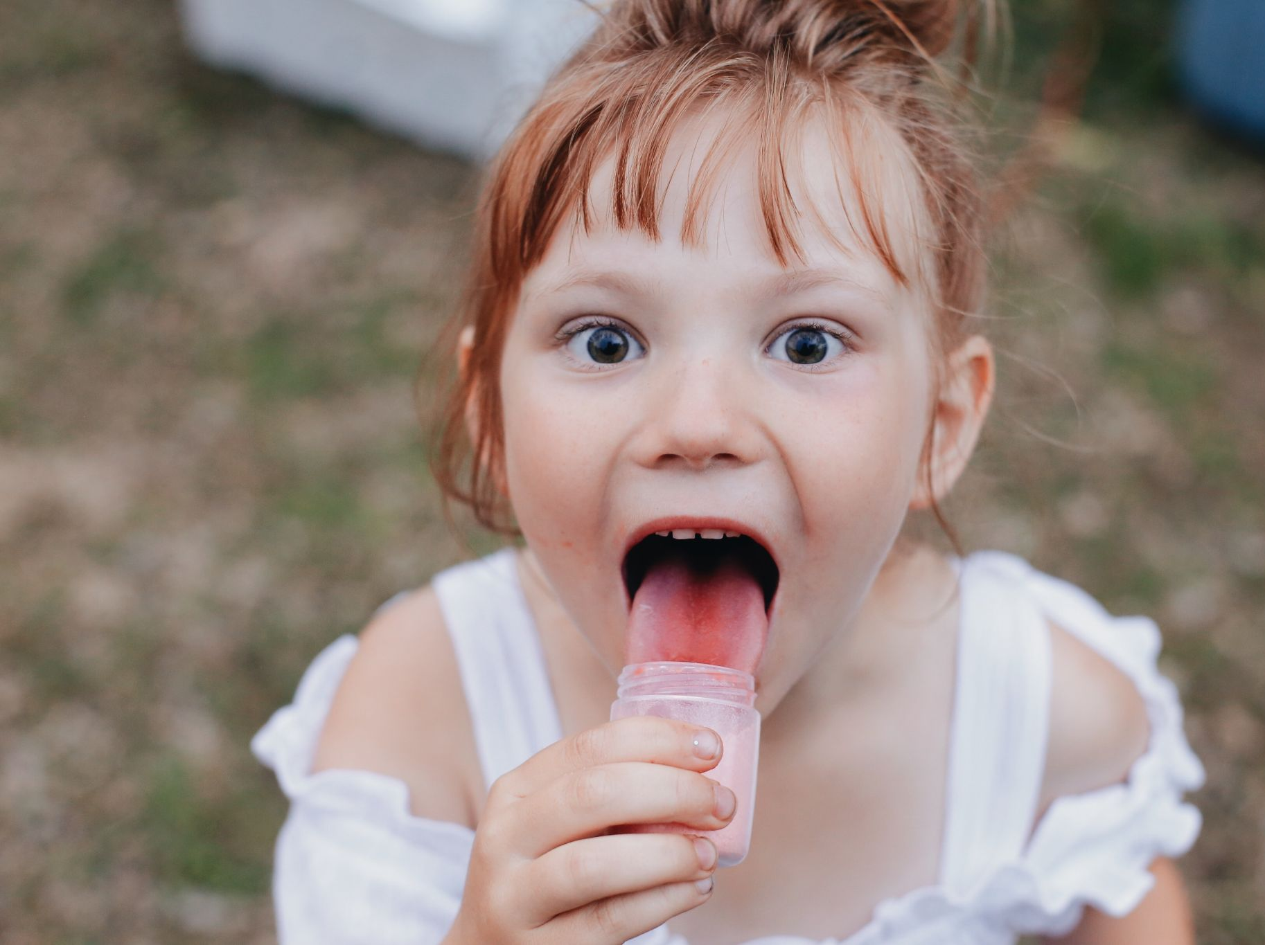
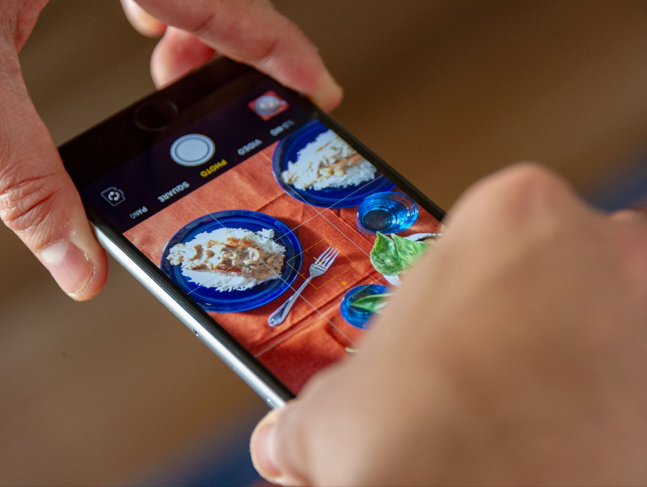
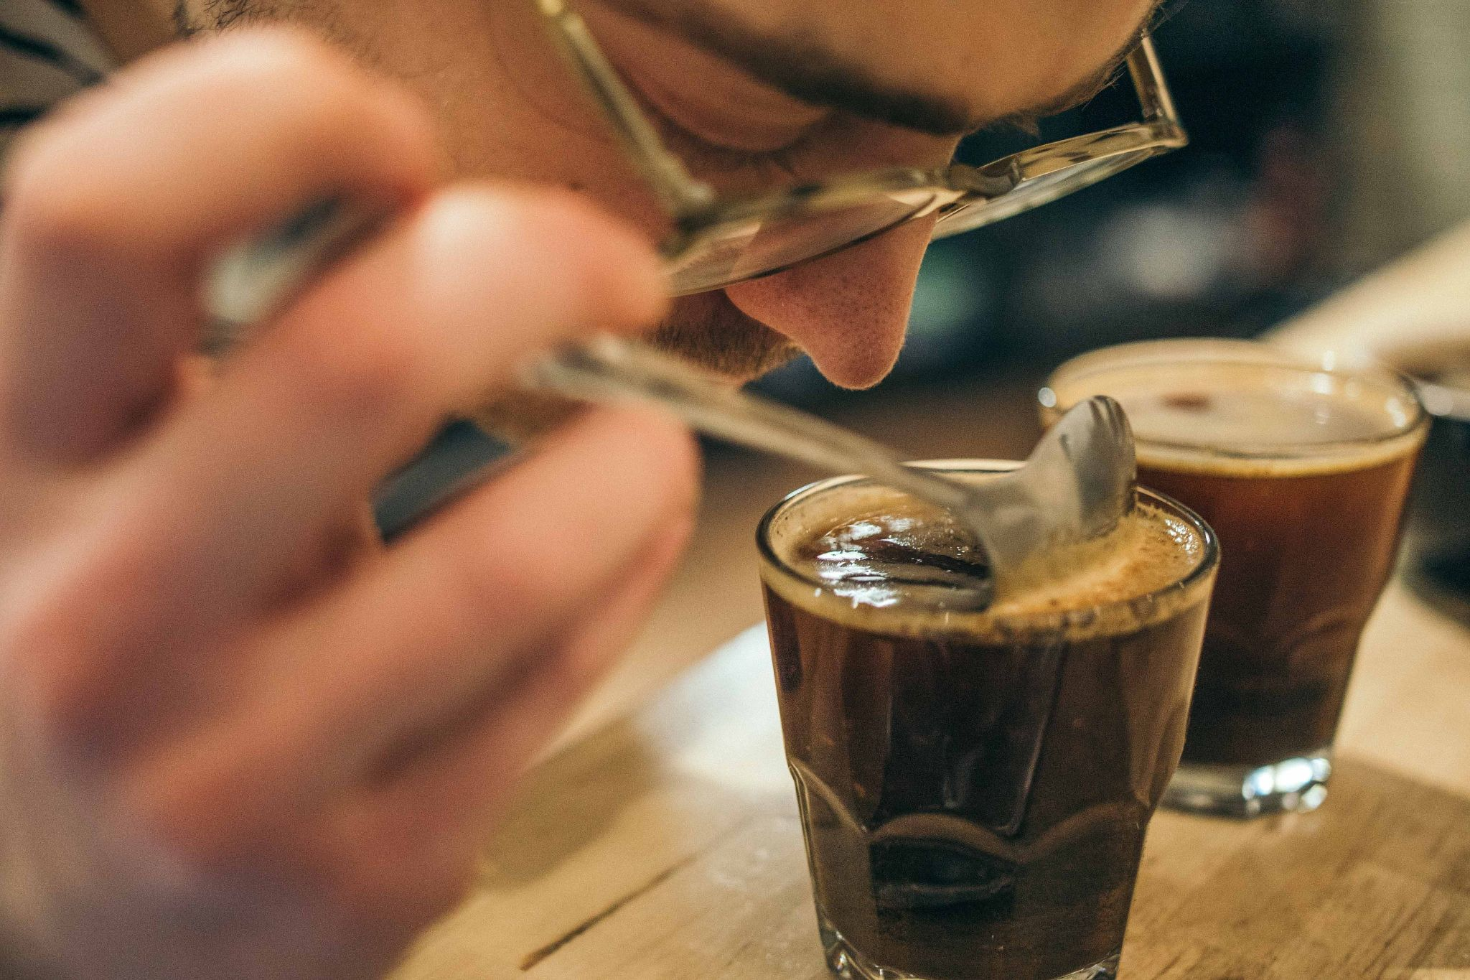
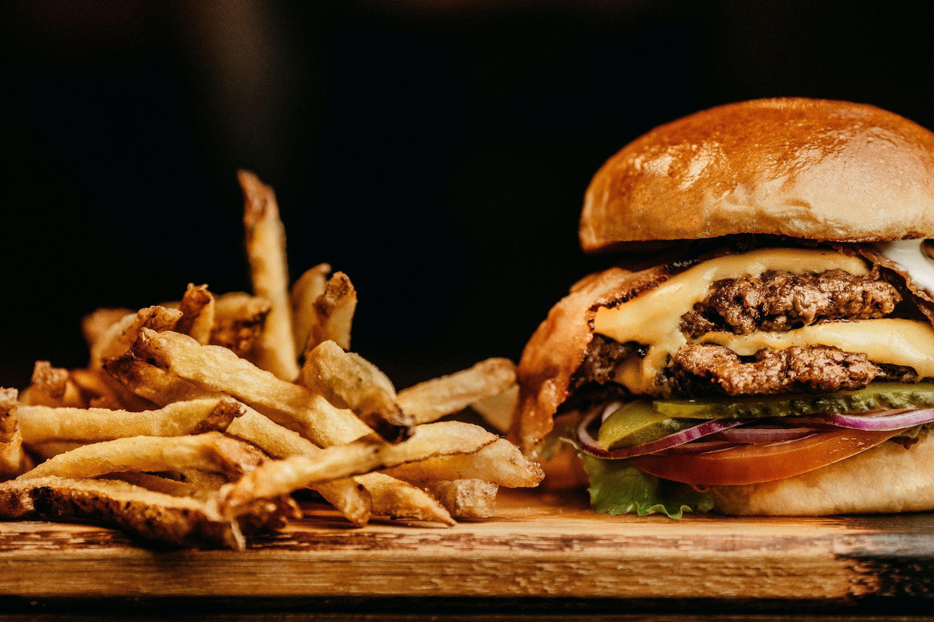
Results / images
Saliency in Sweet foods over salty foods and High calories food over low calories food ratings in all evaluated dimensions.

Slide 9
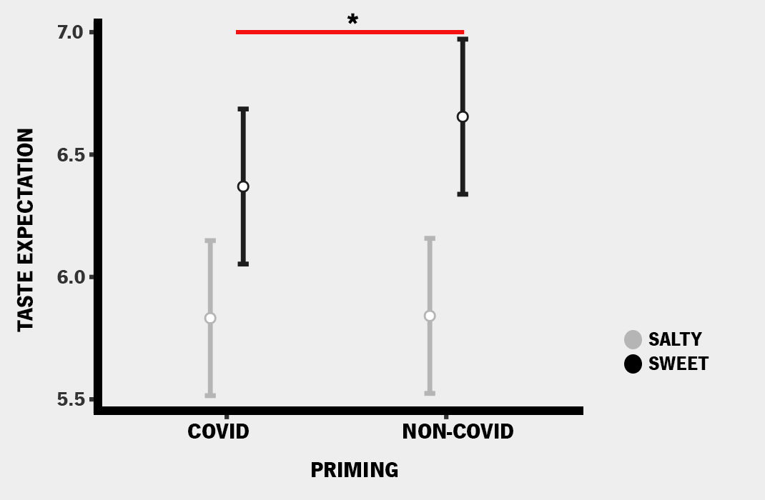
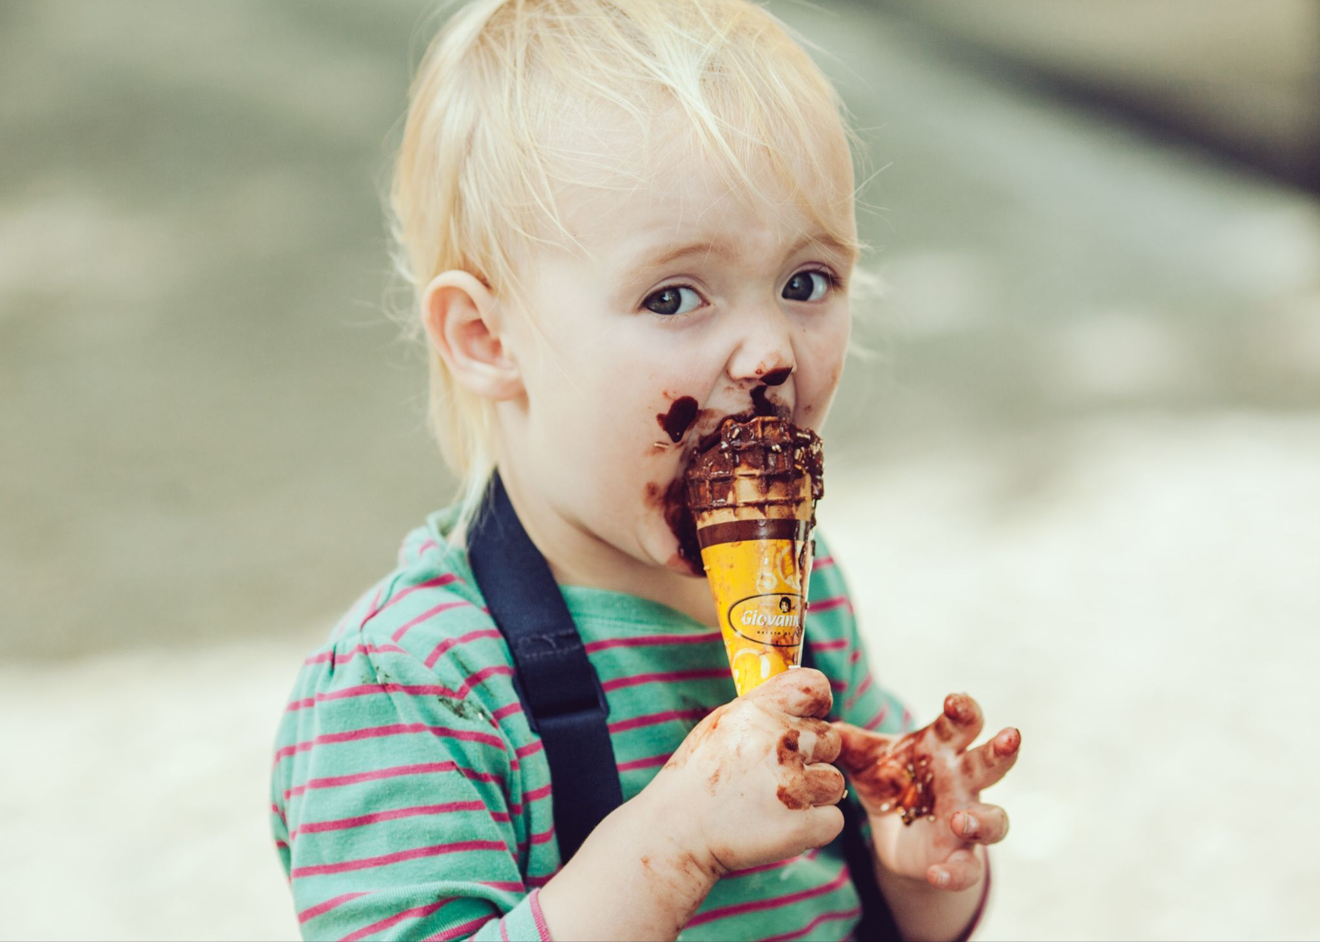
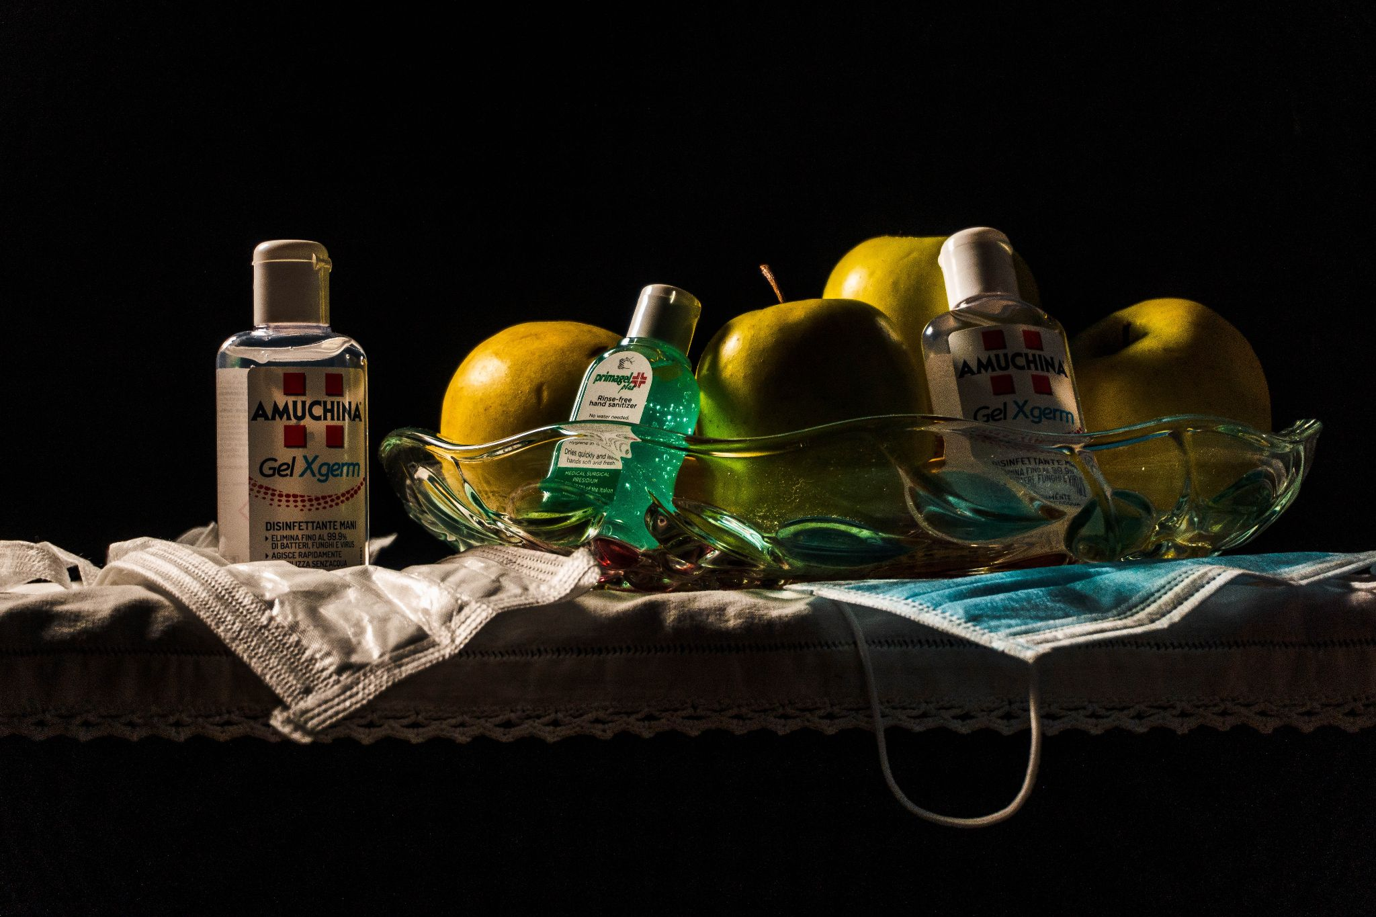
Results / priming
A priming effect was observed on sweet testant comparing Covid and Non Covid conditions.
Note. (*) SwF received higher evaluations at Non Covid condition when compared to SwF at Covid condition. Bars indicate confidence interval (95%).

Slide 10
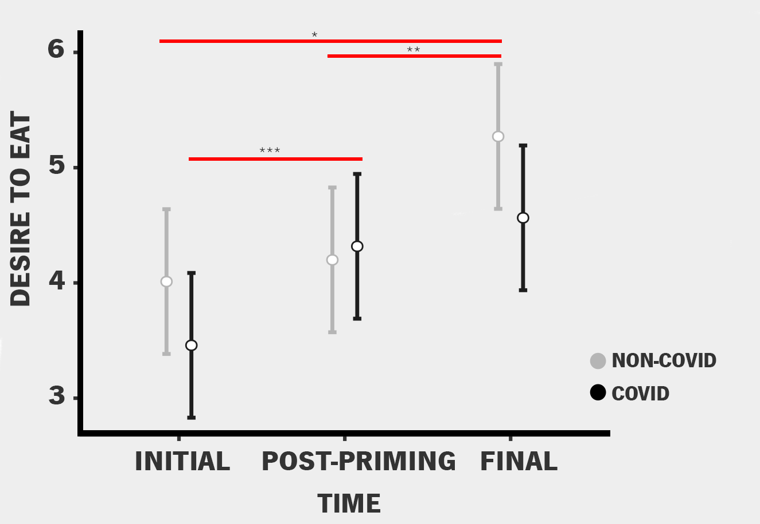
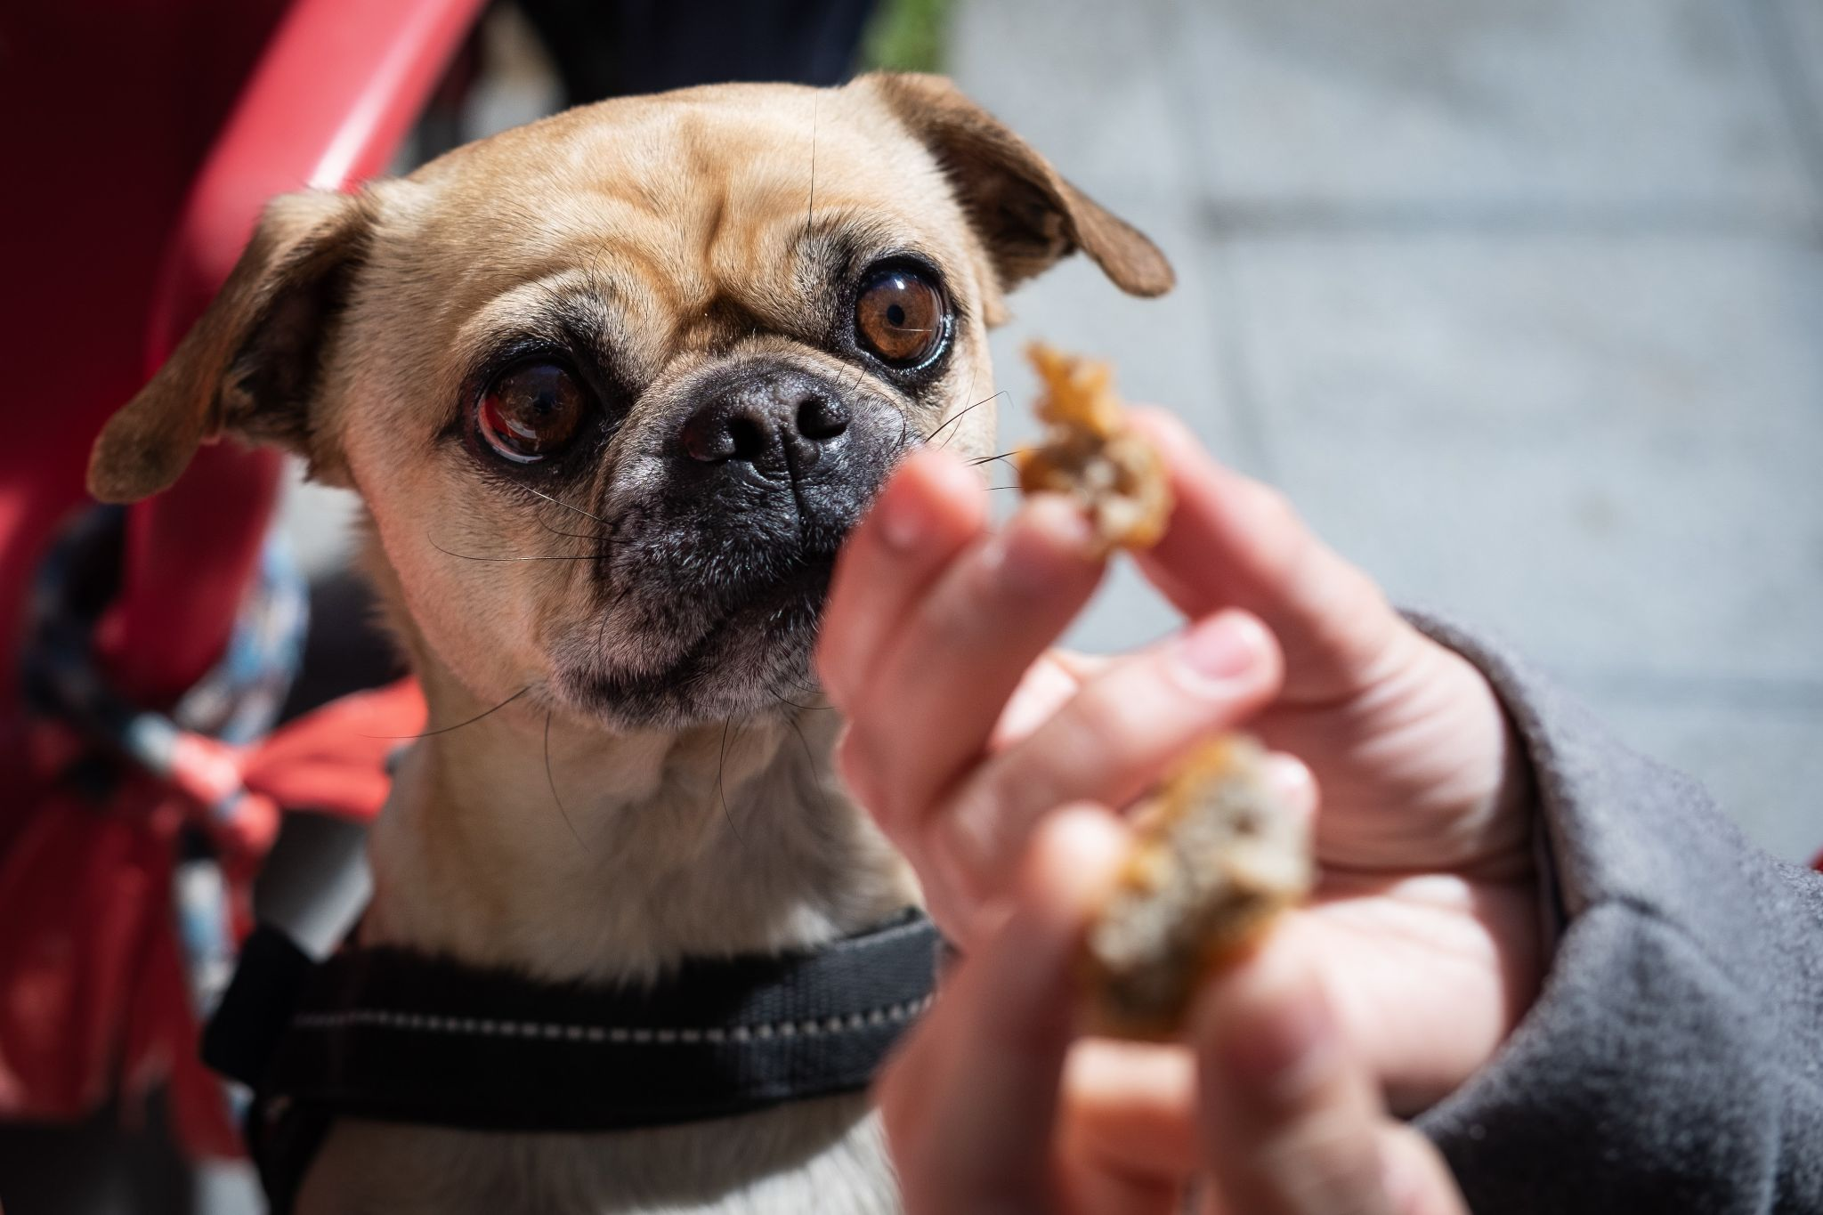
Results / videos
Significant increased in ratings in final desire to eat in both conditions.
Ratings increase on initial and post-priming evaluations for Non Covid condition.
Note. (*) Final assessment, after the end of the task showed higher desire to eat when compared to the assessment before the procedures on both Covid and Non Covid conditions and (**) to Post priming evaluation at Covid condition. Bars indicate confidence interval (95%).

Slide 11
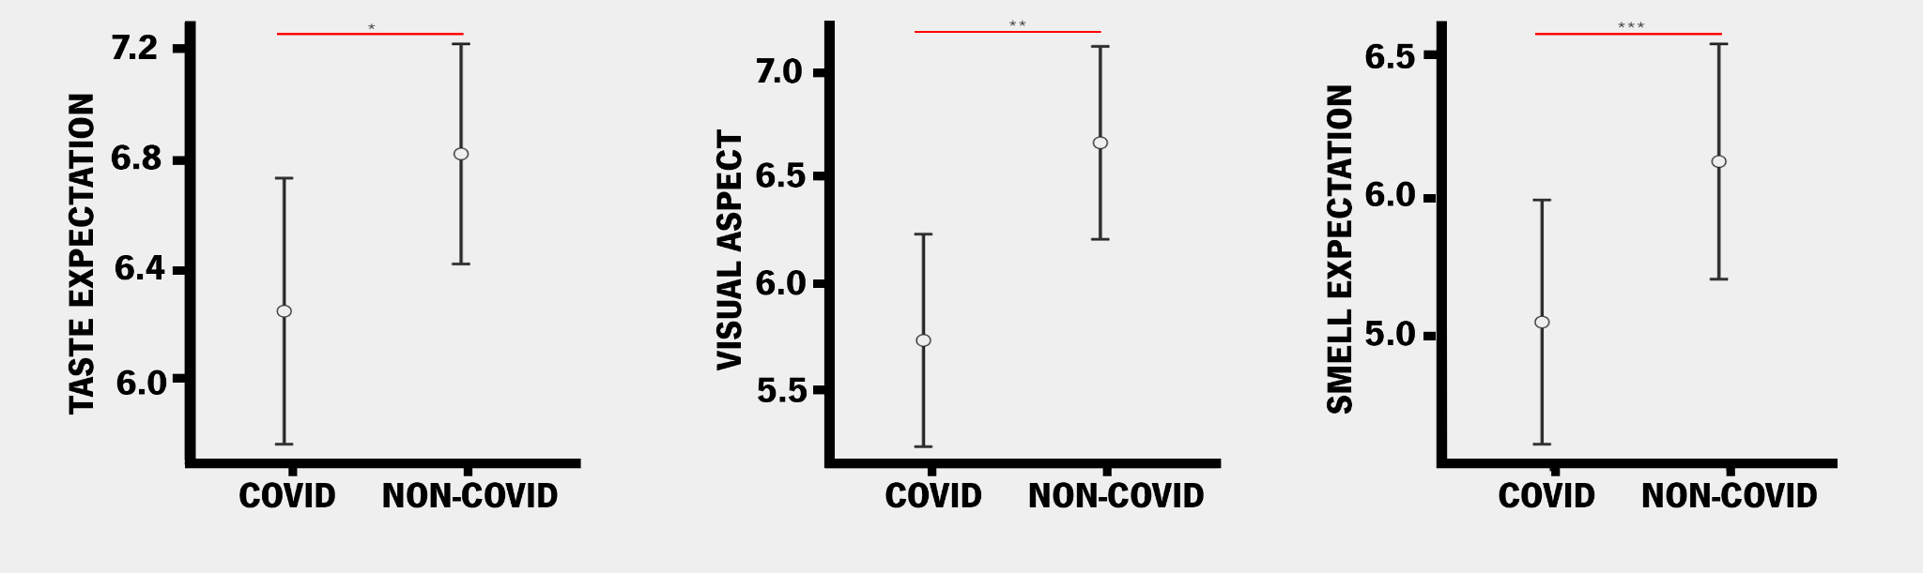
Results / videos
Greater evaluations in Non-Covid condition evaluations, in all dimensions.
Note. (A) Taste expectation, compared between Covid (Mean=6.25, SD=2.29) and Non- Covid (Mean=6.82, SD=1.90) conditions, showed higher scores on Non- Covid condition; (B) Visual aspect between conditions showed higher rates to Non- Covid (Mean=6.67, SD=2.13) condition compared to Covid (Mean=5.77, SD=2.35) and (C) Smell expectation, comparing Covid (Mean=5.55, SD=2.06) to Non -Covid (Mean=6.13, SD=1.99) conditions showed higher scores to Non- Covid condition. Bars confidence interval (95%) and (*)=<0.05. The letter C on the plots stands for Covid-condition whereas the letters NC stands for Non-Covid condition.
Negative correlations between the smell evaluation and PHQ-9 only at the Covid condition.

Slide 12
Discussion
Our strengths corroborating with our primary hypothesis, we have different findings:
For the food pictures, Sweet and high-calorie foods received greater ratings over the other categories and evaluations.
For the food video, in all dimensions (taste and smell expectation, and visual aspect), on Non-Covid condition better evaluations were given.
The video evaluation findings are aligned to the food pictures priming findings, demonstrating that it is more likely to positively evaluate foods in the absence of negative events association.
Other findings
Correlations between PHQ-9 and the video subjective evaluations showed negative correlation between the smell evaluation and PHQ-9 only at the Covid condition.
Importantly, our study differs from investigations which presented real food since the foods were presented in the online format and thus, not allowing actual smell appreciation.
The desire to eat over time showed that the final urge to eat was higher in both conditions compared to baseline assessment, in accordance to our initial hypothesis. Comparing the initial desire to eat with the post video desire to eat we observed that only the Non-Covid video led to increased ratings compared to baseline.
Such effects likely arise from the aversive/negative priming of Covid condition which was also associated with lower hedonic appreciation of the foods. Therefore, the final desire to eat evaluation, which was similar in both conditions, demonstrated a craving effect due to repetitive food exposure, including during the pictures evaluations, which provided no information regarding covid vs non-covid and thus, is expected to increase craving.

Slide 13
Conclusions
Our study supported previous findings
Greater evaluations to sweet and high-calorie foods compared to salty and low-calorie ones (Ohla et al., 2012; Buckland et al., 2021)
Increased desire to eat after food exposure (Sun & Kober, 2020)
And also provided new insights
Hygienic measures of Covid-19 may elicit lower smell assessment and desire to eat
Priming effect was observed for sweet food pictures evaluation, but not other food categories

Slide 14
Thank you
oliveirajarina@gmail.com

