Slide 1
In vivo formed metabolites of polyphenols and their anti-inflammatory efficacy at intestinal level
Gabriele Serreli^{*1}, Maria Paola Melis¹, Micaela Rita Naitza¹, Sonia Zodio¹, Roberto Loi¹, Giuseppina Sanna¹, Juan Carlos Morales², Pablo Peñalver² & Monica Deiana¹.
¹ Department of Biomedical Sciences, University of Cagliari ² Department of Biochemistry and Molecular Pharmacology, Institute of Parasitology and Biomedicine López Neyra, CSIC, PTS Granada

Slide 2
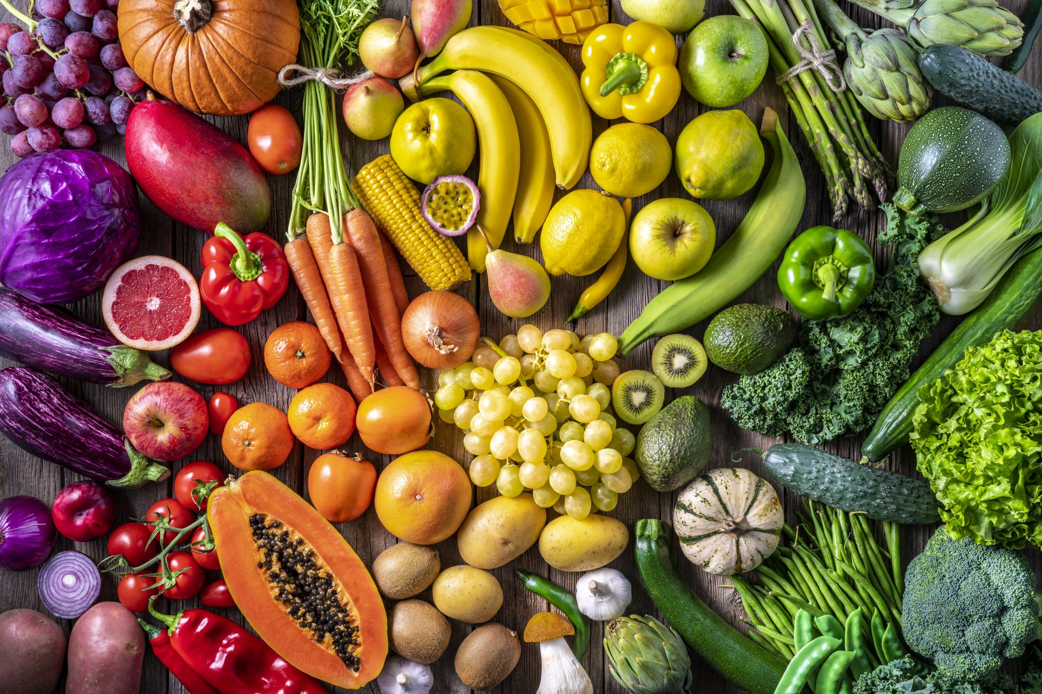
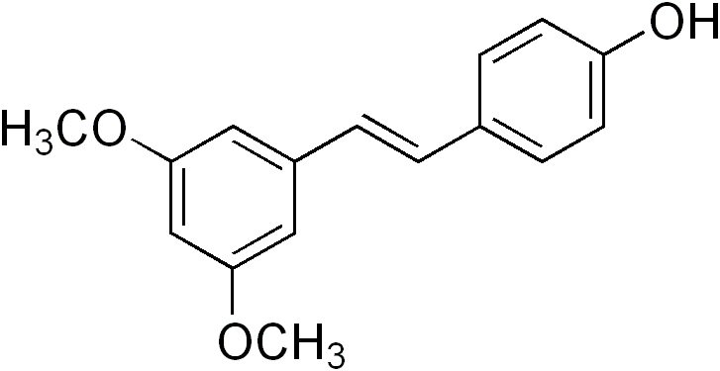
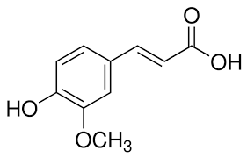
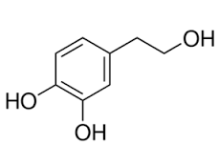
- Polyphenols are a large class of phytochemicals with biological importance as they may confer health benefits. For this reason, they have been the focus of thousands of studies carried out in the last few decades. - Unfortunately, many of the in vitro studies with polyphenols did not take into account the metabolic transformations which normally occur, the physiological concentrations after polyphenol intake, or the contemporary presence of more than one metabolite

Slide 3
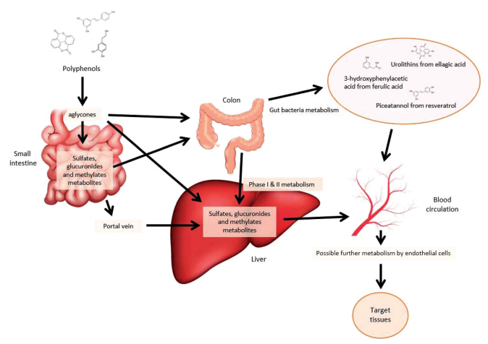
Once polyphenols enter the gastrointestinal tract, they are in fact subjected to phase I/II metabolism which is organ-dependent and is carried out in gut (phase II) and liver cells (phase I/II), and to degradation caused by microflora at the colon level
Patterns of in vivo formation of the main metabolites of polyphenols (Food Funct., 2019, 10, 6999–7021, doi: 10.1039/c9fo01733j).

Slide 4
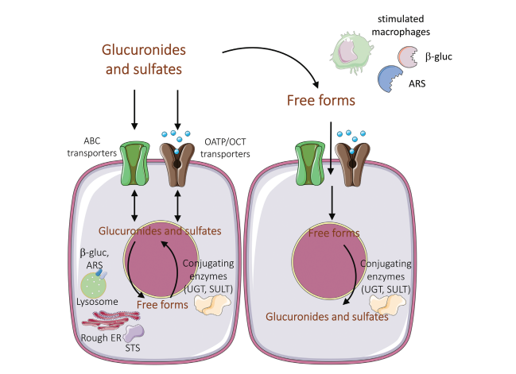
The intra- and extracellular concentration of glucuronide and sulfate metabolites is also regulated by transport proteins and by deconjugating enzymes. Expression, distribution, and activation of metabolizing enzymes and transporters are influenced by pathophysiological status (e.g., activation of macrophages) and by protein polymorphisms.
ABC, ATP-binding cassette; ARS, arylsulfatases; β-gluc, β-glucuronidase; ER, endoplasmic reticulum; OATP, organic-anion-transporting polypeptides; OCT, organic cation transporter; SULT, sulfotransferase; STS, steroid sulfatase; UGT, UDP-glucuronosyltransferase (Adv Nutr 2021;00:1–18; doi: 10.1093/advances/nmab085.).

Slide 5
Evaluate the mechanisms of action of different classes of phase I/II metabolites of polyphenols coming from different plant foods against intestinal inflammation and epithelial barrier damage.
Background
As the most important site of absorption of exogenous substances, the intestine endures the effects not only of harmful substances, but also of positive bioactive compounds deriving from the diet such as the polyphenols
Once formed, the metabolites of polyphenols concentrate in the intestine where they can reach physiologically relevant concentrations
Purpose of our study

Slide 6
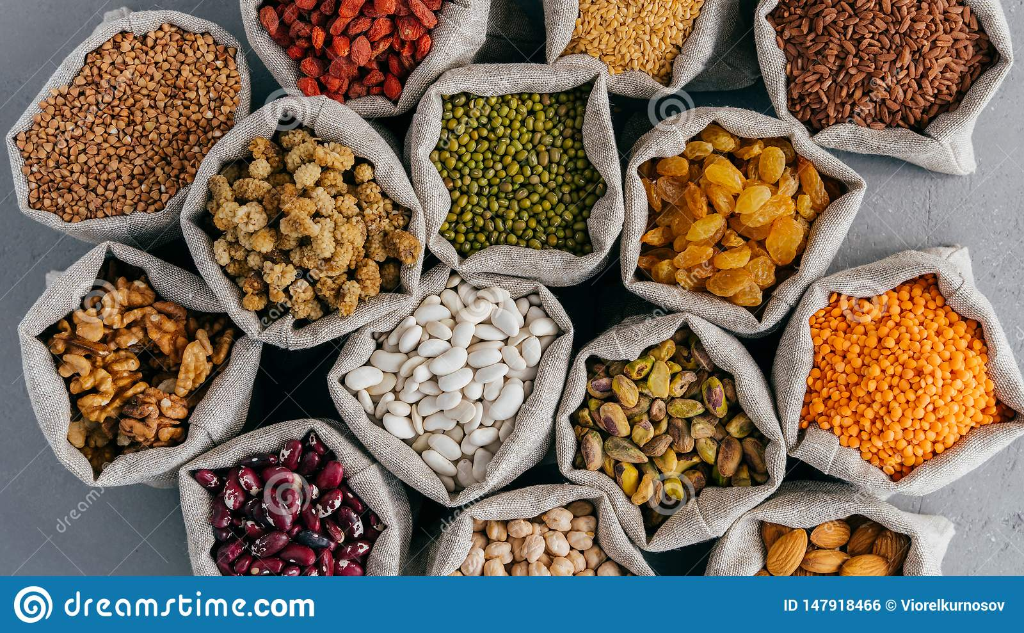
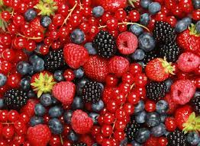
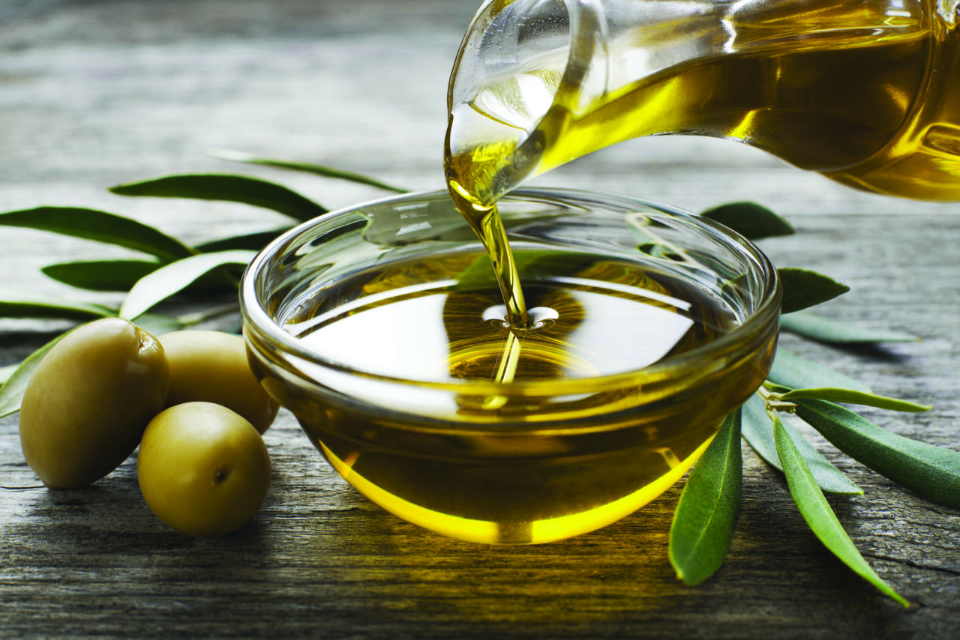
3)
1)
Phenolic compounds tested in this study
Ferulic Acid (FA)
Isoferulic acid (IFA)
Hydroferulic acid (DHFA)
Ferulic acid 4-O-β-D-glucuronide (FA glu)
Isoferulic acid 3-O-sulfate (IFA sulf)
Dihydroferulic acid 4-O-β-D-glucuronide (DHFA glu)
Pterostilbene (PT)
Pinostilbene (PI)
Pterostilbene sulfate (PT sulf)
Pterostilbene glucuronide (PT glu)
Pinostilbene sulfate (PI sulf)
Pinostilbene glucuronide (PI glu)
2)
Tyrosol (Tyr)
Hydroxytyrosol (HT)
Tyrosol sulfate (Tyr sulf)
Tyrosol glucuronide (Tyr glu)
Hydroxytyrosol 3-O-sulfate (HT sulf)
Hydroxytyrosol 3-O-glucuronide (HT glu)
Ferulic acid
Pterostilbene
Hydroxytyrosol

Slide 7
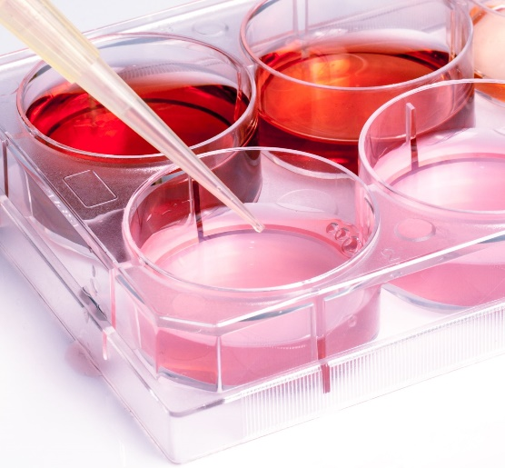
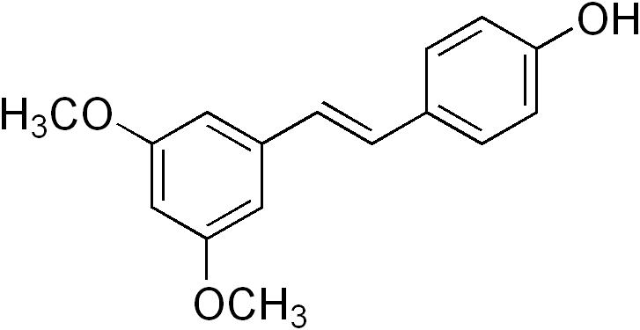
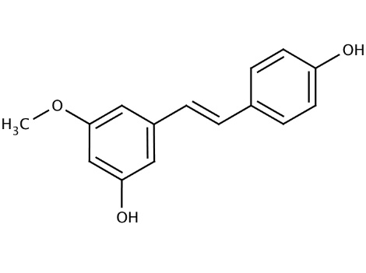
Methods
Metabolites were tested in intestinal cell cultures to assess their efficacy against LPS-induced altered membrane permeability related to disruption and/or relocation of tight junction (TJ) proteins (1. PT and PI), as well as to the induction of iNOS expression associated to MAPKs and NF-ĸB pathways (2. HT and Tyr, 3. FA, DHFA and IFA).
Treatment on intestinal Caco-2 cells differentiated with LPS
(1 µg/mL)
and with the compounds (1 µM)
LPS (Lipopolysaccharide)
Bacterial endotoxin with
pro-inflammatory effects

Slide 8
1)
LPS, IL-1β, TNF-α, IL-6, oxidized lipids…
Dietary pinostilbene and pterostilbene
P38
Occludin an ZO-1 downregulation, redistribution of occludin and ZO-1 protein
TJ
P38, ERK1/2, JNK phosphorylation
TJ impairment
Pathogenic factor of IBDs

Slide 9
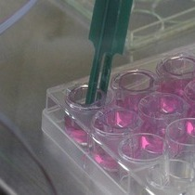
1) Methods
Measurement of transepithelial electrical resistance (TEER) (15’ – 24 h)
Evaluation of occludin and ZO-1 levels after LPS exposure (1 - 48 h)
Assessment of occludin and ZO-1 related to MAPK expression/activation after LPS exposure and co-treatment with the compounds (PT, PI, PT sulf, PT glu, PI sulf, PI glu)

Slide 10
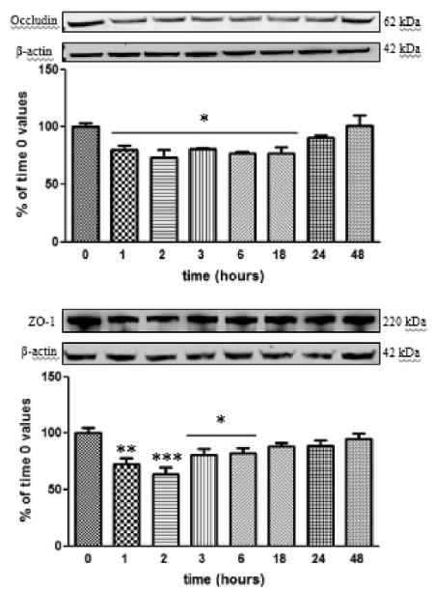
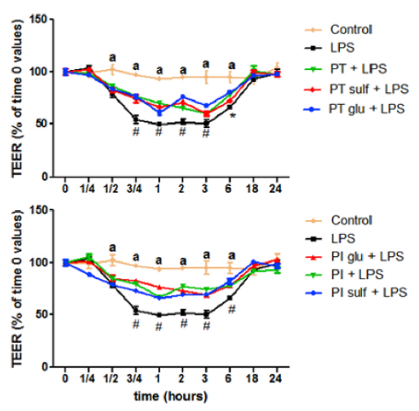
1. Results
Changes of Caco-2 cell monolayer permeability after LPS and stilbenes treatments. TEER value in Caco-2 cell monolayers incubated for 0–24 h with LPS (1 μg/mL) alone or with metabolites (1 μM) a =significant vs LPS and compounds; # =significant vs control and compounds; * =significant vs control, PT and PT glu (p <0.05)
LPS-induced decreased levels of ZO-1 and occludin. Measurements were assessed in differentiated Caco-2 cells incubated with 1 μg/mL from 1 to 48 h. Significant differences vs time 0 are reported when p <0.05. * =p <0.05; ** =p <0.01; *** =p <0.001. Representative WB images of the experiment are shown.

Slide 11
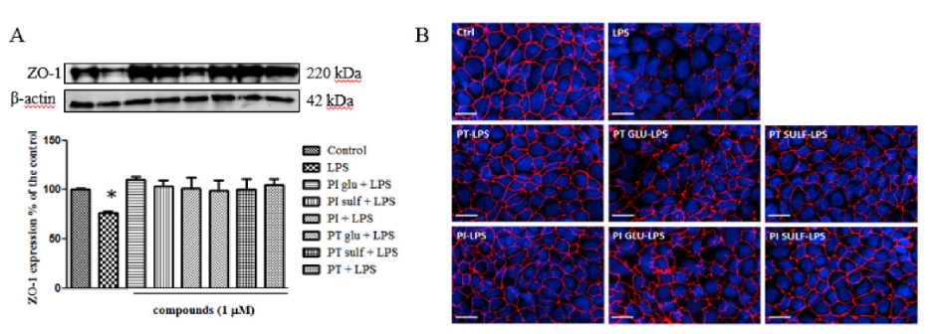
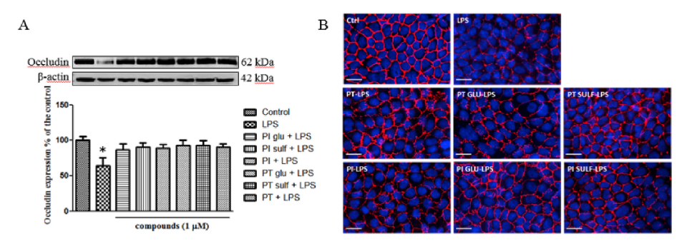
1. Results
Protective effects against ZO-1 and occludin impairment measured by western blotting (WB) (A) and immunofluorescence (B) Significant differences vs control is reported when p <0.05 (*). Representative WB image of the experiments is shown.

Slide 12
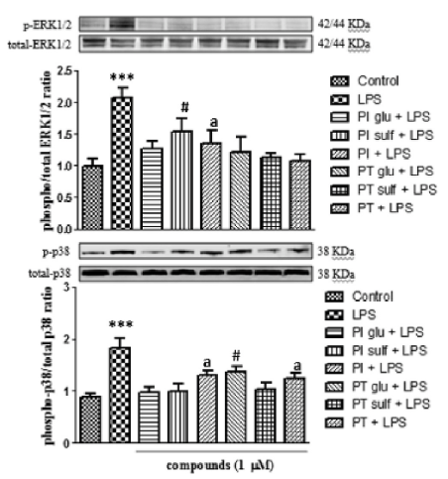
1. Results
Modulation of MAPKs ERK1/2 and p38. Significant differences were expressed with different letters (p <0.05) ERK 1/2: *** =significant (p <0.001) vs control and compounds; # =significant (p <0.05) vs LPS, control, PT and PT sulf; a =significant (p <0.05) vs LPS and control; p38: *** =significant (p <0.001) vs control and compounds; # =significant (p <0.05) vs LPS, control, PI glu, PI sulf and PT sulf; a =significant (p <0.05) vs LPS, control and PI glu.

Slide 13
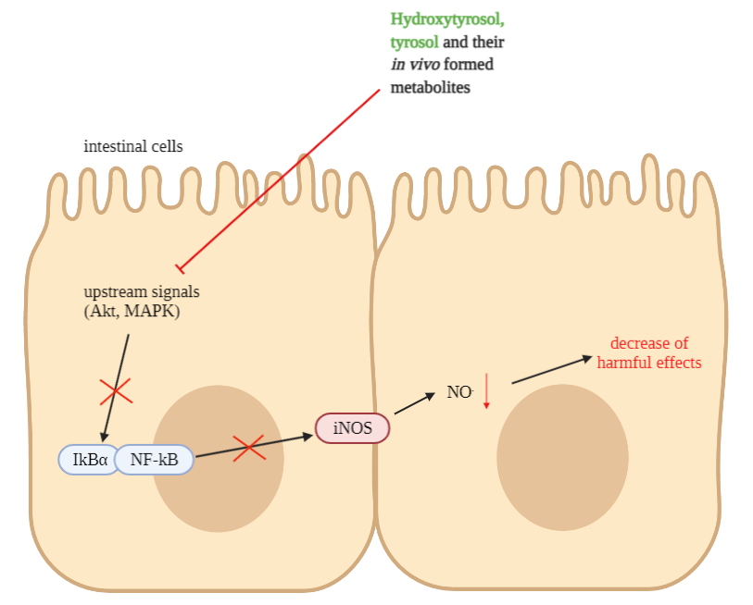
2. Methods
Evaluation of inducible NOS expression and nitric oxide release (48 h) after LPS and compounds coincubation (HT, Tyr and their metabolites)
Assessment of IĸBα degradation related to Akt and MAPK phosphorylation after 2-48 h incubation with LPS and metabolites of HT and Tyr

Slide 14
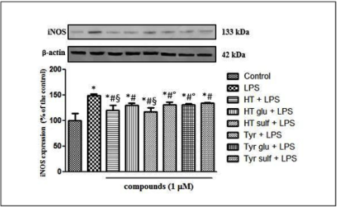
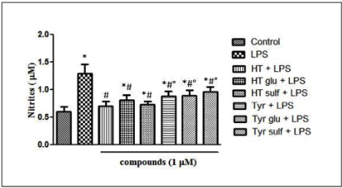
2. Results
Expression of iNOS in Caco-2 cells treated with LPS (1 μg/mL) for 48 h and pretreated (30 min) with hydroxytyrosol (HT), tyrosol (Tyr) and their glucuronide (glu) and sulfate (sulf) metabolites (1 μM) prior to LPS co-exposure. Significant differences among groups are reported using different superscript symbols (p < 0.05);* = significant vs control; # = significant vs LPS; ° = significant vs HTsulf + LPS; § = significant vs Tyr sulf + LPS.
NO production in Caco-2 cells treated with LPS (1μg/mL) for 48 h and pretreated (30 min) with hydroxytyrosol (HT),tyrosol (Tyr) and their glucuronide (glu) and sulfate (sulf) metabolites (1 μM) prior to LPS co-exposure. Significant differences among groups are reported using different superscript symbols (p < 0.05); * = significant vscontrol; # = significant vs LPS; ° = significant vs HT + LPS and HT sulf + LPS.

Slide 15
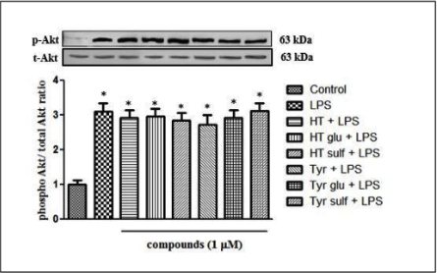
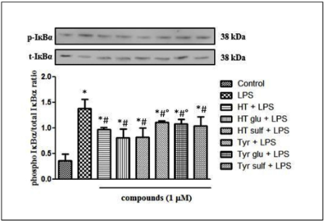
2. Results
Activation of Akt in Caco-2 cells treated with LPS (1 μg/mL) for 2 h and pretreated (30 min) with hydroxytyrosol (HT), tyrosol (Tyr) and their glucuronide (glu) and sulfate (sulf) metabolites (1μM) prior to LPS co-exposure. Significant differences among groups are reported using different superscript symbols (p < 0.05); * = significant vs control.
Degradation of IĸBα in Caco-2 cells treated with LPS (1μg/mL) for 48 h and pretreated (30 min) with hydroxytyrosol (HT), tyrosol (Tyr) and their glucuronide (glu) and sulfate (sulf) metabolites (1 μM) prior to LPS co-exposure. Significant differences among groups are reported using different superscript symbols (p < 0.05);* = significant vs control; # = significant vs LPS; ° = significant vs HT glu + LPS and HT sulf + LPS.
Akt was not modulated, but IĸBα was conversely downregulated…..

Slide 16
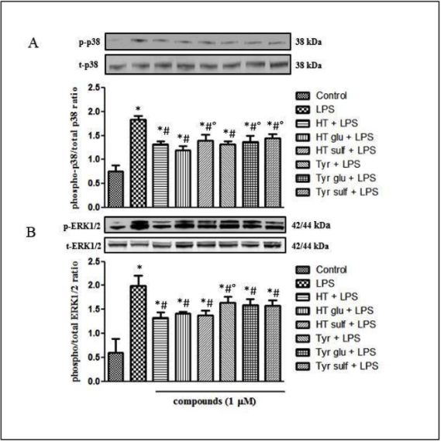
2. Results
Modulation of MAPK p38 (A) and ERK1/2 (B) in Caco-2 cells treated with LPS (1 μg/mL) for 2 h and pretreated (30 min) with hydroxytyrosol (HT), tyrosol (Tyr) and their glucuronide (glu) and sulfate (sulf) metabolites (1 μM) prior to LPS co-exposure. Significant differences among groups are reported using different superscript symbols (p < 0.05); (A) * = significant vs control; # = significant vs LPS; ° = significant vs HT glu + LPS; (B) * = significant vs control; # = significant vs LPS; ° = significant vs HT + LPS.
MAPK were downregulated by the compounds as well as IĸBα

Slide 17
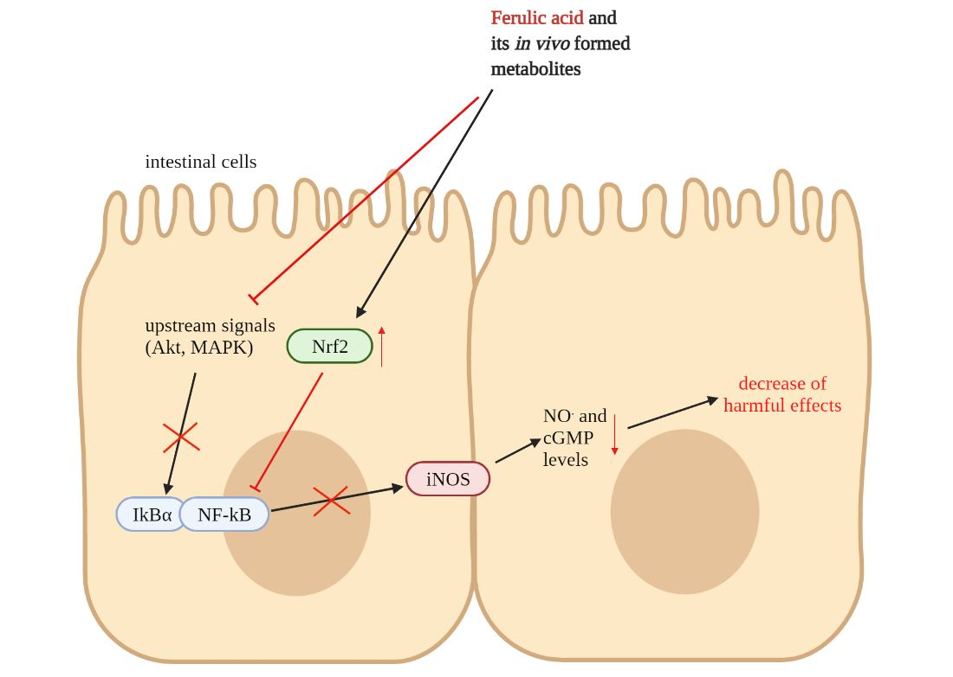
3. Methods
Evaluation of inducible NOS expression and nitric oxide release (48 h) after LPS and compounds coincubation (FA and its metabolites)
Assessment of IĸBα degradation related to Akt and MAPK phosphorylation after 2-48 h incubation with LPS and metabolites of FA
Detection of Nrf2 expression induced by the metabolites of FA

Slide 18
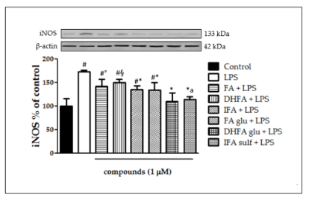
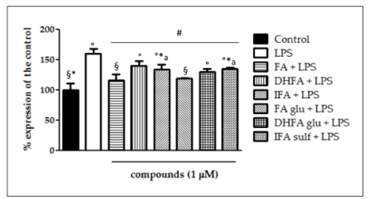
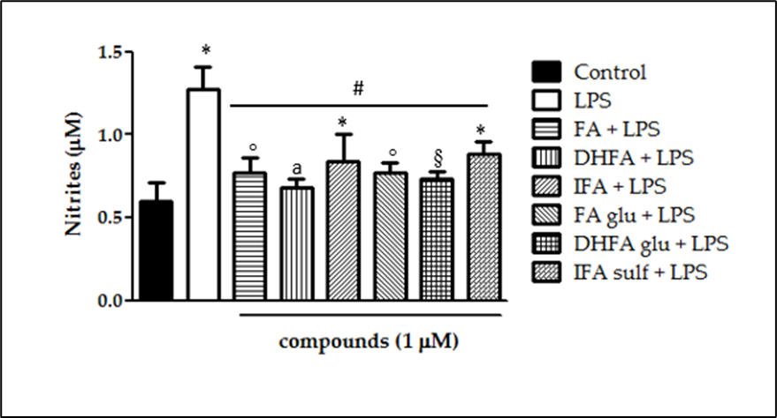
3. Results
Level of iNOS dosed by Western blot and rt-PCR in Caco-2 cells treated with LPS (1 μg/mL) for 48 h and pretreated (30 min) with ferulic acid (FA), dihydroferulic acid (DHFA), isoferulic acid (IFA), ferulic acid glucuronide (FA glu), dihydroferulic acid glucuronide (DHFA glu) and isoferulic acid sulfate (IFA sulf) (1 μM) prior to LPS co-exposure.
NO production in Caco-2 cells treated with LPS (1 μg/mL) for 48 h and pretreated (30 min) with ferulic acid (FA), dihydroferulic acid (DHFA), isoferulic acid (IFA), ferulic acid glucuronide (FA glu), dihydroferulic acid glucuronide (DHFA glu) and isoferulic acid sulfate (IFA sulf) (1 μM) prior to LPS co-exposure.

Slide 19
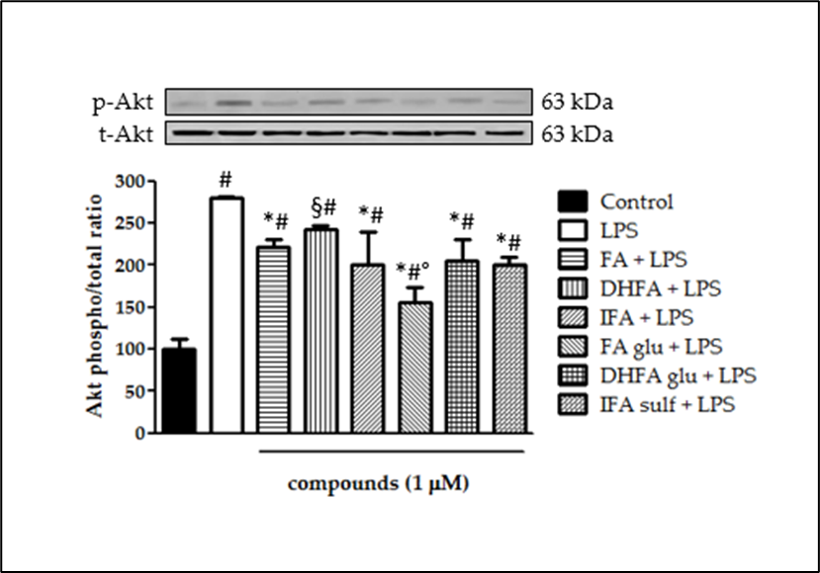
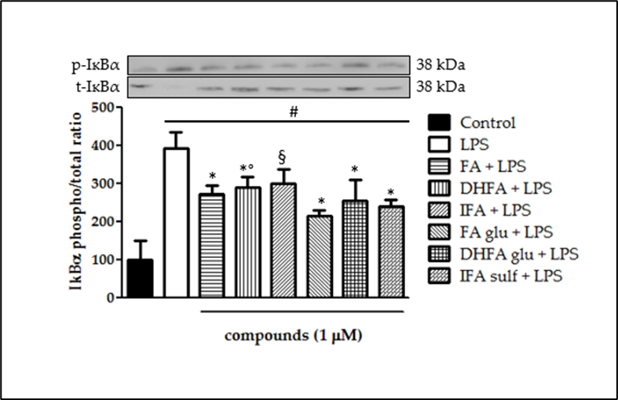
3. Results
Activation of Akt in Caco-2 cells treated with LPS (1 μg/mL) for 2 h and pretreated (30 min) with ferulic acid (FA), dihydroferulic acid (DHFA), isoferulic acid (IFA), ferulic acid glucuronide (FA glu), dihydroferulic acid glucuronide (DHFA glu) and isoferulic acid sulfate (IFA sulf) (1 μM) prior to LPS co-exposure. Significant differences among groups are reported using different superscript symbols; # = significant vs control (p<0.001); * = significant vs LPS (p<0.001); § = significant vs LPS (p<0.05) and vs FA glu + LPS (p<0.001); ° = significant vs FA + LPS, IFA + LPS, DHFA glu + LPS and IFA sulf + LPS (p<0.01).
Degradation of IĸBα in Caco- 2 cells treated with LPS (1 μg/mL) for 48 h and pretreated (30 min) with ferulic acid (FA), dihydroferulic acid (DHFA), isoferulic acid (IFA), ferulic acid glucuronide (FA glu), dihydroferulic acid glucuronide (DHFA glu) and isoferulic acid sulfate (IFA sulf) (1 μM) prior to LPS co-exposure. Significant differences among groups are reported using different superscript symbols; * = significant vs LPS (p<0.001); # = significant vs control (p<0.001); ° = significant vs FA glu + LPS (p<0.05); § = significant vs LPS and FA glu + LPS (p<0.01).

Slide 20
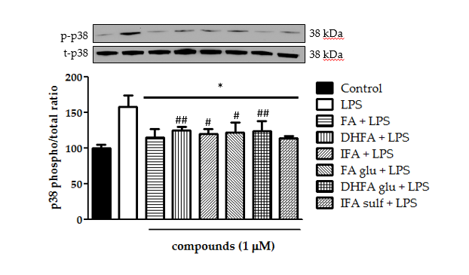
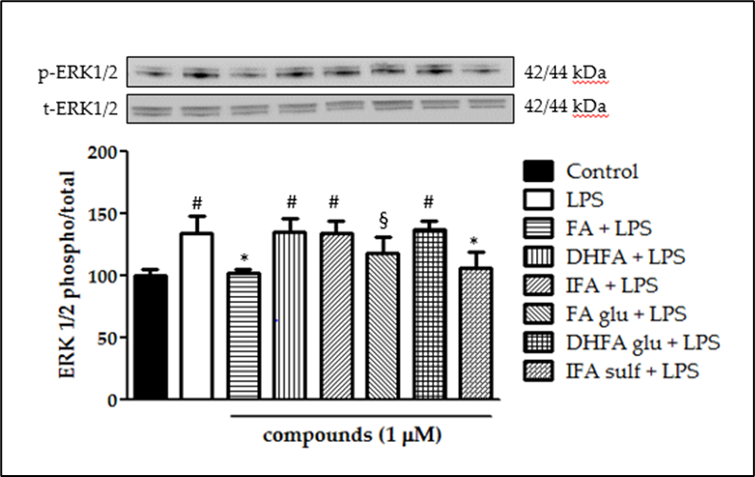
3. Methods
Modulation of MAPK p38 and ERK1/2 in Caco-2 cells treated with LPS (1 μg/mL) for 2 h and pretreated (30 min) with ferulic acid (FA), dihydroferulic acid (DHFA), isoferulic acid (IFA), ferulic acid glucuronide (FA glu), dihydroferulic acid glucuronide (DHFA glu) and isoferulic acid sulfate (IFA sulf) (1 μM) prior to LPS co-exposure.

Slide 21
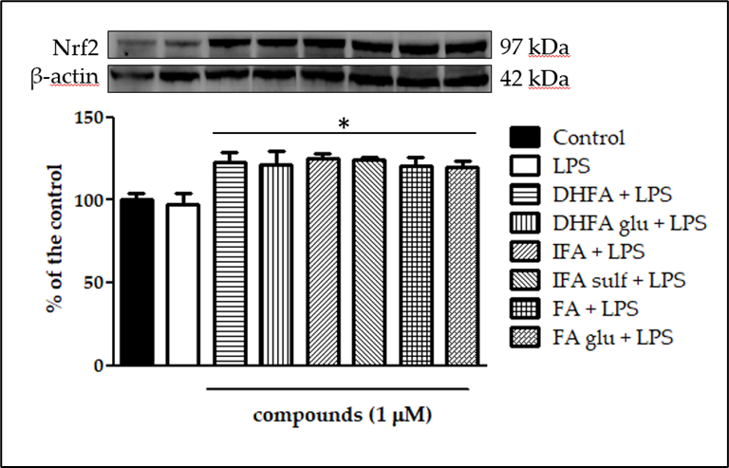
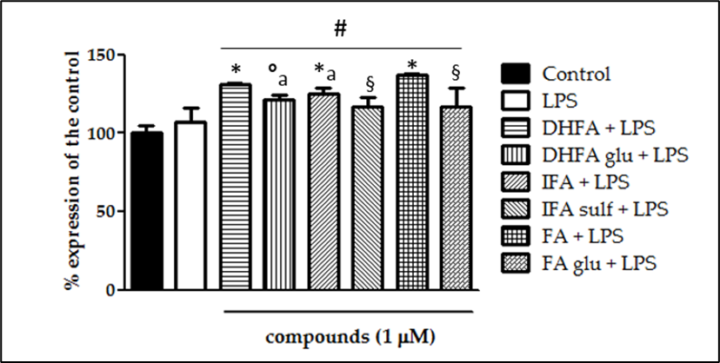
3. Methods
Level of Nrf2 expression dosed by Western blot and rt-PCR reported as percentage of the control, in Caco-2 cells treated with LPS (1 μg/mL) for 48 h and pretreated (30 min) with ferulic acid (FA), dihydroferulic acid (DHFA), isoferulic acid (IFA), ferulic acid glucuronide (FA glu), dihydroferulic acid glucuronide (DHFA glu) and isoferulic acid sulfate (IFA sulf) (1 μM) prior to LPS co-exposure. Significant differences among groups are reported using different superscript symbols; * = significant vs control (p<0.001) and LPS (p<0.001).
Improvement of Nrf-2 expression…

Slide 22
Summarizing…
Pinostilbene and pterostilbene as well as their metabolites are equally effective in the inhibition of TJ degradation through MAPK modulation
Abnormal NO· production was counteracted by pretreatments with olive oil phenolic compounds and ferulic acid derivatives. The inhibition of iNOS expression appeared related to an Akt suppression (in the case of FA), but also to the modulation of MAPK and Nrf2 involved in the NF-ĸB downregulation.

Slide 23
Take home message
The results confirm that the metabolic conversion of dietary polyphenols into its metabolites does not undermine the bioactivity of the free forms, but on the contrary originates compounds equally capable of preserving intestinal integrity against pro-inflammatory agents.

Slide 24
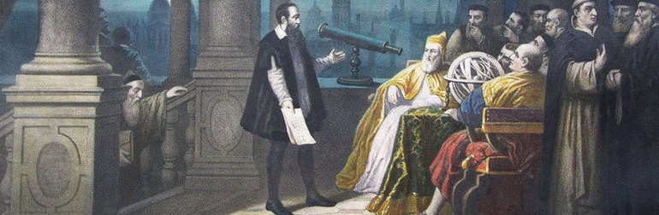
Galileo and his telescope, the first eyes to look deeply into space
Thank you for your attention

