Slide 1
The perspective of nectarine fruit as a functional ingredient of puddings prepared with corn and rice starch
Dasha Mihaylova, Aneta Popova, Zhivka Goranova, Dorina Petkova, Pavlina Doykina, and Anna Lante

Slide 2
Introduction
Milk-based desserts are one of the most popular ones to all age groups.
The food industry has been putting efforts in the development of products with functional properties.
The excessive refined sugar intake has always been seen as one of the major issues leading to unhealthy weight gain at an early age.
Constant advice on the reduction of sugar intake in the children’s daily menu as the over-weight statistics continue to grow.

Slide 3
AIM
evaluate the complete substitution of sugar with nectarines as lyophilized powder and purée, in puddings prepared with corn and rice starches in order to meet the needs of the trending healthy lifestyle and diet;
physical, rheological, nutritional, and sensory characteristics of the nectarine-enriched puddings were used to describe the newly developed formulations.

Slide 4
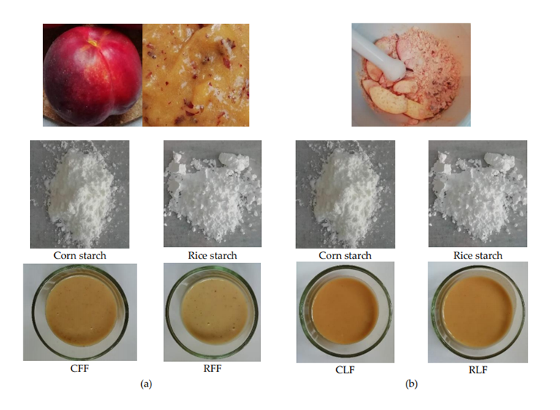
Preparation of formulations
Pudding formulations. (a) RFF – rice starch, peach purée; CFF – corn starch, peach purée; (b) RLF – rice starch, lyophilized fruit; CLF – corn starch, lyophilized fruit.
Type of pudding | Whole cow milk, % | Rice starch, % | Corn starch, % | Peach purée, % | Lyophilized peach powder, %
RFF | 63 | 6 | - | 31 | -
RLF | 85 | 5 | - | - | 10
CFF | 63 | - | 6 | 31 | -
CLF | 85 | - | 5 | - | 10

Slide 5
Methodology
Official AOAC methods were used to determine the moisture and ash content.
The nutritional data was determined by the calculation method.
Data were analyzed using MS Excel software. Relevant statistical analyses of the data were performed using one-way ANOVA and a Tukey–Kramer post hoc test (α = 0.05). The Pearson’s correlation coefficients between moisture content, density, aw and textural parameters have been plotted with the use of Excel STAT Cloud function in Microsoft Excel 365 software.

Slide 6
Results

Slide 7
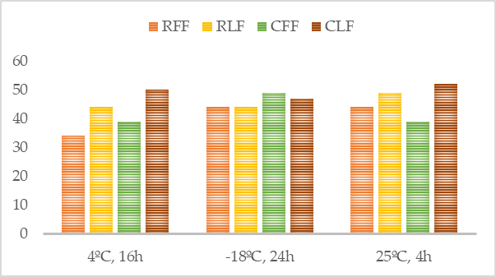
Results
Freeze-thaw stability of pudding formulations (RFF – rice starch, peach purée; RLF – rice starch, lyophilized fruit; CFF – corn starch, peach purée; CLF – corn starch, lyophilized fruit).

Slide 8
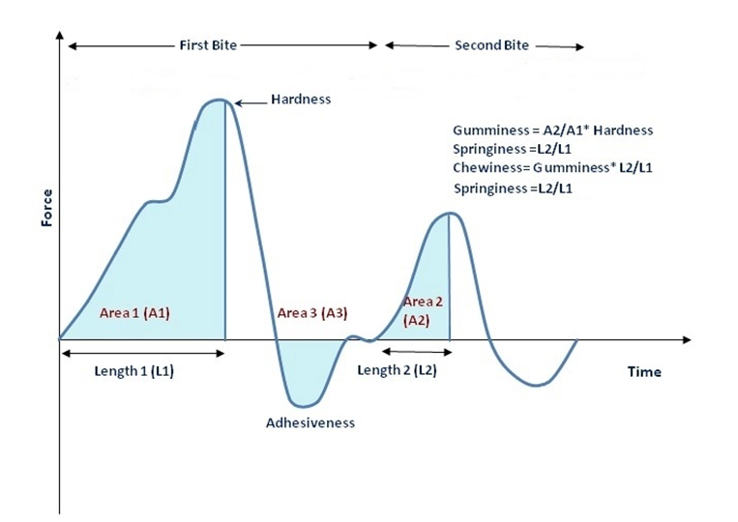
Results

Slide 9
Results
Fruity aroma
Natural color
Smooth, creamy structure

Slide 10
Conclusion
The effect of total sugar substitution in pudding recipes has been evaluated in order to meet the recent necessity of reduced sugar intake and healthier nutrition in general.
Further exploration of the perspective of fruit-enriched puddings should be made in order to improve their technological and health-promoting properties.

Slide 11
Acknowledgements
This research was partially funded by the Ministry of Education and Science Scientific Research Fund, Bulgaria, grant number KП-06-H37/23–2019.
The authors would like to express their gratitude to prof. Zhivondov from the Fruit Growing Institute, Plovdiv (Bulgaria), and his team for kindly providing the nectarine variety “Gergana” used to prepare the formulations, object of analysis.

