Slide 1
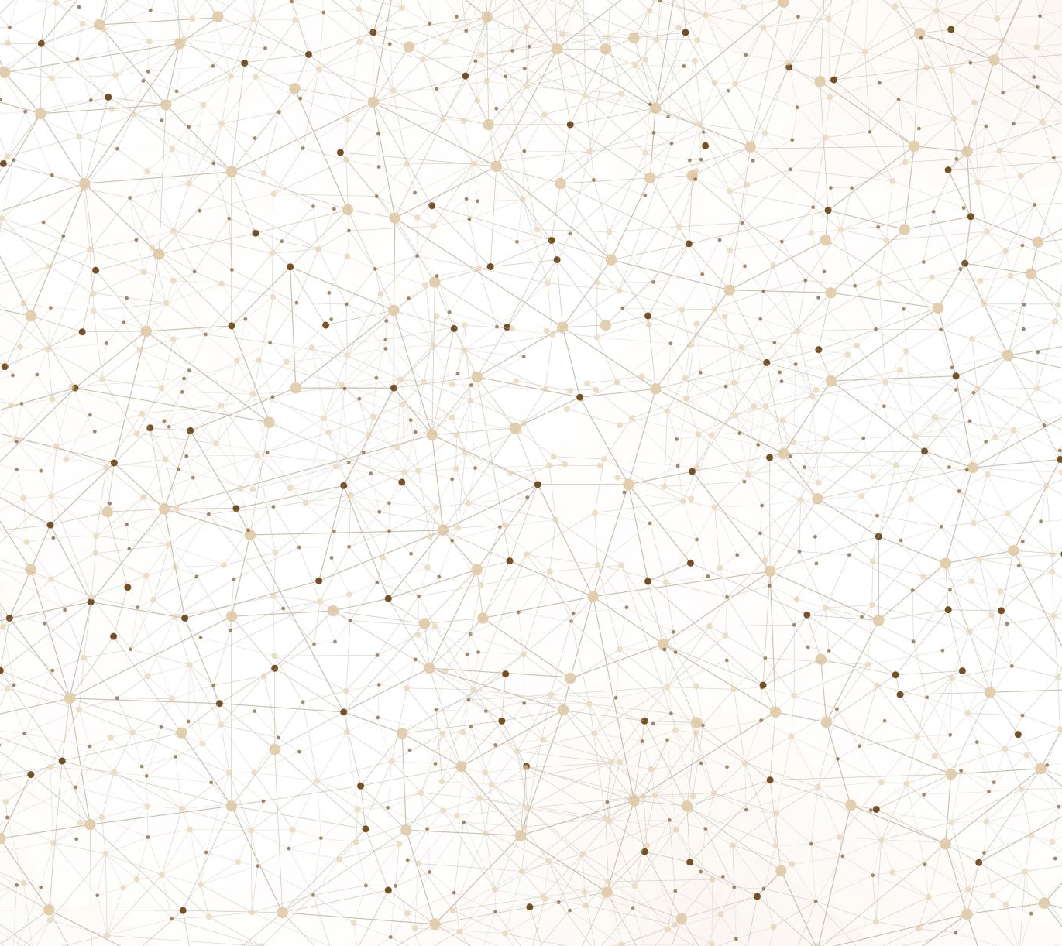
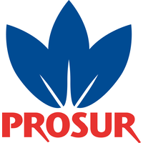
Determination of protoporphyrins in ham samples using UHPLC
Claudia Giménez Campillo¹, Natalia Campillo¹, Marta Pastor-Belda¹, Natalia Arroyo-Manzanares¹, Juan de Dios Hernández², Isidro Guillén², Pascuali Vizcaíno², Ignacio López-García¹ and Pilar Viñas¹
¹ Department of Analytical Chemistry, Faculty of Chemistry, Regional Campus of International Excellence “Campus Mare-Nostrum”, University of Murcia, Murcia, Spain
² Productos del Sur S.A. (Prosur), Av. Francisco Salzillo, P/27-2, 30169 San Ginés, Murcia, Spain

Slide 2
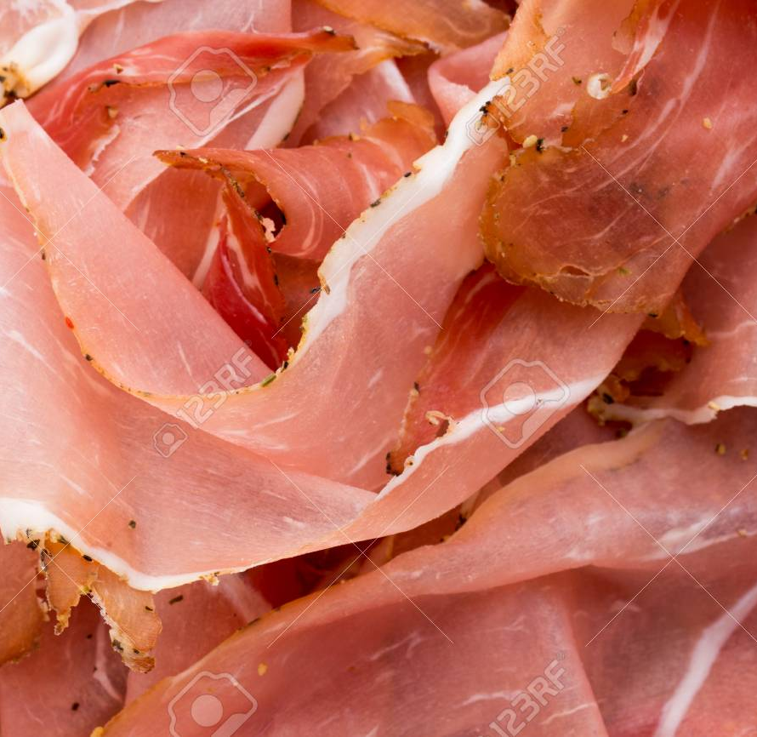
Introduction
Nitrites and nitrates are added to meat products to develop colour, stop the growth of harmful bacteria and improve flavour. However, these additives have some toxicity and could give rise to potentially carcinogenic compounds, such as N-nitrosamines.
Until recently, it was believed that the only responsible for the attractive red colour of meat was myoglobin formed by the addition of nitrite, but it has recently been shown that this is not always the case, for example, the responsible for the red colour of Parma ham is zinc(II) protoporphyrin IX (ZnPP).
The mechanism by which ZnPP is formed in meat products remains unclear; the process depends on oxygen, temperature, salt content, pH, muscle fibre type and other factors. One study has shown that the amount of ZnPP formed decreases with the addition of NO donors, so in the presence of nitrites the formation of ZnPP should be lower.
Notes:
Nitrites and nitrates are added to meat products to develop colour, stop the growth of harmful bacteria and improve flavour. However, these additives have some toxicity and could give rise to potentially carcinogenic compounds, such as N-nitrosamines.
Until recently, it was believed that the only responsible for the attractive red colour of meat was myoglobin formed by the addition of nitrite, but it has recently been shown that this is not always the case, for example, the responsible for the red colour of Parma ham is zinc(II) protoporphyrin IX (ZnPP).

Slide 3
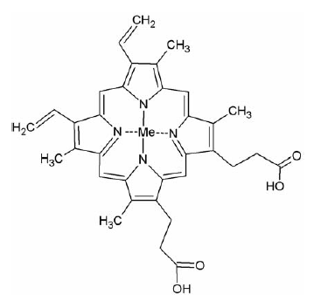
Protoporphyrins
Protoporphyrins are organic compounds consisting of four pyrrole rings linked by methane bridges. They can be produced by different micro-organisms. The process of ZnPP formation in ham is unknown, but it is known that the protoporphyrins present in these products are hemin, protoporphyrin IX (PPIX) and ZnPP, which are biochemically interrelated.
ZnPP: Me=Zn²⁺
Heme: Me= Fe ²⁺
Hemín: Me= Fe ²⁺ ⁻Cl
PPIX: Me= NO
Notes:
Porphyrins are organic compounds consisting of four pyrrole rings linked by methane bridges. They can be produced by different micro-organisms. The process of ZnPP formation in ham is unknown, but it is known that the protoporphyrins present in these products are hemin, PPIX and ZnPP, which are biochemically interrelated.

Slide 4
Objective
The objective of this work is the development and validation of a highly sensitive and reliable analytical procedure for the determination of four protoporphyrins (ZnPP, PPIX, hemin and heme) in samples of different meat products. HPLC was selected as the separation technique and mass, diode array and fluorescence were used as detectors.

Slide 5
Optimisation of separation conditions
The analytical column used was a ZORBAX RRHD Eclipse Plus C18 (1.8 µm, 2.1 x 100 mm). The separation conditions were optimised by testing a mixture of 0.01 M ammonium acetate or milliQ water (solvent A) and methanol (solvent B) in the presence and absence of 0.1 % formic acid. All these solvent mixtures were tested in both positive and negative modes and electrospray ionisation (ESI).
optimal conditions
gradient elution mode
0.01 M ammonium acetate (solvent A)
%B | t (min)
75 | 2.5
100 | 2.8
100 | 8
75 | 8.4
75 | 10
positive mode
MeOH
(solvent B)
flow rate of 0.4 mL min⁻¹

Slide 6
Optimisation of sample processing
For the optimisation of the extraction process, the variables studied were: extractant solvent, sample mass, extractant solvent volume, solvent:acid ratio, amount of water to homogenise the sample and a possible drying step for pre-concentration.
0.7 HCl-75% acetone
1 g
3 mL
ethyl acetate: acetic acid
Sample mass
2 g
Volume of extractant
2 mL
Extract solvent
tetrahydrofuran
3 g
1.5 mL
disodium phosphate-MeOH
5 g
1 mL
2:1
air
2.5 mL
Solvent: acid ratio
3:1
Amount of water
Drying step
nitrogen
4:1
5 mL
no drying
5:1

Slide 7
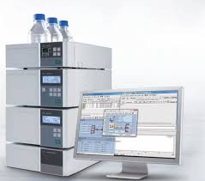
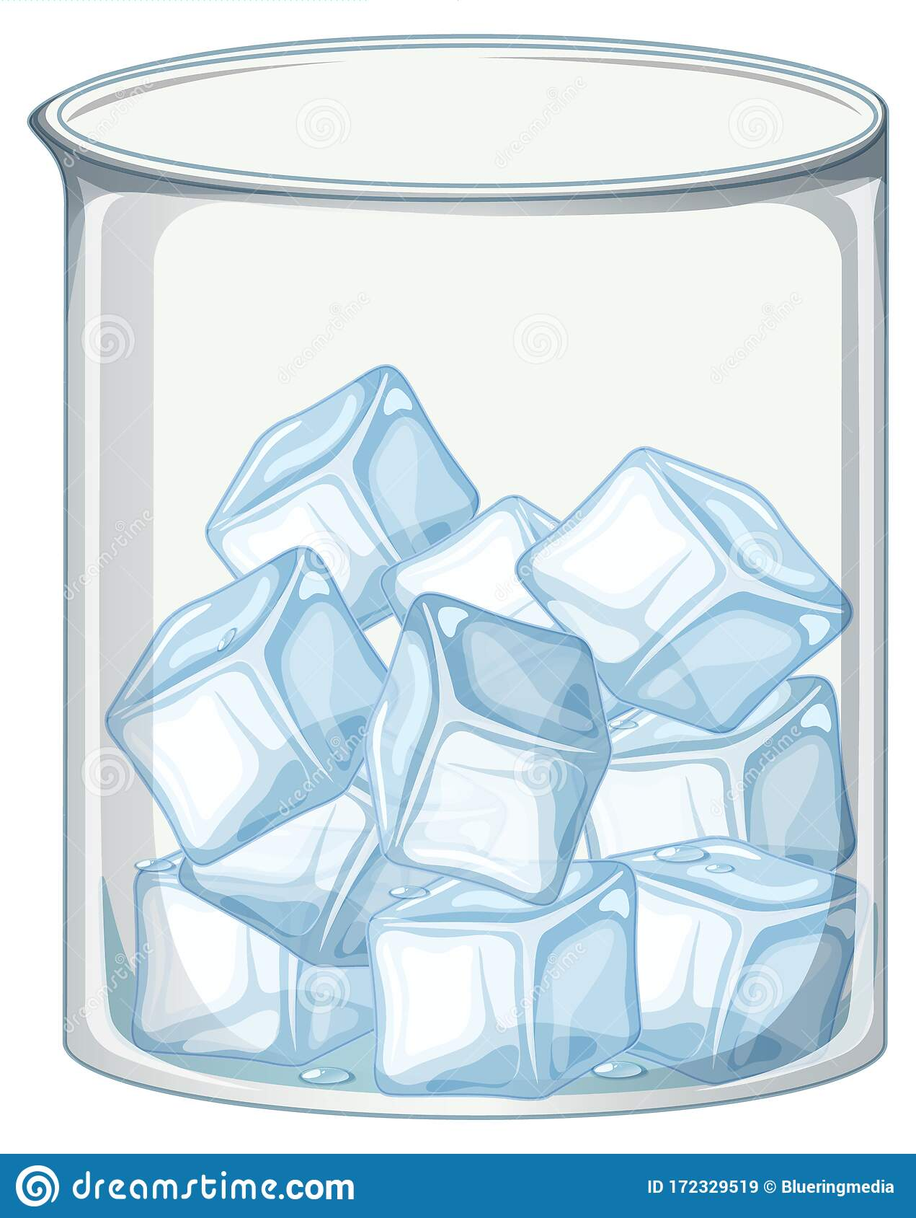
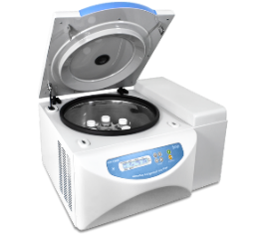
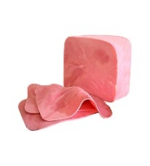
Analytical procedure
2.5 mL H₂O +
1.5 mL ethyl acetate: acetic acid (3:1) +
1 g NaCl
Ice bath
15 min
Filter
2 g of sample
5 min 10ºC
3000 rpm
15 min 10ºC
6000 rpm
HPLC-DAD
HPLC-MS

Slide 8
Method validation
The method was validated by obtaining parameters of linearity, limits of detection and quantification, selectivity, precision and accuracy.
Calibration lines were performed in the absence and presence of meat product matrix using six concentration levels and subjected to the above procedure. The resulting signals were linearly adjusted (R²> 0.99 in all cases) and the slopes, using both methods, showed significant differences (ANOVA test, p-value > 0.05) for each protoporphyrin. This means that the method has a matrix effect and quantification with the aqueous standards was discarded.
 | ZnPP (µg/g) | Hemin (µg/g) | PPIX (µg/g)
LD | 0.05 | 0.13 | 0.14
LQ | 0.17 | 0.43 | 0.46
RSD | 11.0 | 12.6 | 9.3
Linearity → 0.5-500 µg g⁻¹

Slide 9
Analysis of real samples
Sample | ZnPP (µg/g) | Hemin (µg/g) | PPIX (µg/g)
Ham without nitrite | 0.45 | 0.12 | 0.37
Ham with 150 ppm nitrite | 0.21 | 4.2 | 0.28
Haw with natpre | 0.41 | 5.2 | 0.26
Bacon with nitritre | 0.18 | 1.2 | 0.20
Bacon cooked with nitrite | 0.16 | 5 | 0
Bacon with natpre | 0.41 | 14 | 0.31
Bacon cooked with natpre | 0.26 | 0 | 0.067
Without nitrite
With nitrite
Analysis of the samples shows that the presence of nitrite inhibits the formation of ZnPP.

Slide 10
Conclusions
A sensitive and selective analytical method for the detection of protoporphyrins in meat products has been developed using an ethyl acetate: acetic acid (3:1) extraction and an HPLC separation technique. Diode-array, fluorescence and mass spectrometry have been used as detectors.
The complexity of the matrix of meat products requires quantification by standard additions method using a model matrix for all samples.
Analysis of the samples shows that the presence of nitrite inhibits the formation of ZnPP.
The characteristic red color of meat usually occurs due to the addition of nitrites and the presence of ZnPP. The presence of nitrites inhibits the concentration of ZnPP present in meat and also promotes the formation of carcinogenic compounds such as nitrosamines. Therefore, the addition of nitrites to meat may not be the best option to improve meat coloration.

Slide 11
Thank you for your attention
Acknowledgement
The authors acknowledge the financial support of Fundación Séneca (Project 19888/GERM/15) and the Spanish MICINN (PGC2018-098363-B-I00) C. Giménez-Campillo acknowledges a FPU fellowship from the MICINN.

