Slide 1
Tyrosinase inhibition ability provided by hop tannins:
a mechanistic investigation
Jiaman Liu ¹, Yanbiao Chen ², Xinxin Zhang ¹, Jie Zheng ¹, Jiaying Wang ¹, Weiying Hu ¹ and Bo Teng ^{1,3,}*
¹College of Science, Shantou University, Shantou 515063, China; 19jmliu1@stu.edu.cn (J.L.);
²Guangzhou Nali Biotechnology Co., Ltd, Guangzhou 510000, China
³Guangdong Provincial Key Laboratory of Marine Biotechnology, Shantou University, Shantou 515063, China
*Correspondence: bteng@stu.edu.cn

Slide 2
CONTENTS
Introduction
Methods and Results
Conclusions

Slide 3
01
Introduction
The part one

Slide 4
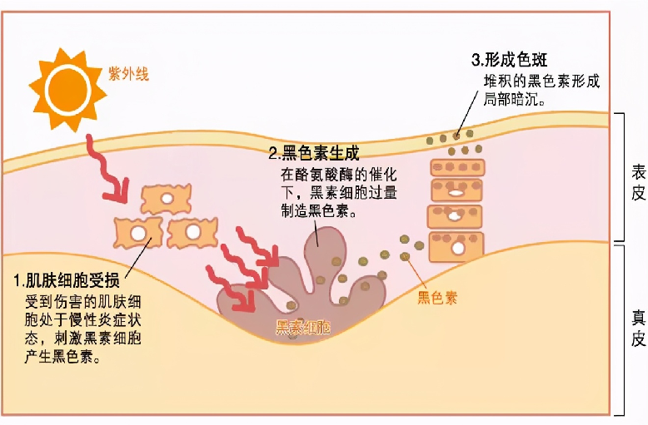
1 Introduction
Tyrosinase is a key enzyme in melanin production
Common tyrosinase inhibitor
3 Formation of spots
Arbutin
Ascorbic acid
2 Melanin production
1 Skin cells are damaged
Nicotinamide
Only limited tyrosinase inhibitors are commercially available

Slide 5
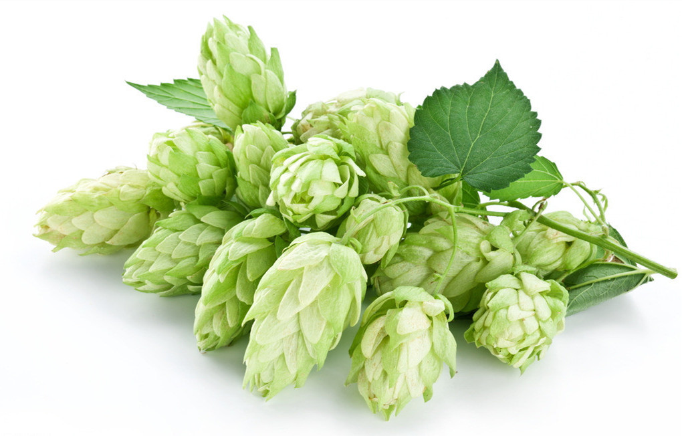
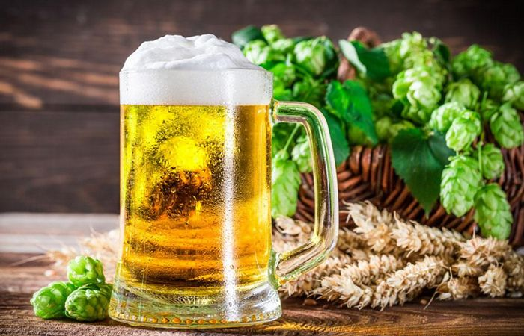
1 Introduction
The natural plant-hop is used as a conventional additive in beer industry
In beer industry, hop is a natural additive, but rich in tannins

Slide 6
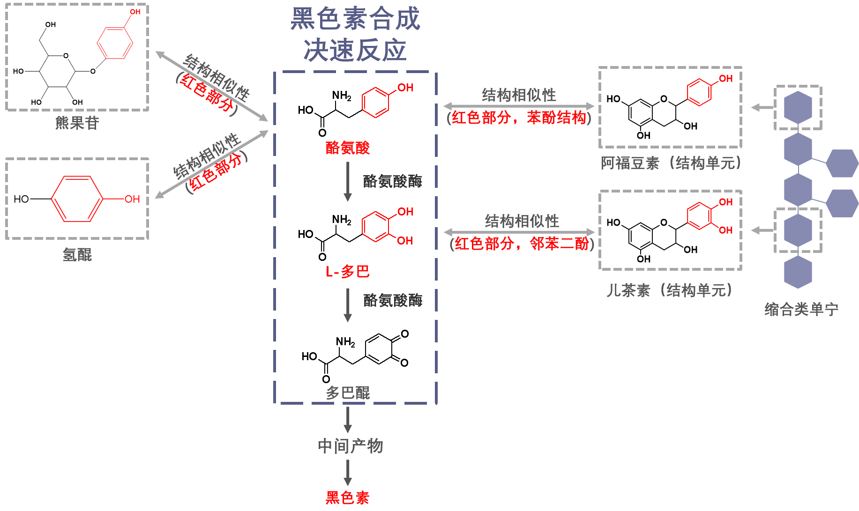
1 Introduction
Melanin
Bio-Synthesis Pathway
Structural similarity
Structural similarity
(red part)
Arbutin
(red part, phenol)
Tyrosine
Afotomin (structural unit)
Tyrosinase
Structural similarity
Hydroquinone
(red part, pyrocatechol)
L-dopa
Catechin (structural unit)
Tyrosinase
Tyrosinase
Condensed tannin
Dopamine quinone
Dopamine quinone
Condensed tannin is a potential inhibitor due to the structural similarity between tannins and tyrosine (or L-dopa)
Intermediate products
Melanin

Slide 7
1 Introduction
The structural characteristics of tannins were determined by molecular mass, structural unit and their connection mode
The inhibitory mechanism was judged from the inhibition effect, copper chelating capacity, secondary structure change, antioxidant ability and active center binding reaction
The inhibitory effect of tannin on tyrosinase was further investigated at the cellular level

Slide 8
02
Methods and Results
The part two

Slide 9
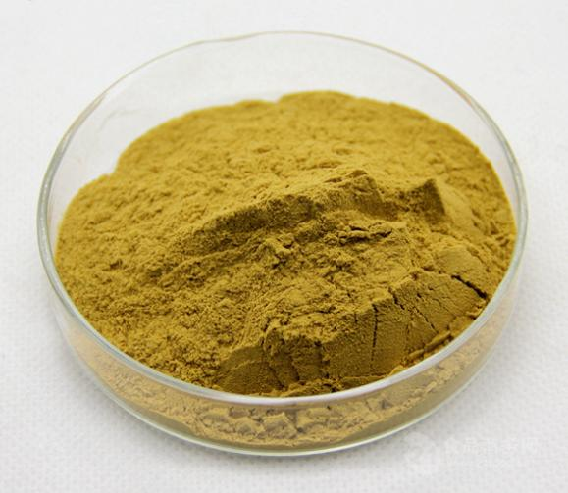
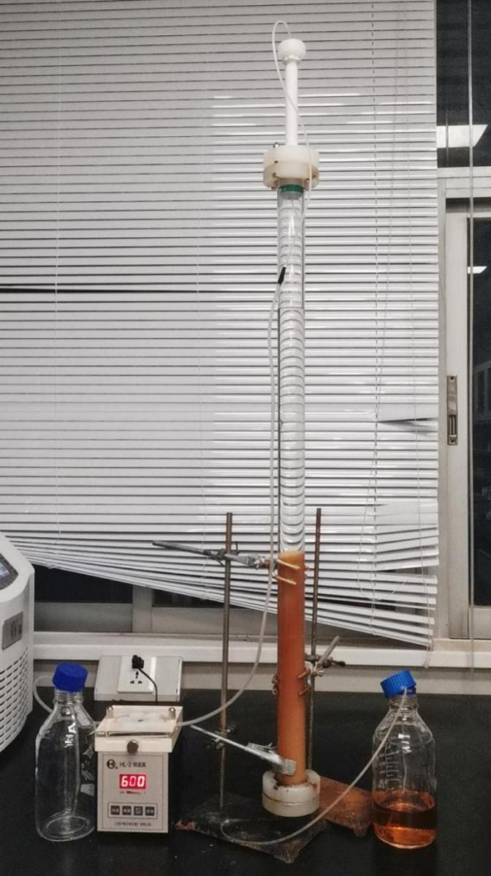
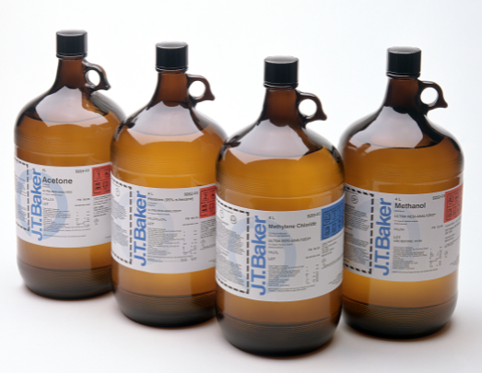
2 Methods and Results
葡萄籽单宁的化学结构分析
2.1. Extraction and purification of the hop tannins
Purified hop tannins
Purify with Sephadex LH-20
Extraction with organic solvent
Hop

Slide 10
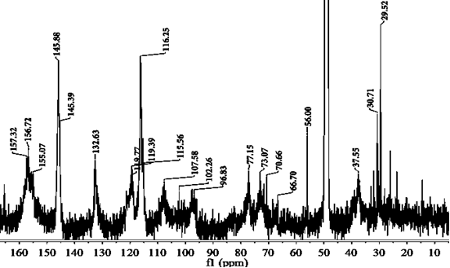
2 Methods and Results
葡萄籽单宁的化学结构分析
2.2. Gel permeation chromatography (GPC) and ¹³C-NMR Analysis
The average molecular mass of hops tannins was 3581
NMR Signals Assignments: (epi)catechin and (epi)gallocatechin

Slide 11
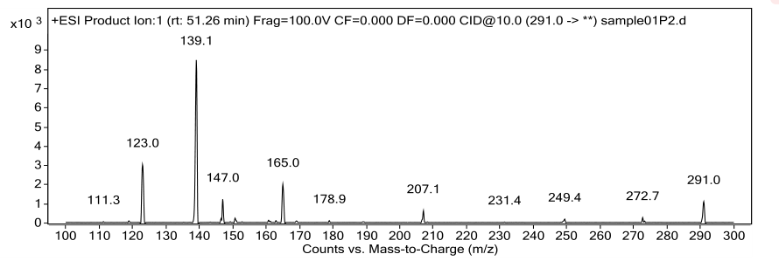
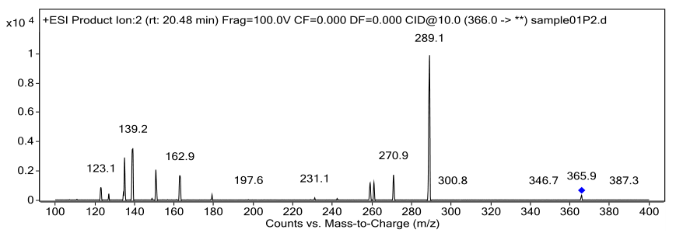
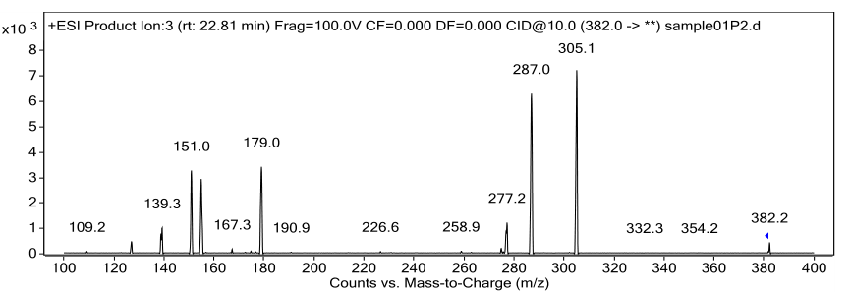
2 Methods and Results
葡萄籽单宁的化学结构分析
2.3. Acid-cleavage coupled with HPLC-ESI-MS/MS analysis
(epi)catechin
(epi)gallocatechin
(epi)catechin-cys
(epi)gallocatechin-cys
Extensional units : (epi)catechin as and (epi)gallocatechin
Terminal units : (epi)catechin
Prodelphenidins were the main constituents of hop tannins.

Slide 12
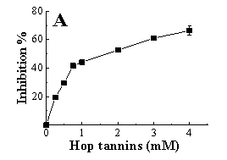
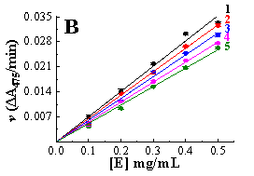
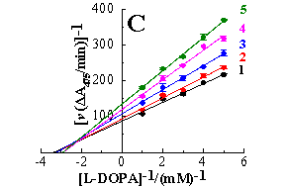
2 Methods and Results
葡萄籽单宁的化学结构分析
Competitive-noncompetitive
K_{I} (1.79 ± 0.12) < K_{IS} (2.61 ± 0.16)
( Affinity: free enzyme > enzyme–substrate complex )
IC₅₀ = 1.68 ± 0.14 mM
6.4 times more effective than hydroquinone
Reversible inhibition

Slide 13
2 Methods and Results
葡萄籽单宁的化学结构分析
2.5. Circular Dichroism (CD) , copper ion chelating and antioxidant abilities
α‐helix ↑，Random coil ↓
Changes in the secondary structure of could lead to a decrease in tyrosinase catalytic activity
Good metal chelation properties
form a inhibitor-copper complex
 | Cu2+ Chelating (%) | DPPH Free radical scavenging activity (IC₅₀ mM) | ABTS Free radical scavenging activity (IC₅₀ mM)
Hops tannin | 44.77 ± 0.45 | 0.051 ± 0.002b | 0.040 ± 0.000b
Ascorbic acid | - | 0.654 ± 0.010a | 0.730 ± 0.008a
substantial antioxidant capability
significantly lower IC₅₀ values than ascorbic acid

Slide 14
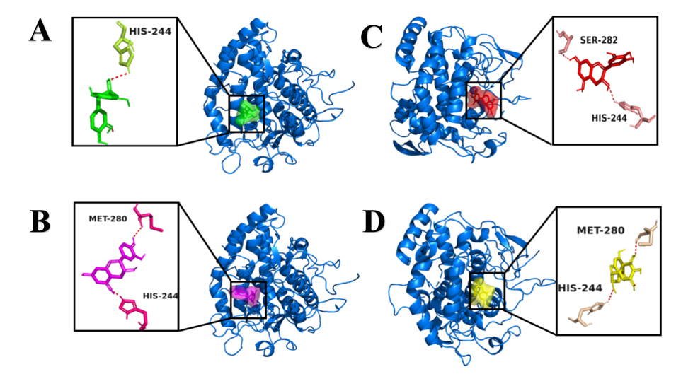
2 Methods and Results
葡萄籽单宁的化学结构分析
2.6. Molecular docking analysis
Embedded into the target active cavity
Interacted with the surrounding amino acid residues
Non-covalent interactions were hydrogen bond
Docking poses of catechin–tyrosinase (A), epicatechin–tyrosinase (B), gallocatechin–tyrosinase (C), and epigallocatechin-tyrosinase (D). The dotted lines were hydrogen bond formed between ligand and tyrosinase

Slide 15
2 Methods and Results
葡萄籽单宁的化学结构分析
2.7. Effect on B16F10 Mouse Melanoma Cells
Melanin production were found reduced by 34.50 % and activity of tyrosinase was reduced by 66.67% while 10 uM hop tannins were applied
Hop tannins regulated tyrosinase and subsequently suppressed melanin synthesis in B16F10 mouse melanoma cells at nontoxic doses.

Slide 16
03
Conclusions
The part three

Slide 17
3 Conclusions
葡萄籽单宁的化学结构分析
Strusture analysis：
·Prodelphenidins (condensed tannin)
·Structural unit :
(epi)catechin and (epi)gallocatechin
Hop tannins
Mechanism in tyrosinase：
Reversible and Competitive-noncompetitive bind with the active site of tyrosinase
The non-covalent interaction is mainly hydrogen bonding force
Chelating copper ion and antioxidant capability that may also contribute to the tyrosinase inhibition ability
Hop tannins has the potential to apply as whitening agents in cosmetic industry
Effect on B16F10 melanoma cells：
Regulated tyrosinase and subsequently suppressed melanin synthesis at nontoxic doses.

Slide 18
THANK YOU

