Slide 1
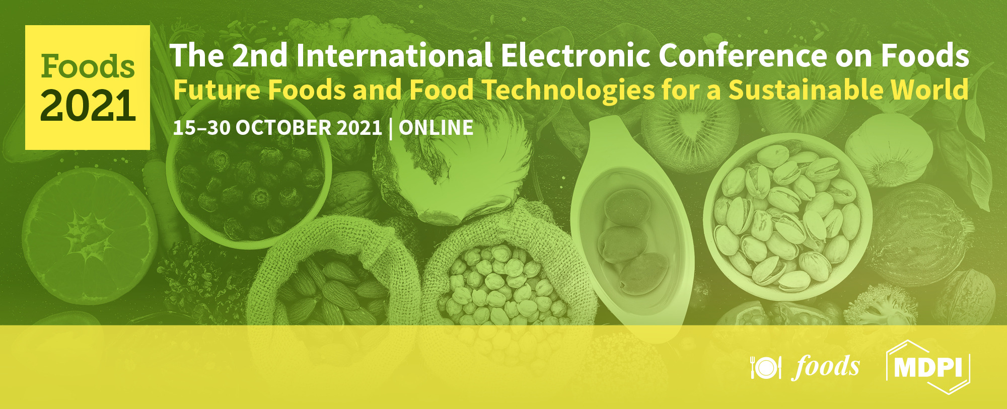
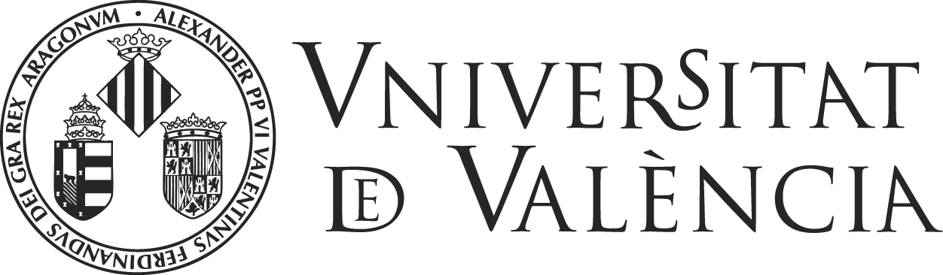
Analysis of polyphenols content and antioxidant capacity from hybrids mandarin peel

Slide 2
INTRODUCTION
Mandarin cultivars (Citrus reticulata) the 22% of the total citrus fruit crops.
Mandarin fruit residues (peel, seeds, and pulp) are usually discarded without regard to nutritional potential and commercial value.
Mandarin peels makes up approximately 35-40% of the weight and are an abundant source of natural flavonoids and other antioxidants.
45-60% citrus waste from industry
Polyphenols
UAE-SFE-UPLC-QTOF-MS/MS

Slide 3
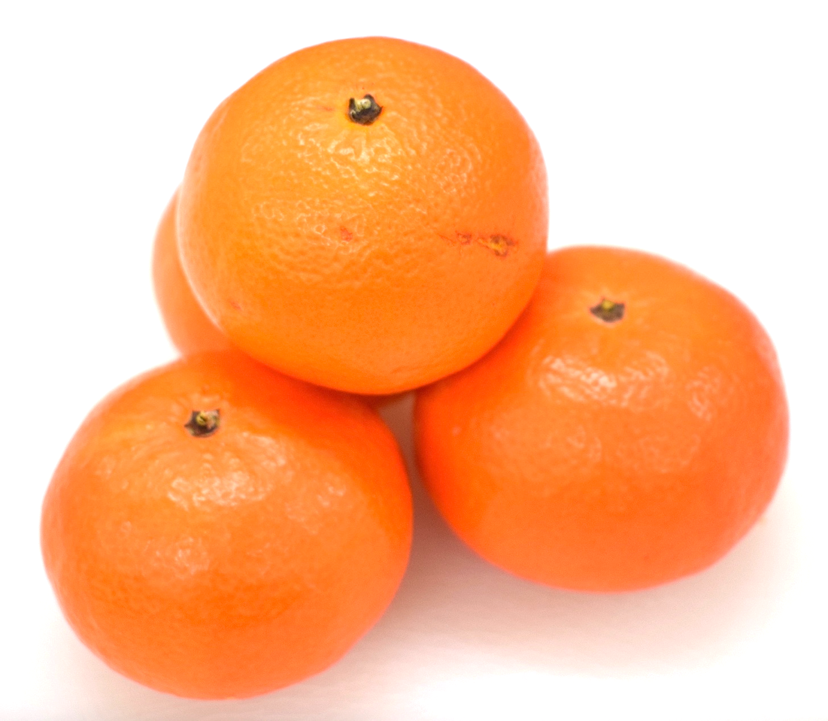
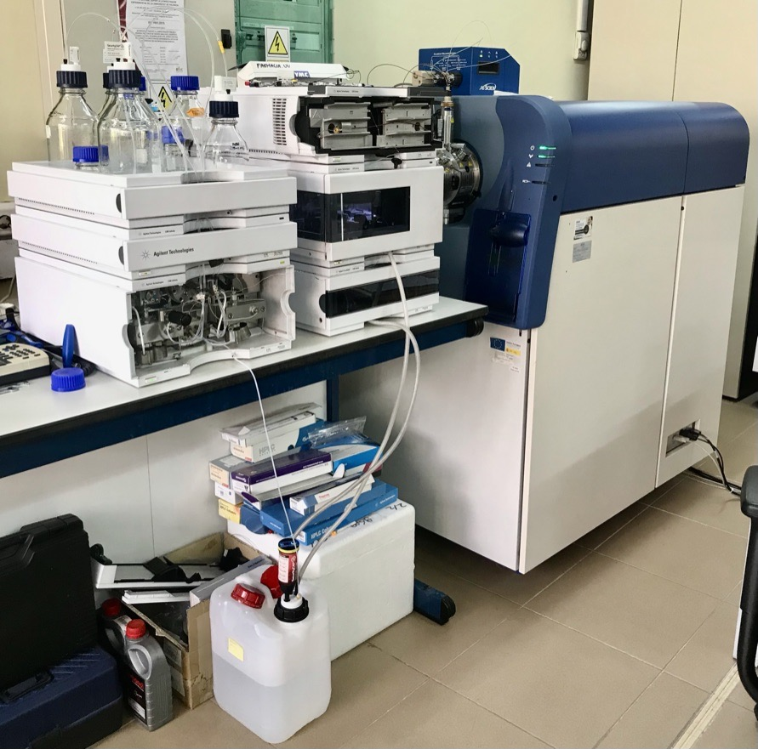
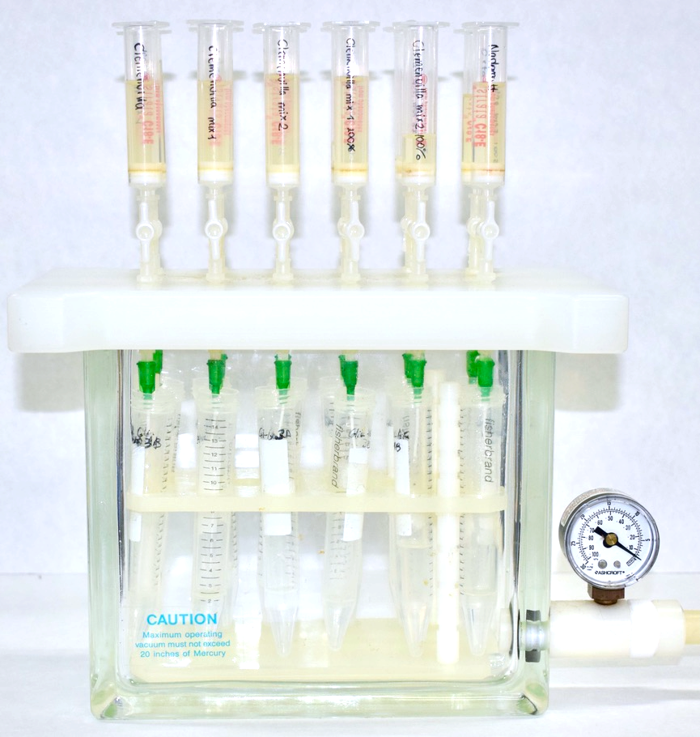
MATERIALS AND METHODS
CLEMENVILLA
ORTANIQUE
NADORCOTT
6g + ethanol 50%, ratio 1:10 w/v
400 W, 80% duty cicle, 40°C and extraction time of 30 min
Total polyphenols
Total flavonoids
DPPH and TEAC
Centrifuged:
4000 r.p.m., 4 ºC, 5 min
SPE
C18
(200 mg)
UPLC-TOF-MS/MS

Slide 4
RESULTS AND DISCUSSION
Table 1. Total polyphenol and flavonoids content determined in hybrid mandarin peels.
Bioactive compound | Clemenvilla | Nadorcott | Ortanique
TP (mg GAE/ 100 g FW ± SD) | 828.4 ± 95.8ª | 724.2 ± 43.0ª | 1155.2 ± 171.3^{b}
TF (mg CE/ 100 g FW ± SD) | 89.6 ± 15.5ª | 70.9 ± 12.5ª | 71.7 ± 17.8ª

Slide 5
Figure 1. Differences of antioxidant capacity assessed by DPPH and TEAC assays in hybrid mandarin peels.
RESULTS AND DISCUSSION
b
a
a
a
b
b

Slide 6
Table 2. Polyphenol compounds identified and quantified in hybrid mandarin peels by UPLC-QTOF-MS/MS
RESULTS AND DISCUSSION
Compound | Molecular formula | [M-H]– | Clemenvilla | Nadorcott | Ortanique
4-hidroxibenzoic acid | C₇H₆O₃ | 137.02442 | 4.1 ± 10.7ª | 1.9 ± 0.8^{b} | 2.1 ± 1.2^{b}
rutin | C₂₇H₃₀O₁₆ | 609.14611 | 7.3 ± 3.8ª | 5.6 ± 3.3^{ab} | 6.9 ± 2.2^{ab}
ferulic acid | C₁₀H₁₀O₄ | 193.05063 | 1.5 ± 0.7ª | 6.8 ± 0.9^{b} | 2.2 ± 0.5^{c}
narirutin | C₂₇H₃₂O₁₄ | 579.17193 | 4.3 ± 2.6ª | 31.8 ± 6.8^{b} | 33.1 ± 6.3^{b}
hesperidin | C₂₈H₃₄O₁₅ | 609.18249 | 63.7 ± 10.7ª | 72.3 ± 7.0^{b} | 63.7 ± 6.8ª
¹ Concentrations are expressed in µg/g FW of peel.

Slide 7
CONCLUSIONS
Results suggest that there are significant differences in the content of TP, TF, and antioxidant capacity according to the varieties analyzed. Finally, hesperidin is the major phenolic compound in hybrid mandarin peels and, narirutin and rutin were identified and quantified in samples analyzed. Mandarin peels are an important source of polyphenol compounds with high antioxidant capacity.

